Slide 1

ALY6010: Probability Theory and Introductory Statistics Final Project Presentation Analysis of the Beer Review Dataset
Student: Zihan Ma
ma.zihan1@northeastern.edu
04/01/2023
Instructor: Prof. Tom Breur

Slide 2
Overview
I know we should keep everything short. But since we won’t present it on class, I will use longer sentence to make the PPT clearer to the audiences
Project Overview
Data Description
Data Cleaning and Preprocessing
Exploratory Data Analysis
Research Questions
Hypothesis Tests
Interpretation and Suggestions

Slide 3
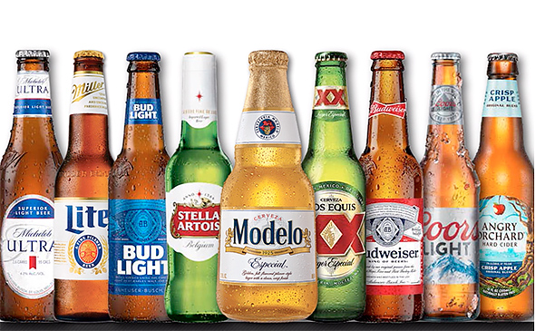
Project Overview
Explore relationships between beer characteristics and ratings using a dataset of beer reviews.
Provide valuable insights to beer enthusiasts and manufacturers.
https://www.cheddars.com/menu/bottled-beer/prod7021202

Slide 4
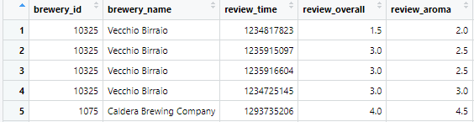
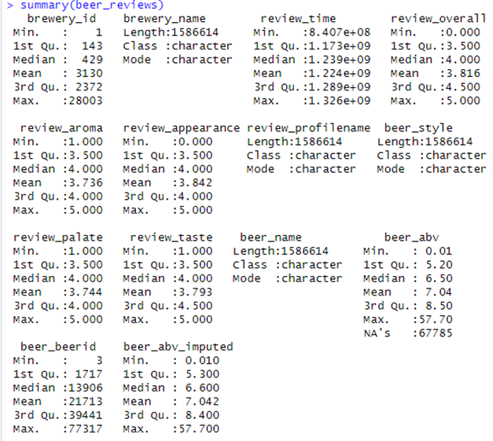
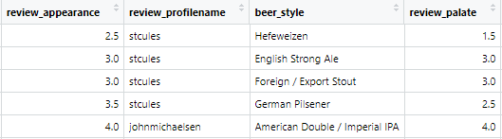
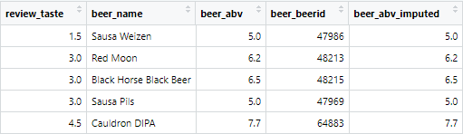
Data Description
Dataset of 1,586,614 beer reviews from BeerAdvocate.com.
The dataset includes information on beer styles, alcohol by volume (ABV), and various rating categories such as aroma, appearance, taste, and overall ratings.

Slide 5
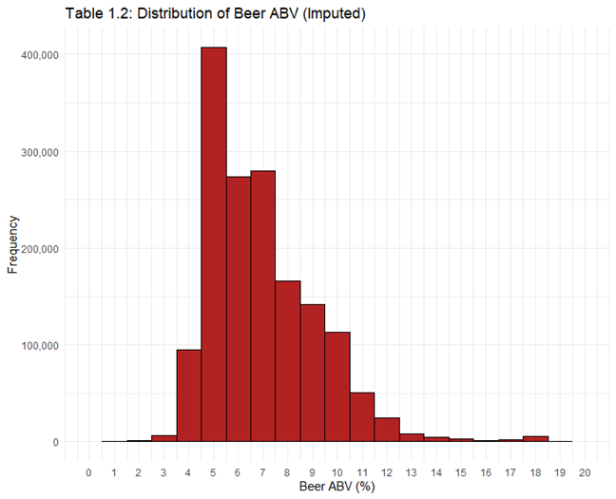
Data Cleaning and Preprocessing
Performed data cleaning and preprocessing.
Removed missing values and imputed beer ABV.
Generated graph related to ABV, causing significant bias.
Bias

Slide 6
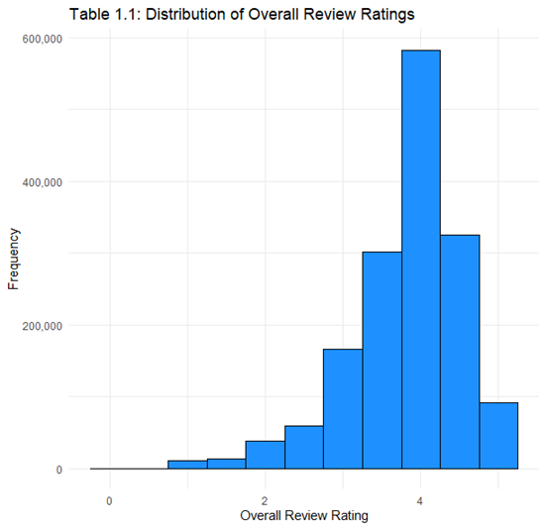
Exploratory Data Analysis
Overall review ratings skewed towards higher values.
Histogram of beer ABV right-skewed.

Slide 7
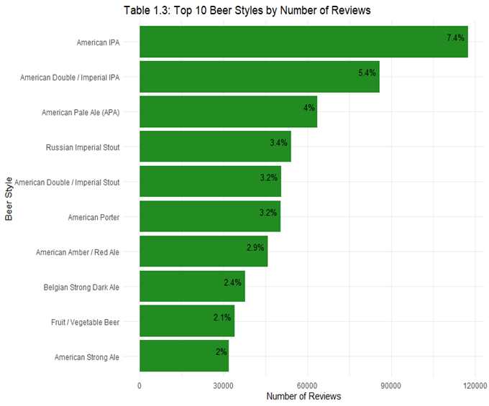
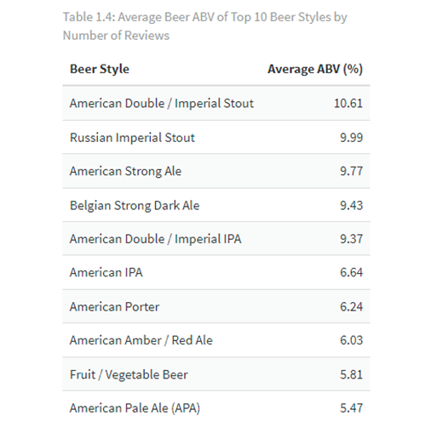



Exploratory Data Analysis
Top 3 beer styles more popular among enthusiasts and reviewed more often.
No connection between Average ABV and beer ranking.

Slide 8
Research Questions
Focused on three research questions:
Relationship between beer ABV and overall review ratings?
Does beer aroma rating influence the overall review rating?
Do beers with a higher appearance rating also have a higher taste rating?

Slide 9
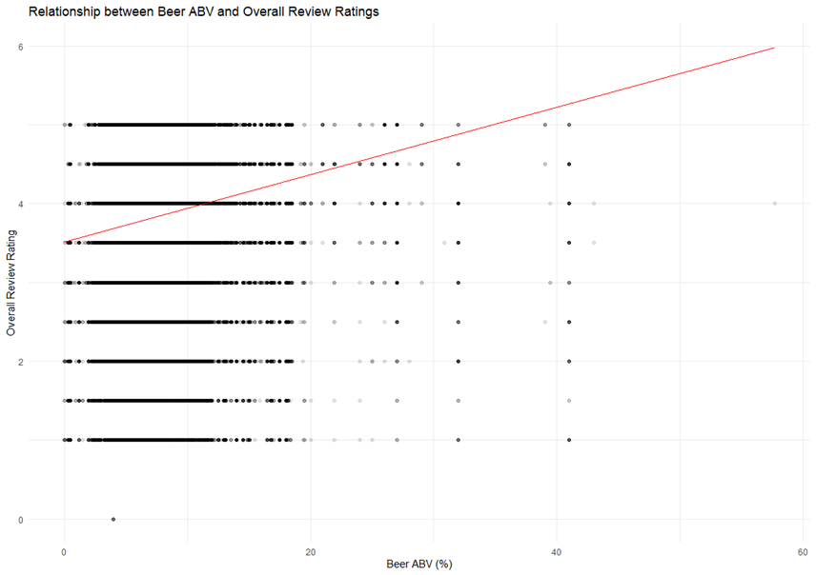
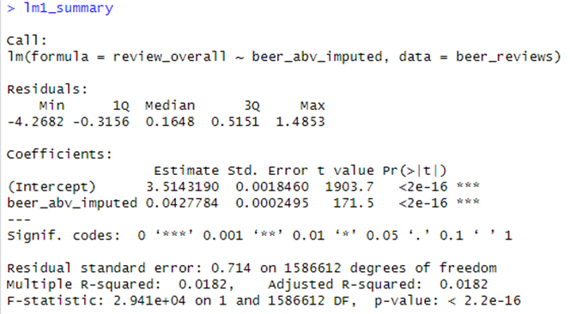
Hypothesis Tests
Weak positive relationship between Beer ABV and Overall Review Ratings.

Slide 10
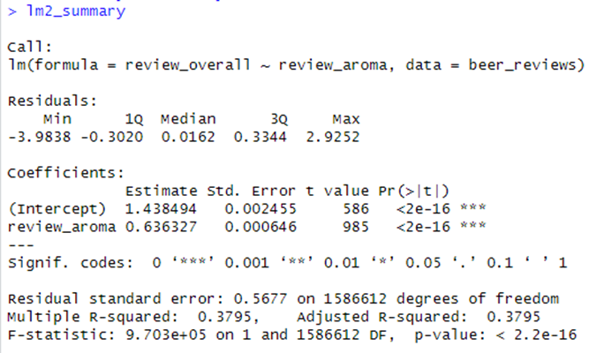
Hypothesis Tests
Strong positive relationship between Beer Aroma Rating and Overall Review Rating.

Slide 11
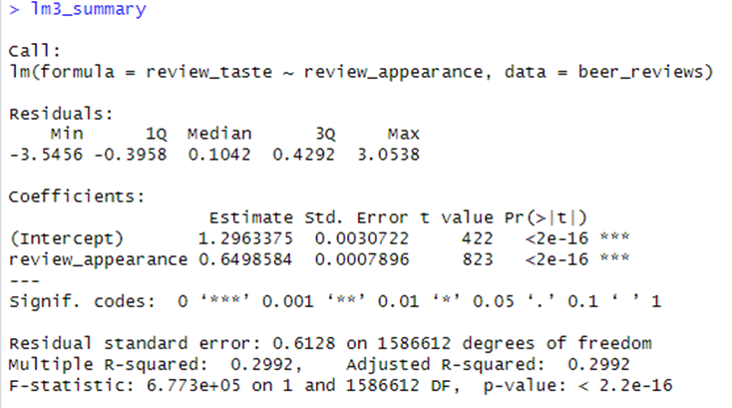
Hypothesis Tests
Moderately strong positive relationship between Beer Appearance Rating and Taste Rating.

Slide 12
Interpretation and Suggestions
Weak positive relationship suggests higher alcohol content does not necessarily lead to higher overall rating.
Focus on improving beer aroma to enhance overall rating.
Strong positive relationship between beer aroma rating and overall review rating suggests better aroma leads to higher overall rating.
Consider product appearance to improve quality.
Moderately strong positive relationship between beer appearance rating and taste rating suggests higher appearance rating often correlates with higher taste rating.
ABV level is not matter.
Linear regression model has limitations and assumptions may not always hold.

Slide 13
References
Betancur et al. (2020) explored the relationships between beer characteristics and review ratings.
Capitello & Todirica (2021) discussed the behavior of beer consumers.
Both sources provide valuable insights for beer enthusiasts and manufacturers.
Data from:
Socialmediadata. (2016, December 20). Beeradvocate - dataset by socialmediadata. data.world. Retrieved April 1, 2023, from https://data.world/socialmediadata/beeradvocate

Slide 14
Thanks!

