Slide 1
Agenda
Quick review of previous designs and findings
Pilot 1 – Restricted viewing (is eye movement necessary for EM effect on WM?)
Pilot 2 – Streamlined + post-hoc MST
fMRI design
Notes:
a second, streamlined pilot that adapts the design for the scanner and adds a standard memory test. Finally, I will discuss whether we are ready to run an fMRI pilot, and outline its design.

Slide 2
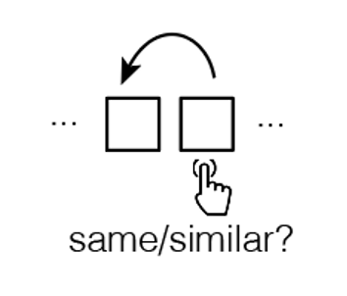
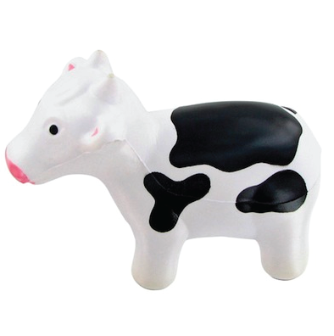
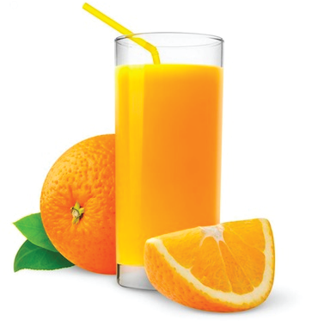
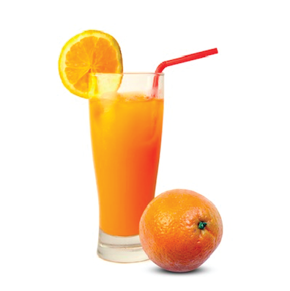
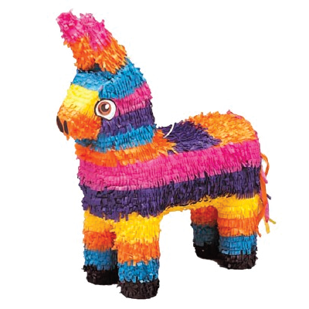
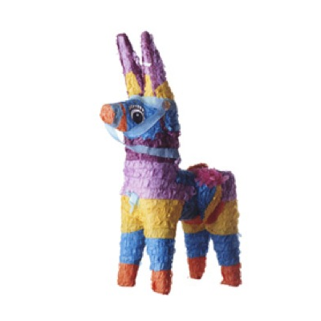
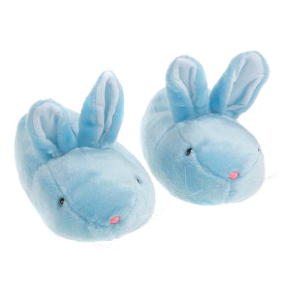
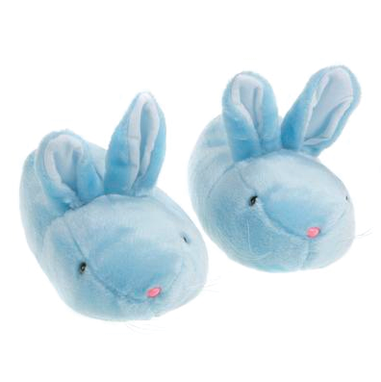
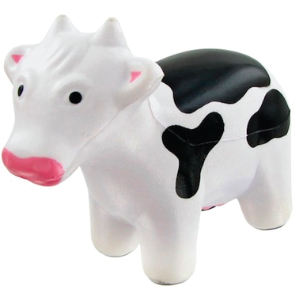
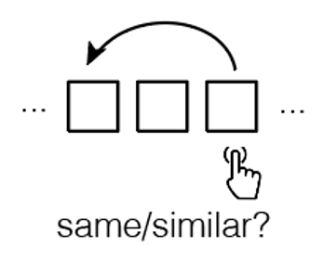
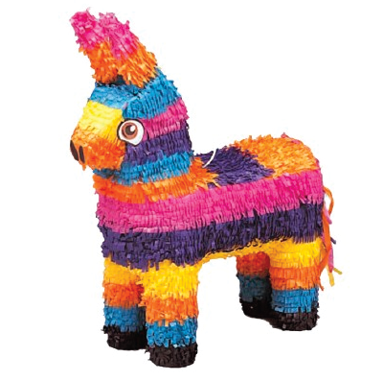

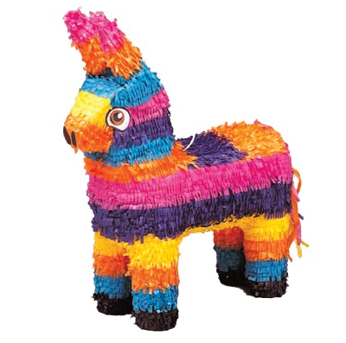
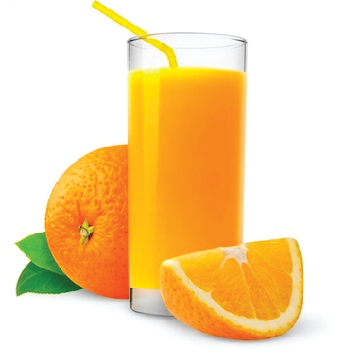
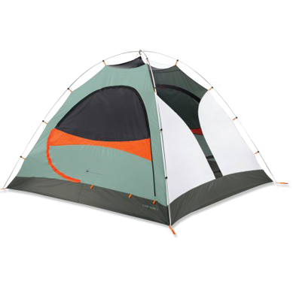

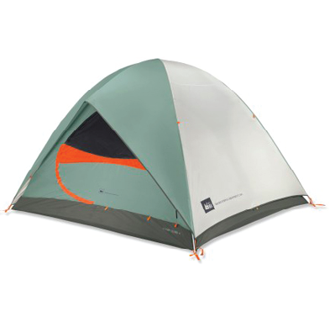
The MST-Back Task (eye-tracking)

Slide 3
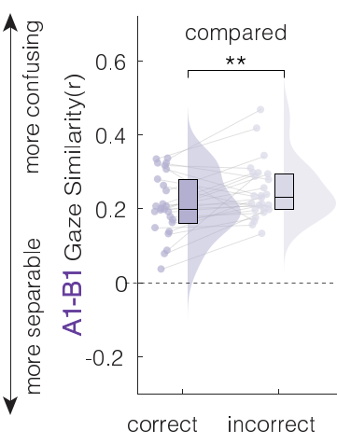
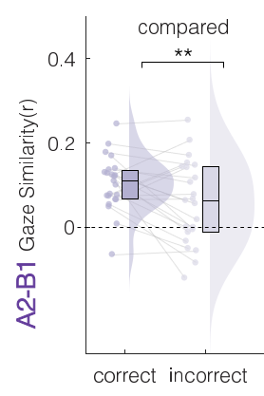
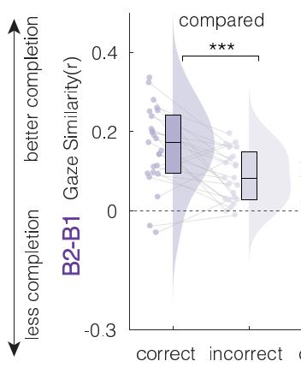
Gaze patterns track EM contributions to WM
Comparing similar items in WM improves later mnemonic discrimination when WM is overload
At encoding, the more discriminative a participant’s viewing pattern was, the better that item was later discriminated
That viewing pattern was reinstated 2 trials before the discrimination demand
…and was re-expressed during successful discrimination
Notes:
Let me begin with what we already know. In our earlier work, Critically, this effect was tied to eye movements at two moments. At encoding, the more discriminative a participant's viewing pattern was, the better that item was later discriminated. And at retrieval, that same viewing pattern was re-expressed during successful discrimination, and could be detected roughly two trials before it was needed. In other words, the behavioral benefit did not stand alone; it was accompanied, and even predicted, by how the eyes moved. This raises an obvious mechanistic question, which motivates the rest of the talk.

Slide 4
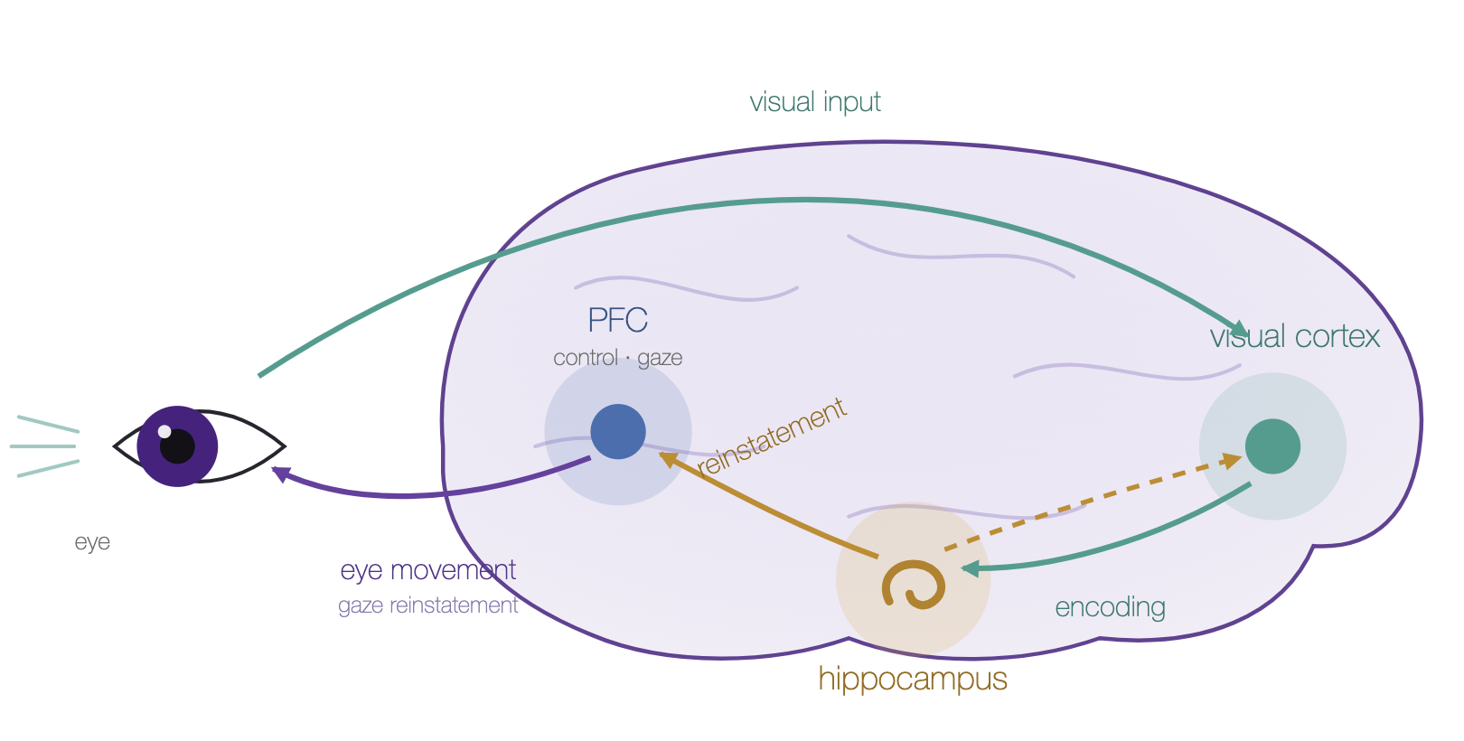
Is gaze reinstatement causally necessary?
Liu et al., 2017, J. Neurosci; Voss et al., 2017, TiCS; Noton & Stark 1971, Science; Johansson & Johansson, 2014, Psych Sci; Hannula & Ranganath, 2009, Neuron; Ferreira, Apel & Henderson, 2008, TiCS
Notes:
where you look sends visual input to visual cortex, which the hippocampus encodes into a trace that carries your viewing pattern. At retrieval, the hippocampus reinstates that trace to cortex and PFC, which in turn drives the eyes back to where the item was — gaze reinstatement, the violet arm that closes the loop. So eye movements are both an input to memory (they choose what gets encoded) and an output of it (memory re-enacts them), all through shared oculomotor–hippocampal–prefrontal circuitry

Slide 5
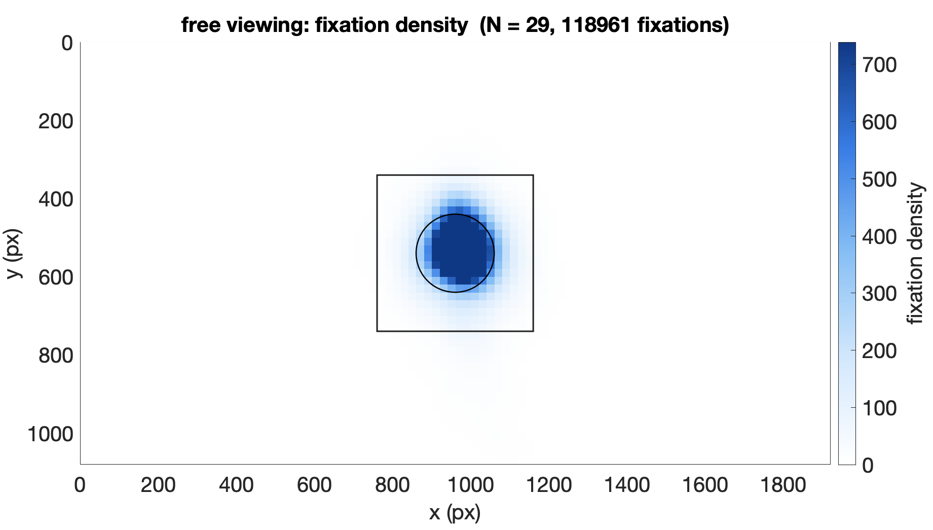
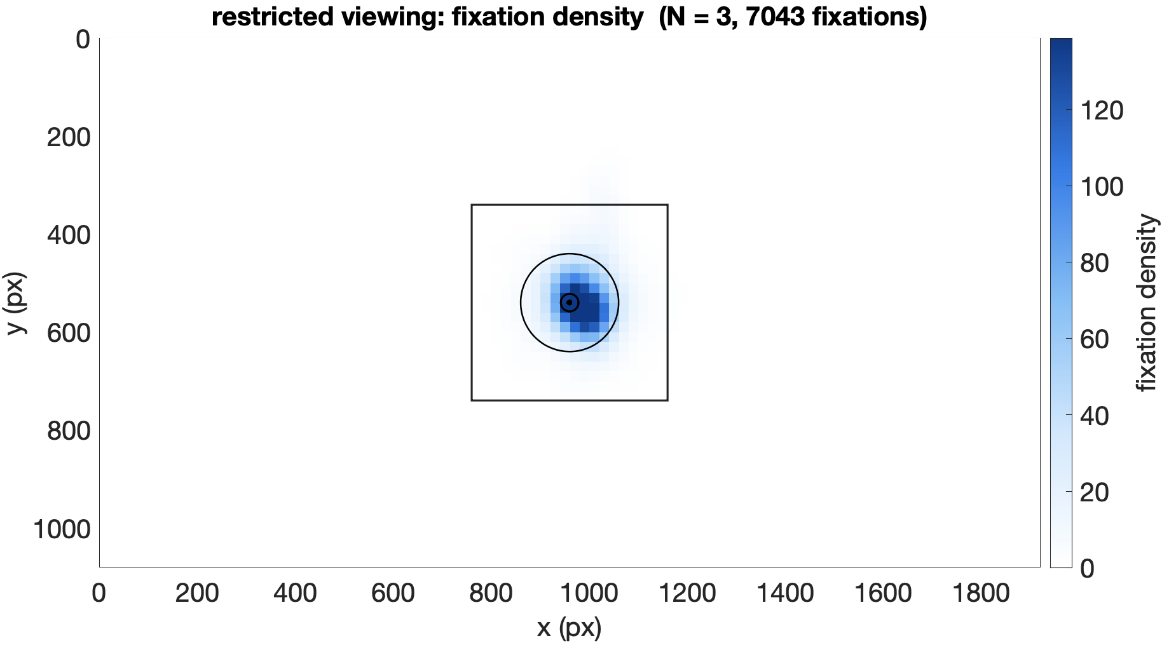
Restricted viewing confines gaze to the center
Notes:
To test that prediction, we ran the same task but enforced central fixation, using a gaze-contingent procedure that allowed a trial to proceed only while the eyes remained within a small window at the center. Before interpreting any behavioral result, we first had to confirm that the manipulation actually worked. These are fixation-density maps over the full screen. On the left, under free viewing, fixations spread across the stimulus. On the right, under restricted viewing, they collapse to a single dense cluster at the center, well inside the enforced window. So spatially, the manipulation is unambiguous: restricted viewing did confine gaze to the fixation point.

Slide 6
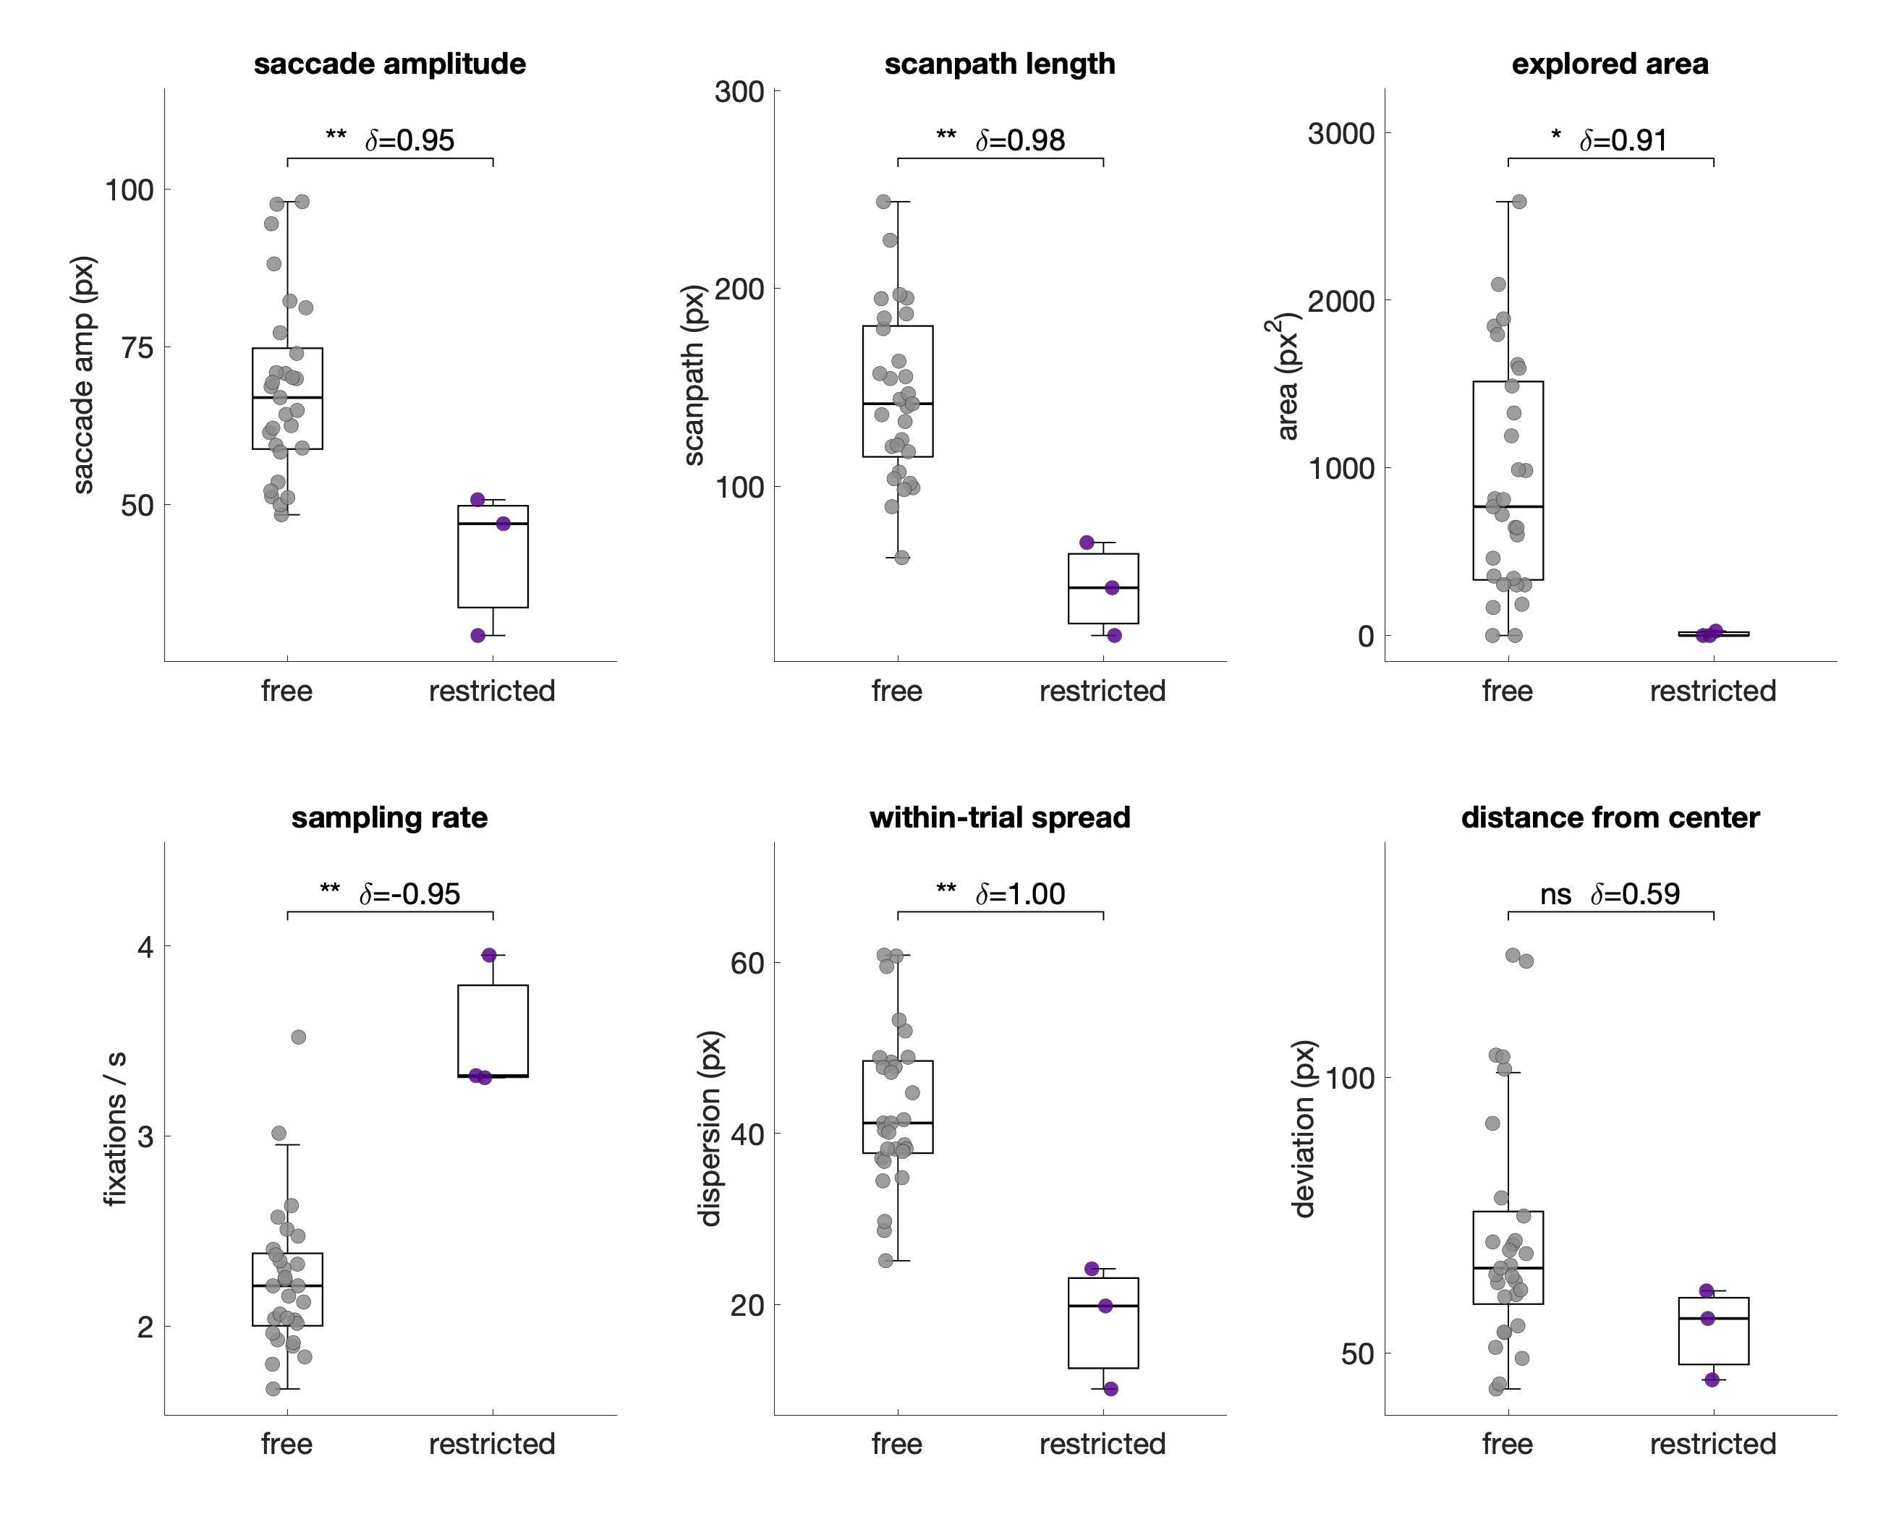
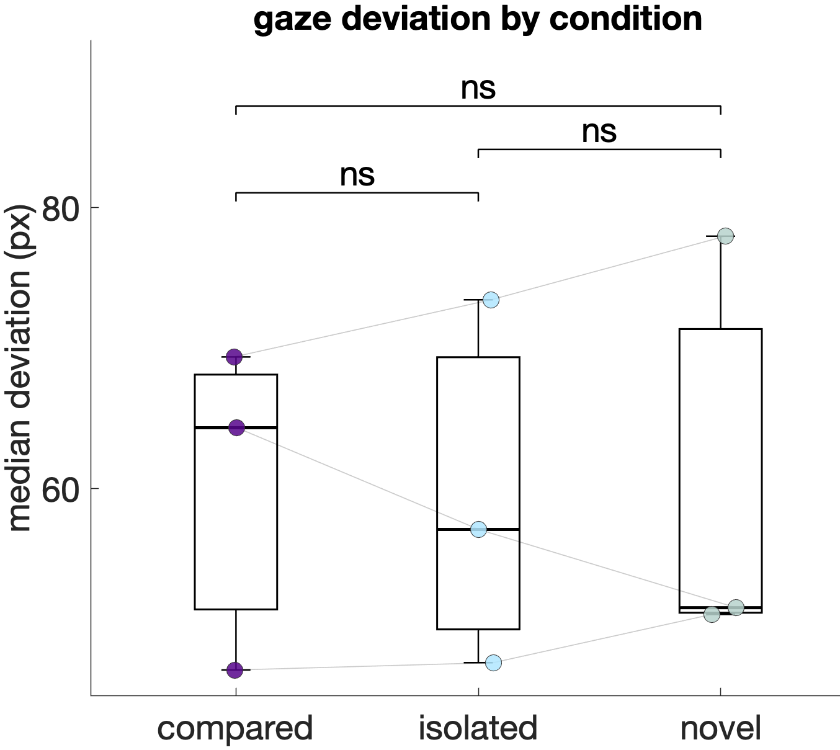
Exploration was limitted under restricted viewing
Notes:
Comparing the free-viewing group with the restricted group across several measures of visual exploration, every measure drops sharply.
Saccade amplitude — how far the eyes jump on each movement — falls by roughly forty percent.
Scanpath length, the total distance the gaze travels within a trial, falls to about a third.
The area of the image that fixations cover falls essentially to zero. Across these measures the two groups separate almost completely; in fact, every restricted participant explored less than every free-viewing participant. The question now is what happened to memory.

Slide 7
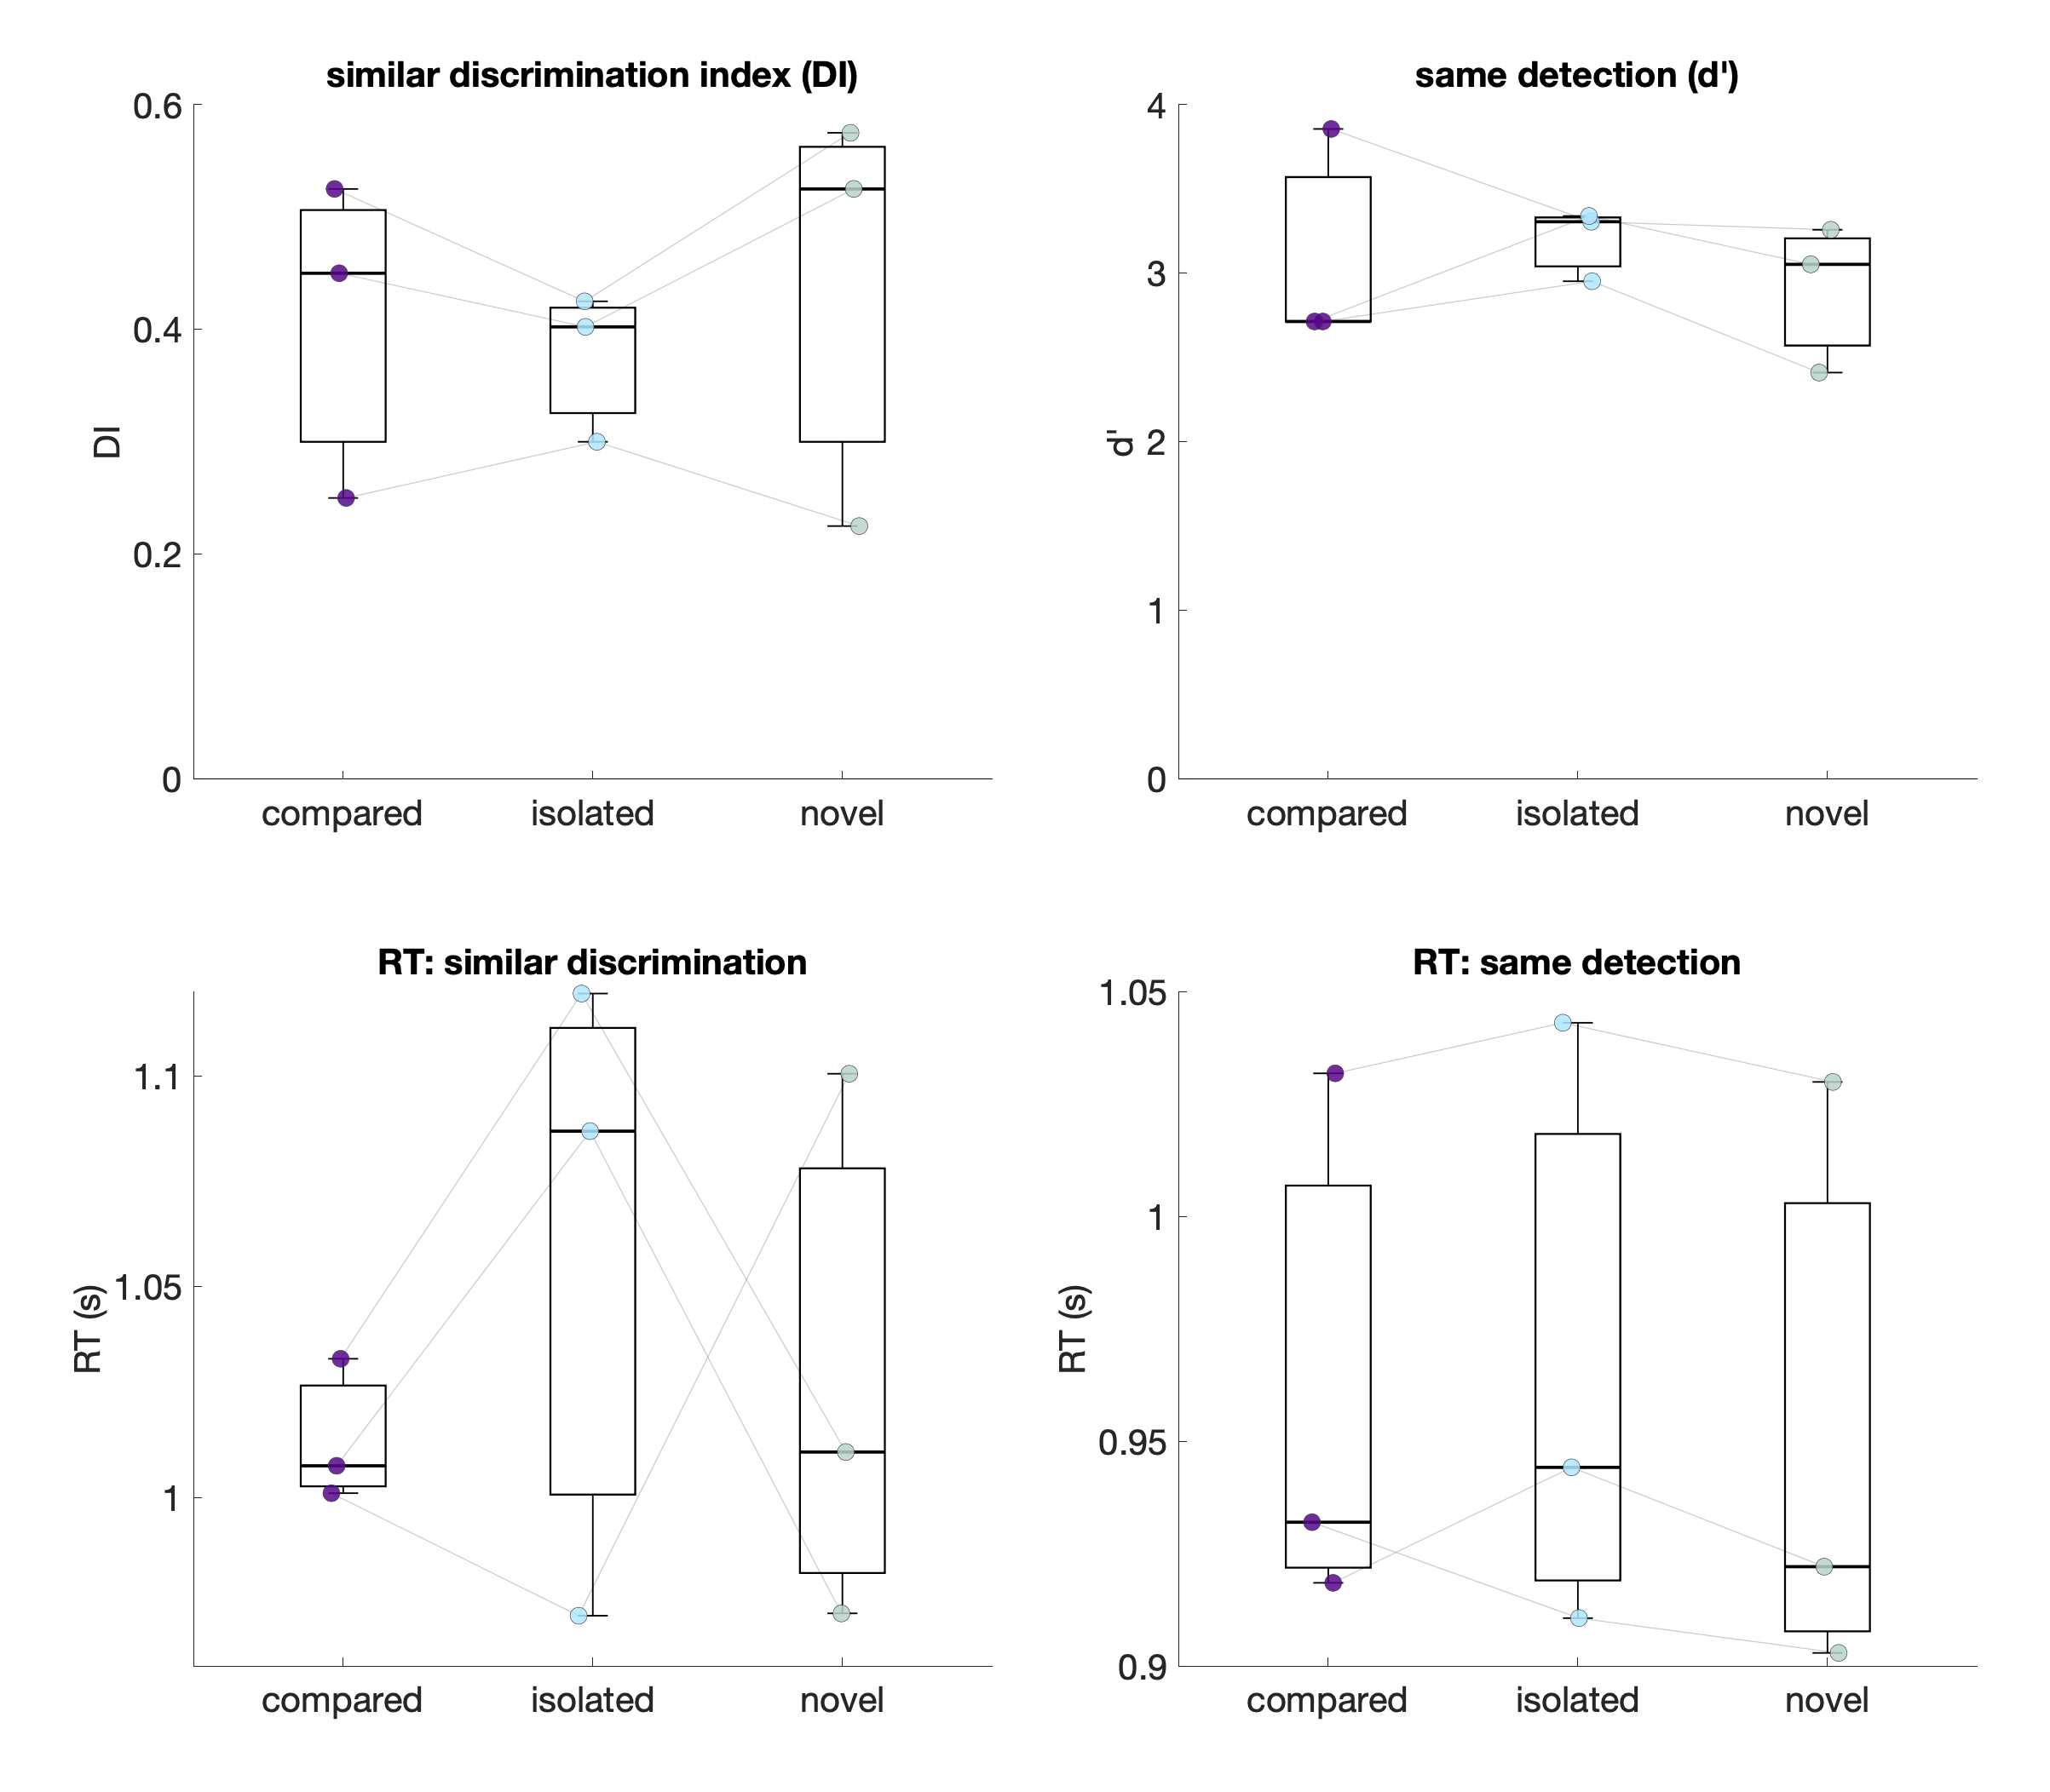
Restricted viewing: no discrimination benefit in 2-back
Notes:
In the two-back task we measured how well participants discriminated similar items — the discrimination index on the left — and detected exact repeats, on the right, separately for the compared, isolated, and novel conditions. Under free viewing we had expected the compared condition to show the strongest discrimination. Under restricted viewing, that advantage is not evident: the discrimination index is essentially flat across conditions, and if anything the novel condition is numerically highest. This is consistent with our prediction that removing gaze abolishes the effect. I will stress that this is three participants, so it is descriptive rather than conclusive — but the direction is exactly what we hypothesized.

Slide 8
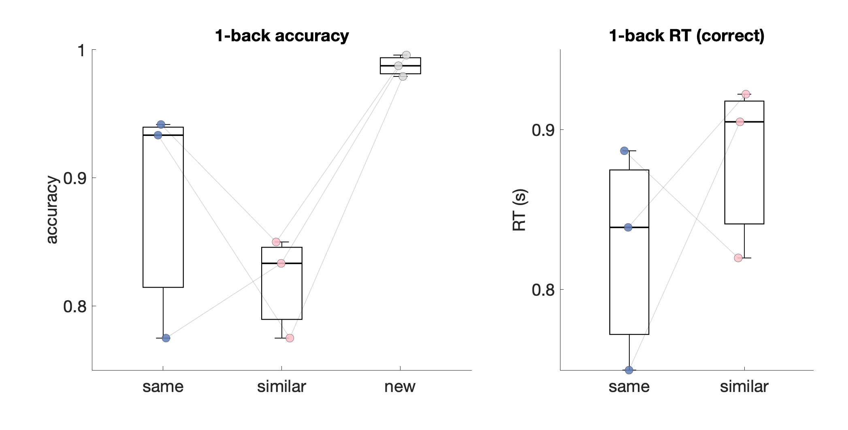
Restricted viewing: 1-back encoding still works
Notes:
One might argue that if

Slide 9
Streamlining for fMRI: drop isolated, add an MST
Drop the “isolated” condition
Keep only “compared” and “novel” conditions
Add filler items
Add a standard post-hoc MST

Slide 10
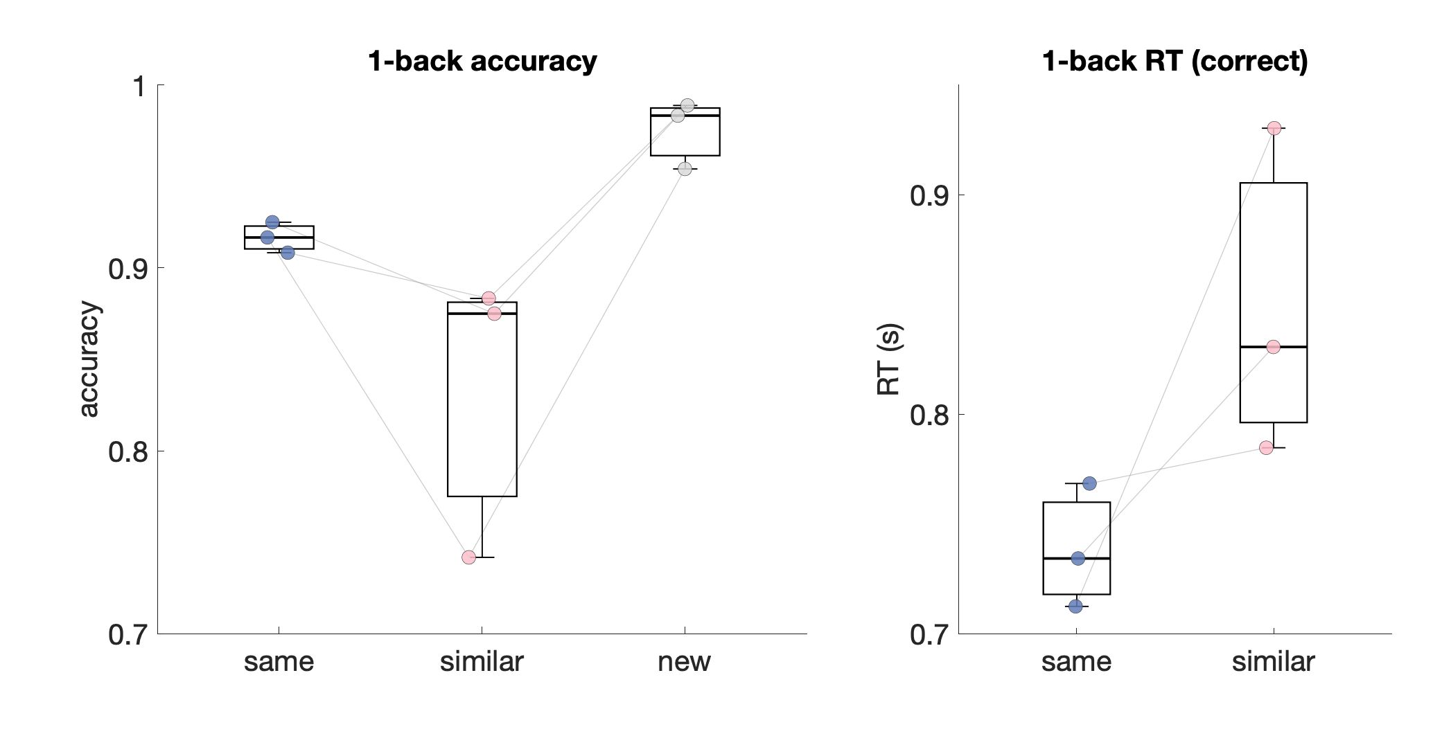
Streamlined pilot: encoding (1-back) still works

Slide 11
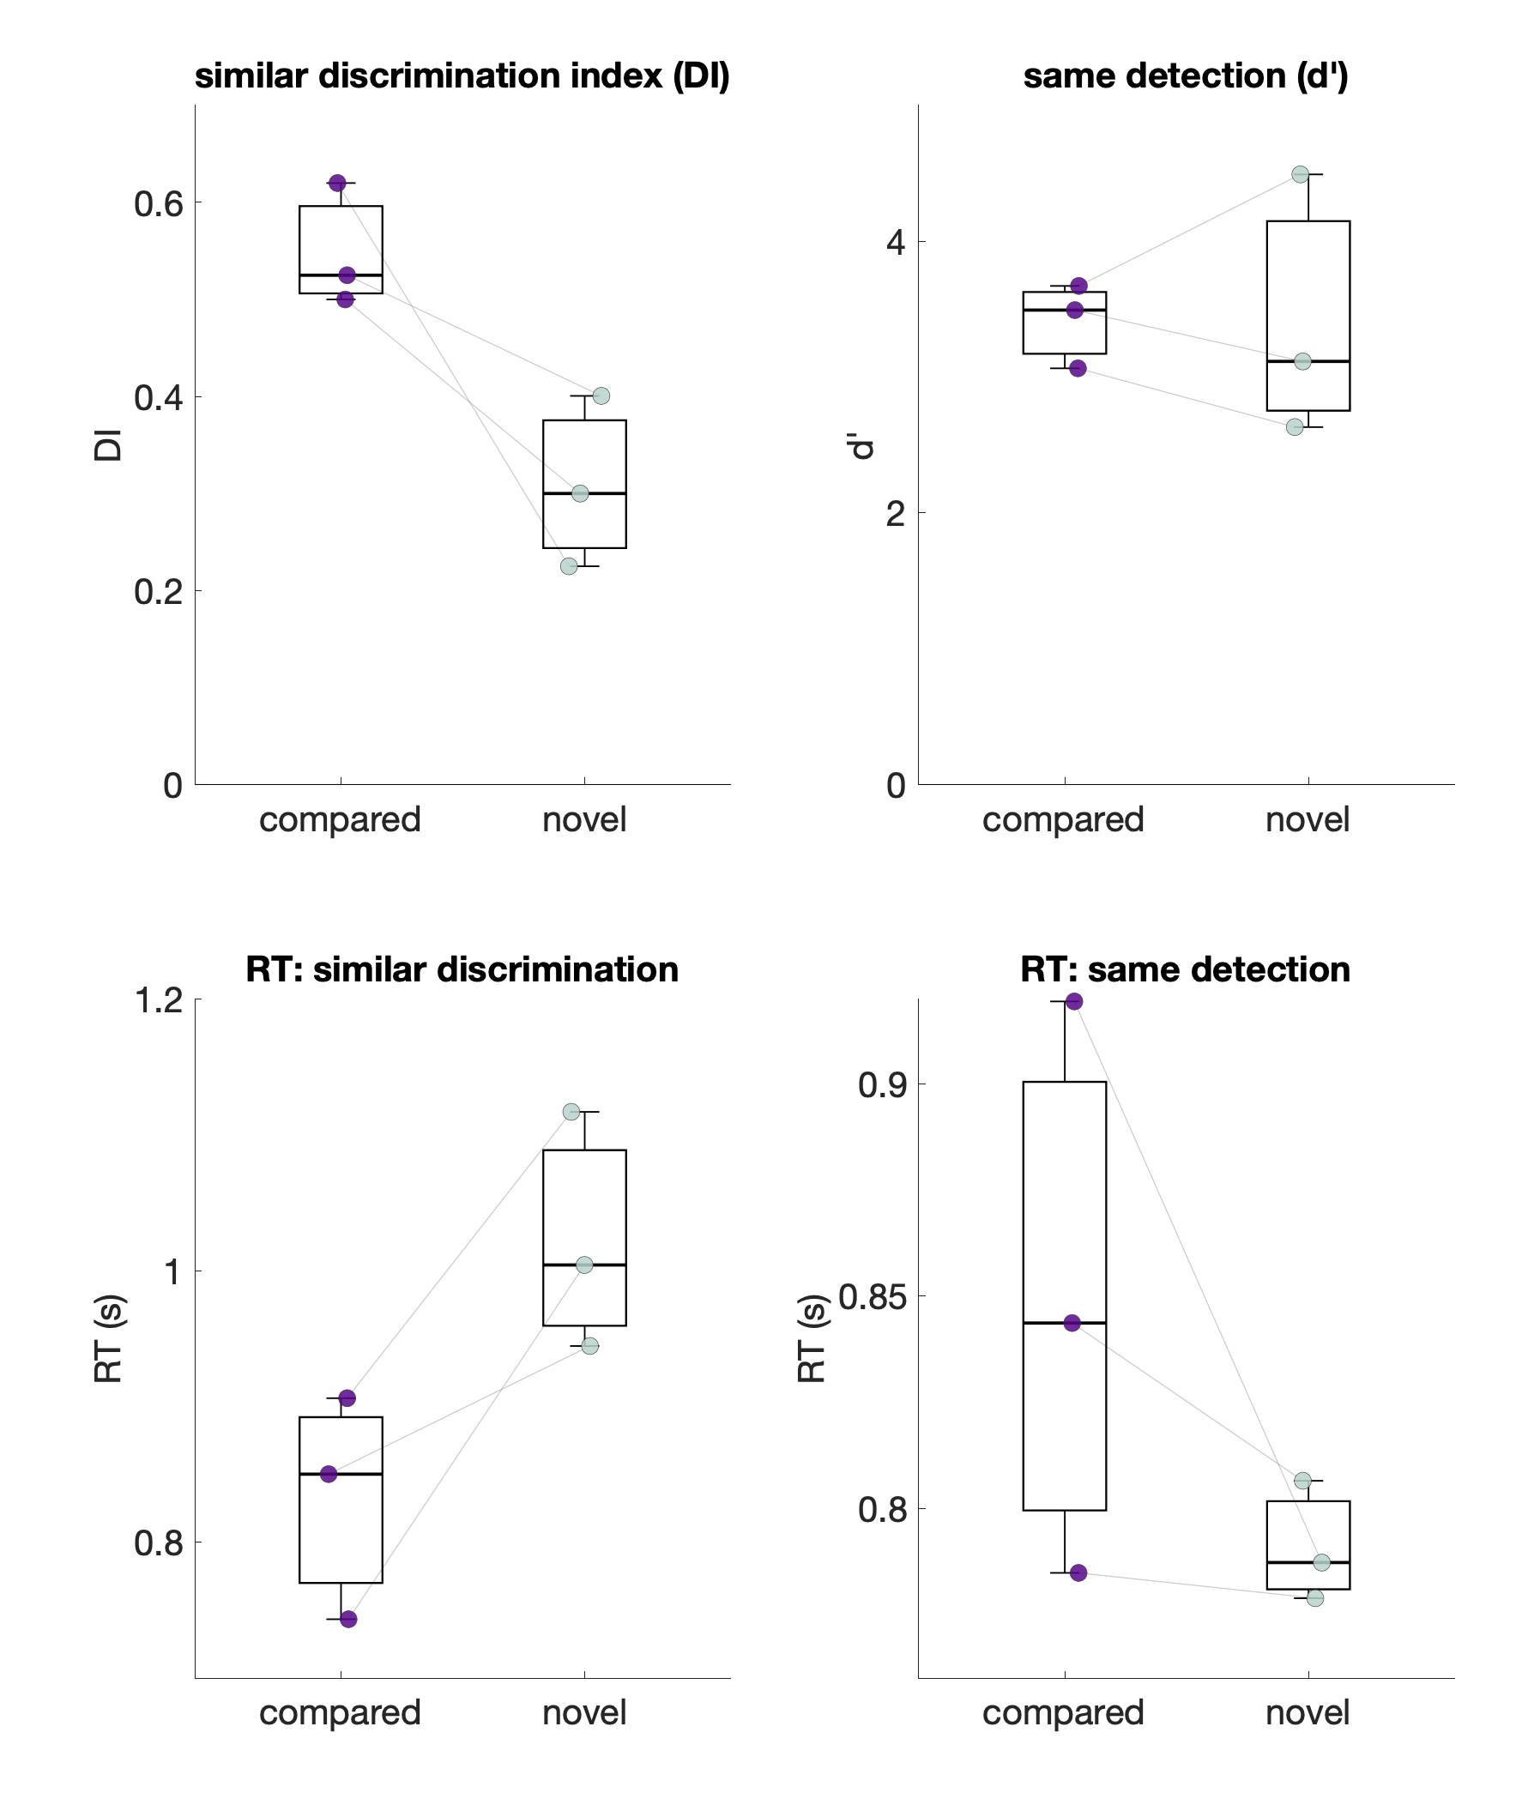
Streamlined pilot: compared > novel discrimination

Slide 12
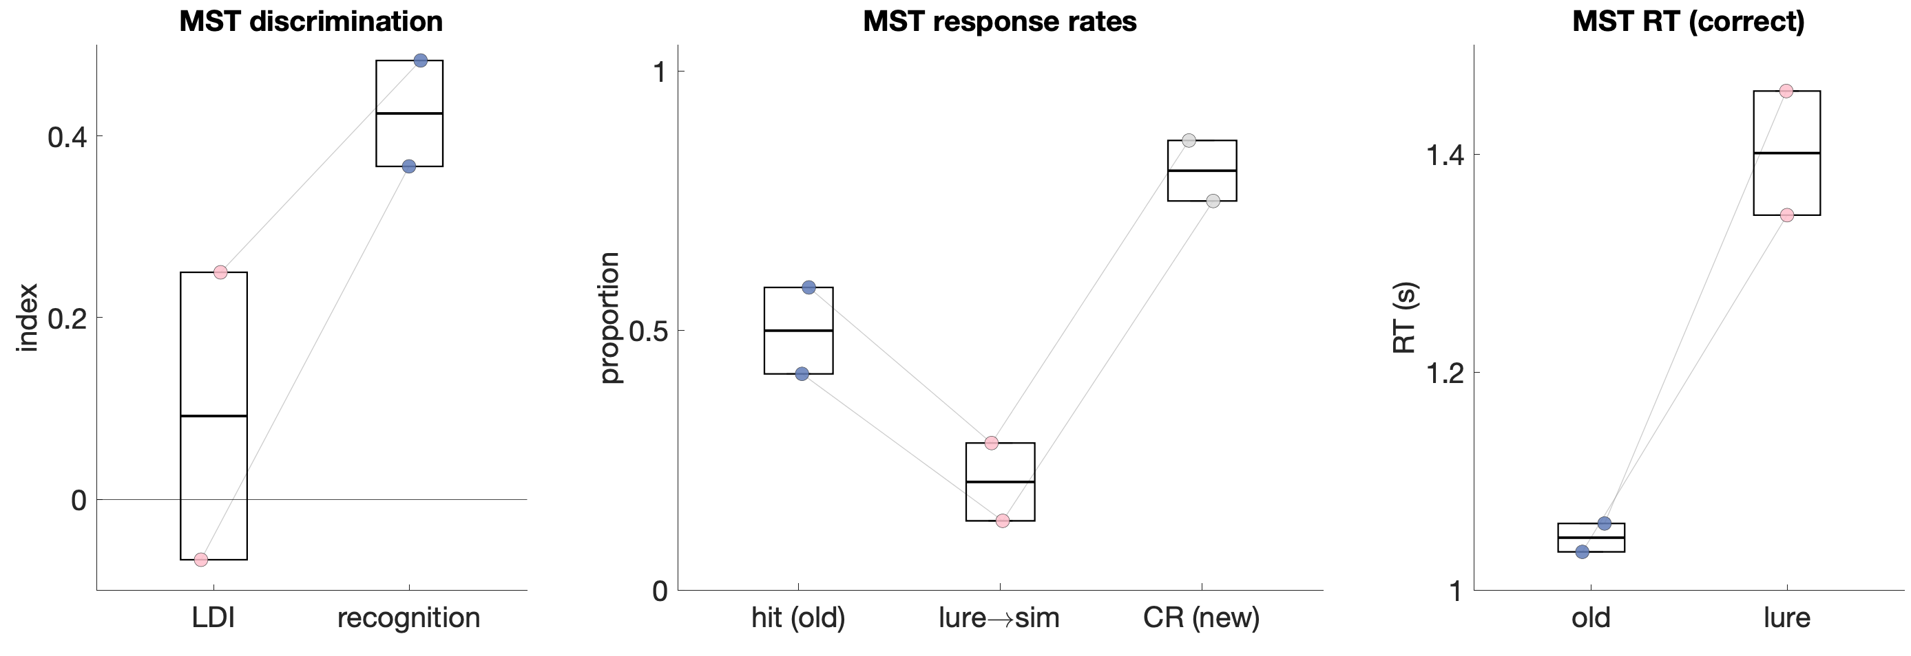
Post-hoc MST

Slide 13
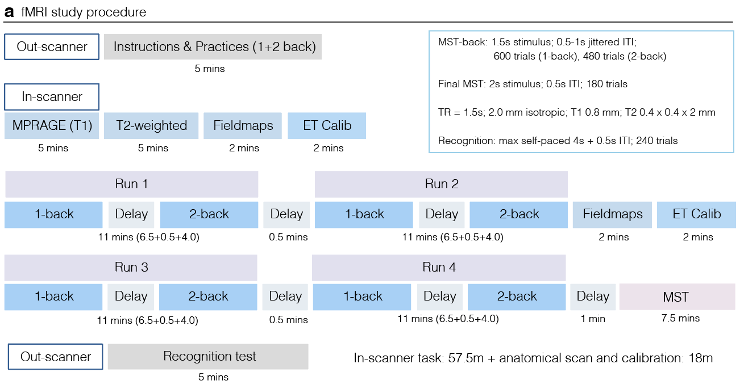
fMRI pilot design
Notes:
Delays at the end align at 1.5s
Wait for 5 a the beginning, ignore the rest of 5s
Page, wait for 5
kbTrigger
Demo runs
Set the ip address on the website

Slide 15
Are we ready to scan?

Slide 16
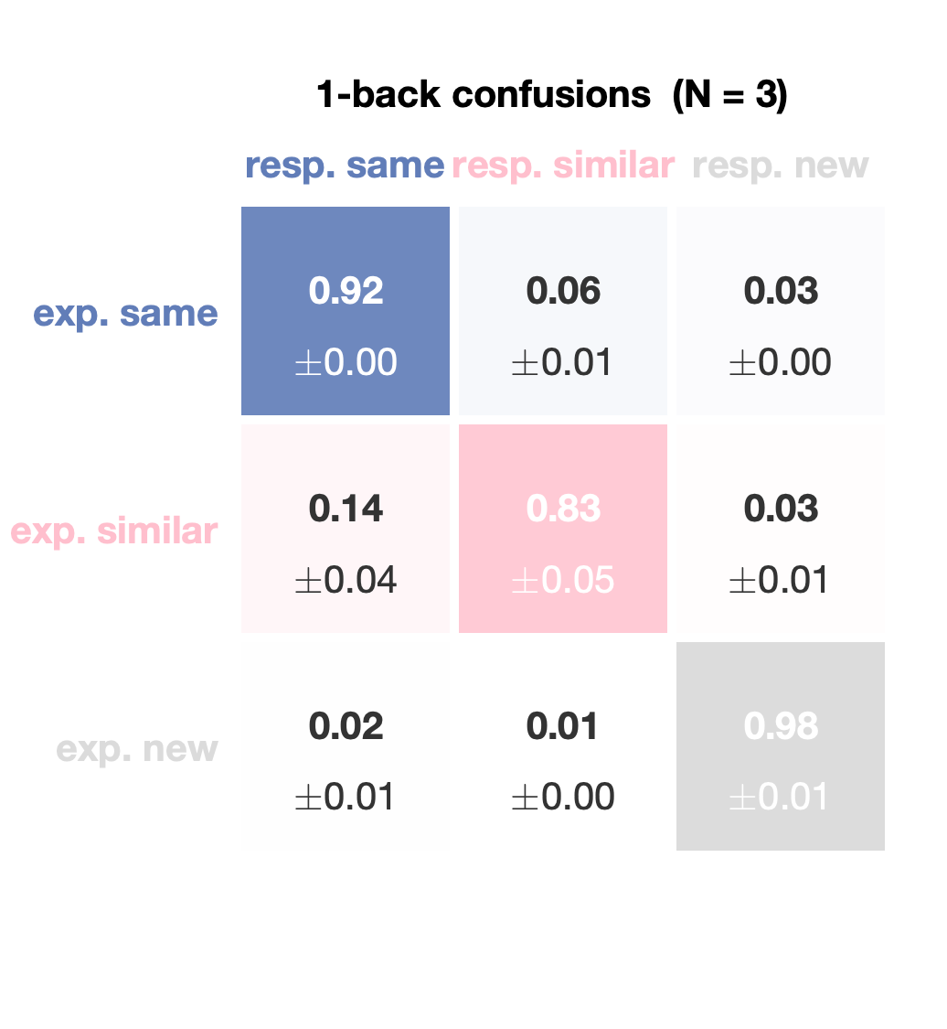
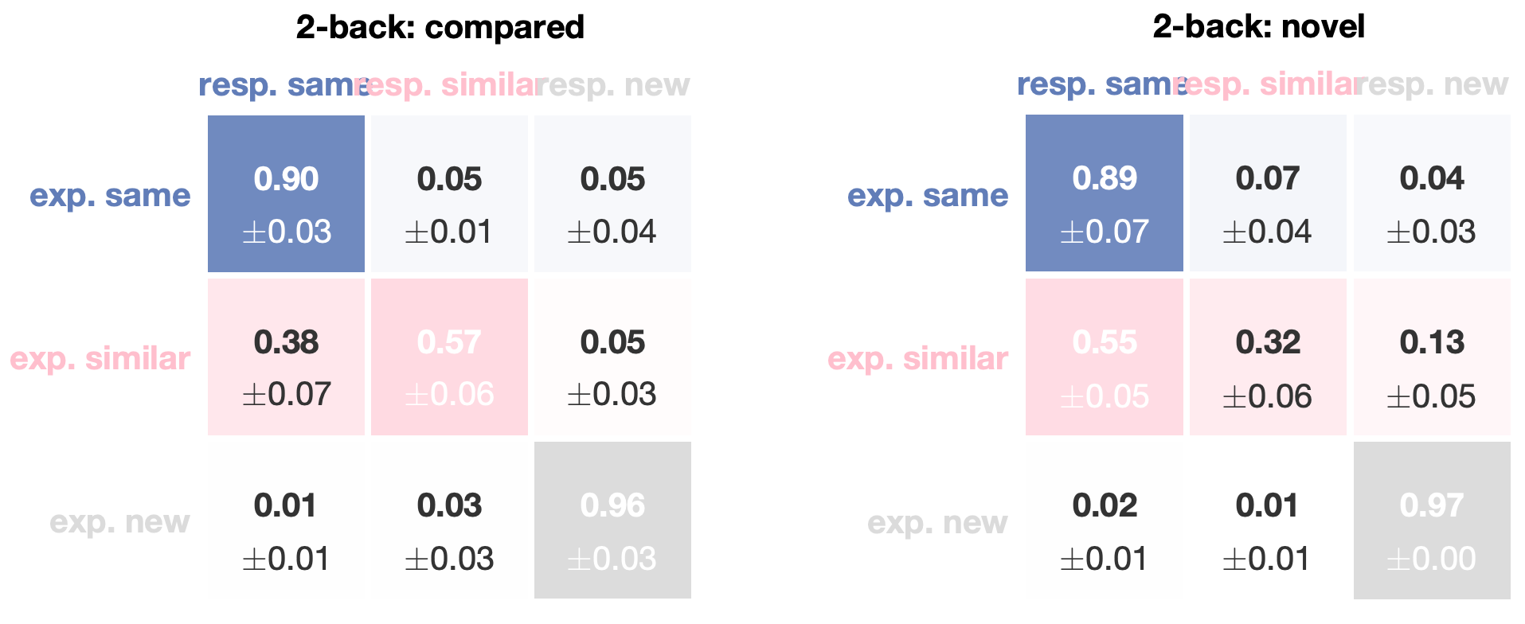
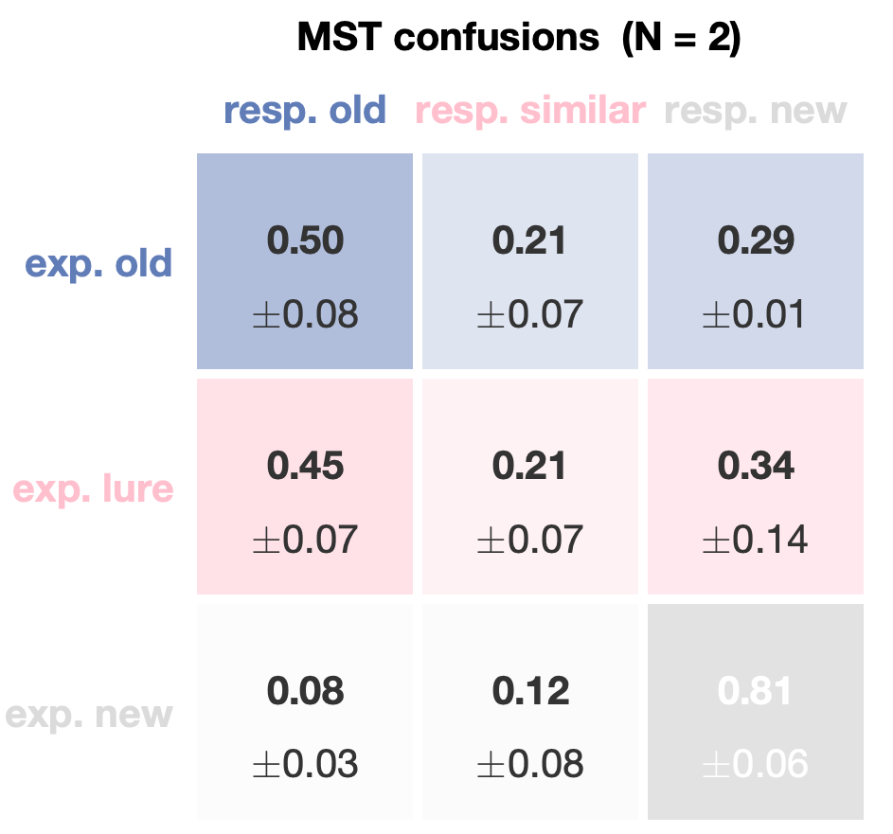
Supplement — confusion matrices

