Slide 1
A graded, item-specific episodic benefit for WM
BF₁₀
> 1000
BF₀₁
= 70.18
***
***
***
***
***
**
*
***
1
Deficits from
cognitive demand
Rescue from episodic memory
1.2
0.8
1
0.6
Discrimination index
Discrimination RT (s)
0.4
0.8
0.2
0.6
0
1-back
2-back
2-back
2-back
1-back
2-back
2-back
2-back
(low load)
novel
isolated
compared
(low load)
novel
isolated
compared
Notes:
We first asked whether EM benefits WM discrimination. We measured WM performance on 2-back trials that required a “similar” response, which indicates how well participants can discriminate a similar item
(c) We computed discrimination index on the left, which is the proportion of similar given similar, minus similar given different, and response time on the right across three conditions.
(c) Across two panels, you can see their performance in the novel condition where participants have no EM, for instance, the tents if you remember from the earlier slide. (c) In the condition where items that have been previously encoded in isolation, for instance the cows, participants are more accurate and faster.
(c) In the condition where items have been previously compared, for instance, the orange juices participants are most accurate and fastest.
So what about those trials requiring same-item detection? Quickly showing here, neither the accuracy nor response time was modulated by encoding conditions.
Together, we found an episodic performance benefit was confined to the mnemonic discrimination of similar items, but was absent for simple recognition of identical repeats.

Slide 2
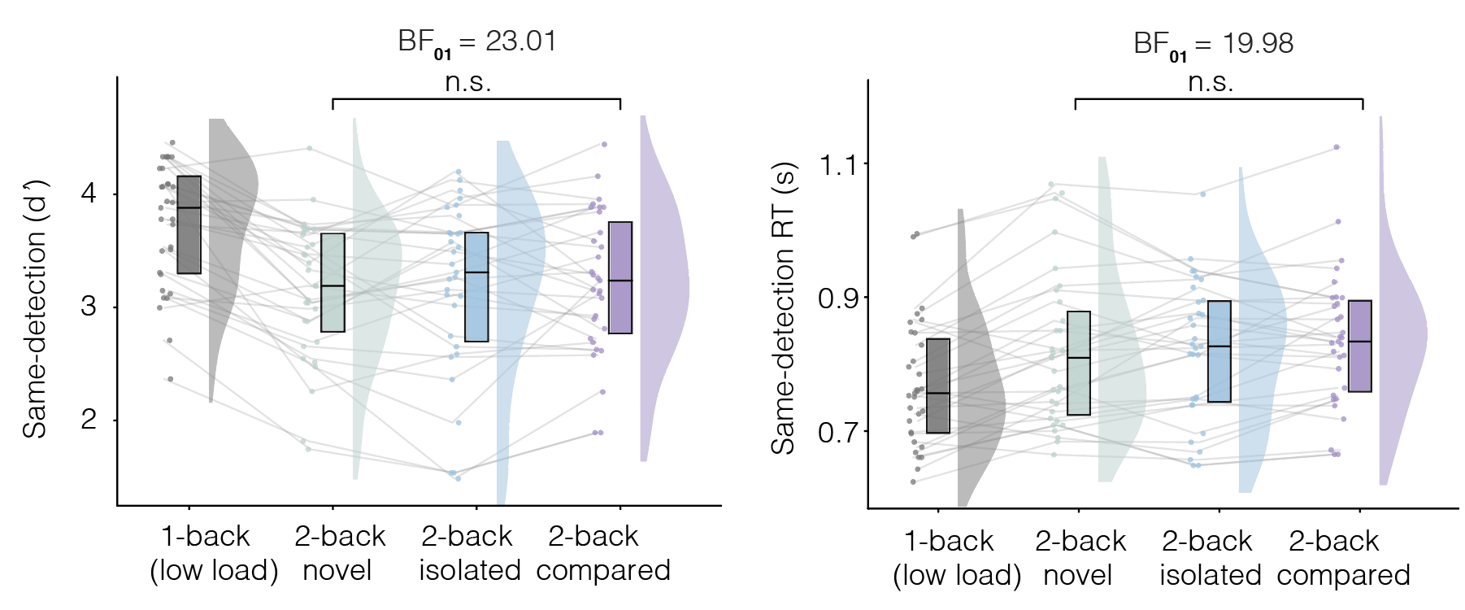
WM same-detection is unaffected by episodic memory

Slide 3
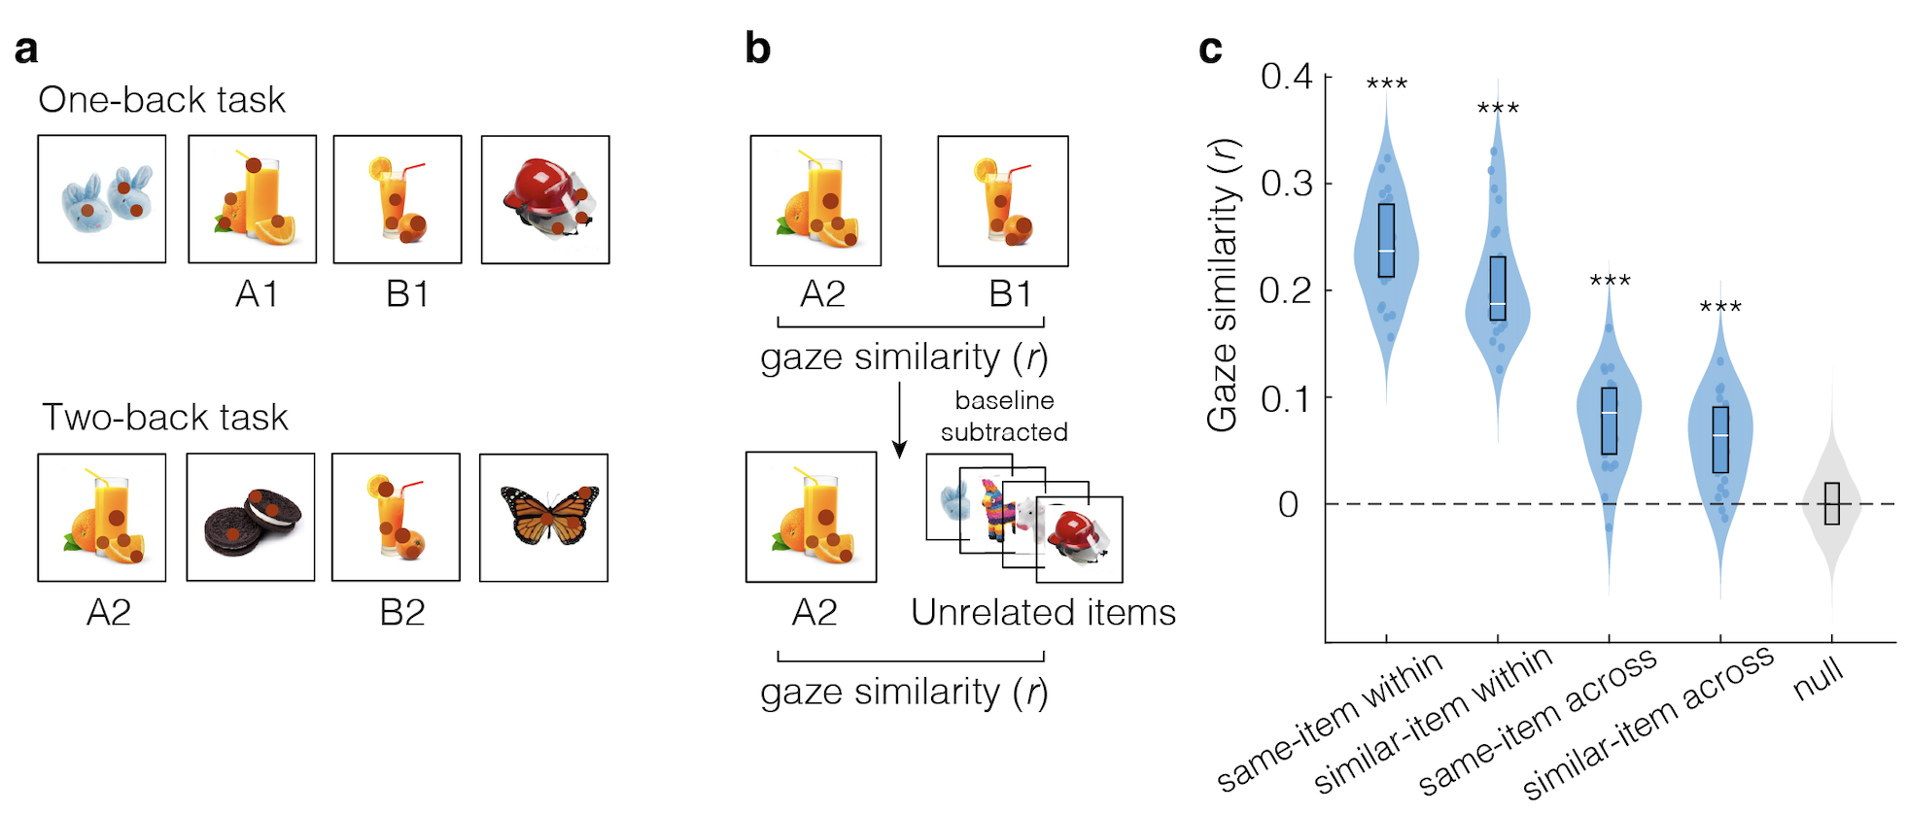
Gaze similarity tracks image similarity

