Slide 1
Anterior hippocampus and cortical reinstatement in mnemonic discrimination
Zihan Bai
fMRI prelim (N = 9) · meeting with Seb · 2026-11-03

Slide 2
Today's questions
1. Where does successful discrimination appear in the brain?
2. How does network connectivity change from encoding to retrieval?
3. Does the anterior hippocampus track successful lure discrimination?
4. Is this specific to lure discrimination, or also same-item detection?
5. Does post-task recognition memory engage the same regions?
6. What content is reinstated during successful discrimination?
7. Is hippocampal reinstatement coupled to cortex?

Slide 3
Where does successful discrimination appear in the brain?
MEASURE
Whole-brain GLM, condition × accuracy contrasts (compared correct > incorrect; interaction). Sign-flip TFCE, FWE-corrected. N = 9.
PREDICTION
If the effect is spatially focal, few or no voxels survive whole-brain correction, motivating a priori ROIs.
No voxels survive whole-brain FWE for the discrimination contrasts; we test a priori ROIs.
interaction / compared / novel: 0 voxels FWE < .05; |t| > 3 uncorrected ≈ 3.2–3.5k
Notes:
Then we asked whether the encoded pattern was recapitulated at retrieval
(c) We measured B2-B1 gaze similarity as a readout of pattern completion, (c) which is how much the gaze pattern for B reappears in 2-back relative to when it was first encoded in 1-back.
(c) In the compared condition, B2-B1 similarity is higher on correct trials, whereas in the isolated condition, we did not see this effect. Thus, this gaze-pattern completion signature supports that: (c) diagnostic gaze pattens laid-down at encoding were recapitulated during successful discrimination at retrieval.

Slide 4
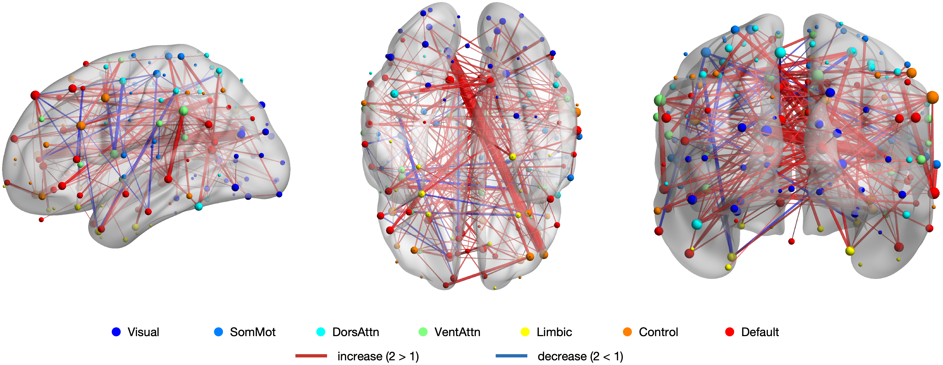
How does network connectivity change from encoding to retrieval?
MEASURE
Yeo 7-network functional connectivity (Fisher-z), 2-back minus 1-back. N = 9.
PREDICTION
Retrieval recruits cross-network integration: between-network coupling increases from 1-back to 2-back.
Between-network coupling increases at retrieval, led by ventral attention–default.
VentAttn–Default d = +.15, p = .009; Visual–SomMot p = .017; Visual–VentAttn p = .036
Notes:
Then we asked whether the encoded pattern was recapitulated at retrieval
(c) We measured B2-B1 gaze similarity as a readout of pattern completion, (c) which is how much the gaze pattern for B reappears in 2-back relative to when it was first encoded in 1-back.
(c) In the compared condition, B2-B1 similarity is higher on correct trials, whereas in the isolated condition, we did not see this effect. Thus, this gaze-pattern completion signature supports that: (c) diagnostic gaze pattens laid-down at encoding were recapitulated during successful discrimination at retrieval.

Slide 5
Does the anterior hippocampus track successful lure discrimination?
MEASURE
ROI parameter estimate (β), condition × accuracy: compared / novel × correct / incorrect. N = 9.
PREDICTION
Anterior HC higher for correct than incorrect on compared lures; no modulation for novel.
Yes: compared correct > incorrect in anterior HC, with a condition × accuracy interaction (also visual, ventral temporal).
HC_ant accuracy p = .018, compared simple effect p = .006, interaction p = .046
Notes:
Then we asked whether the encoded pattern was recapitulated at retrieval
(c) We measured B2-B1 gaze similarity as a readout of pattern completion, (c) which is how much the gaze pattern for B reappears in 2-back relative to when it was first encoded in 1-back.
(c) In the compared condition, B2-B1 similarity is higher on correct trials, whereas in the isolated condition, we did not see this effect. Thus, this gaze-pattern completion signature supports that: (c) diagnostic gaze pattens laid-down at encoding were recapitulated during successful discrimination at retrieval.

Slide 6
Is this specific to lure discrimination, or also same-item detection?
MEASURE
The same condition × accuracy GLM on goal A–A (identical repeats). N = 9.
PREDICTION
If retrieval-specific, no accuracy or interaction effect for same-item detection.
No evidence of modulation in any ROI; the effect is specific to lure discrimination.
all ROIs: accuracy and interaction p > .13
Notes:
Then we asked whether the encoded pattern was recapitulated at retrieval
(c) We measured B2-B1 gaze similarity as a readout of pattern completion, (c) which is how much the gaze pattern for B reappears in 2-back relative to when it was first encoded in 1-back.
(c) In the compared condition, B2-B1 similarity is higher on correct trials, whereas in the isolated condition, we did not see this effect. Thus, this gaze-pattern completion signature supports that: (c) diagnostic gaze pattens laid-down at encoding were recapitulated during successful discrimination at retrieval.

Slide 7
Does post-task recognition memory engage the same regions?
MEASURE
MST old + lure, correct vs incorrect (memory success), ROI β. N = 7.
PREDICTION
A posterior-hippocampal memory signal, dissociable from the anterior-HC discrimination effect.
Posterior hippocampus tracks memory success, with no such effect in anterior HC — a long-axis dissociation.
HC_post p = .041; HC_ant p = .61; visual p = .058
Notes:
Then we asked whether the encoded pattern was recapitulated at retrieval
(c) We measured B2-B1 gaze similarity as a readout of pattern completion, (c) which is how much the gaze pattern for B reappears in 2-back relative to when it was first encoded in 1-back.
(c) In the compared condition, B2-B1 similarity is higher on correct trials, whereas in the isolated condition, we did not see this effect. Thus, this gaze-pattern completion signature supports that: (c) diagnostic gaze pattens laid-down at encoding were recapitulated during successful discrimination at retrieval.

Slide 8
What content is reinstated during successful discrimination?
MEASURE
Item-specific B2→B1 pattern similarity (reinstatement), correct vs incorrect, compared. N = 9.
PREDICTION
Episode content is reinstated: similarity higher for correct in content-carrying cortex.
Ventral temporal reinstatement is higher for correct, angular is promising, and anterior HC carries no item-specific content.
ventral temporal p = .034; angular p = .056 (one-tailed)
Notes:
Then we asked whether the encoded pattern was recapitulated at retrieval
(c) We measured B2-B1 gaze similarity as a readout of pattern completion, (c) which is how much the gaze pattern for B reappears in 2-back relative to when it was first encoded in 1-back.
(c) In the compared condition, B2-B1 similarity is higher on correct trials, whereas in the isolated condition, we did not see this effect. Thus, this gaze-pattern completion signature supports that: (c) diagnostic gaze pattens laid-down at encoding were recapitulated during successful discrimination at retrieval.

Slide 9
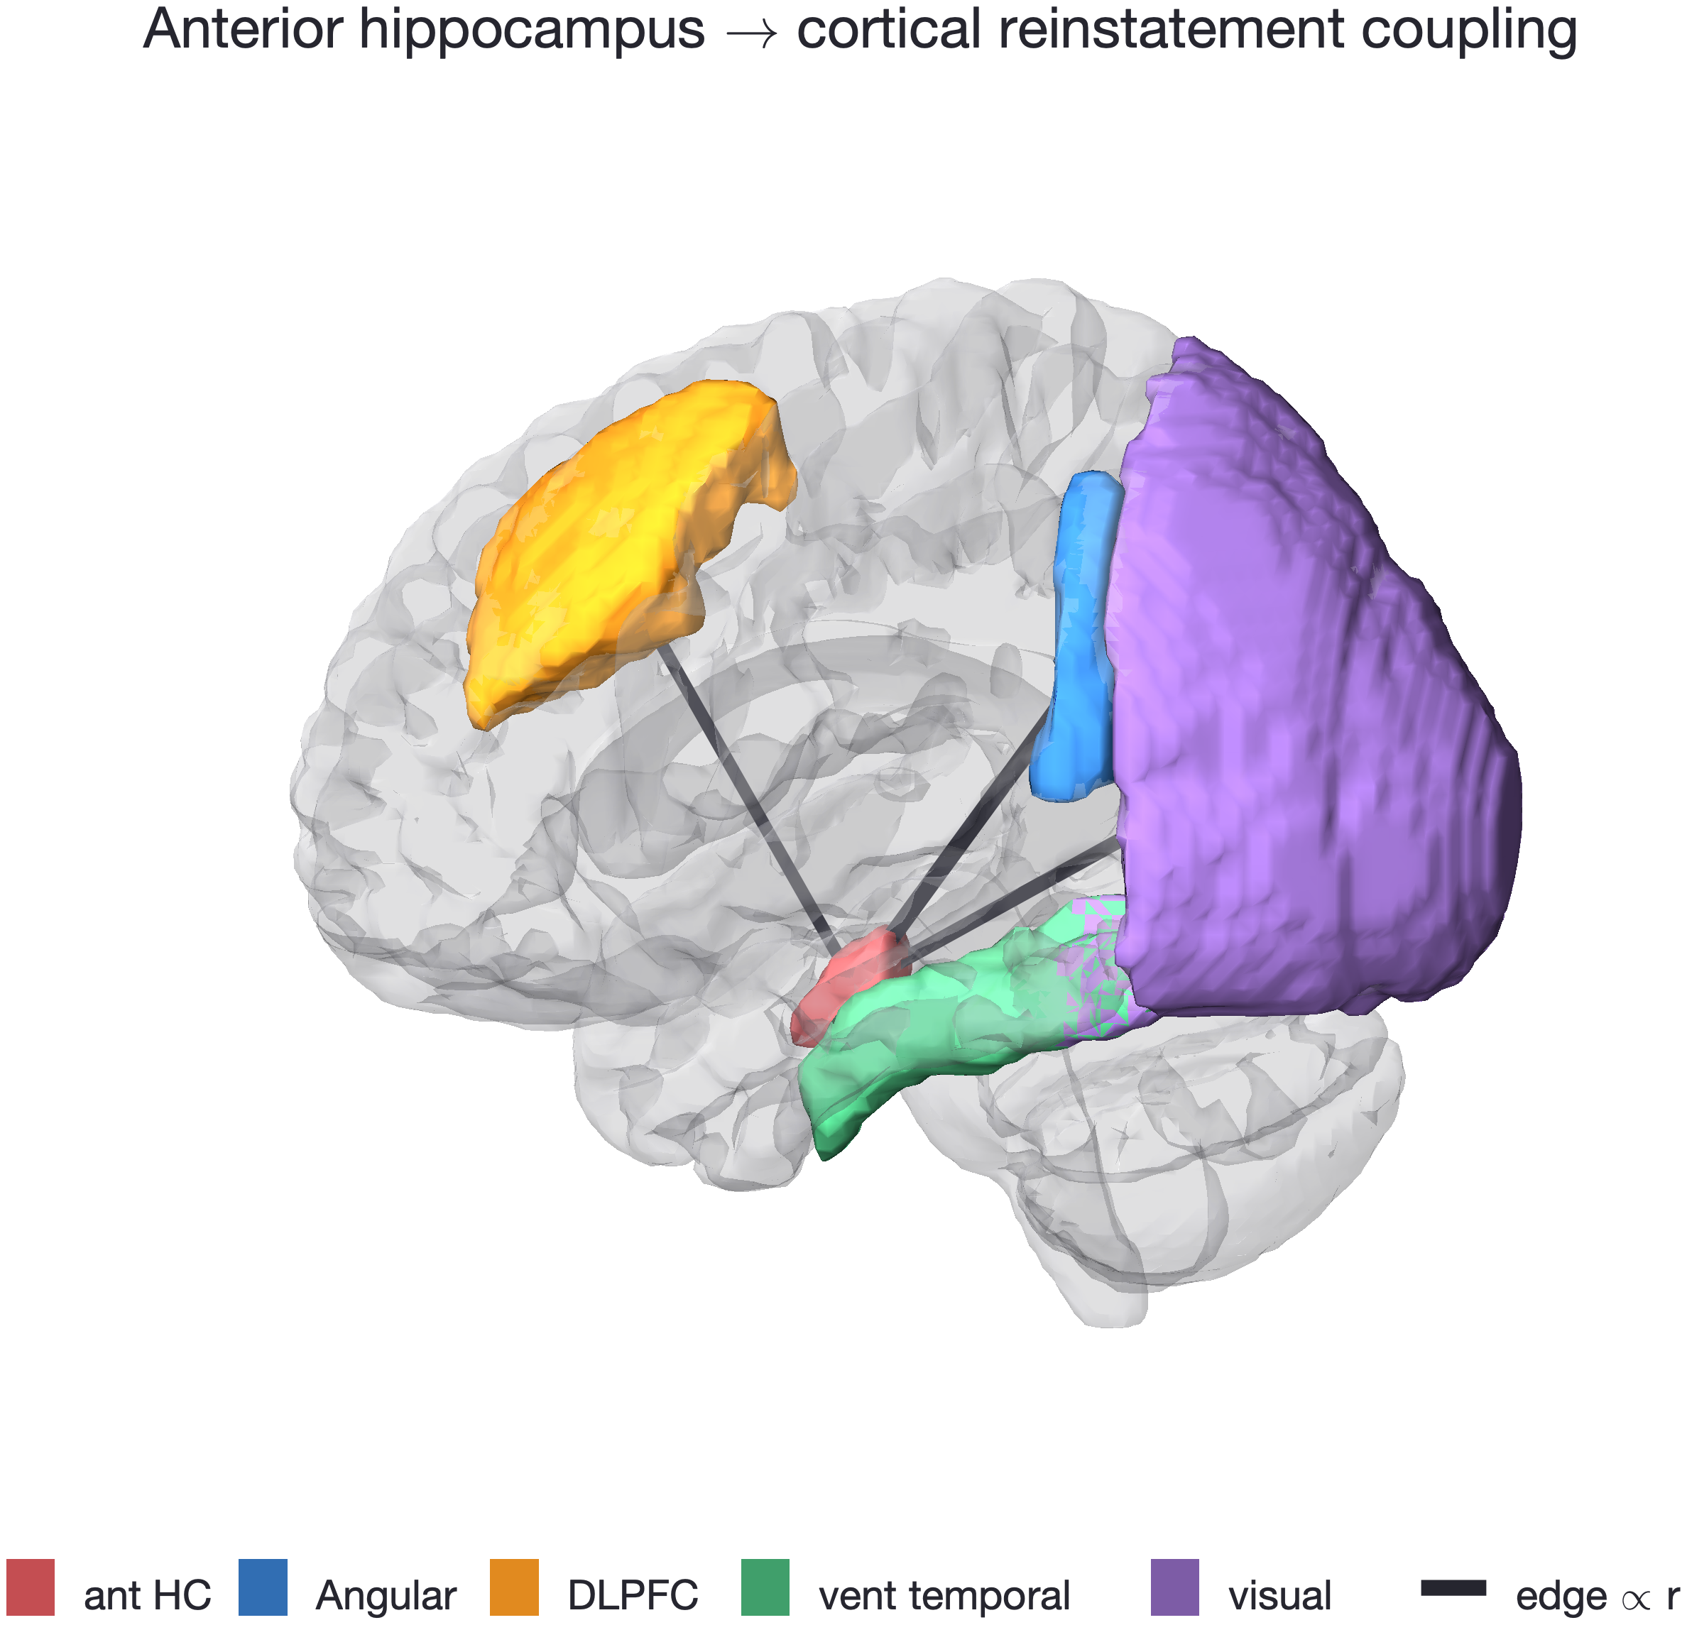
Is hippocampal reinstatement coupled to cortex?
MEASURE
Trial-wise coupling of anterior-HC and cortical B2→B1 reinstatement, correct trials. N = 7.
PREDICTION
If HC indexes the cortical trace, HC reinstatement covaries with cortical reinstatement.
Yes: anterior-HC reinstatement is coupled to angular, DLPFC, ventral temporal and visual, but not vmPFC.
angular p < .001; ventral temporal p = .018; visual p = .023; DLPFC p = .042; vmPFC p = .94
Notes:
Then we asked whether the encoded pattern was recapitulated at retrieval
(c) We measured B2-B1 gaze similarity as a readout of pattern completion, (c) which is how much the gaze pattern for B reappears in 2-back relative to when it was first encoded in 1-back.
(c) In the compared condition, B2-B1 similarity is higher on correct trials, whereas in the isolated condition, we did not see this effect. Thus, this gaze-pattern completion signature supports that: (c) diagnostic gaze pattens laid-down at encoding were recapitulated during successful discrimination at retrieval.

