Slide 1
Neural mechanism of integration between episodic and working memory
Zihan Bai, 11/03/26
Preliminary results
Notes:
Then we asked whether the encoded pattern was recapitulated at retrieval
(c) We measured B2-B1 gaze similarity as a readout of pattern completion, (c) which is how much the gaze pattern for B reappears in 2-back relative to when it was first encoded in 1-back.
(c) In the compared condition, B2-B1 similarity is higher on correct trials, whereas in the isolated condition, we did not see this effect. Thus, this gaze-pattern completion signature supports that: (c) diagnostic gaze pattens laid-down at encoding were recapitulated during successful discrimination at retrieval.

Slide 2
Which brain regions track higher working memory load? – check the maps
Notes:
Then we asked whether the encoded pattern was recapitulated at retrieval
(c) We measured B2-B1 gaze similarity as a readout of pattern completion, (c) which is how much the gaze pattern for B reappears in 2-back relative to when it was first encoded in 1-back.
(c) In the compared condition, B2-B1 similarity is higher on correct trials, whereas in the isolated condition, we did not see this effect. Thus, this gaze-pattern completion signature supports that: (c) diagnostic gaze pattens laid-down at encoding were recapitulated during successful discrimination at retrieval.

Slide 3
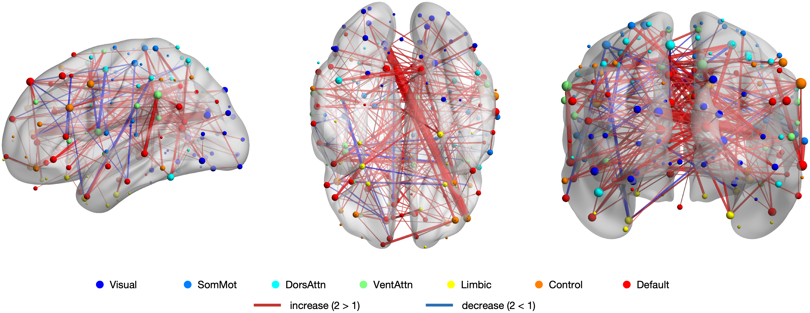
How does network connectivity change from one- to two-back tasks?
Notes:
Then we asked whether the encoded pattern was recapitulated at retrieval
(c) We measured B2-B1 gaze similarity as a readout of pattern completion, (c) which is how much the gaze pattern for B reappears in 2-back relative to when it was first encoded in 1-back.
(c) In the compared condition, B2-B1 similarity is higher on correct trials, whereas in the isolated condition, we did not see this effect. Thus, this gaze-pattern completion signature supports that: (c) diagnostic gaze pattens laid-down at encoding were recapitulated during successful discrimination at retrieval.

Slide 4
Where does successful discrimination appear in the brain?
Measure
ROI-based GLM; parameter estimates for each condition x accuracy interaction:
compared / novel x correct / incorrect
Prediction
Known EM networks show higher activity for correct discrimination of B2, than incorrect; no modulation for novel
Notes:
Then we asked whether the encoded pattern was recapitulated at retrieval
(c) We measured B2-B1 gaze similarity as a readout of pattern completion, (c) which is how much the gaze pattern for B reappears in 2-back relative to when it was first encoded in 1-back.
(c) In the compared condition, B2-B1 similarity is higher on correct trials, whereas in the isolated condition, we did not see this effect. Thus, this gaze-pattern completion signature supports that: (c) diagnostic gaze pattens laid-down at encoding were recapitulated during successful discrimination at retrieval.

Slide 5
Is this specific to discrimination, or also same-detection?
Measure
Same GLM on identical repeat trials
compared / novel x correct / incorrect
Prediction
No accuracy main effect or interaction for same-item detection
Notes:
Then we asked whether the encoded pattern was recapitulated at retrieval
(c) We measured B2-B1 gaze similarity as a readout of pattern completion, (c) which is how much the gaze pattern for B reappears in 2-back relative to when it was first encoded in 1-back.
(c) In the compared condition, B2-B1 similarity is higher on correct trials, whereas in the isolated condition, we did not see this effect. Thus, this gaze-pattern completion signature supports that: (c) diagnostic gaze pattens laid-down at encoding were recapitulated during successful discrimination at retrieval.

Slide 6
Which brain regions track episodic memory performance in post-task MST?
Measure
GLM on MST old + lure trials; split by correct vs. incorrect responses
Prediction
Known EM networks show higher activity for memory success
Notes:
Then we asked whether the encoded pattern was recapitulated at retrieval
(c) We measured B2-B1 gaze similarity as a readout of pattern completion, (c) which is how much the gaze pattern for B reappears in 2-back relative to when it was first encoded in 1-back.
(c) In the compared condition, B2-B1 similarity is higher on correct trials, whereas in the isolated condition, we did not see this effect. Thus, this gaze-pattern completion signature supports that: (c) diagnostic gaze pattens laid-down at encoding were recapitulated during successful discrimination at retrieval.

Slide 7
What content is reinstated during successful discrimination?
Notes:
Then we asked whether the encoded pattern was recapitulated at retrieval
(c) We measured B2-B1 gaze similarity as a readout of pattern completion, (c) which is how much the gaze pattern for B reappears in 2-back relative to when it was first encoded in 1-back.
(c) In the compared condition, B2-B1 similarity is higher on correct trials, whereas in the isolated condition, we did not see this effect. Thus, this gaze-pattern completion signature supports that: (c) diagnostic gaze pattens laid-down at encoding were recapitulated during successful discrimination at retrieval.

Slide 8
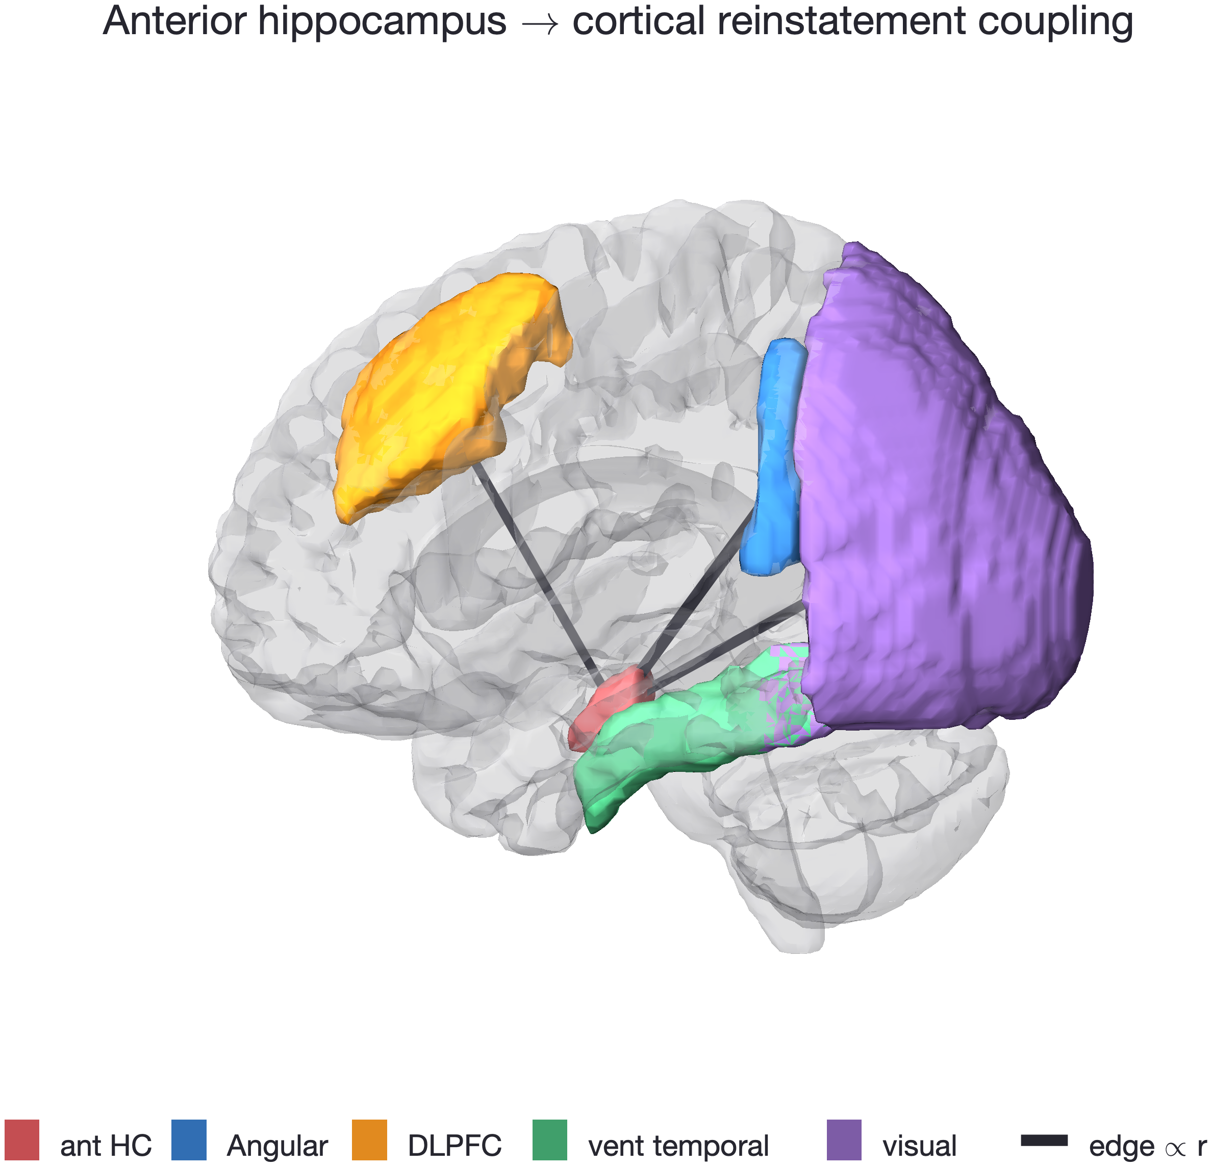
Is hippocampal reinstatement coupled to cortex?
Notes:
Then we asked whether the encoded pattern was recapitulated at retrieval
(c) We measured B2-B1 gaze similarity as a readout of pattern completion, (c) which is how much the gaze pattern for B reappears in 2-back relative to when it was first encoded in 1-back.
(c) In the compared condition, B2-B1 similarity is higher on correct trials, whereas in the isolated condition, we did not see this effect. Thus, this gaze-pattern completion signature supports that: (c) diagnostic gaze pattens laid-down at encoding were recapitulated during successful discrimination at retrieval.

