Slide 1
Episodic memory rescues working memory
via pattern separation, pattern completion, and predictive recall
Zihan Bai
First-year talk, 9/25/26

Slide 2

Background
Notes:
To begin with, imagine you're tryng to find two matching socks from a pile of laundry. As you do this, you need to keep the socks you’ve already seen in working memory, and compare them to highly similar socks in the bucket
Here we ask the quetion: can episodic memory help you in this process^^^?

Slide 3

Project goals
Prior literature suggests EM plays a role in WM tasks
Beukers et al, TiCS, 2021; Hoskin et al., CABN , 2019; Bartsch & Oberauer, Cognition, 2023
How might EM support WM?
Pattern Separation
Predictive recall
Pattern Completion
Yassa & Stark,
Trends Neurosci., 2011
Michelmann et al.,
Nat. Comm., 2021
Wynn et al.,
PNAS, 2020
Notes:
In other words, we wanted to know which computations let episodic memory contribute to working memory in the first place, and when episodic contribution actually occurs.
We hypothesized three different ways in which this could happen
(c) For example, with pattern separation, episodic memory could help keep similar representations in WM apart .
(c) With predictive recall, episodic memory could reinstate relevant information before it is needed in WM
(c) Finally, pattern completion could make missing information available for use in WM processes. (p)

Slide 4
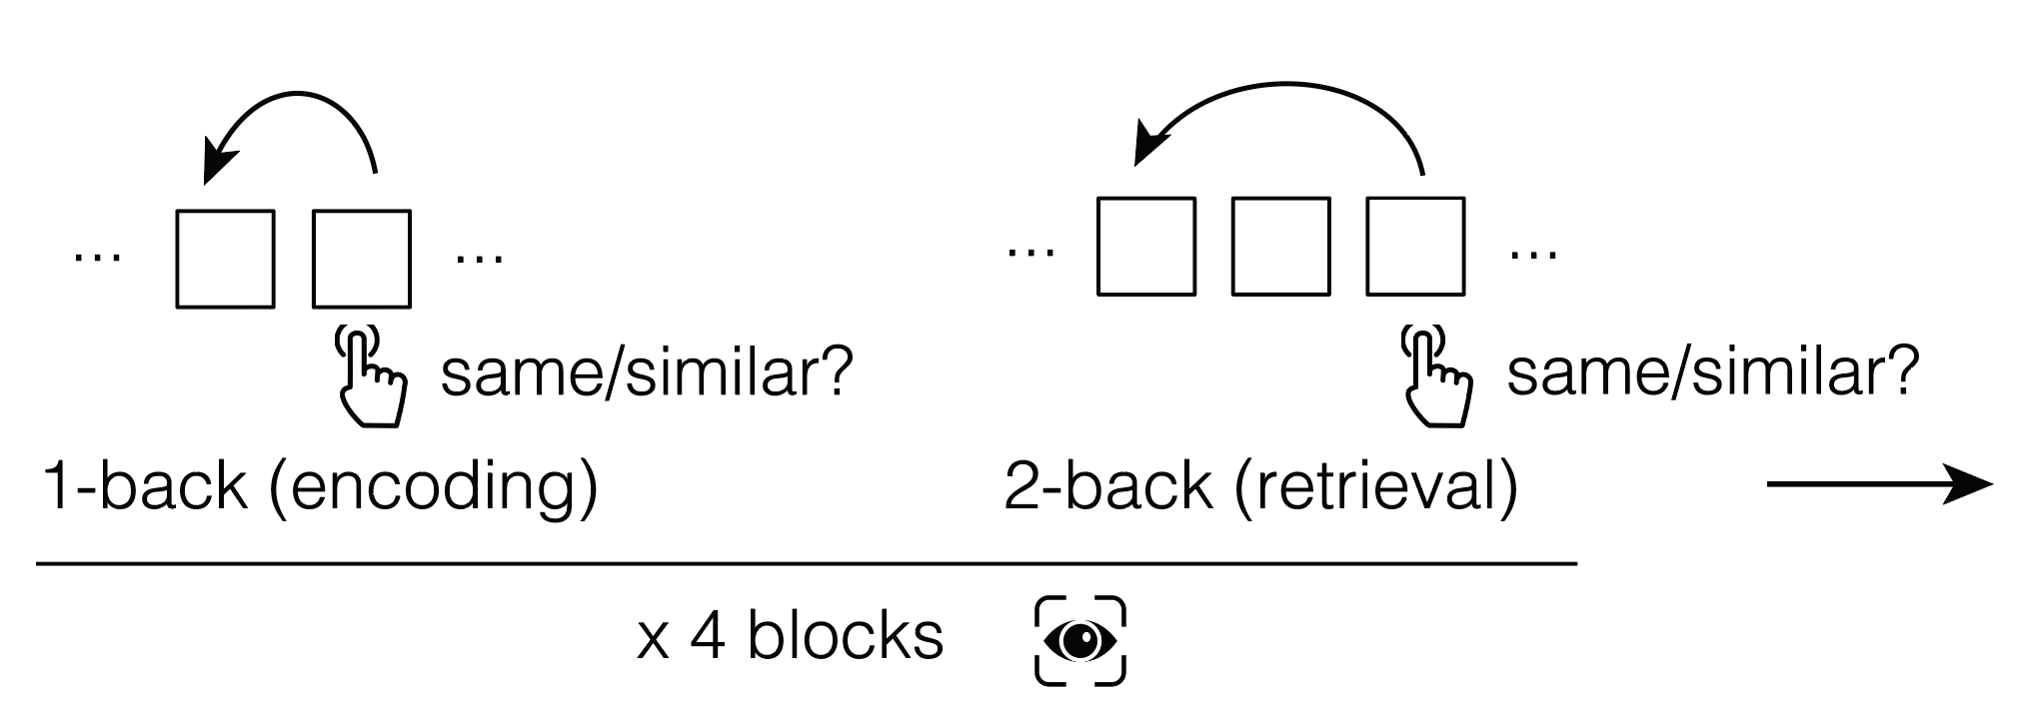
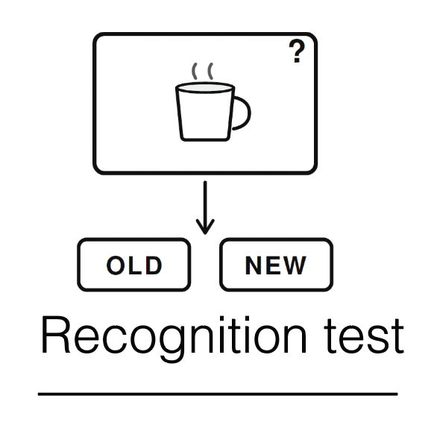
Experiment: the MST-Back task
Notes:
To test this, we developed a paradigm, the MST-Back Task, where we combined mnemonic similarity judgments with a continuous n-back task
(c) Within four blocks, participants rated every items as same, or similar relative to their n-back predecessors.
we started with a 1-back task, where items can be incidentally encoded. In a subsequent 2-back task, some of the pairs from encoding reappeared, allowing us to test whether memory of individual item images support their comparison in working memory.
(c) And we conclude with a old/new recognition test.

Slide 5
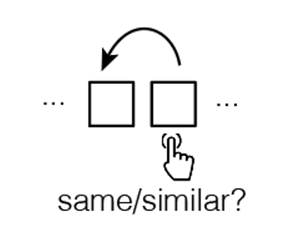
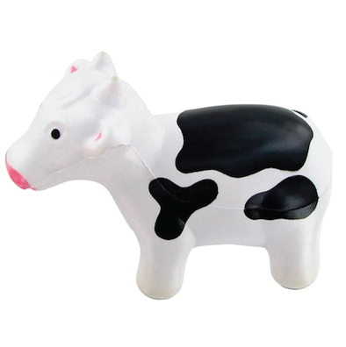


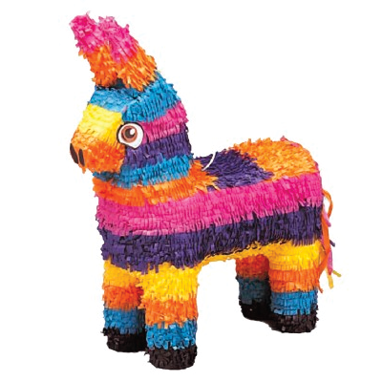
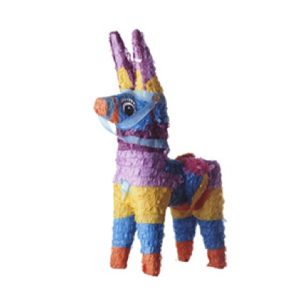

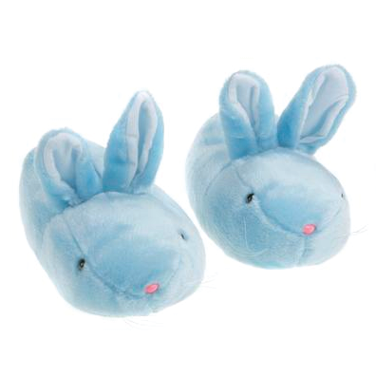
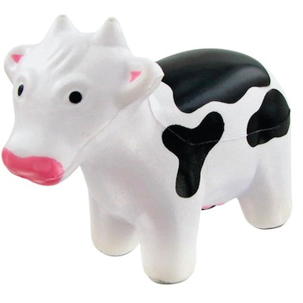
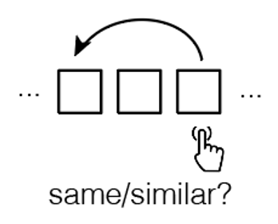
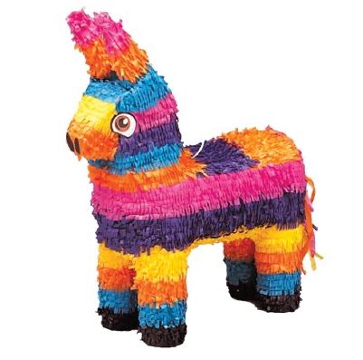

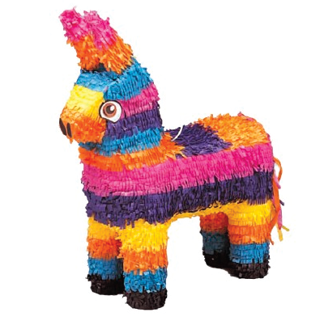

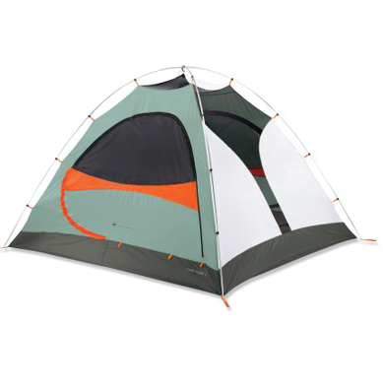

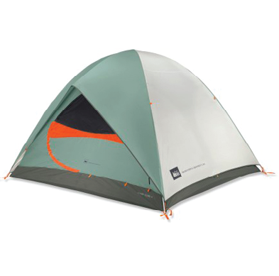
Experiment: the MST-Back task
Notes:
Zooming in,
(c) In 1-back, participants view a stream of 180 items (c) . At each item they indicate whether it’s the same or similar to the immediately preceding one. for different items, they don’t press anything
(c) They then move to a 2-back task, which has a higher WM demand. Now, participants compare each item to the one two trials ago using the same response rules.
In the 2-back task, some of the items come back, so we can identify three conditions. (c) The first condition is that items in 2-back have been previously compared to each other in 1-back, for example, the orange juices. We labeled these items based on the identify and phase they appear, for example A1 is the first item in a given pair, and B1 is its similar pairmate
(c) The second condition is that items in 2-back have been previously presented in isolation in 1-back but never got the chance to directly compared against each other, for example, the cows
(c) The third condition is novel items in 2-back, that were never shown in 1-back, for example, we have a tent A2 and a similar tent B2, without its A1 and B1.
These novel items would give us a baseline WM performance without episodic memory
We carefully counterbalanced the image sequence, so that seeing an A2 image doesn't predict what comes two trials later — the item to discriminate is equally likely to be a repeat, its similar pairmate B2, or a different item. (c) For example, a pair of similar horses, even though they were compared back in 1-back, could reappear as a repeat in 2-back.

Slide 6
A key feature of our task
The novelty of an image is not predictive of the time or type of response.
Consequently, EM can neither reduce WM load, nor can episodic representations replace WM representations.
Instead, object representations stored in EM need to be integrated with the content of WM in order to improve performance.
Notes:
Therefore a key feature of our task is, that

Slide 7






A graded, item-specific episodic benefit for WM
Notes:
We first asked whether EM benefits WM discrimination. We measured WM performance on 2-back trials that required a “similar” response, which indicates how well participants can discriminate a similar item
(c) We computed discrimination index on the left, which is the proportion of similar given similar, minus similar given different, and response time on the right across three conditions.
(c) Across two panels, you can see their performance in the novel condition where participants have no EM, for instance, the tents if you remember from the earlier slide. (c) In the condition where items that have been previously encoded in isolation, for instance the cows, participants are more accurate and faster.
(c) In the condition where items have been previously compared, for instance, the orange juices participants are most accurate and fastest.
So what about those trials requiring same-item detection? Quickly showing here, neither the accuracy nor response time was modulated by encoding conditions.
Together, we found an episodic performance benefit was confined to the mnemonic discrimination of similar items, but was absent for simple recognition of identical repeats.

Slide 8
The benefit reflects a shared memory factor
d’
d’
Greater EM benefit for subjects with better LTM
Greater EM benefit for subjects with better WM
Notes:
Then we asked whether the episodic benefit shares a common source with individual’s pure LTM and WM ability.
(c) First, across participants we correlate the benefit, estimated as the difference in mnemonic discrimination between old and novel items, with long-term memory, measured as recognition d’ from the final recognition test. (c) we found that better LTM performance predicts a stronger episodic benefit. (p)
(c)Then we correlate the benefit with pure WM, estimated on same detection d’ in 2-back, which was unaffected by encoding condition (c) we found that better baseline WM predicts a stronger benefit as well.
And critically, these two abilities are themselves strongly correlated.
This benefit is consistent with a common factor that contributes to episodic memory, working memory, and their interaction

Slide 9

Pupil dilation supports successful similar discrimination
Time after stimulus onset (s)
Notes:
Next, we wanted to test the mechanisms that afford this behavioral benefit using eye-tracking data. We first asked: does pupil dilation track this EM benefit?
(c) Here, we plot average pupil size change across conditions, time-locked to those 2-back trials requiring a “similar” response, which is where we saw the benefit. Discriminating previously compared items (c) led to pupil dilation than isolated or novel ones. (c) We observed a significant cluster where this effect emerged
(c) Importantly, only in the compared condition did correct trials show this dilation (p). This means pupil dilation tracks correct discrimination of previously compared items.
Conversely, pupil dilation in response to same-item detection was not modulated by encoding condition.
This indicates that pupil dilation specifically marks successful discrimination, and cannot by explained by generic differences in arousal, effort, or task engagement across encoding conditions.

Slide 10


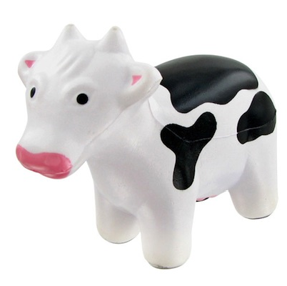
Test the mechanisms of EM that supported WM
Gaze similarity
Gaze similarity tracks image similarity
r
actual fixation
0.3
***
***
Same-item
e.g., A1
e.g., A2
0.15
Gaze Similarity
Similar-item
0
e.g., A1
e.g., B1
Null
Null
Same-item
Similar-item
e.g., A1
unrelated items
Notes:
Next, we wanted to test the mechanisms that afford this behavioral benefit using eye-tracking data. So we looked at gaze pattern similarity, which is basically how similar the fixation patterns are when people view the images.
Before testing specific hypotheses, we first validate this measure. We computed gaze similarity between (c) same-items, for example A1 and A2; (c) similar-items for example A1 and B1, (c) each against unrelated items
(c) As you can see, these two types of gaze similarities are both significantly higher than a null distribution. In other words, we confirmed that gaze similarity tracks image similarity.

Slide 11
Gaze-pattern separation predicts subsequent discrimination success
At encoding
Viewing the difference
A1
B1
A1-B1
Pairs encoded with more discriminative gaze (less similar) in 1-back were better subsequently discriminated in 2-back
Notes:
Next using gaze similarity, we asked whether participants formed distinct episodic representations in 1-back that could support later discrimination in 2-back.
(c) We measured how differently they viewed A1 and B1. (c) Lower A1-B1 similarity suggests they focused on more discriminative features than shared ones.
(c) In the compared condition, trials that were subsequently discriminated correctly had lower A1-B1 similarity. (c) however, that difference was not observed in the isolated condition.
This provides a gaze-level signature of pattern separation. (c) Pairs encoded with more discriminative gaze (in other words, less similar) in 1-back were better subsequently discriminated in 2-back

Slide 12
Gaze-pattern completion at retrieval marks discrimination success
At retrieval
remembering the difference
B2
B1
B2-B1
Diagnostic gaze patterns were recapitulated during successful discrimination
Notes:
Then we asked whether the encoded pattern was recapitulated at retrieval
(c) We measured B2-B1 gaze similarity as a readout of pattern completion, (c) which is how much the gaze pattern for B reappears in 2-back relative to when it was first encoded in 1-back.
(c) In the compared condition, B2-B1 similarity is higher on correct trials, whereas in the isolated condition, we did not see this effect. Thus, this gaze-pattern completion signature supports that: (c) diagnostic gaze pattens laid-down at encoding were recapitulated during successful discrimination at retrieval.

Slide 13
Predictive recall of gaze patterns predict upcoming discrimination success
Before discrimination
Predictive viewing
A2
B1
A2-B1
Two trials before the target appeared, predictive viewing of the first of two pairmate foreshadowed upcoming discrimination success (predictive recall of diagnostic features)
Predictive recall gradually emerged with more fixations
Notes:
Importantly, we asked, before B2 appears, were people already predictively recalling diagnostic representation?
(c) Here A2 is the current item in 2-back people are viewing, and we’re comparing it to B1, which is a previously encoded pairmate.
(c) In the compared condition, correct trials show higher A2-B1 similarity, (c) but not in the isolated condition. (c) Two trials before the target appeared, predictive viewing of the first of two pairmate forshadowed upcoming discrimination success (indicating predictive recall of diagnostic features. (p)
And when we looked at how this effect unfolds over times, we found that (c) predictive recall gradually emerged with more fixations (p)

Slide 14
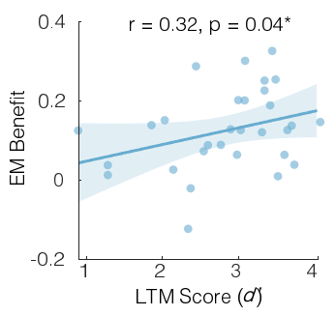
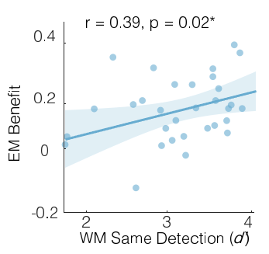
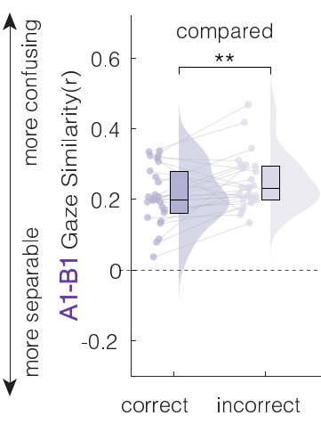
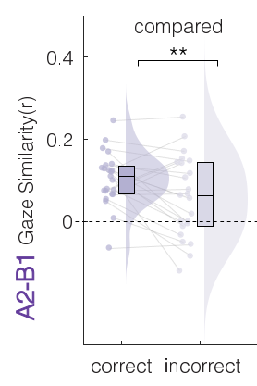
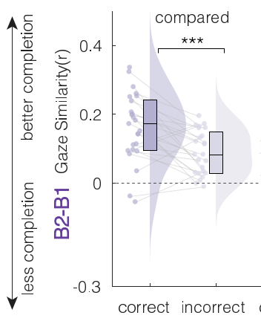
Conclusion
Evidence for an episodic benefit for WM
A shared factor contributing to EM-WM interaction
Three hallmark computations that underlie when and how this performance benefit emerges
(i) Diagnostic memory traces are laid down at encoding
(ii) Upcoming content is predicted before discrimination
(iii) And it is reinstated during discrimination at retrieval
Our findings characterize the mechanism of integration between episodic and working memory
Notes:
In conclusion, (c) we first found evidence that EM benefits WM mnemonic discrimination.
(c) Across participants, the benefit scales with individual’s LTM and WM ability, consistent with a shared factor contributing to interaction between memory systems
(c) and, this benefit is tracked by pupil dilation
(c) Importantly, we identified three hallmark computations underlies when and how this performance benefit emerges:
(c) first,
(c) second,
(c) And finally
Our findings characterize the mechanism of integration between episodic and working memory. We believe that reuniting the study of episodic and working memory is a important step forward to understand either system on its own terms, and human memory more broadly.

Slide 15
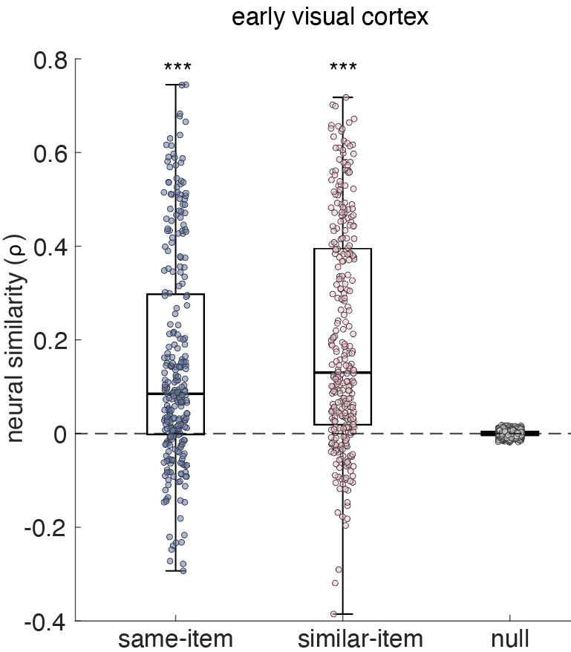
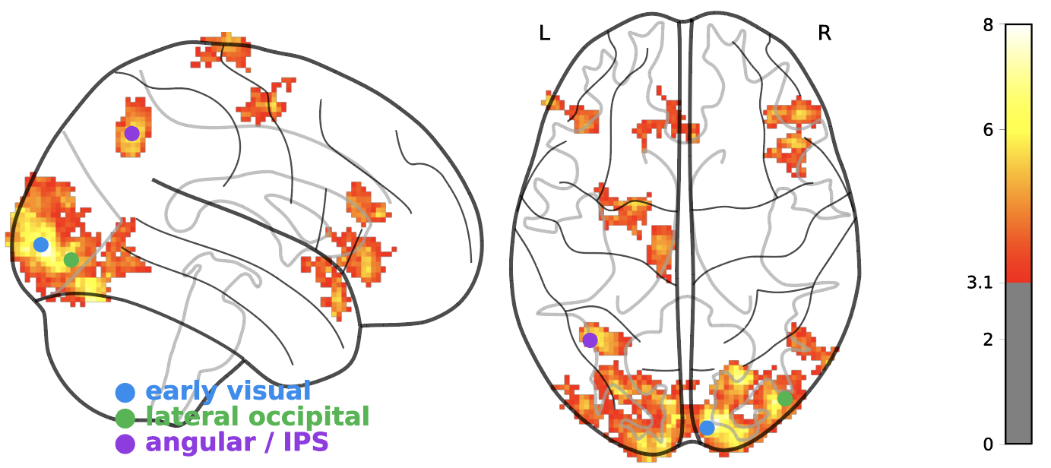
Future direction
To characterize the neural mechanisms of interaction between episodic and working memory
Specifically, where in the brain, and at which moments EM that supported WM discrimination emerged
Ongoing high-res fMRI study (N=1)
Neural similarity tracks image similarity (cluster-corrected (z>3.09, p<.05))
Notes:
to test this, we’ve started an fMRI study. These are preliminary data from a single subject.
First, as a validation, we asked the same question we asked of gaze: does neural pattern similarity track image similarity? Using a whole-brain searchlight, we found that early visual, lateral occipital, and angular/IPS regions carried this image-similarity structure;mWhen we zoom into early visual cortex, which appears to be the largest cluster, both same and similar images were represented more alike than unrelated images. So this confirms that neural similarity carries image-specific information at sufficient resolution, just as we did from gaze.

Slide 16
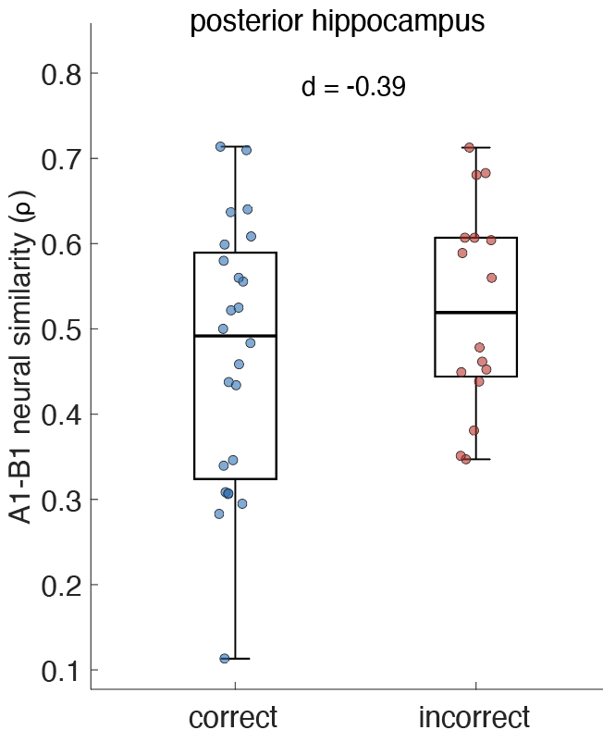
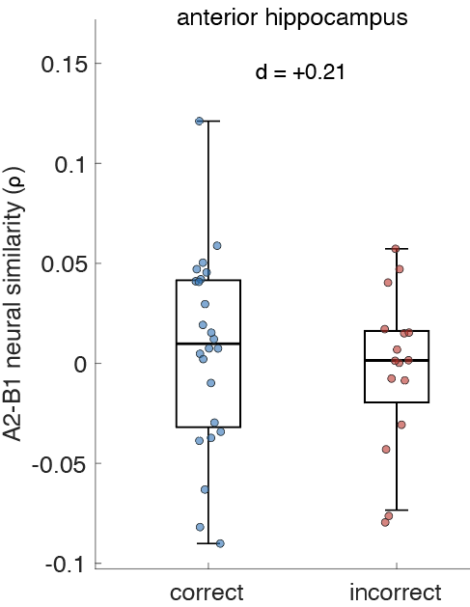
Future direction
Hippocampal pattern separation and predictive recall tracks discrimination success
Pattern separation
Predictive recall
Notes:
Next, we asked whether the memory computations from our gaze result also appear in the hippocampus. At encoding, the posterior hippocampus represented the two similar pairmates more distinctly, with lower A1-B1 similarity, on trials that were later discriminated correctly. Then before the target appeared in 2-back, the anterior hippocampus predictively recalled the encoded pairmate, with higher A2-B1 neural similarity, on trials that were later correct. Again we only have one subject now, so I wouldn’t read too much into it, but our full study will resolve these signals, and further localize the brain networks that support integration between episodic and working memory.

Slide 17







Sebastian Michelmann
Daryl Fougnie
Check out our new preprint!
zihan.bai@nyu.edu
zihanbai.bsky.social

Slide 18
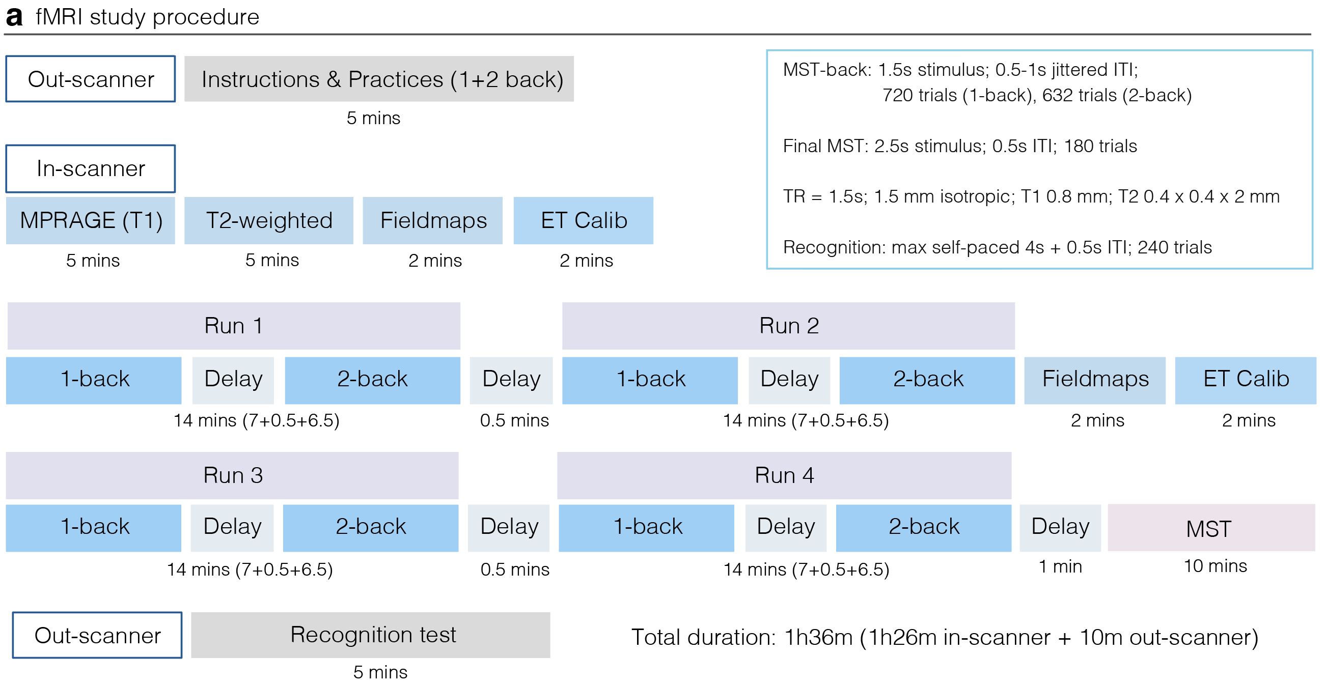
fMRI study design

Slide 19
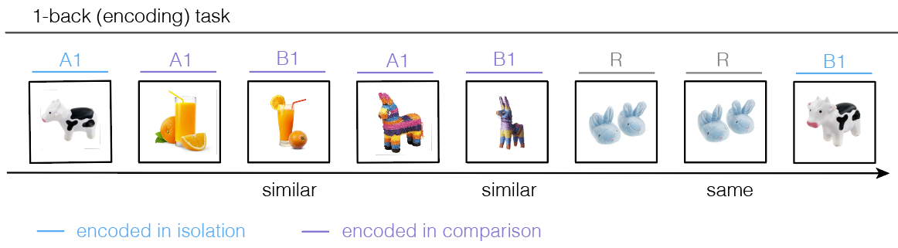
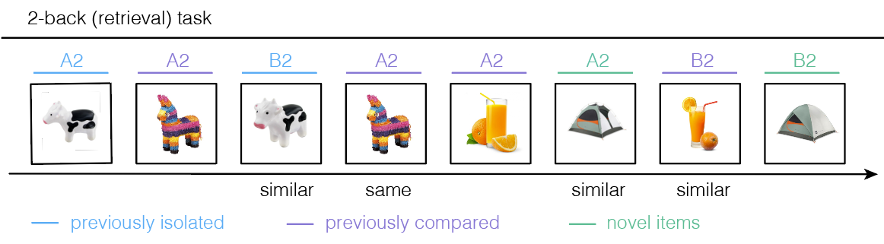
Summary
EM benefits WM mnemonic discrimination
Individuals with stronger WM and EM benefit more from their interaction
Pupil dilation tracks EM benefits
B1 was more separated from A1 (pattern separation),
supporting subsequent B2 discrimination
B1 was more fully re-expressed (pattern completion) at successful B2 discrimination
B1 was predictively recalled at A2 viewing, guiding upcoming B2 discrimination

Slide 20
Why we testing a restricted viewing version?
Gaze reinstatement was found as candidate mechanisms underlying EM effects for WM
It might be confounding to memory-related neural signals
  Eye movements itself is linked to neural activity in the hippocampus and broader brain regions (Liu et al., 2017, J. Neurosci; Voss et al., 2017, TiCS)
Is eye movement causally necessary for our EM-WM effect?
Notes:
If remembered trials involve systematically different eye movements than forgotten ones — which they do (Hannula & Ranganath, 2009, Neuron; the whole gaze-reinstatement literature) — then any subsequent-memory or retrieval-success contrast is partly an eye-movement contrast. Without restricting or explicitly modeling gaze, "memory-related activity" is not purified of oculomotor-driven activity.

Slide 21
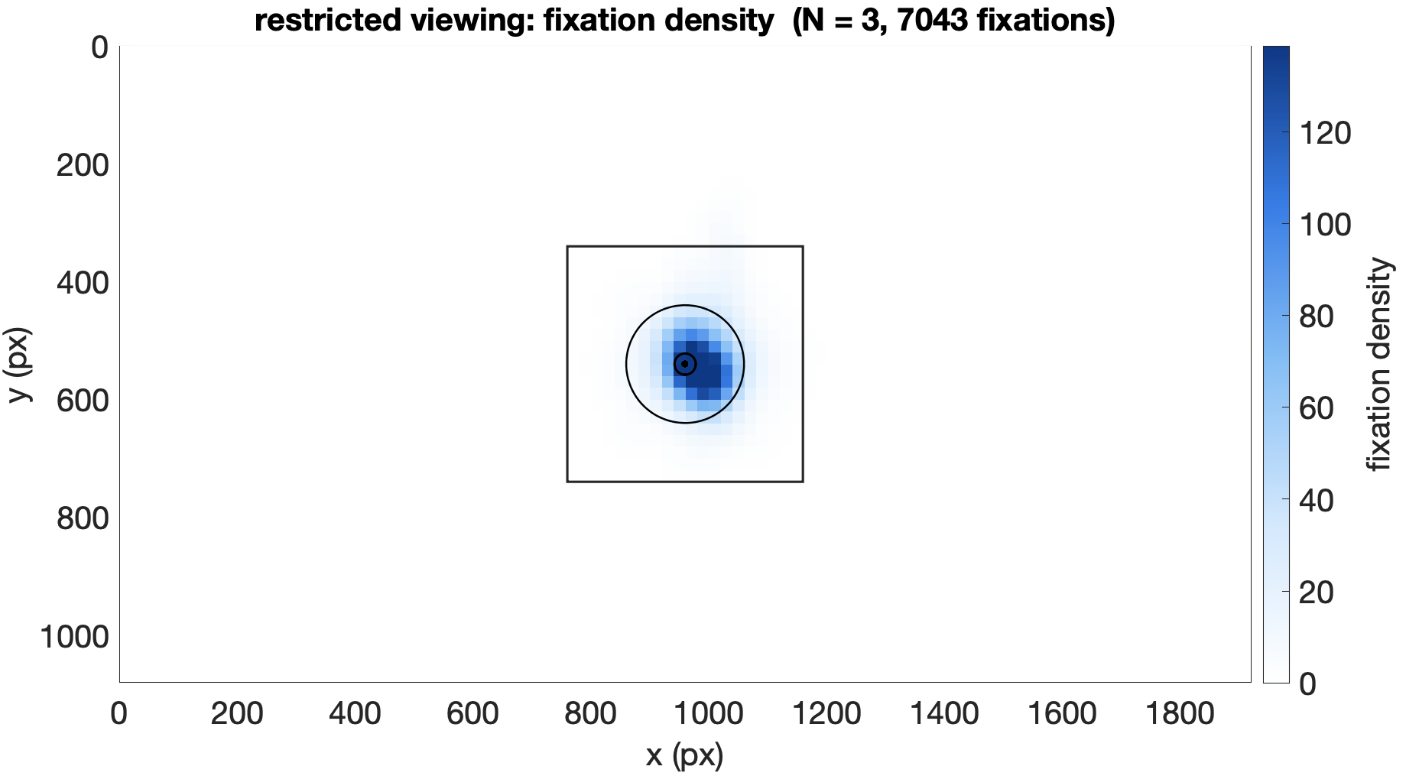
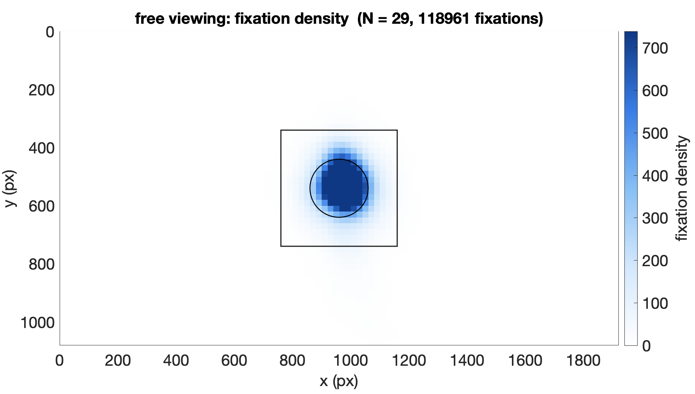
Does restrict viewing work? (visual inspections)

Slide 22
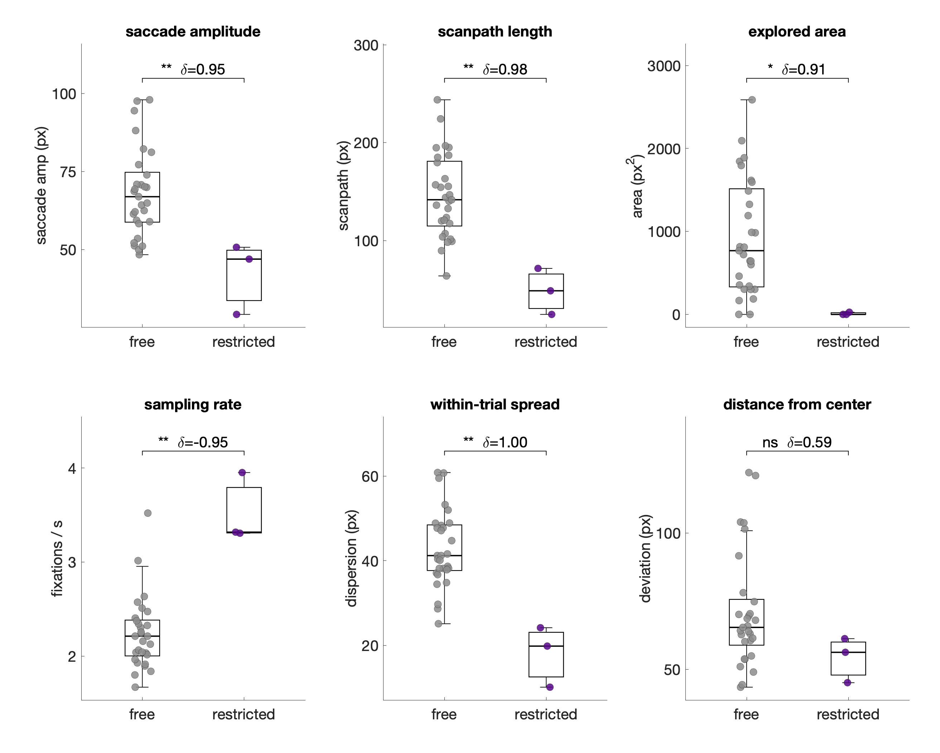
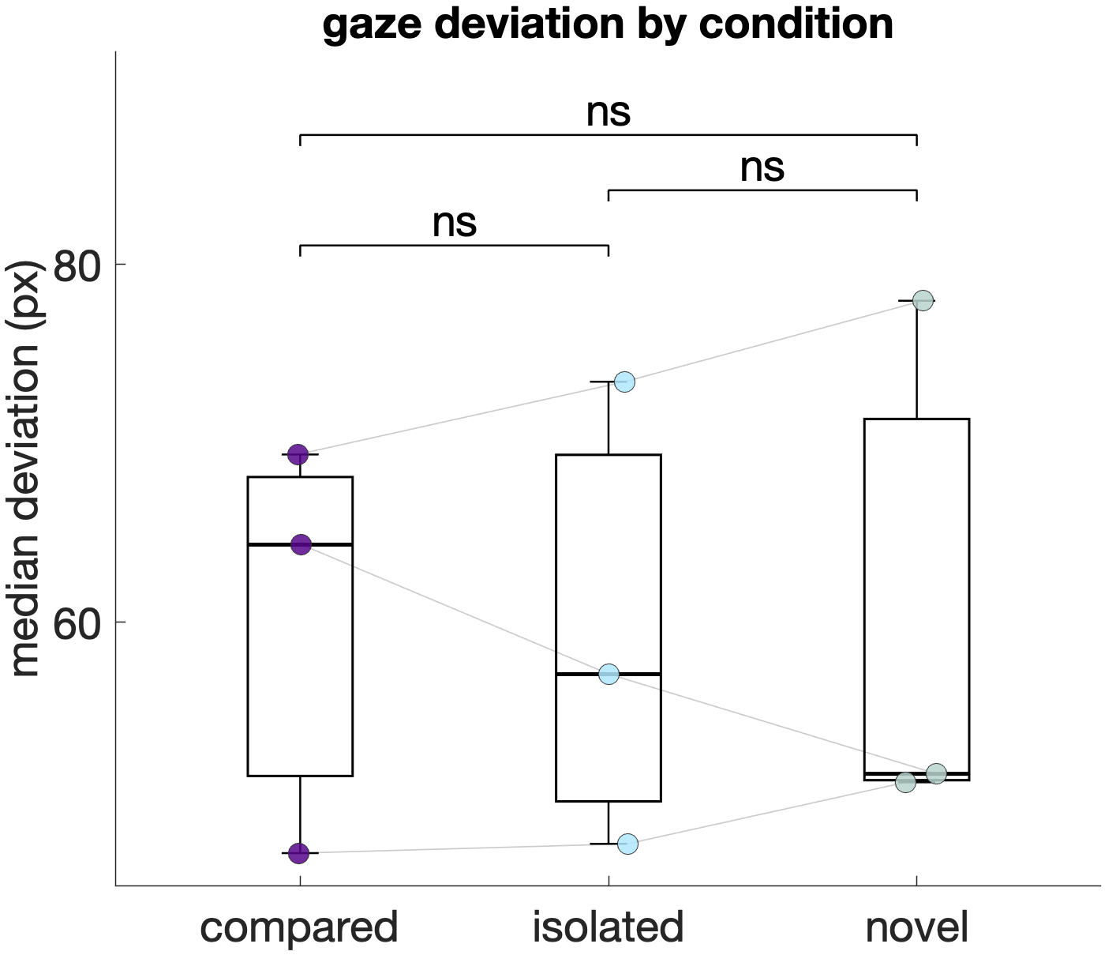
Does restrict viewing work?

Slide 23
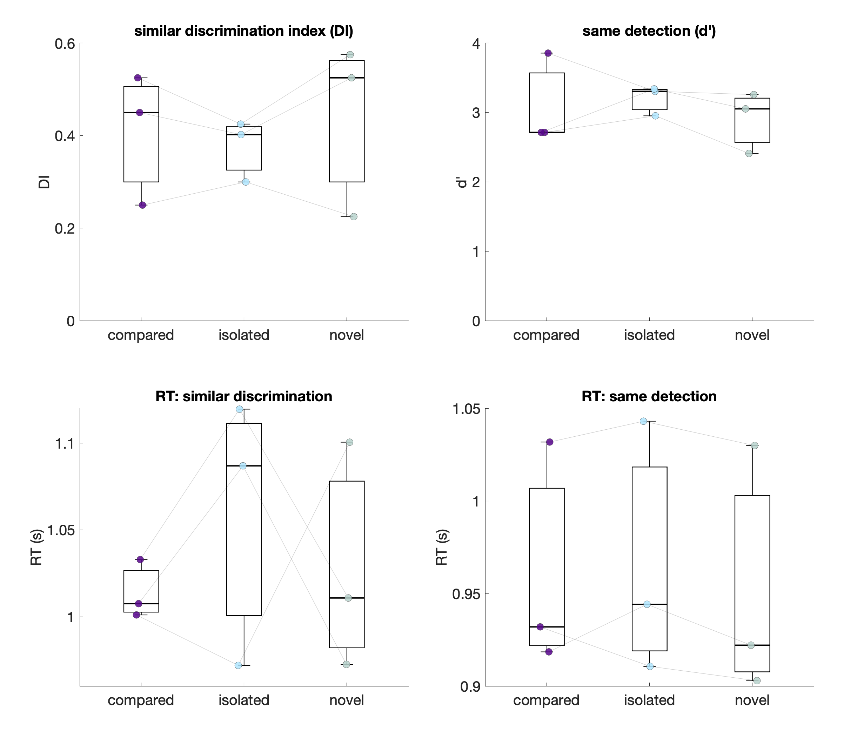
ResView performance

Slide 24
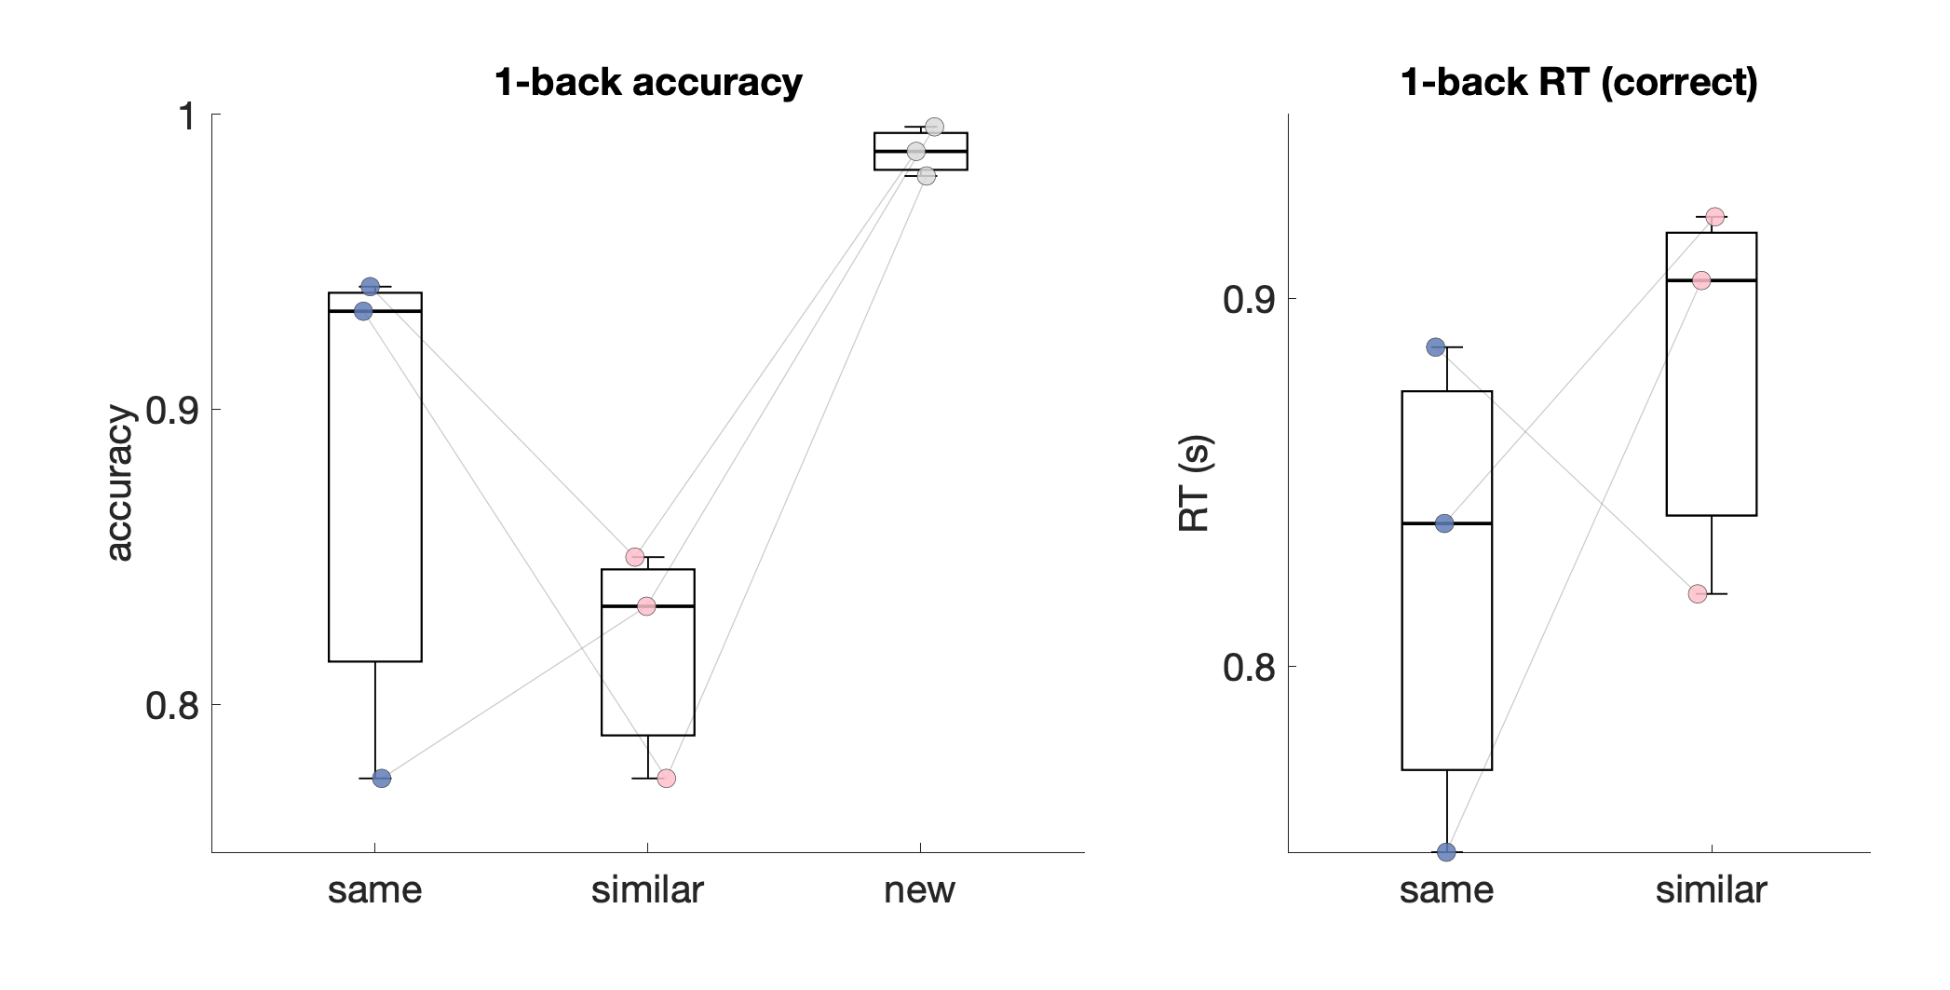
ResView performance

Slide 25
Some modifications for the later fMRI
Cut off the “isolated” condition – keep only previously “compared items” and “novel items”
Add an in-scanner standard MST
Notes:
If remembered trials involve systematically different eye movements than forgotten ones — which they do (Hannula & Ranganath, 2009, Neuron; the whole gaze-reinstatement literature) — then any subsequent-memory or retrieval-success contrast is partly an eye-movement contrast. Without restricting or explicitly modeling gaze, "memory-related activity" is not purified of oculomotor-driven activity.

Slide 26
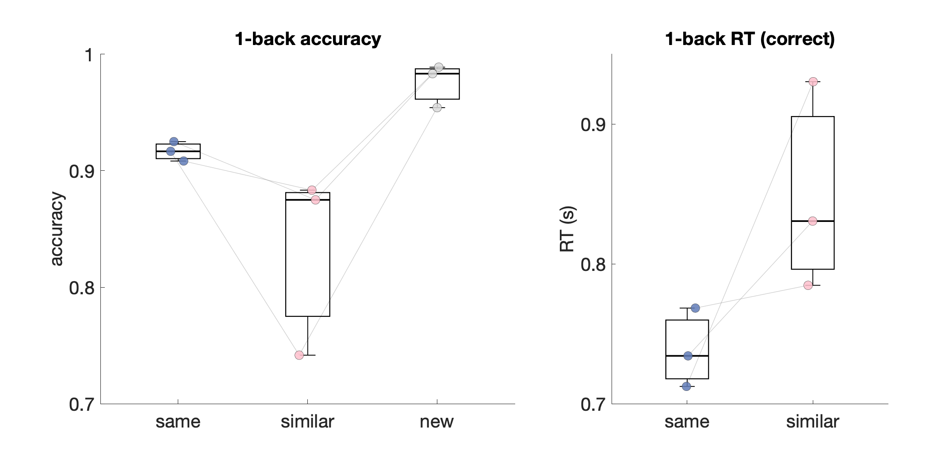
NeurWEM plt: One-back

Slide 27
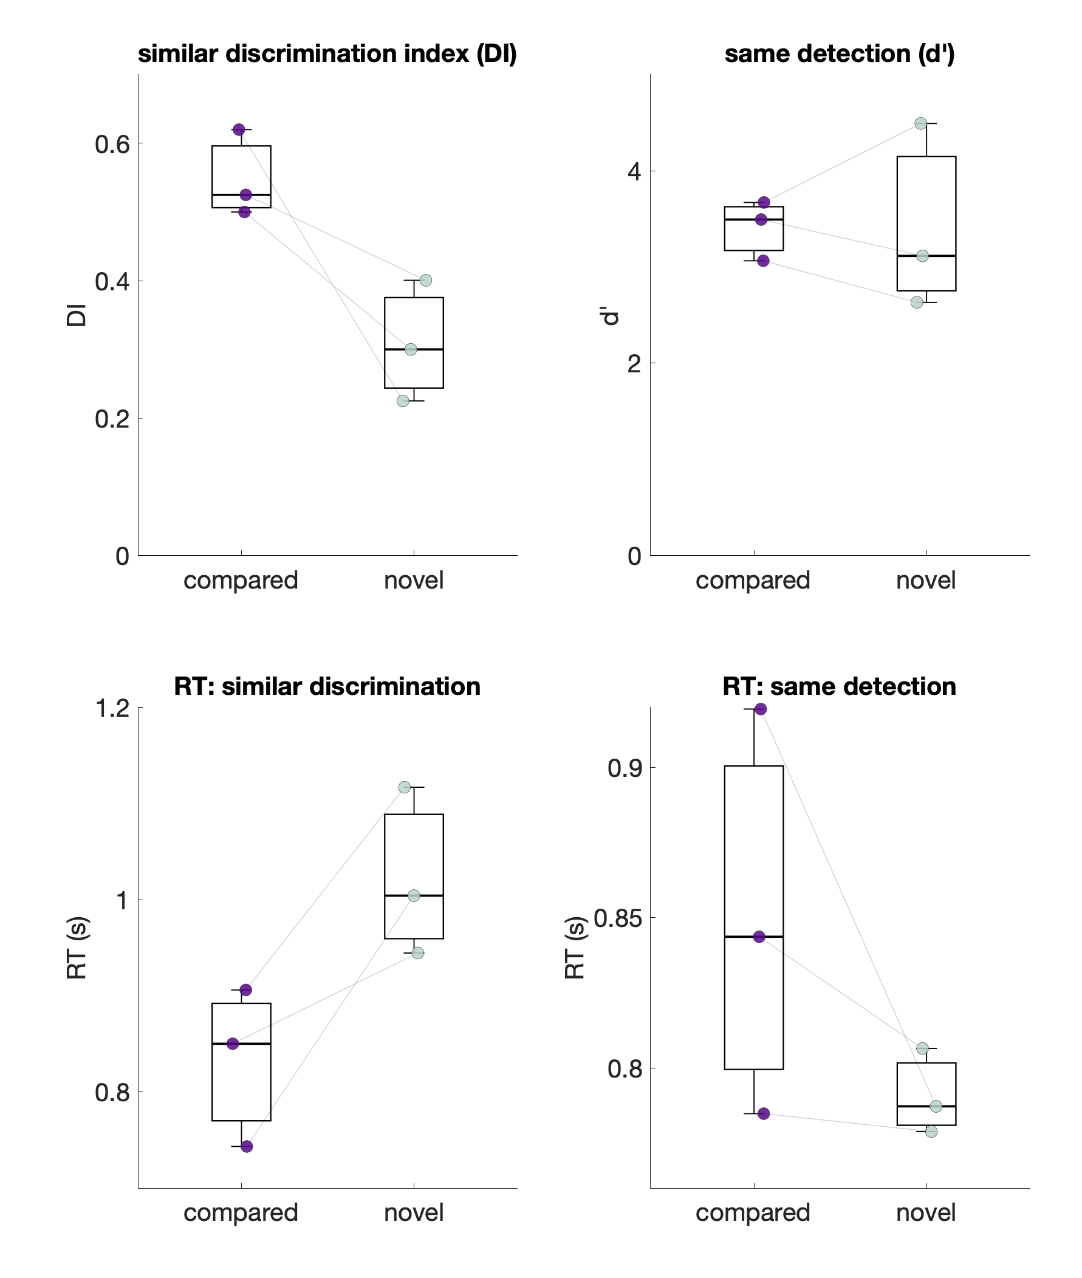
NeurWEM plt: Two-back

Slide 28
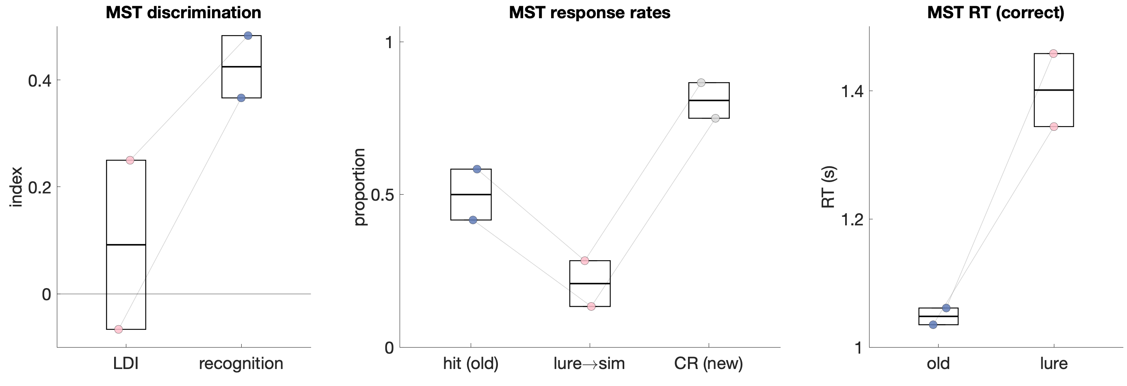
NeurWEM plt: Post-hoc MST

Slide 29
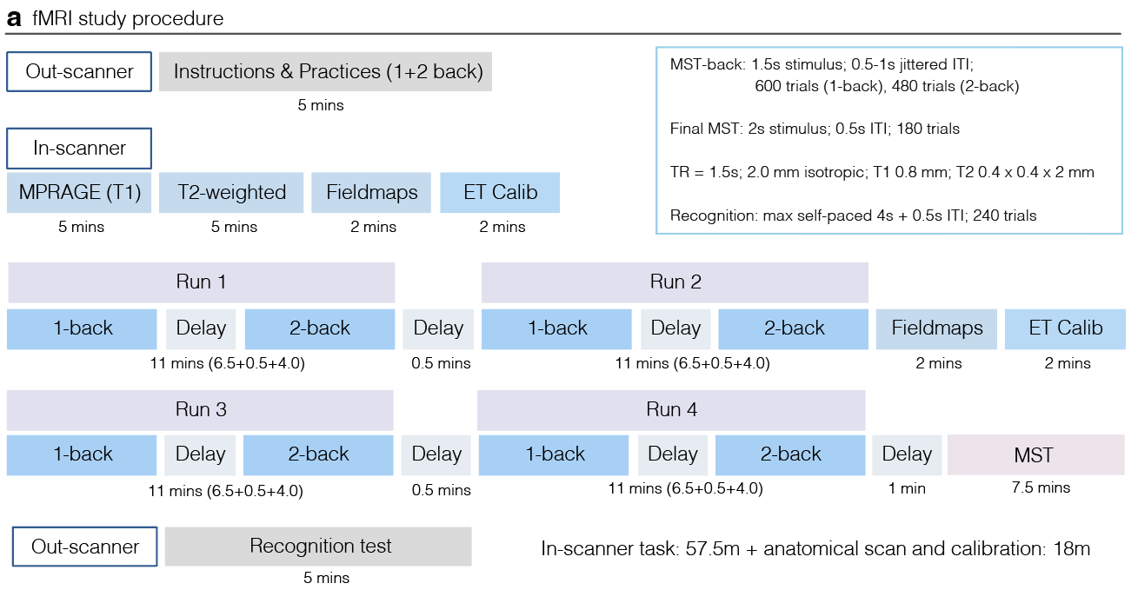
fMRI procedure
Notes:
decoding of items studied before? vs. novel

Slide 30
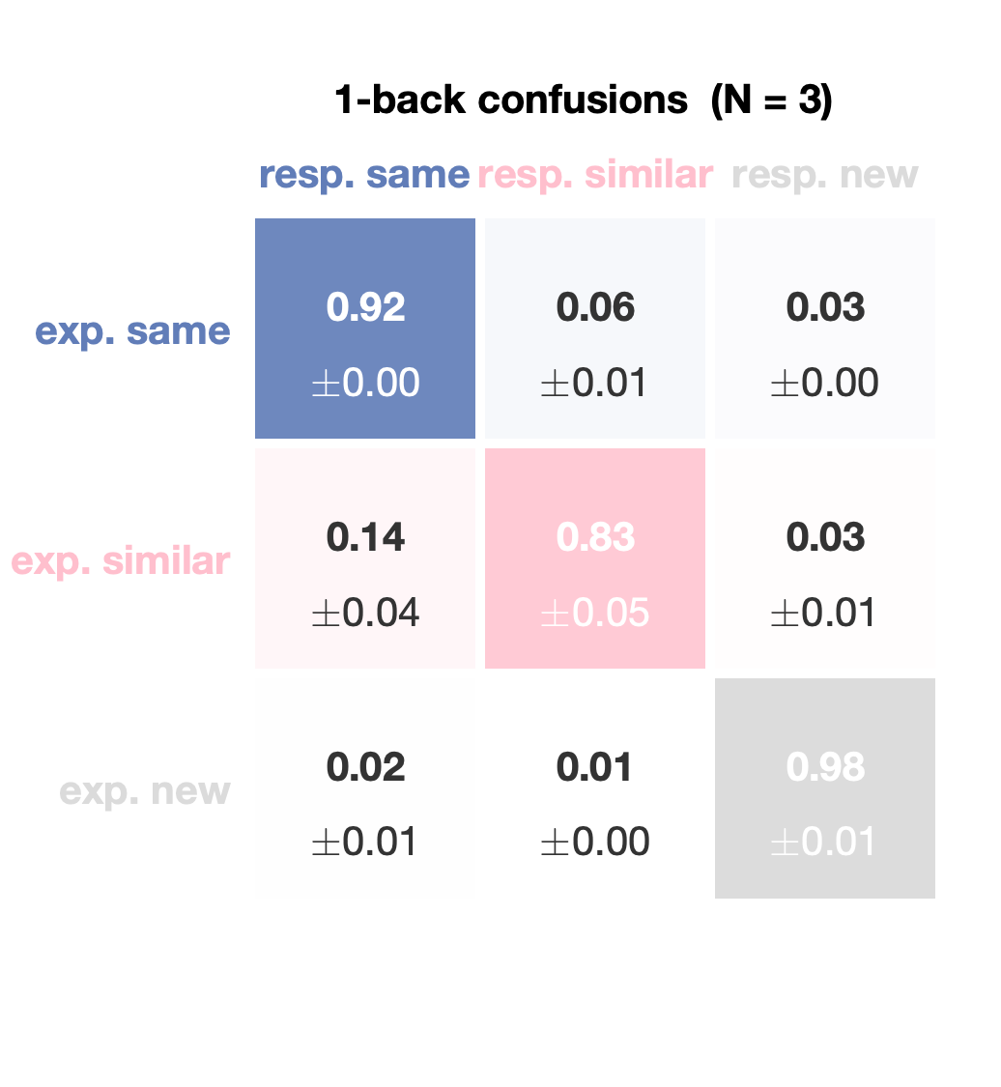
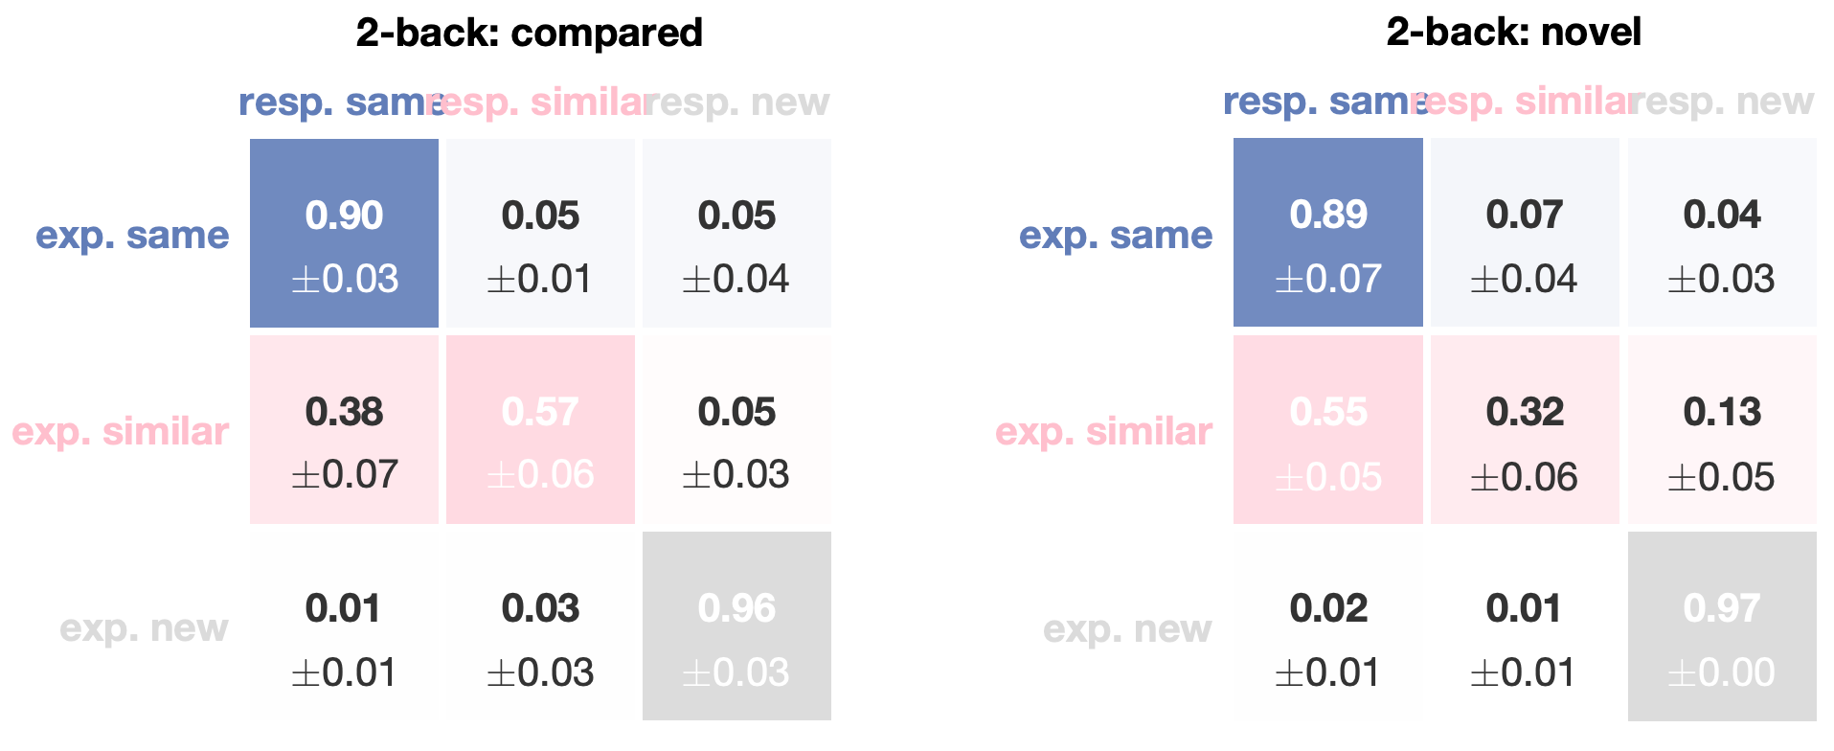
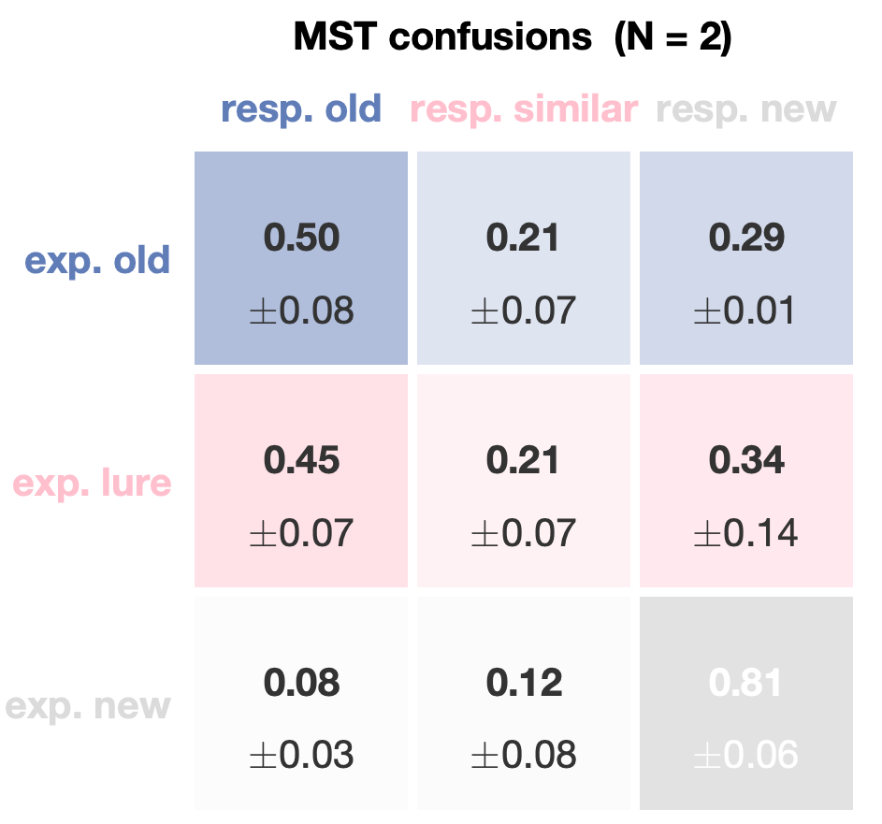
Supp. Confusion matrices

Slide 31
Planned analyses with fMRI
Univariate.
Find two partially overlapping brain networks, namely the WM-network and EM-network
WM-network may support the discrimination of novel items in the 2-back condition (no EM available, pure WM demand)
EM-network may support the discrimination of items from similar lures in the final MST (pure EM demand)
Find a shared subnetwork that modulates the successful discrimination of similar pair-mates in the MST-back task when EM is available
Multivariate.
Three hypotheses about how EM supports WM (Mirroring the gaze-pattern reinstatement analyses):
Lower A1B1 pattern similarity predicts successful discrimination of the pair in the subsequent 2-back condition (pattern separation in the DG/CA3)
Higher B2B1 pattern similarity predicts successful discrimination performance (pattern completion in the CA3/A1 and cortical regions spanning the temporal and parietal lobes)
Higher A2B1 pattern similarity predicts successful upcoming discrimination (predictive recall, along with pattern completion to be strongest in the cortical regions where WM and EM networks overlap, e.g., lateral parietal cortex and precuneus)
Notes:
decoding of items studied before? vs. novel

Slide 32
Open questions
1. Drop the “isolated” condition? Collapse to “compared” vs. “novel” for power and a simpler design – or keep it for the graded compared > isolated > novel effect?
2. Can we get clean RSA effects given the trial and task constraints?
  A1B1 are adjacent, so BOLD responses overlap – can we separate their patterns?
  Only ~40 “similar” trials per condition, split further by successful vs. unsuccessful discrimination
    Would shifting the response balance toward “similar” and away from “new” (3:2) buy enough trials to matter?
3. Duration.
Is ~1.5 hour in-scanner time per subject feasible?
4. Other concerns?

Slide 33
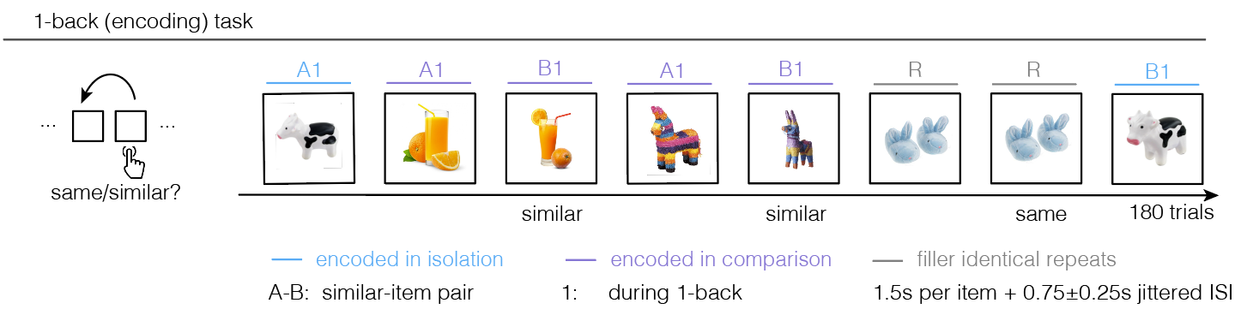
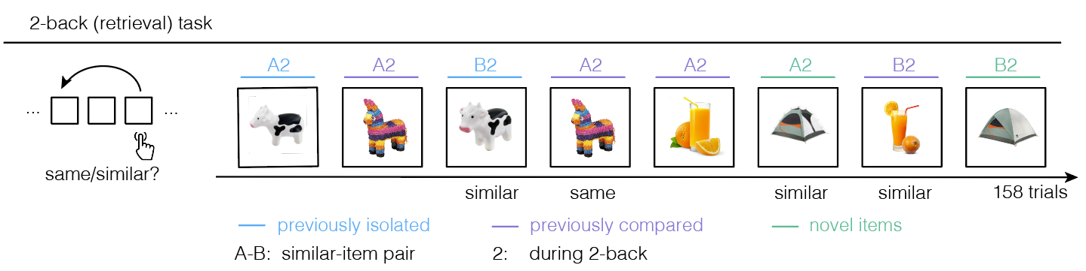
Previous experimental design

Slide 34
Exploratory questions with fMRI
Which regions are more active in the 2-back (higher WM load) than 1-back (lower WM load)?
Which regions show a graded response across the discrimination of compared, isolated, and novel items? (mirroring the pupil EM benefit)
In the final MST, does MTL/parietal activity distinguish correctly recognized old items, correctly discriminated similar lures, and correctly rejected foils? (Kirwan & Stark, 2007, Learn. Mem.)
Functional connectivity
Does HPC-PFC (and broader network) coupling increase from under primarily WM demand (1-back) to under WM-EM demand (2-back)?
Is the behavioral EM-WM benefit mediated by HPC-PFC coupling (EM availability – HPC-PFC coupling – discrimination)?
Univariate/multivariate/FC aims stand independently

Slide 35
Imaging parameters
3T (Siemens Prisma, 64-channel coil)
Whole-brain multiband gradient-echo EPI sequence at 1.5mm isotropic resolution
TR 1.5s, multiband factor 6, in-plane GRAPPA 2 (get cortical coverage together with subfield-scale resolution)
0.8mm T1 MPRAGE
High-res oblique-coronal T2 (0.4 x 0.4 x 2mm, spanning the hippocampal long axis; DG/CA3, CA1, subiculum, EC, and perirhinal reference regions)
MR-compatible eye tracker (Eyelink 1000 Plus, 1000 hz)
Notes:
Integrate important info into fmri slide

