Slide 1

Is this job for real?
Final presentation for MSiA 423
Date: 2020.06.08
Group: 9
Presented by: Joe Zhang
QA: Zach Zhu
Notes:
Hi Chloe and Fausto, I am gonna give my presentation of my app, which is to predict whether a job posting is fake or not.

Slide 2
Problem: Fake job posting is dangerous and hard to find
The scammer uses the job listing to get personal information
The information is then used to access their bank account or their credit cards and to steal their identity
Applying for fake jobs also waste people large amount of time, which can be otherwise used to apply for real jobs
Problem
It is very difficult for students who have just graduated to judge the authenticity of a job posting
We lack experiences in the industry and are disadvantaged under the information asymmetry
Motivation
Using machine learning algorithm in the backend
An web app that predict whether a job posting is fake or real
Can be integrated as job listing filter for job information providers such Glassdoor, Craigslist, or LinkedIn
Solution
Notes:
First is the problem and motivation.
A lot of scammers may use the fake job listing to get people’s personal information and then steal their identity, which is very dangerous.
Although it’s extremely harmful, tt’s very hard to distinguish those fake postings, especially for us students lacking industry experiences.
Thus, I want to solve this problem with machine learning algorithm.

Slide 3
Data Description
Raw Data Example
Data Source
01
title | Head of Content (m/f)
location | DE, BE, Berlin
department | ANDROIDPIT
salary_range | 20000-28000
company_profile | Founded in 2009, we are constantly…
description | Schedules and ensure deadlines…
requirements | Comfortable in a dynamic startup…
benefits | Being part of a fast-growing company…
telecommuting | 0
has_company_logo | 1
has_questions | 1
employment_type | Full-time
required_experience | Mid-Senior level
required_education | Master's Degree
industry | Online Media
function | Management
fraudulent | 0
Kaggle dataset: Employment Scam Aegean Dataset (The University of the Aegean)
Link for the dataset
Dataset size
02
Size: ~ 60M
Records: 17,880, ~900 fake cases
Columns: 18
Features
03
16 features
Text features: company profile, job description, benefits and requirements
Notes:
The dataset I am using is from Kaggle, Employment Scam Aegean Dataset. The dataset is not so large. It’s only about 60 Megabytes with around 18,000 records, among which around 900 are fake cases. So it’s a very imbalanced dataset.
There are 16 features in total, among which 4 are text features. These text features serve a very important role in the prediction part.

Slide 4
Model Pipeline: From data wrangling to model training
Cleaning & Engineering
Model Selection
Model Training & Save
Drop useless columns
Imputation
Text feature cleaning
Tf - idf vectorization
One-hot encoding
Standardization
5-layer full-connect NN using relu activation
Gridsearch: optimizer {sgd, adam, adagrad}, batch_size {8, 16}
Using accuracy as target
Best model: optimizer {adam}, batch_size {16}
Save engineering pipeline and best model’s weights for online prediction
Notes:
As for the model pipeline. There are mainly 3 parts.
For the feature engineering, the 4 steps in bold are very important and are saved for the transformation of the test data or user input data, this is because we cannot assume user inputting cleaned data, right? They are inputting the raw data and the data need to be transformed based on the training set to be fitted in the model.

Slide 5
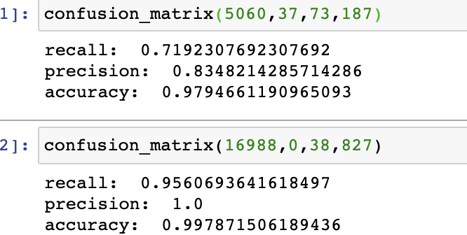
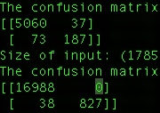
Model Result: All success criteria are met
Test | Predict
Actual | 5060 | 37
 | 73 | 187
Recall | 0.719
Precisioin | 0.835
Accuraccy | 0.979
Model Success Criteria
Accuracy > 90%
Precision > 0.8
Recall > 0.5
Criteria
are met
Training | Predict
Actual | 16988 | 0
 | 38 | 827
Recall | 0.956
Precisioin | 1
Accuraccy | 0.998
Notes:
The original success criteria are:
Although the precision and recall are sometimes against each other, I still want both of them to be high. Because we don’t want people to apply for fake jobs, and we also don’t want them to miss potential opportunities. Thus, I set the goal for both precision and recall. Since the dataset is heavily imbalanced and fake posting is the minority, I set recall a little bit lower.
The results are very good-looking, and all the criteria are met on both training and test set.
The business one is not listed here as it only can be analyzed after model being deployed and putting into production

Slide 6
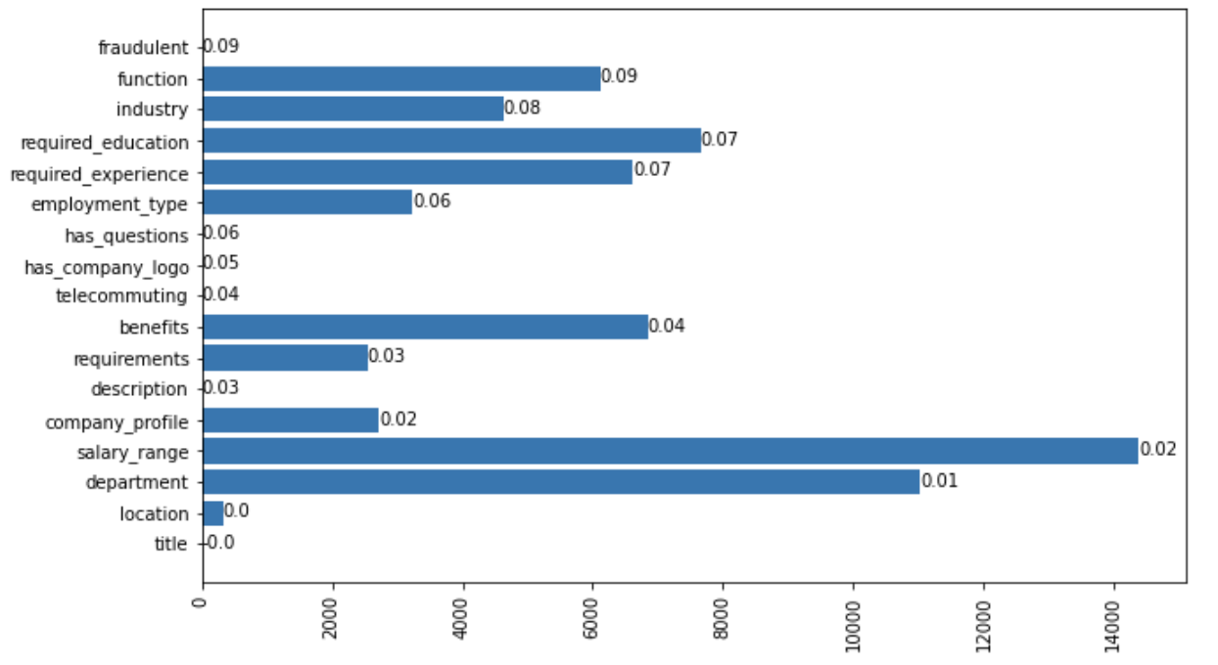
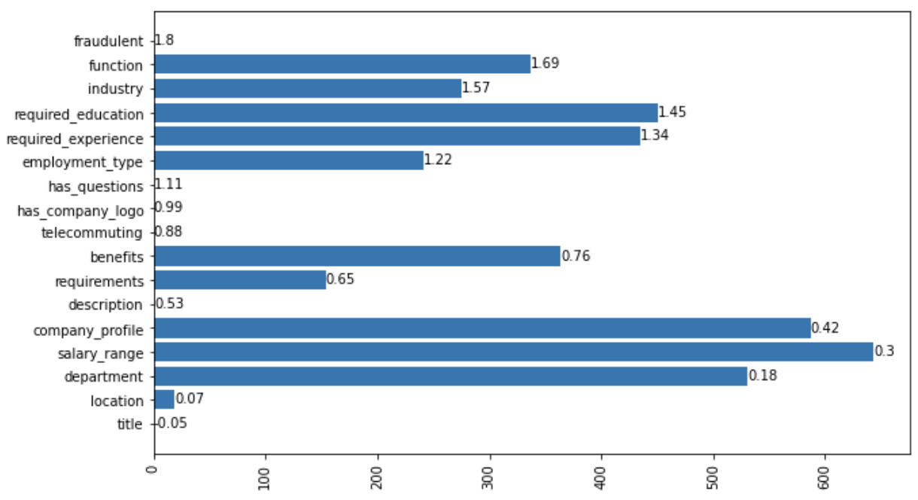
Findings and insights (1/3)
Fake job listing are more likely to have NAs in their postings
Real
Fake
Notes:
This is reasonable because the scammers sometimes have no idea what the job actually is and they are making up these listings. Thus, they may leave some fields in blank due to their limited knowledge of that kind of job.

Slide 7
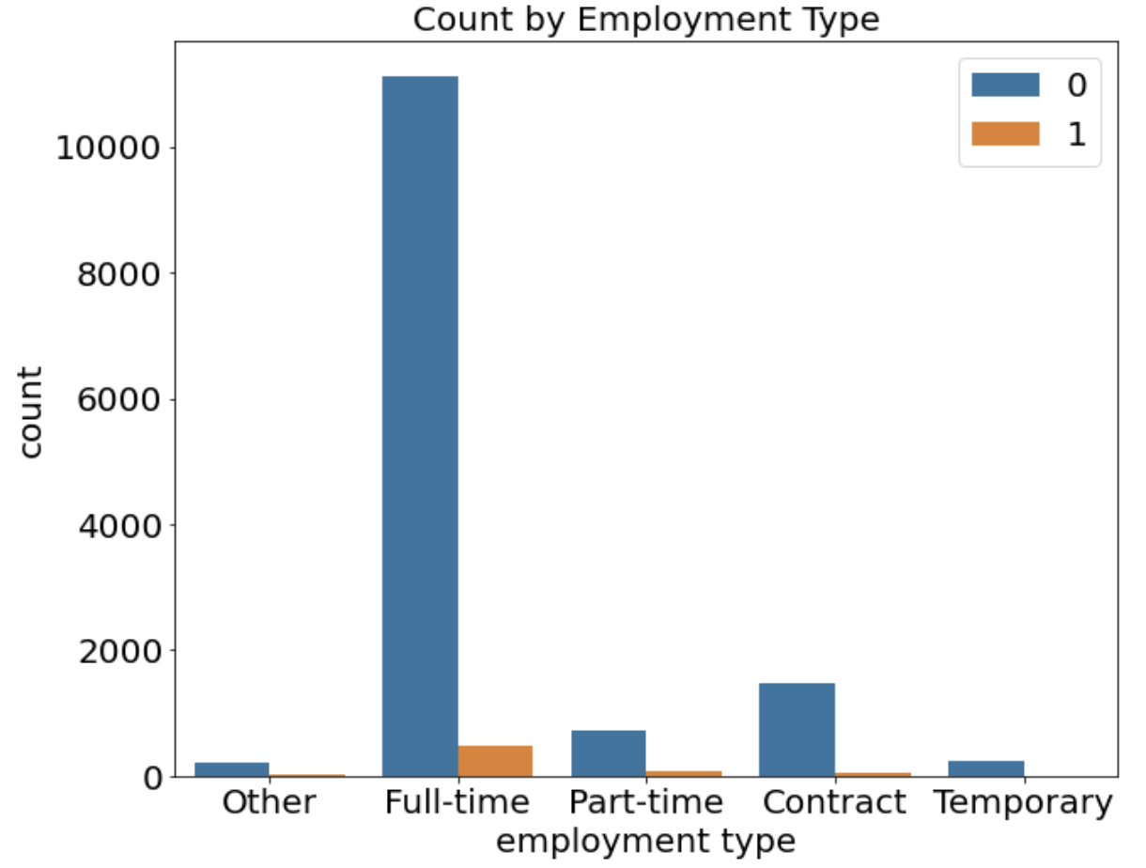
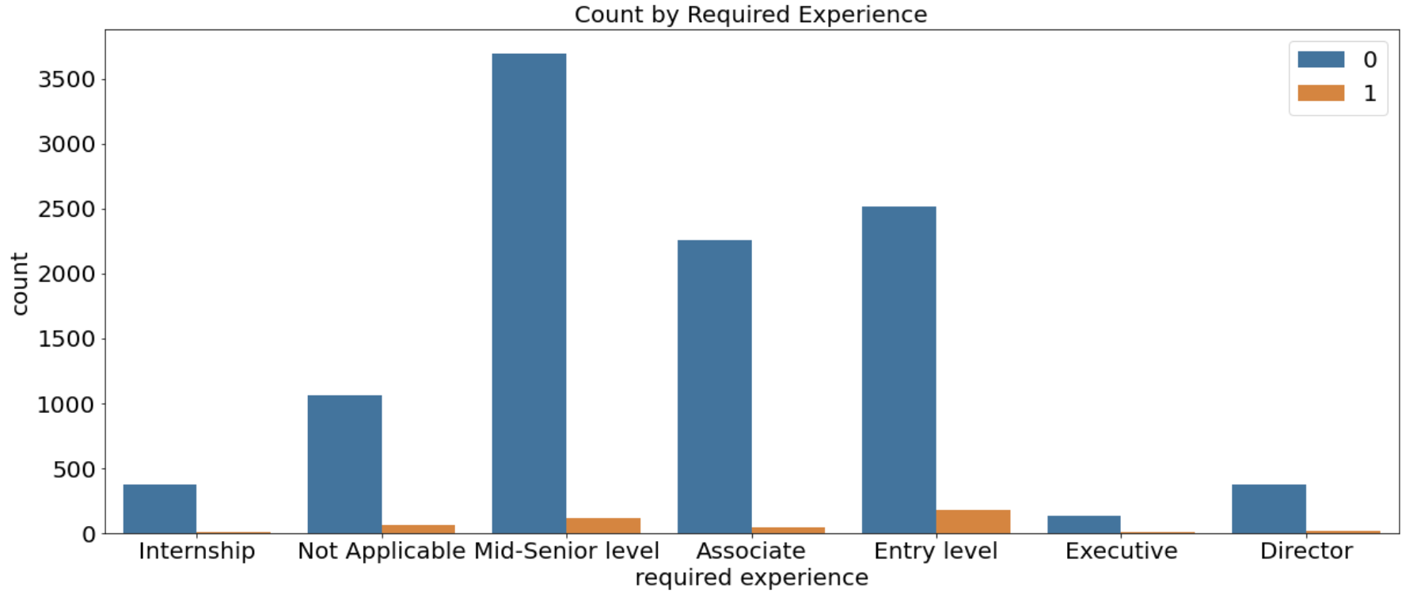
Findings and insights (2/3)
Job postings with requirements of full time, entry level, on-site, and high school degrees are the focus of fraudulent postings

Slide 8
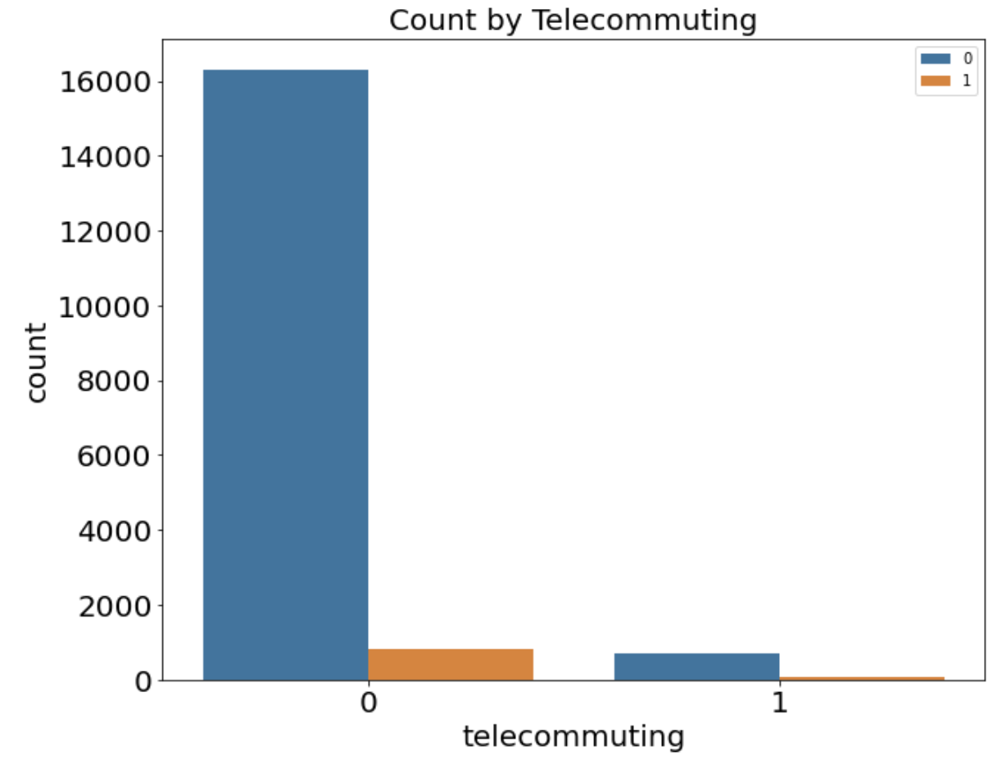
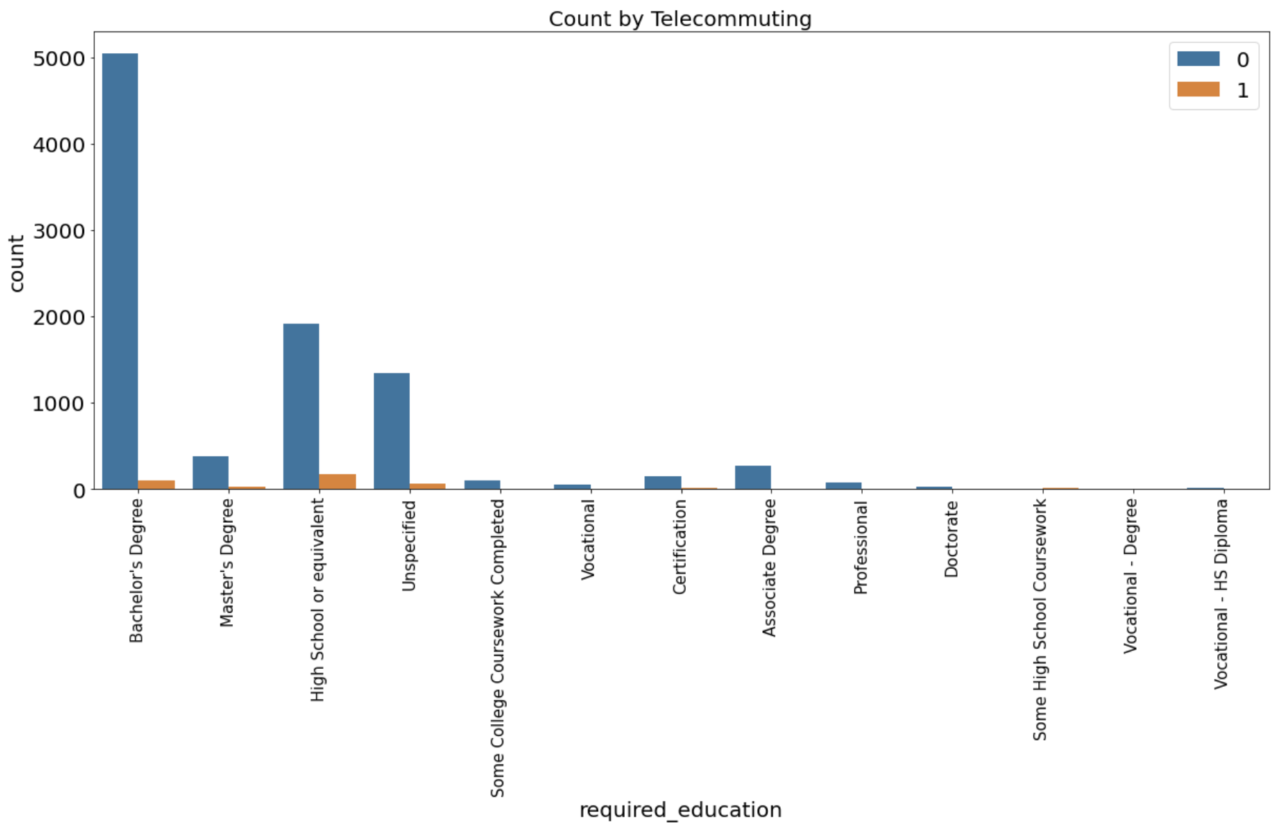
Findings and insights (3/3)
Job postings with requirements of full time, entry level, on-site, and high school degrees are the focus of fraudulent posting
Notes:
Because scammers are always trying to find people that are easily deceived, it can be rationalized that people with lower education level and trying to find entry-level jobs are more easily to be cheated.

Slide 9
Conclusion
Fake job postings are more likely be bond with simple and basic jobs.
Due to the limited number of fake job postings, it’s hard to find very obvious patterns of them. Thus, we have to stay alert when applying for a job and can use machine learning to help us detect the fake postings.
Hope everybody will get their dream offer in the fall.
Notes:
However, the pattern is not so obvious due to the limited number of fake job postings, so we cannot not easily distinguish those fake ones manually.

Slide 10

Thank You!
Joe Zhang
Master of Science in Analytics
Robert R. McCorick School of
Engineering and Applied Science
zihaozhang2020@u.northwestern.edu
Mobile 773.807.5890

