Slide 1

Is this job for real?
Final presentation for MSiA 423
Date: 2020.06.08
Group: 9
Presented by: Joe Zhang
QA: Zach Zhu

Slide 2
Problem: Fake job posting is dangerous and hard to find
The scammer uses the job listing to get personal information
The information is then used to access their bank account or their credit cards and to steal their identity
The fake jobs also cost people large amount of time, which can be otherwise used to apply for real jobs
Problem
It is very difficult for students who have just graduated to judge the authenticity of a job posting
We lack experiences in the industry and are disadvantaged under the information asymmetry
Motivation
Using machine learning algorithm in the backend
An web app that predict whether a job posting is fake or real
Can be integrated as job listing filter for job information providers such Glassdoor, Craigslist, or LinkedIn
Solution
Notes:
The scammer uses the job listing to get job seekers to provide personal information, including SSN, credit card information, and bank account information.

Slide 3
Data Description
Raw Data Example
Data Source
01
title | Head of Content (m/f)
location | DE, BE, Berlin
department | ANDROIDPIT
salary_range | 20000-28000
company_profile | Founded in 2009, we are constantly…
description | Schedules and ensure deadlines…
requirements | Comfortable in a dynamic startup…
benefits | Being part of a fast-growing company…
telecommuting | 0
has_company_logo | 1
has_questions | 1
employment_type | Full-time
required_experience | Mid-Senior level
required_education | Master's Degree
industry | Online Media
function | Management
fraudulent | 0
Dataset form Kaggle: [Real or Fake] Fake JobPosting Prediction
Link for the dataset
Dataset size
02
Size: ~ 60M
Records: 17880
Columns: 18
Features
03
Title, location, department, company profile, salary, JD, requirements, employment type, industry, function, etc.
Notes:
The scammer uses the job listing to get job seekers to provide personal information, including SSN, credit card information, and bank account information.

Slide 4
Model Pipeline: From data wrangling to model training
Cleaning & Engineering
Model Selection
Model Training & Save
Drop irrelevant columns
Imputation
Text feature cleaning
Tfidf vectorization
One-hot encoding
Standardization
5 layers full-connect neural network using relu activation
Gridsearch: optimizer {sgd, adam, adagrad}, batch_size {8, 16}
Best model: optimizer {adam}, batch_size {16}
Save engineering pipeline and best model to pickle files for online prediction

Slide 5
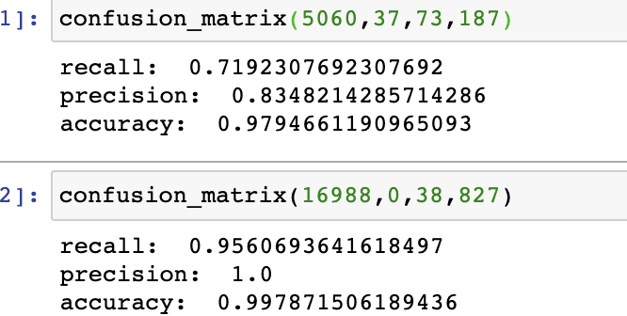
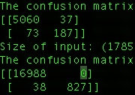
Model Result: All success criteria are met
Test | Predict
Actual | 5060 | 37
 | 73 | 187
Recall | 0.719
Precisioin | 0.835
Accuraccy | 0.979
Success Criteria
Accuracy > 90%
Precision > 0.8
Recall > 0.5
Criteria
are met
Training | Predict
Actual | 16988 | 0
 | 38 | 827
Recall | 0.956
Precisioin | 1
Accuraccy | 0.998

Slide 6
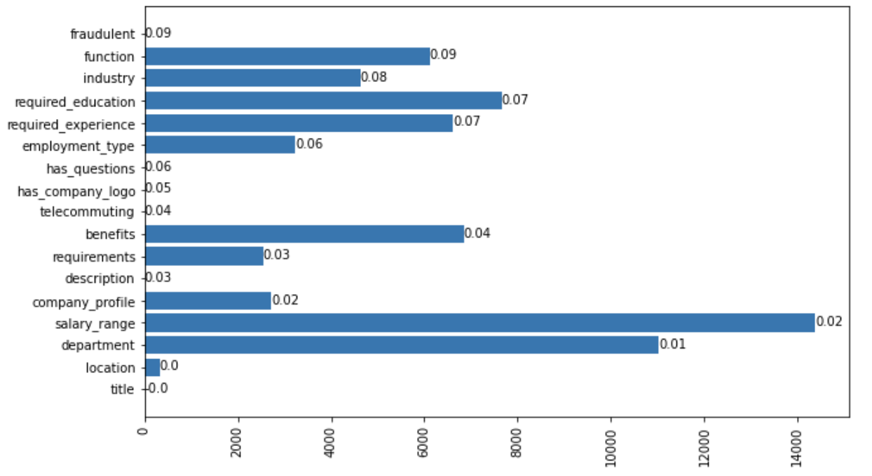
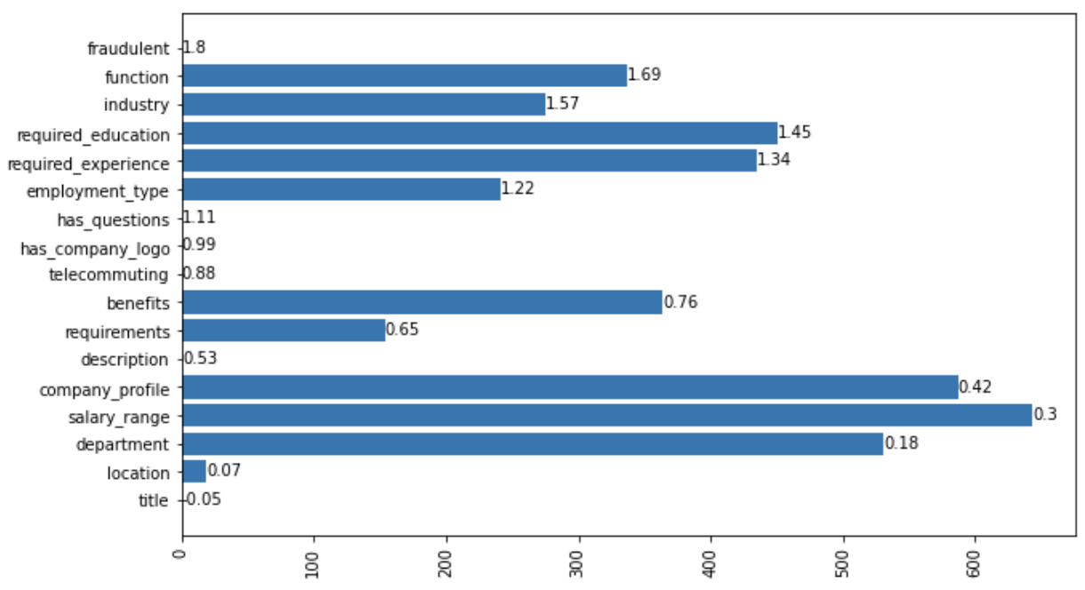
Interesting Finds (1/3)
Fake job listing are more likely to have NAs in their posting
Real
Fake

Slide 7
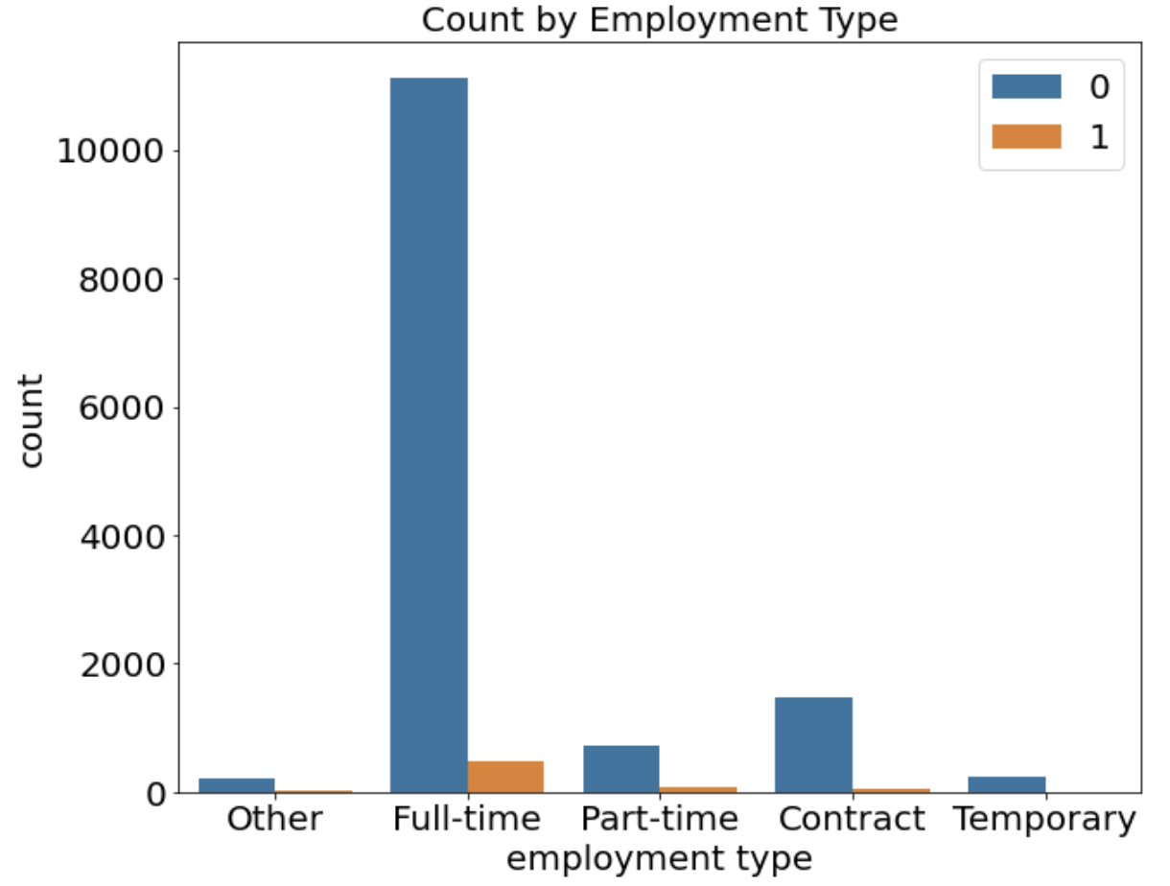
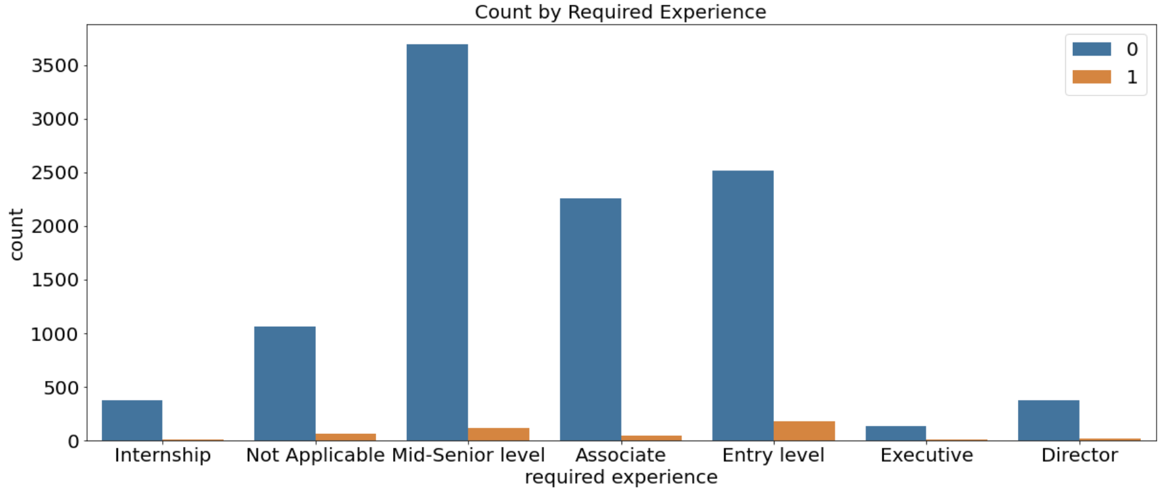
Interesting Finds (2/3)
Job postings with requirements of full time, entry level, on-site, and high school degrees are the focus of fraudulent posting

Slide 8
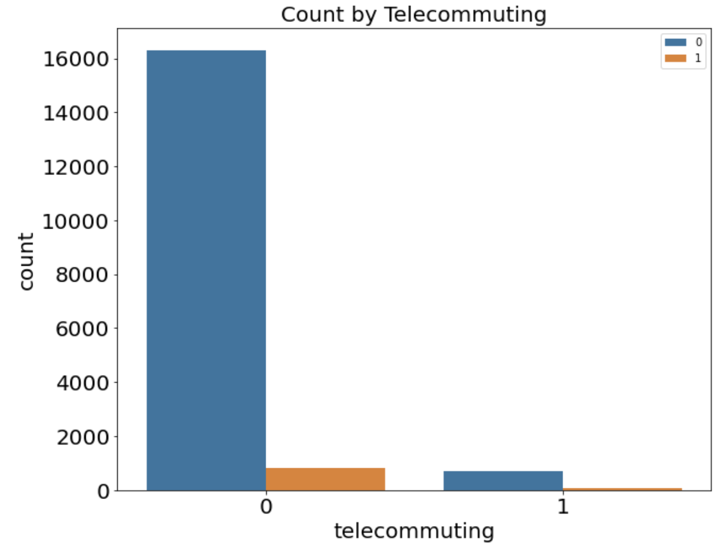
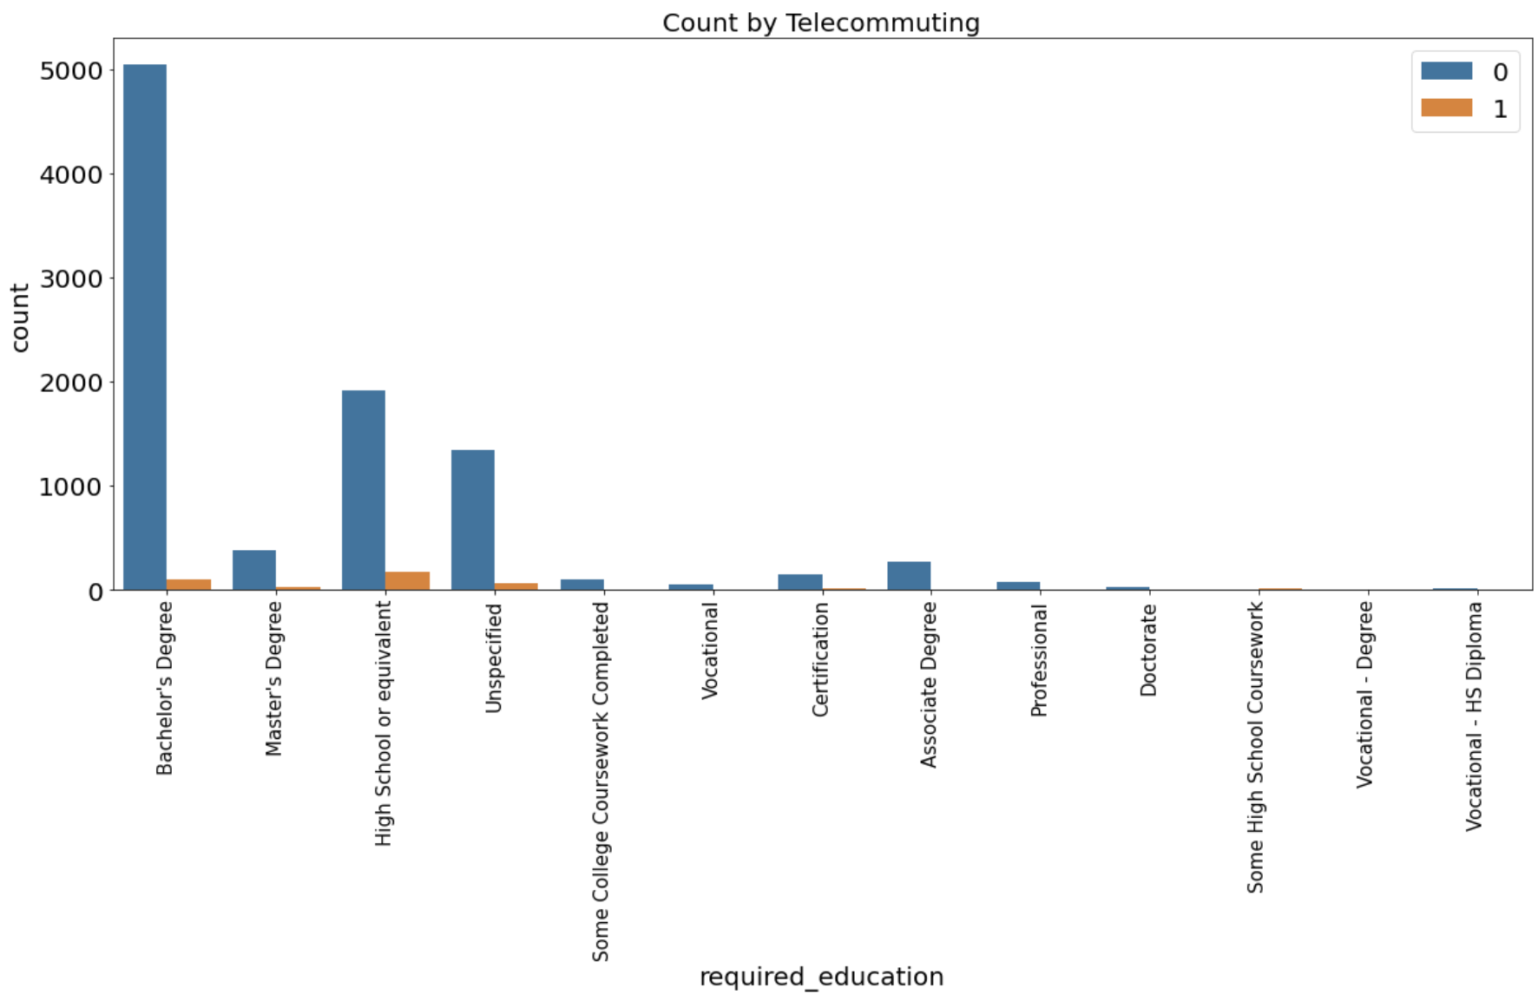
Interesting Finds (3/3)
Job postings with requirements of full time, entry level, on-site, and high school degrees are the focus of fraudulent posting

Slide 9
Conclusion
Fake job postings are more likely to be related to simple and basic jobs.
Due to the limited number of fake job postings, it’s hard to find very obvious patterns of them. Thus, we have to stay alert when applying for a job and can use machine learning to help us detect the fake postings.
Hope everybody will get their dream offer in the fall.

Slide 10

Thank You!
Joe Zhang
Master of Science in Analytics
Robert R. McCorick School of
Engineering and Applied Science
zihaozhang2020@u.northwestern.edu
Mobile 773.807.5890

