Slide 1
Function as a Service
A Programming Language perspective
20220320 常开颜

Slide 2
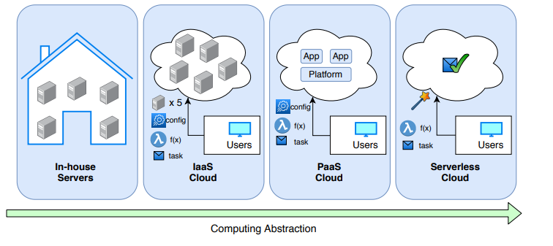
Changing of computing pattern

Slide 3
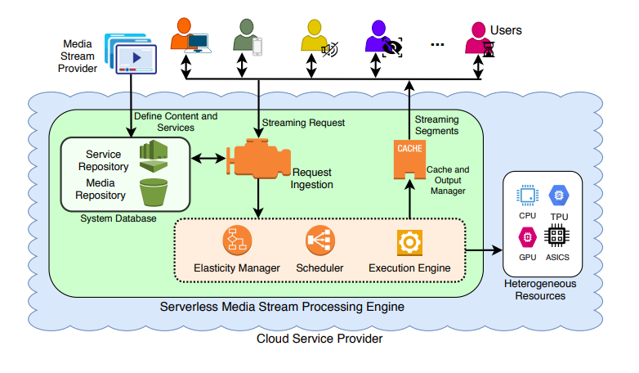

Slide 4
Feature
Elastic
On-demand computing

Slide 5
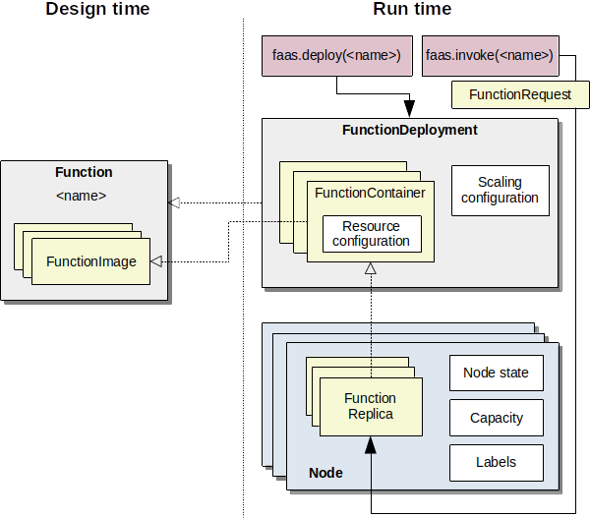

Slide 6
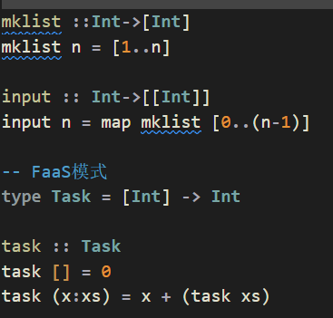
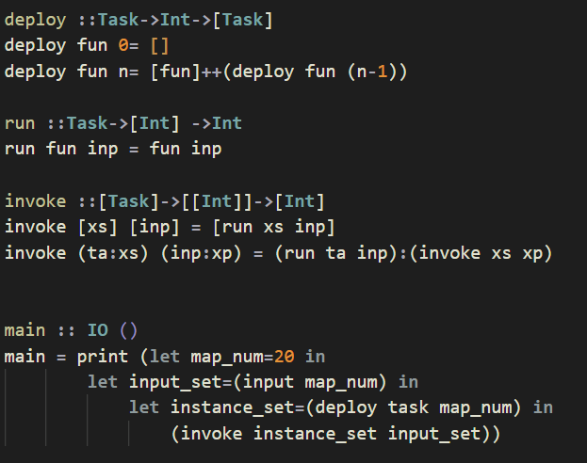
Haskell Description

Slide 7

Challenge and Method

Slide 8
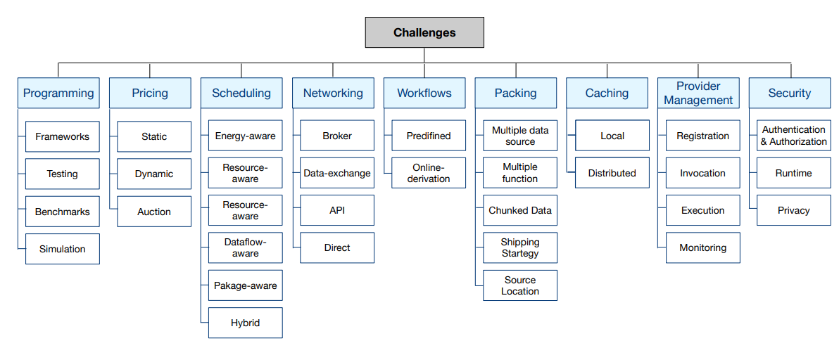

Slide 9
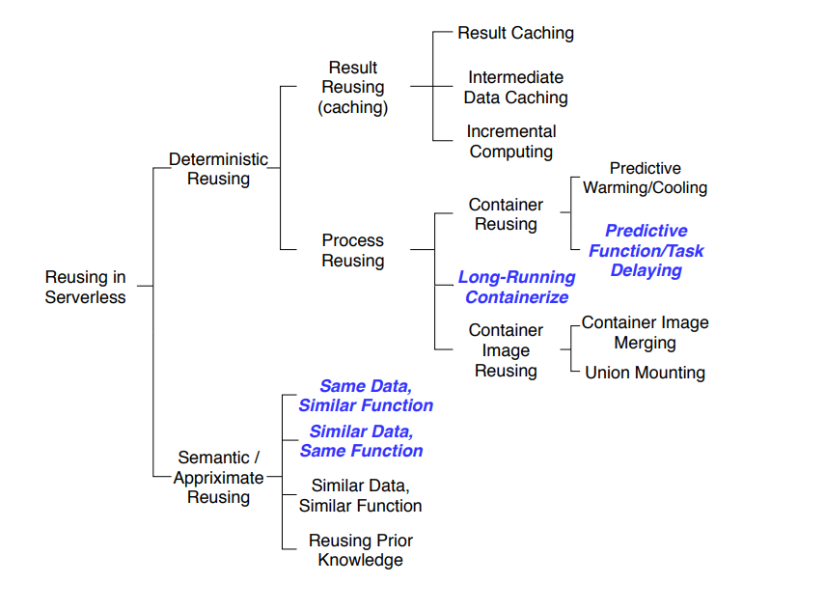
Reusing&Pre-loading

Slide 10
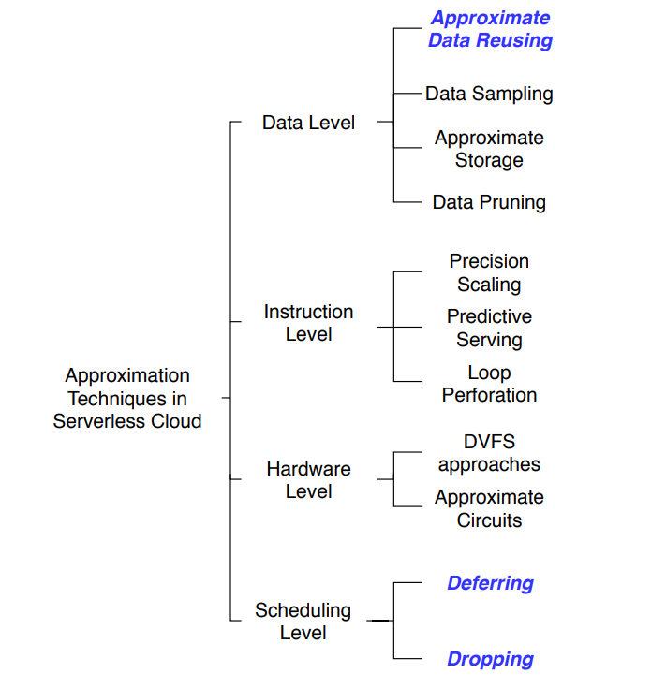
Approximation

Slide 11
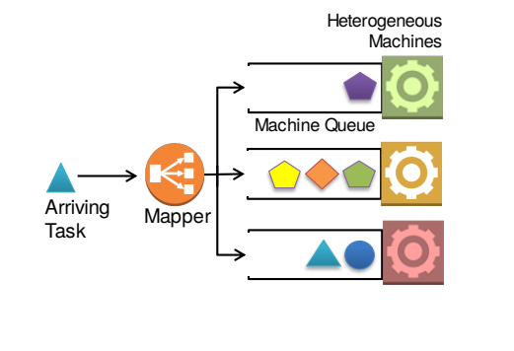
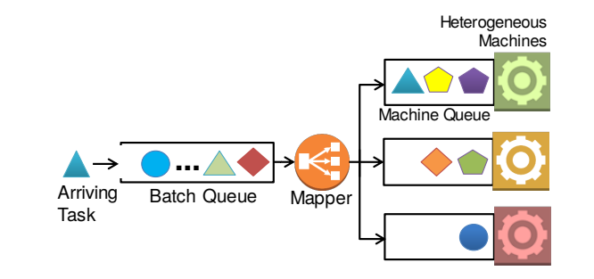
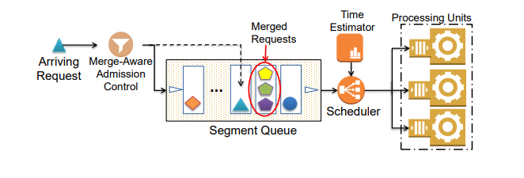
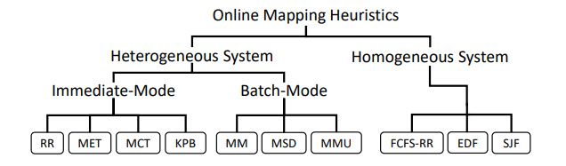
Mapping strategy

Slide 12
References
Chavit Denninnart. Cost- and QoS-Efficient Serverless Cloud Computing.
HOSSEIN SHAFIEI. Serverless Computing: A Survey of Opportunities, Challenges, and Applications.

Slide 13

Thank you.

