Slide 1
Bag of Little Random Forests (BLRF)
Adapting the RF to a Big Data Setting

Slide 2
Motivation and Objectives
The Random Forests (RF) algorithm (Figure 1) is inefficient when handling Big Data:
Time: significant time consumption;
Memory: physical storage of big data sets;
Structure: not well-adapted to a parallelism;
Unable to load the entire data set into memory.
Aim to: build BLRF (Figure 3). Reduce computation time while maintaining prediction accuracy.

Slide 3
Steps and Procedures
Study BLB and RF;
Combine BLB and RF -> BLRF algorithm;
Modify the source C code (regression only);
Evaluate the BLRF algorithm (time and accuracy).

Slide 4
A BLB Decision Tree
Prediction_tree
A Little Random Forest
Prediction_LRF
Training Data Set
Prediction_BLRF
Figure 3. Visualization of BLRF

Slide 5
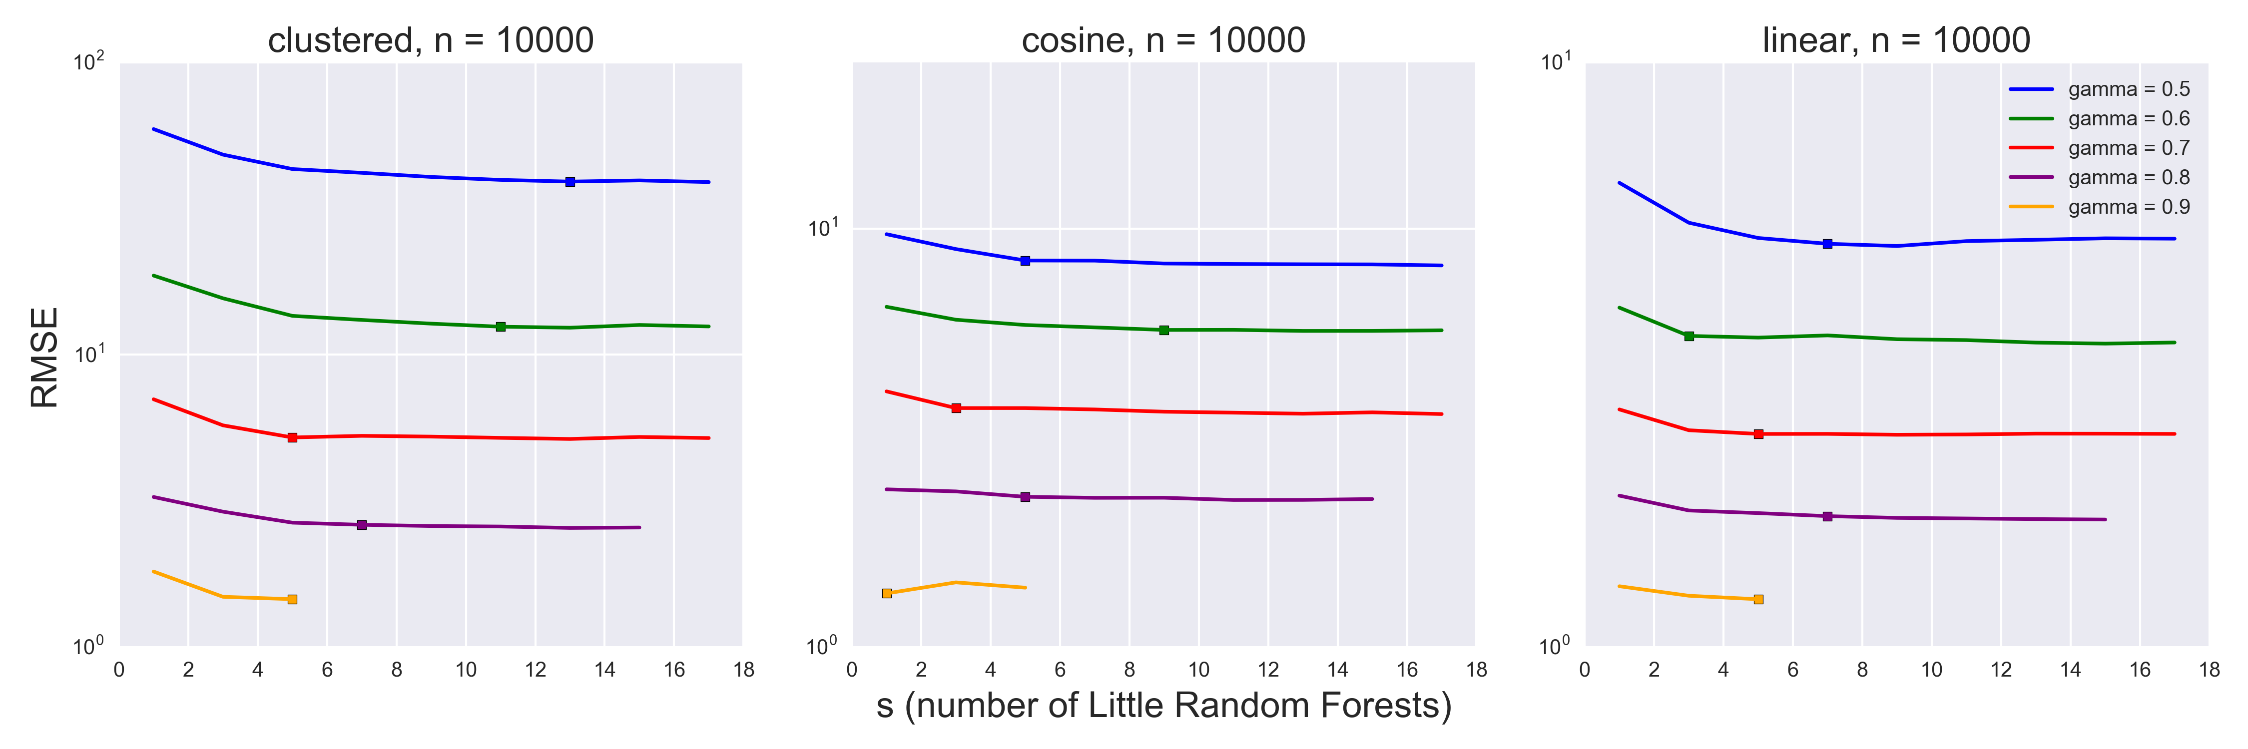
Figure 5. RMSE measures of BLRF algorithm: RMSE ~ s

Slide 6
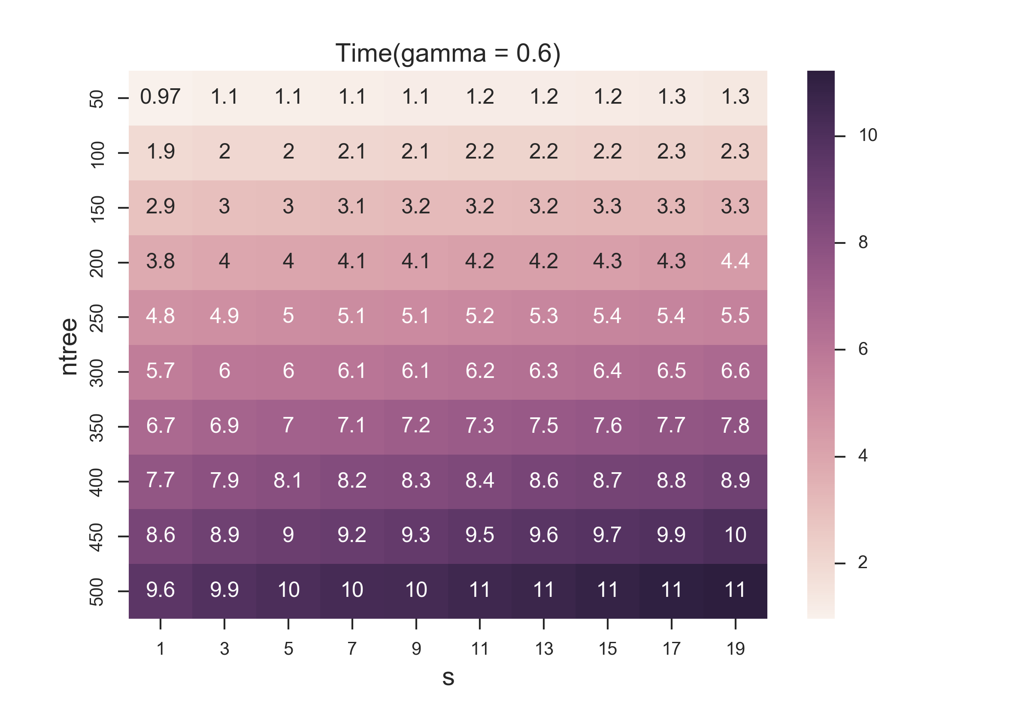

Slide 7
