Slide 1
Data Science Capstone project
<Zihaohan Sang>
<Sep26, 2021>

Slide 2

Outline
Executive Summary
Introduction
Methodology
Results
Conclusion
Appendix

Slide 3

Executive Summary
Summary of methodologies
Data collection
Data wrangling
EDA with data extraction from SQL
Data visualization
Machine learning
Summary of all results
Organized data
Visualization
Predictions and pattern analysis

Slide 4

Introduction
Project background and context
In this capstone, we will predict if the Falcon 9 first stage will land successfully. SpaceX advertises Falcon 9 rocket launches on its website with a cost of 62 million dollars; other providers cost upward of 165 million dollars each, much of the savings is because SpaceX can reuse the first stage. Therefore if we can determine if the first stage will land, we can determine the cost of a launch. This information can be used if an alternate company wants to bid against SpaceX for a rocket launch.
Problems you want to find answers
Therefore if we can determine if the first stage will land, we can determine the cost of a launch. This information can be used if an alternate company wants to bid against SpaceX for a rocket launch.

Slide 5

Methodology
Data collection methodology:
Describe how data were collected
Perform data wrangling
Describe how data were processed
Perform exploratory data analysis (EDA) using visualization and SQL
Perform interactive visual analytics using Folium and Plotly Dash
Perform predictive analysis using classification models
How to build, tune, evaluate classification models

Slide 6
Methodology

Slide 7
Data collection
SpaceX REST API
return as .json
Normalized data into flat data file
Request to the SpaceX API
We extracted information using identification numbers in the launch data from SpaceX API with the following URL ‘https://api.spacexdata.com/v4/launches/past’. Followed record were extracted: rocket, Launchpad, payload, and cores
Clean the requested data using Pandas
1. take a subset of our dataframe keeping only the features we want and the flight number, and date_utc;
2. remove rows with multiple cores;
3. remove the Falcon 1 launches keeping only the Falcon 9 launches
4. deal with missing values
Html response
Extract using beautifulsoup
Clean data using pandas

Slide 8
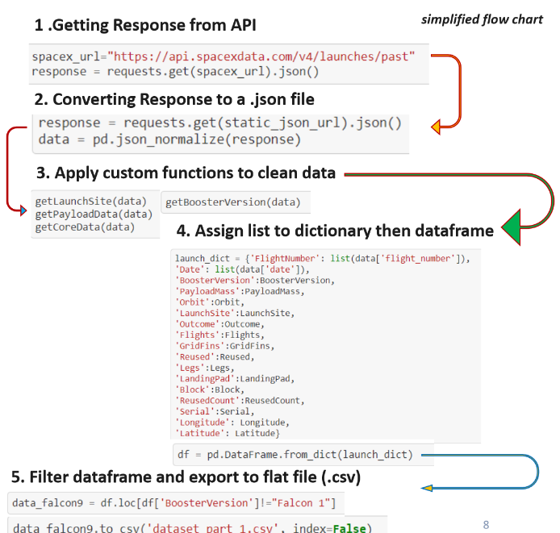
Data collection – SpaceX API
Added a flowchart of SpaceX API calls here
GitHub URL of the completed SpaceX API calls notebook (https://github.com/zihhSang/IBM/blob/main/week1.ipynb)
SpaceX REST API
return as .json
Normalized data into flat data file

Slide 9
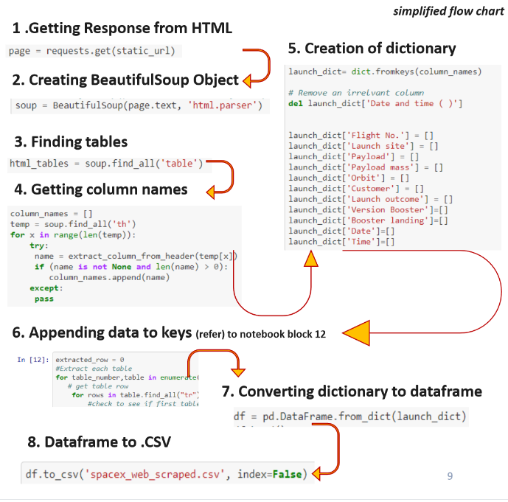
Data collection – Web scraping
Add a flowchart of web scraping here
Html response
Extract using beautifulsoup
Clean data using pandas
GitHub URL of the completed web scraping noteboo (https://github.com/zihhSang/IBM/blob/main/week1_2.ipynb)

Slide 10
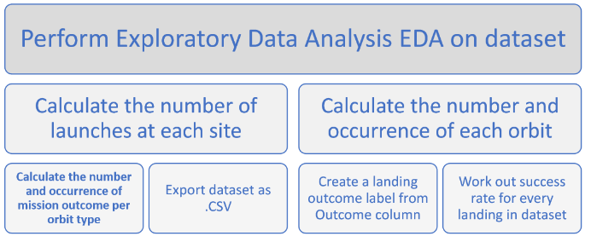
Data wrangling
Introduction: In the data set, there are several different cases where the booster did not land successfully. Sometimes a landing was attempted but failed due to an accident; for example, True Ocean means the mission outcome was successfully landed to a specific region of the ocean while False Ocean means the mission outcome was unsuccessfully landed to a specific region of the ocean. True RTLS means the mission outcome was successfully landed to a ground pad False RTLS means the mission outcome was unsuccessfully landed to a ground pad.True ASDS means the mission outcome was successfully landed on a drone ship False ASDS means the mission outcome was unsuccessfully landed on a drone ship.
Process:
GitHub URL of your completed data wrangling related notebooks (https://github.com/zihhSang/IBM/blob/main/week1_3.ipynb)

Slide 11
EDA with data visualization
Summarize what charts were plotted and why used those charts
1. scatter plots
Flight number vs. payload mass
Flight number vs. launch site
Payload vs. launch site
Orbit vs. flight number
Payload vs. orbit type
2. Bar graph:
Mean vs. orbit
GitHub URL of your completed EDA with data visualization notebook (https://github.com/zihhSang/IBM/blob/main/week2_2.ipynb)

Slide 12
EDA with SQL
Summarize performed SQL queries using bullet points
Display the names of unique launched sites
Display launch sites begin with ‘KSC’
Display the total payload mass launched by CRS
Display the mean payload mass of booster version F9 V11
List of names of boosters with payload mass between 4000 and 6000
List the number of successful and failure missions
The name of booster_version carried the maximum payload mass
Rank the count of successful missions
GitHub URL of your completed EDA with SQL notebook(https://github.com/zihhSang/IBM/blob/main/week2_1.ipynb)

Slide 13
Build an interactive map with Folium
Step:
1. added latitude and longitude coordinates at each launch site and added a circle marker with a label with their names
2. assigned the dataframe given the outcome (fail or success) as 0 and 1, and colors them with green and red markers
3. added the distance from sites to markers
These objects were added to show the distance to railways, highways, coastline and cities
GitHub URL of your completed interactive map with Folium map (https://github.com/zihhSang/IBM/blob/main/week3_1.ipynb)

Slide 14
Build a Dashboard with Plotly Dash
Pie chart showing the total launches by sites
Displaying the proportion of classes
Size of circle represent the total sample size
Scatter plot showing the relationship between outcome and payload mass for boosters
Show linear relationship
Show the range of values
GitHub URL of your completed Plotly Dash lab (https://github.com/zihhSang/IBM/blob/main/Dashboard%20SpaceX%20Dataset.ipynb)

Slide 15
Predictive analysis (Classification)
Building model
Load and transform data
Split data into training and test sets
Decide the algorithms of machine learning
Set parameters and fit the model
Evaluating model
Compute accuracy for model
Tune parameters
Improving model if necessary
GitHub URL of your completed predictive analysis lab (https://github.com/zihhSang/IBM/blob/main/week4.ipynb)

Slide 16
Results
Exploratory data analysis results
Interactive analytics demo in screenshots
Predictive analysis results

Slide 17
EDA with Visualization

Slide 18
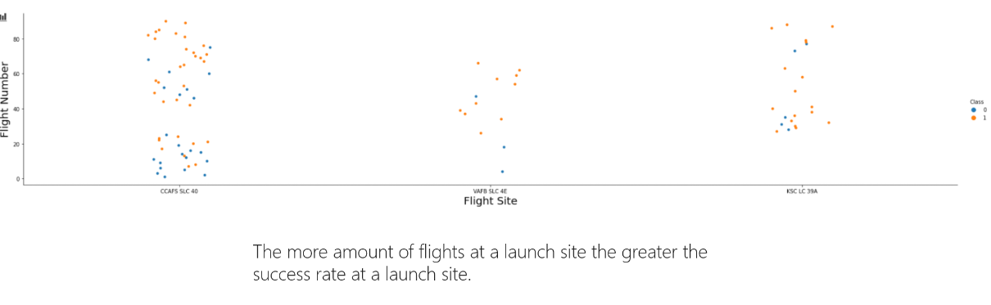
Flight Number vs. Launch Site
Show a scatter plot of Flight Number vs. Launch Site
Show the screenshot of the scatter plot with explanations

Slide 19
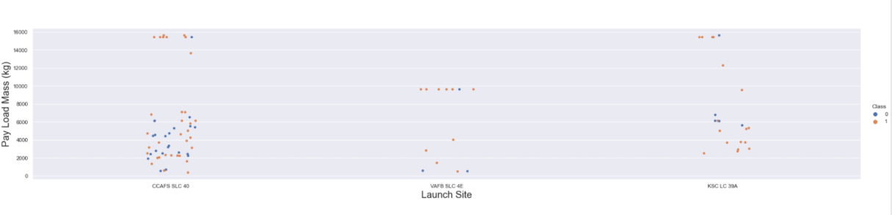
Payload vs. Launch Site
Show a scatter plot of Payload vs. Launch Site
Show the screenshot of the scatter plot with explanations
Greater the payload mass, higher the success rate for the mission, although there is no quite clear pattern whether the launch site id dependent on payload mass for a success launch.

Slide 20
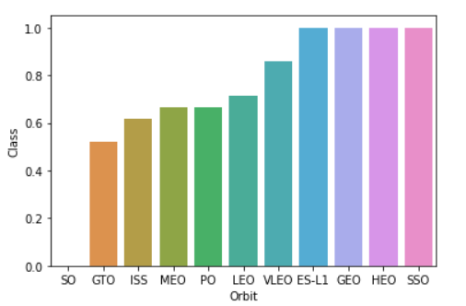
Success rate vs. Orbit type
Show a barchart for the success rate of each orbit type
Orbit VLEO, ES-L1, GEO, HEO and SSO have the most performance.

Slide 21
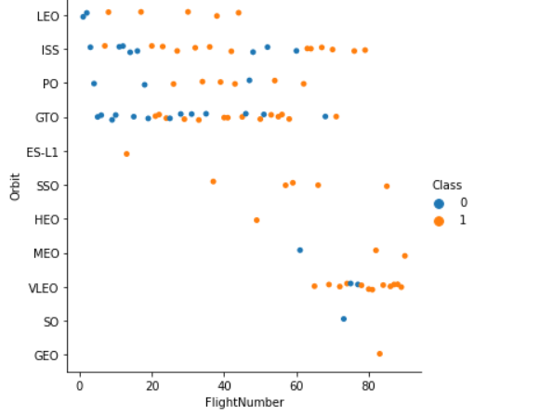
Flight Number vs. Orbit type
Show a scatter point of Flight number vs. Orbit type
Orbit SSO showed all success records across flight numbers. LEO have high success in high flight number, and high fails for lower numbers. Instead, GTO shows no clear pattern of the relationship between output and flightnumber.

Slide 22
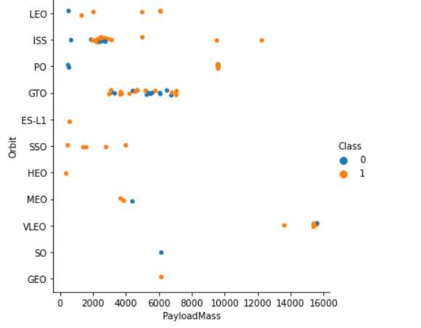
Payload vs. Orbit type
Show a scatter point of payload vs. orbit type
Payload mass tend to have no impacts on GTO. However, ISS show higher success rate for higher payload mass.

Slide 23
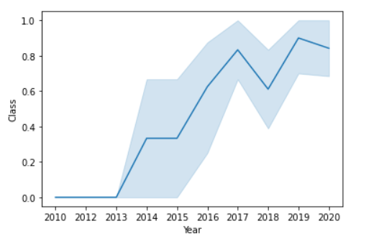
Launch success yearly trend
Show a line chart of yearly average success rate
The success rate keep increasing from 2013.

Slide 24
EDA with SQL

Slide 25
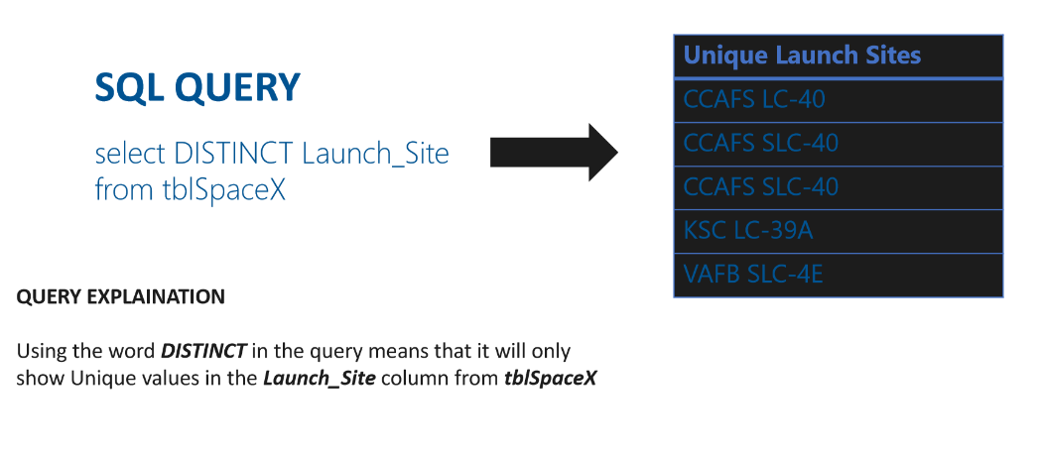
All launch site names
Find the names of the unique launch sites
Present your query result with a short explanation here

Slide 26
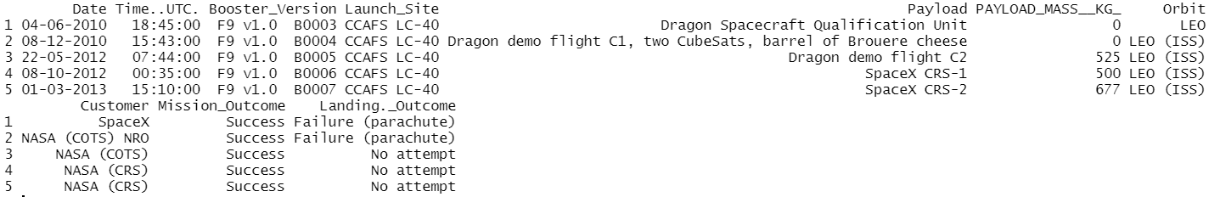
Launch site names begin with `CCA`
SELECT TOP 5 FROM tblSpaceX WHERE Launch_Site LIKE ‘CCA%’
Present your query result with a short explanation here
Using TOP 5 for first 5 rows of records; LIKE ‘CCA%’ is for filtering character strings starts with ‘CCA’.

Slide 27
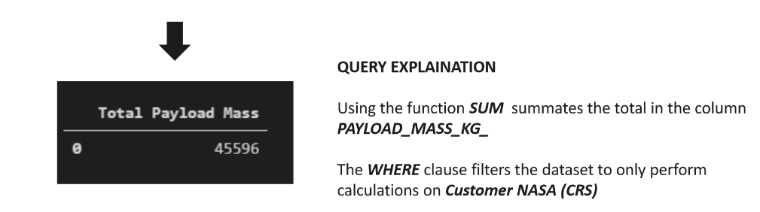
Total payload mass
Select SUM(PAYLOAD_MASS_KG_) from tblSpaceX WHERE CUSTOMER = ‘NASA(CRS)’

Slide 28
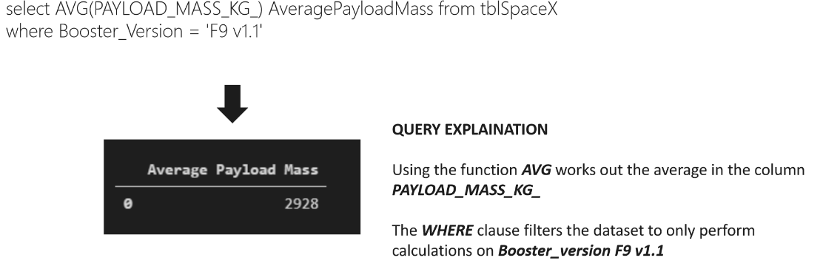
Average payload mass by F9 v1.1

Slide 29
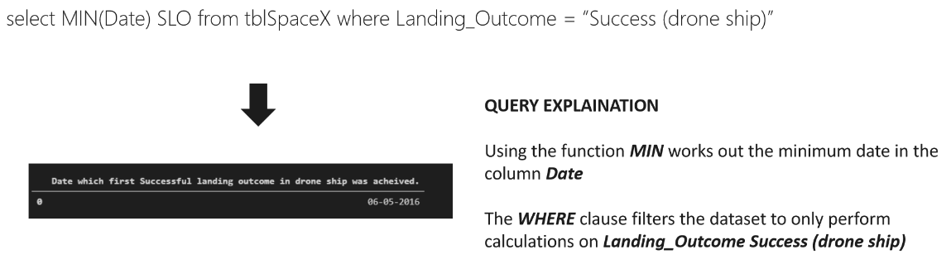
First successful ground landing date

Slide 30
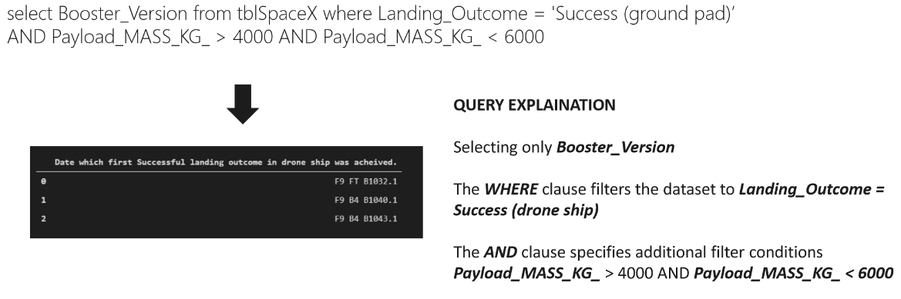
Successful drone ship landing with payload between 4000 and 6000

Slide 31
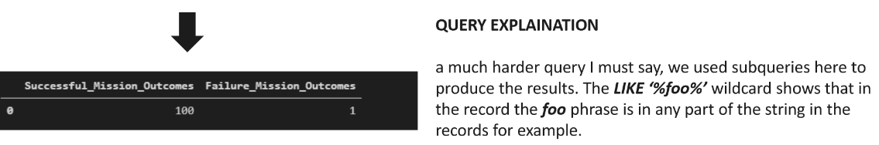
Total number of successful and failure mission outcomes
SELECT (select(count(mission_outcome) from tblSpaceX WHERE Mission_Outcome LIKE ‘%success%’) as successful_missing_outcomes,
(Select count(mission_outcome) from tblSpaceX where Mission_outcome like ‘%Failure%’ as failture_mission_countcomes

Slide 32
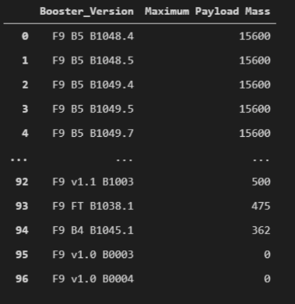
Boosters carried maximum payload
SELECT DISTINCT booster_version, max(payload_mass_kg_) as Maximum_payload_mass
FROM tblSpaceX GROUP BY booster_version ORDER BY Maximum_payload_mass DESC

Slide 33
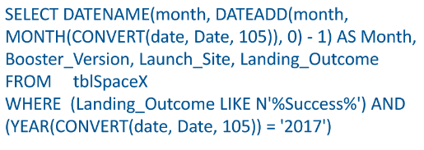
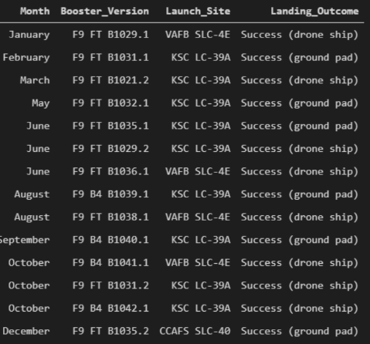
2015 launch records

Slide 34

Rank success count between 2010-06-04 and 2017-03-20
Select count(Landing_Outcome) FROM tblSpaceX
WHERE (Landing_Outcome LIKE ‘%Success%’) AND (Date > ’2010-06-04’) AND (Date < ‘2017-03-20’)
Count is to records the number of records meet the requirements listed by WHERE.

Slide 35
Interactive map with Folium

Slide 36
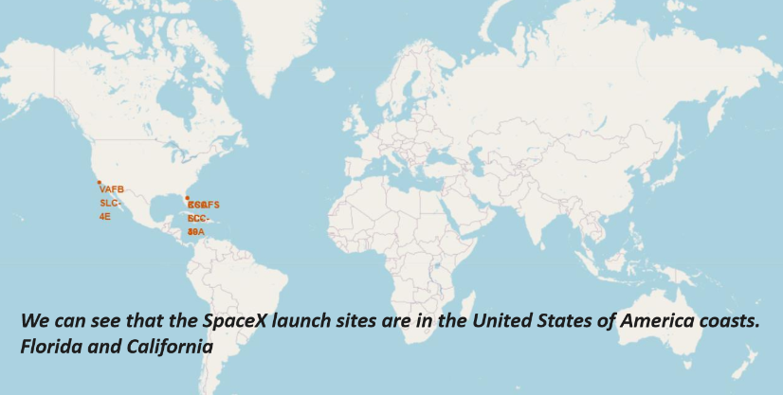
Launch sites locations

Slide 37
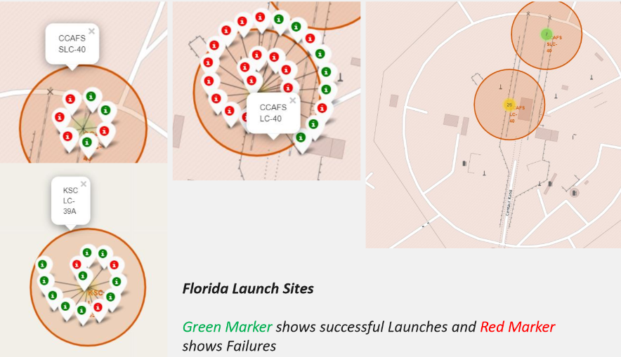
Launch sites labelled with outcomes

Slide 38
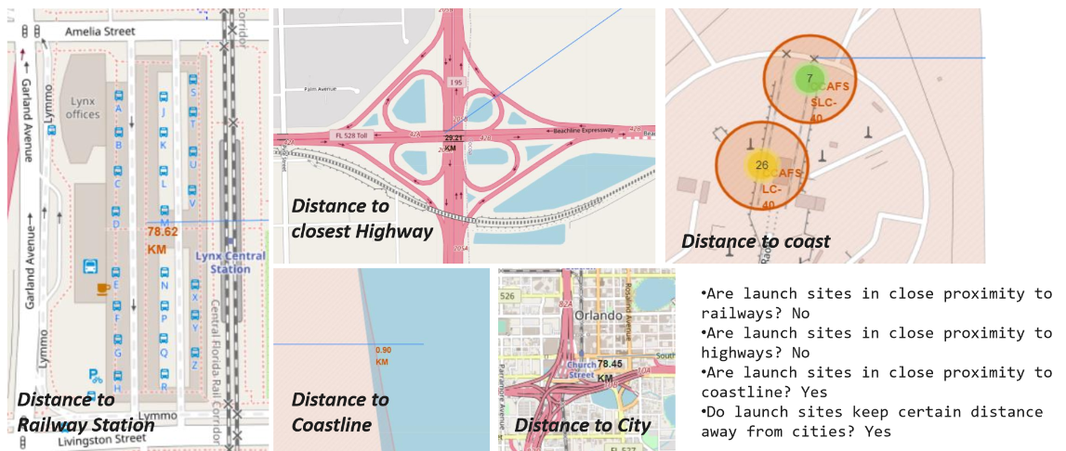
Distance between launch sites and landmarks

Slide 39
Build a Dashboard with Plotly Dash

Slide 40
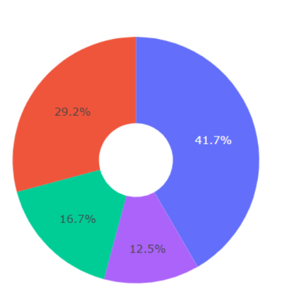
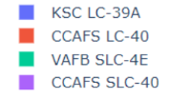
Proportion of success launches by sites
KSC LC-39A had the highest successful proportion from all sites.

Slide 41
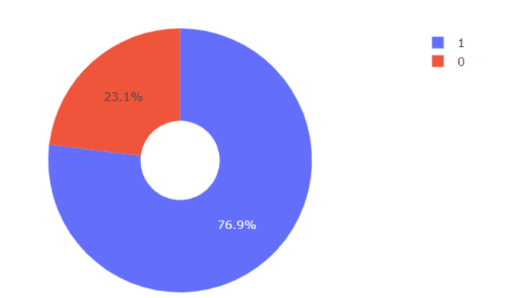
launch site with highest launch success ratio
Successful rate is up to 76.9%

Slide 42
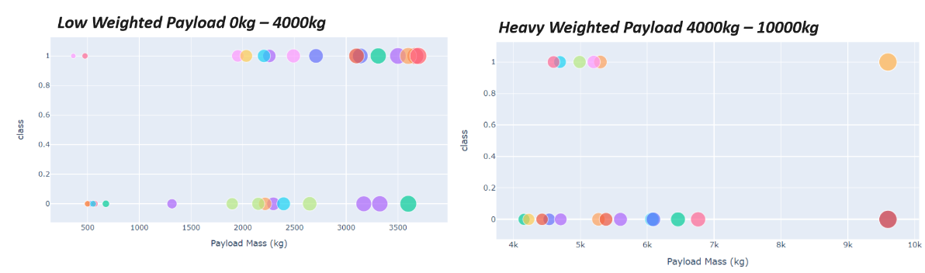
Payload vs. Launch Outcome
Launches with medium payload tend to have higher successful rate

Slide 43
Predictive analysis (Classification)

Slide 44
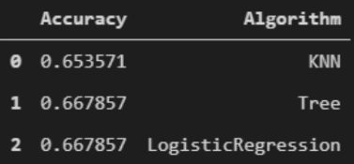
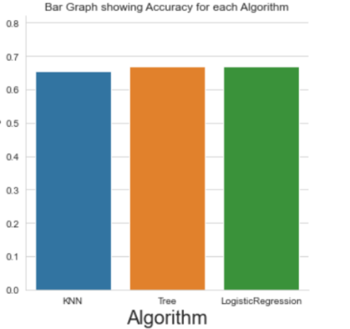
Classification Accuracy
In general, the models show similar accuracy, but Tree algorithm is slightly better.

Slide 45
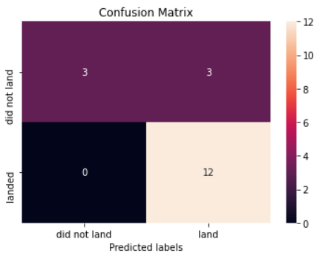
Confusion Matrix
Show the confusion matrix of the best performing model with explanation

Slide 46

CONCLUSION
Machine learning models can make reasonable predictions for the launch outcomes
Many factors influence the successful rates
Orbits GEO,HEO, SSO and ES-L1 have the highest successful rates
The overall successful rates increase through years

Slide 47

APPENDIX
Include all python notebooks in the Github folder

