Slide 1
Predicting Paddy Yield with Machine Learning: An Integrated Analysis of Climate, Agricultural Management, and Ensemble Models
By Ke Xu, Maya Bernstein, Qiuyu Wu, Hsin-Tzu Lin, Zih-Yi Cao

Slide 2
Introduction
Rice as a major global staple crop
Key role in food security
Yield affected by changing environmental conditions
Climate variability increased production risks
Accurate yield understanding supported better planning
Precision agriculture improved crop management decisions

Slide 3
Literature Review
Muthukumaran et al., 2023 - A Hybrid Machine Learning Model With Combined Wrapper Feature Selection Techniques to Improve the Yield of Paddy
Strongly influenced by combined effects of environmental condtions and agricultural management practices using ML models (e.g. RF and SVM)
2）Jeong et al., 2016 - Random Forests for Global and Regional Crop Yield Predictions
RF model: accurately predict crop yields across regional and global scales by combining features
3）Sah et al., 2024 - Rice Yield Prediction Through Integration of Biophysical Parameters with SAR and Optical Remote Sensing Data Using Machine Learning Models
Advanced ML models (e.g. XGBoost and Neural Networks) recognized nonlinear relationships in features

Slide 4
Research Questions
How climate and weather variables across growth stages influence yield?
2）Can feature selectionimprove prediction accuracy and reduce overfitting?
3）What is the nature of the effect of the agricultural management practices on paddy yield?
4）Which machine learning methods provide the most accurate and practical estimates of paddy yield for farm decision-making?
5）How can machine learning yield predictions be translated into practical agricultural decision-support categories?

Slide 5
Methods
Sample and dataset
Obtained from a public paddy farming dataset of UCI
2,789 records and 44 predictors + 1 target variable (Paddy yield)
Variables include climate and agricultural management factors

Slide 6
Methods
The five research questions were designed as a connected analytical pipeline：
variable analysis → feature refinement → prediction modeling → decision support
Variable analysis:
Pearson correlation, RF feature importance, PCA, generalized models
Feature refinement:
feature selection, reduced-feature comparison, overfitting evaluation
Prediction modeling:
multi-model benchmarking, 80/20 validation, model suitability analysis
Decision-support translation:
K-means clustering, category profiling

Slide 7
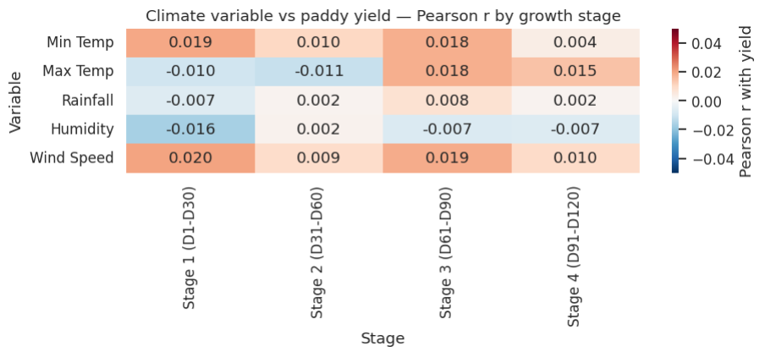
Results/Discussion (RQ1)
All 20 Pearson r values near zero (max |r| = 0.020, min p = 0.26) — no climate variable consistently predicts yield alone

Slide 8
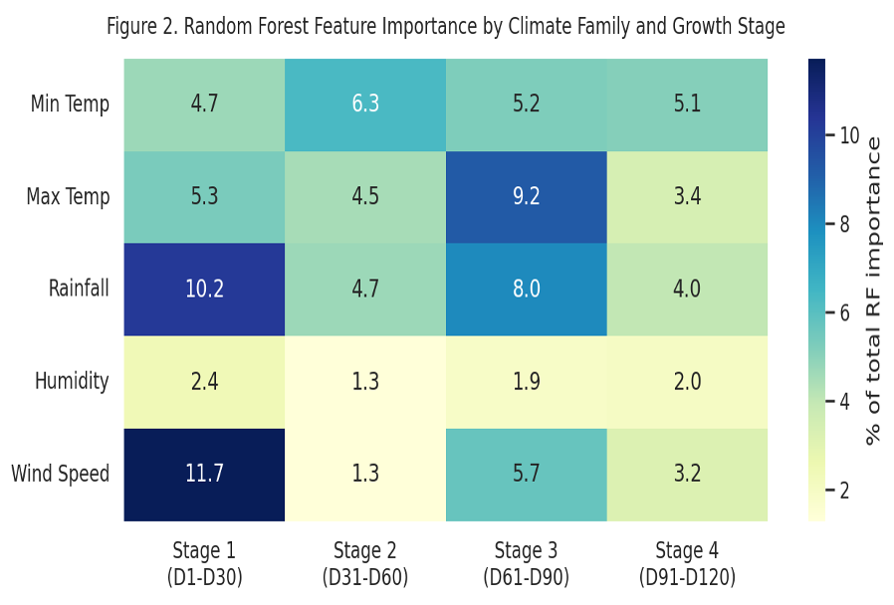
Results/Discussion (RQ1)
RF spreads importance broadly (max cell 11.7%); Wind Speed (Stage 1) and Humidity are top contributors, but no single stage dominates

Slide 9
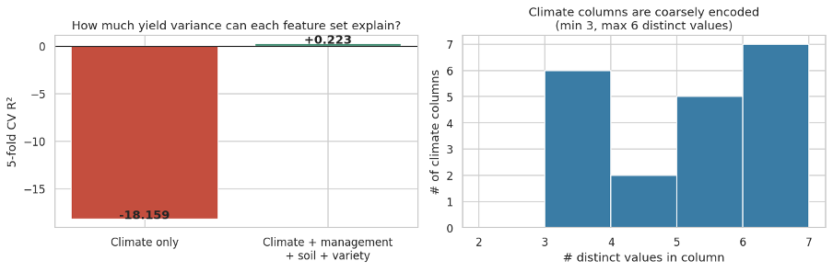
Results/Discussion (RQ1)
Climate-only CV R² = −18.16 vs. +0.223 with management/soil/variety — climate alone cannot predict yield; coarse data granularity (3–7 distinct values per column) further limits its predictive power

Slide 10
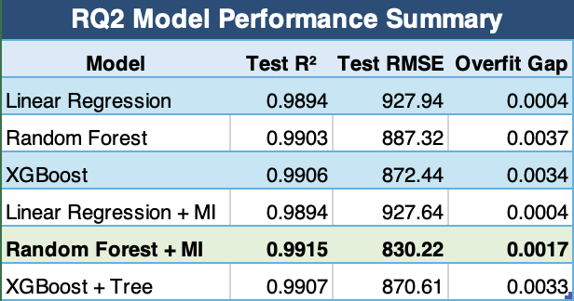
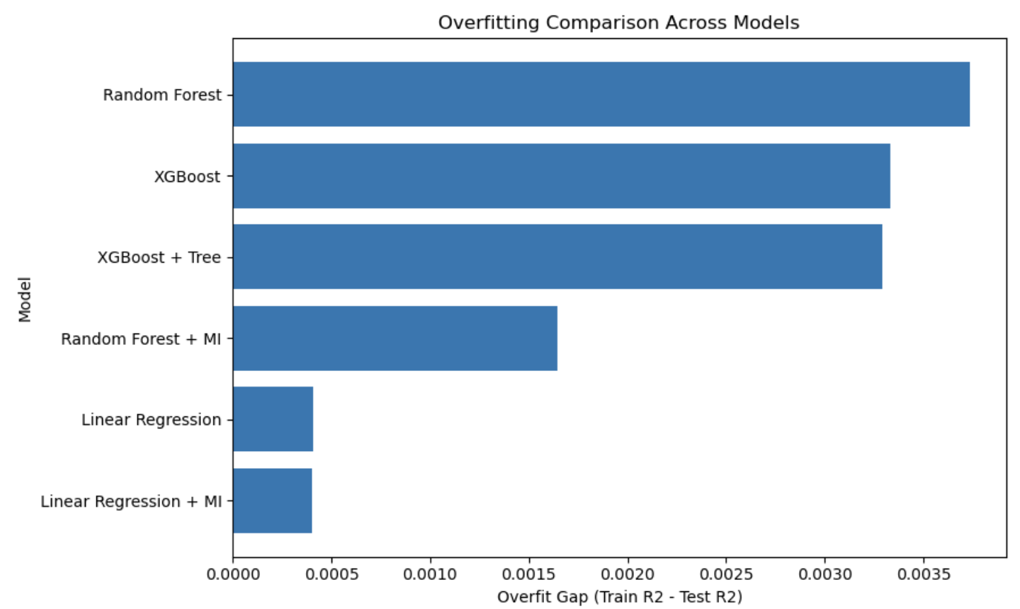
RQ2 Results: Random Forest gained the clearest benefit from feature selection
Random Forest + MI achieved the best balance between high prediction accuracy and lower overfitting.

Slide 11
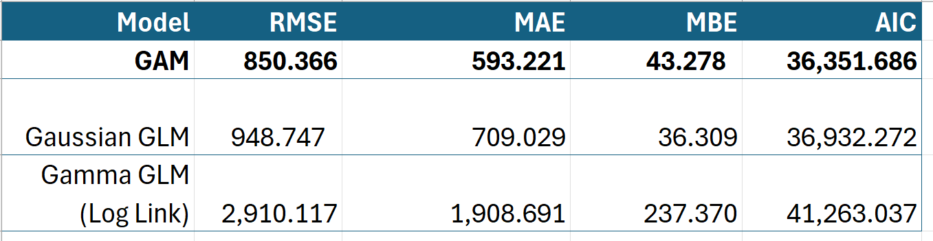
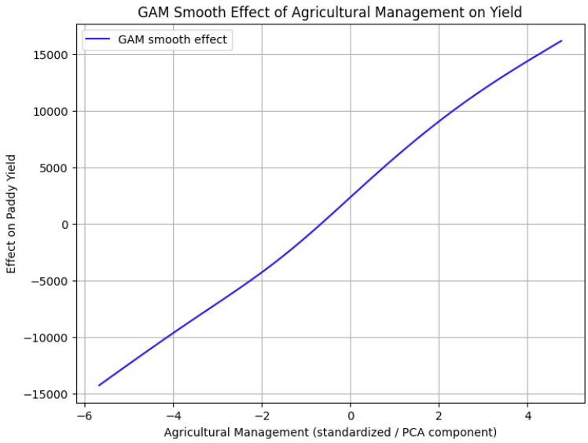
RQ3: What is the nature of the effect of the agricultural management practices on paddy yield?
GAM: Lowest RMSE and AIC
Significant nonlinear relationship with paddy yield (p < 0.001)
Effect size: Total variation of ~30,475 kg
Dominant driver of yield outcomes (statistically significant + meaingful effects)

Slide 12
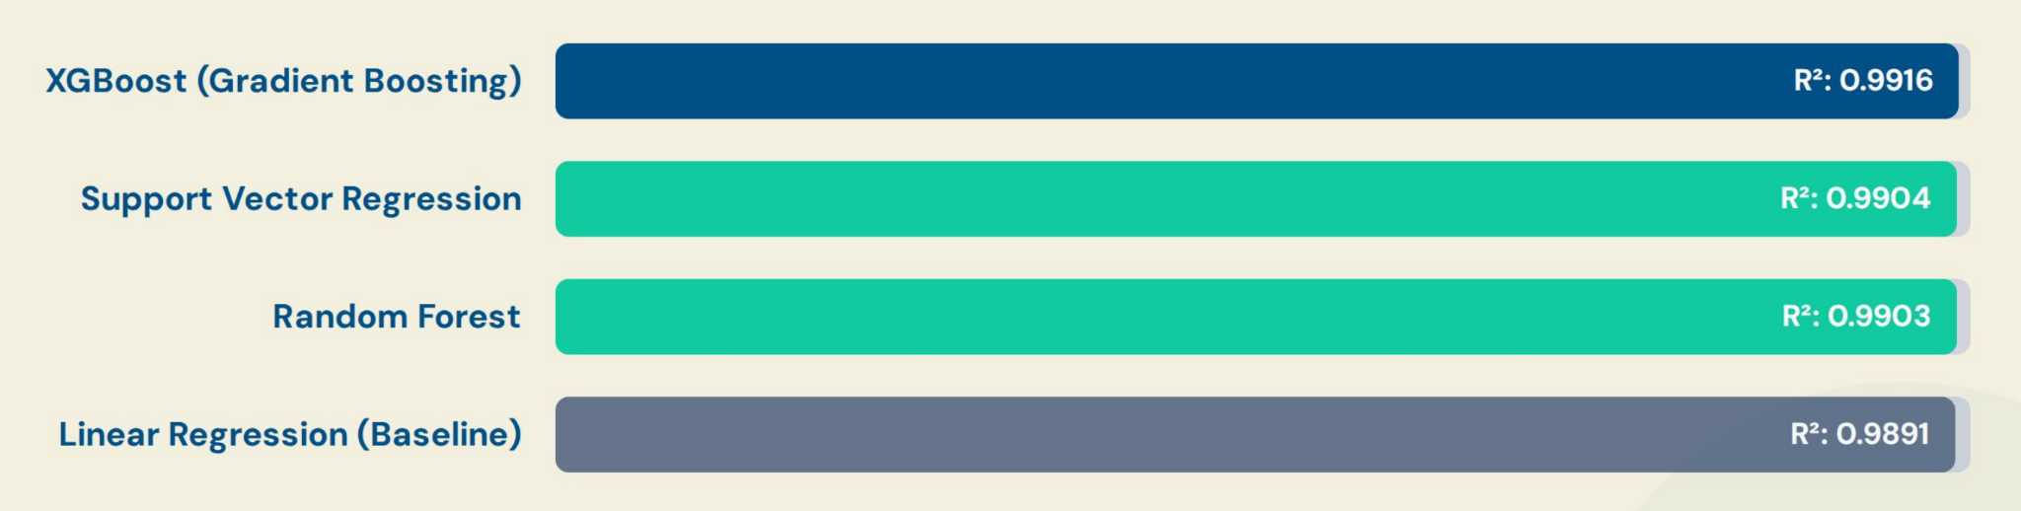
RQ4 Results: Which machine learning methods provide the most accurate and practical estimates of paddy yield for farm decision-making?
The XGBoost model achieved the highest predictive accuracy with the lowest RMSE (826.33 kg), proving that ensemble models effectively capture complex interactions.

Slide 13
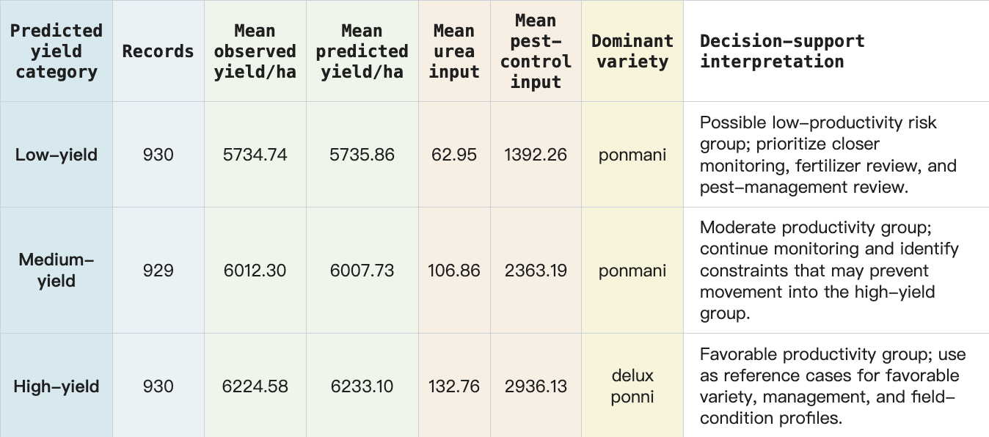
RQ5：How can machine learning yield predictions be translated into practical agricultural decision-support categories?

Slide 14
Limitations
Conceptual
Climate analyzed at agriblock level; plot-level weather not captured (RQ1) — PCA composite for management prevents ranking individual practices (RQ3)
Data Collection
Climate columns have only 3–9 distinct values; 30-day aggregates hide critical short-term events during sensitive growth stages (RQ1)
Single-region dataset with low inter-field variability may limit generalizability across all RQs
Data Analysis
Pearson correlation captures only linear relationships; climate–management interaction effects were not modeled (RQ1, RQ3)
Deep learning excluded based on data structure assumption rather than empirical testing (RQ4)
Interpretation
R² > 0.99 in RQ2/RQ4 may reflect limited data variability rather than true generalizability; low CV R² in RQ1 may partly reflect data sparsity, not absence of climate effects

Slide 15
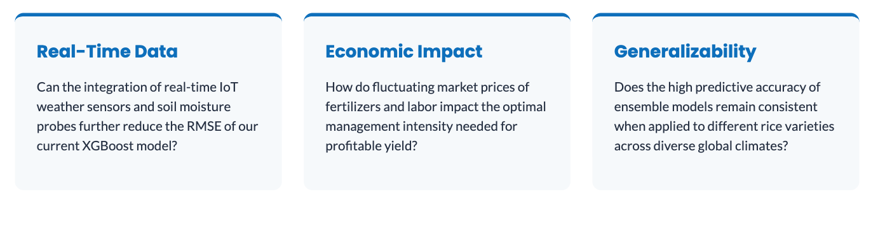
Future Work
Based on our current findings,
we propose three critical research questions for future study:

Slide 16
Conclusion
Paddy yield is shaped by both environmental conditions and agricultural management, but management-related factors showed stronger practical value for understanding yield differences.
More focused data inputs and stronger prediction methods can help improve yield forecasting and planning.
Translating yield outcomes into low-, medium-, and high-productivity groups makes results easier for farmers and planners to use.

Slide 17
References
Alfred, R., Obit, J. H., Chin, C. P.-Y., Haviluddin, H., & Lim, Y. (2021). Towards paddy rice smart farming: A review on big data, machine learning and rice production tasks. IEEE Access, 9, 50358–50380. https://doi.org/10.1109/ACCESS.2021.3069449
Jeong, J. H., Resop, J. P., Mueller, N. D., et al. (2016). Random forests for global and regional crop yield predictions. PLOS ONE, 11(6). https://doi.org/10.1371/journal.pone.0156571
Muthukumaran, S., Peter, K. J., Dilipkumar, E., Savithri, S., & Senbagam, K. (2023). A hybrid machine learning model with combined wrapper feature selection techniques to improve the yield of paddy. International Journal of Electronics and Communication Engineering.
https://www.internationaljournalssrg.org/IJECE/paper-details?Id=512
Saberali, F. S., & Darzi-Naftchali, A. (2024). Yield gap analysis and the relative importance of factors explaining yield variability in paddy fields. European Journal of Agronomy, 156. https://www.sciencedirect.com/science/article/abs/pii/S1161030124000935

Slide 18
References
Sah, S., Haldar, D., Singh, R., et al. (2024). Rice yield prediction through integration of biophysical parameters with SAR and optical remote sensing data using machine learning models. Scientific Reports, 14. https://doi.org/10.1038/s41598-024-72624-4
Sahoo, R. K., Ray, S. S., & Manjunath, K. R. (2024). Advanced prediction of rice yield gaps under climate uncertainty using machine learning techniques in Eastern India. Journal of Agriculture and Food Research, 8, Article 100617. https://doi.org/10.1016/j.jafr.2024.100617
UCI Machine Learning Repository. (2024). Paddy crop dataset. University of California, Irvine. https://archive.ics.uci.edu/
Wickramasinghe, L., Weliwatta, R., Ekanayake, P., & Jayasinghe, J. (2021). Modeling the relationship between rice yield and climate variables using statistical and machine learning techniques. Journal of Mathematics, 2021(1), Article 6646126.
https://doi.org/10.1155/2021/6646126

