Slide 1



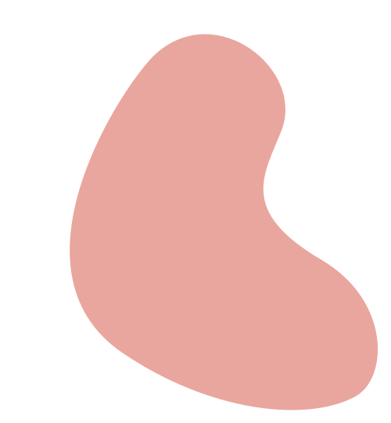


Initial issues arising
The image cannot be displayed correctly, there is an issue with the address format
The carousel image is distorted and not aesthetically pleasing due to inconsistent image sizes
There is an issue with inserting Google Maps into the address page and it cannot be displayed properly
编辑一个
核心观点
1. Add Google Maps iframe: Provide complete Google Maps embedding URL
2. CSS style adjustment: The map container has been styled to ensure the correct display of the map iframe container
3. Adjustment of inline style: Added style="border: 0;" inline style to iframe tag
4. Added loading and refererpolicy attributes: Added loading="lazy" and refererpolicy="no ferro then downgrade" attributes to the iframe tag to enhance the embedding experience.
1. Divide the images in each carousel item into two columns
2. Layout using Bootstrap's grid system and use Bootstrap's' row 'and' col-6 'classes to place each image in a separate column in the carousel item
3. Set the container width of the image (w-100)
Change the image address format from "C: \ Web1 \ credits \ logo. jpg" to indirect format "credits/logo. jpg"
请在此处简要说明你的
主题和想法
请在此处简要说明你的
主题和想法

Slide 2
Menu page navigation bar
The page cannot be moved down with the mouse
Unable to fix the top navigation bar
Click on the link in the navigation bar to jump to a new page instead of the specific location on the menu page
1. Modify the min height attribute in the background image style: min height: 100vh/* Ensure that the background image always covers the minimum height of the viewport*/
2. Add. section {padding: 50px 0;
margin-top: 20px;
3. Set a left margin for the. container custom class of the main content container to leave space for navigation menus, while ensuring that the content is vertically arranged and can be scrolled according to the height of the content
By modifying the CSS template of the menu container class: position: fixed; Fix the navigation bar on the left side of the page.
Modify the link in the navigation bar:<a class="menu item" ref="# vegetarian">Vegetarian</a>Modify the corresponding section of the page:<section id="vegetarian" class="section bg vegan">`

Slide 3
Side shopping cart window function
When the number of items in the shopping cart increases, you can use the scrollbar to view all items and ensure that the 'Checkout' button is visible.
After adding the 'Checkout' button, clicking the button will not redirect you to the checkout. html page
After the shopping cart is redirected, the selected items and total price cannot be displayed on the checkout. html page.
编辑一个
核心观点
Add click event handling for checkoutButton in JavaScript, using window.location.ref for redirection.
Store the shopping cart items locally before jumping to the checkout. html page. When loading on the checkout. html page, retrieve the shopping cart items from local storage and display the total price.
请在此处简要说明你的
主题和想法
Implement scrollbars by adjusting CSS styles and adding max height and overflow y: auto properties.
请在此处简要说明你的
主题和想法

