Slide 1

Department of Computer & information Science
TEMPLE
U N I V E R S I T Y
Department of Computer & information Sciences
Sensors
TEMPLE
U N I V E R S I T Y

Slide 2
Sensors
The Android platform supports three broad categories of sensors:
Motion sensors
These sensors measure acceleration forces and rotational forces along three axes. This category includes accelerometers, gravity sensors, gyroscopes, and rotational vector sensors.
Environmental sensors
These sensors measure various environmental parameters, such as ambient air temperature and pressure, illumination, and humidity. This category includes barometers, photometers, and thermometers.
Position sensors
These sensors measure the physical position of a device. This category includes orientation sensors and magnetometers.

Slide 3
Sensors
Sensor | Type | Description | Common Uses
TYPE_ACCELEROMETER | Hardware | Measures the acceleration force in m/s² that is applied to a device on all three physical axes (x, y, and z), including the force of gravity. | Motion detection (shake, tilt, etc.).
TYPE_AMBIENT_TEMPERATURE | Hardware | Measures the ambient room temperature in degrees Celsius (°C). See note below. | Monitoring air temperatures.
TYPE_GRAVITY | Software or Hardware | Measures the force of gravity in m/s² that is applied to a device on all three physical axes (x, y, z). | Motion detection (shake, tilt, etc.).
TYPE_GYROSCOPE | Hardware | Measures a device's rate of rotation in rad/s around each of the three physical axes (x, y, and z). | Rotation detection (spin, turn, etc.).
TYPE_LIGHT | Hardware | Measures the ambient light level (illumination) in lx. | Controlling screen brightness.
TYPE_LINEAR_ACCELERATION | Software or Hardware | Measures the acceleration force in m/s² that is applied to a device on all three physical axes (x, y, and z), excluding the force of gravity. | Monitoring acceleration along a single axis.

Slide 4
Sensors
We can use the sensor framework to do the following:
Determine which sensors are available on a device.
Determine an individual sensor's capabilities, such as its maximum range, manufacturer, power requirements, and resolution.
Acquire raw sensor data and define the minimum rate at which you acquire sensor data.
Register and unregister sensor event listeners that monitor sensor changes.
SensorManager
This class provides various methods for accessing and listing sensors, registering and unregistering sensor event listeners, and acquiring orientation information. This class also provides several sensor constants that are used to report sensor accuracy, set data acquisition rates, and calibrate sensors.

Slide 5
Determine which sensors are available on a device
Acquire the permission of Body Sensor in AndroidManifest.xml:
To identify the sensors that are on a device you first need to get a reference to the sensor service. To do this, you create an instance of the SensorManager class by calling the getSystemService() method and passing in the SENSOR_SERVICE argument.
get a listing of every sensor on a device by calling the getSensorList() method and using the TYPE_ALL constant. For example:
<uses-permission android:name="android.permission.BODY_SENSORS" />
private SensorManager sensorManager;
...
sensorManager = (SensorManager) getSystemService(Context.SENSOR_SERVICE);
List<Sensor> deviceSensors = sensorManager.getSensorList(Sensor.TYPE_ALL);

Slide 6
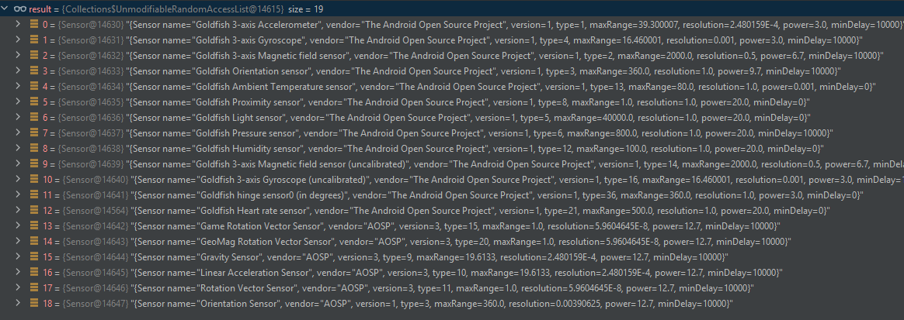
Determine which sensors are available on a device
Example: Wear OS Small Round API 30 (Android 11.0 China version of Wear OS 3)

Slide 7
Determine an individual sensor's capabilities
You can also determine whether a specific type of sensor exists on a device by using the getDefaultSensor() method and passing in the type constant for a specific sensor.
you can use the getResolution() and getMaximumRange() methods to obtain a sensor's resolution and maximum range of measurement. You can also use the getPower() method to obtain a sensor's power requirements.
private SensorManager sensorManager;
...
sensorManager = (SensorManager) getSystemService(Context.SENSOR_SERVICE);
if (sensorManager.getDefaultSensor(Sensor.TYPE_MAGNETIC_FIELD) != null){
// Success! There's a magnetometer.
} else {
// Failure! No magnetometer.
}

Slide 8
Register and unregister sensor event listeners that monitor sensor changes
the system invokes the onSensorChanged() method, providing you with a SensorEvent object. A SensorEvent object contains information about the new sensor data, including: the accuracy of the data, the sensor that generated the data, the timestamp at which the data was generated, and the new data that the sensor recorded.
public final void onSensorChanged(SensorEvent event) {
// The light sensor returns a single value.
// Many sensors return 3 values, one for each axis.
float lux = event.values[0];
// Do something with this sensor value.
}

Slide 9
Register and unregister sensor event listeners that monitor sensor changes
the system invokes the onSensorChanged() method, providing you with a SensorEvent object. A SensorEvent object contains information about the new sensor data, including: the accuracy of the data, the sensor that generated the data, the timestamp at which the data was generated, and the new data that the sensor recorded.
public final void onSensorChanged(SensorEvent event) {
// The light sensor returns a single value.
// Many sensors return 3 values, one for each axis.
float lux = event.values[0];
// Do something with this sensor value.
}

Slide 10
Code
public class SensorActivity extends Activity implements SensorEventListener {
private SensorManager sensorManager;
private List<Sensor> allSensors;
@Override
public final void onCreate(Bundle savedInstanceState) {
sensorManager = (SensorManager) getSystemService(Context.SENSOR_SERVICE);
allSensors = sensorManager.getSensorList(Sensor.TYPE_ALL);
for(int i=0;i<allSensors.size();i++){
sensorManager.unregisterListener(this, allSensors.get(i));
sensorManager.registerListener(this, allSensors.get(i), SensorManager.SENSOR_DELAY_FASTEST);
}
}
@Override
public final void onAccuracyChanged(Sensor sensor, int accuracy) {
// Do something here if sensor accuracy changes.
}
@Override
public final void onSensorChanged(SensorEvent event) {
// The light sensor returns a single value.
// Many sensors return 3 values, one for each axis.
float lux = event.values[0];
// Do something with this sensor value.
}
@Override
protected void onResume() {
super.onResume();
sensorManager.registerListener(this, mLight, SensorManager.SENSOR_DELAY_NORMAL);
}
@Override
protected void onPause() {
super.onPause();
sensorManager.unregisterListener(this);
}
}

Slide 11
TEMPLE
U N I V E R S I T Y
Department of Computer & information Sciences
T h a n k s !
TEMPLE
U N I V E R S I T Y

