Slide 1

供给与需求的市场力量
4
经济学基础
N.格里高利.曼昆 著
Premium PowerPoint Slides
by Ron Cronovich
Notes:
This is perhaps the most important chapter in the textbook. It’s worth mentioning to your students that investing extra time to master this chapter will make it easier for them to learn much of the subsequent material in the book.
This is also one of the longest chapters in the textbook, and this PowerPoint file is one of the most graph-intensive. Many students taking economics for the first time have difficulty grasping the graphs, which are critically important in this and all subsequent chapters in the book. So an extra degree of hand-holding might be appropriate.
Accordingly, this PowerPoint has carefully detailed animations that build many of the graphs with great care. For example, we show a demand or supply schedule next to the axes, and highlight each coordinate pair in the table as the corresponding point appears on the graph.
Please be assured that the presentation of graphs is more streamlined in subsequent chapters. In this early chapter, though, we do not want to leave any students behind.
If your students are already very comfortable with scatter-type graphs, you may wish to simplify or turn off the animation on these slides, in order to get through them faster.

Slide 2

本章我们将探索这些问题的答案：
影响买者物品需求的因素有哪些？
影响卖者物品供给的因素有哪些？
供给与需求怎么决定物品出售的价格与数量？
影响供给与需求的因素又是如何影响市场价格与数量？
市场是如何配置资源的？

Slide 3
市场和竞争
0
市场是让买者与卖者集中在一起的任何安排
竞争市场是有许多买者与卖者，以至于每个人对市场价格的影响都微乎其微的市场
在一个完全竞争市场里：
  可供销售的物品是完全相同的
  买者与卖者人数众多，以至于没有任何一个买者或卖者可以影响市场价格，也就是说，每个人都是“价格接受者”(price-taker)而非制定者。
本章我们假定市场是完全竞争的
需求、供给与市场均衡
Notes:
In the real world, there are relatively few perfectly competitive markets. Most goods come in lots of different varieties – including ice cream, the example in the textbook. And there are many markets in which the number of firms is small enough that some of them have the ability to affect the market price.
For now, though, we look at supply and demand in perfectly competitive markets, for two reasons: First, it’s easier to learn. Understanding perfectly competitive markets makes it a lot easier to learn the more realistic but complicated analysis of imperfectly competitive markets. Second, despite the lack of realism, the perfectly competitive model can teach us a LOT about how the world works, as we will see many times in the chapters that follow.

Slide 4
需求
0
物品的需求量是买者愿意并且能够购买的一种物品的数量
需求定理：认为在其他条件不变时，一种物品的价格上升，对该物品的需求量减少的观点
供给与需求的市场力量
Notes:
Demand comes from the behavior of buyers.

Slide 5
需求表
0
包子价格 | 需求量
￥0.00 | 16
1.00 | 14
2.00 | 12
3.00 | 10
4.00 | 8
5.00 | 6
6.00 | 4
需求表：
表示一种物品的价格与需求量之间关系的表格
例如:
小明对包子的需求
供给与需求的市场力量

Slide 6
小明的需求表与需求曲线
0
包子价格
包子价格 | 包子需求量
￥0.00 | 16
1.00 | 14
2.00 | 12
3.00 | 10
4.00 | 8
5.00 | 6
6.00 | 4
￥ 6.00
5.00
4.00
3.00
2.00
1.00
0.00
包子数量
0
5
10
15
供给与需求的市场力量

Slide 7
市场需求与个人需求
0
市场需求量是所有买者在每一价格水平下需求量的总和
假设小明与小亮是包子市场上唯一的两个买者 （Q^{d} = 需求量）
价格
小明的需求量
小亮的需求量
市场需求量
￥0.00
16
+
=
24
8
1.00
14
+
=
21
7
2.00
12
+
=
18
6
3.00
10
+
=
15
5
4.00
8
+
=
12
4
5.00
6
+
=
9
3
6.00
4
+
=
6
2
Notes:
This example violates the “many buyers” condition of perfect competition. Yet, we are merely trying to show here that, at each price, the quantity demanded in the market is the sum of the quantity demanded by each buyer in the market. This holds whether there are two buyers or two million buyers. But it would be harder to fit data for two million buyers on this slide, so we settle for two.

Slide 8
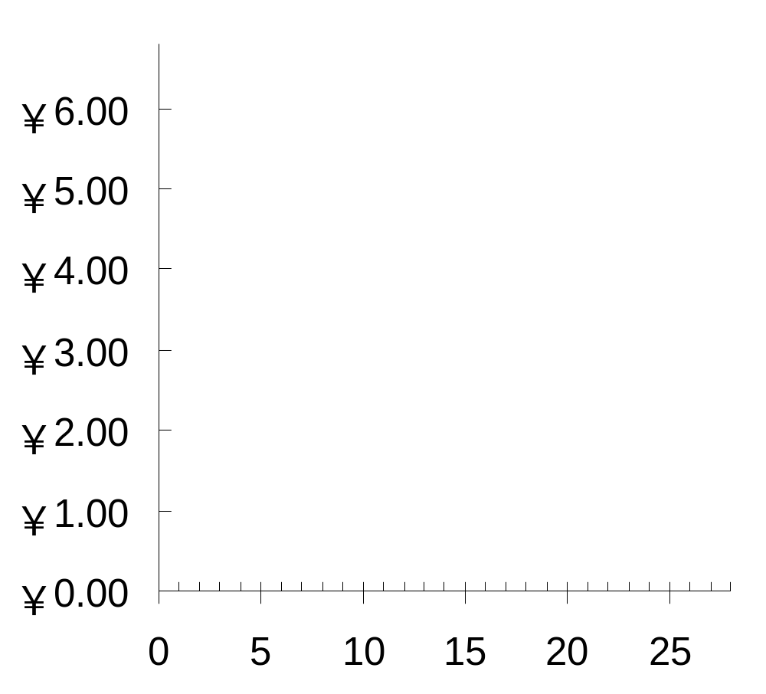
包子的市场需求曲线
0
P | Q^{d} (市场)
￥0.00 | 24
1.00 | 21
2.00 | 18
3.00 | 15
4.00 | 12
5.00 | 9
6.00 | 6
P
Q
供给与需求的市场力量

Slide 9
需求曲线的移动
0
需求曲线表示在其他条件不变的情况下，价格与需求量之间关系的图形
这些“其他条件”是决定需求的非价格因素（也就是决定买者对物品需求的除开物品价格的其他因素）
改变它们会引起需求曲线的移动…
供给与需求的市场力量

Slide 10
需求曲线的移动: 买者的数量
0
买者数量的增加会增加每一种价格水平下需求量，并使需求曲线向右移动
供给与需求的市场力量
Notes:
Income is the first demand shifter discussed in this chapter of the textbook. I chose to start with a different one (number of buyers), for the following reason:
In discussing the impact of changes in income on the demand curve, the textbook also introduces the concept of normal goods and inferior goods. Students may find it easier to learn about curve shifts if the presentation focuses solely on a curve shift (at least initially) without simultaneously introducing other concepts.
If you wish to present the demand shifters in the same order as they appear in the book, simply reorder the slides in this presentation.

Slide 11
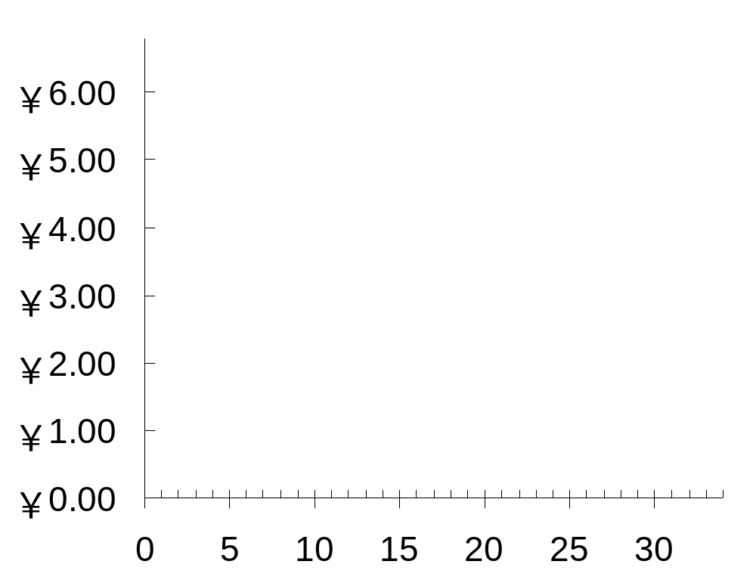
需求曲线的移动：买者的数量
0
P
如果买者数量增加，那在每一种价格水平P，需求量Q会增加（在本例中需求量增加为5）
Q
供给与需求的市场力量
Notes:
Beginning economics students often have trouble understanding the difference between a movement along the curve and a shift in the curve. Here, the animation has been carefully designed to help students see that a shift in the curve results from an increase in quantity at each price.
(A more realistic scenario would involve a non-parallel shift, where the horizontal distance of the shift would be greater for lower prices than higher ones. However, to remain consistent with the textbook, and to keep things simple, this slide shows a parallel shift.)

Slide 12
需求曲线的移动：收入
0
正常物品的需求与收入成正比：
  收入增加会增加每种价格水平下的需求量，并使需求曲线向右移动
（低档物品的需求与收入成反比，收入增加会使低档物品的需求曲线向左移动）
供给与需求的市场力量

Slide 13
需求曲线的移动：相关物品的价格
0
替代品：一种物品价格上升引起另一种物品需求量增加的两种物品
例如，面包与包子。面包价格的上升会增加包子的需求，并使包子的需求曲线向右移动
其它例子：可口可乐与百事可乐，笔记本电脑与台式电脑，CD与音乐下载
供给与需求的市场力量
Notes:
If you are willing to spend a couple extra minutes on substitutes and complements, and have a blackboard or whiteboard to draw on, here’s an idea:
Before (or instead of) showing this slide, draw the demand curve for hamburgers. Pick a price, say ￥5, and draw a horizontal line at that price, extending from the vertical axis through the D curve and continuing to the right. Suppose Q = 1000 when P = ￥5. Label this on the horizontal axis.
Now ask your students: If pizza becomes more expensive, but price of hamburgers does not change, what would happen to the quantity of hamburgers demanded? Would it remain at 1000, would it increase, or would it decrease? Explain.
Some and perhaps most students will see right away that people will want more hamburgers when the price of pizza rises. After establishing this, note that the increase in the price of pizza caused an increase in the quantity demanded of hamburgers. Then state the term “substitutes” and give the definition.
Before giving the other examples (listed in the 3rd bullet of this slide), do a similar exercise to develop the concept of complements. Finally, give the examples of substitutes and complements from the 3rd bullet point of this and the following slides, but mix up the order and ask students to identify whether each example is complements or substitutes.

Slide 14
需求曲线的移动：相关物品的价格
0
互补品：一种物品价格上升引起另一种物品需求量减少的两种物品
例如，电脑与软件。如果电脑价格上升，那人们会减少电脑的购买，因此也会减少软件的购买。软件的需求曲线向左移动
其它例子：大学学费与教材，油条和豆浆
供给与需求的市场力量

Slide 15
需求曲线的移动：嗜好
0
对一种物品嗜好的增加会使那种物品的需求增加，并使它的需求曲线向右移动
比如，现在人们更追求西式的餐饮方式，将会减少包子的需求
供给与需求的市场力量

Slide 16
需求曲线的移动：预期
0
预期会影响消费者的购买决定
例如:
  如果人们预期他们的收入将增加，他们对于昂贵餐厅的饮食需求现在就可能增加
  如果经济不好，人们会担心他们未来的就业保障，现在对新汽车的需求就可能减少
供给与需求的市场力量

Slide 17
总结：影响买者的变量
0
变量 这些变量的变动将……
价格 表现为沿着需求曲线 的变动
买者的数量 需求曲线移动
收入 使需求曲线移动
相关物品的价格 使需求曲线移动
嗜好 使需求曲线移动
预期 使需求曲线移动
供给与需求的市场力量
Notes:
Students should notice that the only determinant of quantity demanded that causes a movement along the curve is price. Also notice: price is one of the variables measured along the axes of the graph.
Here’s a handy “rule of thumb” to help students remember whether the curve shifts: If the variable causing demand to change is measured on one of the axes, you move along the curve. If the variable that’s causing demand to change is NOT measured on either axis, then the curve shifts.
This rule of thumb works with all curves in economics that involve an X-Y relationship. (I.e., it works for the supply curve, the marginal cost curve, the IS and LM curves, among many others, but it does not apply to curves drawn on time series graphs.)

Slide 18

主动学习 1
需求曲线
画出一个音乐下载的需求曲线。在下述情况下需求曲线将如何改变？为什么？
A. 耳机的价格下降
B. 音乐下载的价格下降
C. CD价格下降
Notes:
In each case, there are only three possible answers:
- The curve shifts to the right
- The curve shifts to the left
- The curve does not shift (though there may be a movement along the curve)

Slide 19
主动学习 1
A. 耳机价格的下降
音乐下载和 耳机是互补品。耳机价格的下降会使音乐下载的需求曲线向右移动
音乐下载的价格
P₁
D₁
D₂
Q₁
Q₂
音乐下载的数量
Notes:
Point out to your students that there are no numbers or units on either axis, and we are using “P₁” and “Q₁” to represent the initial price and quantity, rather than specific numerical values. Tell them that this is common, because in much economic analysis, the goal is only to see the direction of changes, not specific amounts. (Besides, if we put numbers on this graph, they’d just have been made up, so why bother?)
Also point out the following:
The price of music downloads is the same, but the quantity demanded is now higher. In fact, this is the nature of a shift in a curve: at any given price, the quantity is different than before.

Slide 20
主动学习 1
B. 音乐下载价格的下降
音乐下载的价格
需求曲线并不移动，而是沿着需求曲线到一个价格更低，需求量更高的点
P₁
P₂
D₁
Q₁
Q₂
音乐下载的数量

Slide 21
主动学习 1
C. CD价格的下降
音乐下载的价格
CD与音乐下载是替代品，CD价格的下降使音乐下载的需求曲线向左移动
P₁
D₂
D₁
Q₂
Q₁
音乐下载的数量

Slide 22
供给
0
供给量：卖者愿意并且能够出售的一种物品的数量
供给定理：认为在其他条件不变时，一种物品价格上升，该物品供给量增加的观点
供给与需求的市场力量
Notes:
Supply comes from the behavior of sellers.

Slide 23
供给表
0
供给表：
表示一种物品的价格与供给量之间关系的表格
例如：
青露对包子的供应
包子的价格 | 包子的供应数量
￥0.00 | 0
1.00 | 3
2.00 | 6
3.00 | 9
4.00 | 12
5.00 | 15
6.00 | 18
供给与需求的市场力量

Slide 24
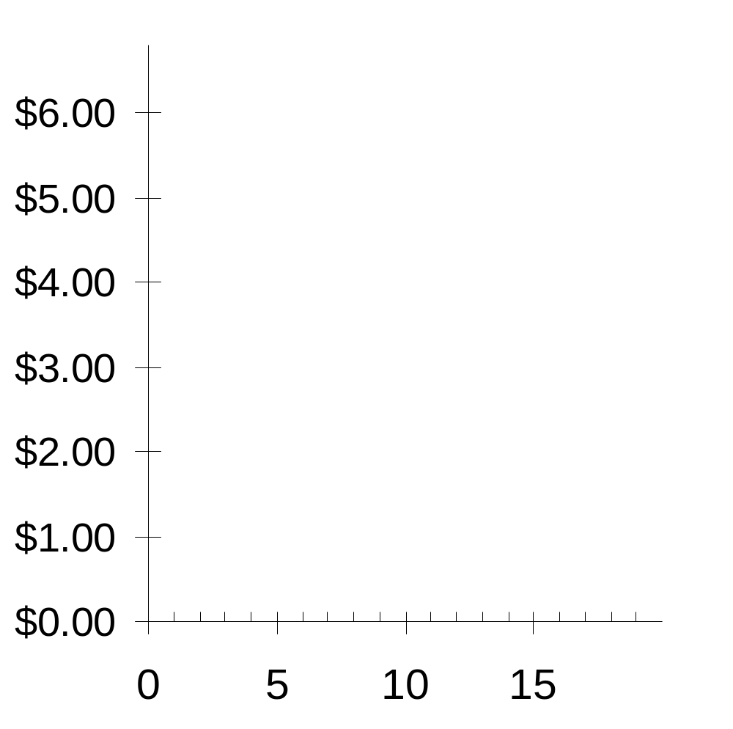
青露的供给表与供给曲线
0
包子的价格 | 包子的供应数量
￥0.00 | 0
1.00 | 3
2.00 | 6
3.00 | 9
4.00 | 12
5.00 | 15
6.00 | 18
P
Q
供给与需求的市场力量

Slide 25
市场供给与个人供给
0
市场供给量是在每种价格水平下所有卖者的供给量之和
假设青露和蒸优味是这个市场上仅有的两个卖家 (Q^{s} = 供应数量)
价格
青露
蒸优味
市场供应数量
￥0.00
0
+
0
=
0
1.00
3
+
2
=
5
2.00
6
+
4
=
10
3.00
9
+
6
=
15
4.00
12
+
8
=
20
5.00
15
+
10
=
25
6.00
18
+
12
=
30
Notes:
Again, the assumption of only two sellers is a clear violation of perfect competition. However, it’s much easier for students to learn how the market supply curve relates to individual supplies in the two-seller case.

Slide 26

市场供给曲线
0
P | Q^{S} (市场)
￥0.00 | 0
1.00 | 5
2.00 | 10
3.00 | 15
4.00 | 20
5.00 | 25
6.00 | 30
P
Q
供给与需求的市场力量

Slide 27
供给曲线的移动
0
供给曲线表示其他条件不变的情况下，一种物品的价格与供给量之间的关系
这里的“其他条件”是决定供应的非价格因素
改变这些非价格因素会使供给曲线移动…
供给与需求的市场力量
Notes:
“Non-price determinants of supply” simply means the things – other than the price of a good – that determine sellers’ supply of the good.

Slide 28
影响供给曲线移动的因素
0
变量 这些变量的变动将…
价格 表现为沿着供给曲线的变动
投入品价格 使供给曲线移动
技术 使供给曲线移动
卖者的数量 使供给曲线移动
预期 使供给曲线移动
供给与需求的市场力量

Slide 29
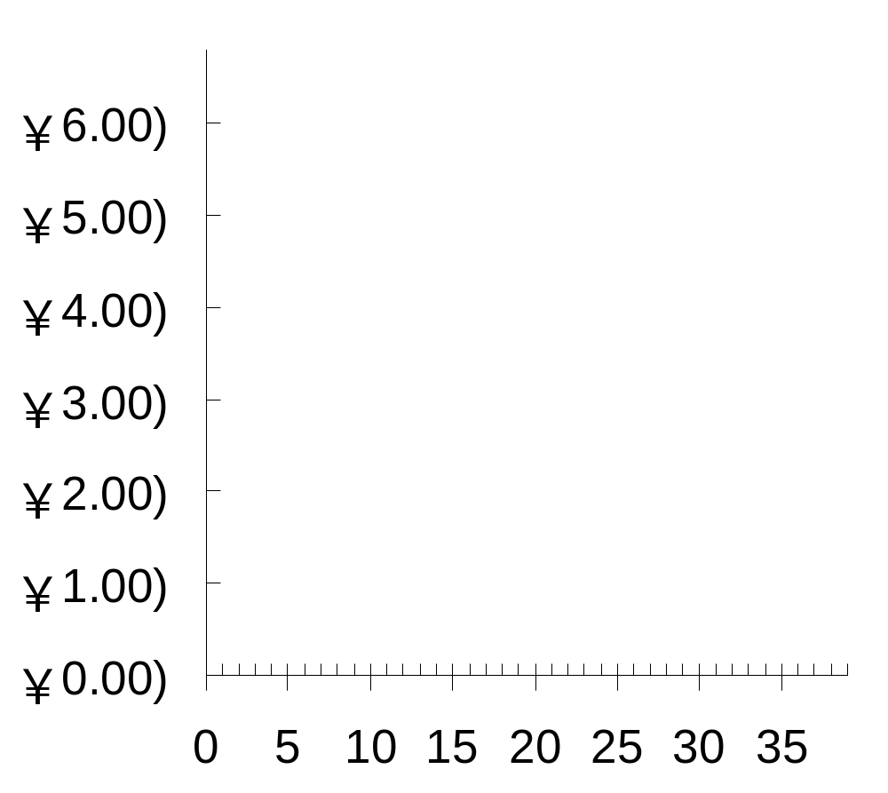
供给与需求的结合
0
P
均衡：市场价格达到使供给量与需求量相等的水平时的状态
D
S
Q
供给与需求的市场力量
Notes:
We now return to the latte example to illustrate the concepts of equilibrium, shortage and surplus.

Slide 30

均衡价格
0
使供给与需求平衡的价格
P
D
S
P | Q^{D} | Q^{S}
￥0 | 24 | 0
1 | 21 | 5
2 | 18 | 10
3 | 15 | 15
4 | 12 | 20
5 | 9 | 25
6 | 6 | 30
Q
供给与需求的市场力量

Slide 31
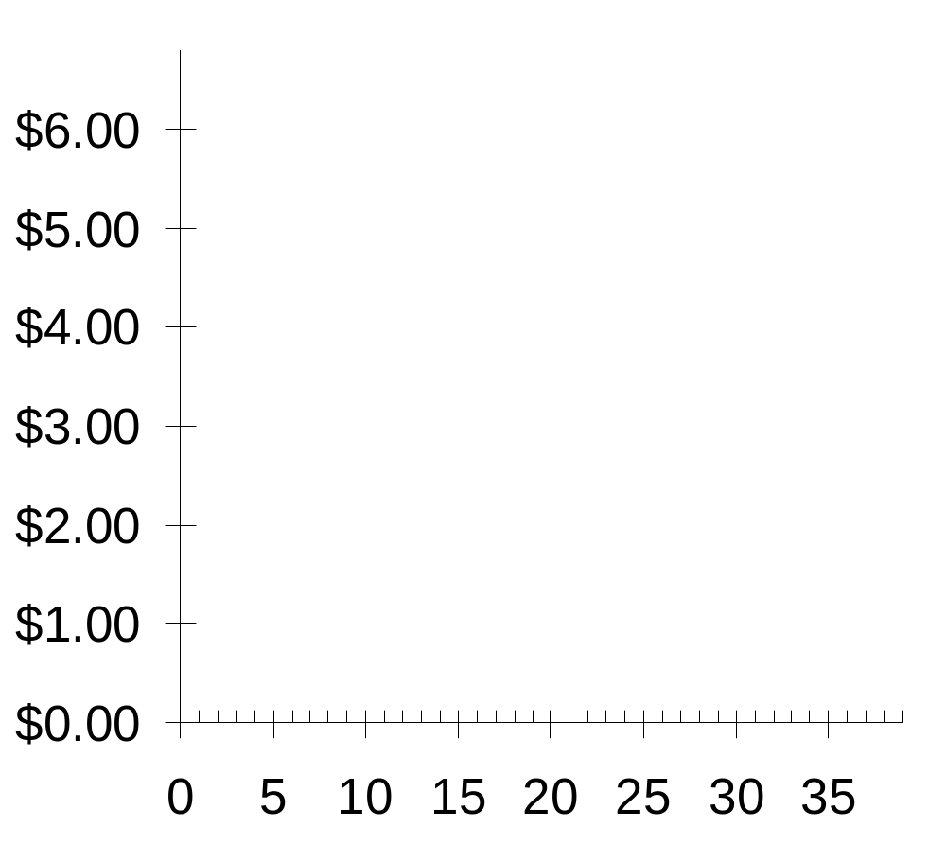
均衡数量
0
均衡价格下的供给量与需求量
P
D
S
P | Q^{D} | Q^{S}
￥0 | 24 | 0
1 | 21 | 5
2 | 18 | 10
3 | 15 | 15
4 | 12 | 20
5 | 9 | 25
6 | 6 | 30
Q
供给与需求的市场力量

Slide 32
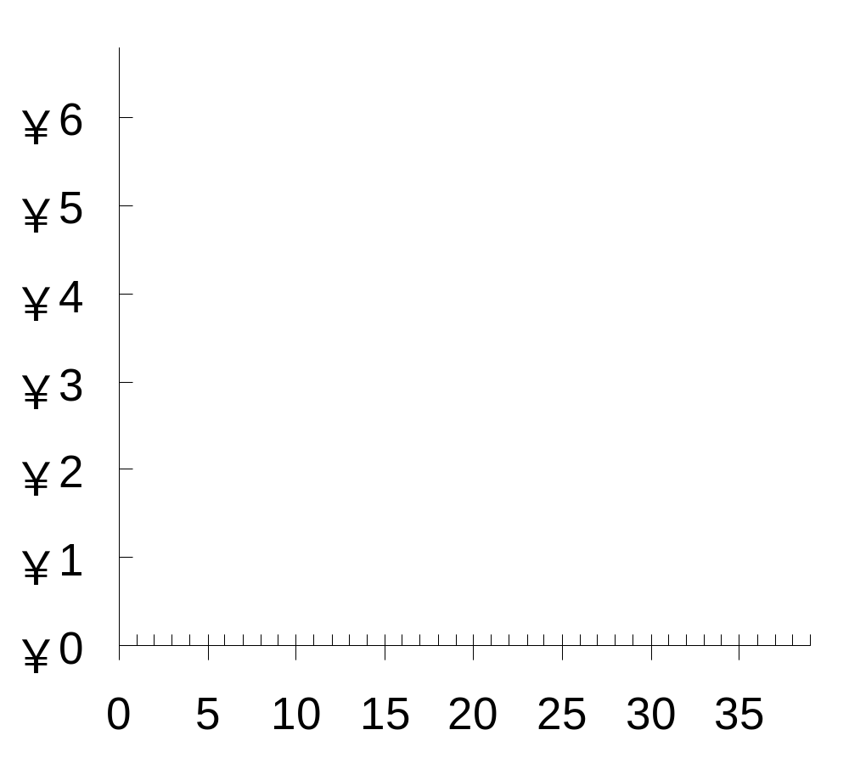
过剩 (超额供给):
0
供给量大于需求量的状态
P
D
过剩
S
例如:
如果 P = ￥5,
那 Q^{D} = 9
Q^{S} = 25
会有16单位的过剩
Q
供给与需求的市场力量

Slide 33
过剩(超额供给）:
0
供给量大于需求量的状态
P
面临过剩，卖者会通过降低价格来增加销量
D
过剩
S
这会使 Q^{D} 增加
Q^{S} 减少…
……减少过剩
Q
供给与需求的市场力量

Slide 34
过剩（超额供给）:
0
供给量大于需求量的状态
P
面临过剩，卖者会通过降低价格来增加销量
D
过剩
S
这会使Q^{D} 增加，Q^{S} 减少
价格会继续下降，直到达到均衡价格
Q
供给与需求的市场力量

Slide 35
短缺（超额需求）:
0
需求量大于供给量的状态
P
D
S
例如:
如果 P = ￥1
那 Q^{D} = 21
Q^{S} = 5
会有16单位的短缺
短缺
Q
供给与需求的市场力量

Slide 36
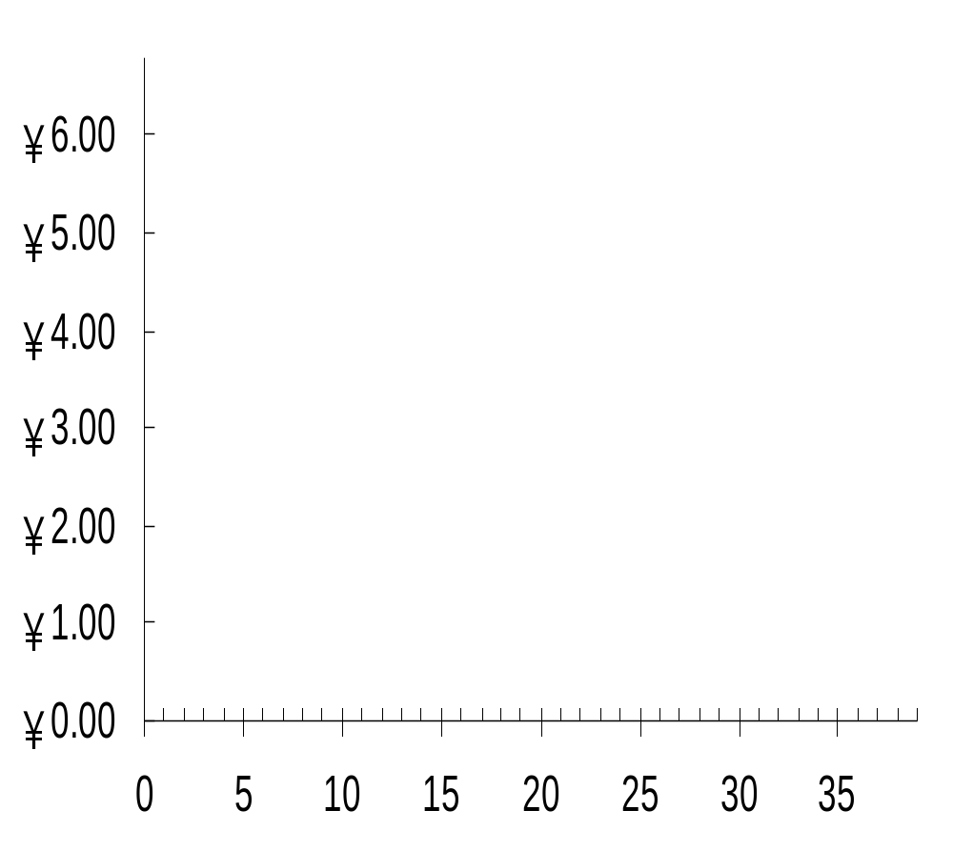
短缺（超额需求）:
0
需求量大于供给量的状态
P
面对短缺，卖者会提高价格
D
S
使 Q^{D} 减少
Q^{S} 增加
……这会使短缺减少
短缺
Q
供给与需求的市场力量

Slide 37
短缺(超额需求）:
0
需求量大于供给量的状态
P
面对短缺，卖者会提高价格,
D
S
使 Q^{D} 减少
Q^{S} 增加
价格继续上升直到达到均衡价格
短缺
Q
供给与需求的市场力量

Slide 38
分析均衡变动的三个步骤
分析均衡的变动：
  1. 确定该事件是使供给曲线移动还是使需求曲线移动（还是使两者都移动）
  2. 确定曲线移动的方向
  3. 用供求图说明这种移动如何改变均衡价格和均衡数量
供给与需求的市场力量
Notes:
Step one requires knowing all of the things that can shift D and S – the non-price determinants of demand and of supply.

Slide 39
例子：混合动力汽车市场
P
混合动力汽车价格
S₁
P₁
D₁
Q
Q₁
混合动力汽车数量
供给与需求的市场力量

Slide 40
例 1: 需求移动
事件分析:
天然气价格上升
P
S₁
第1步：需求曲线移动，因为天然气价格影响混合动力汽车的需求，供给曲线不变，因为天然气价格并不影响生产混合动力汽车的成本
P₂
第2步：需求曲线向右移动，因为天然气价格上升使混合动力汽车相对于其他汽车更有吸引力
P₁
第3步：这种移动使混合动力 汽车的价格上升，产量增加
D₁
D₂
Q
Q₁
Q₂
供给与需求的市场力量

Slide 41
例 1: 需求移动
注意：当混合动力汽车价格上升时，生产者的供应量会增加，即使供给曲线没有移动
P
S₁
P₂
P₁
仔细区分供给/需求曲线的移动和沿着供给/需求曲线的移动
D₁
D₂
Q
Q₁
Q₂
供给与需求的市场力量

Slide 42
曲线移动与沿曲线移动
供给变动: 影响供给变动的非价格因素使供给曲线移动（比如技术或投入品成本）
供给量的变动：沿着一条固定供给曲线的变动
需求变动: 影响需求变动的非价格因素使需求曲线移动（比如收入或买者的数量）
需求量的变动：沿着一条固定需求曲线的变动
Notes:
“Supply” refers to the position of the supply curve, while “quantity supplied” refers to the specific amount that producers are willing and able to sell.
Similarly, “demand” refers to the position of the demand curve, while “quantity demanded” refers to the specific amount that consumers are willing and able to buy.
If you’d like to be a rebel, delete this slide and all references to the jargon it contains, and just use the terms “movement along a curve” and “shift in a curve.” Note, however, that this is not the official recommendation of Cengage/South-Western or Dr. Mankiw.
If you’d like to cover this slide but make it move more quickly, delete the text next to each second-level bullet (starting with “occurs when”). Instead, give the information to your students verbally or rely on them to read it in the textbook.

Slide 43
例 2: 供给移动
事件: 新技术降低了生产混合动力汽车的成本
P
S₁
S₂
第一步：供给曲线移动，因为该事件影响生产成本。而需求曲线不变，因为生产技术并不影响需求
P₁
第二步：供给曲线向右移动，因为该事件降低生产成本，使在任何一个给定价格下生产都更有利可图
P₂
第三步：这种移动使价格下降，产量增加
D₁
Q
Q₁
Q₂
供给与需求的市场力量

Slide 44
例3：供给与需求的移动
事件：天然气价格上升与新技术降低生产成本
P
S₁
S₂
第1步：两条曲线都移动
P₂
第2步：两条曲线都向右移动
P₁
第3步：产量增加，但价格不确定。如果需求相对于供给增加的更多，那价格上升
D₁
D₂
Q
Q₁
Q₂
供给与需求的市场力量

Slide 45
例 3: 供给与需求的移动
事件：天然气价格上升与新技术降低生产成本
P
S₁
S₂
第3步：继续
如果供给相对于需求增加更多，那价格下降
P₁
P₂
D₁
D₂
Q
Q₁
Q₂
供给与需求的市场力量

Slide 46
主动学习 2
供给与需求的移动
用三步法来分析下列事件对音乐下载的均衡价格与均衡数量的影响
  事件 A：CD价格下降
  事件 B：音乐下载的卖者通过谈判降低了他们出售每一首歌需要支付的特许使用费
  事件 C：事件A和事件B都发生
Notes:
Important note about Event B:
The royalties that sellers must pay the artists are part of sellers’ “costs of production.” Typically, this royalty is a fixed amount each time one of the artist’s songs is downloaded. Event B, therefore, describes a reduction in sellers’ “costs of production.”

Slide 47
主动学习 2
A. CD价格下降
音乐下载市场
步骤
P
1. 需求曲线移动
S₁
2. 需求曲线向左移动
P₁
3. 价格与数量都下 降
P₂
D₂
D₁
Q
Q₂
Q₁
Notes:
This is an extension of Active Learning exercise 1C, where we saw that a fall in the price of compact discs would cause a fall in demand for music downloads, because the two goods are substitutes.

Slide 48
主动学习 2
B. 特许使用费的下降
步骤
音乐下载市场
P
1. 供给曲线移动
S₁
S₂
(特许使用费是卖者成本的一部分)
2. 供给曲线向右移动
P₁
3. 价格下降，数量增加
P₂
D₁
Q
Q₁
Q₂
Notes:
NOTE: Don’t worry that the text on this slide looks garbled in “Normal view” (i.e., edit mode). It works fine in “Slide Show” (i.e., presentation mode).
Event B: Sellers of music downloads negotiate a reduction in the royalties they must pay for each song they sell. This event causes a fall in “costs of production” for sellers of music downloads. Hence, the S curve shifts to the right.

Slide 49
主动学习 3
C. CD价格下降且特许使用费也下降
步骤
1. 两条曲线都移动（见 A与 B）
2. 需求曲线向左移动，供给曲线向右移动
3. 价格肯定下降，而数量则不确定：需求减少会减少数量，而供给增加会使数量增加
Notes:
It’s not necessary to draw a graph here. The answers to steps 1 and 2 should be clear from parts A and B. The answer to step 3 is a combination of the results from A and B.

Slide 50
结论：价格如何配置资源
第一章中讨论的经济学十大原理之一是:
市场通常是一种组织经济活动的好方法
在市场经济中，价格调整使供给与需求相等。这些均衡价格是引导经济决策，从而配置稀缺资源的信号
供给与需求的市场力量
Notes:
In the textbook, the conclusion of this chapter offers some very nice elaboration on the second bullet point. There is also an “In the News” box with a very nice article titled “In Praise of Price Gouging.”

Slide 51
内容提要
经济学家使用供给与需求模型来分析竞争市场
根据需求定理，随着一种物品价格下降，需求量增加。向右下方倾斜的需求曲线反应了需求定理

Slide 52
内容提要
除了价格之外，决定消费者想购买多少物品的其他因素包括收入，替代品和互补品的价格，嗜好和买者的数量。如果这些因素中的一种改变了，需求曲线就会移动
根据供给定理，随着一种物品价格上升，供给量增加。向右上方倾斜的供给曲线反应了供给定理
除了价格之外，决定生产者想出售多少物品的其他因素包括投入品价格，技术，预期和卖者的数量。如果这些因素中的一种改变了，供给曲线就会移动

Slide 53
内容提要
供给曲线与需求曲线相交决定了市场均衡。当价格为均衡价格时，需求量等于供给量
当市场价格高于均衡价格时，存在物品的过剩，引起市场价格下降。当市场价格低于均衡价格时，存在物品的短缺，引起市场价格上升

Slide 54
内容提要
为了分析某个事件如何影响一个市场，我们用供求图来考察该事件对均衡价格和均衡数量的影响。我们遵循三个步骤进行：第一，确定该事件是使供给曲线移动，还是使需求曲线移动（还是使两者都移动）。第二，确定曲线移动的方向。第三，比较新均衡与原来的均衡
在市场经济中，价格是引导经济决策，从而配置稀缺资源的信号

