Slide 1

消费者、生产者与市场效率
7
经济学原理
N.格里高利.曼昆 著
Premium PowerPoint Slides
by Ron Cronovich

Slide 2

本章我们将探索这些问题的答案:
什么是消费者剩余？它与需求曲线有什么联系？
什么是生产者剩余？它与供给曲线有什么联系？
市场能使资源达到合意的配置吗？还是市场结果有改善的余地？

Slide 3
福利经济学
资源配置涉及下述问题：
  每种物品分别生产多少？
  谁生产它们？
  谁消费它们？
福利经济学（welfare economics）：研究资源配置如何影响经济福利的一门学问
首先，我们来看看消费者的福利
消费者、生产者与市场效率

Slide 4
支付意愿
一个买者对一种物品的支付意愿是他愿意为这种物品支付的最高量
支付意愿衡量买者对于物品的评价/物品对于买者的价值/买者消费它所得到的利益
人名 | 支付意愿
小张 | 250
小李 | 175
小王 | 300
小陈 | 125
例如：4个买者对于一张春节火车票的支付意愿
消费者、生产者与市场效率

Slide 5
支付意愿与需求曲线
问题: 如果一张春节火车票的价格为200,，谁会买它？会买多少？
人名 | 支付意愿
小张 | $250
小李 | 175
小王 | 300
小陈 | 125
A: 小张 和小王会买， 小李和小陈不会买
因此,当价格为P = 200时
Q^{d} = 2
消费者、生产者与市场效率

Slide 6
支付意愿与需求曲线
得出需求表
P (春节火车票的价格)
谁会买
Q^{d}
301及以上
没人
0
人名 | 支付意愿
小张 | 250
小李 | 175
小王 | 300
小陈 | 125
251 – 300
小王
1
176 – 250
小王，小张
2
126 – 175
小王，小张，小李
3
0 – 125
小王，小张，小李，小陈
4
消费者、生产者与市场效率
Notes:
Give your students a few moments to fill in the table. Then reveal the answers. Tell them that they have just constructed the demand schedule for 春节火车票s.
Next, we will use the demand schedule to draw the demand curve (just like in Chapter 4 when we first covered demand schedules & curves).

Slide 7
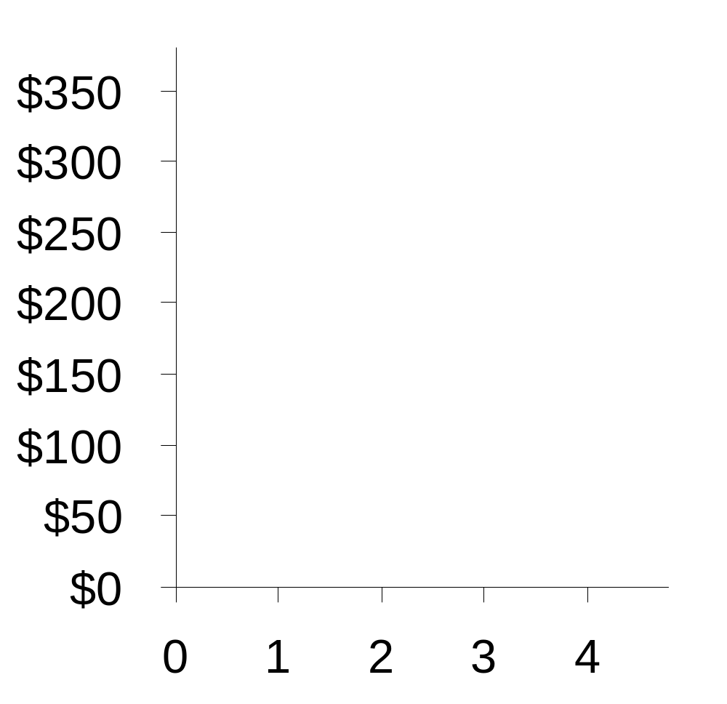
支付意愿与需求曲线
P
P | Q^{d}
$301及以上 | 0
251 – 300 | 1
176 – 250 | 2
126 – 175 | 3
0 – 125 | 4
Q
消费者、生产者与市场效率
Notes:
The table on this slide consists of the 1st and 3rd columns of the table on the preceding slide. The numbers in these columns are the demand schedule for 春节火车票s, and give us the demand curve shown in the graph on this slide.
The animation is as follows:
When P is $301 or higher, Q^{d} is zero. That part of the table is highlighted when the upper-most segment of the demand curve is revealed.
If the price falls to $300, then Q^{d} increases to 1.
If the price is anywhere in the range $251-300, Q^{d} = 1.
If the price falls to $250, then Q^{d} increases to 2.
If the price is anywhere in the range $176-250, Q^{d} = 2.
…and so forth.

Slide 8
梯形图
P
需求曲线看起来像一个梯形，有四个台阶—-每一个台阶代表一个买者。
如果像在竞争市场那样有许多买者
那就会有很多小的台阶
看起来就更像一条光滑的曲线
Q
消费者、生产者与市场效率
Notes:
After the previous slide, most of your students will probably understand where this D curve comes from, but its staircase-like shape will seem quite odd to them.
Point out that it has 4 “steps,” one for each buyer. Suppose there were 10 buyers instead of 4; how many steps would it have? Ten, of course. If there were 20 buyers, this D “curve” would have 20 steps.
A perfectly competitive market has a huge number of buyers. Suppose there were 10,000 buyers in the market for 春节火车票s (a tiny fraction of the actual number of buyers!). Then, the number of steps would be 10,000. In relation to the graph, each step would be insignificantly small, and the D curve would look like a smooth curve rather than a staircase – even though it really is a staircase – one with 10,000 infinitesimally small steps.

Slide 9
支付意愿与需求曲线
P
小王的支付意愿
在任意数量，需求曲线的高度代表边界买者的支付意愿
边际买者：指如果价格再提高一点就首先离开市场的买者
小张的支付意愿
小李的支付意愿
小陈的支付意愿
Q
消费者、生产者与市场效率
Notes:
When Q = 1, the height of the demand curve is $300, which is Flea’s willingness to pay, or how much he values an 春节火车票. At any price higher than $300, Flea leaves the market; hence, at Q = 1, Flea is the marginal buyer.
When Q = 2, the height of the demand curve is $250, which is Anthony’s willingness to pay, or how much he values an 春节火车票. At any price higher than $250, Anthony leaves the market; hence, at Q = 2, Anthony is the marginal buyer.
And so forth.
The lesson here is summarized in the text on the right side of the screen: At each Q, the height of the D curve tells you the marginal buyer’s willingness to pay, or how much that buyer values the good.

Slide 10
消费者剩余
消费者剩余：买者愿意为一种物品支付的量减去其为此实际支付的量
消费者剩余 = 支付意愿 – 市场价格
人名 | 支付意愿
小张 | 250
小李 | 175
小王 | 300
小陈 | 125
如果 P = 260
小王的消费者剩余 = 300 – 260 = 40
其他人没有消费者剩余，因为他们不会在这个价格下购买春节火车票
总消费者剩余 = 40
消费者、生产者与市场效率

Slide 11
消费者剩余与需求曲线
P
小王的支付意愿
P = 260
小王的消费者剩余 = 300 – 260 = 40
总消费者剩余 =40
Q
消费者、生产者与市场效率
Notes:
The area of any rectangle equals base times height.
For the green rectangle on this slide,
base = 1
height = $300 – 260 = $40
area = 1 x $40 = $40

Slide 12
消费者剩余与需求曲线
P
小王的消费者剩余
如果
P = 220
小王的消费者剩余 = 300 – 220 = 80
小张的消费者剩余 =250 – 220
= 30
总消费者剩余
= 110
小张的消费者剩余
Q
消费者、生产者与市场效率
Notes:
The entire green area (total CS) can be divided into two rectangles:
The first (and leftmost) represents Flea’s CS. It has a height of $80 and a width of 1.
The second represents Anthony’s CS. It has a height of $30 and a width of 1.
The sum of these two rectangular areas equals total CS.

Slide 13
消费者剩余与需求曲线
P
消费者(们)剩余：一种物品的边际(买者)利益超过了为其支付的价格，并按消费数量加总后得到的值。
总结：总消费者剩余等于需求曲线以下和价格以上的面积
Q
消费者、生产者与市场效率
Notes:
The text in the yellow box summarizes the lesson of the two preceding slides.

Slide 14
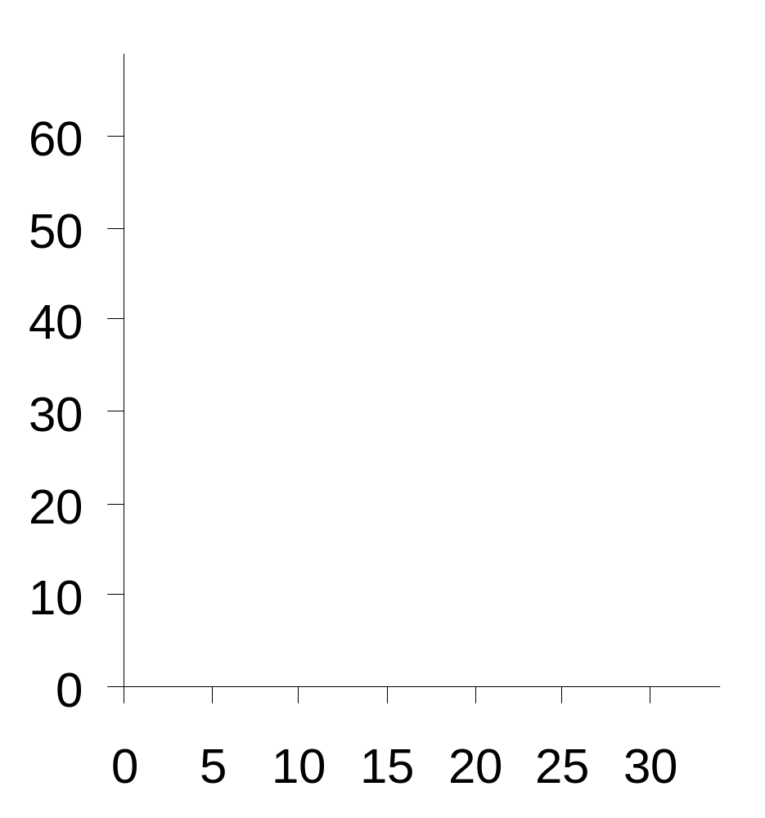
许多消费者的剩余与一条光滑的需求曲线
当 Q = 5(千双), 边际买者为每双鞋的支付意愿是$50
如果 P = $30.
他的消费者剩余
= $20.
对鞋的需求
每双鞋的价格
P
$
千双
D
Q
消费者、生产者与市场效率
Notes:
In “normal” or edit mode, the text appears to overlap with the vertical axis label. Don’t worry – in “Slide Show” or presentation mode, the axis labels disappear before the text appears.

Slide 15
许多消费者的剩余与一条光滑的需求曲线
消费者剩余是买者愿意为一种物品支付的量减去其为此实际支付的量
复习：三角形的面积 =½ x 底 x 高
高 =$60 – 30 = $30.
所以
CS = ½ x 15 x $30
= $225
对鞋的需求
P
$
h
D
Q
消费者、生产者与市场效率
Notes:
Some students mistake the upper vertical intercept ($60 in this example) for the height of the blue triangle: they forget to subtract off the height of the bottom of the triangle from the height of the top of the triangle. So, the first one or two times, it might be worthwhile to show them how to find the height of the triangle.

Slide 16
更高的价格如何减少消费者剩余
如果价格上升到$40,
CS = ½ x 10 x $20
= $100.
消费者剩余减少的两个原因：
P
1. 一些买者离开市场
2. 留在市场中的买者支付更高的价格
D
Q
消费者、生产者与市场效率
Notes:
The book shows how a lower price increases CS.

Slide 17
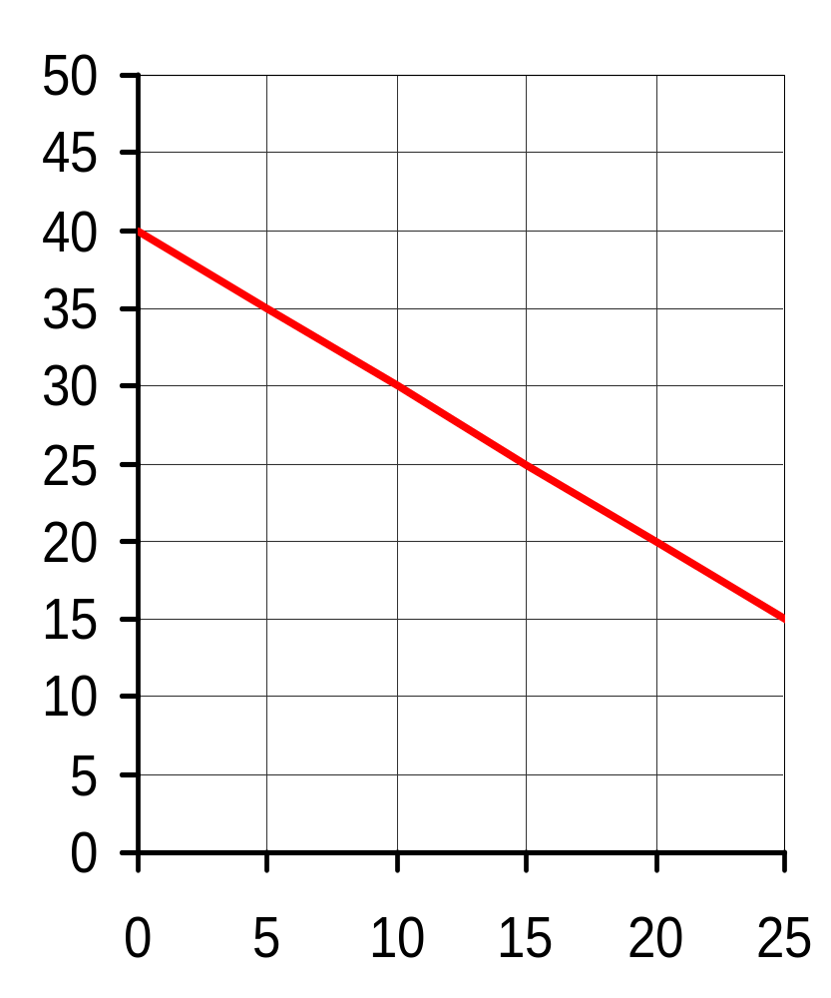
主动学习 1
消费者剩余
需求曲线
P
A. 找出边际买者在
Q = 10的支付意愿
B. 计算在 P = $30时的消费者剩余
$
如果价格降到$20，消费者剩余会增加多少……
C. 新进入市场的买者
D. 已进入市场的买者能以更低的价格购买
Q

Slide 18
主动学习 1
参考答案
需求曲线
P
A. 在 Q = 10, 边际买者的支付意愿为 $30.
B. CS = ½ x 10 x $10
= $50
$
价格降到 $20
C. 新进入市场买者的消费者剩余
= ½ x 10 x $10 = $50
D. 已进入市场买者由于价格下降而增加的消费者剩余
= 10 x $10 = $100
Q

Slide 19
成本与供给曲线
成本：卖者为了生产一种物品所放弃的其他东西的价值（也是机会成本）
包括所有用于生产物品的资源的成本和卖者对于他们自己时间的评价
例如：三个提供除草服务卖者的成本
人名 | 成本
小白 | $10
小青 | 20
小敏 | 35
只有价格高于成本，一个卖者才会生产和出售物品或服务，
因此，成本衡量了（最低的）出售意愿
消费者、生产者与市场效率

Slide 20
成本与供给曲线
P
Q^{s}
根据成本数据画出供给表：
$0 – 9
0
人名 | 成本
小白 | $10
小青 | 20
小敏 | 35
10 – 19
1
20 – 34
2
35 及以上
3
消费者、生产者与市场效率
Notes:
Your students should be able to figure out how to get the Q^{s} numbers in the second column of the table.

Slide 21
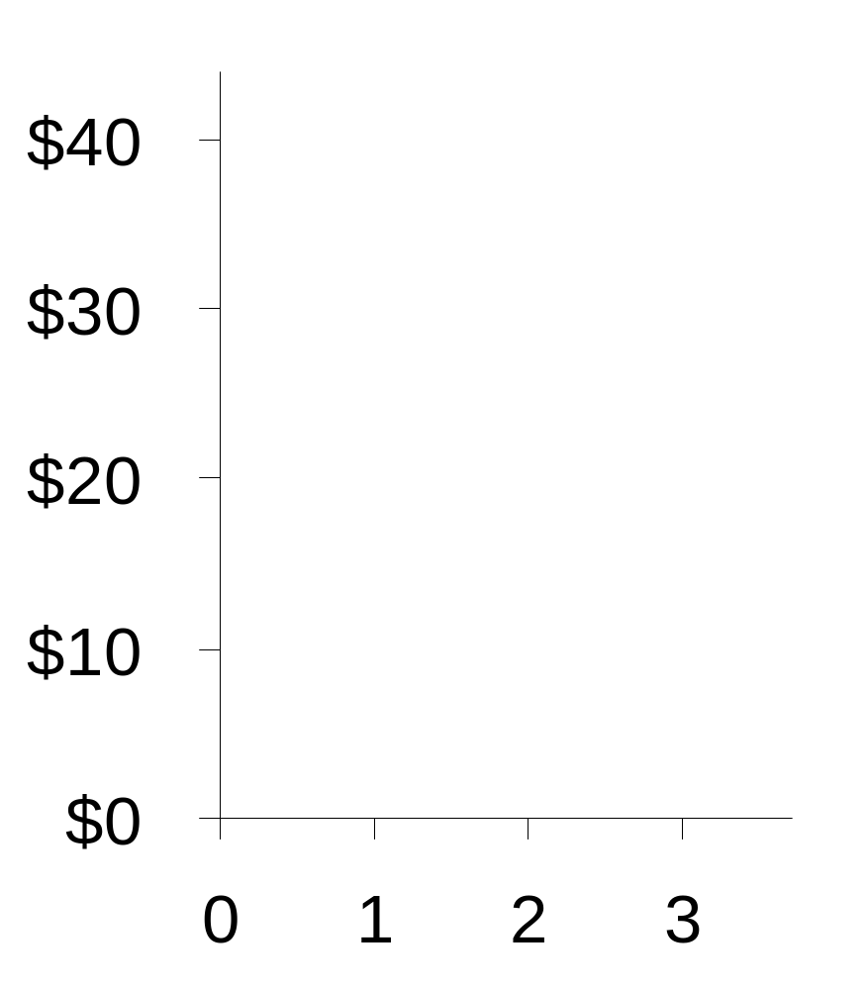
成本与供给曲线
P
P | Q^{s}
$0 – 9 | 0
10 – 19 | 1
20 – 34 | 2
35 及以上 | 3
Q
消费者、生产者与市场效率
Notes:
The derivation of the staircase-supply curve is analogous to that of the staircase demand curve in the earlier example. Hence, the animation is not as detailed.

Slide 22
成本与供给曲线
P
在每个数量，供给曲线的高度是边际卖者的成本
边际卖者：如果价格再低一点就首先离开市场的卖者
小敏的成本
小青的成本
小白的成本
Q
消费者、生产者与市场效率
Notes:
For your students’ future reference, you might also note that we can use the term “marginal cost” as short-hand for “cost of the marginal seller.”

Slide 23
生产者剩余
P
PS = 价格– 成本
生产者剩余 (PS)：卖者出售一种物品得到的量减去其生产成本
Q
消费者、生产者与市场效率

Slide 24
生产者剩余与供给曲线
P
PS = 价格 – 成本
如果 P = $25.
小白的 PS = $15
小青的PS = $5
小敏的PS = $0
总生产者剩余
= $20
小敏的成本
小青的成本
小白的成本
总生产者剩余等于价格以下和供给曲线以上的面积
Q
消费者、生产者与市场效率

Slide 25
许多卖者的生产者剩余与光滑的供给曲线
每双鞋的价格
P
鞋的供给
如果 P = $40
在Q = 15(千双), 边际卖者的成本是$30，
她的生产者剩余为$10
S
千双
Q
消费者、生产者与市场效率

Slide 26
许多卖者的生产者剩余与光滑的供给曲线
生产者剩余是价格以下和供给曲线以上的面积
这个三角形的高度
= $40 – 15 = $25.
因此,
PS = ½ x b x h
= ½ x 25 x $25
= $312.50
鞋的供给
P
S
h
Q
消费者、生产者与市场效率

Slide 27
更低的价格如何减少生产者剩余
如果价格降到$30,
PS = ½ x 15 x $15
= $112.50
生产者剩余减少的原因两个原因：
P
1. 卖者离开市场减少的生产者剩余
S
2. 仍留在市场的卖者只能得到更低的价格所引起生产者剩余的减少
Q
消费者、生产者与市场效率

Slide 28
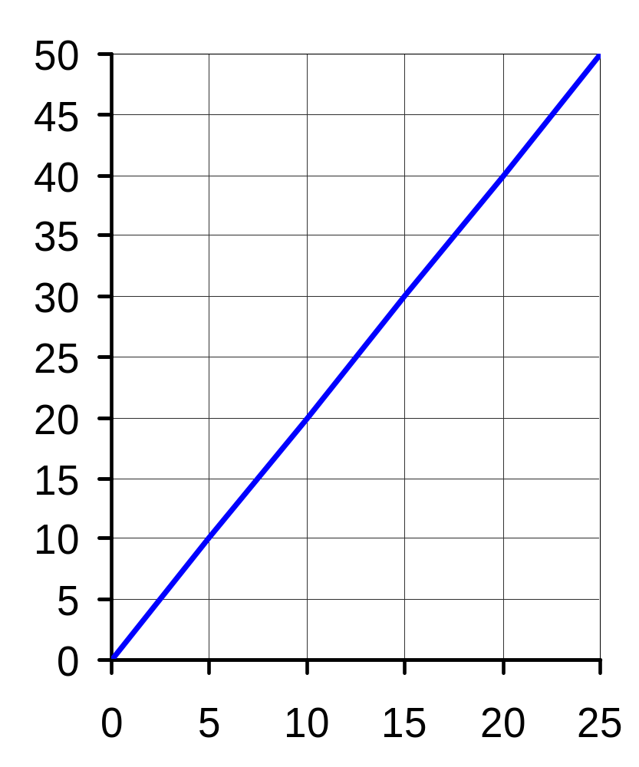
主动学习 2
生产者剩余
供给曲线
P
A. 找出边际卖者在Q = 10时的成本
B. 计算P = $20时的总生产者剩余
如果价格上升到$30，计算下列情况下的生产者剩余：
C. 多售出5个单位物品所增加的生产者剩余
D. 最初10个单位物品在更高价格下增加的生产者剩余
Q

Slide 29
主动学习 2
参考答案
供给曲线
P
A. 在Q = 10时,边际成本
= $20
B. PS = ½ x 10 x $20
= $100
价格上升到 $30
C. 多售出5个单位所增加的PS
= ½ x 5 x $10= $25
D. 最初10个单位所增加的生产者剩余
= 10 x $10 = $100
Q

Slide 30
消费者剩余、生产者剩余与总剩余
CS = (买者的评价) – (买者支付的量)
= 买者参与市场得到的收益
PS = (卖者得到的量) – (卖者的成本)
= 卖者参与市场得到的收益
总剩余 = CS + PS
= 参与市场贸易得到的总收益
= (买者的评价) – (卖者的成本)
消费者、生产者与市场效率
Notes:
It might help to say “participating in the market” means buying and selling.
It might also help to say that CS measures the net benefit to buyers: the value they get from the good is the gross benefit, minus what they pay leaves the net benefit, or CS. Similarly, PS is the net benefit to sellers. I did not put “net benefit” on this slide because it is not in the book. But if you wish, you may add it.
After showing this slide in class, I show my students a short scene from the movie “Pretty Woman” as an example of these concepts. In this scene, Julia Roberts is taking a bubble bath in Richard Gere’s hotel room (don’t worry – there’s no nudity!). Gere comes into the bathroom and they negotiate a price for her to “be at his beck and call” for one week. After bargaining for a few seconds, they agree on a price of $3000. A minute later, he says he would have paid $4000 (his willingness to pay), and she says she would have accepted $2000 (her “cost”). From this, we can deduce that CS = $1000, PS = $1000, and total surplus = $2000. If this transaction did not occur, then these characters would not have received these “gains from trade.”
Disclaimer: We officially urge you to consult with your institution’s legal advisor to verify that showing this brief clip in your class does not violate any copyright laws. We accept no responsibility in this matter. For example, we absolutely do not recommend that you rent “Pretty Woman” on DVD, download a free evaluation copy of a program like AoA DVD Ripper from the website www.aoamedia.com, and use that software to create a video clip of the above-described segment of Pretty Woman from the DVD, a video clip which could then be moved to the computer in your classroom to be shown in your classroom presentation of this chapter. We urge you to respect the intellectual property of others, and all copyright laws.

Slide 31
资源的市场配置
市场经济中，资源的配置是由许多分散自利的买者与卖者相互作用决定的
市场对资源的配置是合意的吗？还存在另一个不同的配置方法能使社会更好吗？
为回答这个问题，我们使用总剩余作为衡量社会福利的指标，我们也考虑市场配置是否有效率
（尽管这里我们主要关注效率 ，但政策制定者同样关注公平）
消费者、生产者与市场效率
Notes:
Is the market’s allocation of resources desirable? This question is important, because the answer to it has implications for the proper role and scope of government.
If the market’s allocation is generally desirable, then the role of government should be limited to the protection of property rights, national defense and so forth. If not, then public policy may potentially be able to improve upon the market’s allocation.

Slide 32
效率
总剩余
= (买者的评价) – (卖者的成本)
如果资源配置使总剩余最大化，那我们可以说，这种配置表现出效率。效率意味着：
  物品是由对这种物品评价最高的买者消费
  物品是由生产这种物品成本最低的卖者生产
  增加或减少这种物品的数量并不会事总剩余增加
消费者、生产者与市场效率

Slide 33
市场均衡的评价
市场均衡：
P = $30
Q = 15,000
总剩余
= CS + PS
市场均衡有效率的?
P
S
CS
PS
D
Q
消费者、生产者与市场效率

Slide 34
谁会消费物品？
支付意愿≥ $30的买者会购买
支付意愿< $30 的买者不会买
因此, 对物品评价最高的买者就是最终消费物品的人
P
S
D
Q
消费者、生产者与市场效率
Notes:
It may be worth reminding your students that, at each Q, the height of the D curve is the marginal buyer’s valuation of the good. Hence, the buyers from 0 to 15 all value the good at least as much as the price, so they will purchase the good at the market price.
The buyers from 15 on up value the good less than $30, so they won’t buy the good.

Slide 35
谁会生产物品?
成本≤ $30的卖者会生产物品
成本> $30的卖者不会生产物品
因此,具有最低生产物品成本的卖者会生产物品
P
S
D
Q
消费者、生产者与市场效率
Notes:
Because the height of the S curve tells us seller’s costs, we can determine the following:
The sellers of the first 15 units have cost < $30, so it is worthwhile for them to produce the good.
The other sellers have cost > $30, so they will not sell the good if P = $30.

Slide 36
市场均衡产量最大化总剩余了吗?
在Q = 20,生产物品的边际成本是$35
消费者对物品的边际评价是$20
这时，降低产量能增加总剩余.
P
S
D
Q
消费者、生产者与市场效率
Notes:
This slide shows that, if we are starting from a Q greater than the market equilibrium quantity, we can increase total surplus by reducing Q. The slide demonstrates this for one particular Q (20), but it is true for any Q greater than the equilibrium quantity.
Thus, if we continue to reduce Q, total surplus will continue to increase – until we get to the equilibrium quantity.

Slide 37
市场均衡产量最大化总剩余了吗?
在Q = 10,
生产物品的边际成本是$25
消费者对物品的边际评价是$40
这时，增加产量能增大总剩余.
P
S
D
Q
消费者、生产者与市场效率
Notes:
This slide shows that, if we are starting from a Q less than the market equilibrium quantity, we can increase total surplus by increasing Q. The slide demonstrates this for one particular Q (10), but it is true for any Q below the equilibrium quantity.
Thus, if we continue to increase Q, total surplus will continue to increase – until we get to the equilibrium quantity.

Slide 38
市场均衡产量最大化总剩余了吗?
P
市场均衡产量使总剩余最大：在其他任何产量条件，向市场均衡产量移动都能使总剩余增加
S
D
Q
消费者、生产者与市场效率
Notes:
This slide summarizes the lesson of the preceding two slides.

Slide 39
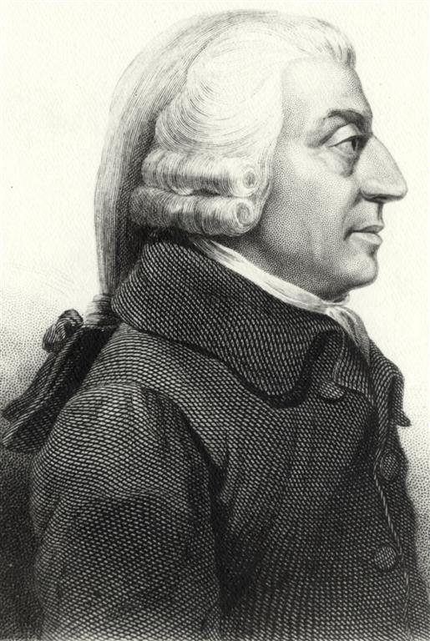
亚当.斯密与看不见的手
引自《国富论》,1776
“人类几乎随时随地都需要同胞的协助，仅仅指望他们的慷慨是徒劳的。如果他能够唤起他们的利己心，并向他们证明，他要他们做的事情也对他们有利，那他更有可能成功……
我们想要的食品，不是出自屠户、酿酒人或面包师的仁慈，而是出于他们对自身利益的关心……”
亚当.斯密，1723-1790
消费者、生产者与市场效率
Notes:
This and the following slide contain passages from The Wealth of Nations. It would be hard to overstate the impact of the ideas in these passages.
I have included them here because students should be able to better understand and appreciate their significance after having just seen the analysis of market efficiency.
If you’re pressed for time, you might delete the first of these two slides, as it is probably less important than the second one. The passages on this first slide convey the sense that the economy is made up of a completely uncoordinated mass of individuals, each acting in his or her own self interest. On the next slide, Smith discusses the invisible hand.

Slide 40
亚当.斯密与看不见的手
引自《国富论》,1776
“每个人都力图用好他的资本，使其产出能实现最大的价值。一般说来，他既不企图增进公共福利，也不知道他能够增进多少。他所追求的仅仅是一己的安全或私利。但是，在他这样做的时候，有一只看不见的手在引导着他去帮助实现另外一种目标，尽管该目标并非是他的本意。追逐个人利益的结果，是他经常的增进社会的利益，其效果要比他真的想要增进社会的利益会更好”。
亚当.斯密，
1723-1790
消费者、生产者与市场效率

Slide 41
自由市场与政府干预
市场均衡是有效率的，任何其他结果的总剩余都不会高于市场均衡产量的总剩余
政府不能通过改变资源的市场配置方法而增加总剩余
自由放任 (法语的意思是“让他们自由行事吧”)：表达了政府不应该干预市场的主张
消费者、生产者与市场效率

Slide 42
自由市场与政府干预
如果资源不是由市场来配置，而是由一个关心社会福利的中央计划者来配置
为了达到资源配置的有效率和最大化总剩余，计划者需要知道市场中每个特定物品对每个潜在消费者的价值和每个潜在生产者的成本
这个任务实际上是不可能完成的，这就解释了为什么中央计划经济没有效率
消费者、生产者与市场效率
Notes:
Example of central planner: the Communist leaders of the former Soviet Union.

Slide 43
结论
本章用福利经济学来证明了经济学十大原理之一：
市场通常是组织经济活动的一种好方法
重要的注释：
这些观点都是在假定完全竞争市场基础上推导出来的
我们将在接下来的章节中学习其他情况：市场也可能使资源配置无效率……
消费者、生产者与市场效率

Slide 44
结论
市场失灵出现在：
  一个买者或卖者具有市场势力—影响市场价格的能力
  交易具有副作用—外部性，会影响旁观者的福利（比如污染）
我们将用福利经济学分析，在这些情况下，公共政策如何改善市场结果
尽管存在市场失灵的可能，本章的分析在许多市场里都适用，看不见的手仍然非常重要
消费者、生产者与市场效率
Notes:
The italicized terms market power and externalities will be formally defined in later chapters.

Slide 45
内容提要：
需求曲线的高度反应了物品对于买者的评价—他们对它的支付意愿
消费者剩余等于买者对于一种物品的支付意愿减去其实际为此支付的量
在图形上，消费者剩余是需求曲线以下和价格以上的面积

Slide 46
内容提要：
供给曲线的高度反应了卖者生产物品的成本。只有物品的价格至少高于它们的成本时，卖者才会愿意出售它们
生产者剩余等于卖者出售其物品等到的量减去其生产成本
在图形上，生产者剩余是价格以下和供给曲线以上的面积

Slide 47
内容提要：
我们使用总剩余—消费者剩余和生产者剩余之和来衡量生活的福利
效率意味着总剩余最大化，也就是说物品由具有最低成本的卖者生产，由对它们评价最高的买者消费
在完全竞争条件下，市场结果是有效率的。改变这个结果会减少总剩余

