Slide 1

应用：赋税的代价
8
经济学原理
N.格里高利.曼昆 著
Premium PowerPoint Slides
by Ron Cronovich

Slide 2

本章我们将探索这些问题的答案：
税收如何影响市场结果？对买者还是卖者征税对市场结果有什么不同吗？
什么是税收归宿？
税收怎样影响消费者剩余，生产者剩余和总剩余？
什么是税收的无谓损失？
Notes:
When we talk about how a policy “affects the market outcome,” we mean the policy’s impact on the price and quantity of the good and therefore on the market’s allocation of resources. The concluding slide elaborates on this a bit.

Slide 3
税收
政府对许多物品与劳务征税是为了给国防，公立学校等这类公共项目筹资
税收可以是物品价格的一个比例或者每售出一单位物品需支付一定数量的货币
  简化起见，我们仅分析后者
政府能向买者或卖者征税
谁实际承担了税收？向买者征税和向卖者征税会有不同吗？
供给、需求与政府政策
Notes:
The slides in this section have been revised from the previous edition. They now better explain why a tax on buyers shifts D down by the amount of the tax, and why a tax on sellers shifts S up by the amount of the tax.

Slide 4
例 子: 皮萨市场
P
没有税收时的均衡
S₁
$10.00
D₁
Q
500
供给、需求与政府政策

Slide 5
向买者征税
现在买者支付的价格比市场价格要高$1.50
为使买者购买相同多的数量，价格需下降$1.50
例：要使买者仍愿意购买500个，市场价格需从 $10.00下降到$8.50
对买者征税使需求曲线向下移动，其幅度为税收量
向买者征收$1.50的税收
P
S₁
$10.00
税收
$8.50
D₁
D₂
Q
500
供给、需求与政府政策
Notes:
NOTE: On this and subsequent slides, “P_{B}” denotes the price buyers pay and “P_{S}” denotes the price sellers receive. (The Chapter 8 PowerPoint uses the same notation for the welfare analysis of taxes.)
The government makes buyers pay a $1.50 on each pizza they purchase. The new demand curve (in red, labeled D₂) reflects buyers’ demand as a function of the after-tax price. The original demand curve (D₁) still reflects buyers’ demand as a function of the total price – inclusive of the tax.
Thus, buyers’ demand hasn’t really changed: at each quantity, the height of the original (blue) D curve is still the maximum that buyers will pay for that quantity, while the height of the new (red) D curve is the maximum that buyers will pay sellers for that quantity, given that buyers also must pay the tax. At any Q, the vertical distance between the blue and red D curves equals the tax.
(If this were a percentage tax rather than a per-unit tax, the new D curve would not be parallel to the old one, it would be flatter: a tax of a given percentage would be a larger dollar amount at high prices than at low prices, so the downward shift would be greater in absolute terms when P is high than when it is low. This is the type of complexity we avoid by working with per-unit taxes.)

Slide 6
向买者征税
新均衡：
Q = 450
卖者得到的价格：
P_{S} = $9.50
买者支付的价格：
P_{B} = $11.00
两者之差
= $1.50 = 税收
向买者征收$1.50的税收
P
S₁
P_{B} =
$11.00
税收
$10.00
P_{S} =
$9.50
D₁
D₂
Q
450
500
供给、需求与政府政策

Slide 7
税收归宿：
税收负担在市场参与者之间进行分配的方式
P
在我们的例子中，
买者支付
$1.00的税收
卖者支付
$0.50 的税收.
S₁
P_{B} =
$11.00
税收
$10.00
P_{S} =
$9.50
D₁
D₂
Q
450
500
供给、需求与政府政策
Notes:
“Market participants” simply means buyers and sellers.

Slide 8
向卖者征税
税收增加了卖者的成本
$1.50
卖者只有在市场价格上升到$11.50时才愿意出售500个匹萨，因为只有如此才能弥补成本的增加
向卖者征税$1.50
P
S₂
$11.50
税收
S₁
$10.00
D₁
因此，对卖者征税使供给曲线向上移动，移动幅度为税收量
Q
500
供给、需求与政府政策
Notes:
The government makes sellers pay a $1.50 on each pizza they sell. The new, red supply curve reflects sellers’ supply as a function of the after-tax price.

Slide 9
向卖者征税
新的均衡：
Q = 450
买者支付
P_{B} = $11.00
卖者得到
P_{S} = $9.50
两者之差
= $1.50 = 税收
向卖者征税$1.50
P
S₂
S₁
P_{B} =
$11.00
税收
$10.00
P_{S} =
$9.50
D₁
Q
450
500
供给、需求与政府政策

Slide 10
两种情况下结果是相同的!
无论对买者还是卖者征税，最后的市场价格，均衡数量以及税收归宿都是相同的！
在这两种情况下：税收都在买者支付的价格和卖者得到的价格之间打入了一个契子
P
S₁
P_{B} =
$11.00
税收
$10.00
P_{S} =
$9.50
D₁
Q
450
500
供给、需求与政府政策
Notes:
Whether the government makes buyers or sellers pay the tax, all of the effects are the same:
- the price buyers pay rises (in this case to $11)
- the price sellers receive falls (to $9.50)
- the equilibrium quantity falls (to 450)
- the incidence of the tax is the same (here, buyers pay $1 of the tax, while sellers pay $.50 of the tax on each unit)
This should make sense if students think it through: A tax on buyers means buyers will have to pay more, which causes their demand to fall. The fall in demand hurts sellers, forcing them to reduce their price. Similarly, a tax on sellers is like a cost increase, and sellers pass along a portion of that increase to buyers in the form of higher prices.
The equivalence of taxes on buyers and taxes on sellers means that we can ignore whether the tax is imposed on buyers or sellers. All that matters is the size of the tax.
So, in future problems, we can think of the tax as a wedge between the price buyers pay and the price sellers receive. On a supply-demand diagram, this wedge is a vertical line segment (shown in green on this graph). You can think of taking a toothpick the size of the tax and wedging it between the S and D curves. The quantity at which the toothpick fits just snuggly is the new equilibrium quantity. Students will have a chance to practice this in a moment with an exercise.
One last remark: Someone once said “if you want less of something, tax it.” A tax on any good or service causes a fall in its quantity. This is because people respond to incentives:
the tax gives buyers an incentive to buy less and gives sellers an incentive to produce less.

Slide 11
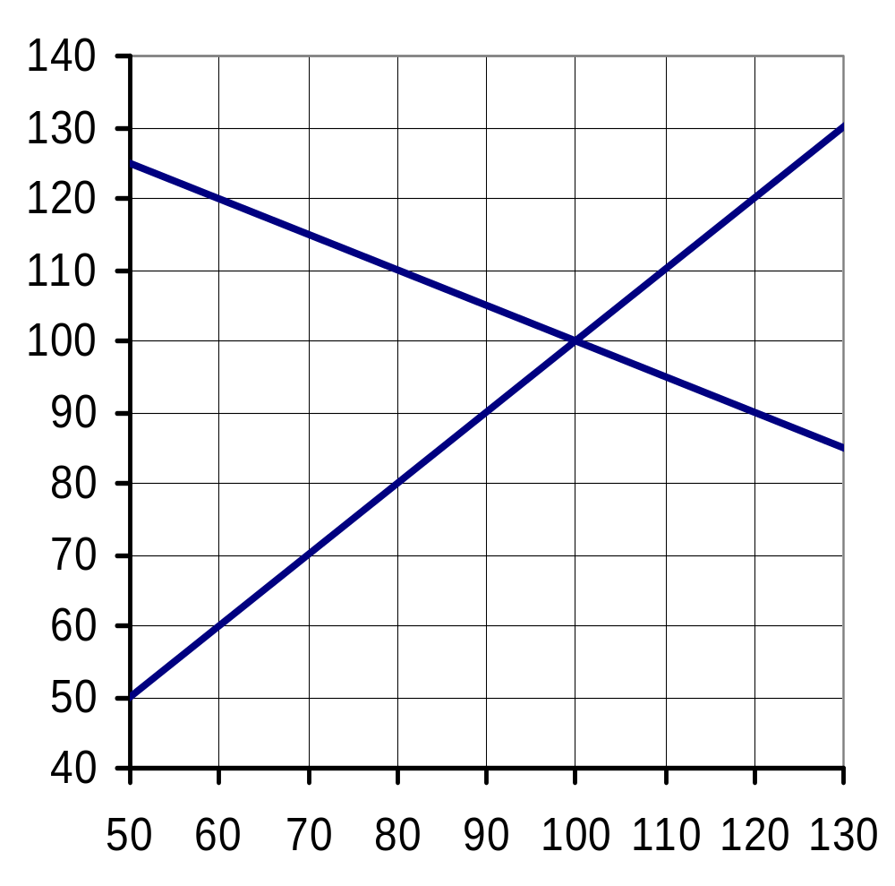
主动学习 2
税收的影响
宾馆住房的市场
P
假定政府对买者所入住的每个房间都征税$30
找出新的
Q, P_{B}, P_{S},
以及税收归宿
S
D
0
Q
Notes:
These are the same supply and demand curves used in the previous exercise.

Slide 12
主动学习 2
参考答案
宾馆住房市场
P
S
Q = 80
P_{B} = $110
P_{B} =
P_{S} = $80
税收
P_{S} =
D
税收归宿
  买者：$10
  卖者：$20
0
Q
Notes:
First, the equilibrium quantity is the quantity where P_{B} – P_{S} = $30. This quantity is 80.
Next, to find P_{B}, start at Q=80 and go up to the demand curve to see that P_{B} = $110.
To find P_{S}, start at Q=80 and go up to the supply curve to see that P_{S} = $80.
To find incidence, just compare P_{B} and P_{S} to the no-tax equilibrium price, $100.

Slide 13
税收效应
没有税收时的均衡：
价格 = P_{E}
均衡数量= Q_{E}
P
税收规模 = $T
S
P_{B}
每单位物品征税$T时的均衡：
P_{E}
买者支付 P_{B}
P_{S}
D
卖者得到P_{S}
均衡数量 = Q_{T}
Q
Q_{T}
Q_{E}
应用：赋税的代价

Slide 14
税收效应
下面我们应用福利经济学来衡量从税收中得到的收益与损失
我们计算有税收与没有税收时的消费者剩余，生产者剩余，税收收入以及总剩余
税收能为对公众有利的服务提供资金支持（比如教育，公路，警察），因此我们把它算入总剩余
应用：赋税的代价
Notes:
If you wish, you may delete this slide and give the information verbally at the beginning of the next slide.

Slide 15
税收效应
没有税收时：
P
CS = A + B + C
PS = D + E + F
A
税收收入 = 0
S
B
C
总剩余
= CS + PS
= A + B + C
+ D + E + F
P_{E}
D
E
D
F
Q
Q_{T}
Q_{E}
应用：赋税的代价

Slide 16
税收效应
有税收时,
P
CS = A
PS = F
A
税收收入
= B + D
S
P_{B}
B
C
总剩余
= A + B
+ D + F
E
D
P_{S}
D
F
税收使总剩余减少 C + E
Q
Q_{T}
Q_{E}
应用：赋税的代价

Slide 17
税收效应
P
C + E 被称为税收的无谓损失：市场扭曲（例如税收）引起的总剩余减少
A
S
P_{B}
B
C
D
E
P_{S}
D
F
Q
Q_{T}
Q_{E}
应用：赋税的代价

Slide 18
无谓损失
由于税收，在
Q_{T} 与 Q_{E} 单位之间的物品没有被售出
买者对于这些单位物品的评价高于生产它们的成本，因此税收使一些对买者和卖者都有利的交易未能实现
P
S
P_{B}
P_{S}
D
Q
Q_{T}
Q_{E}
应用：赋税的代价

Slide 19
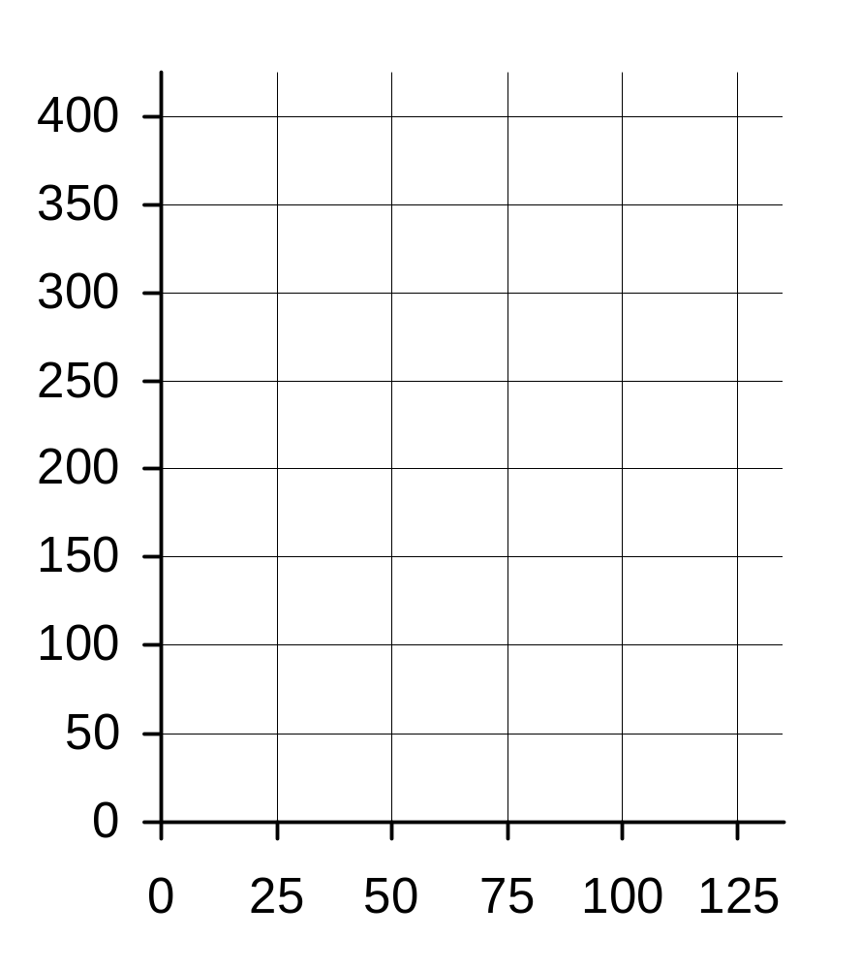
主动学习 1
税收分析
机票市场
P
A. 计算没有税收时的CS, PS，以及总剩余
B. 如果每张机票征税$100，计算：
CS, PS,税收收入，总剩余以及无谓损失
$
S
D
Q
Notes:
In chapter 7, students learned how to compute the area of triangles representing CS, PS, and total surplus. This skill is required to do this exercise.
Most students will need a calculator to do part B.
Your students need not draw the graph in order to do these calculations. However, if your students are using the gutted student handouts we provide to accompany the Premium PowerPoint presentations, they will have parts of the graph on their handouts. Ask your students to shade the areas corresponding to CS, PS, tax revenue and DWL directly on the printed graphs.

Slide 20
主动学习 1
参考答案：A
机票市场
P
CS
= ½ x $200 x 100
= $10,000
$
S
PS
= ½ x $200 x 100
= $10,000
P =
D
总剩余
= $10,000 + $10,000
= $20,000
Q

Slide 21
主动学习 1
参考答案：B
对每张机票征税$100
P
CS
= ½ x $150 x 75
= $5,625
$
PS = $5,625
S
P_{B} =
税收收入
= $100 x 75
= $7,500
P_{S} =
D
总剩余
= $18,750
Q
无谓损失
= $1,250
Notes:
To compute DWL, simply subtract total surplus with the tax ($18750) from total surplus without the tax ($20,000, which was computed on the preceding slide).
Equivalently, compute the area of the blue shaded triangle:
½ x (100-75) x ($250 – $150) = $1250.

Slide 22
无谓损失与税收规模
P
新的无谓损失
最初，每单位物品征税T
双倍征税
S
使无谓损失的增加超过一倍
2T
T
D
最初的无谓损失
Q
Q₂
Q₁
应用：赋税的代价
Notes:
The new DWL is four times the initial DWL, even though the tax is just twice as large.

Slide 23
无谓损失与税收规模
P
新的无谓损失
最初，每单位物品征税T
三倍征税
S
使无谓损失超过原来的三倍
3T
T
D
最初的无谓损失
Q
Q₃
Q₁
应用：赋税的代价
Notes:
The new DWL is nine times the initial DWL, even though the tax is only three times as large.

Slide 24
无谓损失与税收规模
含义：
当税率低时，提高或降低税率既不会带来太大的损失，也不会带来太多的好处
当税率高时，提高税率的损失非常大，而降低税率的好处也非常明显
总结：
税收规模增加时，无谓损失增加的更快
无谓损失
税收规模
应用：赋税的代价

Slide 25
内容提要
对一种物品征税是在买者支付的价格和卖者得到的价格之间打入的一个契子，并使均衡数量降低，无论是向买者征税还是向卖者征税
税收归宿是税负在买者与卖者之间额分担，并不取决于是向买者征税，还是向卖者征税
税收归宿取决于供给与需求的价格弹性

Slide 26
内容提要
一种物品的税收使该物品买者与卖者的福利减少了，而且，消费者剩余和生产者剩余的减少常常超过了政府筹集到的收入。
总剩余---消费者剩余，生产者剩余和税收收入之和---的减少被称为税收的无谓损失
税收带来无谓损失是因为它使买者少消费，使卖者少生产，而且这种行为变动使市场规模缩小到使总剩余最大化的水平之下

Slide 27
内容提要
税收规模的增大可能使税收的无谓损失增加的更多

