Slide 1
Search Engine
CS600 Advance Algorithm
Final Project
Zijing Huang
Department of Computer Science
zhuang21@stevens.edu
2017.12.10

Slide 2
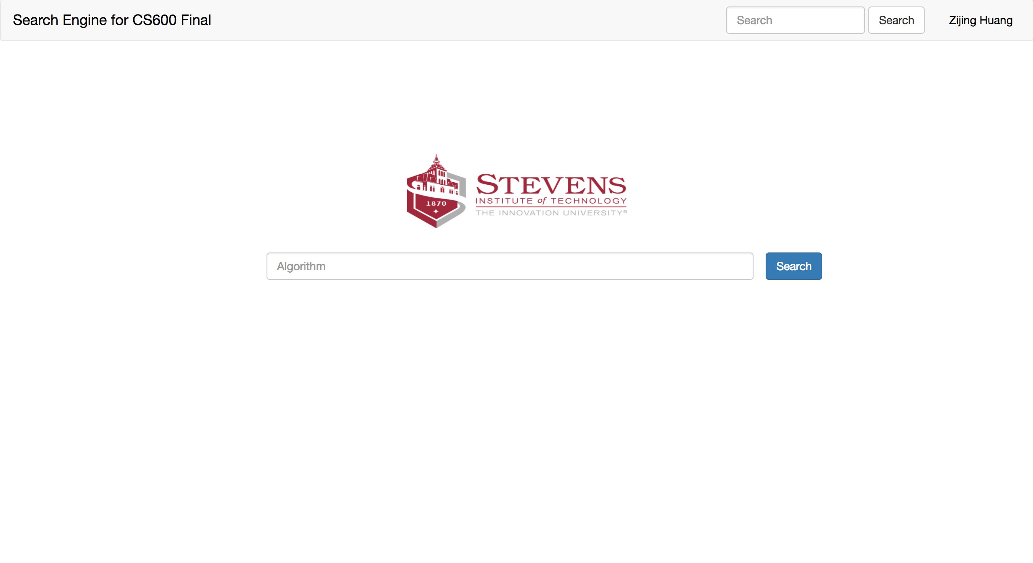

Slide 3
Zijing Huang
zhuang21@stevens.edu
201-736-5027

