Slide 1
Tweibo
A bridge between Twitter and Weibo

Slide 2
Introduction
● our ideas ● our production ● our team
Implementation
List
CONTENTS
● process ● tools and framework
Scaling
● statistics ● process Management

Slide 3

Part1
Introduction
● our ideas
● our production
● our team

Slide 4
How do we get this idea?
Actually, this is not the first idea in our brain storm. We got Two great ideas first, like a Chrome extension for RabbitMQ and a NPM add-on for a EDM system. But this is absolutely the most interesting topic that we can’t stop talking about it. So Let’s get started!
Our Formula:
1.Chinese people “like” President Trump
2.President Trump likes tweet
3.China government uses Weibo and blocks Twitter
=> How about building our own tweet channel in Weibo

Slide 5
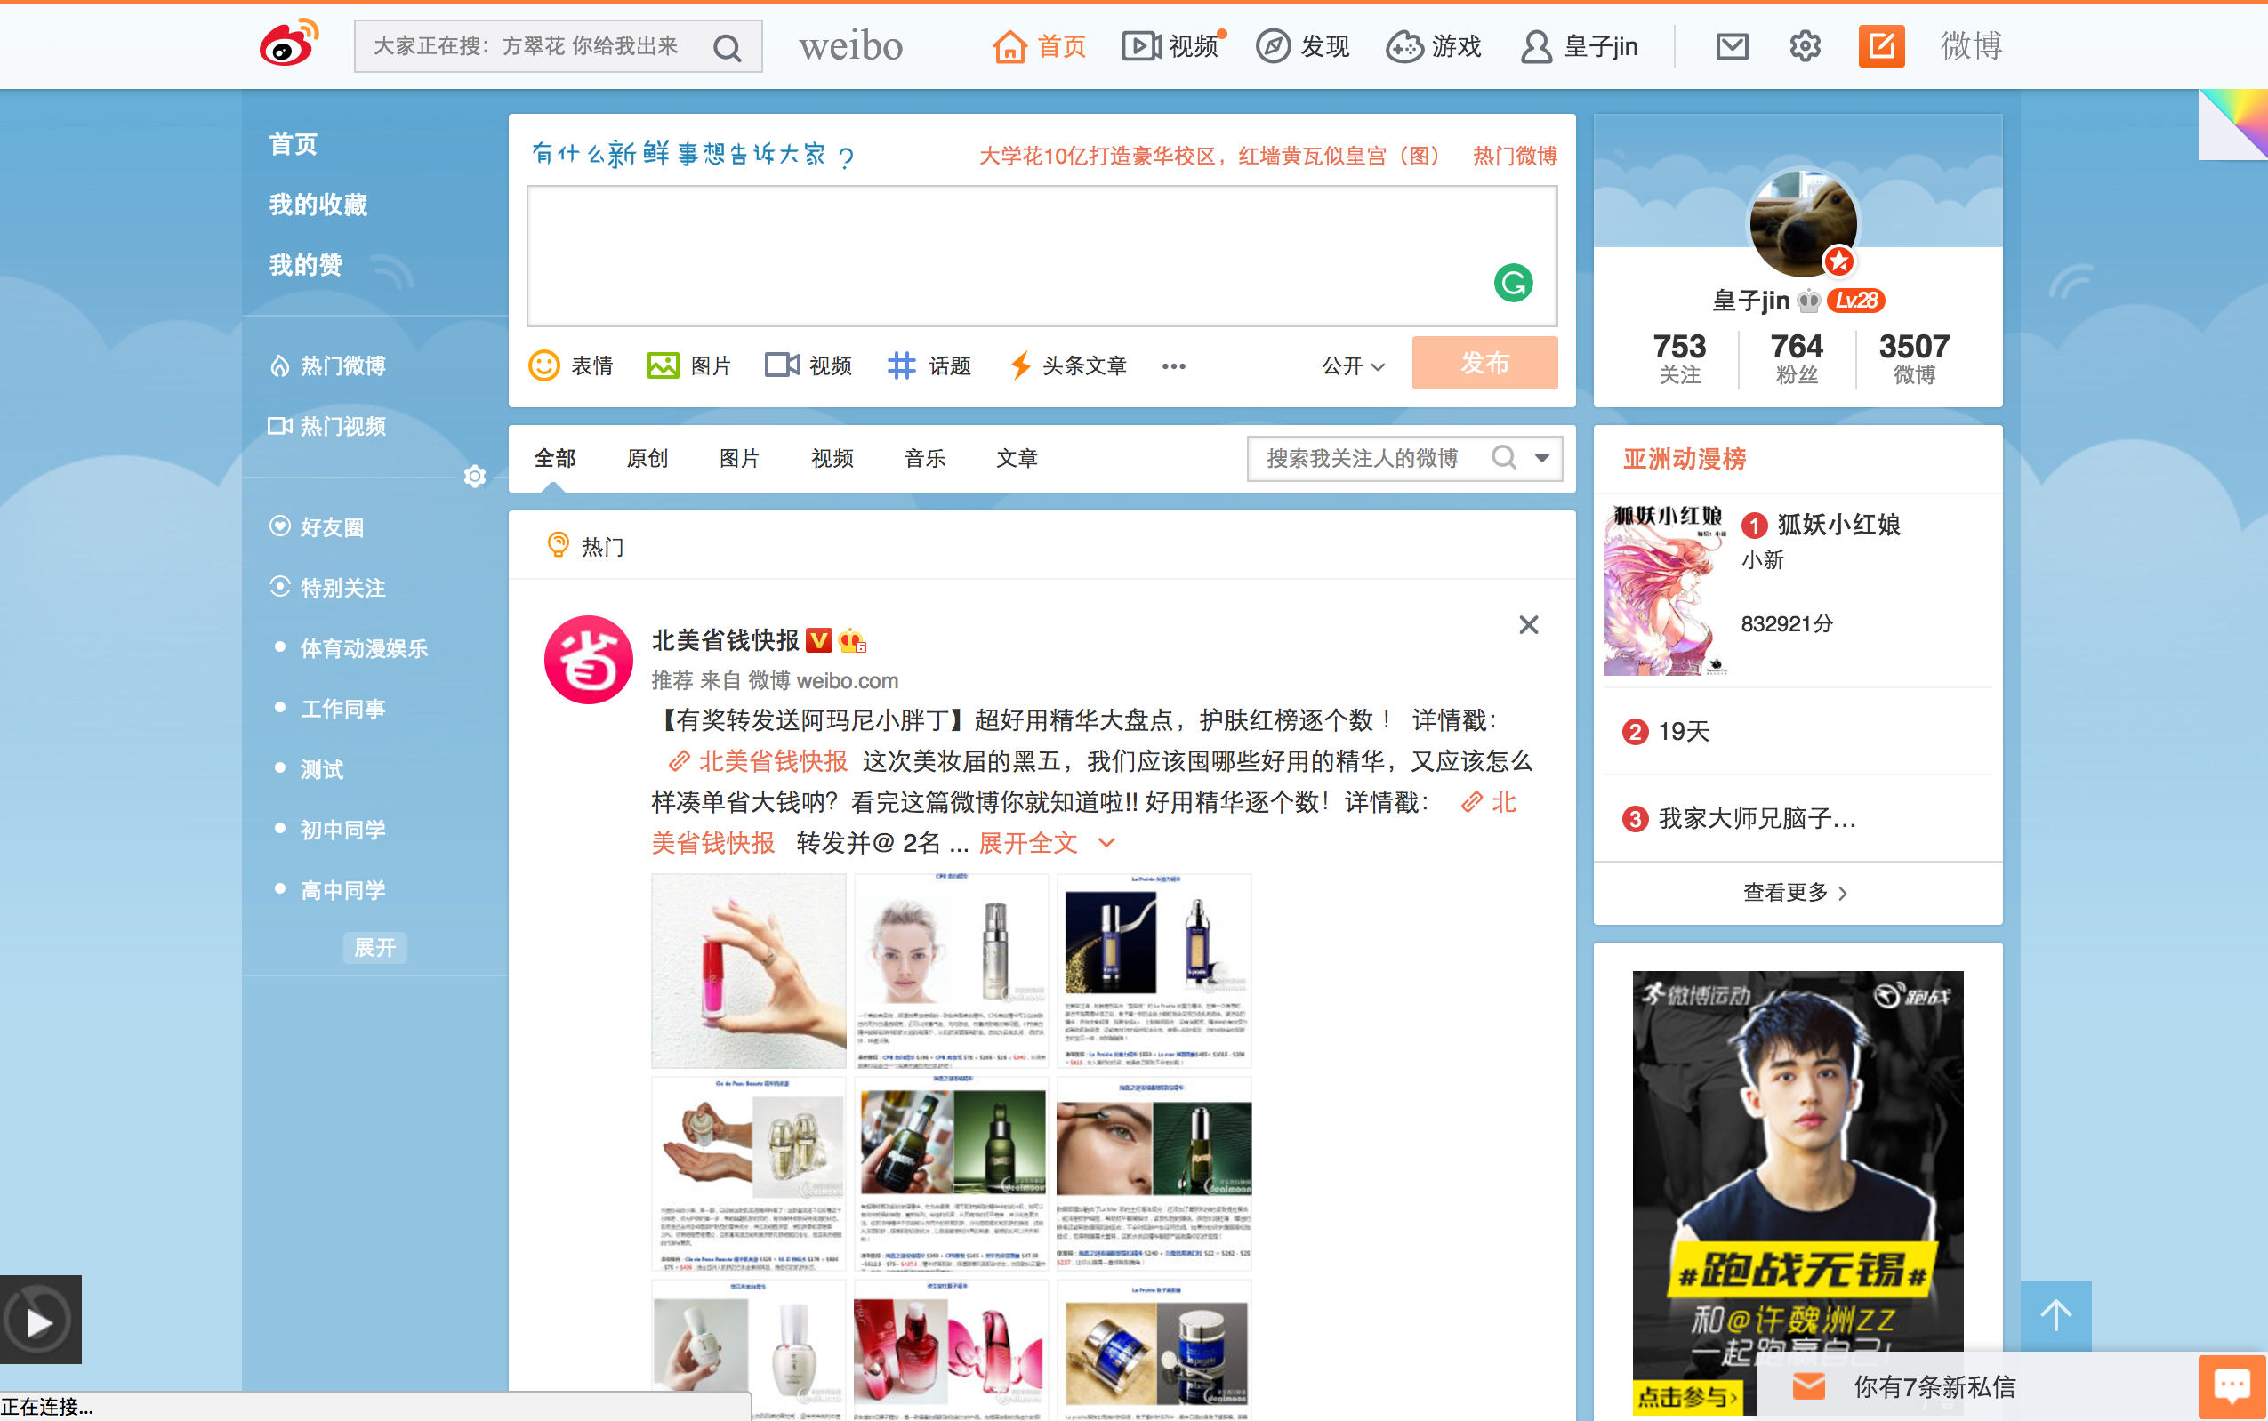
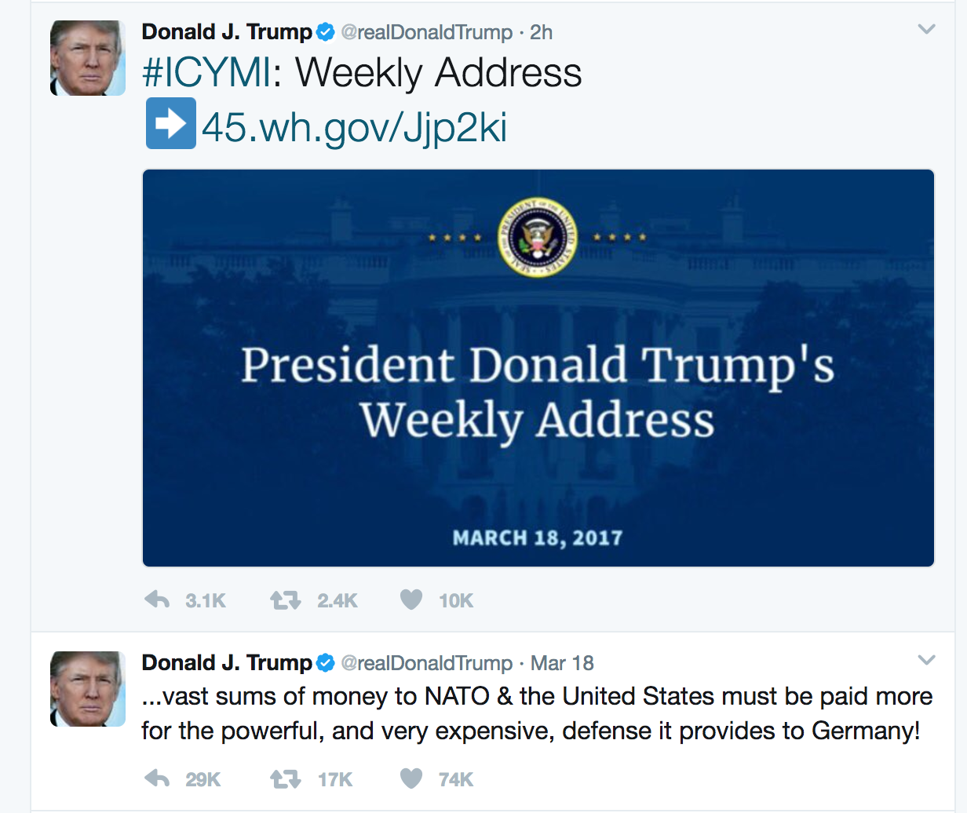
Tweibo is just like:

Slide 6
Our Production
Get targets’ feeds in twitter, put them into our database
Analysis if our targets post a new tweet
Translate and Synchronize the post to Weibo
(The next step)
We will choose the most popular comment and put it into the target’s comment
If the target reply, we will continue synchronizing.

Slide 7
Win-Win-Win
This is a 3-win Idea.
For Twitter, they get more comments.
For Weibo, they have more “celebrities” to join in.
For us, we can po some adv to earn credit lol.
For Chinese Gov, they can still control the message we send.
Even for President Trump, he can get more followers.
No one going to pay here, everyone’s winner.

Slide 8
Our Team

Slide 9

Part2
Implementation
● process
● tools and framework

Slide 10
OUR PROCESS IS EASY
Authorization
Configuration
Run Tasks

Slide 11
Step1 Authorization
Twitter
Auth
Process
Twitter
1.App-only Auth request
Tweibo
3.Store twitter acess_token
MongoDB
2.Access_token
2.Redirect with client cred
Weibo
Auth
Process
Weibo
3.Return auth_code
Tweibo
MongoDB
4.Request with auth_code
5.Return access_token
6.Store weibo access token
1.access
Robot accounts

Slide 12
Step2 Configuration
[
{
Id : 1,
t_name : realDonaldTrump,
w_name: twitter_trump,
w_id : 11111111,
t_access_token : afadsfsdaf,
w_access_token : asdfsafsdaf,
w_refresh_token : asdfsdafsad,
create_at : 123123123,
update_at : 1231231312,
post_freq : 1800,
recent_post : [
{},
…
],
{}….
}]
Tweibo
Admin
Here we can set up 2 types of configuration:
1.Robot inform
2.Task inform
CRUD
MongoDB

Slide 13
Step3 Run tasks
Cron
Daemon
monitor
worker3
3.Enqueue the task
worker1
MSQ
4.Allocate task
1.Request config
2.Return task config
worker2
MongoDB
5.Return task result

Slide 14
Independent Technologies
1.OAuth
The OAuth 2.0 authorization framework enables a third-party application to obtain limited access to an HTTP service
https://tools.ietf.org/html/rfc6749
Here we use two types of OAuth
2.React Native
With React Native, we can put our admin into IOS. Then we can control our Robots through Mobile. Amazing!

Slide 15
Course Technologies
Redis
We use Redis as a MSQ (task container) and a timer.
Workers
Suppose many tasks happened at the same time, they will stuck until the end of previous task. So we use worker to avoid this happen.
Angular 2
We need Angular 2 fast build the Admin Interface.

Slide 16

Part 3 Scaling ● statistics ● comment ● advertisement ● recommendation

Slide 17
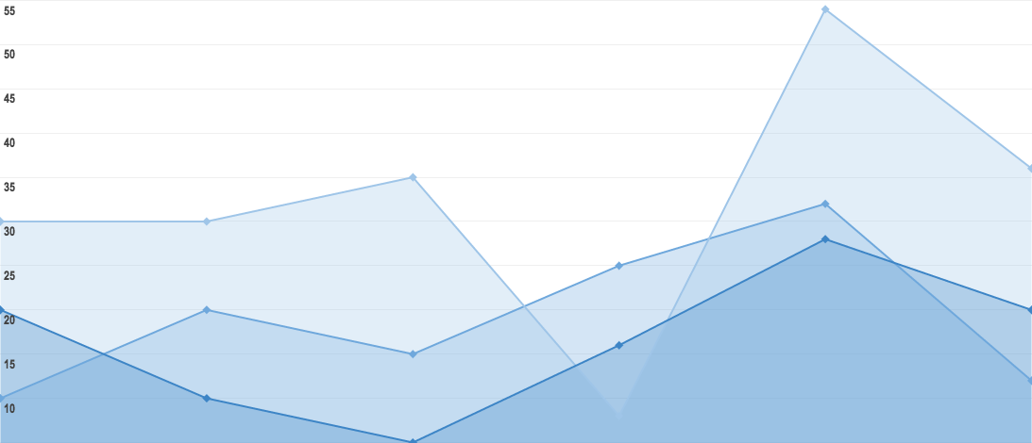
Statistics
Data we can get like:
1.Targets‘ habit of tweeting time, so we can run the update task after that
2.When Weibo user like to read and reply, we can make task that time too.
3.Give more resource to the root that user like the most.
So on and so forth.

Slide 18
Advertisement
Assume we have thousands of Robots, and we know what our user like. We can push the advertisement precisely to them and estimate the response and profit lol.

Slide 19
Recommendation
The same concept, we know what user like through what account they follow and we can recommend other robot to them.

Slide 20
THANKS!
Any questions?
You can find me at
@username
user@mail.me

Slide 21
SlidesCarnival icons are editable shapes.
This means that you can:
Resize them without losing quality.
Change fill color and opacity.
Change line color, width and style.
Isn’t that nice? :)
Examples:

Slide 22
😉
Now you can use any emoji as an icon!
And of course it resizes without losing quality and you can change the color.
How? Follow Google instructions https://twitter.com/googledocs/status/730087240156643328
✋👆👉👍👤👦👧👨👩👪💃🏃💑❤😂😉😋😒😭👶😸🐟🍒🍔💣📌📖🔨🎃🎈🎨🏈🏰🌏🔌🔑 and many more...

