Slide 1

Objective dyspnea evaluation on COVID-19 patients learning from exertion-induced dyspnea scores
1
Zijing Zhang,
PhD Candidate,
2019-Expected May 2023,
School of Electrical and Computer Engineering
Cornell University, Ithaca, NY
Notes:
Hello, welcome to my A exam. The topic of my presentation is ….

Slide 2
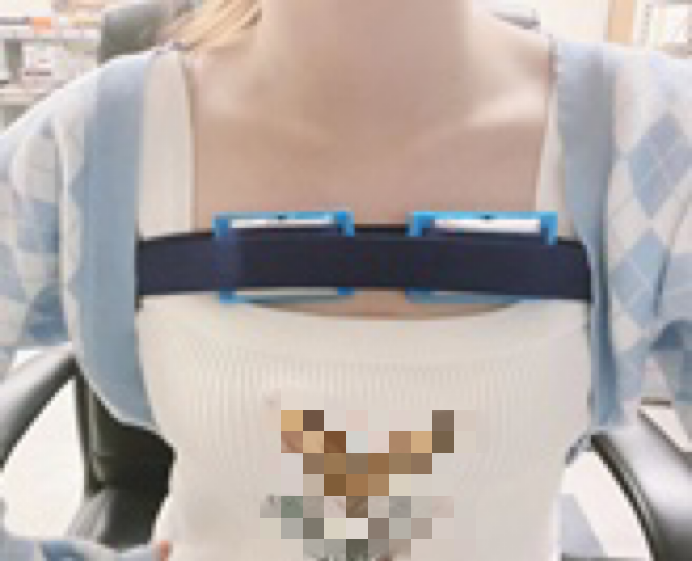
Setup
Non-invasive wearable respiratory sensors were employed to retrieve continuous respiratory characteristics with user comfort and convenience.
Overnight (~16h) respiratory waveforms were collected on 12 COVID-19 patients, and a benchmark on 13 healthy subjects with exertion-induced dyspnea were also performed for blind comparison.
 | Participants | Recording Time | Sensors
COVID | 12 COVID patients | Continuous 14 hours | Portable NCS sensors with accelerometers.
Exp. 1 | 13 healthy subjects | Normal (30 mins) Post-exercise (5 mins) | Portable NCS sensors with accelerometers.
Exp. 2 | 32 healthy subjects | Normal (5 mins) Post-exercise (5 mins) | Wearable NCS software-defined radios.
R
L
Acquisition of Different datasets

Slide 3
1D Time waveform
(a)
Waveform examples:
COVID patients;
Healthy normal baseline breathing in Exp 1;
Healthy post-exertion breathing in Exp 1;
Healthy normal breathing in Exp 2;
Healthy post-exertion breathing in Exp 2;
Min-max peak detection for respiratory parameter extraction.
(b)
(c)
(d)
(e)
IN
EX
IBI
PP
(f)

Slide 4
Data processing
Feature extraction
Instantaneous Respiratory parameters (7)
Extracted Parameters | Description
Breath Rate (BR) | Inverse of the interval between two neighboring minima.
Peak-to-Peak (PP) | Lung volume represented by signal difference in successive peaks.
Inhalation Interval (IN) | Time difference between one minimum and the following maximum.
Exhalation Interval (EX) | Time difference between one maximum and the following minimum.
Inter-Breath Interval (IBI) | Interval between two neighboring maxima.
In- Ex Ratio (IER) | Inhalation/Exhalation interval ratio.
In- Ex Volume Ratio (IEPP) | Inhalation/exhalation volume ratio.
Downsample signals to 20Hz.
Bandpass filter signals to [0.01,2] Hz.
Smooth signals by 4th-order FIR filters
Segment waveforms into epochs (T_{epoch} =60s).
5. Normalize the respiratory features in epoch
6. Feature statistics in epochs.
Respiratory features (37)
7. Select the optimal channels.
8. Remove noisy epochs.
µ_{BR} | µ_{PP} | µ_{IN} | µ_{EX} | µ_{IBI} | µ_{IER} | µ_{IEPP}
σ_{BR} | σ_{PP} | σ_{IN} | σ_{EX} | σ_{IBI} | σ_{IER} | σ_{IEPP}
CoV_{BR} | CoV_{PP} | CoV_{IN} | CoV_{EX} | CoV_{IBI}
ℜ_{BR} | ℜ_{PP} | ℜ_{IN} | ℜ_{EX} | ℜ_{IBI} | ℜ_{IER} | ℜ_{IEPP}
ς_{BR} | ς_{PP} | ς_{IN} | ς_{EX} | ς_{IBI} | ς_{IER} | ς_{IEPP}
µ_{skew} | µ_{kurt} | entropy | cycle
Processing procedures of respiratory datasets in COVID patients and healthy participants.
Frequency features (14)
ƞ_{f1} | ƞ_{f2} | ƞ_{f3} | ƞ_{f4} | ƞ_{f5}
ƿ_{f1} | ƿ_{f2} | ƿ_{f3} | ƿ_{f4} | ƿ_{f5}
f_{BR} | f_{HR} | SNR_{BR} | SNR_{HR}

Slide 5
Feature analysis
(a)
(b)
Scatter plots of chosen respiratory features from COVID and human study datasets. Top and right lines are smoothed continuous distribution by Gaussian kernels. (a): ℜ_{BR} and ℜ_{PP}; (b): ς_{IBI} and ℜ_{IBI}.

Slide 6
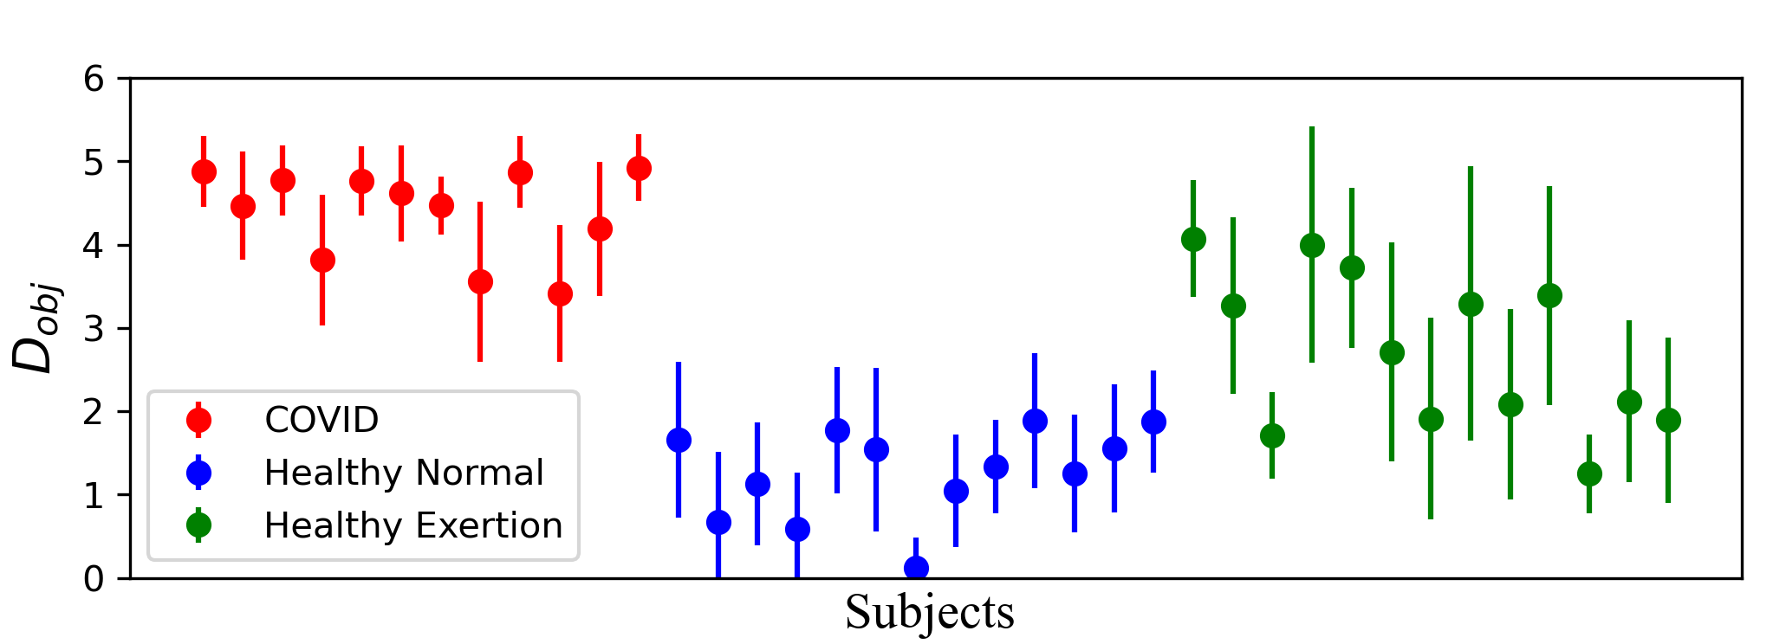
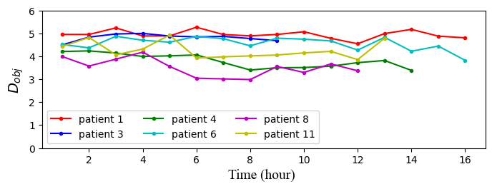
Dyspnea scoring ML model:
The learning model was built from the respiratory features with self report on 32 healthy subjects under exertion and airway blockage.
Dyspnea scoring results for COVID patients and healthy subjects (Exp 1). The average of D_{obj} : COVID = 4.39; Healthy Normal = 1.26; Healthy Exertion = 2.72.
High similarity between dyspnea on COVID patients and physiologically induced dyspnea on healthy subjects was established. COVID patients have consistently high objective dyspnea scores in comparison with normal breathing of healthy subjects.
We also exhibited continuous dyspnea scoring capability for 12-16 hours on patients.

