Slide 1

Early detection of sleep disorders
develop an autonomous system to detect and predict
sleep disorders reliably based on real-time covert sensing.
Zijing Zhang,
PhD Candidate,
2019-Expected May 2023,
School of Electrical and Computer Engineering
Cornell University, Ithaca, NY
Notes:
Respiratory disorders during sleep are a prevalent health condition that affects a large adult population.
Currently, the disorder events can hardly be predicted using the respiratory waveforms preceding the events. Predictive warning of the sleep disorders in advance can help prevent serious apnea, especially for servicemen, and patients with chronic conditions.
Our goal is to predict

Slide 2
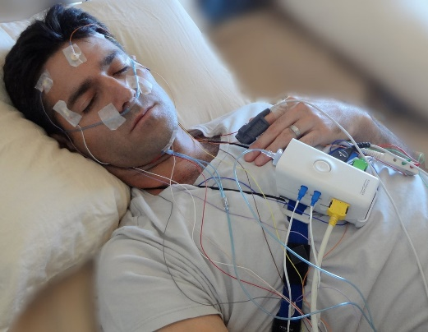
Experimental Setup in sleep center
Overnight recordings collected from 27 patients
in the Weill Cornell Center for Sleep Medicine.
Invisible sensing:
Notched transmission line sensor
under the mattress pad.
Current technology:
Polysomnography
(PSG)
Notes:
The gold standard to evaluate sleep disorders including apnea is PSG, which requires a trained technician for live monitoring and post-processing scoring.
Transfer from wearable sensing to non-invasive sensing, A bed-integrated radio-frequency (RF) sensor without user’s awareness,

Slide 3
Signal processing procedures
Down sample and synchronize NCS and PSG.
Filter and smoothing (0.05-2 Hz).
Segment waveform (T_{epoch} = 40s, T_{slide} = 15 s).
Label operator annotation.
Extract features in epoch.
Select epochs by signal quality.
Output to the ML model.
The prediction labelling criterion.
Notes:
We extracted respiratory features to feed into the random-forest machine learning model for disorder detection and prediction. The technician annotation, derived from observation by polysomnography, was used as the ground truth during the supervised learning.

Slide 4
Waveform examples
Normal
Disorders
Notes:
Normal: consistent and regular
Disorder: abnormal and irregular patterns

Slide 5
Detect sleep disorders using ML model
5-fold Cross Validation
Normal (0) Disorders (1)
Model: Random Forest
Data set | NCS + SpO2 | PSG + SpO2
Accuracy(%) | 88.9 | 85.2
Sensitivity(%) | 88.6 | 78.3
Specificity(%) | 89.0 | 87.4
Feature importance | σ_{SpO2} (0.58) σ_{PP} (0.14) σ_{BR} (0.08) CoV_{PP} (0.04) | σ_{SpO2} (0.36) ƞ_{SpO2} (0.05) μ_{BR} (0.05) σ_{PP} (0.05)
SpO2 : Oxygen saturation level
Notes:
Reason for model: Random forest: tree model is white box, The most important features can be assessed in the learning model
Reason for binary class: separate disorders into OSA, CSA, hypopnea, accuracy degrades a lot, finally choose to combine together.
Results show that achieve high accuracy for disorder detection

Slide 6
Predict sleep disorders using ML model
5-fold Cross Validation
Normal (0) Disorders (1)
Model: Random Forest
Data set | NCS | PSG
Accuracy(%) | 81.9 | 74.1
Sensitivity(%) | 74.6 | 55.8
Specificity(%) | 84.9 | 78.9
Feature importance | ƞ_{p0} (0.31) σ_{PP} (0.30) CoV_{PP} (0.19) σ_{BR} (0.13) | σ_{PP} (0.21) min_{PP} (0.17) CoV_{PP} (0.10) μ_{PP} (0.09)
Notes:
Prediction of forthcoming apneic events could be made up to 90 s in advance.
sPo2 is not used because it doesn’t help
Results show that achieve high accuracy for disorder prediction.

Slide 7
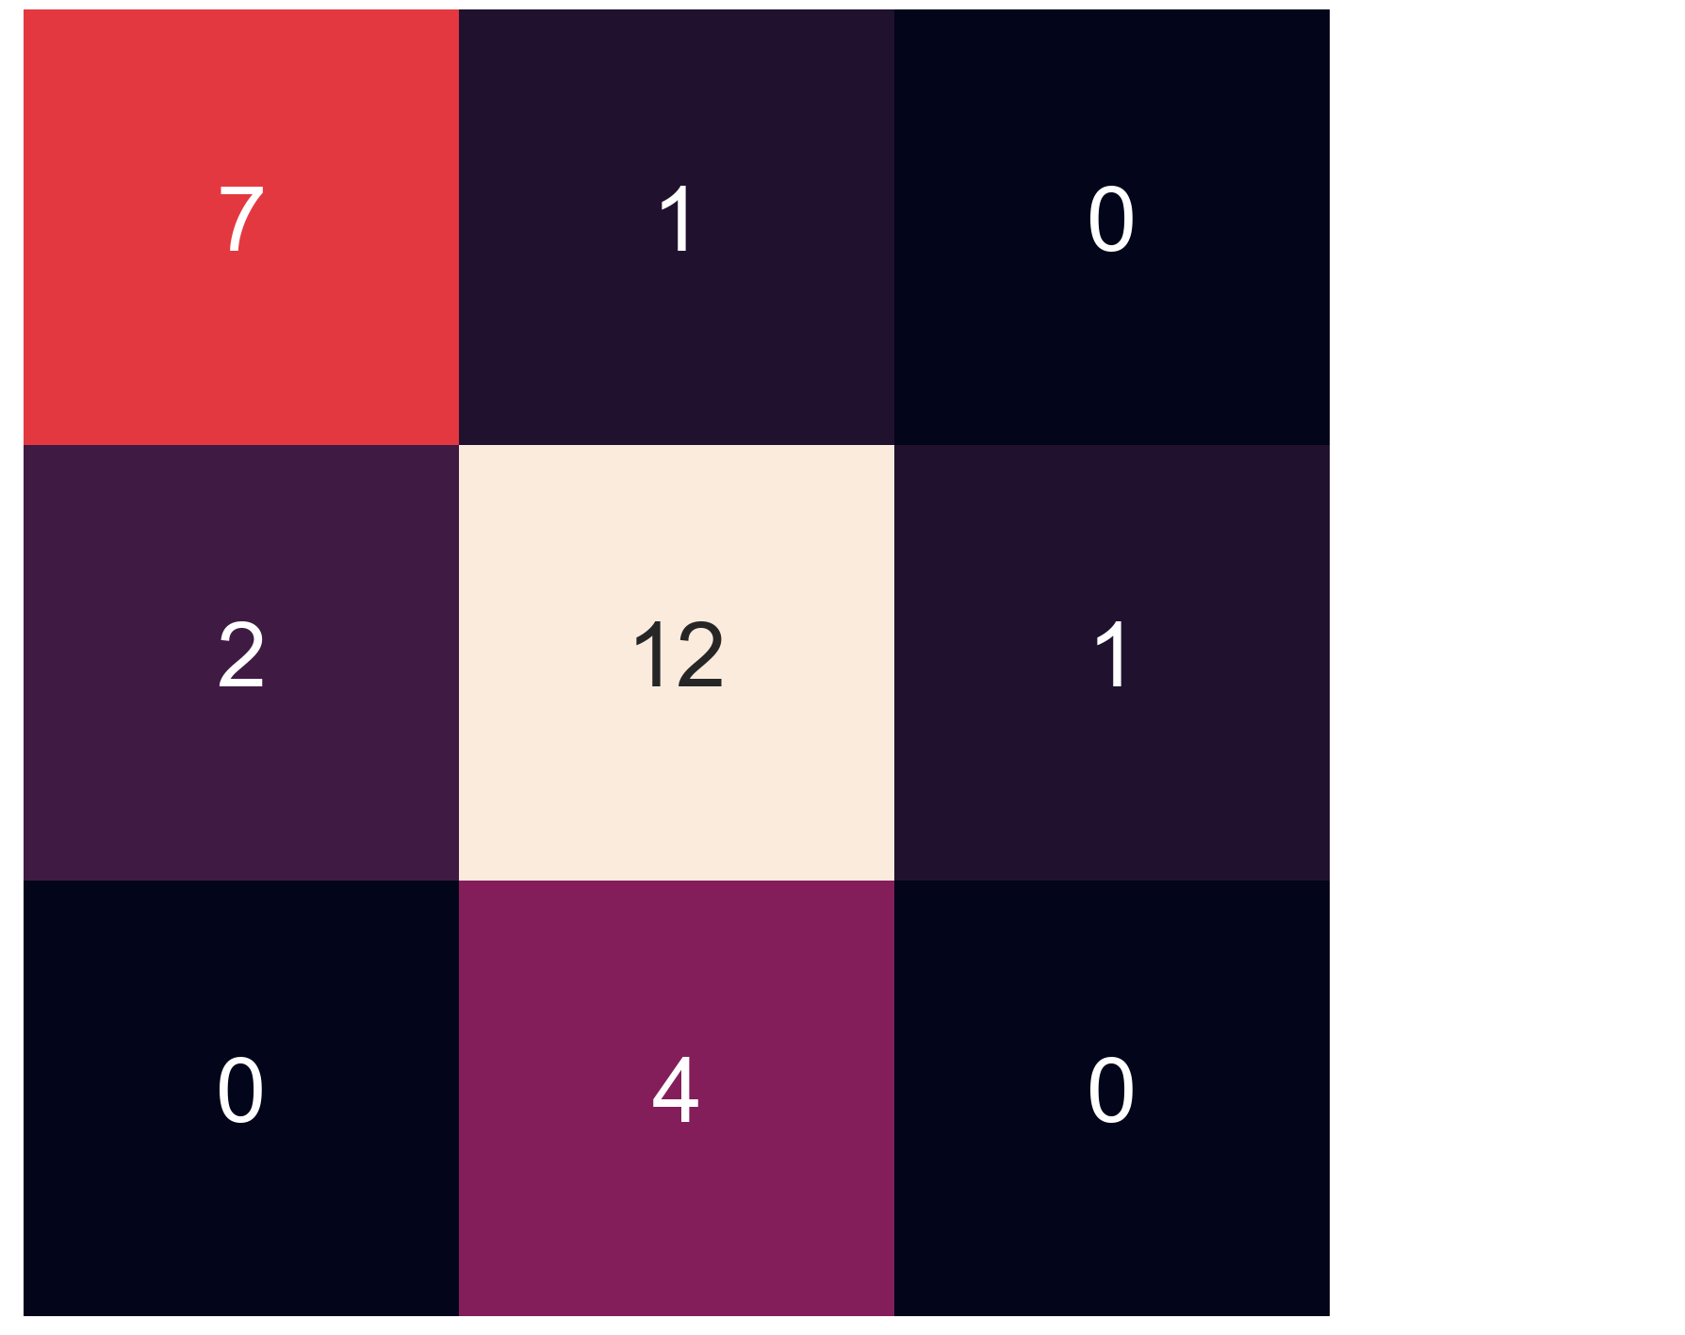
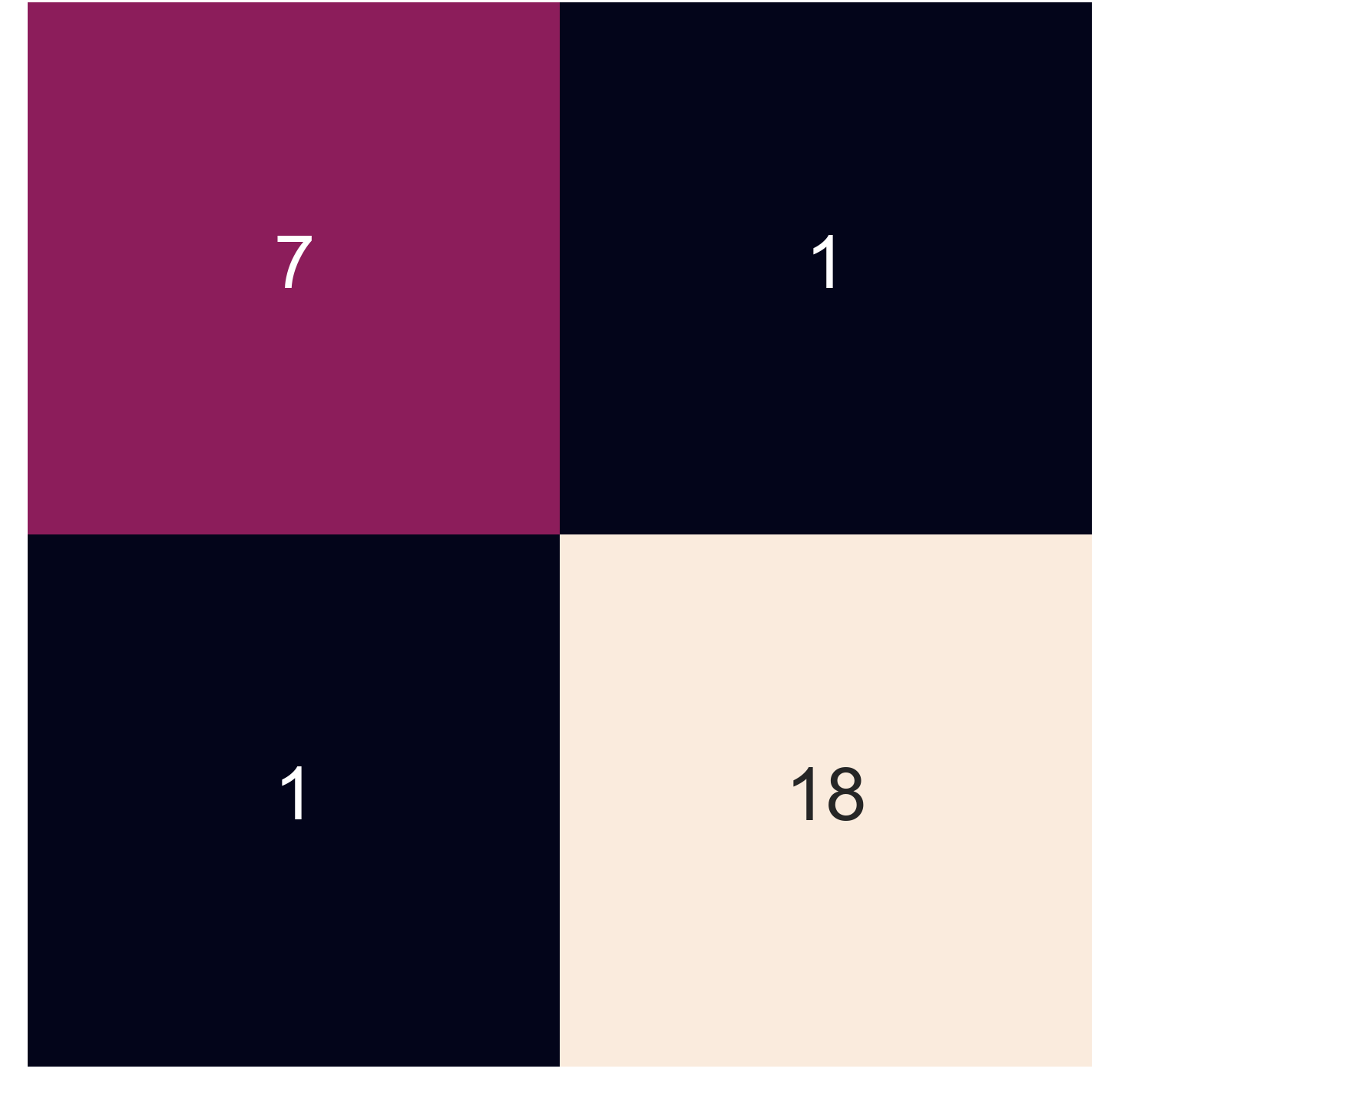
AHI, calculated by the number of apnea and hypopnea events per hour of sleep
Normal
True
True
Normal OSA Present
Mild
OSA
Moderate
OSA
Moderate
OSA
Normal OSA Present
Normal
Mild
OSA
(a)
NCS
(b)
NCS
binary AHI classes
AHI ≤ 5 Normal
AHI > 5 as OSA Present
accuracy = 0.93
the three AHI classes :
AHI ≤ 5: Normal;
5 < AHI ≤ 15: Mild OSA;
15 < AHI < 30: Moderate OSA,
accuracy = 0.70.

Slide 8
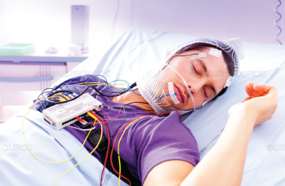
The current sleep apnea diagnosis platform was mostly based on PSG, which remained expensive in terms of hardware and operators, uncomfortable from body electrodes, and time-consuming for deployment. The ability to predict upcoming SDB events by PSG was also limited.
In the future, our covert detection and prediction system could expedite intervention, and improve diagnosis and therapy for respiratory disturbance during sleep.
To invisible sensing
Automatic respiratory disorders detection using non-invasive sensors integrated into bed.
Notes:
Non-invasivee respiration sensors integrated into furniture can be invisible to the user and greatly enhance comfort and convenience to facilitate many applications.
The proposed radio-frequency (RF) sensor can be worn over clothing or completely invisible to the user with the least concerns of discomfort and awareness. It can be integrated into cloth, a bed, or a chair, hidden behind layers of fabrics. The senor can be cost-effective, compact, stable and compatible to various digital wireless protocols.
EMG measures electric activity of muscle, invasive, needles inserted into body, or non-invasive on surface, direct skin contact.
susceptible to various types of noises, motion interference, ECG artifacts, ambient noise
RMG is touchless, sensitive to muscle motion, more resistant to interference, can capture deep muscle motion

