Slide 1
Smart Home Security
Name:-
Muhammad Zikria Tahir
Mail:-
TAHIR.MUHAMMAD.ZIKRIA@student.mmu.edu.my
Student ID:-
243EC2468Y
Submitted To:-
Prof Dr Tan Wooi Haw

Slide 2
Introduction
Hook: Start with a compelling statement about the growing need for home security. (e.g., "In today's world, home security is more important than ever...")
Problem Statement:
Clearly state the limitations of traditional home security systems:
  Delayed response times
  Frequent false alarms
  Limited remote control
  High installation and maintenance costs
Project Goal: Introduce the goal of your project: to develop a cost-effective and user-friendly smart home security system that addresses these limitations.

Slide 3
01
Key Objectives of the Project
Enhance Home Security:
  Real-time intrusion detection and immediate response.
  Proactive protection against potential threats.
Improve User Convenience:
  Remote monitoring and control through a user-friendly interface (app/web).
  Easy system arming/disarming.
Reduce False Alarms:
  Implement intelligent sensor data processing and adaptive algorithms.
Energy Efficiency:
  Optimize power consumption for long-term operation.
Cost-Effectiveness:
  Affordable hardware and software components.
  Minimize ongoing maintenance costs.

Slide 4
System Architecture
Key Components:
ESP32 Development Board: The core processing unit.
Sensors:
  PIR Motion Sensor: Detects motion.
  Temperature & Humidity Sensor: For environmental monitoring.
Actuators:
  Buzzer: Sounds an alarm.
  Relay Module: Controls lights, sirens, etc.
Communication:
  Wi-Fi: Enables wireless communication.
  (Optional) Cellular: For improved connectivity.
User Interface:
  Mobile App: User-friendly interface for monitoring and control.
  Web Interface: Alternative access for remote management
.

Slide 5
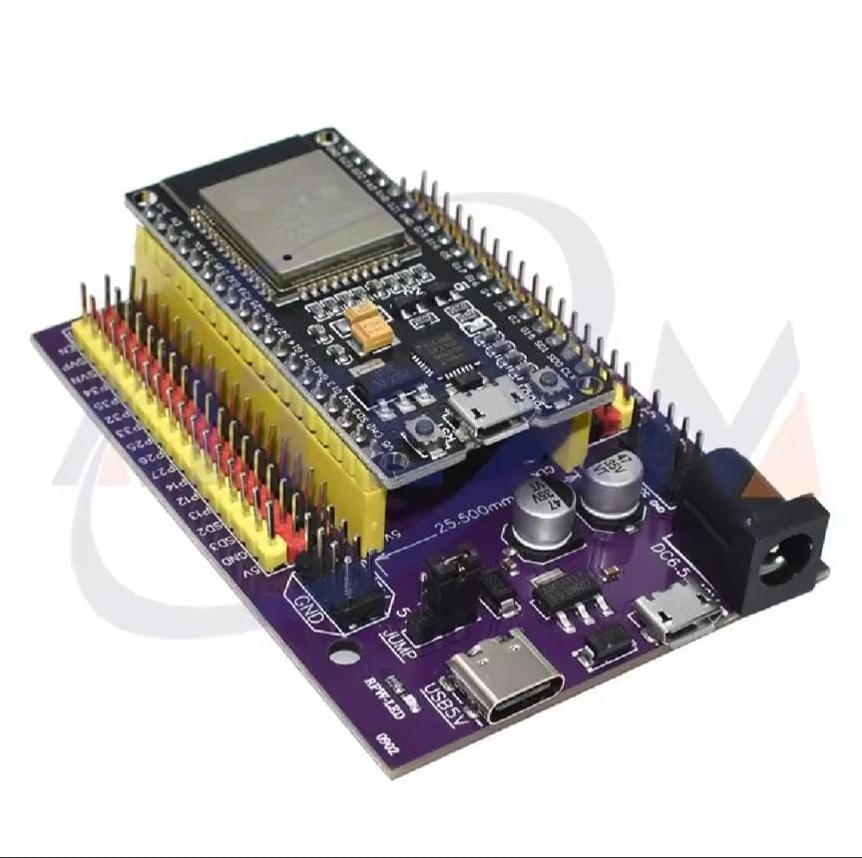
The system is built upon the following hardware platform
"The ESP32 is the brains of our system."
=>This emphasizes its role as the central processing unit.
"We chose the ESP32 for its Wi-Fi capabilities."
=>Highlights the key advantage for remote control and
alerts.
"The ESP32 provides the necessary processing
power and connectivity."
=>A concise summary of its key benefits.

Slide 6
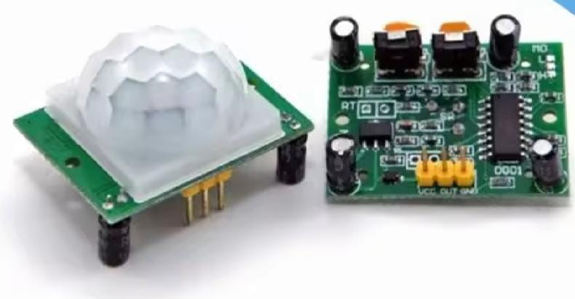
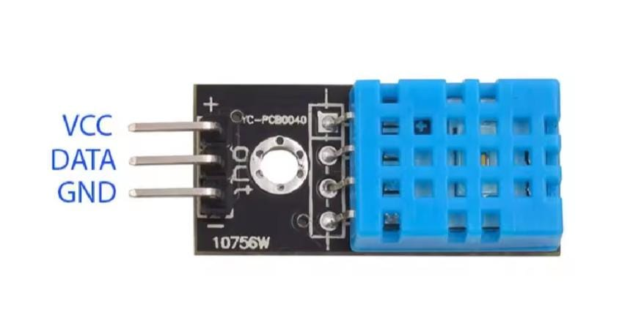
Smart Sensors
"PIR sensors detect changes in infrared radiation
caused by the movement of warm objects in their
field of view.
=>This explanation is more detailed and accurate.”
"Temperature & Humidity Sensor:
=> Measures temperature and humidity levels
for enhanced environmental awareness."

Slide 7
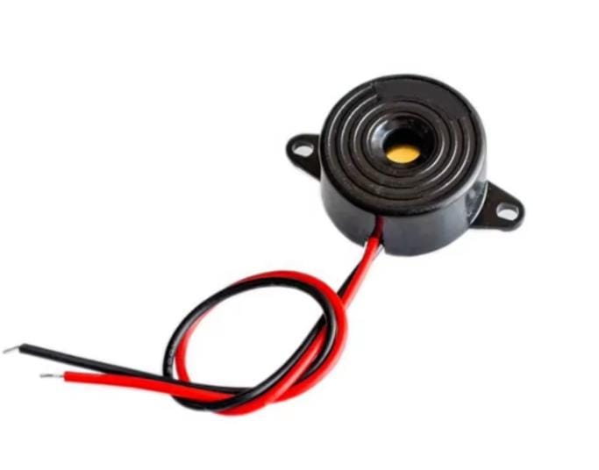
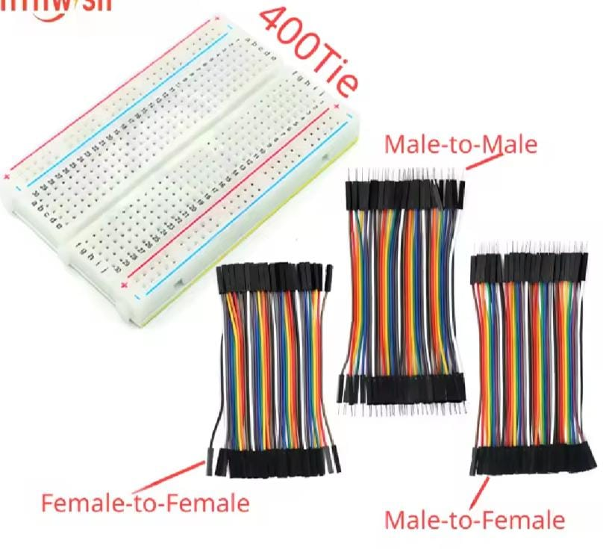
Actuators
1:-buzzer:-
=>"The buzzer acts as an acoustic output, generating an audible signal to alert the user of a security breach.“
Breadboard:
=>A reusable platform for prototyping electronic circuits.
=>Provides a convenient way to connect components without soldering.
Jumper Wires:
=>Used to connect components on the breadboard.
=>Flexible wires with connectors at both ends for easy connections.

Slide 8
. Software Development
Sensor Data Acquisition:
Reading data from sensors accurately and efficiently.
Data filtering and calibration to minimize noise and improve accuracy.
Intrusion Detection Algorithms:
Developing logic to analyze sensor data and identify potential intrusions.
Handling different scenarios (e.g., motion detection, door/window events).
Alarm Activation & Control:
Triggering alarms (buzzer, lights, sirens) based on detected events.
Implementing user-defined alarm settings.
Communication Protocols:
Implementing secure Wi-Fi communication for data transmission and remote control.
User Interface Development:
Designing and developing intuitive mobile app and/or web interface.

Slide 9
Hardware Implementation
1. Circuit Design
The ESP32 acts as the central processing unit, so it must be correctly connected to all sensors, actuators, and communication modules.
Proper wiring ensures signals are transmitted efficiently without interference.
Grounding and shielding are essential to prevent electrical noise that could cause false alarms or malfunctions.
2. Component Selection
Choosing high-quality sensors (like PIR motion sensors and door/window sensors) ensures accurate detection.
Reliable actuators (such as buzzers and relay modules) help in triggering alarms and controlling external devices.
Cost-effective yet durable components help in building a budget-friendly yet robust system.
3. Enclosure Design
The system needs a protective casing to safeguard the components from dust, moisture, and physical damage.
Ventilation holes should be included to prevent overheating of the ESP32 and other electronic components.
A well-designed enclosure improves durability and ensures the system remains functional in various environmental conditions.

Slide 10
Testing & Validation
Unit Testing:
Testing individual software modules for functionality.
Integration Testing:
Testing the interaction of hardware and software components.
System Testing:
Evaluating overall system performance, reliability, and security.
User Acceptance Testing:
Gathering feedback from users to ensure usability and satisfaction n.

Slide 11
02
Future Enhancements
1. Camera Integration 🎥
Adding a camera allows the system to capture images or video when motion is detected.
Users can visually verify whether an alert is a real threat or a false alarm.
Could integrate with cloud storage or local recording for evidence collection.
2. Voice Control 🗣️
Enables users to arm, disarm, or control the system using voice commands.
Can be integrated with Google Assistant, Amazon Alexa, or Apple Siri for hands-free operation.
Adds convenience, especially for users with accessibility needs.
3. Geofencing 📍
Uses GPS or Wi-Fi location tracking to automate security settings.
Example: The system can automatically arm when the user leaves home and disarm when they return.
Reduces the chances of forgetting to enable security features.

Slide 12
4. Machine Learning 🤖
AI-powerccced algorithms can analyze sensor data to improve detection accuracy.
Helps reduce false alarms by distinguishing between pets, normal movements, and actual intrusions.
Can adapt over time to detect unusual activity patterns for better security.
5. Cloud Integration ☁️
Stores security logs, sensor data, and camera recordings in secure cloud storage.
Enables real-time monitoring and analytics from anywhere via a mobile app or web interface.
Improves system reliability by ensuring data is not lost even if the hardware is damaged.

Slide 13
Conclusions
Smart home security systems offer comprehensive and convenient solutions to modern security needs. By integrating advanced technologies such as surveillance cameras, smart sensors, and home automation features, they significantly enhance the safety and management of residential environments. Understanding these components helps homeowners make informed decisions about their security measures, ensuring greater peace of mind.

Slide 14
Thank you!
Do you have any questions?

