Slide 1

1072 Pixels
One pixel (255, 235, 223)
1920 Pixels

Slide 2
1
2
3
0 | 0 | 0
0 | 0 | 0
1 | 0 | 0
0
0
0
0 | 0 | 0
0 | 0 | 0
0 | 0 | 0
0
0
0
1 | 0 | 0
0 | 1 | 1
1 | 1 | 0
0
1
0
0 | 0 | 0
0 | 0 | 0
0 | 1 | 0
Number of ‘1’s reduced from 5 to 1
Optimization

Slide 3
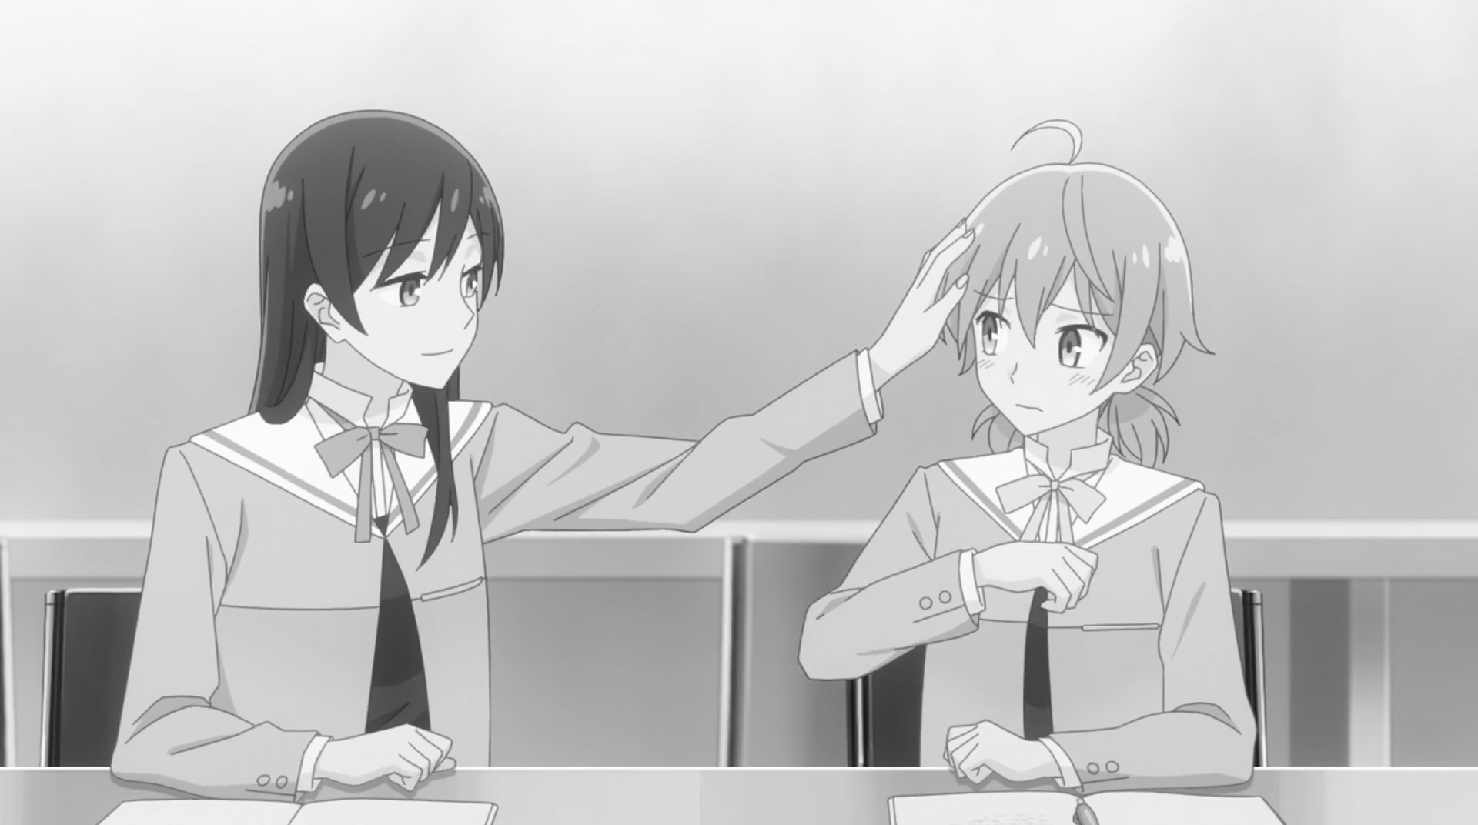
Cover Image
Information to be embedded
‘Y’ – ASCII 0101 1001₂
(IM)
1 | 0 | 0 | 1
1 | 1 | 0 | 0
1 | 1 | 1 | 1
0 | 1 | 1 | 0
0 | 1 | 0
1 | 1 | 0
0 | 1
LM*
Top Left-hand Corner of LSB Matrix (LM)

Slide 4
LM
Treated as column switches
1 | 0 | 0 | 1
1 | 1 | 0 | 0
1 | 1 | 1 | 1
0 | 1 | 1 | 0
0 | 1 | 0
1 | 1 | 0
0 | 1
LM*
IM
Bitwise XOR
Treated as row switches
M
1 | 0 | 0 | 1
1 | 1 | 1 | 0
1 | 0 | 0 | 1
0 | 1 | 0 | 0
M*

Slide 5

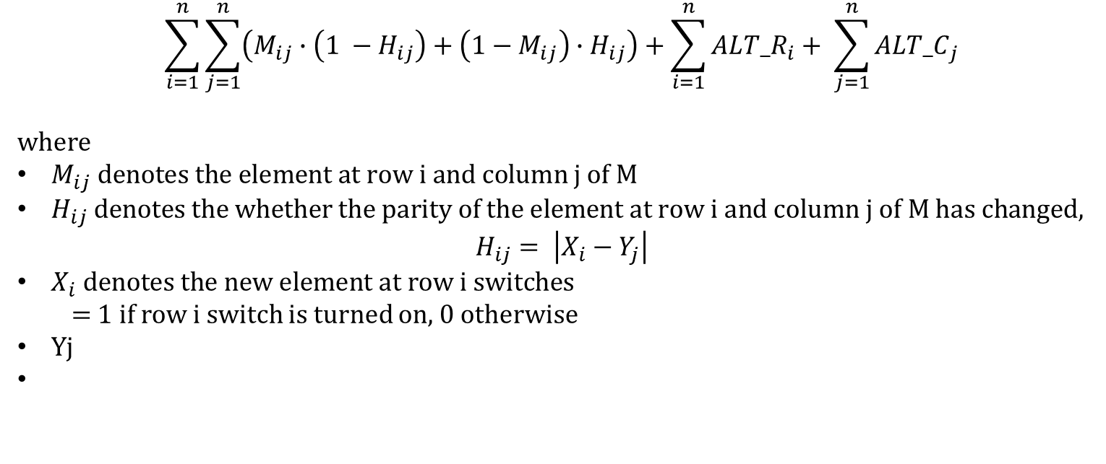

$$\sum_{i=1}^{n}{\sum_{j=1}^{n}{\left(M_{ij}∙\left(1 −H_{ij}\right)+\left(1−M_{ij}\right)∙H_{ij}\right)}}+\sum_{i=1}^{n}{AL{T_R}_{i}}+ \sum_{j=1}^{n}{{ALT_C}_{j}}$$
where
$M_{ij} denotes the element at row i and column j of M$
$H_{ij} denotes the whether the parity of the element at row i and column j of M has changed,$
$$H_{ij}= \left|X_{i}−Y_{j}\right|$$
$X_{i} denotes the new element at row i switches$
  = 1 if row i switch is turned on, 0 otherwise
$Y$j
$${ALT_R}_{i}=\left(R_{i}+X_{i}\right) \% 2$$
$${ALT_C}_{j}=\left(C_{j}+Y_{j}\right) \% 2$$

Slide 6

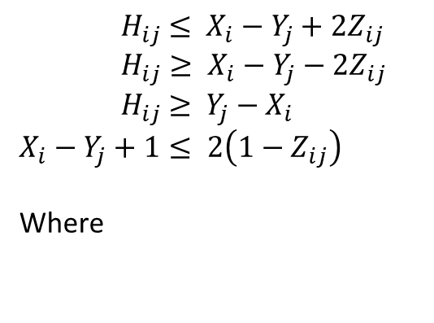

$${ H}_{ij} ≤ X_{i}−Y_{j}+2Z_{ij}$$
$$H_{ij}≥ X_{i}−Y_{j}−2Z_{ij}$$
$${ H}_{ij} ≥ {Y_{j}−X}_{i}$$
$$X_{i}−Y_{j}+1≤ 2\left(1−Z_{ij}\right)$$
Where
$$R_{i}+X_{i}=2T_{i}+{ALT_R}_{i}$$
$$C_{j}+Y_{j}=2S_{j}+{ALT_C}_{j}$$

Slide 7
M
OM
1 | 0 | 0 | 1
1 | 1 | 1 | 0
1 | 0 | 0 | 1
0 | 1 | 0 | 0
1 | 0 | 0 | 1
1 | 0 | 0 | 0
0 | 0 | 0 | 0
0 | 1 | 0 | 1
Optimization
M*
OM*
OM
OM’
0 1 2 3
1 | 0 | 0 | 1
1 | 0 | 0 | 0
0 | 0 | 0 | 0
0 | 1 | 0 | 1
0 1 2 3
0 | 0 | 0 | 0
0 | 0 | 0 | 0
1 | 0 | 0 | 0
0 | 1 | 0 | 1
1 | 0 | 0 | 1
1 | 1 | 0 | 0
0 | 1 | 1 | 1
0 | 0 | 1 | 1
OM*

Slide 8
LM*
OM’
0 | 0 | 0 | 0
0 | 0 | 0 | 0
1 | 0 | 0 | 0
0 | 1 | 0 | 1
LM
LM’
1 | 0 | 0 | 1
1 | 1 | 0 | 0
1 | 1 | 1 | 1
0 | 1 | 1 | 0
1 | 0 | 0 | 1
1 | 1 | 0 | 0
0 | 1 | 1 | 1
0 | 0 | 1 | 1
Embedding

Slide 9
Top Left-hand Corner of LSB Matrix (LM)
Information to be embedded
‘Y’ – ASCII 0101 1001₂
1 | 0 | 0 | 1
1 | 1 | 0 | 0
1 | 1 | 1 | 1
0 | 1 | 1 | 0
0 | 1 | 0
1 | 1 | 0
0 | 1
LM*
IM
Mismatch
LM’’
1 | 0 | 0 | 1
1 | 0 | 1 | 0
1 | 1 | 1 | 0
0 | 0 | 1 | 0

Slide 10
LM’
0 1 2 3
0 1 2 3
0 1 2 3
1 | 0 | 0 | 1
1 | 1 | 0 | 0
0 | 1 | 1 | 1
0 | 0 | 1 | 1
0 1 2 3
1 | 0 | 0 | 0
0 | 0 | 1 | 0
0 | 1 | 1 | 0
0 | 0 | 1 | 0

