Slide 1
Investigating Pixel Device
Android 10
Notes:
https://digitalcorpora.s3.amazonaws.com/corpora/mobile/android_10/Non-Cellebrite%20Extraction/Pixel%203.zip

Slide 2
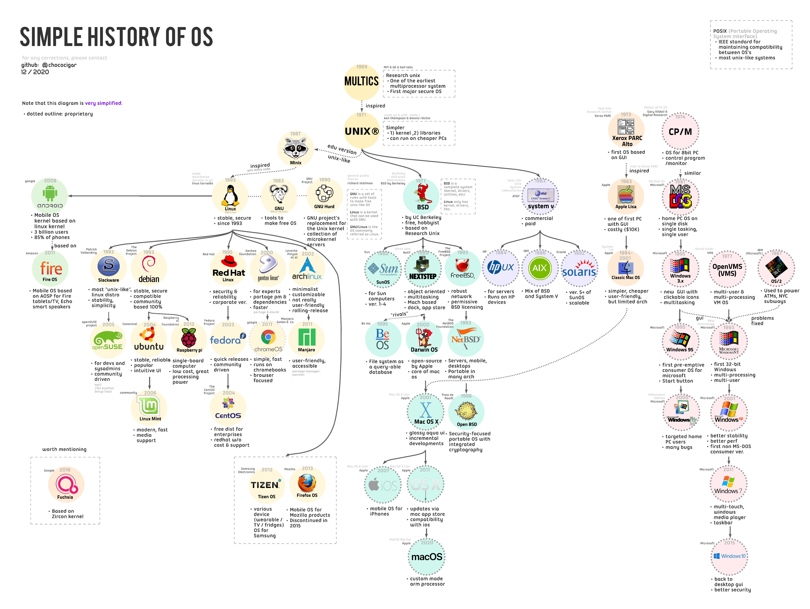

Slide 3
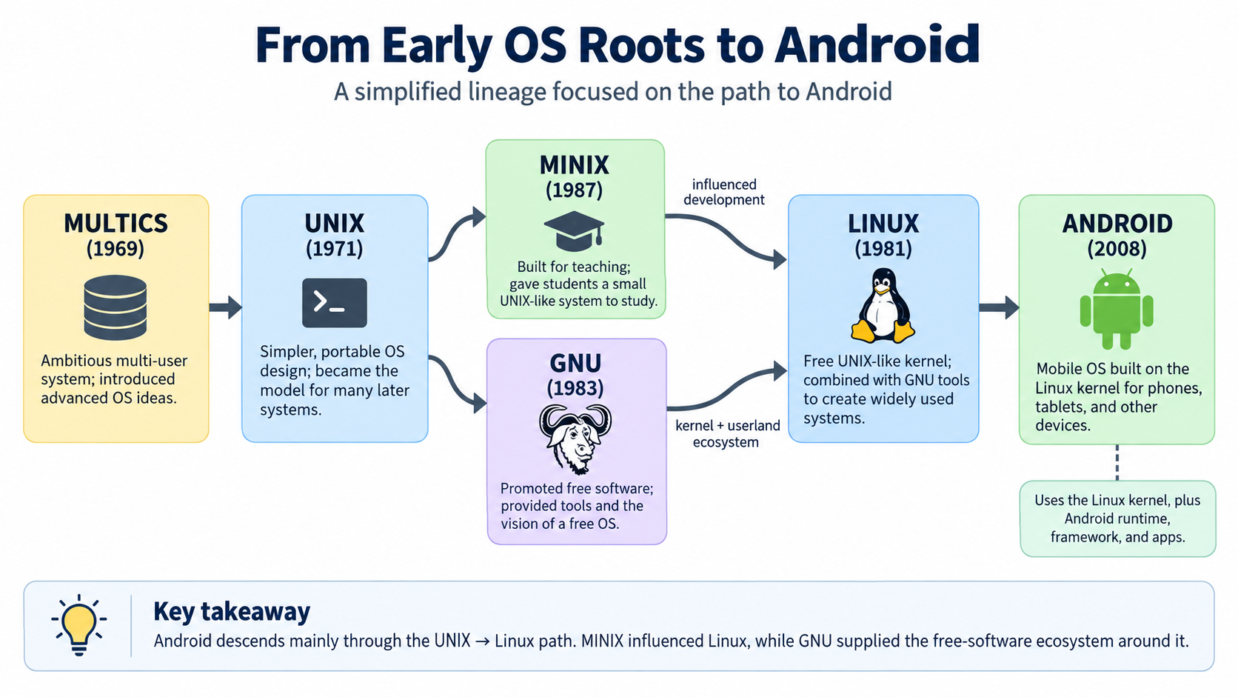
Government of National Unity

Slide 4
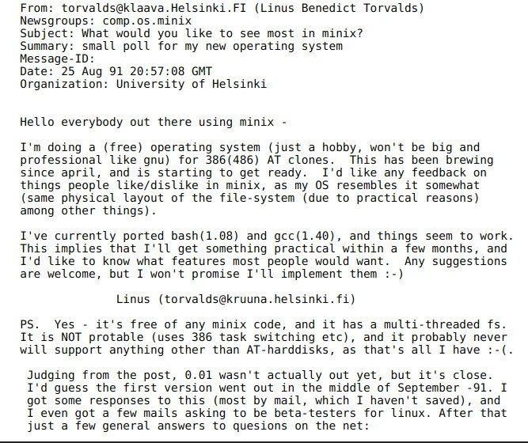

Slide 5
Introduction to Android

Slide 6
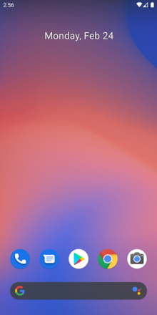
What is Android?
Android is a mobile operating system
  Based on a modified version of the Linux kernel
  Was unveiled in November 2007
Android is open-source software
  Its source code is known as the Android Open-Source Project (AOSP)
Most Android devices ship with additional proprietary software pre-installed, including
  Google Apps: Google Chrome, YouTube, Google Maps
  Google Play Services: Location, authentication, and other background APIs
Notes:
https://en.wikipedia.org/wiki/Android_(operating_system)
https://en.wikipedia.org/wiki/Google_mobile_services

Slide 7
Google controls AOSP
Google controls and maintains AOSP
  Core Development by Google
  Open Source Contribution
  Apache License 2.0
  Google manages the release schedule, documentation, and feature roadmap for AOSP
Examples of AOSP-derived projects
  Amazon Fire OS
  LineageOS: completely open-source and community-driven
  Huawei HarmonyOS

Slide 8
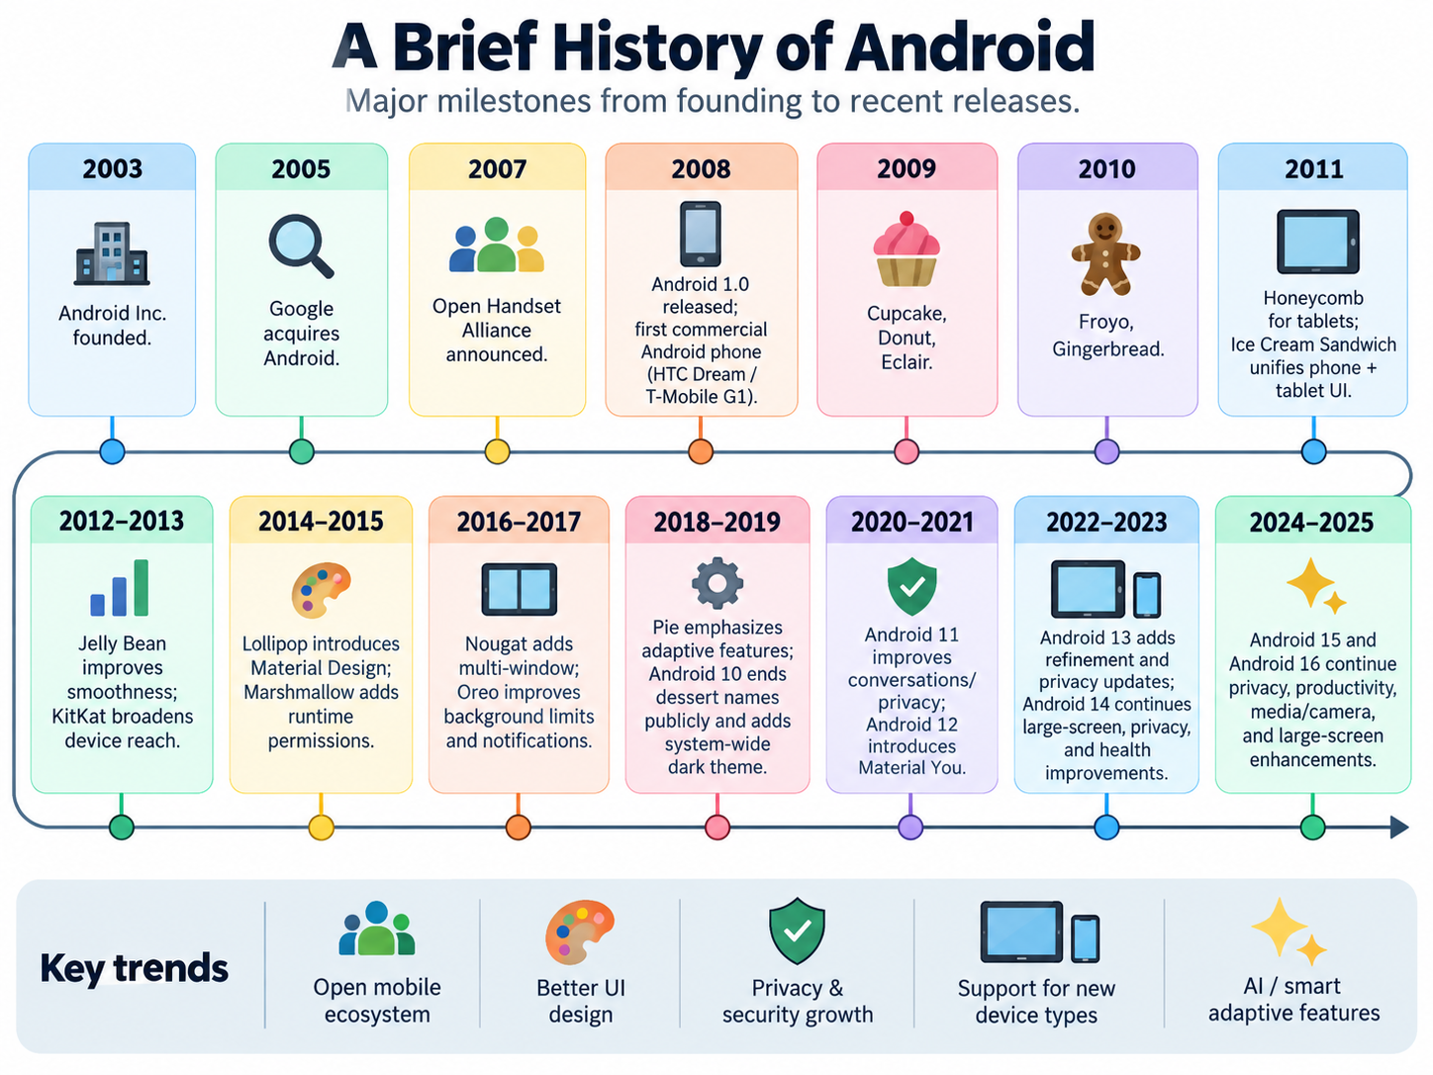
Code Name
Version Name

Slide 9
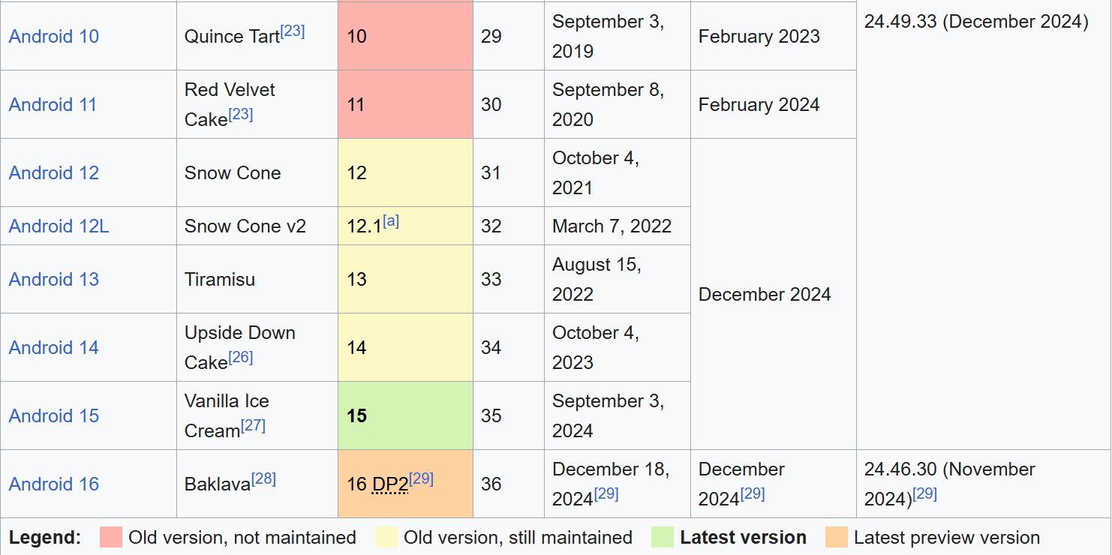
Other Android Attributes
https://en.wikipedia.org/wiki/Android_version_history

Slide 10
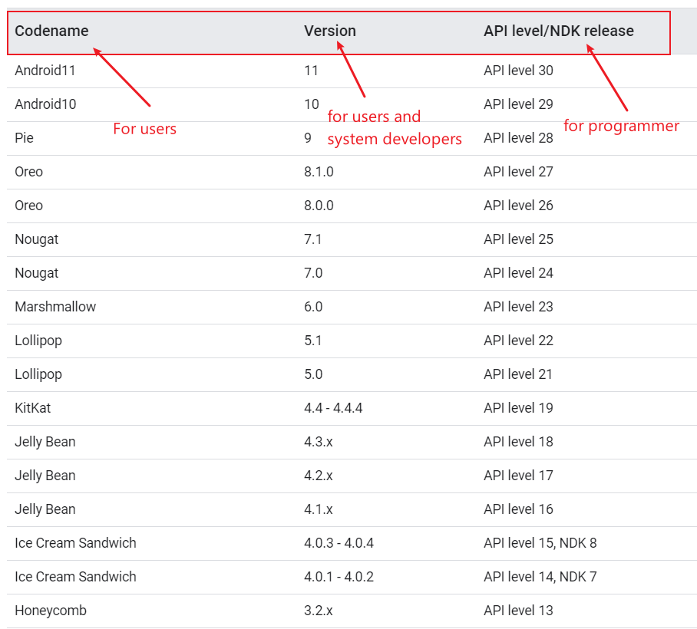
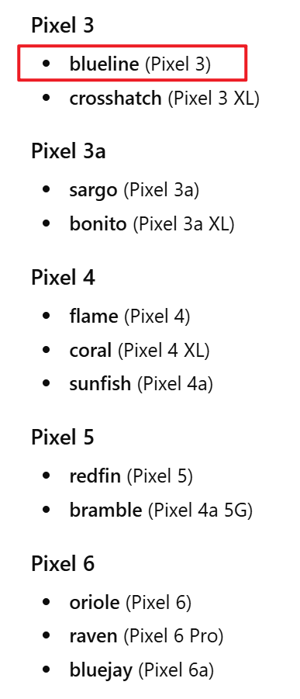
Codename, Version, API, hardware codename
The Android NDK is a toolset that lets you implement parts of your app in native code, using languages such as C and C++.
hardware codename
Notes:
https://source.android.com/setup/start/build-numbers

Slide 11
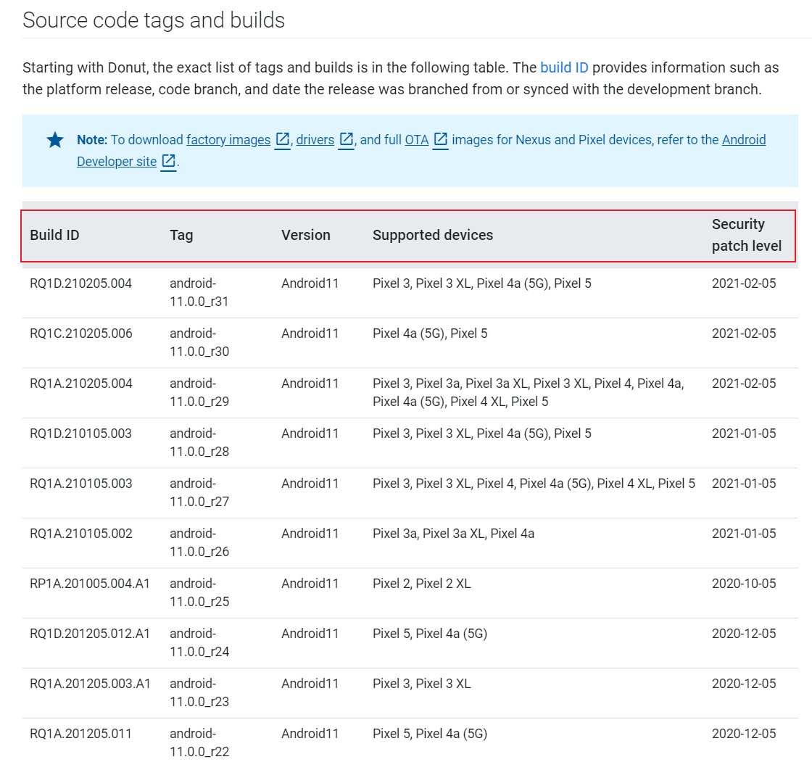
Source code tags and builds
build ID provides information such as the platform release, code branch, and date the release was branched from or synced with the development branch.
Notes:
https://source.android.com/setup/start/build-numbers
Each stage of the Android boot process involves completing specific tasks, preparing for the next stage, and then handing over control to the subsequent stage. Here's a breakdown of how this works across the key stages:
---
### **1. Boot ROM (Read-Only Memory)**
- **Tasks Completed**:
- Executes when the device is powered on.
- Detects the boot media (e.g., internal storage or external memory) to locate the bootloader.
- Loads the first-stage bootloader into RAM.
- **Preparation for Next Stage**:
- Initializes minimal hardware components (e.g., CPU, clocks).
- Ensures external RAM is ready for use.
- **Control Transfer**:
- Hands control to the **bootloader**.
---
### **2. Bootloader**
- **Tasks Completed**:
- Sets up initial memory configurations.
- Loads the Linux kernel and its associated RAM disk (temporary file system) into memory.
- Handles security checks (e.g., locked/unlocked bootloader).
- **Preparation for Next Stage**:
- Configures file systems, additional memory, and low-level security options.
- Prepares the environment for the kernel to execute.
- **Control Transfer**:
- Jumps to the **Linux kernel** after decompressing it in memory.
---
### **3. Linux Kernel**
- **Tasks Completed**:
- Initializes hardware drivers (e.g., interrupt controllers, memory management units, caches).
- Sets up virtual memory and scheduling mechanisms.
- **Preparation for Next Stage**:
- Mounts the root file system.
- Locates the `init` process (found in `/system/core/init`) to serve as the first user-space process.
- **Control Transfer**:
- Passes control to the **init process**.
---
### **4. Init Process**
- **Tasks Completed**:
- Parses initialization scripts (`init.rc` or `init<machine name>.rc`).
- Sets up system services, file systems, and other parameters defined in the script.
- **Preparation for Next Stage**:
- Launches core system services and processes.
- Starts the **Zygote process**, which preloads common application classes and initializes the Dalvik/ART runtime.
- **Control Transfer**:
- Hands control to the **Zygote process**.
---
### **5. Zygote and Dalvik/ART**
- **Tasks Completed**:
- Preloads common application classes and resources into memory.
- Initializes the Android Runtime (ART) or Dalvik Virtual Machine (DVM).
- **Preparation for Next Stage**:
- Speeds up app launches by sharing preloaded code across all apps.
- Prepares the environment for launching the **System Server**.
- **Control Transfer**:
- Passes control to the **System Server**.
---
### **6. System Server**
- **Tasks Completed**:
- Starts core Android services:
- Activity Manager, Package Manager, Window Manager, etc.
- Telephony registry, alarm manager, sensor service, Bluetooth service, etc.
- Manages system-wide functionalities like notifications, location services, and audio settings.
- **Preparation for Next Stage**:
- Completes the initialization of the Android framework.
- Broadcasts the `ACTION_BOOT_COMPLETED` intent to signal that the boot process is complete.
- **Control Transfer**:
- Allows third-party apps and services to start running by responding to the `ACTION_BOOT_COMPLETED` broadcast.
---
### **7. User-Space Services and Apps**
- **Tasks Completed**:
- Third-party apps and services register to receive the `ACTION_BOOT_COMPLETED` broadcast.
- Custom services or apps can perform actions (e.g., setting alarms, initializing background tasks).
- **Preparation for Next Stage**:
- The system is now fully operational, and the user interface is ready for interaction.
- **Control Transfer**:
- Control is handed over to the user, who can interact with the device.
---
### Summary Table of Boot Process Stages
| **Stage** | **Tasks Completed** | **Preparation for Next Stage** | **Control Transfer** |
|-----------------------|-------------------------------------------------------------------------------------|------------------------------------------------------------------|---------------------------------|
| **Boot ROM** | Detects boot media, loads bootloader | Initializes minimal hardware | Bootloader |
| **Bootloader** | Loads kernel and RAM disk, handles security | Configures memory, file systems, and low-level settings | Linux Kernel |
| **Linux Kernel** | Initializes hardware drivers, sets up memory management | Mounts root file system, locates `init` process | Init Process |
| **Init Process** | Parses `init.rc`, starts core services | Launches Zygote process | Zygote |
| **Zygote** | Preloads app classes, initializes ART/Dalvik | Prepares environment for System Server | System Server |
| **System Server** | Starts core Android services (Activity Manager, etc.) | Broadcasts `ACTION_BOOT_COMPLETED` | User-space apps/services |
| **User-Space Apps** | Responds to `ACTION_BOOT_COMPLETED`, performs custom actions | Fully operational system | User Interaction |
---
This sequential flow ensures that each stage builds upon the previous one, creating a stable and functional Android environment by the time the user gains control.

Slide 12

What is Stock Android and Android Skins?
Unmodified version of Android
  known as vanilla or pure Android
Companies can modify Android
  adding a custom skin
  new features.
Popular skins
  Samsung Experience,
  HTC Sense,
  EMUI (Huawei), and
  OxygenOS (OnePlus)

Slide 13
Stock Android
Advantages
  Fast updates
  Bloatware-free: pre-installed software can’t be deleted from a device, unless you root it.
Popular stock Android smartphones are those made by Google
  older Nexus devices
  Pixel, Pixel 2, and Pixel 3 handsets
Android holds over 71% of the global mobile OS market share
  as of November 2020 (StatCounter)

Slide 14
Android Architecture

Slide 15
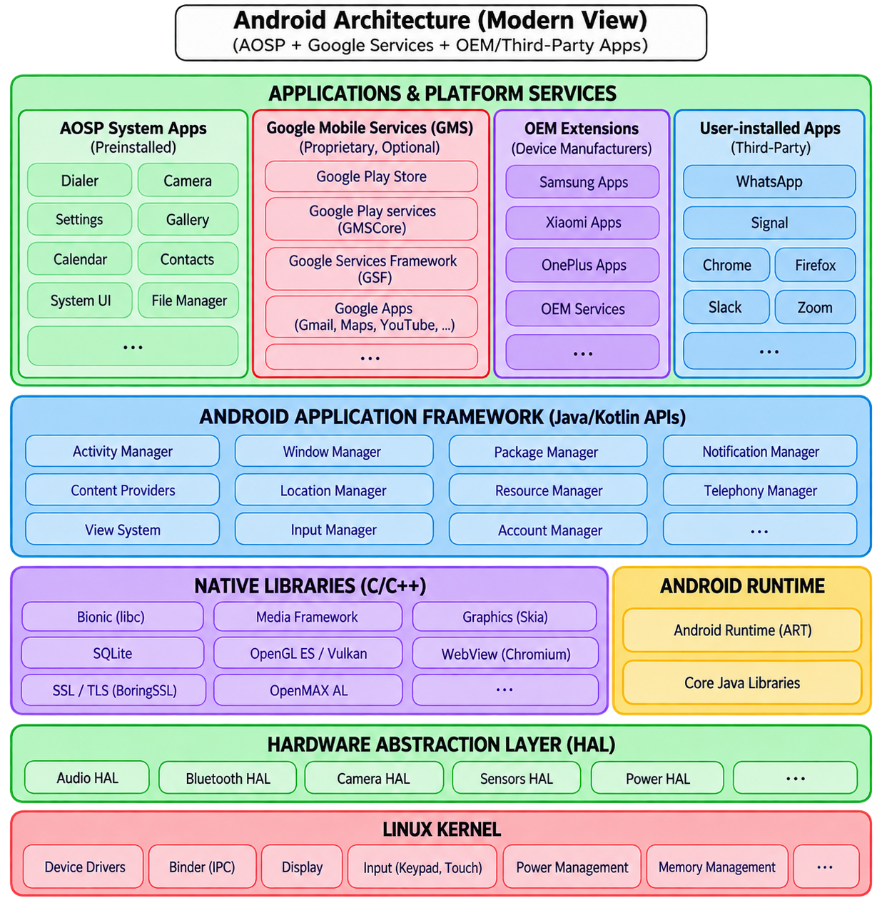
Java APIs for developers
A set of Libraries and the Android Runtime.
defines a standard interface for hardware vendors to implement
Security, Process management, Memory management, Device management
Notes:
https://medium.com/@deepamgoel/understanding-android-architecture-1f0fb4b52f90
https://source.android.com/devices/architecture

Slide 16
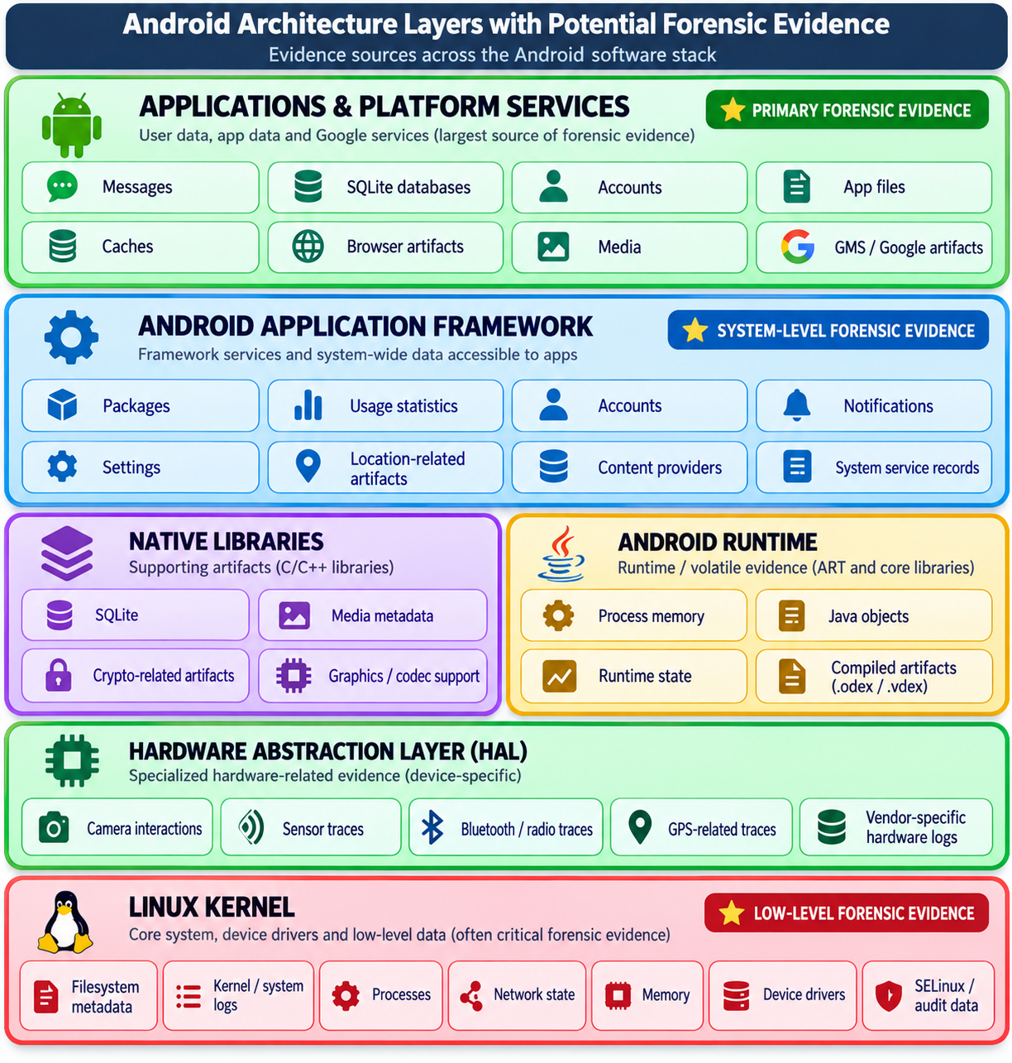

Slide 17
Android layer | Forensic evidence? | Typical examples
Applications & Platform Services | ★★★★★ Primary | App databases, messages, call records, contacts, browser history, account data, tokens, preferences, caches, Google/GMS artifacts
Application Framework | ★★★★ High | Package installation information, accounts, notifications, usage statistics, location-related records, system settings, activity/task information
Native Libraries | ★★ Limited/directly | SQLite structures, media metadata, crypto-related artifacts; libraries themselves are generally code rather than evidence
Android Runtime (ART) | ★★–★★★ Mostly volatile/derived | Process memory, Java objects, runtime state, compiled app artifacts such as .odex/.vdex, traces
HAL | ★–★★ Specialized | Sensor/camera/GPS/hardware interaction traces, depending on vendor implementation
Linux Kernel | ★★★★ Important | Filesystem metadata, kernel logs, process information, network state, device information, SELinux/audit logs, memory
Notes:
https://developers.google.com/android/guides/overview

Slide 18
Android RunTime (ART)
The managed runtime that runs Android app bytecode
ART executes DEX bytecode for apps and some system services, while managing compilation, memory, and runtime execution.
Execution flow
Inside ART
ART
Android Runtime
➜
Java / Kotlin
source code
DEX bytecode
(.dex in APK)
Native machine
code
CPU + Linux
process
➜
➜
➜
What ART does
Why it matters
Forensic lens
• Runs managed Android code
• Compiles DEX to efficient code
• Manages heap memory and GC
• Supports debugging/profiling
Without ART, Android apps would not have a common execution engine. ART is the bridge between app bytecode and native execution.
ART is usually not the main storage layer, but it can expose runtime and compiled artifacts: .dex, .oat, .vdex, heap, stack, traces.
Key idea: ART sits in the Android Runtime layer, below apps/framework APIs and above native libraries/kernel execution.
Notes:
https://medium.com/android-news/closer-look-at-android-runtime-dvm-vs-art-1dc5240c3924
https://stackoverflow.com/questions/28435860/what-does-oat-mean
The Dalvik Virtual Machine (DVM) was named after the Dalvik village in Iceland, which is the hometown of Dan Bornstein, the Google engineer who led the development of Dalvik.

Slide 19
Android Booting Process

Slide 20
Android booting process needs multiple stages
Start when users press the power button
  To a fully functional user interface
Perform a series of checks and configurations to properly launch the OS on the diverse hardware of different Android devices
  Initialize various hardware components
  Load the necessary software components like the kernel
  Prepare the system environment by setting up services and processes
  Use the "Snowball Effect" Strategy

Slide 21
The "Snowball Effect" Strategy
Each stage is designed to be just "smart" enough to find and start the next, more complex stage. This happens for two main reasons:
Hardware Constraints: When you first press the power button, the phone’s brain (CPU) is "blank." It doesn't know what a screen or a battery is yet. It only knows how to execute one tiny piece of code stored in a permanent spot (the Boot ROM).
Efficiency: Small code is fast and reliable. By starting small, the system ensures the foundation is solid before loading the heavy, "hungry" parts of the software like the camera drivers or your wallpaper.

Slide 22
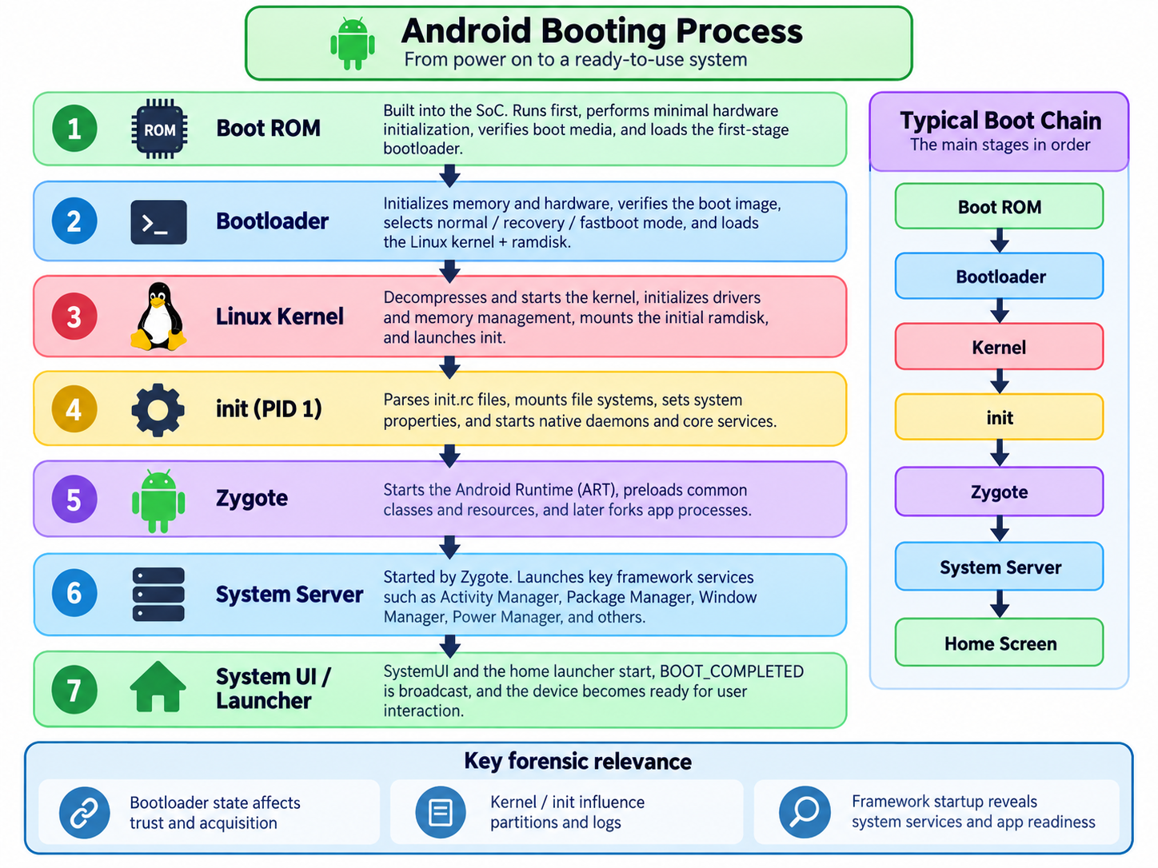

Slide 23
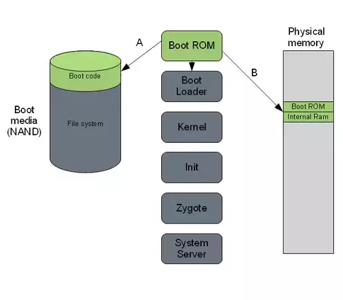
1. Boot ROM (Read-only Memory)
Power On and Boot ROM code starts executing
  A: ROM Code detects the boot media to determine where to find the boot loader.
  B: ROM Code loads the first stage Bootloader into RAM, and the Bootloader starts executing in RAM.
Notes:
https://community.nxp.com/t5/i-MX-Processors-Knowledge-Base/The-Android-Booting-process/ta-p/1129182
https://www.quora.com/How-does-Android-boot-process-work

Slide 24
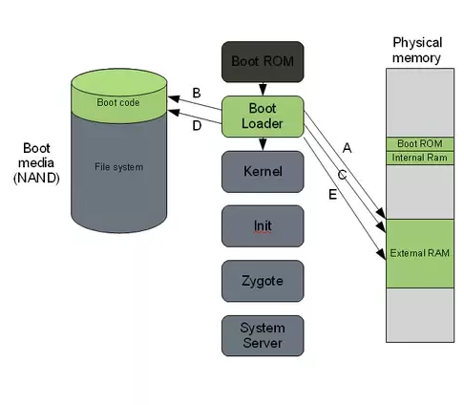
2. Bootloader
A special program to set up initial memory and load the kernel to RAM.
  Kernel and Ramdisk (a temporary filesystem to assist in loading the real root filesystem) are flashed to /boot partition
  locked by manufacturers
Must unlock bootloader to root Android devices
  get system permission to acquire data for forensic investigations
Notes:
https://community.nxp.com/t5/i-MX-Processors-Knowledge-Base/The-Android-Booting-process/ta-p/1129182
https://www.quora.com/How-does-Android-boot-process-work
GNU GRand Unified Bootloader

Slide 25
A. The first boot loader stage will detect and set up external RAM (Initialize minimal hardware, e.g., CPU, clocks).
B. Once external RAM is available and the system is ready to run something more significant, the first stage will load the main bootloader and place it in external RAM.
C. The second stage of the bootloader is the first major program that will run.
This may contain code to set up file systems, additional memory, network support, and other things.
On a mobile phone, it may also be responsible for loading code for the modem CPU and setting up low-level memory protections and security options.

Slide 26
D. Once the bootloader is done with any special tasks it will look for a Linux kernel to boot.
It will load this from the boot media (or some other source depending on system configuration) and place it in the RAM.
It will also place some boot parameters in memory for the kernel to read when it starts up.
E. Once the boot loader is done it will perform a jump to the Linux kernel
usually some decompression routine, and the kernel assumes system responsibility.

Slide 27
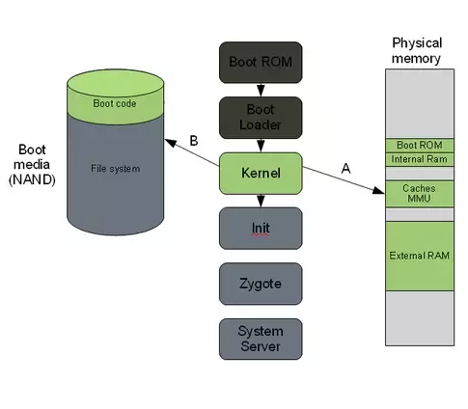
3. The Linux kernel
Set up everything that is needed for the system to run.
  Initialize interrupt controllers
  Set up memory protections, caches and scheduling.
A. Once the memory management units and caches have been initialized, the system will be able to use virtual memory and launch user space processes.
B. The kernel will look in the root file system for the init process (found under system/core/initial the Android open-source tree) and launch it as the initial user space process.

Slide 28
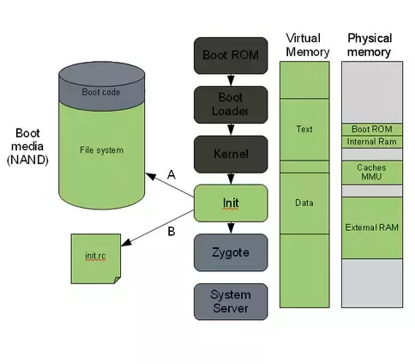
4. The init process
.rc. Early Unix used run commands(rc) for the name of the operating system's boot script
The "grandmother" of all system processes.
Every other process in the system will be launched from this process or one of its descendants.
A. The init process in Android will look for a file called init.rc. or init<machine name>.rc
  This is a script that describes the system services, file system and other parameters that need to be set up.
  The script is placed in system/core/rootdir in the Android open-source project.
B. The init process will parse the init script and launch the system service processes.

Slide 29
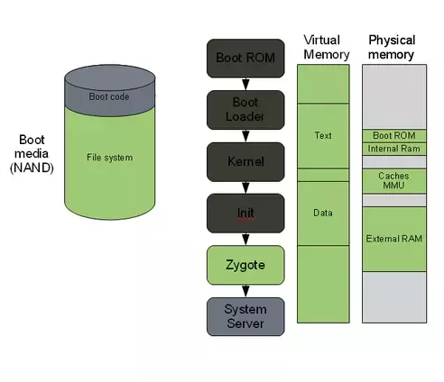
5. Zygote and ART
A process of the Android Runtime
The init process launches the Zygote and will basically start executing and initializing ART
Zygote enables library sharing across ART, achieving a lower memory footprint and minimal startup time.

Slide 30
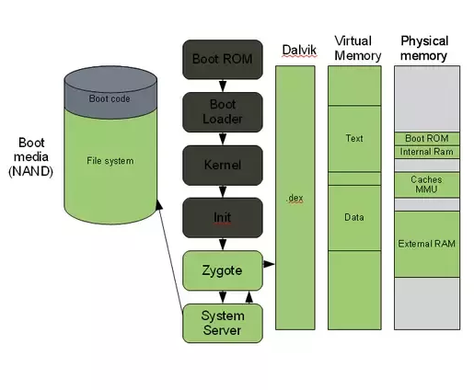
6. The system server
The system server is the first java component to run in the system.
Core services: Creating the Activity Manager, Starting telephony registry, context manager, system contact providers Starting alarm manager, sensor service, window manager, Bluetooth service, mount service
Other services: Starting hardware service, Starting NetStat service, connectivity service, Notification Manager, Device Storage Monitor service, Location Manager, Search Service, Clipboard Service, checkin service, Wallpaper service, Audio Service, Headset Observer, AdbSettings Observer

Slide 31
7. System UI
Once the System Server is up and running and the system boot has completed
  there is a standard broadcast action called ACTION_BOOT_COMPLETED.
To start your own service
  register an alarm or otherwise make your application perform some action after boot
  register to receive this broadcast intent.

Slide 32
Android Partition Layout
mapping booting process to partitions

Slide 33
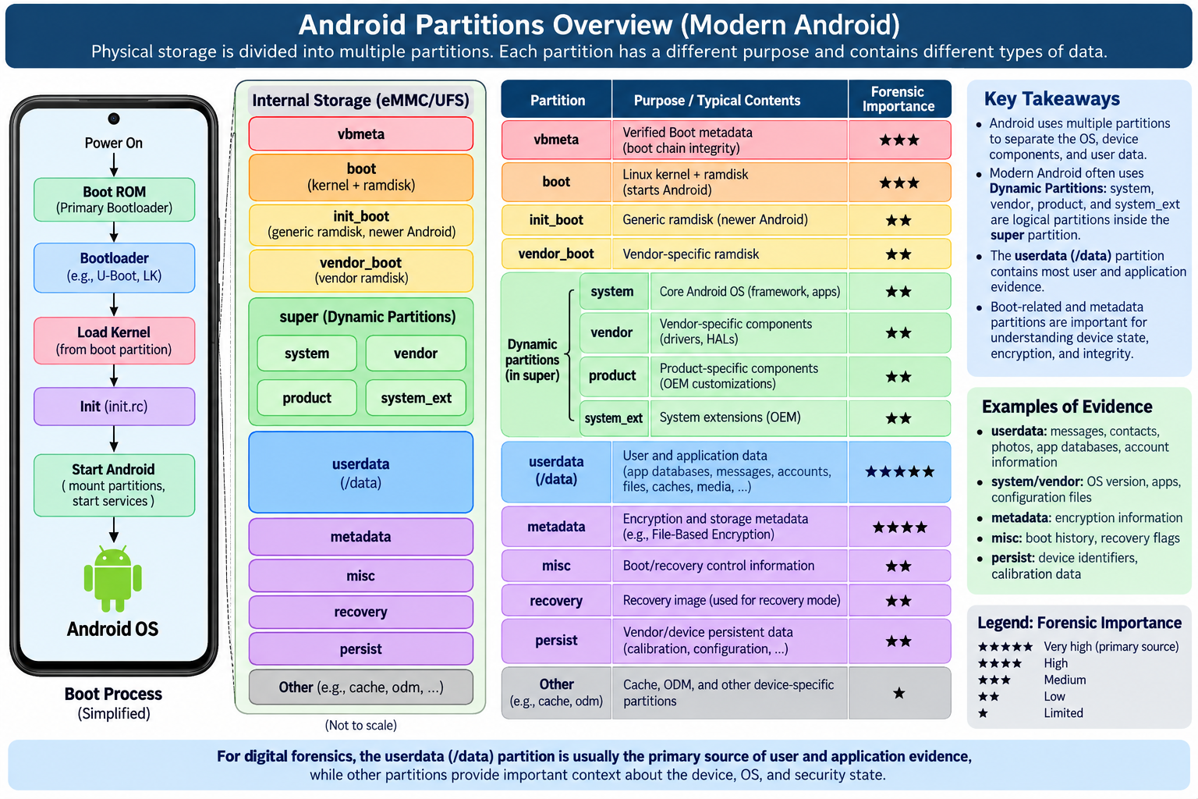
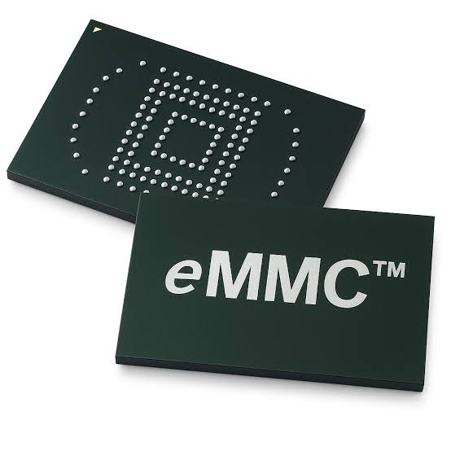

Slide 34
Mental model
userdata → What did the user/apps do?
system / vendor / product → What software and configuration were present?
boot / vbmeta / misc → How did the device boot, and was the boot chain trusted?
metadata → How was storage/encryption managed?
super → How are modern Android logical partitions organized?

Slide 35
Partition | Purpose / Typical contents | Forensic importance
userdata/(/data) | Stores user and application data. Includes app-private directories, SQLite databases, shared preferences, account-related data, messages, browser artifacts, caches, downloaded files, media references, and other user-generated content. This is usually the primary forensic evidence source. | ★★★★★
system | Contains the core Android operating system, including framework components, system libraries, system apps, configuration files, and other AOSP components needed for Android to operate. Useful for identifying OS version, installed system components, and system configuration. | ★★
vendor | Contains hardware- and manufacturer-specific software, such as HAL implementations, vendor libraries, device configuration, firmware-support files, and hardware-specific services. Useful for understanding device-specific behavior and hardware support. | ★★
product / system_ext | Contains OEM- or product-specific extensions to Android, including additional system apps, framework extensions, permissions, overlays, configuration, and manufacturer customizations. Helps identify vendor modifications to stock Android. | ★★
boot | Contains the Linux kernel and boot ramdisk used to start Android. The ramdisk includes early boot files and initialization logic. Useful for examining boot configuration, kernel version, rooting/modification, and acquisition-related issues. | ★★★
vbmeta | Stores Android Verified Boot (AVB) metadata, including hashes, signatures, and verification information used to validate boot-related partitions. Useful for determining boot integrity and whether system components may have been modified. | ★★★
metadata | Stores storage-management and encryption-related metadata. On modern devices it may support file-based encryption, metadata encryption, checkpointing, and related boot/storage functions. Important when interpreting encrypted devices and acquisition state. | ★★★★
super | A container partition for Dynamic Partitions. It typically holds logical partitions such as system, vendor, product, system_ext, and sometimes odm. It does not usually contain user evidence directly, but is important for reconstructing the modern Android partition layout. | ★★
misc | Stores small boot- and recovery-control information, such as bootloader messages, recovery commands, boot-mode flags, slot-related state, and other device-control metadata. Useful when investigating recovery activity or boot state. | ★★

Slide 36
iOS Partition List
Volume / Path | Description | Forensic Value
System (/) | Contains the core iOS binaries. This partition is cryptographically signed and read-only. | Low
Data (/private/var) | The Data Partition. This is where all user content, messages, and third-party app data live. | Critical
Preboot | Contains files needed to boot the OS (Apple Logo, login screen). | Low
Recovery | The environment used for "Find My iPhone" wipes or system repairs. | Low
VM | Virtual Memory / Swap space. (Temporary data). | Low

Slide 37
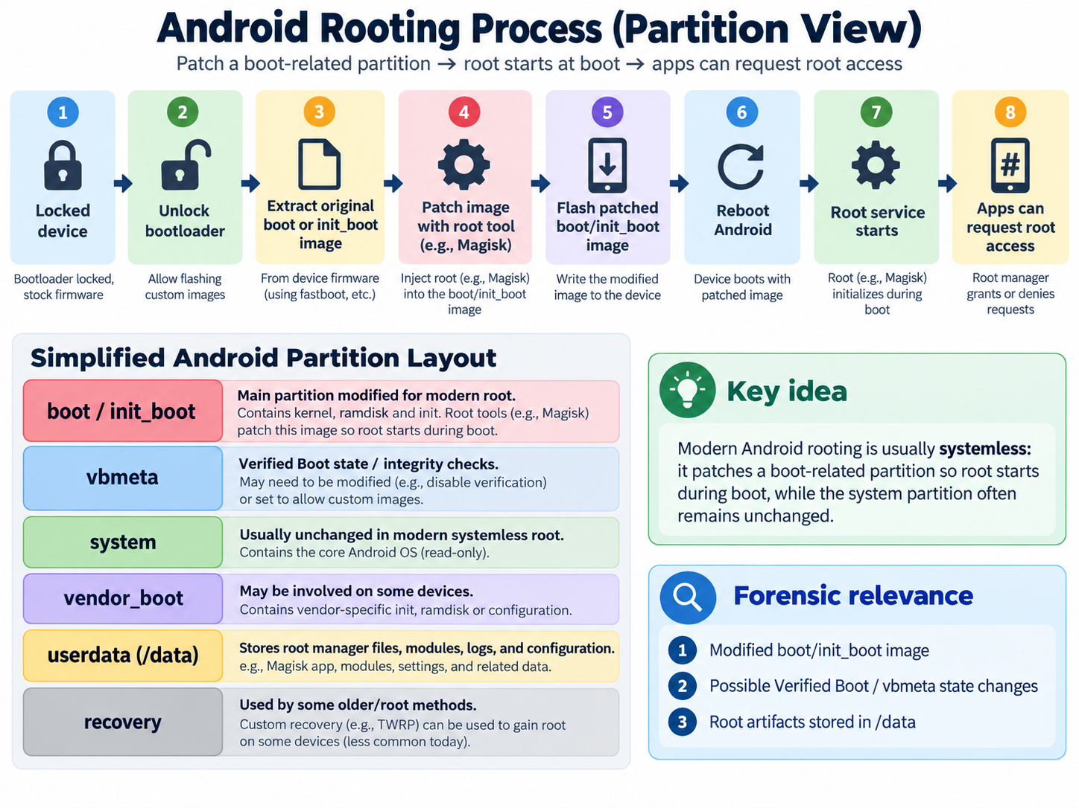

Slide 38
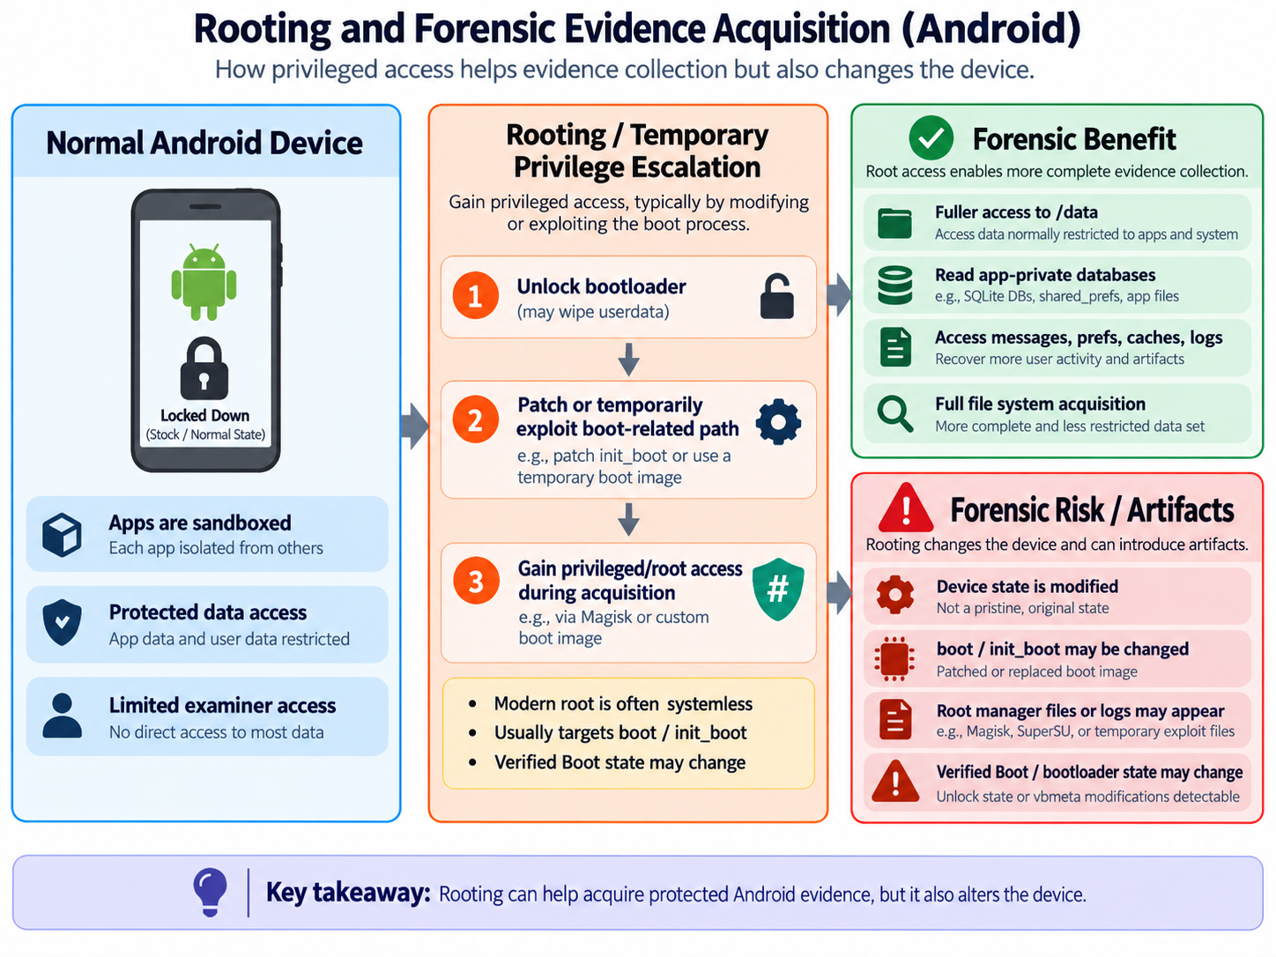

Slide 39
Commercial acquisition method | Typical evidence yield | Root / privilege? | Main limitation
Logical extraction | Low–Medium — contacts, calls, messages, media, and data exposed through Android APIs | Usually no | Limited access to app-private data; little or no deleted data
Agent-based extraction | Medium — data collected by a forensic agent running on the device | Usually no permanent root | Limited by agent permissions/device support; modifies device slightly
Temporary root / privilege escalation | High potential — enables access to protected /data and app-private files | Yes, temporarily | Device/version specific; may modify device state; does not automatically defeat encryption
Full File System (FFS) | High — app databases, preferences, files, caches, system artifacts | Sometimes obtained using root/exploit | Usually does not provide all raw/unallocated storage; encryption may still restrict data
Bootloader / chipset-level access | High–Very High — deeper filesystem or raw storage access | Not necessarily Android root | Device/chipset specific; encrypted data may remain encrypted
Physical extraction | Very High raw coverage — raw or near-raw flash/storage image | Varies | Modern File-Based Encryption can make raw data unusable without keys; acquisition can be complex

Slide 40
Data Acquisition method used by commercial forensics tools
Cellebrite
  Use multiple Android access techniques
    Full File System (FFS) extraction
    Its Advanced ADB documentation described a “unique temporary rooting method.”
Magnet AXIOM
  For a full Android image, if a device is not already rooted, AXIOM may attempt tested rooting methods to gain the required privileged access.

Slide 41
Acquisition Procedure

Slide 42
Mobile Forensics Steps
Preparation
Seizure
Acquisition
Analysis
Report

Slide 43
Acquisition
Physical acquisition
  bit-by-bit copy or disk imaging, tricky
Logical acquisition
  extracting the logical storage objects, such as files and directories
  data may be modified
Evidence only (Logical acquisition)
  message, call log, contacts, social apps, GPS, images, videos, and
  other common activities, browser history

