Slide 1

Troubleshoot Real-World Scenarios with Extended Events

Slide 2


Hi, I'm Tom Zíka a SQL Developer from the Czech Republic.
I optimize queries and chew bubblegum.
You can find me on Twitter @Zikato25.
https://straightforwardsql.com
I work at alza.cz as a Database Specialist.

Slide 3
What are Extended Events?
Light weight monitoring solution for SQL Server
It’s more than a replacement for SQL Profiler
We will look at grabbing in our demos:
Data integrity errors (Unique constraint, not null column, data type overflows)
Security problems - missing permissions
Calling a non-existing object (typo, deletion)
Custom user checks and errors

Slide 4
Outline
Creating a new session
Configuring the events
Filtering
Aggregating
Viewing Data

Slide 5
Demos

Slide 6
Resources
Github - https://github.com/zikato/ExtendedEvents
Tom Zíka Blogs - https://straightforwardsql.com/tags/extended-events/
Jason Brimhall’s Blogs - https://jasonbrimhall.info/category/xevents/
Jonathan Kehayias’ Blogs - https://www.sqlskills.com/blogs/jonathan/category/extended-events/

Slide 7
Resources
10 DBA recipes with XESmartTarget - https://spaghettidba.com/2022/02/21/10-dba-recipes-with-xesmarttarget/

Slide 8
Thanks!
👍
Any questions?
You can find me
on Twitter @Zikato25

Slide 9
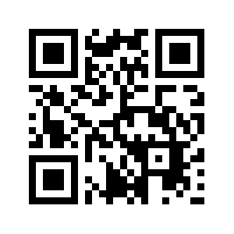
Please Provide Feedback!
https://sqlb.it/?7140

Slide 10
Credits
Special thanks to all the people who made and released these awesome resources for free:
Presentation template by SlidesCarnival
Photographs by Unsplash

