Slide 1

Lab 01 report basic java syntax
Siem khattyavatey (p20250056) ; Group 3
I2-IP-Group AIECS

Slide 2
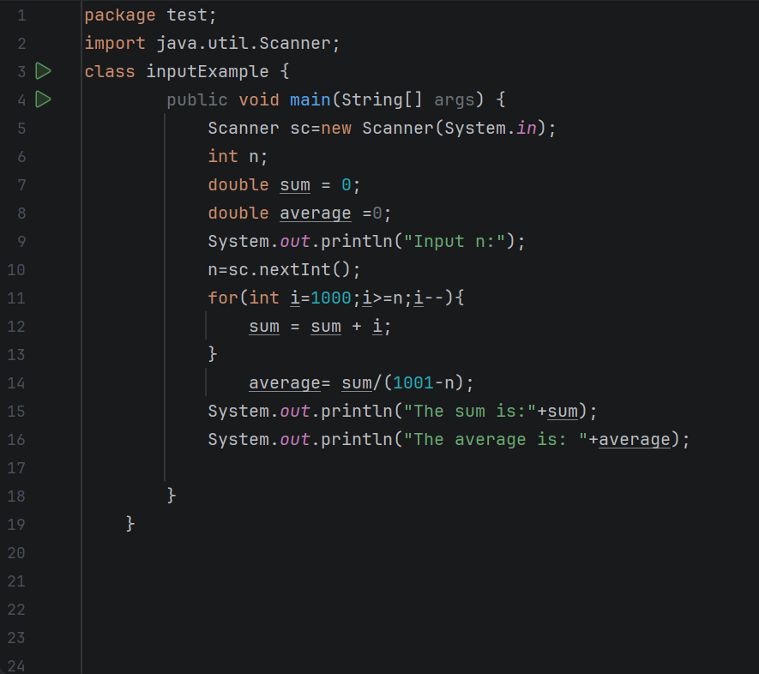

Exercise 1
Ask a user for a number, say n. Display all sequence numbers from 1000 to n. Find the sum and the average of these numbers and display on screen.
.

Slide 3

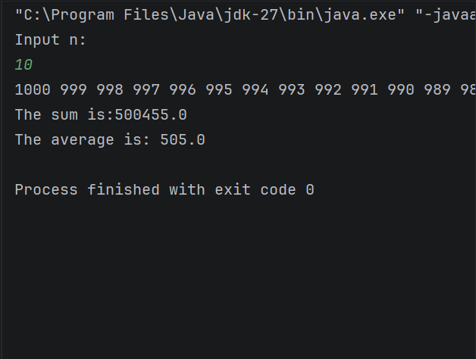
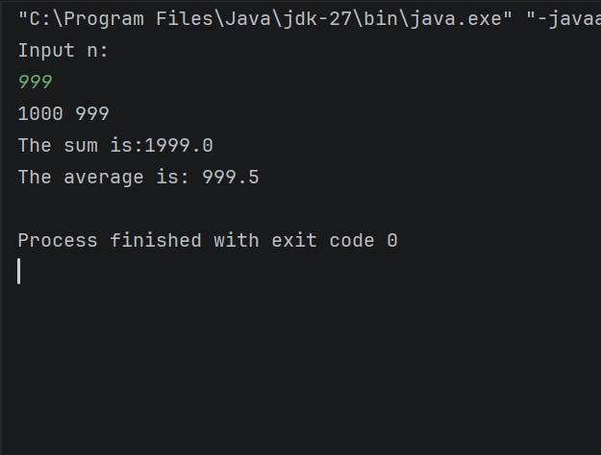
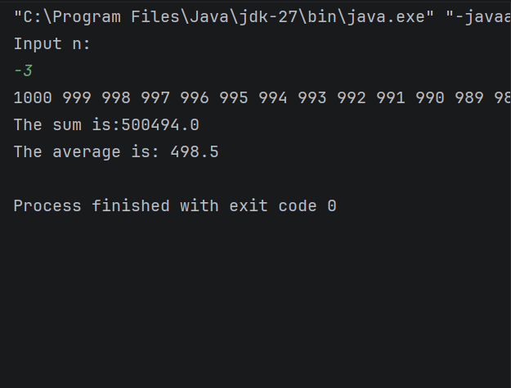
Output:

Slide 4
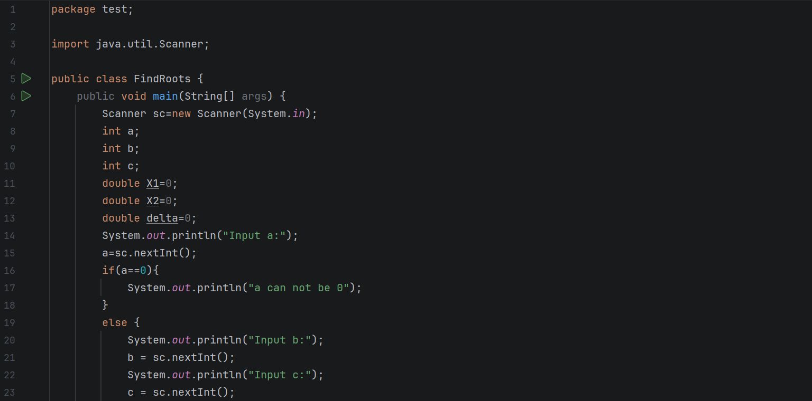
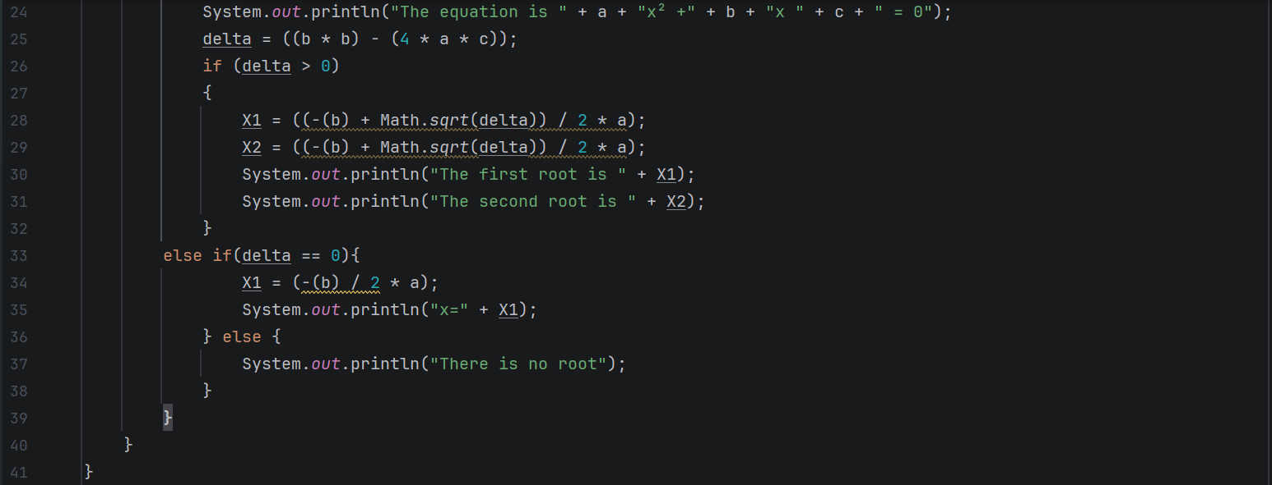

Exercise 2
Write a program to solve quadratic equation${ax}^{2}+bx+c=0$ using the following formula.
Ask the input a , b , c from the user . Then the program find the roots and display it on screen
$$x=\frac{−b±\sqrt{b^{2}−4ac}}{2a}$$

Slide 5
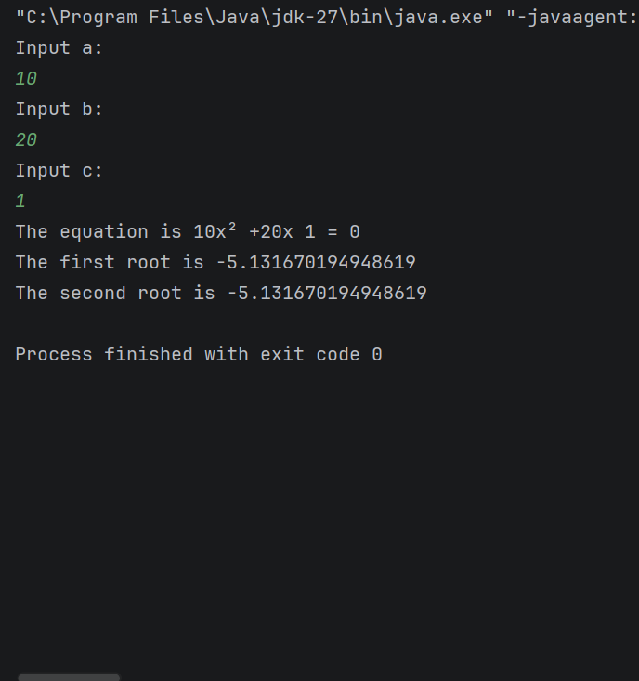
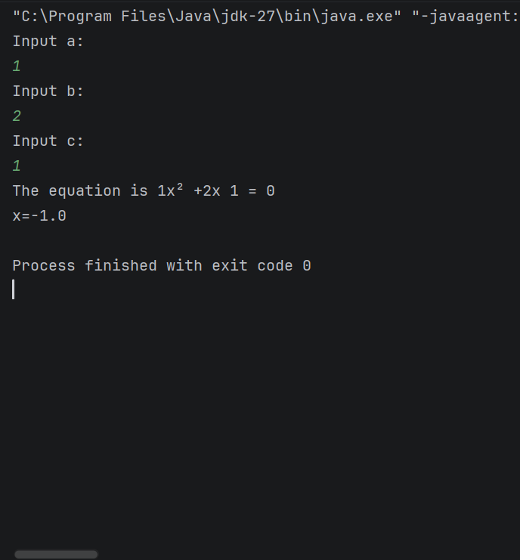
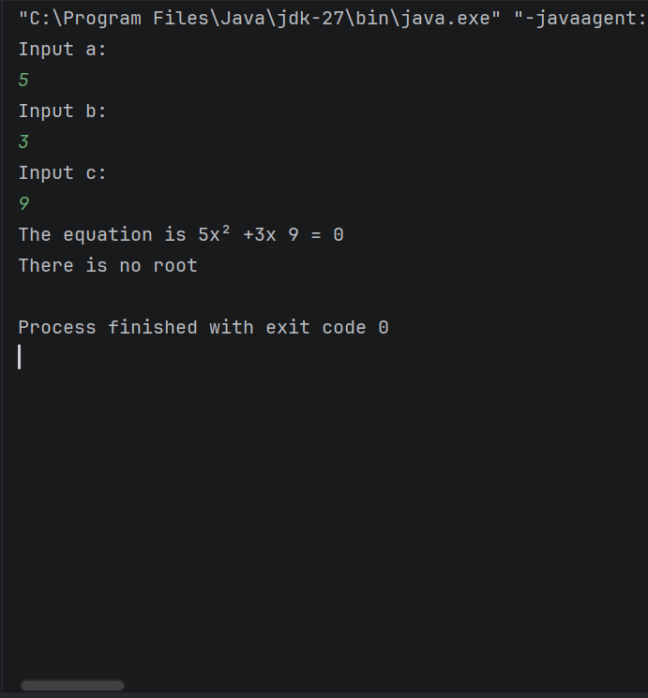
Output:
Delta is bigger than zero
Delta is equal to zero
Delta is smaller than zero

Slide 6
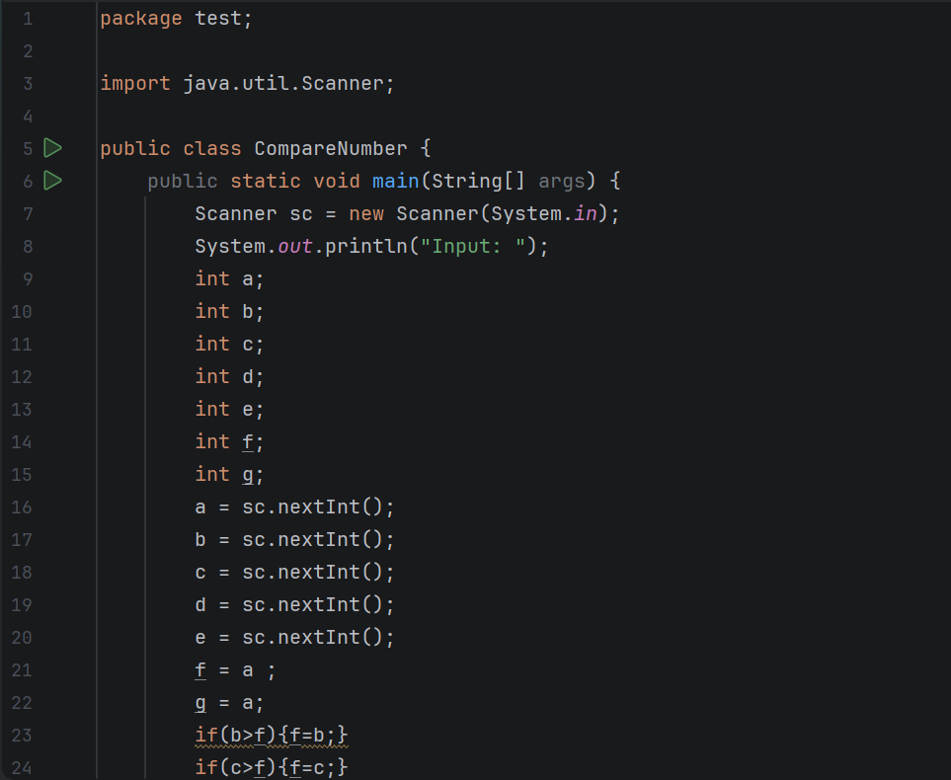
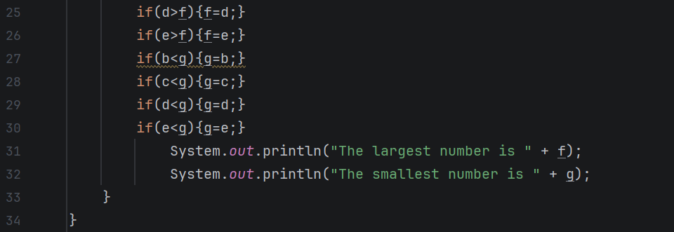
Exercise 3
Write a program that asks the user to input 5 numbers.
The program processes the input from the user and find out the minimum and maximum numbers.

Slide 7
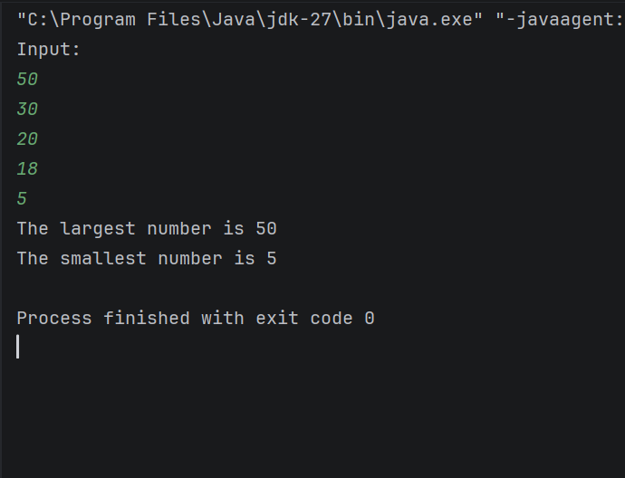
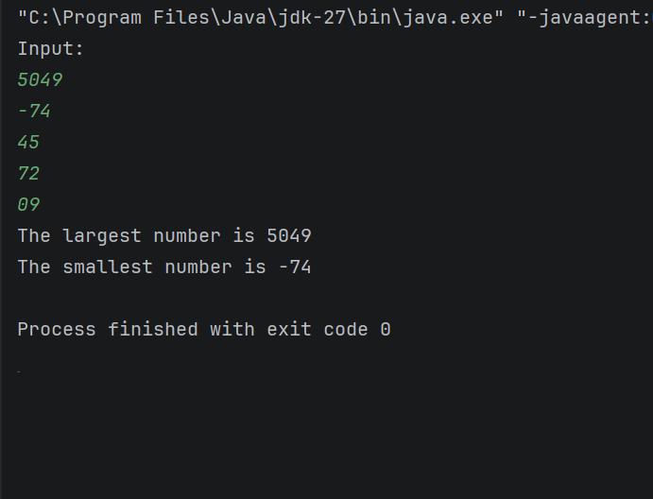
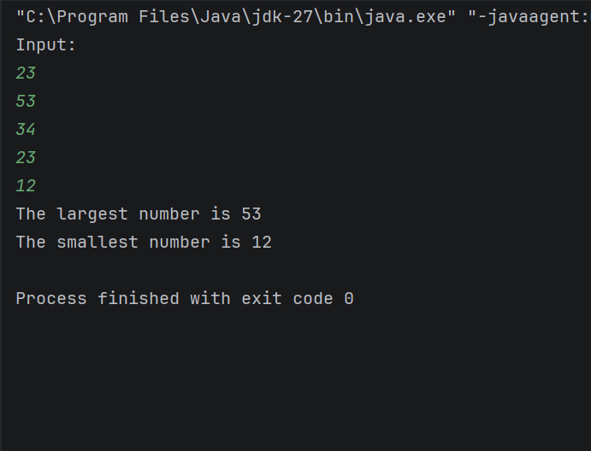
Output:

Slide 8
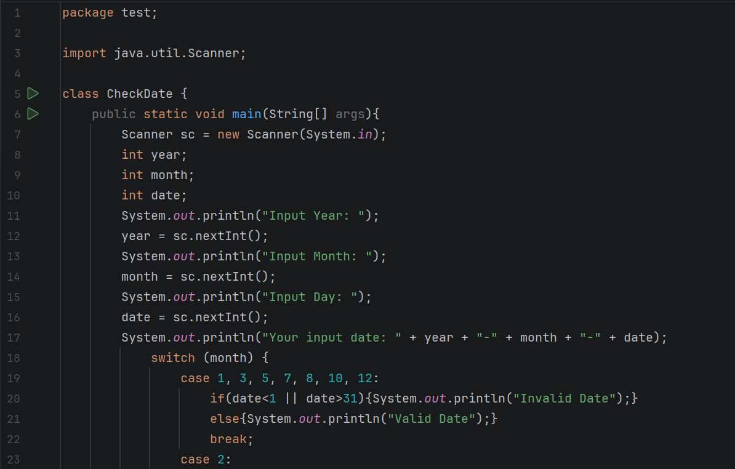
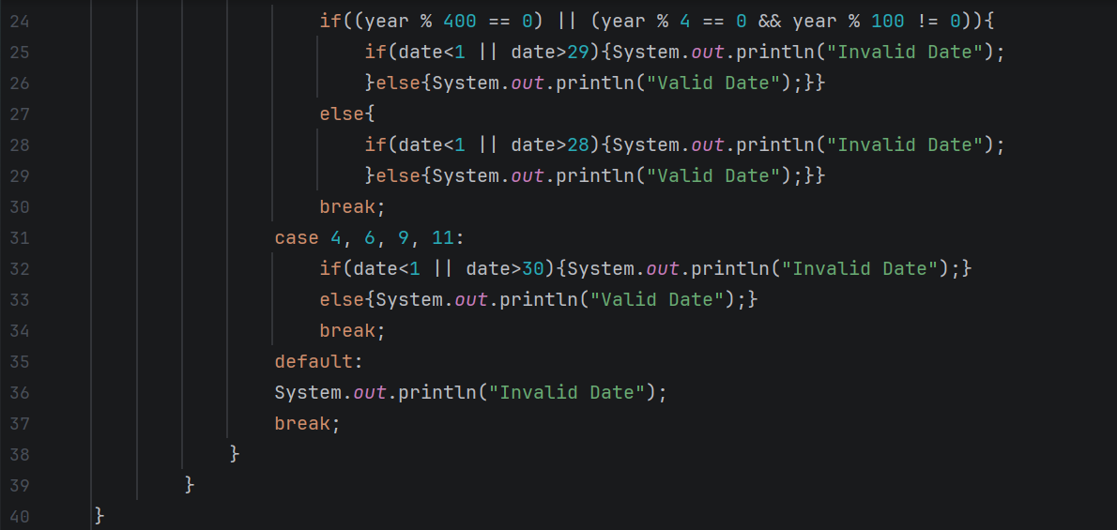
Exercise 4
Write a program that can check if the given input date (yy-mm-dd) is valid or invalid.

Slide 9
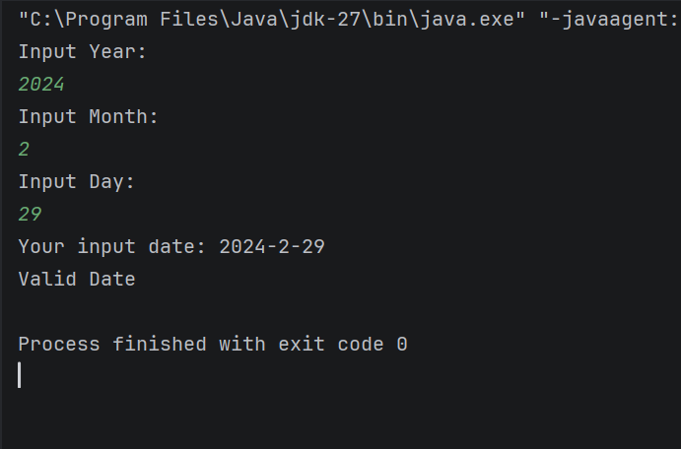
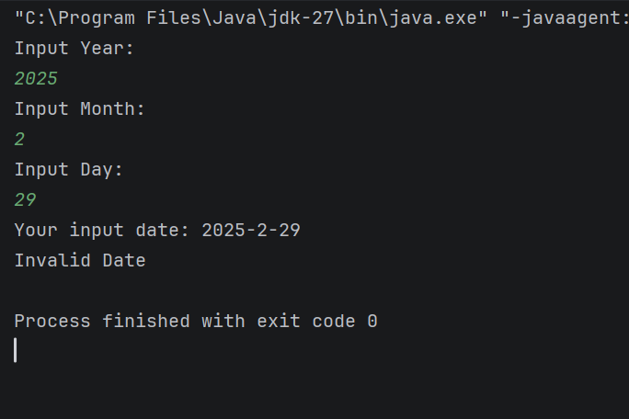
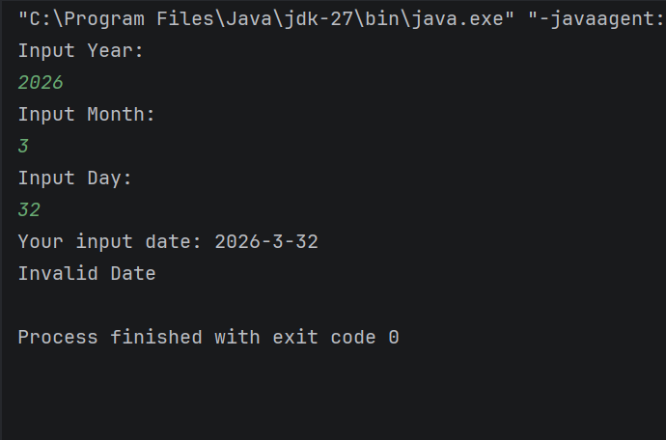
Output:
Leap year
Not leap year
Day exceed 31 day

Slide 10
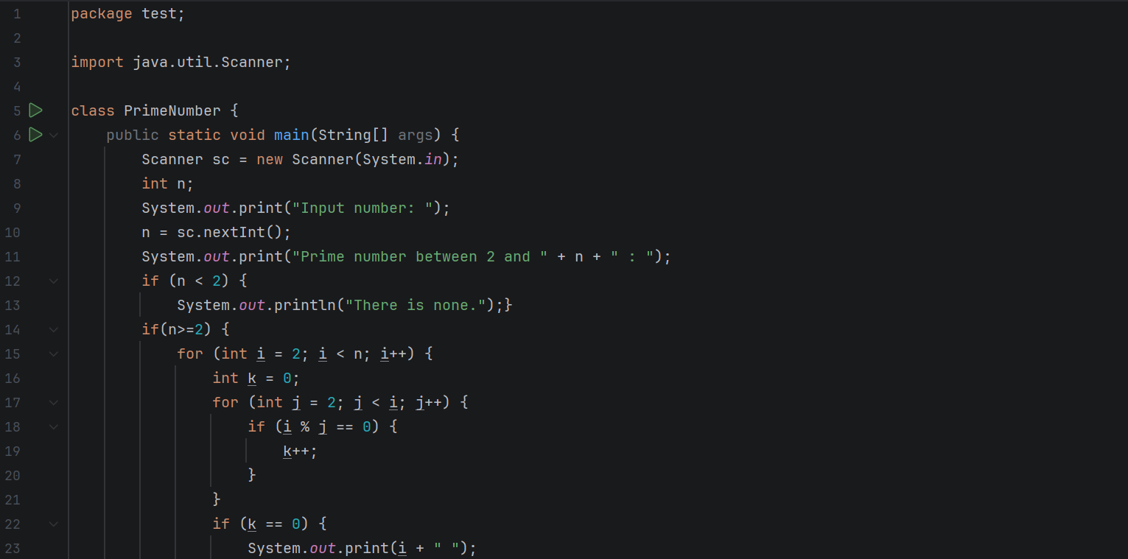
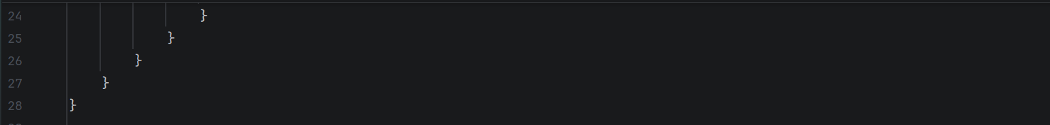
Exercise 5
Write a program that can display all prime number from 2 to n , where n is an input by user.

Slide 11
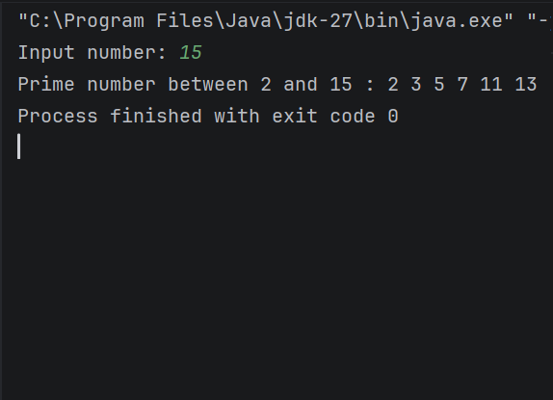
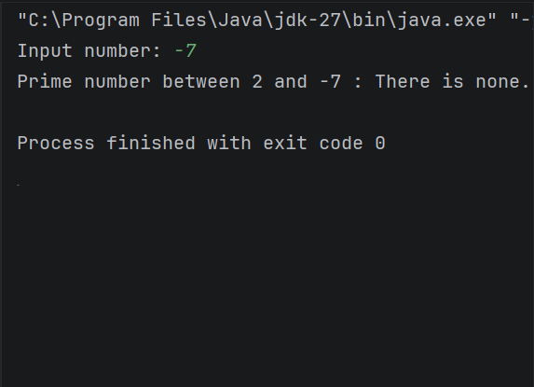
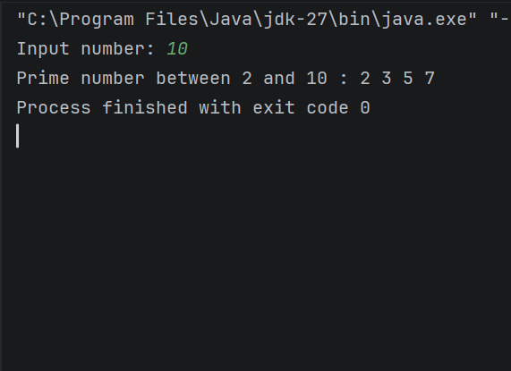
Output:

Slide 12
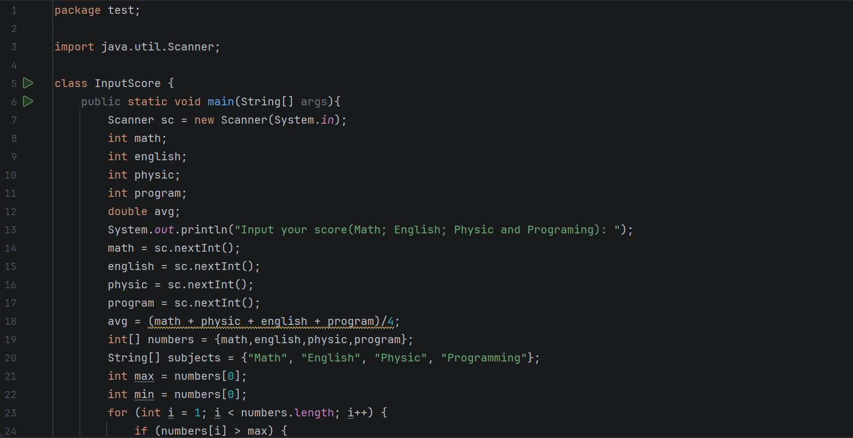
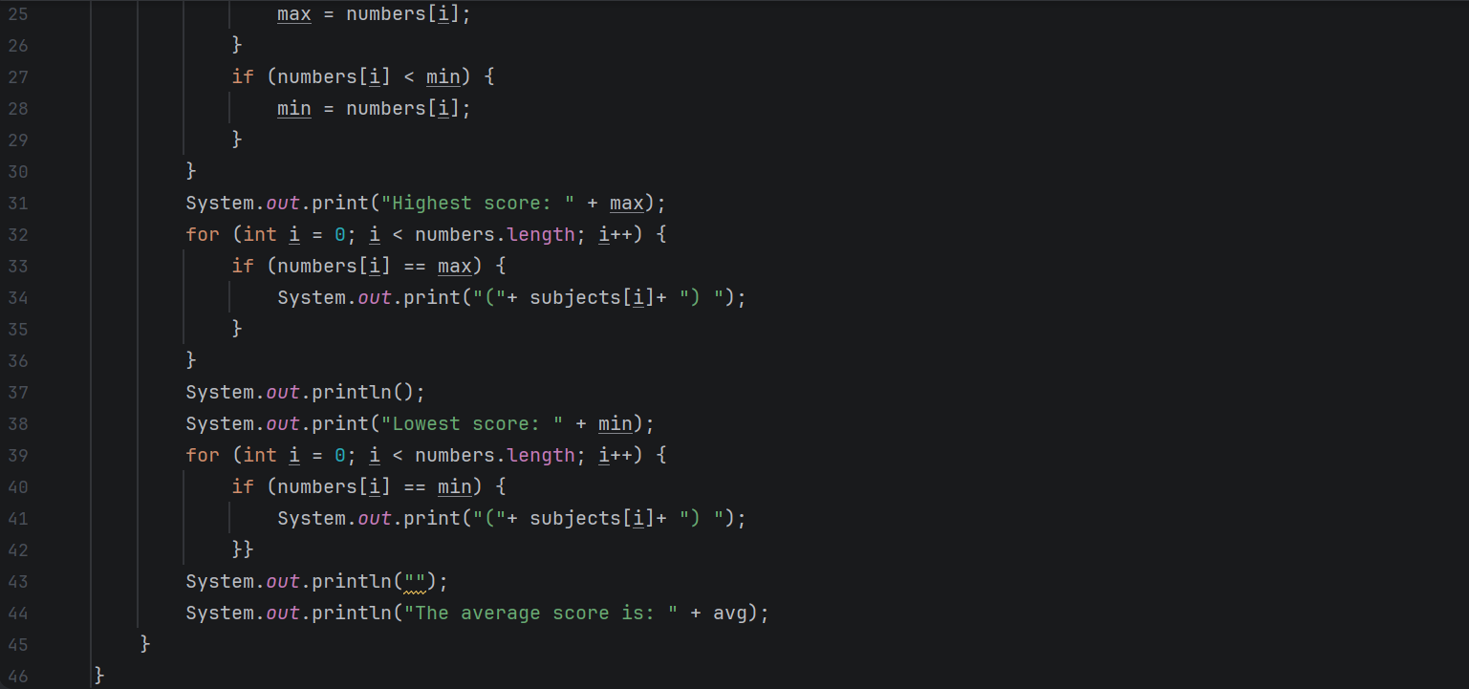
Exercise 6
Write a program that prompt the user for inputting the score of 4 subjects (Math , English, Physic, Programming).
a. Which course did the student got max score; min score?
b. What are the average score of this student?

Slide 13
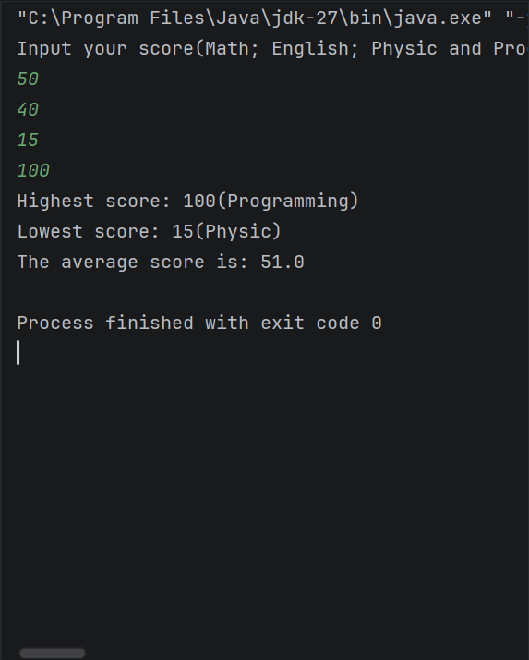
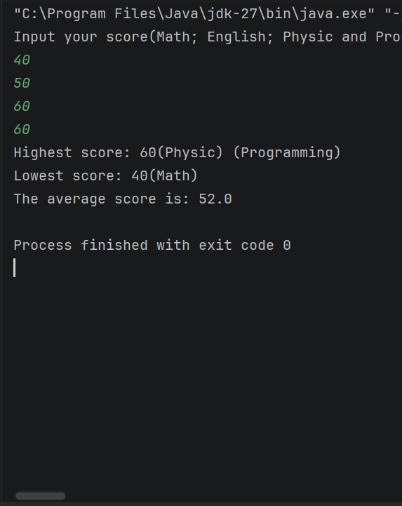
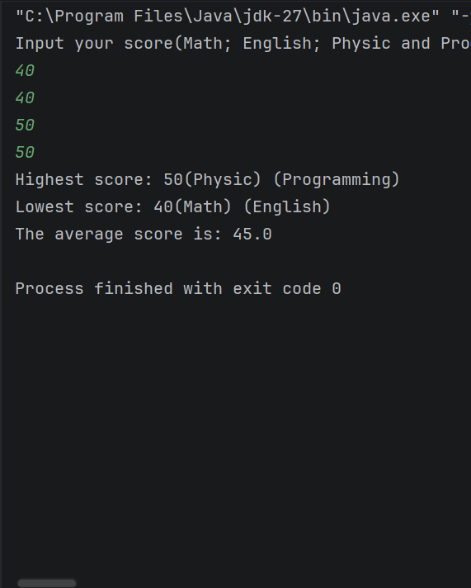
Output:

