Slide 1
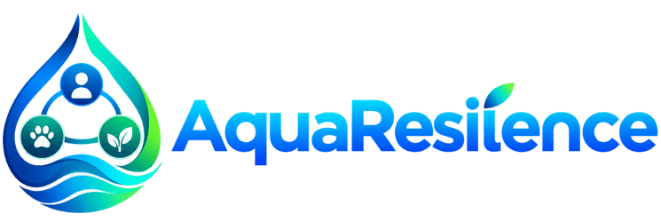
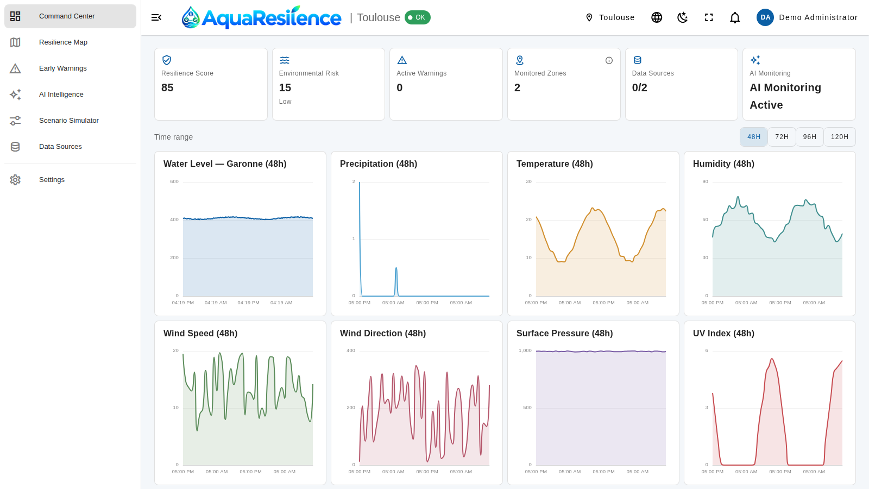
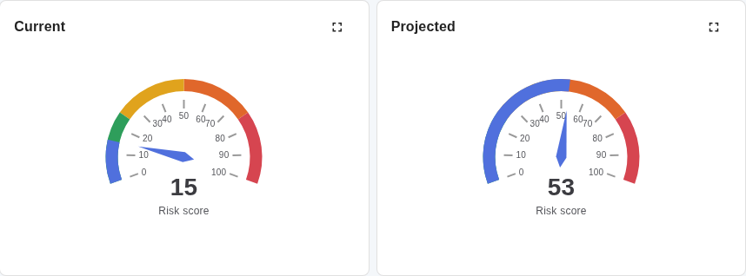
Early warning for healthier urban waters
OneAquaHealth IEEE Global Hackathon 2026
Track 6 · Resilience Informatics
Zakaria ABIDI
Notes:
Hi, I'm Zakaria Abidi, solo builder of AquaResilience for Track 6, Resilience Informatics. One sentence: AquaResilience turns open hydrology and weather data into an explainable risk score and an early warning, city by city.

Slide 2



Cities watch their waters after the damage
Sudden floods
Fragmented data
No shared warning view
Rivers and urban waterways can rise within hours. Reactive monitoring leaves communities little time to act.
Hydrology, weather and environmental feeds sit in separate national portals, each with its own format and API.
Operators and communities lack one explainable place to see risk, acknowledge alerts and plan ahead.
AquaResilience closes the gap: one shared, predictive view, from sensor to warning.
Notes:
The problem is not the lack of data, it is that data is scattered and reactive. We want communities and operators to see risk building before it becomes damage.

Slide 3




From open data to an actionable warning
1 Ingest
2 Score
3 Warn
4 Explain
Open hydrology and weather APIs, through reusable connectors.
Four weighted factors become one explainable 0–100 risk score.
Threshold-based early warnings: Active, Acknowledged, Resolved.
A validated AI situation brief per city, within a strict budget.
Open data sources, one connector each
Hub'Eau · Toulouse
Open-Meteo · Toulouse
eHYD · Vienna
Waterinfo.be · Ghent
NVE HydAPI · Oslo
Notes:
Four steps. Ingest open data, score the risk with a deterministic engine, raise warnings with a clear lifecycle, then let an AI explain the situation in plain language. Five connectors are already written.

Slide 4


Healthy waters, ecosystems and communities
Track 6: Resilience Informatics
Predictive dashboards, alerts and resilience tools for early warning and planning.
Waters
Ecosystems
Waters
River level, rainfall and rate-of-rise drive the risk score.
One Health
Ecosystems
Soil moisture, temperature, humidity, pressure and UV give environmental context.
Communities
Communities
Warnings, a nine-language interface and role-based access put it in people's hands.
Notes:
The One Health framing: the health of the water, the ecosystem and the people are one question. Our risk factors and our alerts map directly onto these three.

Slide 5



One Command Center for every city
At-a-glance KPIs
Resilience score, environmental risk, active warnings and AI monitoring status.
Live charts
Water level, precipitation, temperature, humidity, wind, pressure and UV.
Your time range
Switch between 48, 72, 96 and 120 hours; expand any widget full screen.
Screenshot: Command Center for Toulouse, built-in demo data
Notes:
This is the Command Center for Toulouse. KPI tiles on top, live charts below. The header shows the selected city and system status. The data shown here is the built-in demo dataset.

Slide 6
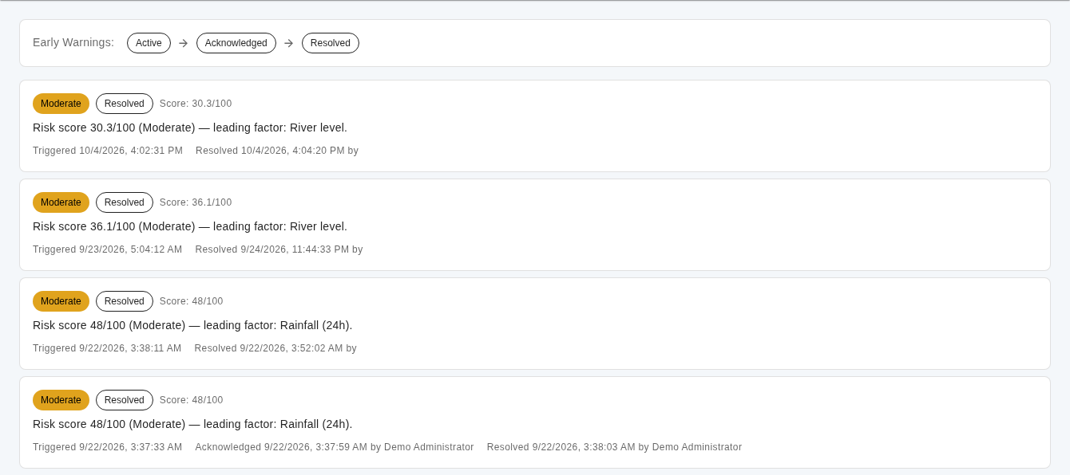
Early warnings with a clear lifecycle
Active
A risk threshold was crossed. Operators are notified.
Acknowledged
An operator has taken ownership.
Resolved
Severity from score bands
Full audit trail
Low, Moderate, High or Critical, from configurable thresholds.
Who acknowledged or resolved a warning, and when.
Conditions normalized; the history is kept.
Notes:
Every warning moves through three states. The platform records who acknowledged and resolved it. A high or critical warning can also trigger an automatic AI analysis, under the same budget as a manual refresh.

Slide 7
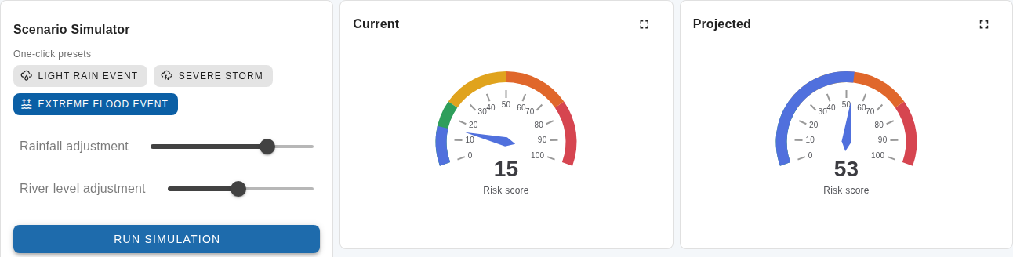
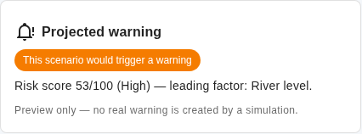
Scenario Simulator: what if it rains harder?
Risk score
15 → 53
Extreme flood preset on today's Toulouse data.
Presets or sliders re-run the real risk engine on current data.
Would trigger a High warning. Preview only: no real warning is created.
Light rain
Severe storm
Extreme flood
Notes:
The simulator answers 'what if' without touching real data. With the extreme flood preset the score goes from 15 to 53, a High warning. It is a preview only, nothing is written.

Slide 8
An explainable risk engine, not a black box
Rainfall (24 h)
Critical
75 and above
30%
vs. a 40 mm reference
Hydrology
Weighted average
High
50 to 75
30%
level vs. station history
0–100
Environmental
Moderate
25 to 50
20%
risk score
soil moisture
Trend
Low
below 25
20%
6-hour rate of rise
Missing data? That factor is dropped and the others are renormalized. Weights and thresholds are editable in Settings.
Notes:
The score is a plain weighted average of four factors, so anyone can audit it. If a factor has no data, it drops out and the remaining weights are renormalized, so the score never silently under-counts. Weights and thresholds live in Settings.

Slide 9








AI explains. Rules decide.
Risk engine
Structured output
Honest confidence
Deterministic, tested and explainable. The AI never calculates risk.
Validated JSON, not a free-form chatbot.
Confidence and limitations are shown.
No medical claims
Graceful degradation
No diagnosis and no official emergency statements.
If the AI is down, the platform keeps working. Tested.
AI situation brief
One per city, rotated under a shared daily budget. It reads the score and explains it in plain language.
Budget and cooldown
Keys stay secret
Daily ceiling and cooldown enforced server-side.
Encrypted at rest; the provider is configurable.
Notes:
Responsible AI by design. The AI is never the source of truth: the deterministic engine is. The AI writes a structured, validated brief, shows its confidence and limits, makes no medical claims, and is held to a daily budget and cooldown on the server.

Slide 10
A production-grade, open architecture
Frontend
nginx
FastAPI backend
Data
Vue 3 + TypeScript
Reverse proxy, single entry point, HTTP or HTTPS
Auth: JWT + role-based access
PostgreSQL + PostGIS
Vuetify
Risk engine
Stations, measurements, warnings, geography
Pinia
Connector registry
vue-i18n
Scheduler (APScheduler)
Redis
ECharts
Login rate limiting, health
MapLibre GL
AI brief service
External open data and AI provider (optional)
Hub'Eau
Open-Meteo
eHYD
Waterinfo.be
NVE HydAPI
AI provider
Notes:
Everything runs from one docker compose command. nginx is the single entry point, FastAPI hosts the risk engine, connectors and scheduler, PostgreSQL with PostGIS stores the data, and Redis handles login rate limiting. External sources feed the connector registry.

Slide 11



Built for everyone, in nine languages
English
Français
Español
Light and dark themes
Comfortable in a control room or in daylight.
Português
Norsk
Ελληνικά
Role-based access
Viewer, Operator and Administrator, with per-user custom overrides.
Deutsch
Italiano
Nederlands
Accessible controls
Labelled controls and keyboard-friendly Vuetify components.
Every label, chart title and alert message is translated. Switch language at any time, even on the login page.
Secure by default
JWT sessions, rate-limited login and a maintenance-mode gate.
Notes:
The interface is available in the nine languages of the OneAquaHealth consortium countries. Roles control what each person can see and do, and the platform has light and dark themes.

Slide 12



Starts in Toulouse, scales to nine cities
One connector per city
Oslo
A reusable interface: a new city is one class and one registry line.
Ghent
Vienna
Honest by design
Toulouse
A city without a live connector shows a clear 'no live data' state, never borrowed numbers.
Barcelona
Naples
Coimbra
Athens
Deploy anywhere
Holon
Docker Compose with nginx; HTTP-only demo mode or full HTTPS.
Live data (Toulouse)
Connector built
Planned
Notes:
Toulouse is live today. Vienna, Ghent and Oslo have connectors written. Coimbra, Athens, Barcelona, Naples and Holon are the next steps, each one connector away. Cities without live data say so plainly.

Slide 13

What's next for AquaResilience
Every consortium city live
Per-city early warnings
Finish the remaining connectors and validate them with local partners.
Give warnings their own city scope, alongside per-city briefs.
Forecasting
Community channels
Extend the predictive trajectory with calibrated short-term models.
Alert delivery and citizen-science observations, in the user's language.
Zakaria ABIDI, solo builder
Live demo and source code are linked on the Devpost submission. Thank you!
Notes:
Next: finish the connectors for the remaining cities, give warnings a city scope, add forecasting, and open community channels. Thank you, and I'm happy to take questions.

