Slide 1
Javascrıpt hoıstıng
What ıs and how It works?

Slide 2
What ıs javascrıpt hoıstıng?
Hoisting is a JavaScript mechanism where variables and function declarations are moved to the top of their scope before code execution.
Of note however, is the fact that the hoisting mechanism only moves the declaration. The assignments are left in place.

Slide 3
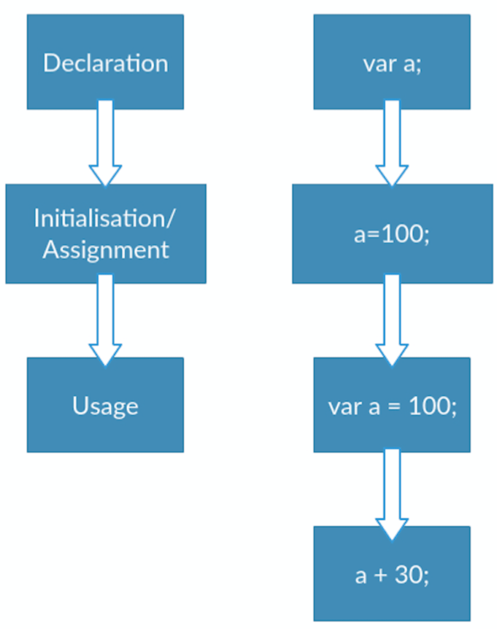
How ıt works
The following is the JavaScript lifecycle and indicative of the sequence in which variable declaration and initialisation occurs.
However, since JavaScript allows us to both declare and initialise our variables simultaneously, this is the most used pattern. It is however important to remember that in the background, JavaScript is religiously declaring then initialising our variables.

Slide 4
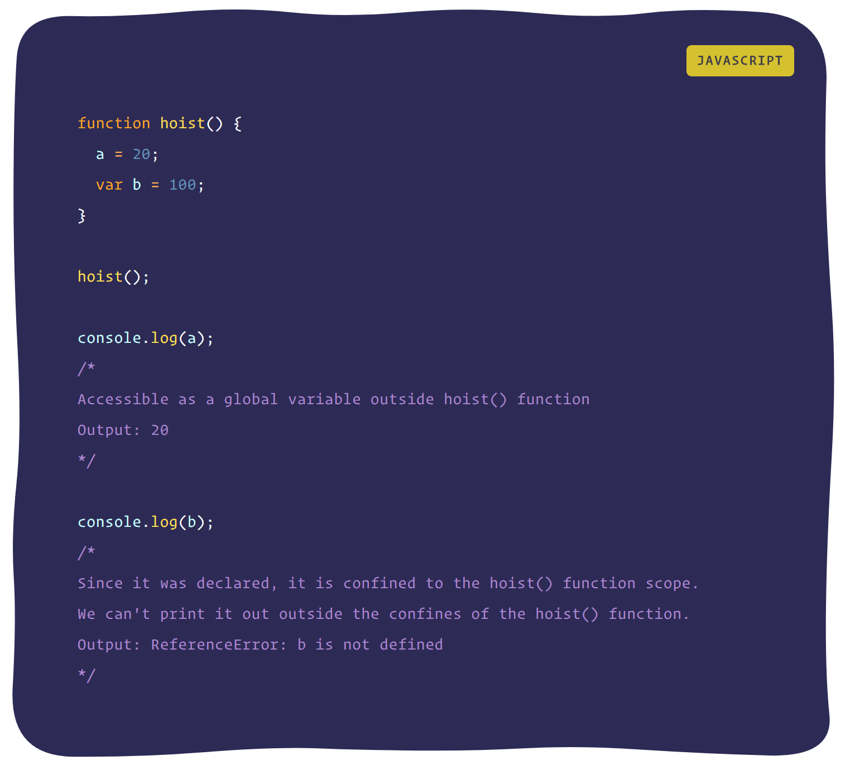
How ıt works ?
All variable and function declarations are hoisted to the top of their scope
Variable declarations are processed before any code is executed.
But undeclared variables ?

Slide 5
How ıt works
Undeclared variables do not exist until code assigning them is executed. Therefore, assigning a value to an undeclared variable implicitly creates it as a global variable when the assignment is executed.
All undeclared variables are global variables.

Slide 6
Recommendation
Always declare variables regardless of whether they are in a function or global scope.

Slide 7
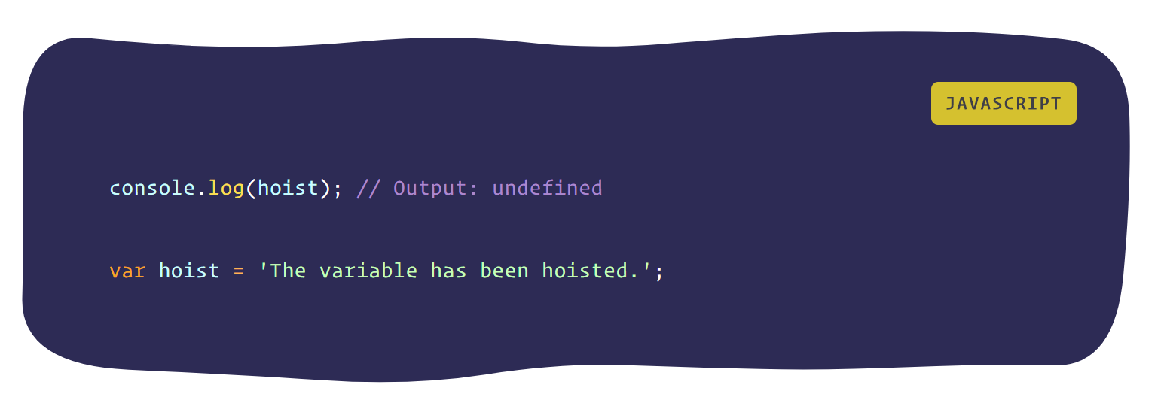
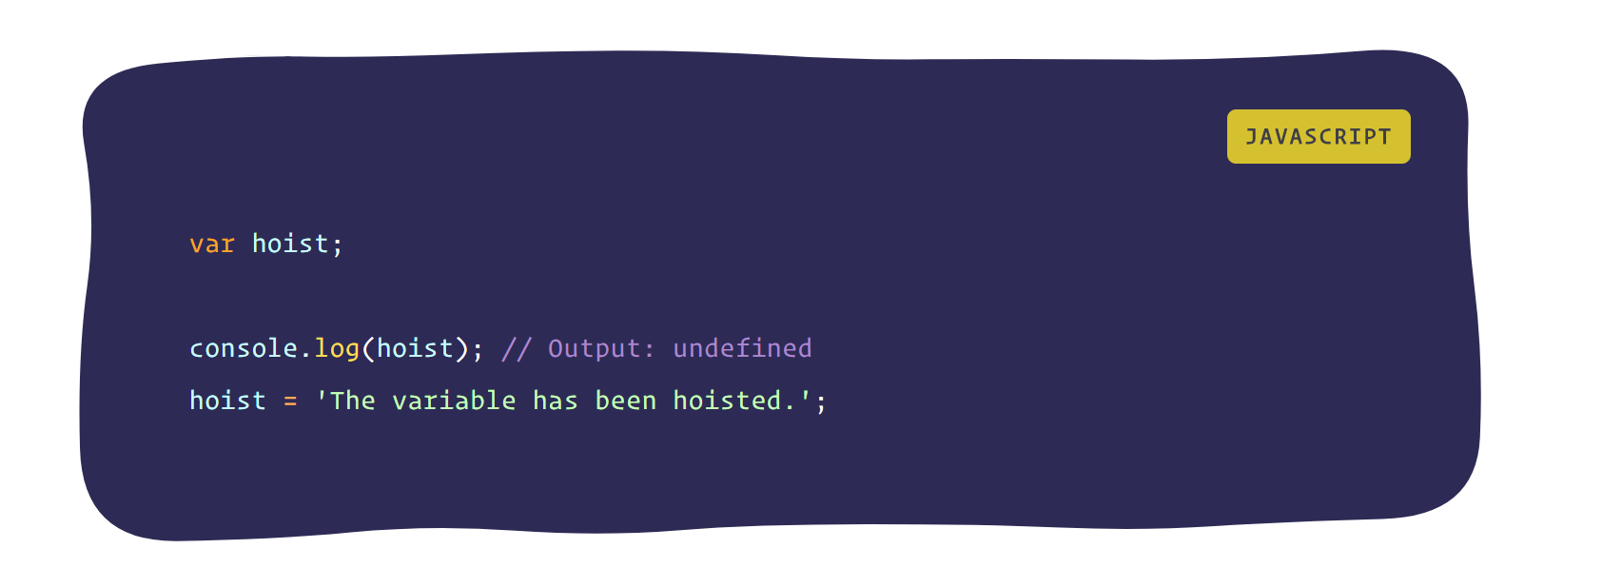
Code examples
Code in editor
Code in runtime

Slide 8
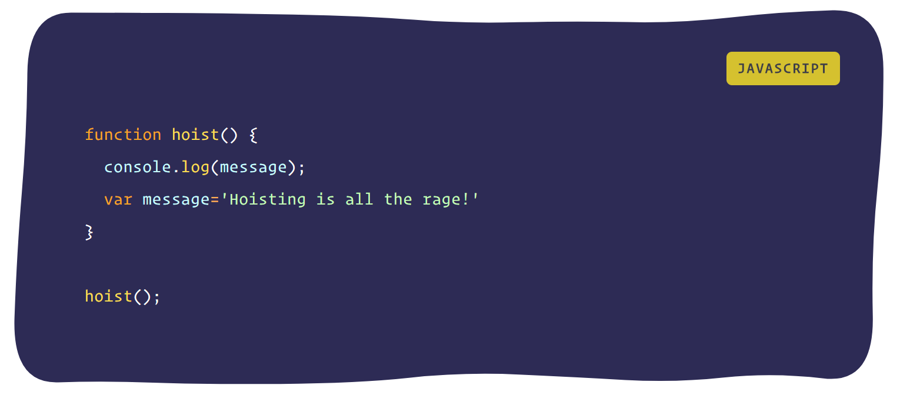
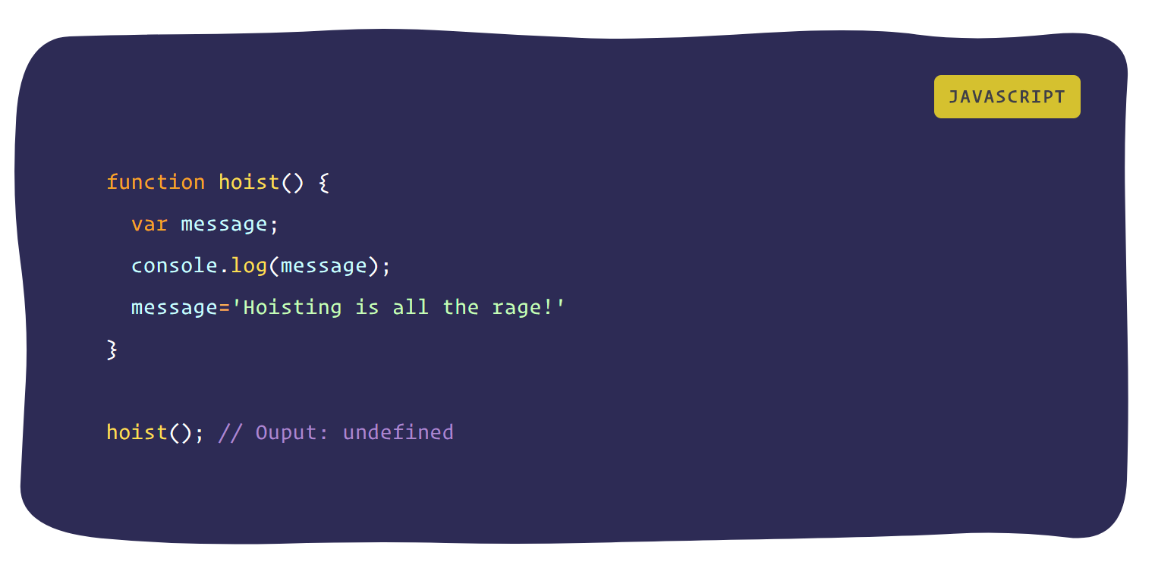
Function scoped variables
Code in editor
Code in runtime

Slide 9
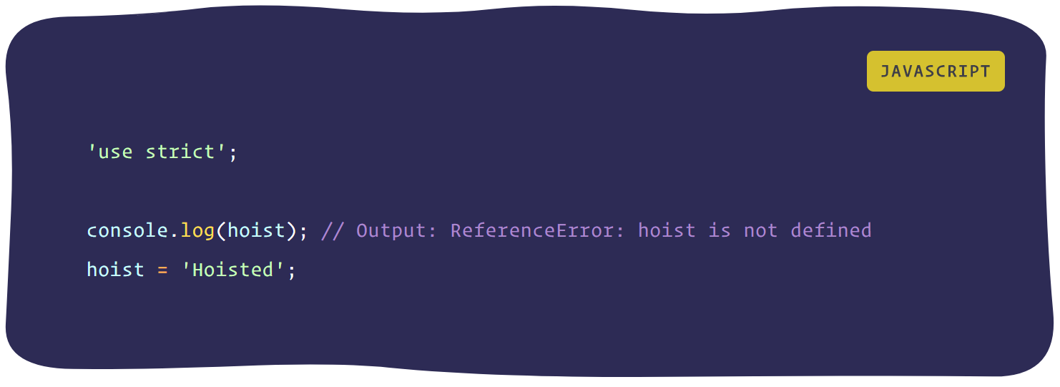
Strict Mode
Thanks to a utility of the es5 version of JavaScript known as strict-mode, we can be more careful about how we declare our variables.
By enabling strict mode, we opt into a restricted variant of JavaScript that will not tolerate the usage of variables before they are declared.

Slide 10
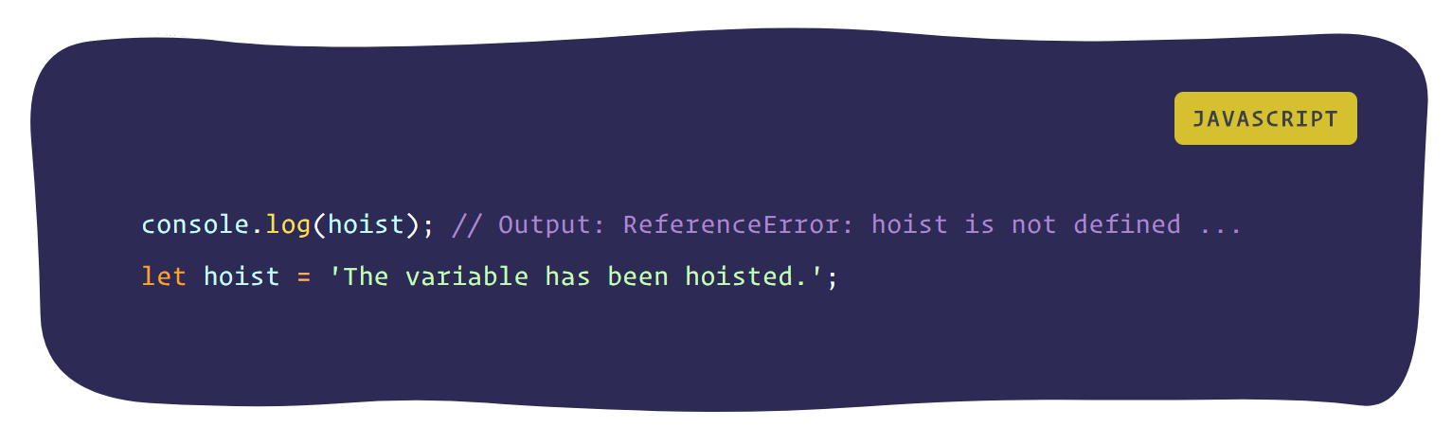
ES6 - ECMAScript 2015
Like before, for the “var” keyword, we expect the output of the log to be “undefined”.
However, since the es6 let doesn't take kindly on us using undeclared variables, the interpreter explicitly spits out a ”Reference” error.
“This ensures that we always declare our variables first.”

Slide 11
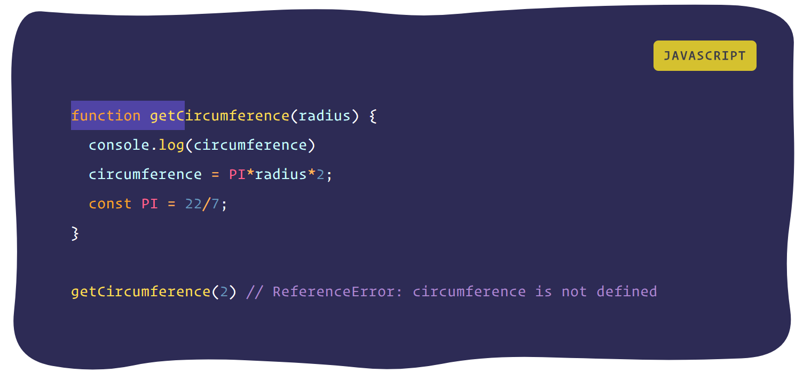
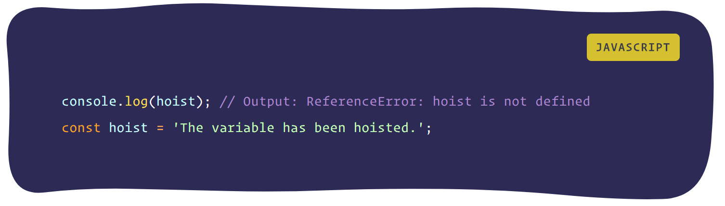
Const - Immutable variables
With “const” es6 goes further. The interpreter throws an error if we use a constant before declaring and initialising it.

Slide 12

Thanks …

