Slide 1

GREETING & MY SELF

Slide 2
Agenda
Objective
Sapaan Asas (Basic Greeting)
Bertanya Khabar (Greet)
Kata Ganti nama diri (personal pronouns)
Contoh ayat struktur pengenalan diri (example for personal pronouns)

Slide 3
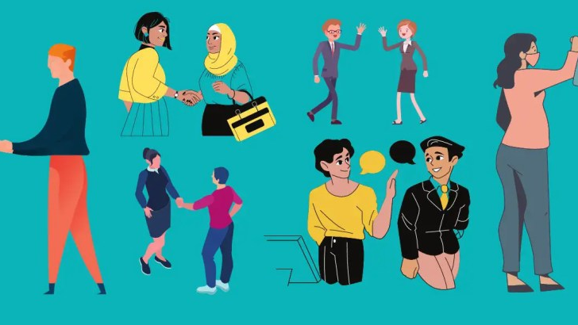
Sapaan (Greeting)

Slide 4
Sapaan Asas (Basic Greeting)
BAHASA ENGLISH | BAHASA MELAYU
Hi / Hello | Hai / Halo
Good Morning | Selamat Pagi
Good Afternoon | Selamat Tengah Hari
Good Evening | Selamat Petang
Good Night | Selamat Malam

Slide 5
Bertanya Khabar (Asking & Responding to Greeting)
BAHASA ENGLISH | BAHASA MELAYU
How are you? | Apa Khabar
I’m Good | Khabar Baik
I’m Healthy | Saya sihat
Thank you | Terima Kasih
You’re welcome | Sama-sama

Slide 6
Let’s Matching It !!
Selamat Pagi
Selamat Malam
Apa Khabar?
Hai
Terima Kasih
How are you?
Good Morning
Hi
Thank you
Good Night
Notes:
B
E
A
C
D

Slide 7

Pengenalan Diri
Myself

Slide 8
Kata Ganti Nama Diri (Personal Pronouns)
BAHASA ENGLISH | BAHASA MELAYU
I / Me / My / Mine | Saya
You | Awak / Kamu
He / Him / His / She / Her | Dia
We (Exclusive) | Kami
We (Inclusive) | Kita
They | Mereka
Everyone | Semua Orang

Slide 9
Pengenalan Diri (Self Introduction)
BAHASA MELAYU | MEANING IN ENGLISH
Nama Saya…… | My name is ……..
Saya dari ………. | I am from ………
Umur saya …….. tahun | I am ………. Years old
Saya seorang ……… | I am a ……..
Saya tinggal di ………. | I live in ………
Saya Suka ………. | I like ……….

Slide 10
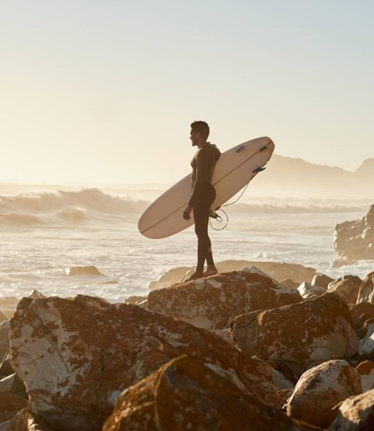
What?
Write 5 sentences using the sentences you have learned.

