Slide 1
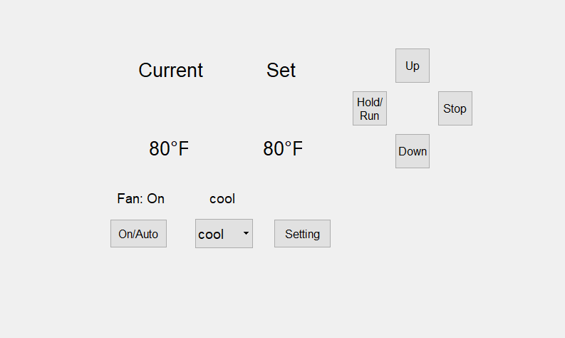
Turn Up the Temperature setting
Set Temperature
Indoor Temperature
Hold/Run Schedule
Turn down the Temperature Setting
Current Fan Mode
Fan Mode: ON/AUTO
Switch Cool/Heat Mode, or AC off
Switch to Schedule and Mode Page

Slide 2
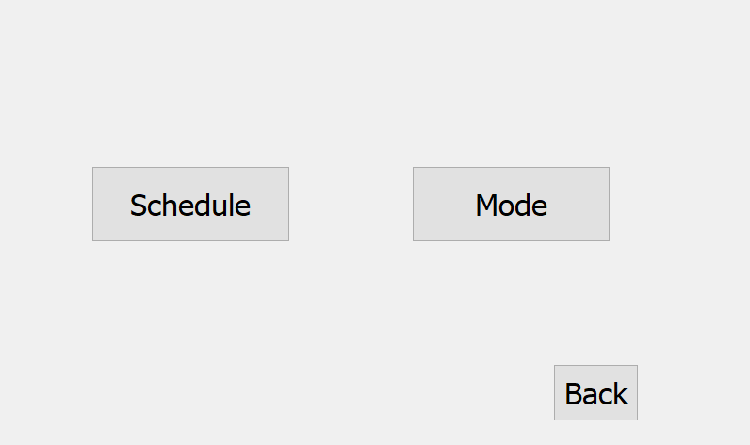
Change Schedule Settings
Change Mode Settings
Return to Main Page

Slide 3
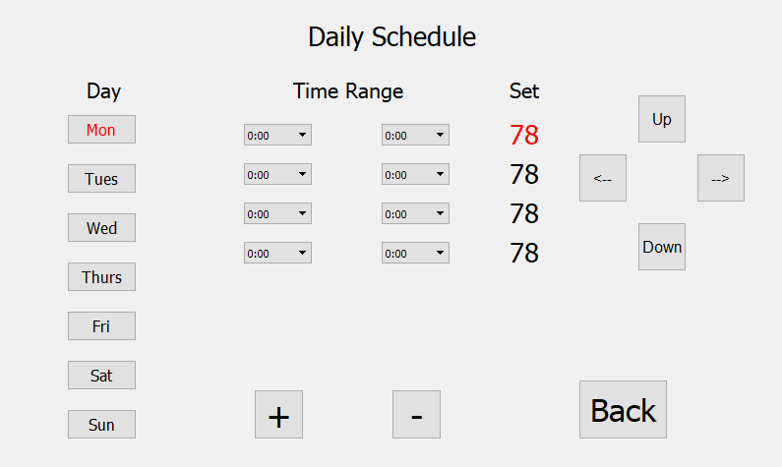
The Start Time
The End Time
Turn up the Temperature Setting
Move the Position of Set Up and Down
7 Days
Turn down the Temperature Setting
Back to Main Page and Set Schedule
Add a Time Range (Maximum is 6)
Time Range 12am~12pm
Decrease a Time Range (Minimum is 4)

Slide 4
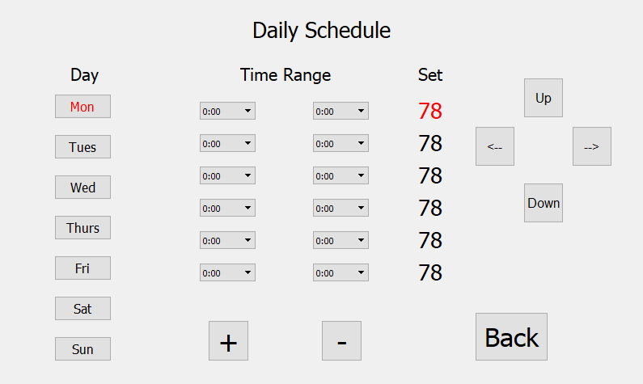
New Adding Time Range

Slide 5
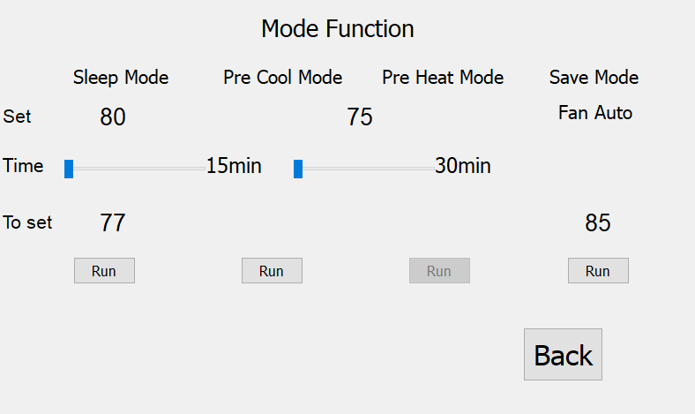
Set Mode Temperature
Cycles through preset time setting 15,30,60,90mins
Run the Sleep Mode
Run the Pre-Cool Mode
Run the Pre-Heat Mode
Run the Save Mode

Slide 6
Mode Function:
(1) Save Mode
Save mode is intended to help user reduce household power consumption. When the user leaves the house, the Save Mode can be turned on. The system then does the following:
If the Temperature mode is set to Cool, the Save Mode Temperature increases the set temperature to 5 degrees Fahrenheit above the current set temperature.
If the Temperature mode is set to Heat, the Save Mode Temperature decreases the set temperature to 5 degrees Fahrenheit below the current set temperature.
(2) Pre-Heat/Pre-Cool Mode
When the user sets up the Pre-Heat or Pre-Cool mode, the system takes into account the estimated-time-of-arrival of the user and begins a heat/cool cycle 15 minutes before arrival, during which it brings up or down the temperature to the set temperature. This feature is intended to make the house temperature comfortable for the user on arrival.
(3) Sleep Mode
Sleep Mode is intended to give a better sleeping experience. The Sleep Mode modifies the temperature settings in order to suit the body temperature changes as well as the environmental temperature flux, thus keeping the user comfortable throughout the night.

Slide 7
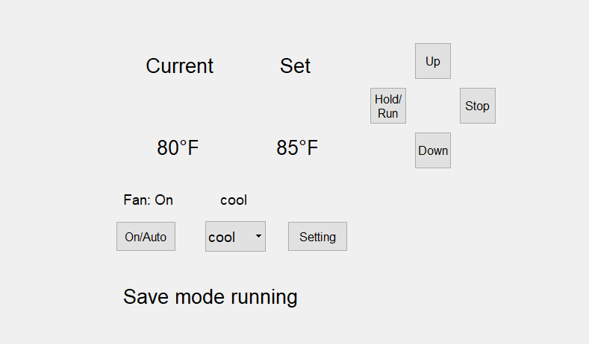
Save Mode Running
Set to Save Mode Temperature
When Save Mode is Running, this Will Show on Main page

Slide 8
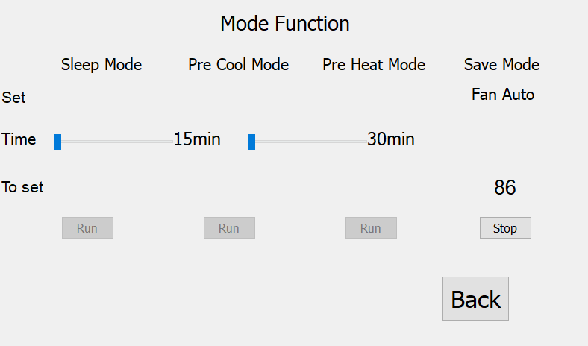
Save Mode Running
Cycles through Preset Time Setting 30,60,90mins
Stop the Save Mode Running
When Save Mode Running, Button cannot Press

Slide 9
Mention:
1. The Wi-Fi-Thermostat allows for users to set time schedules on the thermostat only using the thermostat interface. The phone application however can Hold or Run the time schedules.
2. Fan Modes:
a. In the Fan ON Mode, the Fan runs whether the AC Compressor is on or not.
b. In the Fan AUTO Mode, the fan works only when the AC Compressor is on.

