Slide 1




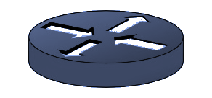

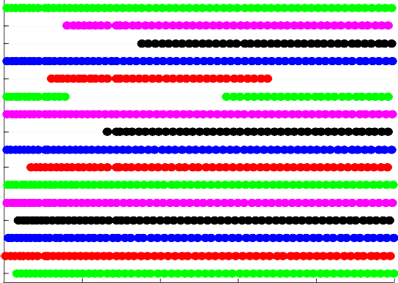
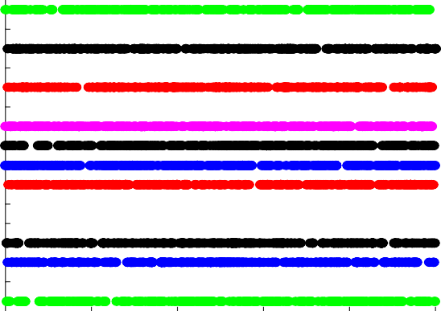





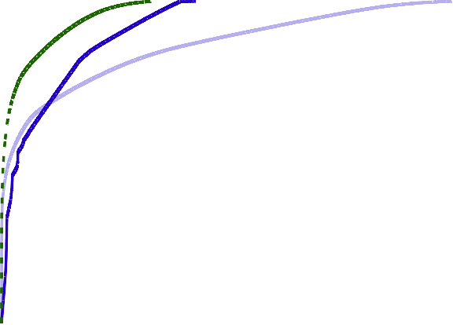
Suraj Jog, Zikun Liu, Antonio Franques, Vimuth Fernando, Haitham Hassanieh, Sergi Abadal, Josep Torrellas
Performance of Massive Multicores Bottlenecked by “Coherency Wall”
TX RX
CORE
TX RX
CORE
TX RX
CORE
TX RX
CORE
Speedup gained by parallelism and multithreading is outweighed by the wired network’s communication cost for keeping the caches coherent
a
Augment wired interconnect with millimeter wave transceivers to form Wireless Network-on-Chip
Latency : Enables every core to reach every other core in just 1-hop
Broadcast : Local changes in the cache of a core can be instantaneously replicated at all other cores with single packet transmission
CACHE
CACHE
CACHE
CACHE
TX
CORE
TX
CORE
TX
CORE
TX
CORE
_{RX} CACHE
_{RX} CACHE
_{RX} CACHE
_{RX} CACHE
CORE
CORE
CORE
CORE
TX
_{RX} CACHE
TX
_{RX} CACHE
TX
_{RX} CACHE
TX
_{RX} CACHE
TX
CORE
TX
CORE
TX
CORE
TX
CORE
_{RX} CACHE
ROUTER
_{RX} CACHE
_{RX} CACHE
_{RX} CACHE
ROUTER ROUTER ROUTER
Traditional Medium Access Protocols Fall Short
Traffic patterns on wireless NoCs tend to be very dynamic and can change drastically across different cores, different time intervals and different applications.
(a) PageRank (b) Shortest Path (c) BodyTrack 1 (d) BodyTrack 2
16
15
14
13
12
11
10
9
8
7
6
5
4
3
2
1
16
15
14
13
12
11
10
9
8
7
6
5
4
3
16
15
14
13
12
11
10
9
8
7
6
5
4
3
16
15
14
13
12
11
10
9
8
7
6
5
4
3
2
1
Core ID
Core ID
Core ID
Core ID
2
2
1
1
2000 4000 6000 8000 10000 2000 4000 6000 8000 10000 2000 4000 6000 8000 10000 2000 4000 6000 8000 10000
Time (Clock Cycles) Time (Clock Cycles) Time (Clock Cycles) Time (Clock Cycles)
Building block functions like FFT, Graph Search, Sorting etc. repeatedly appear in applications producing unique periodic patterns
As number of cores increase, spatiotemporal correlations and structure in traffic increases
NeuMAC: Unifying Networking, Architecture and AI
System Overview
NeuMAC’s AI agent collects traffic statistics over wireless channel as state information for RL inference
NeuMAC’s agent periodically generates new actions which dictate new MAC protocol for WNOC
Listening Interval k
Core 1 TX Idle
Update Interval k
Listening Interval k+1
Listening Interval t
Collision
Update Interval t
Listening Interval t+1
Collision
Inference
New MAC Policy
Core 6 TX
…
…
…
AI
AI
AI
AI
AI
AI
j = 1 j = 2
2-Layer Protocol Design
j = 3
j = L
Clock Cycles
Deterministic Underlying TDMA
Scheme
…
NeuMAC assigns contention probabilities p_{i} to cores for opportunistic channel capture
Can gracefully shift from TDMA to CSMA scheme while supporting all intermediate protocols, since p_{i}
= 0 for all i, emulates pure TDMA and p_{i} > 0 mimics CSMA with varying degrees of aggressiveness
Allows fine grained control to each core’s action so as to generate highly optimized protocols++
Re…peats
Probabilistic CSMA
Scheme Overlayed P₇
p₁ p₂ p₃
P₁ P₂ P₃
P₁
P₂ P₃
P₁
P₂ P₃
…
P₁ P₂ P₃
P₄ P₅ P₆
P₄ P₅ P₆
P₄ P₅ P₆
P₄ P₅ P₆
^{P}4 ^{P}5 ^{P}6
P₈ P₉
P₇
P₈ P₉
^{P}7 ^{P}8 ^{P}9
^{P}7 ^{P}8 ^{P}9
P₇ P₈ P₉
t = 1
t = 2
t = 3
t = 4
t = 9 Clock Cycles
Preliminary Results
Apps | NeuMAC | Inf. Cap. Channel | % Achieved
CC | 1.96x | 2.06x | 95%
BFS | 6.53x | 6.56x | 99.5%
Pagerank | 1.07x | 1.11x | 96.4%
SSSP | 2.24x | 2.25x | 99.5%
Volrend | 1.32x | 1.33x | 99.2%
StrmClstr | 9.70x | 9.77x | 99.28%
Canneal | 1.14x | 1.15x | 99.13%
Bodytrack | 1.37x | 1.38x | 99.3%
Commnty | 3.77x | 3.82x | 98.6%
1.8
Over CSMA Over TDMA
3.74x
1
CSMA TDMA NeuMAC
Execution Time Speedup
1.6
0.8
CSMA TDMA
NeuMAC
1.4
CDF
0.6
CSMA
TDMA
NeuMAC
1.2
0.4
1
0.2
CC
BFS
PageRnk
SSSP
StrmClstr
Canneal
BdyTrck
Commnty
0
0
5 10 15 20 25
Packet Latency in Clock Cycles
Packet Latency CDF
x10
3
Application Speedup over Purely Wired Network
Volrend
(b) CDF of packet latency
Application Speedup over Baselines

