Slide 1
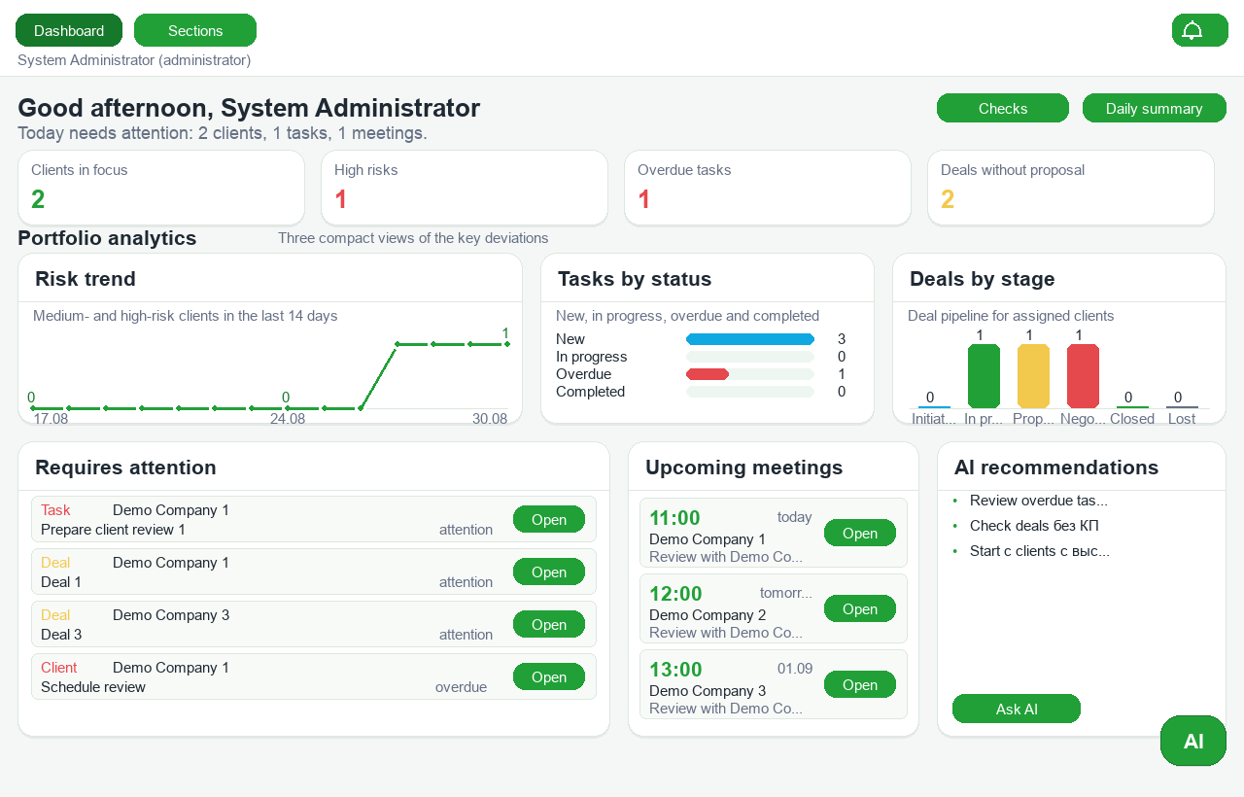
PORTFOLIO OVERVIEW
Live portfolio signals, risk exposure, meetings and recommended next actions.
Notes:
[Sources]
- Local product screenshot captured on 2026-08-30 using only synthetic demo data.
- Product screen: Portfolio overview.
[/Sources]

Slide 2
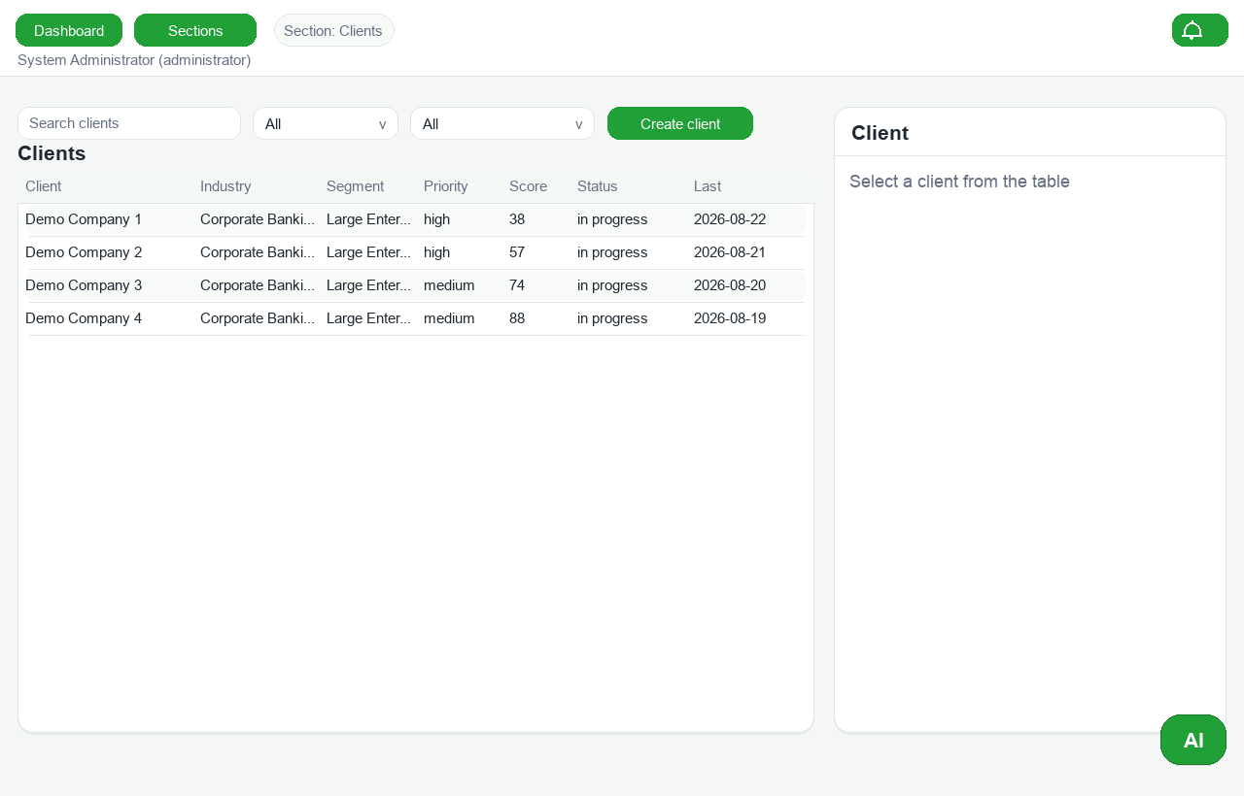
CLIENT PORTFOLIO
Searchable client records with relationship status, health score and ownership context.
Notes:
[Sources]
- Local product screenshot captured on 2026-08-30 using only synthetic demo data.
- Product screen: Client portfolio.
[/Sources]

Slide 3
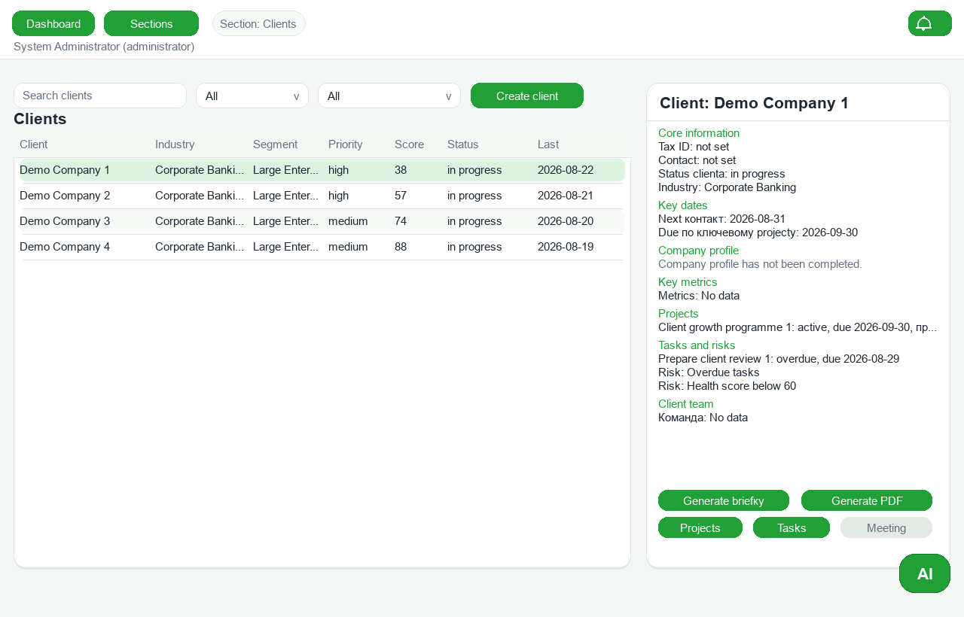
CLIENT 360
One client record brings together profile, risk signals, projects, tasks and export actions.
Notes:
[Sources]
- Local product screenshot captured on 2026-08-30 using only synthetic demo data.
- Product screen: Client 360.
[/Sources]

Slide 4
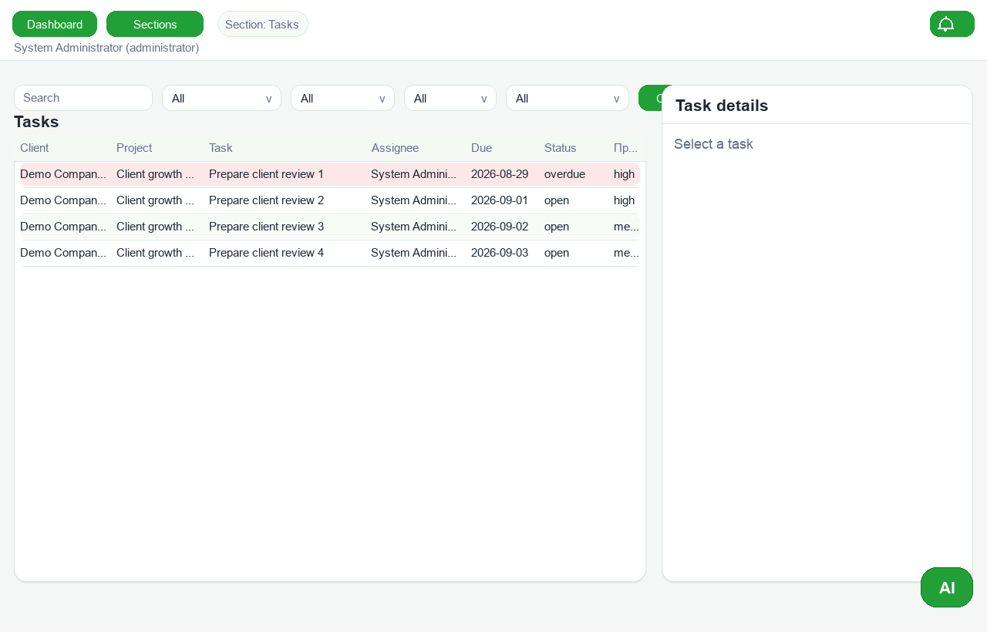
EXECUTION WORKSPACE
Prioritised client tasks surface overdue work and make follow-up operational.
Notes:
[Sources]
- Local product screenshot captured on 2026-08-30 using only synthetic demo data.
- Product screen: Execution workspace.
[/Sources]

Slide 5
AI-ASSISTED OVERSIGHT
The dashboard combines deterministic portfolio monitoring with an AI action layer.
Notes:
[Sources]
- Local product screenshot captured on 2026-08-30 using only synthetic demo data.
- Product screen: AI-assisted oversight.
[/Sources]

