Slide 1
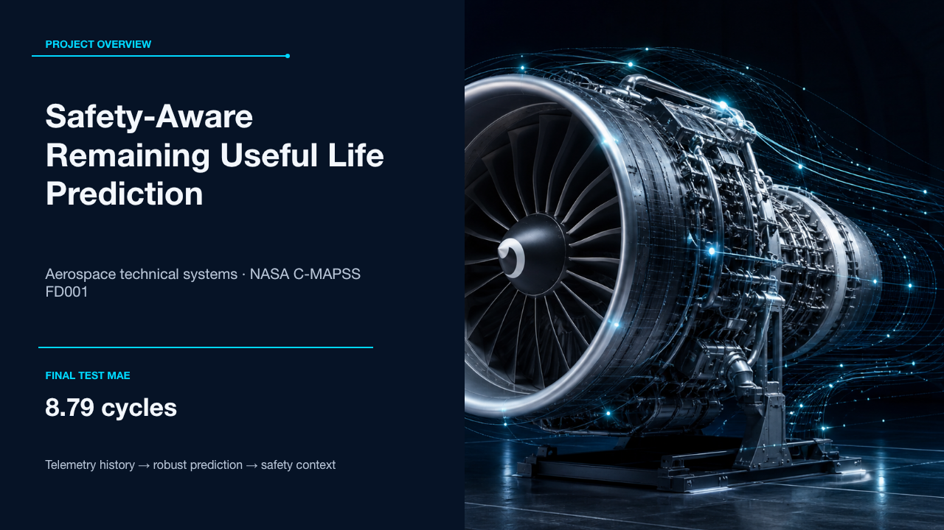
Notes:
[Sources]
- Local project README and executed consolidated notebook.
- Visual: hero-engine.png, generated for the original project deck; no external source.

Slide 2
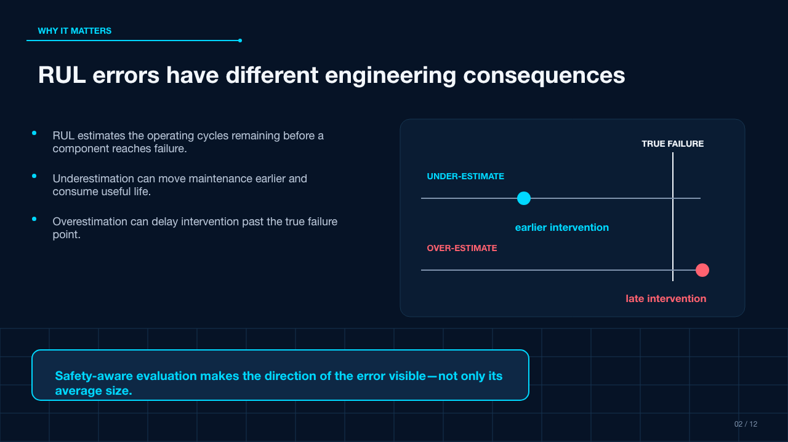
Notes:
[Sources]
- Executed safety-aware project notebook.
- Narrative coverage informed by the supplied VK PDF; claims verified against the project notebook.

Slide 3
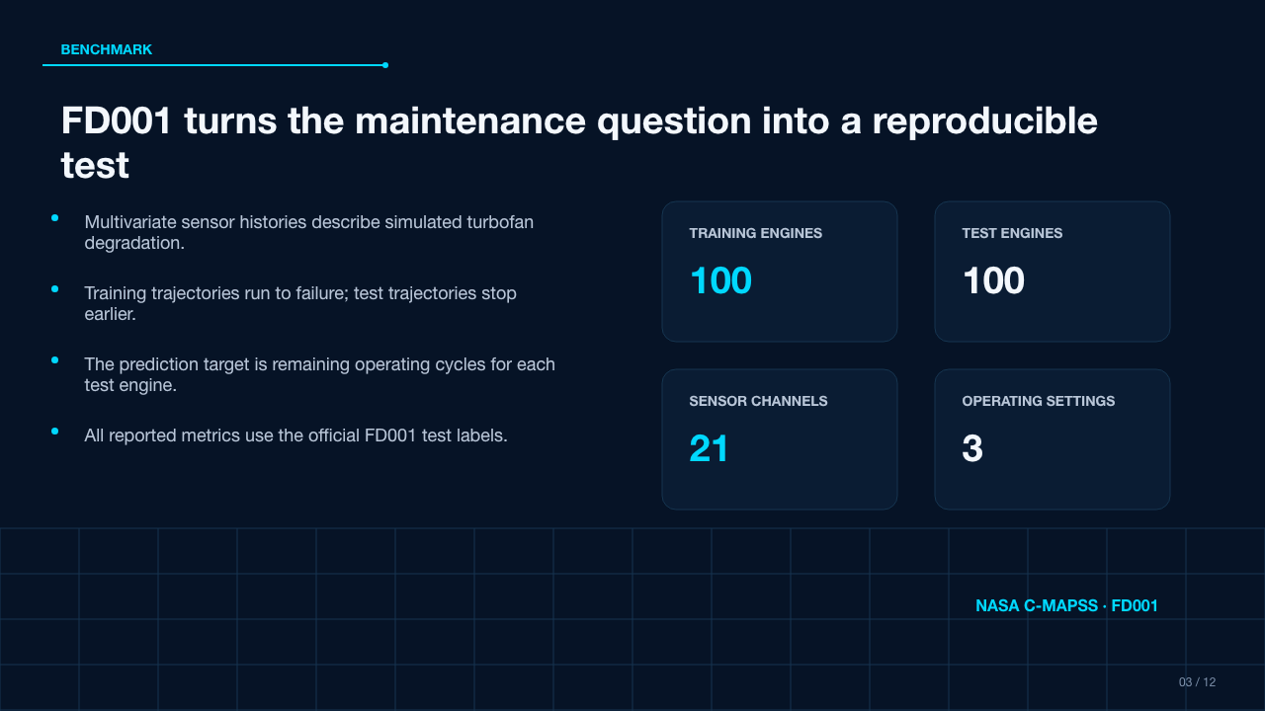
Notes:
[Sources]
- Local project README and NASA C-MAPSS FD001 data description included in the project.

Slide 4
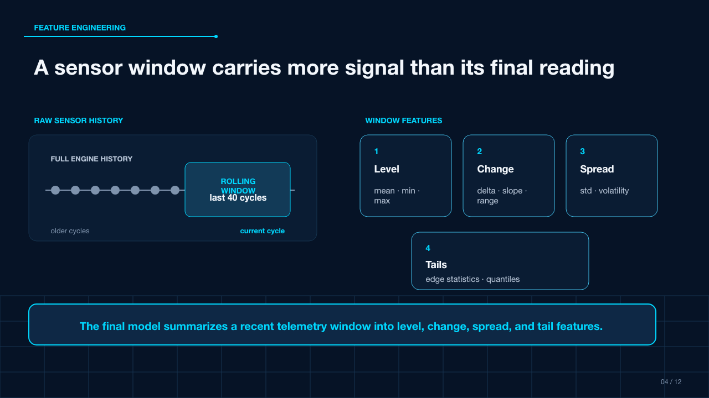
Notes:
[Sources]
- Final project notebook and feature-engineering experiments 01, 05, 06, 08.

Slide 5
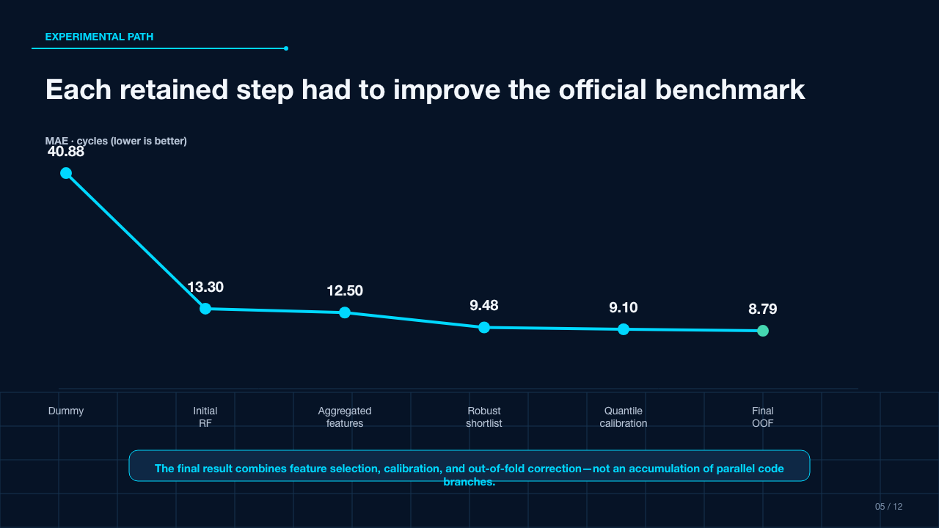
Notes:
[Sources]
- README Development Path table and project notebooks 01, 05, 06, 08.

Slide 6
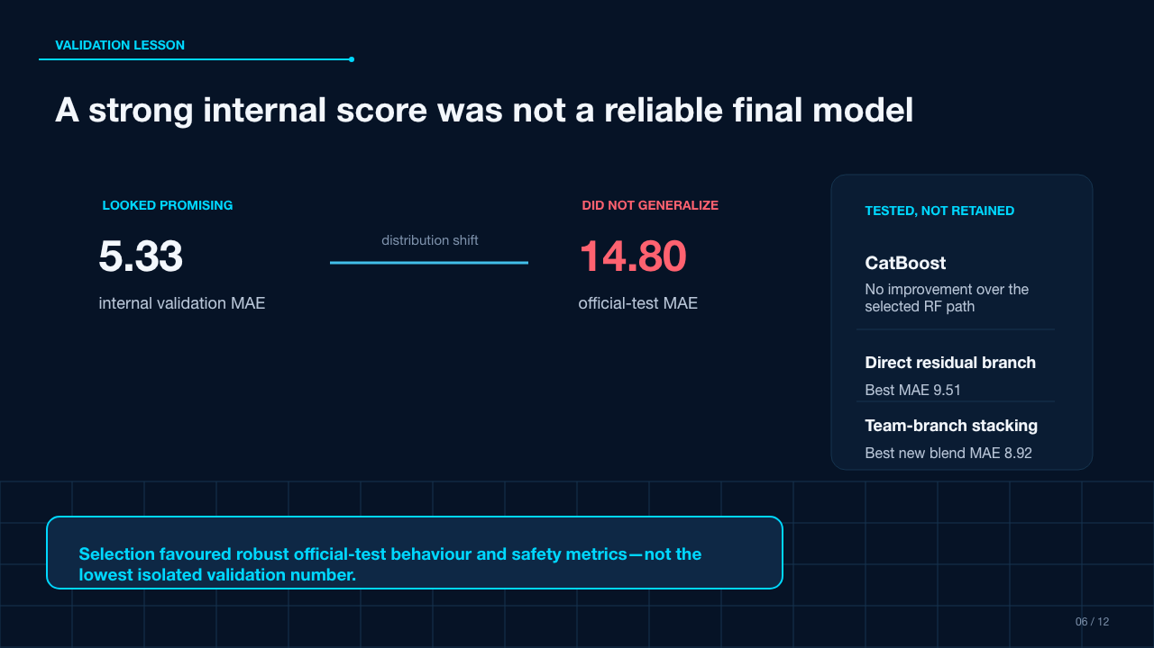
Notes:
[Sources]
- 04_failed_evolutionary_search.ipynb, 05_robust_evolutionary_search.ipynb, 07_oof_stacking_asymmetric.ipynb; archived CatBoost experiment.

Slide 7
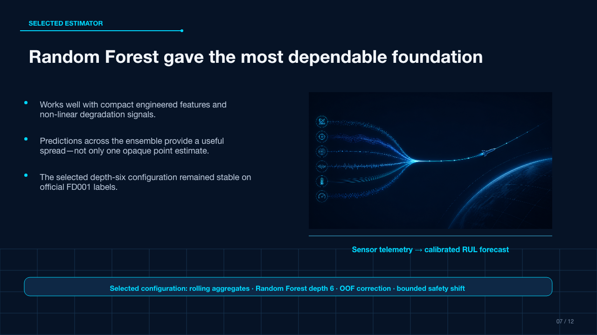
Notes:
[Sources]
- Final executed safety-aware notebook and README model description.
- Visual: rf-ensemble-forecast.png, generated for this presentation; no external source.

Slide 8
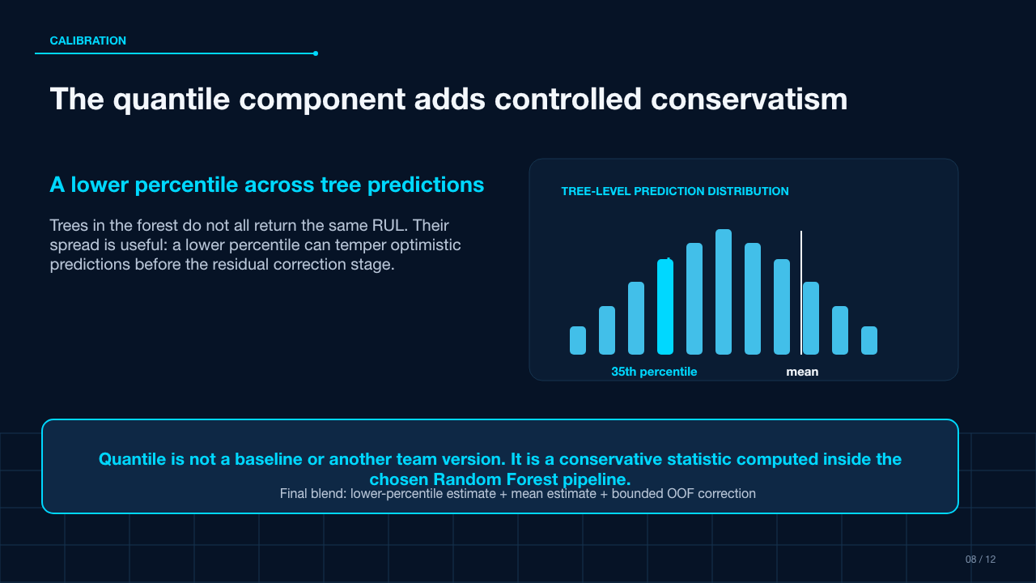
Notes:
[Sources]
- 06_quantile_calibration.ipynb and final executed safety-aware notebook.

Slide 9
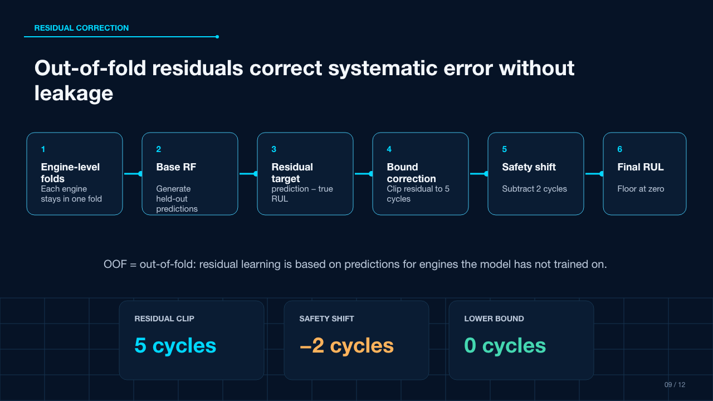
Notes:
[Sources]
- 07_oof_stacking_asymmetric.ipynb and final executed safety-aware notebook.

Slide 10
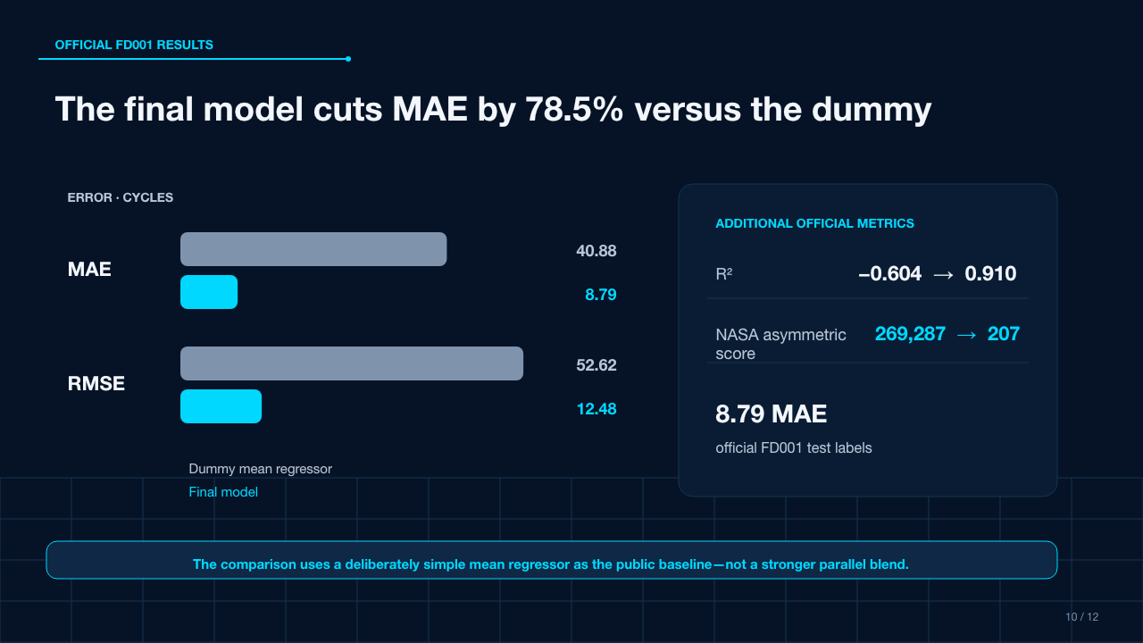
Notes:
[Sources]
- Exact official dummy and final metrics reproduced in the executed consolidated notebook.

Slide 11
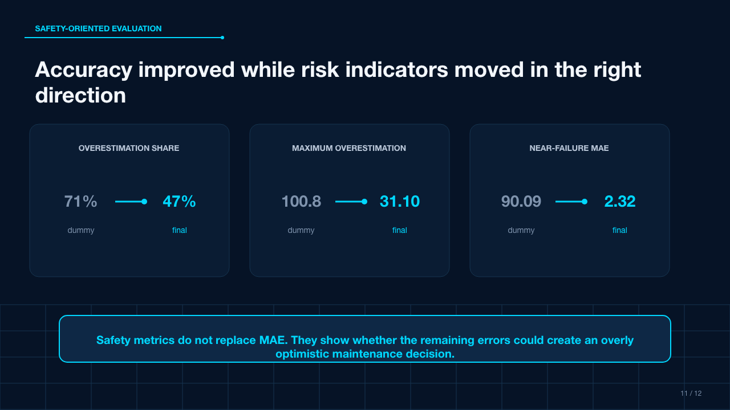
Notes:
[Sources]
- Exact safety metrics reproduced in the executed consolidated notebook.

Slide 12
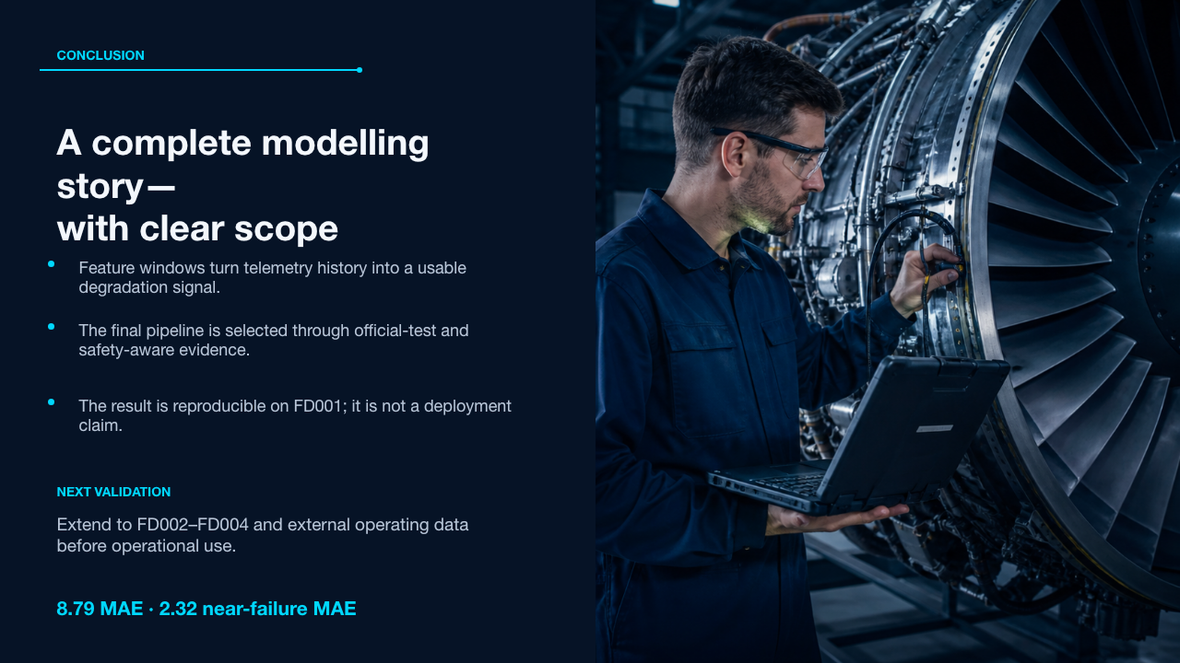
Notes:
[Sources]
- Local project README limitations and final executed notebook.
- Visual: maintenance-engineer.png, generated for the original project deck; no external source.

