Slide 1


Towards Robust Multi-UAV Collaboration: MARL with Noise-Resilient Communication and Attention Mechanisms
Zilin Zhao, Chishui Chen, Haotian Shi, Jiale Chen, Xuanlin Yue, Zhejian Yang*, and Yang Liu*
@Jilin University, Changchun, China
IEEE/RSJ International Conference on Intelligent Robots and Systems(IROS) 2025
Notes:
Welcome to the introduction video of our submitted paper! We are very excited to present our work to you.

Slide 2
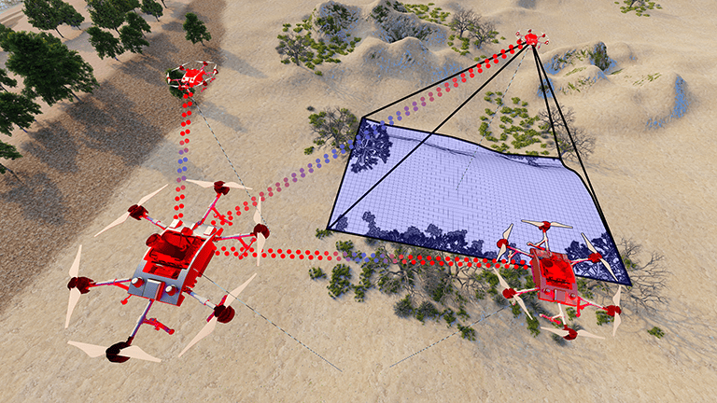
Introduction: what problem to solve?
Multi-agent Informative Path Planning (MAIPP) Problem:
planning information-rich paths for each agent while considering constrained resource budgets (e.g., time, energy, distance, etc.) to achieve efficient collaborative data collection.
multiple UAVs collaborating to scan a region of interest, their goal is to model the area of interest from the unknown to the known.
Notes:
We aim to solve the Multi-agent Informative Path Planning (MAIPP) problem, that is, to plan individual paths for each agent with higher information gain under a limited budget, in order to achieve cooperative information collection.
More specifically, we consider a 3D scenario where multiple UAVs collaborate to scan an area of interest. Their goal is to model the area of interest from the unknown to the known.

Slide 3
Introduction: why MARL?
Methods for MAIPP problem:
Non-adaptive: rely on static & predefined paths
Adaptive
Non-learning-based: computation complexity
Learning-based: shifting computational burden
Supervised Learning
Imitation Learning
…
Multi-agent Reinforcement Learning
Notes:
The methods for IPP problem can be categorized into two types: Non-adaptive and Adaptive.
Among the adaptive approaches, non-learning-based methods need to evaluate a large number of candidate paths. As the task scale increases, the computational complexity grows exponentially.
In contrast, learning-based methods shift the computational burden to the training phase in advance, ensuring that the decision-making complexity during deployment remains constant.
In learning-based approaches, Multi-Agent Reinforcement Learning (MARL) stands out as an ideal choice due to its unique ability to automatically simulate interactions between agents and the environment.
Unlike supervised learning, which struggles to define a proper supervisory standard, or imitation learning, which requires manually designed expert demonstrations,
MARL only requires a well-designed interaction mechanism. By employing appropriate algorithms to distribute global rewards to each agent, MARL enables an autonomous learning process.

Slide 4
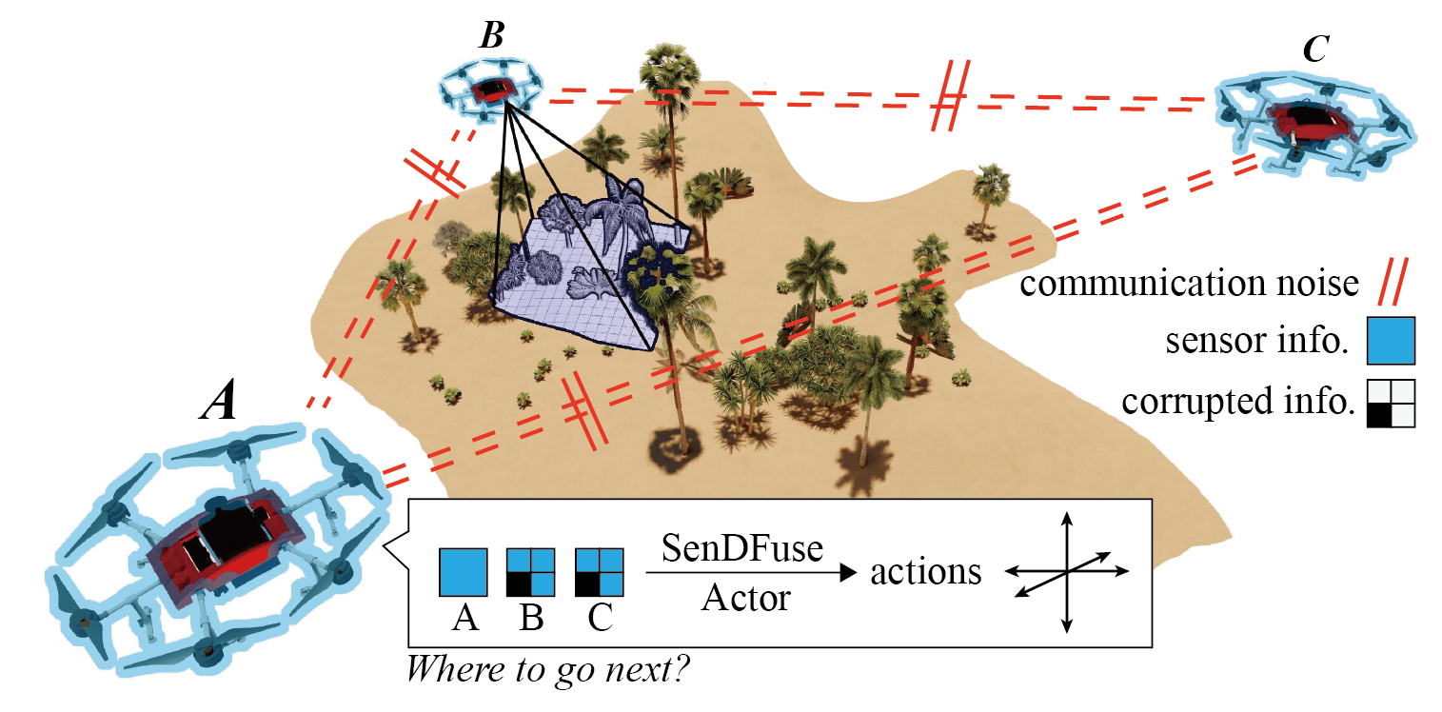
Introduction: what do we concern?
How can drones achieve efficient collaboration?
Multi-sensor Denoising & Fusion Network (SenDFuse)
Decentralized path planning for every agent
How to construct a proper MARL framework in such scenario?
Attention-based Actor-Critic Network
Counter Factual Policy Gradient Descent (COMA) Algorithm
Notes:
We focus on two main questions in this task:
How can drones achieve efficient collaboration? To address this, we propose a vision-based communication and information-sharing path planning method called Sendi-Fuse, which enables drones to exchange sensor information while considering denoising and data fusion.
Additionally, each agent independently plans its own path.
2. How to construct a proper MARL framework in such a scenario? To this end, we design a training framework based on an attention-based Actor-Critic network and utilize the COMA algorithm for global reward allocation.

Slide 5
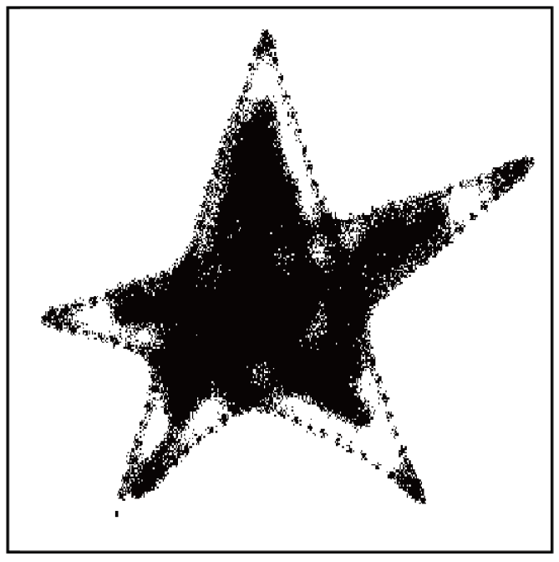
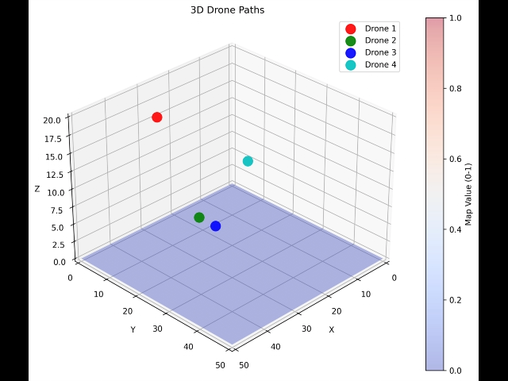
Experiment: demo
Suppose we are interested in black pixels
The sensor noise is standard Gaussian noise related to altitude,
while the communication noise consists of Gaussian noise and multiplicative attenuation related to distance.
Notes:
We deploy the trained framework on synthetic data to evaluate its performance. The environment is a square-shaped area containing a star-shaped high-value region inside.
The UAVs' sampling of the environment is affected by sensor noise, and their communication is influenced by communication noise.
The following demonstration shows the path planning process of four UAVs. By the end of the mission, the star-shaped region is successfully revealed.

Slide 6
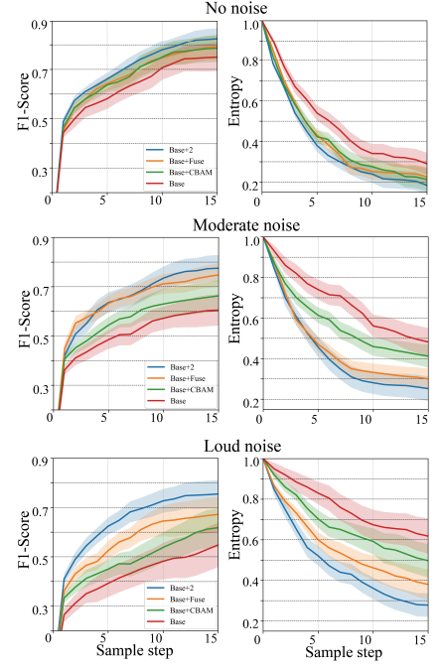
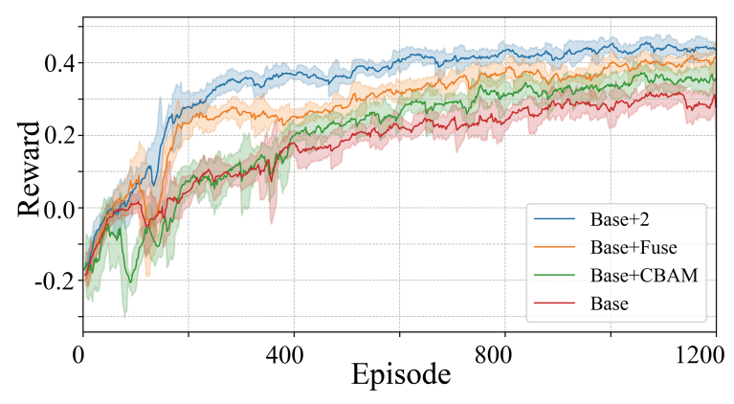
Experiment: ablation study
improvement on
deployment phase:
As the noise intensity increases, the importance of main models becomes more evident.
improvement on training phase
SenDFuse is robust to noise, as expected.
CBAM is also learning to deal with noise
Notes:
We conducted ablation experiments on the main modules of our framework. The Base model represents a naïve approach that lacks both the CBAM module and the Sendi-Fuse module.
From the training phase results, we observe that the red line, representing the framework without these key modules, performs poorly.
In contrast, our method, represented by the blue line, achieves the best convergence speed and final performance.
This difference becomes even more pronounced in the deployment phase. We use F1-Score to measure recognition accuracy and Entropy to represent the uncertainty in the belief map (lower entropy indicates higher confidence).
While the differences are minor in a noise-free environment, the performance gap increases as noise levels rise.
Notably, besides the expected robustness of the Sendi-Fuse method to noise, the CBAM module also outperforms the baseline.
This suggests that CBAM might be learning a form of denoising technique through attention weighting, although it is less effective than Sendi-Fuse.

Slide 7
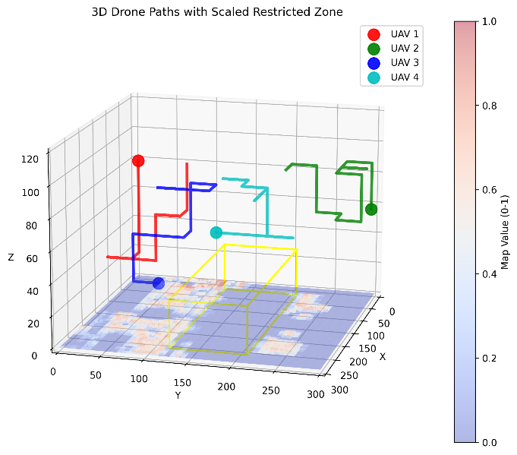
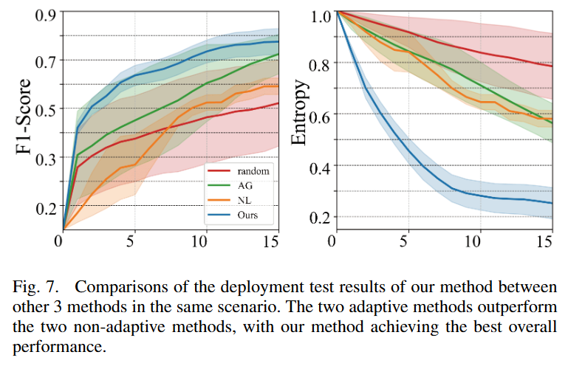
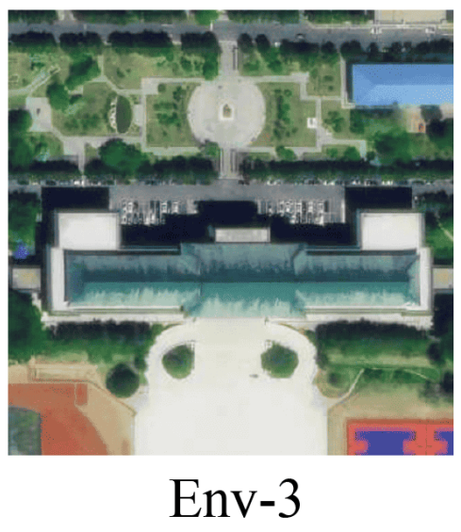
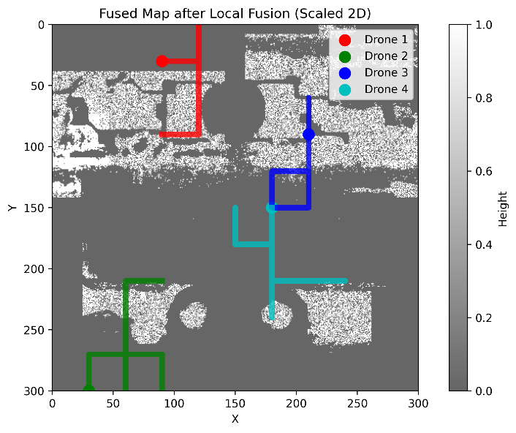
Experiment: against other approaches
Notes:
We present comparative results on real-world data against other methods. In this campus environment, we define green vegetation areas as high-value regions.
We deploy four UAVs to accomplish the task, setting the noise level to moderate, and compare our approach with other IPP methods.
The results indicate that our method achieves the best performance in terms of both accuracy (F1-Score) and confidence (lower entropy in the belief map).

Slide 8
Thanks for watching
Notes:
Our presentation ends here. Thanks for watching!

Slide 9
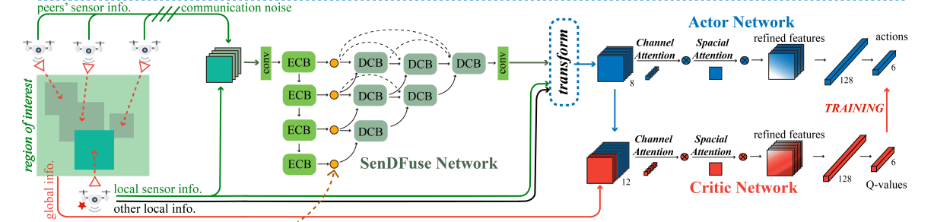
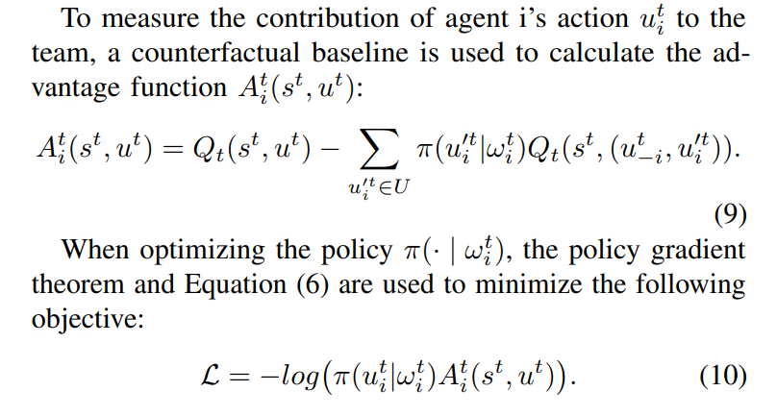
Method
our proposed framework
COMA training for MARL
Notes:
Our framework is illustrated in the figure above. Taking the drone marked with a star as an example, it stacks the received noisy information with its local information and then performs the Sendi-Fuse Network, obtaining a denoised and fused global vision map. This fused map, along with other local information, is processed and passed through the Actor network, which outputs a discrete action probability distribution.
The Critic network is used to evaluate the performance of the Actor network. It takes all inputs from the Actor network and additionally receives four channels of global information. We employ the COMA algorithm for global reward allocation, ensuring that each drone's actions are correctly assessed.

