Slide 1

IoT Data Marketplace

Slide 2
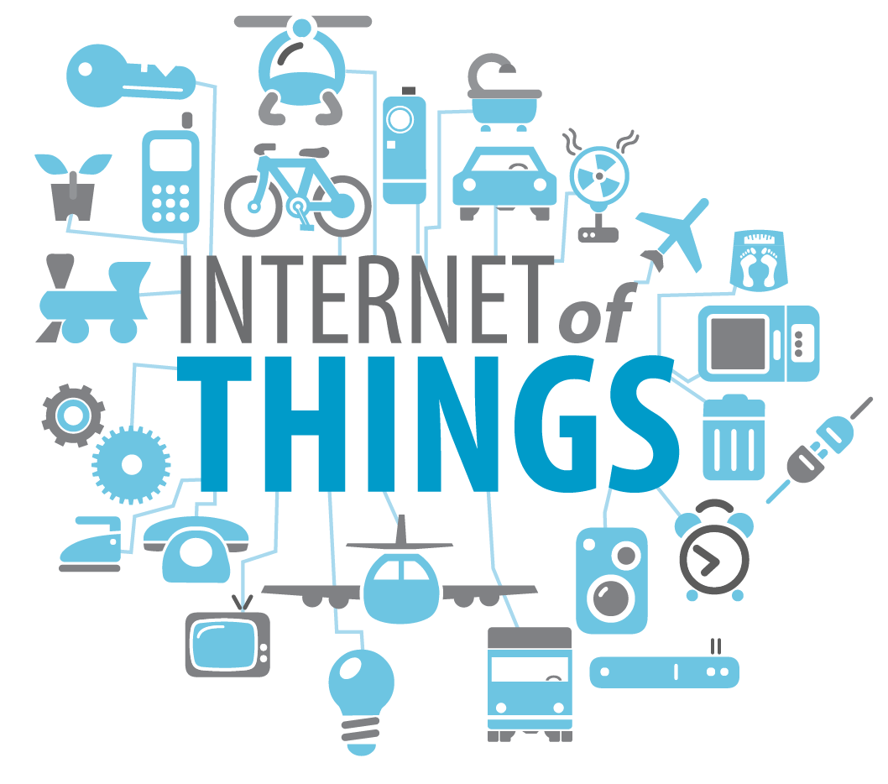
Connected devices:
2017: 13 billion
2020: 29 billion
Source: IBM

Slide 3
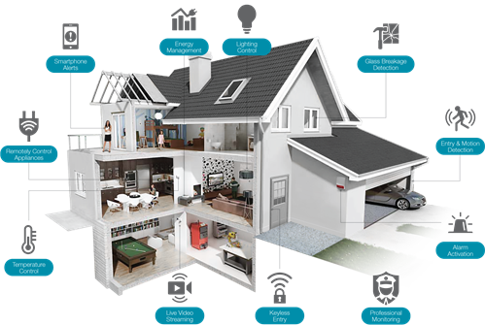

Slide 4
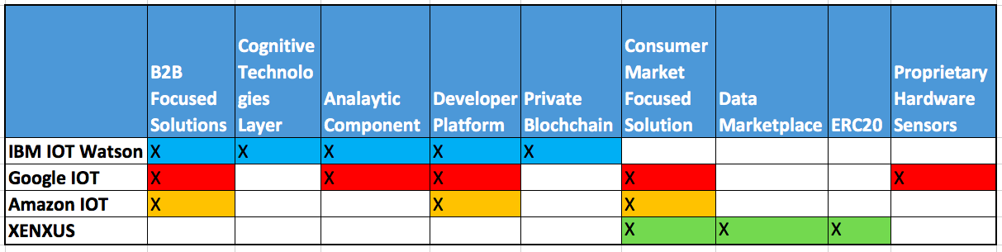
Competitors Landscape

Slide 5
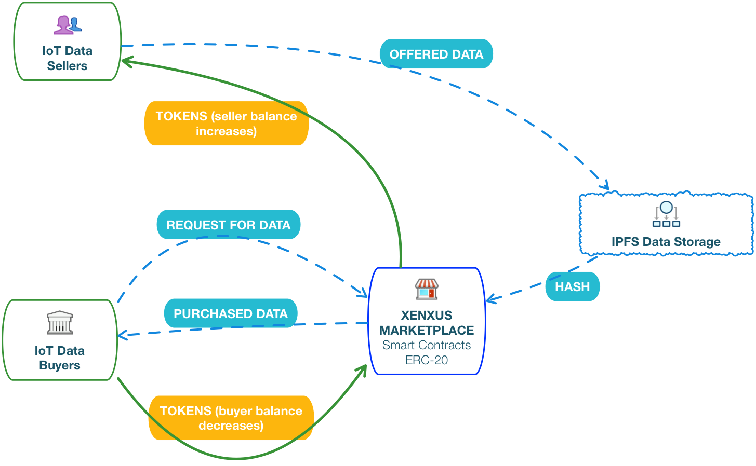
XENXUS Core Technologies

Slide 6
DEMO!

Slide 7
Questions

