Slide 1
石英晶体的设计应用
Notes:
爱因斯坦说过：“所有事物都应该尽可能简单地表达，但不是过于简单。”这个指南的目的就是尽可能简单地对于学习频率控制和定时方面最经常遇到的问题加以指导和说明。
经常有短期的访问者，管理者和晶体振荡器的潜在使用者来拜访我，我经常会被邀请在一些大学，IEEE，和其他专业团体进行讨论和访问。最初，我花费许多时间来准备这些发言。许多时候要准备幻灯片。 由于我积累了许多幻灯片，准备发言就变得越来越容易了。.

Slide 2
内容目录
………………………………..……………………….
前言：石英晶体的电子应用范围
石英晶体谐振器
石英晶体振荡器
产品选型
电路设计注意事项
2
Notes:
-

Slide 3
石英晶体的电子应用范围
谐振器与钟振器的应用范围十分广泛，由低端的玩具产品至高端的卫星通讯都会使用谐振器和钟振器
产品的基本应用是提供准确的时基，要产生时基电源是不可缺的，所以像厨房用的机械式定时器是没有使用石英器件的
目前我司的石英晶体产品主要分为两类：石英晶体谐振器和石英晶体振荡器（又叫做钟振器），前者行业中一般简称晶体，所谓晶振一般指振荡器
3

Slide 4
石英晶体的电子应用范围
军事 & 航空宇宙
通讯
航海
IFF
雷达
传感器
导航系统
Fuzes
电子
声纳浮标
研究 & 度量衡
原子钟
器械
天文学 & 测地学
空间跟踪
天体导航
行业
通讯
无线电通讯
移动/无线电讯/手提式
无线电通信,电话& 呼机
航空
航海
导航
器械元件
数码系统
CRT 显示器
磁盘驱动器
调制解调器
跟踪/标识
应用程序
传感器
消费者
手表 & 钟表
（细胞式）无线电通讯 &
无线电话，呼机
无线电通信 & hi-fi 设备
彩色电视
有线电视系统
家用电脑
VCR & 摄像机
CB & 业余无线电通信
玩具 & 游戏
起博器
其他医用设备
汽车（自动系统）
发动机控制，立体声系统
钟表
旅行电脑，GPS
4
Notes:
Quartz for the National Defense Stockpile, Report of the Committee on Cultured Quartz for the National Defense Stockpile, National Materials Advisory Board Commission on Engineering and Technical Systems, National Research Council, NMAB-424, National Academy Press, Washington, D.C., 1985.

Slide 5
石英技术发展的里程碑
1880 Jacques和Pierre Curie发现压电作用
1905 G. Spezia第一次在实验室用高温高热方法制作出石英
1917 第一次在声纳定位仪应用压电作用中
1918 第一次在一个振荡器中使用石英压电晶体
1926 第一次用石英晶体控制广播台
1927 第一次发现温度补偿石英切割
1927 第一次制作石英晶体钟表
1934 第一次开发实践中的温度补偿切割，AT－切割
1949 开发轮廓，高Q值，高稳定性的AT切割
1956 第一次在商业中人工合成石英
1956 第一次制成TCXO
1972 开发微型石英音叉；制成石英表
1974 预测SC－切割 (和TS/TTC-切割)；1976进行验证
1982 第一次制成带双头c－模式自动－温度感应的MCXO
5
Notes:
The Frequency Control website <http://www.ieee.org/uffc/fc> contains a collection of historical papers on both quartz and atomic frequency control technologies.
W. A. Marrison, "The Evolution of the Quartz Crystal Clock," Bell System Technical Journal, Vol. 27, pp. 510-588, 1948.
F. D. Lewis, "Frequency and Time Standards," Proc. of the Institute of Radio Engineers, pp. 1046-1068, Sept. 1955.
V. E. Bottom, "A History of the Quartz Crystal Industry in the USA," Proc. 35th Annual Symposium on Frequency Control, pp. 3-12, 1981.

Slide 6
第1节
石英晶体谐振器
1-1
Notes:
General References
A. Ballato, "Piezoelectric Resonators," in B. Parzen, Design of Crystal and Other Harmonic Oscillators, pp. 66-122, John Wiley and Sons, Inc., 1983.
V. E. Bottom, Introduction to Quartz Crystal Unit Design, Van Nostrand Reinhold Company, 1982.
R. A. Heising, Quartz Crystals for Electrical Circuits, D. Van Nostrand Co., 1946.
T. R. Meeker, “Theory and Properties of Piezoelectric Resonators and Waves,” in E. A. Gerber and A. Ballato, Precision Frequency Control, Vol. 1, pp. 48-118, Academic Press, 1985.
J. A. Kusters, "Resonator and Device Technology," in E. A. Gerber and A. Ballato, Precision Frequency Control, Vol. 1, pp. 161-183, Academic Press, 1985.
E. Hafner, "Resonator and Device Measurements," in E. A. Gerber and A. Ballato, Precision Frequency Control, Vol. 2, pp.1-44, Academic Press, 1985.
J. C. Brice, "Crystals for Quartz Resonators," Rev. of Modern Physics, Vol. 57, pp. 105-146, 1985.
J. R. Vig & F. L. Walls, "Fundamental Limits on the Frequency Instabilities of Quartz Crystal Oscillators," Proc. 1994 IEEE Int'l Frequency Control Symposium, pp. 506-523, 1994; also, in IEEE Trans. on Ultrasonics, Ferroelectrics, and Frequency Control, vol. 42, pp. 576-589, July 1995.
J. R. Vig, "Introduction to Quartz Frequency Standards," Army Research Lab. Tech. Rep't SLCET-TR-92-1 (Rev. 1), October 1992, AD-A256373; also in the Tutorials from the Twenty-third Annual Precise Time and Time Interval (PTTI) Applications and Planning Meeting, Pasadena, CA, pp. 1-49, December 1991, AD-A254745, and at <http://www.ieee.org/uffc/fc>.

Slide 7
为什么选择石英?
石英是已知的唯一满足以下条件的化合物：
压电 (“压力-电子”; piezein = 希腊语，压力)
有零温度系数
有压力补偿
低损失 (即，高Q值)
容易加工，理化性质稳定；在“常规”条件下，除遇氟化物和高温的碱性蚀
环刻性以外，在境中有低溶解性，坚硬但是不易碎。
在自然界资源丰富，增长数量大，成本低，并且拥有相应的高纯度和完美的特性。对于普通生长的晶体，石英，每年大约~3,000吨，是除硅以外数量增长第二多的物质。（ 1997年，大约是Si每年增加的3到4倍）
1-2
Notes:
-

Slide 8
压电作用图解
Y
Y
_
_
_
+
_
+
+
+
_
_
_
+
_
+
+
+
_
_
_
+
_
+
+
_
+
_
_
+
_
+
_
+
_
+
+
_
+
-
_
_
_
+
+
X
_
_
•
+
+
X
+
_
+
•
+
_
+
_
+
_
_
+
_
+
_
_
+
+
+
+
_
+
_
_
_
+
+
+
_
+
_
+
+
_
+
_
_
+
_
+
无变形结构
变形结构
压电作用在一个压电晶体的机械部分与一个电子电路之间提供一个接合连接。
1-3
Notes:
The direct piezoelectric effect was discovered by the Curie brothers in 1880. They showed that when a weight was placed on a quartz crystal, charges appeared on the crystal surface; the magnitude of the charge was proportional to the weight. In 1881, the converse piezoelectric effect was illustrated; when a voltage was applied to the crystal, the crystal deformed due to the lattice strains caused by the effect. The strain reversed when the voltage was reversed. The piezoelectric effect can, thereby, provide a coupling between an electrical circuit and the mechanical properties of the crystal. Under the proper conditions, a “good” piezoelectric resonator can stabilize the frequency of an oscillator circuit.
Of the 32 crystal classes, 20 exhibit the piezoelectric effect (but only a few of these are useful). Piezoelectric crystals lack a center of symmetry. When a force deforms the lattice, the centers of gravity of the positive and negative charges in the crystal can be separated so as to produce surface charges. The figure shows one example (from Kelvin’s qualitative model) of the effect in quartz. Each silicon atom is represented by a plus, and each oxygen atom by a minus. When a strain is applied so as to elongate the crystal along the Y-axis, there are net movements of negative charges to the left and positive charges to the right (along the X-axis).
When a crystal has a center of symmetry, i.e., when the properties of the crystal are the same in both directions along any line in the crystal, no piezoelectric effect can occur. Electrostriction, however, exists in all dielectric solids. It is a deformation quadratic in the applied electric field (whereas, piezoelectricity is a linear effect; reversal of the electric field reverses the mechanical deformation.) Biased electrostriction, where small electric field variations are superimposed on a constant component, is phenomenologically equivalent to linear piezoelectricity; this artifice may be used with nonpiezoelectric crystals such as silicon, but the coupling depends upon the bias, and is often small.
R. A. Heising, Quartz Crystals for Electrical Cicuits - Their Design and Manufacture, D. Van Nostrand Co., New York, pp. 16-20, 1946.

Slide 9
振动模式
弯曲模式
外部模式
面切变模式
厚度切变模式
基频厚度切变模式
第三泛音厚度切变
1-4
Notes:
Shown above are the bulk acoustic wave (BAW) modes of motion. For example, AT-cut and SC-cut resonators vibrate in the thickness shear mode. Above 100 MHz, overtone units that operate at a selected harmonic mode of vibration are often used (e.g., third overtone or 5th overtone). Higher than 100 MHz fundamental mode units can be manufactured by, e.g., chemical polishing (diffusion controlled wet etching), plasma etching, and ion milling techniques. Below 1 MHz, tuning forks, X-Y and NT bars (flexure mode), +5° X-cuts (extensional mode), or CT-cut and DT-cut units (face shear mode) can be used. Tuning forks have become the dominant type of low-frequency units due to their small size and low cost (see “Quartz Resonators for Wristwatches” and the following pages later in this chapter).
The velocities of acoustic waves in solids are typically ~3,000 m/s (~10⁻⁵ times the velocity of light). For the shear waves in AT-cut quartz, for example, the velocity of propagation in the thickness direction is 3,320 m/s; the fundamental mode frequency ~ v/2h, where v is the acoustic wave velocity and h is the plate thickness. (The thickness of the plate is one half the wavelength.)

Slide 10

零温度系数石英切割
90º
60º
FC
IT
30º
AT
LC
SC
θ
0
z
SBTC
-30º
BT
-60º
-90º
0º
10º
20º
30º
θ
φ
Singly
Rotated
Cut
Doubly
Rotated
Cut
θ
AT, FC, IT, SC, BT, 和 SBTC-切割是零温度系数下的切割。LC是“线性系数”切割已经应用于石英温度计。
y
φ
Y－切割: ≈ +90 ppm/⁰C
(厚度切变模式)
x
x^{l}
X－切割≈ -20 ppm/⁰C
(外延模式)
1-5
Notes:
90
o
60
o
30
o
0
-30
o
-60
o
-90
o
0
o
10
o
20
o
30
o
AT
FC
IT
LC
SC
SBTC
BT
θ
φ
Singly
Rotated
Cut
Doubly
Rotated
Cut
The locus of zero-temperature-coefficient cuts in quartz is shown above. The cuts usually have two-letter names, where the "T" in the name indicates a temperature-compensated cut; for instance, the AT-cut was the first temperature-compensated cut discovered. The FC, IT, BT, and SBTC-cuts are other cuts along the zero-temperature coefficient locus. These cuts were studied in the past (before the discovery of the SC-cut) for some special properties, but are rarely used today. The highest-stability crystal oscillators employ SC-cut crystal units. The X, Y, and Z directions have been chosen to make the description of properties as simple as possible. The Z-axis is an axis of threefold symmetry in quartz; in other words, the physical properties repeat every 120° as the crystal is rotated about the Z-axis.
------------------------------------
A. Ballato, "Doubly Rotated Thickness Mode Plate Vibrators," in Physical Acoustics, Vol. XIII, W. P. Mason and R. N. Thurston, Eds., pp. 115-181, Academic Press, New York, 1977.
J. P. Buchanan, Handbook of Piezoelectric Crystals for Radio Equipment Designers, WADC Technical Report 56-156, October 1956 (692 pages), available from NTIS, AD 110448.
D. L. Hammond, C. A. Adams and P. Schmidt, "A Linear, Quartz Crystal, Temperature Sensing Element," ISA Transactions, vol. 4, pp. 349-354, 1965.
M. Valdois, B. K. Sinha, and J. J. Boy, “Experimental Verification of Stress Compensation in the SBTC-Cut,” IEEE Trans. on Ultrasonics, Ferroelectrics and Frequency Control, vol. 36, pp. 643-651, 1989.
------------------------
A. Ballato, “Doubly rotated thickness mode plate vibrators,” in Physical Acoustics, Vol. XIII, pp. 115-181, Academic Press, 1977.

Slide 11
温度特性 ( AT 切)
AT-切
Z
25
BT-切
Δθ
35¼º
49º
20
R
r
R
8’
m
m
Y
15
R
r
R
-1’
7’
6’
Z
0’
10
Y-bar 石英
5’
1’
(ppm)
5
4’
2’
Δf
f
0
3’
3’
-5
2’
4’
-10
1’
0’
5’
-15
6’
-1’
θ = 35º 20’ + Δθ, ϕ = 0
基频 AT-切
-20
7’
-25
8’
-45
-40
-35
-30
-25
-20
-15
-10
-5
0
5
10
15
20
25
30
35
40
45
50
55
60
65
70
75
80
85
90
温度 (ºC)
1-6
Notes:
AT切諧振器的物理溫度曲線是3次元曲線，溫度越寬，溫飄越大。因此在選用和加工方片時，需特別注意切角。由於切角屬非標設計，預先備庫存較困難。

Slide 12

THHF-49U的结构图
带引线产品
石英
晶片
电极
银胶
外壳
支架
封囗
基座
引线
顶视图
1-7

Slide 13
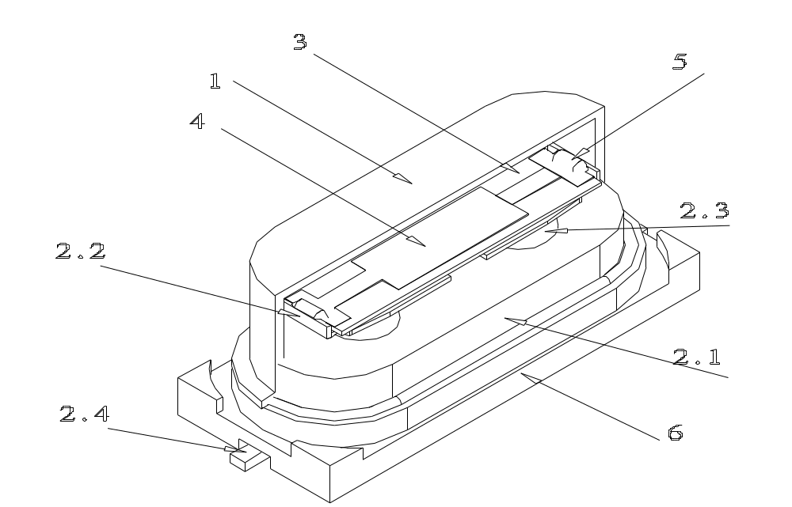
SMHF-49S3的结构图
外壳
基座
  基座
  支架
  绝缘子
  引出端
晶片
电极
导电胶
绝缘片
1-8

Slide 14
石英晶体谐振器的等效电路
C_{L}
石英晶体符号
负载电容
C₀
C_{L}
C₁
L₁
R₁
石英晶体的等效电路
1-9

Slide 15
一个石英晶体的泛音谐振
jX
假响应
假响应
假响应
电抗
0
频率
第5泛音
第3泛音
-jX
基本模式
1-10
Notes:
The above figure illustrates the mode spectrum of a quartz resonator, showing the fundamental mode, third overtone, fifth overtone, and some of the spurious responses (“spurs”), i.e., unwanted modes. In oscillator applications, the oscillator usually selects the strongest mode. Some of the unwanted modes have steep frequency vs. temperature characteristics. Occasionally, as the temperature changes, at a certain temperature, the frequency of an unwanted mode coincides with the oscillator frequency, which causes an “activity dip” (see next page, and “Activity Dips” in chapter 4). At the activity dip, excitation of the unwanted mode results in extra energy dissipation in the resonator, which results in a decrease in the Q, an increase in the equivalent series resistance, and a change in the frequency of the oscillator. When the resistance increase is sufficiently large, the oscillation stops, i.e., the oscillator fails. When the temperature changes away from the activity dip temperature, the oscillation restarts.
Unwanted modes can be controlled by proper design and fabrication methods. Maintaining the correct relationships among electrode and resonator plate dimensions (i.e., applying energy trapping rules), and maintaining the parallelism between the major faces of the resonator plate, can minimize the unwanted modes.
W. Shockley, D. R. Curran & D. J. Koneval, “Trapped Energy Modes in Quartz Crystal Filters,” J. Acoustical Soc. Amer., vol. 41, pp. 981-993, 1967.
G.K. Guttwein, T. J. Lukaszek, and A. D. Ballato, “Practical Consequences of Modal Parameter Control in Crystal Resonators,” Proc. 21st Ann. Symp. On frequency Control, pp. 115-137, 1967.
T. R. Meeker, “Theory and Properties of Piezoelectric Resonators and Waves,” in E. A. Gerber and A. Ballato, Precision Frequency Control, Vol. 1, pp. 48-118, Academic Press, 1985.

Slide 16
三次泛音石英晶体谐振器的等效电路
C₀
C_{L}
负载电容
C₁
L₁
R₁
C₃
L₃
R₃
三次泛音石英晶体的等效电路
1-11

Slide 17
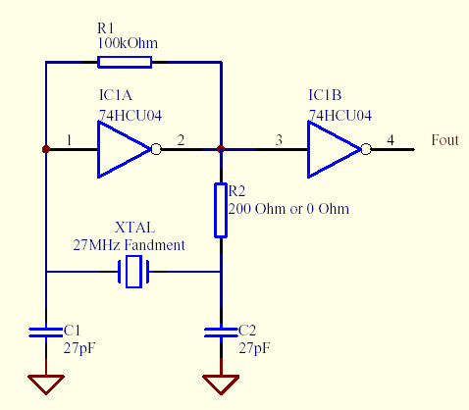
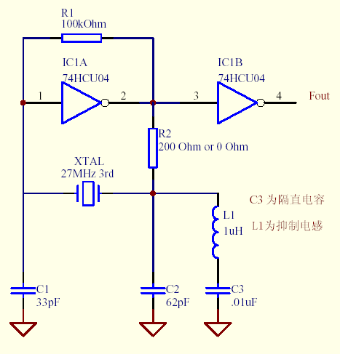
基频与泛音典型振荡电路
基频振荡电路
泛音振荡电路
注：C1、C2的选择因考虑晶体的负载电容
注：C1、C2的选择因考虑晶体的负载电容，
L1、C3的介入抑制了基频响应
1-12

Slide 18
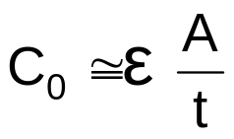
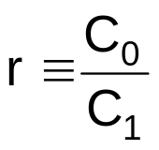
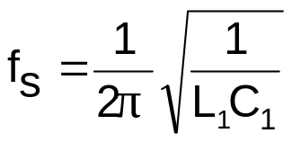
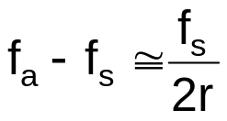
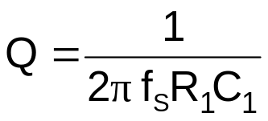
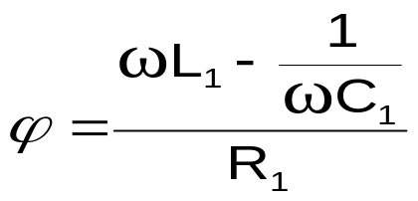

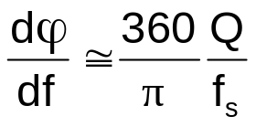
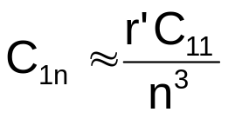
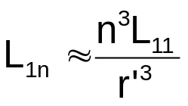
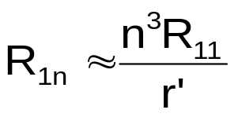
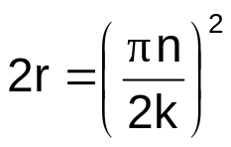
等效电路参数关系
n: 泛音数
C₀: 静态电容
C₁: 动态电容
C_{1n}: C₁ 的 n-th 泛音
L₁: 动态感应系数
L_{1n}: L₁ 的n-th 泛音
R₁: 动态电阻
R_{1n}: R₁ 的n-th 泛音
ε: Dielectric permittivity of quartz
≈40 x 10⁻¹³ pF/mm (average)
A: 电极区域
t: 镀膜厚度
r: 电容比
r’: f₁/f_{n}
f_{s}: 串联谐振频率 ≈f_{R}
f_{a}: 反谐振频率
Q; 品质因数
τ₁: 动态持续时间
ω: 角度频率 = 2πf
ϕ: 相位角度阻抗
k; 压电耦合因数
=8.8% for AT-cut, 4.99% for SC
1-13
Notes:
In the last row, the r’ is the ratio between the fundamental mode and the n-th overtone frequencies. For example, when comparing the parameters of a 10 MHz fundamental mode and a 10 MHz 3rd overtone (of similar design), r’ = 1, and when comparing the parameters of a 10 MHz fundamental mode resonator when excited at the fundamental mode, and when excited at the 3rd overtone frequency, i.e., at ~30 MHz, r’ = 3.

Slide 19
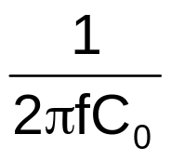
谐振器电抗和频率
一个振荡器
通常工作区域
+
谐振频率f_{r}
反谐振频率 f_{a}
电抗
0
频率
-
1-14
Notes:
At frequencies far from the resonance frequency, the resonator is a simple parallel plate capacitor having a capacitance C_{o} ≅ kε_{o}(A/t), where A is the area of the electrodes, t is the thickness of the plate, k is the dielectric constant and ε_{o} is the permittivity of free space. The reactance is zero at resonance, and it is maximum at the antiresonance frequency. The antiresonance to resonance separation, f_{a} - f_{r} ≈ f_{r}/2r’ – r’/2Q², where r’ = C_{o}/C_{1.}
In most oscillator circuits, the frequency is in the region shown, where the resonator’s reactance is inductive. An adjustable capacitance in series (or parallel) with the resonator can then used to adjust the frequency of oscillation.
The reactance vs. fractional frequency slope, ΔX/(Δf/f), is a measure of the resonator’s “stiffness,” i.e., the amount the resonator’s frequency changes with load capacitance. The stiffer the resonator, the less the resonator’s frequency changes with a change in load capacitance. Near f_{S}, ΔX/(Δf/f) = 1/(πf_{S}C₁). Overtone resonators are stiffer than fundamental mode units because the C₁ of overtone resonators is smaller than the C₁ of fundamental mode units.
A. Ballato, "Piezoelectric Resonators," in B. Parzen, Design of Crystal and Other Harmonic Oscillators, pp. 66-122, John Wiley and Sons, Inc., 1983.
E. Hafner, "Resonator and Device Measurements," in E. A. Gerber and A. Ballato, Precision Frequency Control, Vol. 2, pp.1-44, Academic Press, 1985.
V. E. Bottom, Introduction to Quartz Crystal Unit Design, Chapters 6 and 7, Van Nostrand Reinhold Company, 1982.

Slide 20
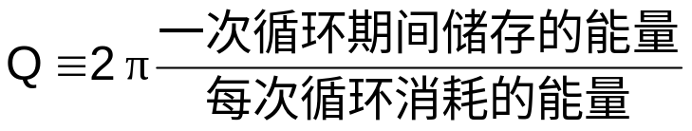
Q值的重要性
Q值与衰减时间成正比，与谐振器线宽成反比（见下页）
Q值越高，谐振器频率稳定性和精确性越高。(即，高的Q值时必要不充分条件）。假设，Q = 10⁶，10⁻¹⁰ 精确性要求有确定谐振曲线为0.01% 带宽的能力，（在平均时间）10⁻¹² 的稳定性要求在谐振顶峰的谐振曲线为10⁻⁶ 带宽。
靠近传送者的相位噪声对于Q值有很强的依赖型。
(L(f) ∝ 1/Q⁴).
1-15
Notes:
See the next page for other definitions of Q, and see chapter 5 for additional information about the Q of quartz resonators. When the signal is decaying, as shown on the next page, the energies in the definition above are averaged over the cycle. Close to the carrier, a factor of two difference in Q results in a factor of 16 difference in phase noise.
IEEE Std 100-1996, The IEEE Standard Dictionary of Electrical and Electronics Terms, http://shop.ieee.org/store/
H. Hellwig, "Frequency Standards and Clocks: A Tutorial Introduction," NBS Technical Note 616, 1977, Time and Frequency Division, NIST, Boulder, CO 80303.
V. B. Braginsky, V. P. Mitrofanov & V. I. Panov, Systems with Small Dissipation, The University of Chicago Press, 1985.
E. I. Green, "The Story of Q," American Scientist, pp. 584-595, 1955.

Slide 21
石英晶体谐振器的基本参数
石英晶体谐振器的基本参数包括：
需要由需求方提出的基本要求：
标称频率： F
负载电容：CL
其它要求：工作温度范围、C0/C1等
2. 需要由供应商测试控制的参数：
频率精度：一般并联谐振电路用FL（ppm）
等效电阻：Rr(ohms)
静态电容：C0(pF)
动态电容：C1(fF)
等效电感：L(mH)
品质因数：Q(k)
牵引能力：TS(ppm/pF)
驱动功率依赖性：DLD
频率温度特性：TC(Relative to 25 C)
1-16

Slide 22
谐振器的生产流程
具体的生产流程比较复杂，如有兴趣，可参考我司QC工程图
清洗
研磨
X光檢測
/修正
切割
角度修正
/粘板
X光定位
成形
付蝕
清洗
/檢測
烘烤
蒸鍍
組裝
OQA
性能檢測
溫度循環
/預老化
檢漏
封裝
調頻
付運
1-17
Notes:
由於工作溫度寬，在設計與加工時需選用特殊切角的晶片
組裝進程要注意產品的結構性能
增加溫度循環工序以提升產品長期老化和可靠性指標

Slide 23
第2节
石英晶体振荡器
2-1
Notes:
General References
A. Ballato, "Piezoelectric Resonators," in B. Parzen, Design of Crystal and Other Harmonic Oscillators, pp. 66-122, John Wiley and Sons, Inc., 1983.
V. E. Bottom, Introduction to Quartz Crystal Unit Design, Van Nostrand Reinhold Company, 1982.
R. A. Heising, Quartz Crystals for Electrical Circuits, D. Van Nostrand Co., 1946.
T. R. Meeker, “Theory and Properties of Piezoelectric Resonators and Waves,” in E. A. Gerber and A. Ballato, Precision Frequency Control, Vol. 1, pp. 48-118, Academic Press, 1985.
J. A. Kusters, "Resonator and Device Technology," in E. A. Gerber and A. Ballato, Precision Frequency Control, Vol. 1, pp. 161-183, Academic Press, 1985.
E. Hafner, "Resonator and Device Measurements," in E. A. Gerber and A. Ballato, Precision Frequency Control, Vol. 2, pp.1-44, Academic Press, 1985.
J. C. Brice, "Crystals for Quartz Resonators," Rev. of Modern Physics, Vol. 57, pp. 105-146, 1985.
J. R. Vig & F. L. Walls, "Fundamental Limits on the Frequency Instabilities of Quartz Crystal Oscillators," Proc. 1994 IEEE Int'l Frequency Control Symposium, pp. 506-523, 1994; also, in IEEE Trans. on Ultrasonics, Ferroelectrics, and Frequency Control, vol. 42, pp. 576-589, July 1995.
J. R. Vig, "Introduction to Quartz Frequency Standards," Army Research Lab. Tech. Rep't SLCET-TR-92-1 (Rev. 1), October 1992, AD-A256373; also in the Tutorials from the Twenty-third Annual Precise Time and Time Interval (PTTI) Applications and Planning Meeting, Pasadena, CA, pp. 1-49, December 1991, AD-A254745, and at <http://www.ieee.org/uffc/fc>.

Slide 24
石英晶体振荡器基本电路
调频
电压
石英晶体
输出频率
放大器
2-2

Slide 25
有源元件与被动元件
谐振器与钟振器的最大区别是，前者是被动元件，後者是有源元件。
谐振器是被动元件，产品本身并无讯号输出，只能在特定的条件下协助振荡电路将频率锁定，稳定性容易受外部元件影响。
钟振器是有源元件，特点是输出端能直接提供驱动讯号，频率的稳定性不容易受外接元件影响。
2-3

Slide 26
钟振器对比谐振器的优缺点
优点
  直接输出讯号，不易受外部元件影响频率精度
  精度比谐振器高，OCXO能达5x10E⁻¹⁰
  使用放便，最终频率的精度由供应商控制，，可减省调频工序所花的费用
  客户开发时能节省振荡电路的开发成本、时间，可更快地掌握商机
缺点
  成本高
  普通钟振的占用面积/体积大
  同系列产品的高度比谐振器高，不利於有高度限制的使用条件
  使用的灵活性比谐振器低
2-4

Slide 27

钟振器分类
调频电压
+10 ppm
-45⁰C
+100⁰C
输出
25⁰C
T
• 水晶振荡器 (XO)
-10 ppm
温度传感器
补偿网络
或计算器
+1 ppm
-45⁰C
+100⁰C
T
水晶振荡器
-1 ppm
• 温度补偿水晶振荡器 (TCXO)
温箱
水晶
振荡器
温箱控制
+1 x 10⁻⁸
-45⁰C
+100⁰C
温度传感器
T
-1 x 10⁻⁸
• 温控水晶振荡器 (OCXO)
2-5
Notes:
A wide temperature range XO has a typical f vs. T stability of ~10 to 50 ppm. A TCXO can reduce that to ~1 ppm. An OCXO can reduce that stability to 1 x 10⁻⁸ or better (but at the cost of much higher power consumption). High-end (SC-cut) OCXOs can stay within 1 x 10⁻¹⁰ over a wide temperature range.

Slide 28
晶体振荡器频率和温度补偿
未补偿
频率
频率 / 电压
T
变容二极管
补偿电压 C_{L}
TCXO补偿
频率
2-6
Notes:
When the load capacitor is connected in series with the crystal, the frequency of operation of the oscillator is increased by a Δf', where Δf' is given by the equation on the previous page. When an inductor is connected in series with the crystal, the frequency of operation is decreased. The ability to change the frequency of operation by adding or changing a reactance allows for compensation of the frequency versus temperature variations of crystal units in TCXOs, and for tuning the output frequency of voltage controlled crystal oscillators (VCXO). In both, the frequency can be changed, e.g., by changing the voltage on a varactor.
Other means of temperature compensation include the use of a temperature sensitive reactance element such that the variations of the reactance with temperature compensate for the f vs. T variations of the resonator, and the use digital compensation techniques. The microcomputer compensated crystal oscillator (MCXO), which uses a high-accuracy digital compensation technique, is discussed in chapter 2.
M. E. Frerking, “Temperature Control and Compensation,” in E. A. Gerber and A. Ballato, Precision Frequency Control, Vol. 2, pp.1-44, Academic Press, 1985.
M. E. Frerking, Crystal Oscillator Design and Temperature Compensation, Van Nostrand Reinhold Company, 1978.
S. Okano, T. Mitsuoka & T. Ohshima, “Direct-temperature Compensated Crystal Oscillator for Advanced VHF/UHF Radio Communication Systems,” Proc. 34th Ann. Frequency Control Symposium, pp. 488-497, 1980.

Slide 29
第3节
产品选型
3-1
Notes:
General References
A. Ballato, "Piezoelectric Resonators," in B. Parzen, Design of Crystal and Other Harmonic Oscillators, pp. 66-122, John Wiley and Sons, Inc., 1983.
V. E. Bottom, Introduction to Quartz Crystal Unit Design, Van Nostrand Reinhold Company, 1982.
R. A. Heising, Quartz Crystals for Electrical Circuits, D. Van Nostrand Co., 1946.
T. R. Meeker, “Theory and Properties of Piezoelectric Resonators and Waves,” in E. A. Gerber and A. Ballato, Precision Frequency Control, Vol. 1, pp. 48-118, Academic Press, 1985.
J. A. Kusters, "Resonator and Device Technology," in E. A. Gerber and A. Ballato, Precision Frequency Control, Vol. 1, pp. 161-183, Academic Press, 1985.
E. Hafner, "Resonator and Device Measurements," in E. A. Gerber and A. Ballato, Precision Frequency Control, Vol. 2, pp.1-44, Academic Press, 1985.
J. C. Brice, "Crystals for Quartz Resonators," Rev. of Modern Physics, Vol. 57, pp. 105-146, 1985.
J. R. Vig & F. L. Walls, "Fundamental Limits on the Frequency Instabilities of Quartz Crystal Oscillators," Proc. 1994 IEEE Int'l Frequency Control Symposium, pp. 506-523, 1994; also, in IEEE Trans. on Ultrasonics, Ferroelectrics, and Frequency Control, vol. 42, pp. 576-589, July 1995.
J. R. Vig, "Introduction to Quartz Frequency Standards," Army Research Lab. Tech. Rep't SLCET-TR-92-1 (Rev. 1), October 1992, AD-A256373; also in the Tutorials from the Twenty-third Annual Precise Time and Time Interval (PTTI) Applications and Planning Meeting, Pasadena, CA, pp. 1-49, December 1991, AD-A254745, and at <http://www.ieee.org/uffc/fc>.

Slide 30
产品选用的基本原则
开发时间
应用目的
  一般情况多以电气性能进行描述
应用时的外部环境
  一般情况多以机械性能和产品温度特性进行描述
对产品的期望值
  来料检验标准、产品可靠性、特殊要求。
3-2

Slide 31
电气特性
中心频率
负载电容
振荡模式/切型
频率误差
阻抗特性
温度特性
特殊特性 –牵引、CO/C1比、Q值、相位噪声
3-3

Slide 32
机械特性
外型尺寸 – 高度限制/焊盘尺寸/引线长短
抗振能力
抗冲击能力
耐湿耐热
外观
3-4

Slide 33
第4节
电路设计的注意事项
4-1
Notes:
General References
A. Ballato, "Piezoelectric Resonators," in B. Parzen, Design of Crystal and Other Harmonic Oscillators, pp. 66-122, John Wiley and Sons, Inc., 1983.
V. E. Bottom, Introduction to Quartz Crystal Unit Design, Van Nostrand Reinhold Company, 1982.
R. A. Heising, Quartz Crystals for Electrical Circuits, D. Van Nostrand Co., 1946.
T. R. Meeker, “Theory and Properties of Piezoelectric Resonators and Waves,” in E. A. Gerber and A. Ballato, Precision Frequency Control, Vol. 1, pp. 48-118, Academic Press, 1985.
J. A. Kusters, "Resonator and Device Technology," in E. A. Gerber and A. Ballato, Precision Frequency Control, Vol. 1, pp. 161-183, Academic Press, 1985.
E. Hafner, "Resonator and Device Measurements," in E. A. Gerber and A. Ballato, Precision Frequency Control, Vol. 2, pp.1-44, Academic Press, 1985.
J. C. Brice, "Crystals for Quartz Resonators," Rev. of Modern Physics, Vol. 57, pp. 105-146, 1985.
J. R. Vig & F. L. Walls, "Fundamental Limits on the Frequency Instabilities of Quartz Crystal Oscillators," Proc. 1994 IEEE Int'l Frequency Control Symposium, pp. 506-523, 1994; also, in IEEE Trans. on Ultrasonics, Ferroelectrics, and Frequency Control, vol. 42, pp. 576-589, July 1995.
J. R. Vig, "Introduction to Quartz Frequency Standards," Army Research Lab. Tech. Rep't SLCET-TR-92-1 (Rev. 1), October 1992, AD-A256373; also in the Tutorials from the Twenty-third Annual Precise Time and Time Interval (PTTI) Applications and Planning Meeting, Pasadena, CA, pp. 1-49, December 1991, AD-A254745, and at <http://www.ieee.org/uffc/fc>.

Slide 34
负载电容(CL)的选定
谐振器一如常见的电阻、电容是被动组件，其振荡性能和频率精度均受外部条件影响。最常见的是频率偏倚，常见原因是谐振器的规格与在板等效负载电容不符。
4-2

Slide 35
负载电容(CL)的选定
虽然外接电容值是固定的，但IC、三极管和PCB的分布电容会因加工工艺而做成差异。30
常见的反相器振荡电路设计，其等效负载可用:
CL={C1 C2 / (C1 + C2)} + CS+ CIC
CS:PCBA的分布电容
CIC:IC的输入/输出电容
4-3

Slide 36
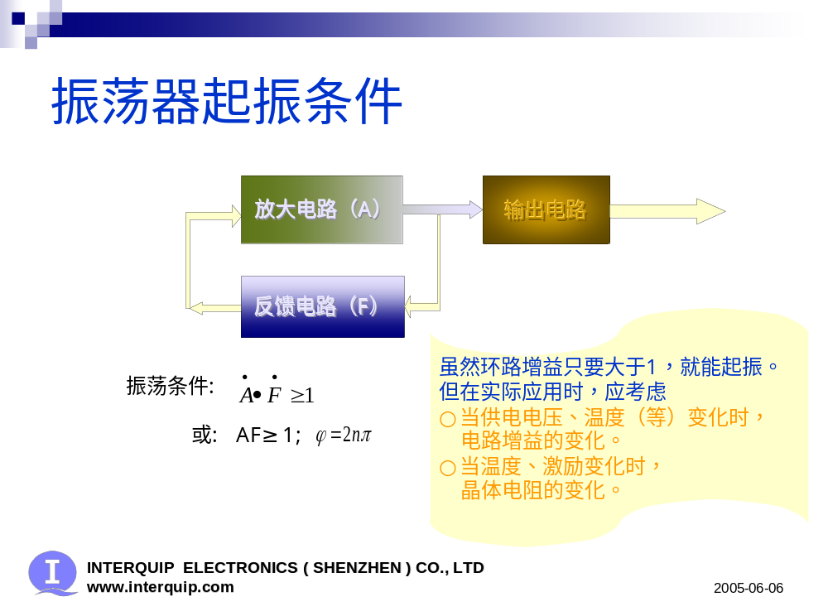
振荡器起振条件
4-4

Slide 37
振荡电路的负性阻抗(-R)
在设计振荡器时，工作时的相位和振荡电路的负性抗阻(-R)是要注意的。当振荡达至稳定时，其相位状态是:
ω Le – 1 / ω C1 = 0
如上文所说，这受外部条件影响的。
振荡电路的-R对振荡的起动性能和稳定性是非常重要的。要达至振荡的最低条件是:
Re <= | –R |
4-5

Slide 38
振荡电路的负性阻抗(-R)
这个条件会随应用频率和应用环境而改变。当振荡电路的-R越大时，振荡电路越容易起振。建议用下标准作为设计指引:
设计基频振荡器
  | –R | >谐振器最大规格电阻的10倍
设计泛音振荡器
  | –R | >谐振器最大规格电阻的5倍
4-6

Slide 39
振荡电路的负性阻抗(-R)
在确认振荡电路的设计时，建议采用简易方法去确认振荡电路的-R的设计容差是否足够。
简易检测方法
方法是在谐振器一端串上固定电阻，电阻值是谐振器规格电阻的5-10倍。在串上电阻后重复测试振荡电路的起动情况。
4-7

Slide 40
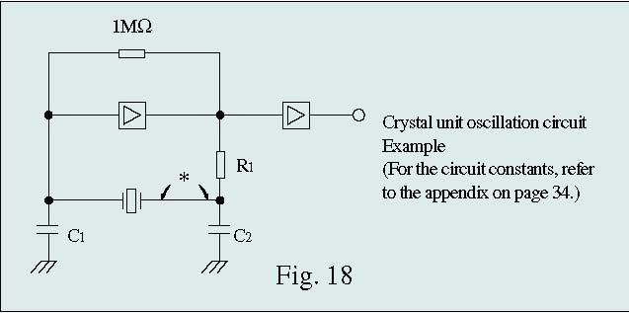
振荡电路的负性阻抗(-R)
4-8

Slide 41
振荡电路的负性阻抗(-R)
简易检测方法的判断标准
当串上电阻后，振荡电路起振畅顺、振荡幅度合适，可将电阻去掉并放心使用。
在出现以下情况时，请与应达利的技术人员联系:
不起振
需要较长时间才能起振
振荡幅度非常微弱
4-9

Slide 42
驱动功率
石英谐振器是压电器件，AT切谐振器在工作中会因应电讯号而产生微细的机械变形
机械变形的幅度随驱动功率增加 。若驱动功率不受制时，当机械变形大于石英材料弹性能承受时，振子便会破裂损毁。
在设计振荡电路时应控制驱动功率，特别是涉及异步通讯的应用中，尽可能将驱动功率控制在10-100uW之间。
4-10

