Slide 1
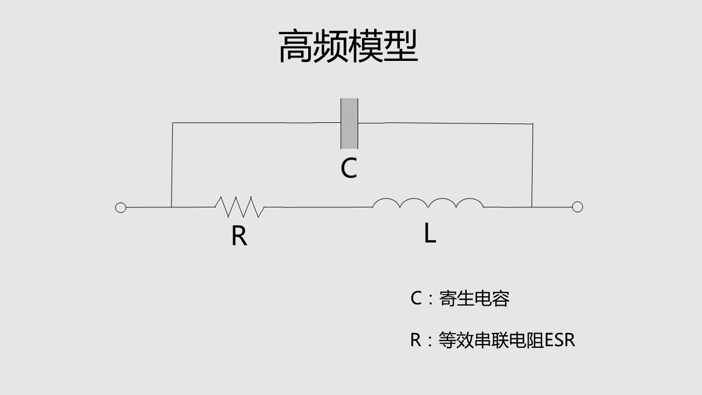









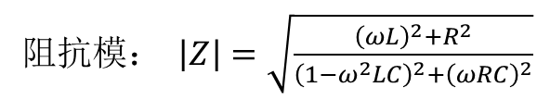


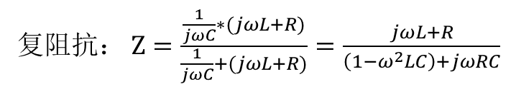


复阻抗： $Z=\frac{\frac{1}{jωC}∗(jωL+R)}{\frac{1}{jωC}+(jωL+R)}=\frac{jωL+R}{\left(1−ω^{2}LC\right)+jωRC}$
$${10}^{6}$$
$${10}^{5}$$
感性
容性
阻抗模： $\left|Z\right|=\sqrt{\frac{{\left(ωL\right)}^{2}+R^{2}}{{\left(1−ω^{2}LC\right)}^{2}+{\left(ωRC\right)}^{2}}}$
$${10}^{4}$$
|Z| 阻抗(Ohm)
$${10}^{3}$$
$${10}^{2}$$
$${10}^{1}$$
$${10}^{0}$$
理想电感
$$f_{谐振}=\frac{1}{2π\sqrt{LC}}$$
SRF
实际电感
$${10}^{4}$$
$${10}^{5}$$
$${10}^{6}$$
$${10}^{7}$$
$${10}^{8}$$
频率（Hz）

Slide 2

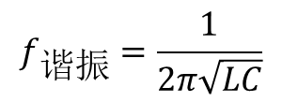



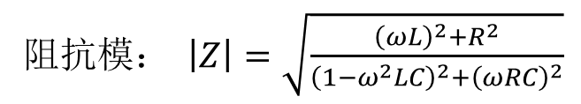
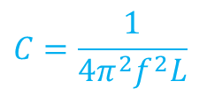
MATLAB绘制电感曲线
阻抗模： $\left|Z\right|=\sqrt{\frac{{\left(ωL\right)}^{2}+R^{2}}{{\left(1−ω^{2}LC\right)}^{2}+{\left(ωRC\right)}^{2}}}$
$$L$$
$$R$$
$$C?$$
$$f_{谐振}=\frac{1}{2π\sqrt{LC}}$$
$$C=\frac{1}{4π^{2}f^{2}L}$$

Slide 3
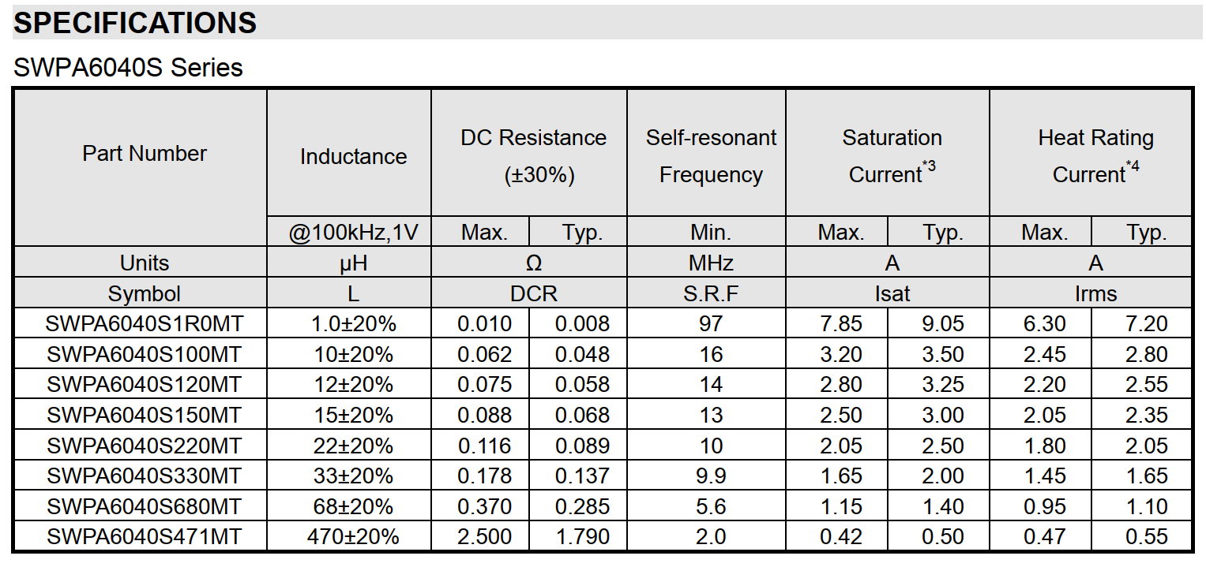
MATLAB绘制电感曲线
1uH
10uH
470uH

Slide 4


MATLAB绘制电感曲线
 | 理想电感 | 1uH电感 | 10uH电感 | 470uH电感
L | 1uH | 1uH | 10uH | 470uH
谐振频率 | 无 | 97Mhz | 16Mhz | 2Mhz
C | 0 | 2.7pF | 10pF | 13.4pF
R | 0 | 0.01Ω | 0.062Ω | 2.5Ω
1uH
10uH
$$f_{谐振}=\frac{1}{2π\sqrt{LC}}$$
$$C=\frac{1}{4π^{2}f^{2}L}$$
470uH

Slide 5
%顺络SWPA6040S1R0MT 1uH电感
C1=0.0000000000027; %2.7pF
L1=0.000001; %1uH
R1=0.01; %0.01Ω
%SWPA6040S100MT 10uH 电感
C2=0.00000000001; %10pF
L2=0.00001; %10uH
R2=0.062; %0.062Ω
%SWPA6040S471MT 470uH 电感
C3=0.0000000000134; %13.4pF
L3=0.00047; %470uH
R3=2.5; %2.5Ω
f=[10000:1000:1000000000];
w=(f.*pi*2);
Z0=w.*L1;
Z1=(((w.*L1).^2+R1^2)./((1-w.^2*L1*C1).^2+(w.*R1*C1).^2)).^0.5;
Z2=(((w.*L2).^2+R2^2)./((1-w.^2*L2*C2).^2+(w.*R2*C2).^2)).^0.5;
Z3=(((w.*L3).^2+R3^2)./((1-w.^2*L3*C3).^2+(w.*R3*C3).^2)).^0.5;
loglog(f,Z0,f,Z1,f,Z2,f,Z3);
legend('理想1uH','顺络1uH','顺络10uH','顺络470uH');
grid on;
xlabel('频率-Hz'), ylabel('|Z|:阻抗Ω');
title '电感阻抗-频率曲线';
MATLAB源代码
获取方法：
关注视频末尾微信公众号“硬件工程师炼成之路”，
在微信公众号后台回复“器件”

