Slide 1
§3.2: the Growth of functions
How to measure efficiency?
Empirical comparison (run programs)
  Factors affecting running time: Environment, compiler, language
  Empirical comparison is difficult to do “fairly” and is time consuming
Asymptotic algorithm analysis
  For most algorithms, running time depends on the “size” of the input .
  Running time is expressed as for some function T on input size n.
Notes:
效率分析：经验/计算机上的执行情况，environment (frequencies, buses, peripherals)
渐进分析（理论/数学上的分析）

Slide 2
the Growth of functions
A function is defined to determine the cost of an ALGORITHM
If f(x) is faster growing than g(x), then f(x) always eventually becomes larger than g(x) in the limit (for large enough values of x).
  We only care about the behavior for large problems.
  Even bad algorithms can be used to solve small problems.
Useful in engineering for showing that one design/algorithm scales better or worse than another.

Slide 3
Orders of Growth - Motivation
Suppose you are designing a web site to process user data (e.g., financial records).
Suppose database program A takes f_{A}(n)=30n+8 microseconds to process any n records, while program B takes f_{B}(n)=n²+1 microseconds to process the n records.
Which program do you choose, knowing you’ll want to support millions of users?

Slide 4
Visualizing Orders of Growth
On a graph, as you go to the right, the faster-growing function always
eventually becomes the larger one...
f_{A}(n)=30n+8
Value of function →
f_{B}(n)=n²+1
Increasing n →
Notes:
n²+1>30n+8 when n>30

Slide 5
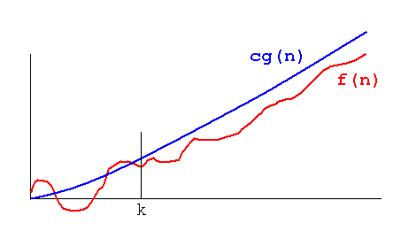
Definition: O(g), Upper Bound
Let g be any function R→R.
Define “at most order g”, written O(g), to be:
{f:R→R | ∃c,k: ∀x>k: |f(x)| ≤ c |g(x)|}.
“Beyond some point k, function f is at most a constant c times g (i.e., proportional to g).”
“f is at most order g”, or “f is big-O of g”, or “f=O(g)” all just mean that f∈O(g).
Notes:
asymptotic upper bound. Often the phrase “at most” is omitted.

Slide 6
“Big-O” Proof Examples
Show that 30n+8 is O(n).
  Show ∃c,k: ∀n>k: 30n+8 ≤ cn.
    Let c=31, k=8. Assume n>k=8. Then
    cn = 31n = 30n + n > 30n+8, so 30n+8 < cn.
Show that n²+1 is O(n²).
  Show ∃c,k: ∀n>k: n²+1 ≤ cn².
    Let c=2, k=1. Assume n>k=1. Then
    cn² = 2n² = n²+n² > n²+1, or n²+1< cn².
Even though f(n) =3n² is in O(n³), we prefer the tightest upper bound, i.e., O(n²).

Slide 7
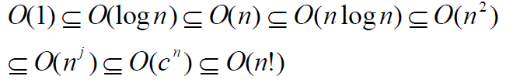
Complexity class
Also note that O(g) is a set called a complexity class. It contains all the functions which g dominates.
  f is O(g) means f ∈ O(g).
Important Complexity Classes

Slide 8
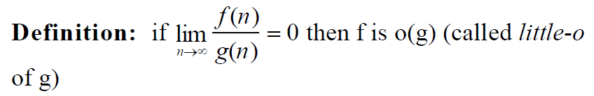
Definition: o(g)
Theorem: If f is o(g) then f is O(g).
Proof: by definition of limit as n goes to infinity, f(n)/g(n) gets arbitrarily small.That is for any ε>0, there must be an integer N such that
when n > N, | f(n)/g(n) | < ε.
Hence, choose C = ε and k = N.

Slide 9

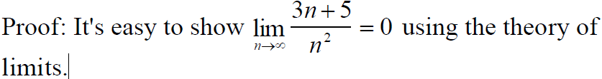

Example
It is usually easier to prove f is o(g)
  • using the theory of limits
  • using L'Hospital's rule
  • using the properties of logarithms
etc.
Example:
Notes:
the log is an increasing function whatever conclusion we draw about the logs will also apply to the original functions

Slide 10
Useful Facts about Big O
If f is O(g) and g is O(f) then O(f) = O(g).
Big O, as a relation, is transitive:
f∈O(g) ∧ g∈O(h) → f∈O(h)
Closed under addition:
If g∈O(f) and h∈O(f), then g+h∈O(f).
Closed under multiplication by a real number:
∀c>0, O(cf)=O(f)
∀c>0, O(f+c)=O(f−c)=O(f)

Slide 11
More Big-O facts
f₁∈O(g₁) ∧ f₂∈O(g₂) →
  f₁ f₂ ∈O(g₁g₂)
  f₁+f₂ ∈O(g₁+g₂)
  = O(max(g₁,g₂))
  = O(g₁) if g₂∈O(g₁)
Very useful!

Slide 12
Dominant Factor
A dominant factor in the equation that determines the “order of magnitude” of the growth function
The big-O notation can be derived from f(n) using the following steps:
  In each term, set the coefficient of the term to one
  Keep the term with the largest rank order in the function and discard the others.

Slide 13
Rank Order
Terms are ranked from lowest to highest as shown below:
1. log n
2. n
3. n log n
4. n² , n³ , n⁴ , …, n^{k}
5. 2^{n}
6. n!
7. n^{n}

Slide 14
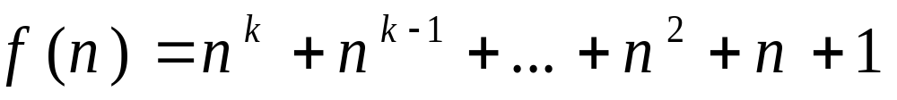
Examples
Find the complexity class of the function
  eliminate all coefficients
  the largest term is the first one n^{k}
  big-Ο notation Ο(f(n)) = Ο(n^{k})

Slide 15


Examples
Find the complexity class of the function
  Eliminate the terms 3n¹⁰⁰ and 3^{n+2} since n! grows much faster.
  Now simplify the second term. Take the log (base 2) of both. n log n grows faster so we keep the n^{n} term.
  big-Ο notation Ο(f(n)) = Ο(n n! n^{n})

Slide 16
Minor Factor
Suppose
  Algorithm 1 has complexity n² - n + 1
  Algorithm 2 has complexity n²/2 + 3n +2
Then both are O(n²) but Algorithm 2 has a smaller leading coefficient and will be faster for large problems.
Hence we write
  Algorithm 1 has complexity n² + O(n)
  Algorithm 2 has complexity n²/2 + O(n)

Slide 17
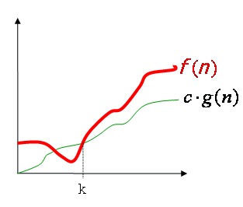
Definition: Ω(g), Low Bound
Let g be any function R→R.
Define “at least order g”, written Ω(g), to be: {f:R→R | ∃c,k: ∀x>k: |f(x)| ≥ c |g(x)|}.
“Beyond some point k, function f is at least a constant c times g
“f is at least order g”, or “f is big-Ω of g”, or “f=Ω (g)” all just mean that f∈ Ω (g).
Notes:
Everywhere beyond some point k, f(x) lies in between two multiples of g(x).

Slide 18
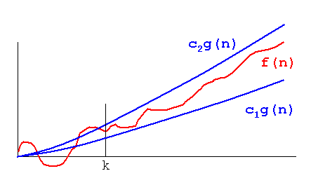
Definition: Θ(g), Tight Bound
If f∈O(g) and g∈O(f), then we say “g and f are of the same order” or “f is (exactly) order g” and write f∈Θ(g).
Another, equivalent definition:
Θ(g) ≡ {f:R→R |
∃c₁,c₂,k>0 ∀x>k: |c₁g(x)|≤|f(x)|≤|c₂g(x)| }
O(f(n)) is often misused
instead of Θ(f(n))
Notes:
too often in the case

Slide 19
Relations Between the
Order-of-Growths
Subset relations between order-of-growth sets.
R→R
O( f )
Ω( f )
• f
Θ( f )

Slide 20
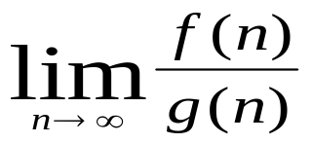
Asymptotical Comparing
Comparing f(n) and g(n) as n approaches infinity,
If r = , then
  r < ∞, including the case in which the limit is 0 then f ∈O(g)
  r > 0, including the case in which the limit is ∞ then f ∈ Ω(g)
  r = c and 0 < c < ∞ then f ∈ Θ(g)
  r = 0 then f ∈ o(g) //read as “little oh of g”
  r = ∞ then f ∈ ω(g) //read as “little omega of g”

Slide 21
Asymptotic Notation
Analogy with real numbers
  f(n) = O(g(n)) ≅f ≤ g
  f(n) = Ω(g(n)) ≅f ≥ g
  f(n) = Θ(g(n)) ≅f = g
  f(n) = o(g(n)) ≅f < g
  f(n) = ω(g(n)) ≅f > g
Abuse of notation: f(n) = O(g(n)) actually means f(n) ∈O(g(n))
Notes:
for memorization

