Slide 1
§3.3: Algorithmic Complexity
The algorithmic complexity of a computation is a measure of how difficult it is to perform the computation.
Some of the most common complexity measures:
  “Time” complexity: # of operations or steps required to solve a problem of size n.
  “Space” complexity: # of memory bits required to solve a problem of size n.
Notes:
Determine the approximate number of

Slide 2
Asymptotic Analysis
Goal: to simplify analysis of running time by getting rid of ”details”, which may be affected by specific implementation and hardware
  “rounding” for numbers: 1,000,001 ≈ 1,000,000
  “rounding” for functions: 3n² ≈ n²
Capturing the essence: how the running time of an algorithm increases with the size of the input in the limit.
  Asymptotically more efficient algorithms are best for all but small inputs
Notes:
by intuition of “rounding” for numbers

Slide 3
Basic operation
Time efficiency is analyzed by determining the number of repetitions of the basic operation as a function of input size
Basic operation: the operation that contributes most towards the running time of the algorithm
T(n) ≈ c_{op}C (n)
input size
running time
execution time
for basic operation
Number of times basic operation is executed

Slide 4
Examples on Growth function
Example 1:
sum=0;
for(i=1;i<=n;i++)
for(j=1;j<=n;j++)
sum++;
  T(n)=Cn²
Notes:
我们用增长率 growth rate来描述算法的效率

Slide 5
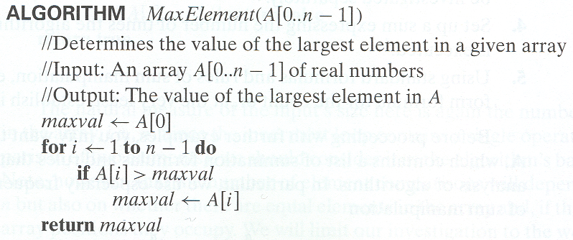
Examples on Growth function
  T(n)=Cn

Slide 6
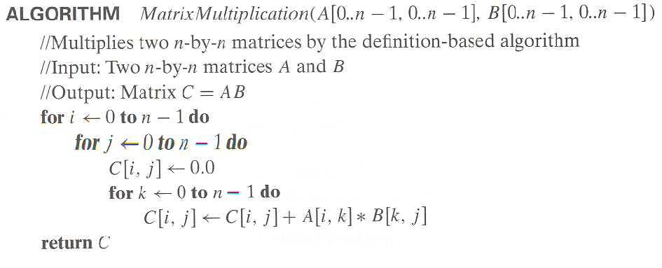
Examples on Growth function
  T(n)=Cn³

Slide 7
Complexity Depends on Input
Most algorithms have different complexities for inputs of different sizes.
  E.g. searching a long list typically takes more time than searching a short one.
Therefore, complexity is usually expressed as a function of the input length.
  This function usually gives the complexity for the worst-case or the average-case input of any given length.

Slide 8
Best、Worst and Average case
Efficiency may depend on the form of input:
Best case: minimum over inputs of n
Worst case: maximum over inputs of n
  When is the worst case time analysis important?
    Critical system (flight control) , Real-time system
Average case: “average” over inputs of n
  NOT the average of worst and best case
  Expected cost under some assumption about the probability distribution of all possible inputs
Notes:
Not all inputs of a given size take the same time. Normally we assume the probability distribution of all possible inputs be uniform.

Slide 9
Complexity & Orders of Growth
Suppose algorithm A has worst-case time complexity f(n) for inputs of length n, while algorithm B (for the same task) takes time g(n).
Suppose that f∈O(g).
Which algorithm will be faster on all sufficiently-large, worst-case inputs?
  f(n) is at most order of g(n), and hence not slower

Slide 10
Example 1: Max algorithm
Problem: Find the simplest form of the exact order of growth (Θ) of the worst-case time complexity (w.c.t.c.) of the max algorithm, assuming that each line of code takes some constant time when it is executed (with possibly different times for different lines of code).
Notes:
Acronym of w.c.t.c.: worst-case time complexity

Slide 11
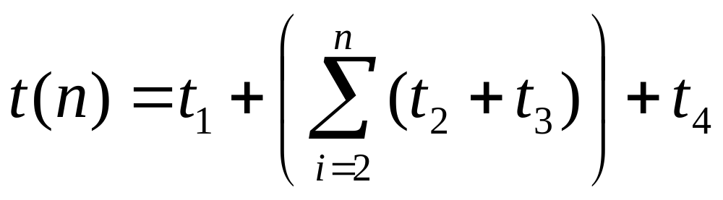
Complexity analysis, cont.
procedure max(a₁, a₂, …, a_{n}: integers)
v := a₁ t₁
for i := 2 to n t₂
if a_{i} > v then v := a_{i} t₃
return v t₄
w.c.t.c.:
Times for each execution of each line.

Slide 12
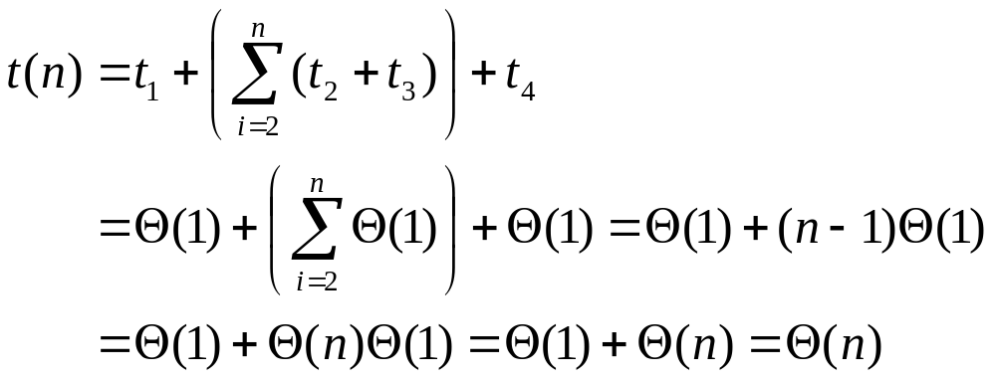
Complexity analysis, cont.
Now, what is the simplest form of the exact (Θ) order of growth of t(n)?

Slide 13
Example 2: Linear Search
procedure linear search (x: integer,
a₁, a₂, …, a_{n}: distinct integers)
i := 1 t₁
while (i ≤ n ∧ x ≠ a_{i}) t₂
i := i + 1 t₃
if i ≤ n then location := i t₄
else location := 0 t₅
return location t₆

Slide 14
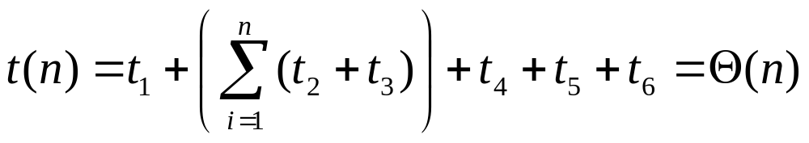
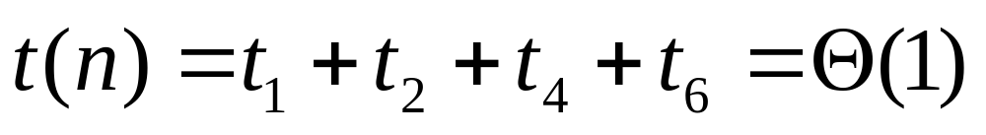
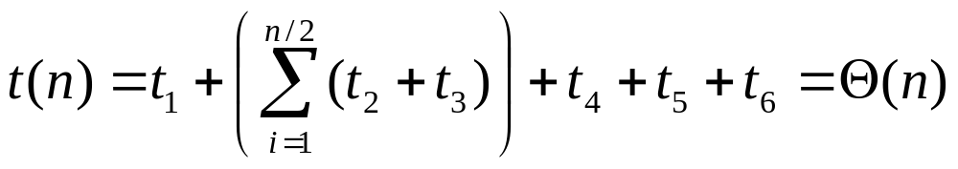
Linear search analysis
Worst case time complexity order:
Best case:
Average case, if item is present:

Slide 15
Example 3: Binary Search
procedure binary search (x:integer, a₁, a₂, …, a_{n}: distinct integers, sorted smallest to largest)
i := 1
j := n
while i<j begin
m := ⎣(i+j)/2⎦
if x>a_{m} then i := m+1 else j := m
end
if x = a_{i} then location := i else location := 0
return location
Θ(1)
Key question:
How many loop iterations?
Θ(1)
Θ(1)

Slide 16
Binary search analysis
Suppose that n is a power of 2, i.e., ∃k: n=2^{k}.
Original range from i=1 to j=n contains n items.
Each iteration: Size j−i+1 of range is cut in ~half.
Loop terminates when size of range is 1=2⁰ (i=j).
Therefore, the number of iterations is:
k = log₂n = Θ(log₂ n)= Θ(log n)
Even for n≠2^{k} (not an integral power of 2),
time complexity is still Θ(log₂ n) = Θ(log n).

Slide 17
Names for some orders of growth
Θ(1) Constant
Θ(log_{c} n)Logarithmic (same order ∀c)
Θ(log^{c} n)Polylogarithmic
Θ(n) Linear
Θ(n^{c}) Polynomial (for any c)
Θ(c^{n}) Exponential (for c>1)
Θ(n!) Factorial
(With c a constant.)
NP Problems

Slide 18
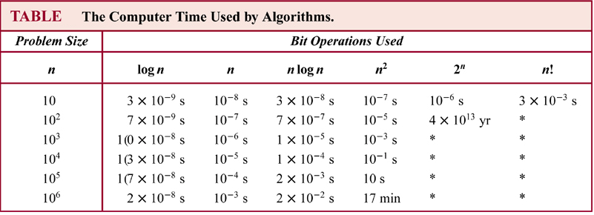
Can you wait?
If a flop takes a nanosecond, how big can a problem be for the complexity class O( n n! n^{n}).

Slide 19
Complexity of Problems
Tractable Problem: There exists a polynomial time algorithm to solve this problem. These problems are said to belong to the Class P.
Intractable Problem: There does not exist a polynomial time algorithm to solve this problem
Unsolvable Problem : No algorithm exists to solve this problem, e.g., halting problem.
Class NP: Solution can be checked in polynomial time. But no polynomial time algorithm has been found for finding a solution to problems in this class.
NP Complete Class: If you find a polynomial time algorithm for one member of the class, it can be used to solve all the problems in the class.
Notes:
易处理

Slide 20
P Versus NP Problem
It is generally believed that P≠NP since no one has been able to find a polynomial time algorithm for any of the problems in the NP complete class.
The problem of P versus NP remains one of the most famous unsolved problems in mathematics (including theoretical computer science). The Clay Mathematics Institute has offered a prize of $1,000,000 for a solution.

