Slide 1
Chapter 4: Number Theory and Cryptography

Slide 2
§4.1: Divisibility and Modular Arithmetic
Of course, you already know what the integers are, and what division is…
But: There are some specific notations, terminology, and theorems associated with these concepts which you may not know.
These form the basics of number theory.
  Vital in many important algorithms today (hash functions, cryptography, digital signatures).

Slide 3
Divides, Factor, Multiple
Let a,b∈Z with a≠0.
Def.: a|b ≡ “a divides b” :≡ (∃c∈Z: b=ac)
“There is an integer c such that c times a equals b.”
  Example: 3|12 ⇔ True, but 3|7 ⇔ False.
Iff a divides b, then we say a is a factor or a divisor of b, and b is a multiple of a.
Ex.: “b is even” :≡ 2|b.

Slide 4
the Divides Relation
Theorem: ∀a,b,c,m,n ∈ Z:
  1. a|0
  2. (a|b ∧ a|c) → a | (b + c)
  3. a|b → a|bc
  4. (a|b ∧ b|c) → a|c
  5. a | b ∧ a | c → a | mb + nc
Proof of (2): a|b means there is an s such that b=as, and a|c means that there is a t such that c=at, so b+c = as+at = a(s+t), so a|(b+c) also.■

Slide 5
The Division “Algorithm”
Theorem: For any integer dividend a and divisor d≠0, there is a unique integer quotient q and remainder r∈N such that
a = dq + r and 0 ≤ r < |d|.
Formally, the theorem is:
∀a,d∈Z, d≠0: ∃!q,r∈Z: 0≤r<|d|, a=dq+r.
We can find q and r by: q=⎣a/d⎦, r=a−qd.
Notes:
The symbol that looks like a backwards “set-membership” relational operator is an abbreviation for “such that”.

Slide 6
The mod operator
An integer “division remainder” operator.
Let a,d∈Z with d>1. Then a mod d denotes the remainder when a is divided by d.
  Using e.g. long division.
We can compute (a mod d) by:
        a − d·⎣a/d⎦.
In C/C++/Java languages, “%” = mod.

Slide 7
Modular Congruence
Let a,b∈Z, m∈Z⁺.
Then a is congruent to b modulo m, written “a ≡ b (mod m)”, iff m | a−b .
    17 ≡ 5 (mod 6) because 6 divides 17 − 5 = 12.
    24 ≢ 14 (mod 6) since 6 divides 24 − 14 = 10 is not divisible by 6.
It’s also equivalent to: (a−b) mod m = 0.
The use of “mod” in a ≡ b (mod m) and a mod m = b are different.
Notes:
a ≡ b (mod m) is a relation; In a mod m = b, mod denotes a function.

Slide 8
Useful Congruence Theorems
Theorem: Let a,b∈Z, m∈Z⁺. Then:
a ≡ b (mod m) ⇔ ∃k∈Z a=b+km.
Proof:
  If a ≡ b (mod m), then (by the definition of congruence) m | a – b. Hence, there is an integer k such that a – b = km and equivalently a = b + km.
  Conversely, if there is an integer k such that a = b + km, then km = a – b. Hence, m | a – b and a ≡ b (mod m).
Notes:
leave you the proof as an exercise

Slide 9
Useful Congruence Theorems
Theorem: Let a,b,c,d∈Z, m∈Z⁺. Then if
a ≡ b (mod m) and c ≡ d (mod m), then:
  ▪ a+c ≡ b+d (mod m), and
  ▪ ac ≡ bd (mod m)
Proof:
  Because a ≡ b (mod m) and c ≡ d (mod m), by Theorem there are integers s and t with b = a + sm and d = c + tm. Therefore,
    b + d = (a + sm) + (c + tm) = (a + c) + m(s + t) and
    b d = (a + sm) (c + tm) = ac + m(at + cs + stm).
  Hence, a + c ≡ b + d (mod m) and ac ≡ bd (mod m).
Notes:
leave you the proof as an exercise

Slide 10
Algebraic Manipulation of Congruences
Multiplying both sides of a valid congruence by an integer preserves validity.
  a ≡ b (mod m) → c∙a ≡ c∙b (mod m)
Adding an integer to both sides of a valid congruence preserves validity.
  a ≡ b (mod m) → c + a ≡ c + b (mod m)
Dividing a congruence by an integer does not always produce a valid congruence.
  Example: The congruence 14≡ 8 (mod 6) holds. But dividing both sides by 2 does not produce a valid congruence

Slide 11
Computing the mod m Function
Corollary: Let m be a positive integer and let a and b be integers. Then
  (a + b) (mod m) = ((a mod m) + (b mod m)) mod m
  ab mod m = ((a mod m) (b mod m)) mod m.

Slide 12
Arithmetic Modulo m
Definitions: Let Z_{m} be the set of nonnegative integers less than m: {0,1, …., m−1}
The operation +_{m} is defined as a +_{m} b = (a + b) mod m. This is addition modulo m.
    7 +₁₁ 9 = (7 + 9) mod 11 = 16 mod 11 = 5
The operation ∙_{m} is defined as a ∙_{m} b = (a + b) mod m. This is multiplication modulo m.
    7 ∙₁₁ 9 = (7 ∙ 9) mod 11 = 63 mod 11 = 8

Slide 13
Arithmetic Modulo m
The operations +_{m} and ∙_{m} satisfy many of the same properties as ordinary addition and multiplication.
  Closure:
    a +_{m} b and a ∙_{m} b belong to Z_{m} .
  Associativity:
    (a +_{m} b) +_{m} c = a +_{m} (b +_{m} c) ; (a ∙_{m} b) ∙_{m} c = a ∙_{m} (b ∙_{m} c).
  Commutativity:
    a +_{m} b = b +_{m} a ; a ∙_{m} b = b ∙_{m} a.
  Identity elements:
    a +_{m} 0 = a and a ∙_{m} 1 = a.
continued →

Slide 14
Arithmetic Modulo m
  Additive inverses: If a≠ 0 belongs to Z_{m} , then m− a is the additive inverse of a modulo m and 0 is its own additive inverse.
    a +_{m} (m− a ) = 0 and 0 +_{m} 0 = 0
  Multiplicatative inverses have not been included since they do not always exist.
  Distributivity: If a, b, and c belong to Z_{m} , then
    a ∙_{m} (b +_{m} c) = (a ∙_{m} b) +_{m} (a ∙_{m} c) and
    (a +_{m} b) ∙_{m} c = (a ∙_{m} c) +_{m} (b ∙_{m} c).
Using the terminology of abstract algebra, Z_{m} with +_{m} is a commutative group and Z_{m} with +_{m} and ∙_{m} is a commutative ring.

Slide 15
§4.2: Integer Representations and Algorithms
Topics:
  Base-b representations of integers.
    Especially: binary, hexadecimal, octal.
    Also: Two’s complement representation of negative numbers.
  Algorithms for computer arithmetic:
    Binary addition, multiplication, division.
  Euclidean algorithm for finding GCD’s.

Slide 16
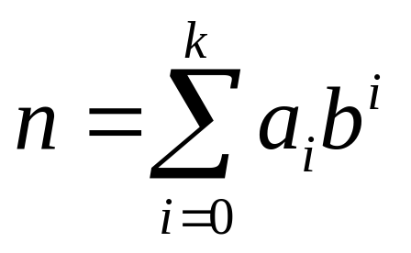
Base-b number systems
Ordinarily, we write base-10 representations of numbers, using digits 0-9.
But, 10 isn’t special! Any base b>1 will work.
For any positive integers n,b, there is a unique sequence a_{k} a_{k-1}… a₁a₀ of digits a_{i}<b such that:
The “base b expansion
of n”
Notes:
We’ll deal with summation notation in detail later. For now, explain what it means in this particular case.

Slide 17
Particular Bases of Interest
Used only because we have 10 fingers
Base b=10 (decimal):
10 digits: 0,1,2,3,4,5,6,7,8,9.
Base b=2 (binary):
2 digits: 0,1. (“Bits”=“binary digits.”)
Base b=8 (octal):
8 digits: 0,1,2,3,4,5,6,7.
Base b=16 (hexadecimal):
16 digits: 0,1,2,3,4,5,6,7,8,9,A,B,C,D,E,F
Used
internally in all modern computers
Octal digits correspond to groups of 3 bits
Hex digits give groups of 4 bits
10, 11, 12, 13, 14, 15

Slide 18
Converting to Base b
(An algorithm, informally stated.)
To convert any integer n to any base b>1:
To find the value of the rightmost (lowest-order) digit, simply compute n mod b.
Now, replace n with the quotient ⎣n/b⎦.
Repeat above two steps to find subsequent digits, until n is gone (=0).

Slide 19
Addition of Binary Numbers
Consider a 4-bit binary number
Examples of binary arithmetic:
  3 + 2 = 5 3 + 3 = 6
Decimal
Binary
Decimal
Binary
0
0000
4
0100
1
0001
5
0101
2
0010
6
0110
3
0011
7
0111
1
1
1
0
0
1
1
0
0
1
1
+
0
0
1
0
+
0
0
1
1
0
1
0
1
0
1
1
0
Notes:
Here is a quick review of a 4-bit binary number .
With this representation, you can perform addition just like adding decimal numbers.
For example here, I show you how to add 3 and 2 with the carry propagates from the 2nd bit to the 3rd bit.

Slide 20
Pseudocode of Addition
procedure add(a_{n−1}…a₀, b_{n−1}…b₀: binary representations of non-negative integers a,b)
carry := 0
for bitIndex := 0 to n−1 {go through bits}
bitSum := a_{bitIndex}+b_{bitIndex}+carry {2-bit sum}
s_{bitIndex} := bitSum mod 2 {low bit of sum}
carry := ⎣bitSum / 2⎦ {high bit of sum}
s_{n} := carry
return s_{n}…s₀: binary representation of integer s

Slide 21
Two’s Complement Representation
In binary, negative numbers can be conveniently represented using two’s complement notation.
In this scheme, a string of n bits can represent any integer i such that −2^{n−1} ≤ i < 2^{n−1}.
The bit (msb) in the highest-order bit-position (n−1) represents a coefficient multiplying −2^{n−1};
  The other positions i < n−1 just represent 2^{i}, as before.
The negation of any n-bit two’s complement number a = a_{n−1}…a₀ is given by a_{n−1}…a₀ + 1.
The bitwise logical complement of the n-bit string a_{n−1}…a₀.
Notes:
calculate the 2’s compliment representation by taking the bit-wise inverse of the positive number and then add one to 1.

Slide 22
Example of Two’s Complement
  Positive numbers: normal binary representation
  Negative numbers: flip bits (0 ←→1) , then add 1
Decimal
-8
-7
-6
-5
-4
-3
-2
-1
0
1
…
7
Two’s Complement Binary
1000
1001
1010
1011
1100
1101
1110
1111
0000
0001
…
0111
Smallest 4-bit
number: -8
Biggest 4-bit
number: 7

Slide 23
Pseudocode of Subtraction
  procedure sub(a,b)
  begin
  return a + (2’s complement of b)
  end
Uses simple adder for + and – numbers
7 + (- 6) = 1 3 + (- 5) = -2
1
1
1
1
1
0
1
1
1
0
0
1
1
+
1
0
1
0
+
1
0
1
1
0
0
0
1
1
1
1
0
Notes:
The best thing about 2’s complement representation is that your adder does not have to know about negative number.

Slide 24
Details of 2’s complement notation
Negation
  flip bits and add 1. (Magic! Works for + and -)
  Might cause overflow.
Extend sign when loading into larger register
  +3 => 0011, 00000011, 0000000000000011
  -3 => 1101, 11111101, 1111111111111101
Overflow detection (need to raise “exception” when answer can’t be represented)
  0101 5
  + 0110 6
  1011 -5 ??!!!
Notes:
Addition/subtraction

Slide 25
Overflow Detection
0
0
1
0
1
1
0
0
0
0
1
0
2
1
1
0
0
- 4
+
0
0
1
1
3
+
1
1
1
0
- 2
0
1
0
1
5
1
0
1
0
- 6
0
1
1
1
1
0
1
0
0
1
1
1
7
1
1
0
0
- 4
+
0
0
1
1
3
+
1
0
1
1
- 5
1
0
1
0
-6
0
1
1
1
7
Overflow is signaled by carry out of most-significant bit being different from carry from next bit!
Notes:
So how do we detect overflow? Overflow is signaled by carry out of most-significant bit being different from carry from next bit

Slide 26
Pseudocode of Multiplication
procedure multiply(a_{n−1}…a₀, b_{n−1}…b₀: binary representations of a,b∈N)
product := 0
for i := 0 to n−1
if b_{i} = 1 then
product := add(a_{n−1}…a₀0^{i}, product)
return product
i extra 0-bits appended after
the digits of a
Notes:
The best thing about 2’s complement representation is that your adder does not have to know about negative number.

Slide 27
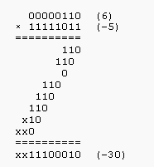
Another Example of Multiplication
The precision of two's complement operands is doubled before the multiplication, direct multiplication (discarding any excess bits beyond that precision).
Notes:
The best thing about 2’s complement representation is that your adder does not have to know about negative number.

Slide 28
Pseudocode of Division
procedure div-mod(a,d ∈ Z⁺)
n := length of a in bits-length of d in bits
q := 0;
for i := n downto 0
if a ≥ d0^{i} then
q_{i} := 1 {This bit of quotient is 1.}
a := a − d0^{i} {Subtract to get remainder.}
else q_{i} := 0 {This bit of quotient is 0.}
r := a
return q,r {q = quotient, r = remainder}
Notes:
How about if a<b?

Slide 29
Modular Exponentiation
In cryptography, it’s important to calculate b^{n} mod m efficiently. E.g. 2⁶⁴⁴ mod 645.
procedure ME (b:integer, a_{k−1} a_{k−2} …a₀:binary representation of n, m: positive integer)
  x := 1; power := b mod m
  for i := 0 to k−1
  begin
    if a_{i} = 1 then x := (x．power) mod m
    power := (power．power) mod m
  end
  return x
Notes:
b^{n}=(b¹)^{a0}(b²)^{a1 (}b⁴)^{a2….}

Slide 30
§4.3: Primes and Greatest Common Divisors
An integer p>1 is prime iff it is not the product of two integers greater than 1:
p>1 ∧ ¬∃a,b∈N: a>1, b>1, ab=p.
The only positive factors of a prime p are 1 and p itself. Some primes: 2,3,5,7,11,13...
Non-prime integers greater than 1 are called composite, because they can be composed by multiplying two integers greater than 1.

Slide 31
Fundamental Theorem of Arithmetic
Its "Prime Factorization"
Every positive integer has a unique representation as the product of a non-decreasing series of zero or more primes.
  Some examples:
    1 = (product of empty series) = 1
    2 = 2 (product of series with one element 2)
    4 = 2·2 (product of series 2,2)
    2000 = 2·2·2·2·5·5·5; 2001 = 3·23·29;
    2002 = 2·7·11·13; 2003 = 2003
Notes:
factorization

Slide 32
The Sieve of Erastosthenes
The Sieve of Erastosthenes can be used to find all primes not exceeding a specified positive integer. For example, begin with the list of integers between 1 and 100.
  Delete all the integers, other than 2, divisible by 2.
  Delete all the integers, other than 3, divisible by 3.
  Next, delete all the integers, other than 5, divisible by 5.
  Next, delete all the integers, other than 7, divisible by 7.
{2,3,7,11,19,23,29,31,37,41,43,47,53,59,61,67,71,73,79,83,89, 97}
continued →
Notes:
厄拉多塞（Eratosthenes, 公元前276--前196）古希腊天文学家

Slide 33
Infinitude of Primes
Theorem: There are infinitely many primes. (Euclid)
Proof: Assume finitely many primes: p₁, p₂, ….., p_{n}
  Let q = p₁p₂∙∙∙ p_{n} + 1
  Either q is prime or it is a product of primes.
    But none of the primes p_{j} | q since
    if p_{j} | q, then p_{j} | q − p₁p₂∙∙∙ p_{n} = 1 .
    Hence, there is a prime not on the list p₁, ..., p_{n}.
  Consequently, there are infinitely many primes.

Slide 34
Mersenne Primes
Definition: Prime numbers of the form 2^{p} − 1 , where p is prime, are called Mersenne primes.
  2² − 1 = 3, 2³ − 1 = 7, 2⁵ − 1 = 31 , and 2⁷ − 1 = 127 are Mersenne primes.
  2¹¹ − 1 = 2047 = 23∙89 is not a Mersenne prime.
  The largest known prime numbers is 2^{43,112,609} − 1 are Mersenne primes, which has nearly 13 million decimal digits.
  The Great Internet Mersenne Prime Search (GIMPS) is a distributed computing project.
  http://www.mersenne.org/

Slide 35
Greatest Common Divisor
The greatest common divisor gcd(a,b) of integers a,b (not both 0) is the largest (most positive) integer d that is a divisor both of a and of b.
  d = gcd(a,b) = max(d: d|a ∧ d|b) ⇔
  d|a ∧ d|b ∧ ∀e∈Z, (e|a ∧ e|b) → d ≥ e
Example: gcd(24,36)=?
Positive common divisors: 1,2,3,4,6,12.
The largest one of these is 12.

Slide 36
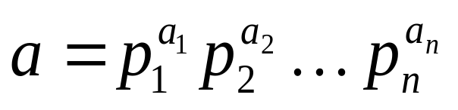
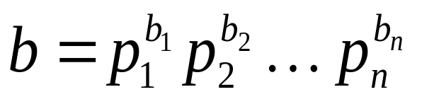
GCD shortcut
If the prime factorizations are written as
and ,
then the GCD is given by:
Example of using the shortcut:
  a=84=2·2·3·7 = 2²·3¹·7¹
  b=96=2·2·2·2·2·3 = 2⁵·3¹·7⁰
  gcd(84,96) = 2²·3¹·7⁰ = 2·2·3 = 12.

Slide 37
Relative Primality
Integers a and b are called relatively prime or coprime iff their gcd = 1.
  Example: Neither 21 nor 10 is prime, but they are coprime. 21=3·7 and 10=2·5, so they have no common factors > 1, so their gcd = 1.
A set of integers {a₁,a₂,…} is (pairwise) relatively prime if all pairs (a_{i}, a_{j}), for i≠j, are relatively prime.

Slide 38
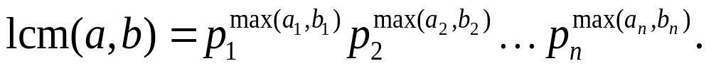
Least Common Multiple
lcm(a,b) of positive integers a, b, is the smallest positive integer that is a multiple both of a and of b. E.g. lcm(6,10)=30
  m = lcm(a,b) = min(m: a|m ∧ b|m) ⇔
  a|m ∧ b|m ∧ ∀n∈Z: (a|n ∧ b|n) → (m ≤ n)
If the prime factorizations are written as
and
then the LCM is given by

Slide 39
Euclid’s Algorithm for GCD
Finding GCDs by comparing prime factorizations can be difficult when
the prime factors are not known!
Euclid discovered: For all ints. a, b,
gcd(a, b) = gcd((a mod b), b).
Sort a,b so that a>b, and then (given b>1)
(a mod b) < a, so problem is simplified.

Slide 40
Euclid’s Algorithm Example
gcd(372,164) = gcd(372 mod 164, 164).
  372 mod 164 = 372−164⎣372/164⎦ = 372−164·2 = 372−328 = 44.
gcd(164,44) = gcd(164 mod 44, 44).
  164 mod 44 = 164−44⎣164/44⎦ = 164−44·3 = 164−132 = 32.
gcd(44,32) = gcd(44 mod 32, 32) = gcd(12, 32) = gcd(32 mod 12, 12) = gcd(8,12) = gcd(12 mod 8, 8) = gcd(4,8) = gcd(8 mod 4, 4) = gcd(0,4) = 4.
Notes:
Have students come up with other examples and work through them. Maybe start with a 2-digit example.

Slide 41
Euclid’s Algorithm Pseudocode
procedure gcd(a, b: positive integers)
while b ≠ 0 begin
r ≔ a mod b; a ≔ b; b ≔ r; end
return a
Fast! Number of while loop iterations
turns out to be O(log(min(a,b))).

Slide 42
gcds as Linear Combinations
Bézout’s Theorem: : If a and b are positive integers, then there exists integers s and t such that gcd(a,b)=sa+tb (so called Linear Combination of GCD).
E.g. Express gcd(252,198)=18 in a linear combination of 252 and 198
  252=1* 198+54 198=3*54+36
  54=1*36+18 36=2*18
Notes:
How to calculate s and t ?
18=54-36
36=198-3*54 substitute this expression for 36 in the previous expression, we have 18=4*54-1*198
54=252-198 substitute this expression for 54 in the previous expression, we have 18=4*252-5*198

Slide 43
Linear Combination example
  Now working backwards, from above
    18 = 54 − 1 ∙36
    36 = 198 − 3 ∙54
  Substituting the 2nd equation into the 1st yields:
    18 = 54 − 1 ∙(198 − 3 ∙54 )= 4 ∙54 − 1 ∙198
  Substituting 54 = 252 − 1 ∙198 yields:
    18 = 4 ∙(252 − 1 ∙198) − 1 ∙198
    = 4 ∙252 − 5 ∙198

Slide 44
Consequences of Bézout’s Theorem
Lemma: If a, b, and c are positive integers such that gcd(a, b) = 1 and a | bc, then a | c.
Proof:
  Since gcd(a, b) = 1, by Bézout’s Theorem there are integers s and t such that
  sa + tb = 1.
  Multiplying both sides of the equation by c, yields sac + tbc = c.
  Since a | bc, we have a | tbc
  We conclude a | c, since sac + tbc = c.

Slide 45



Uniqueness of Prime Factorization
A prime factorization of a positive integer where the primes are in nondecreasing order is unique. Proof: (by contradiction) Suppose that the positive integer n can be written as a product of primes in two distinct ways:
n = p₁p₂ ∙∙∙ p_{s} and n = q₁q₂ ∙∙∙ p_{t}.
  Remove all common primes from the factorizations to get
  By Lemma, it follows that divides , for some k, contradicting the assumption that and are distinct primes.
  Hence, there can be at most one factorization of n into primes in nondecreasing order.

Slide 46
Dividing Congruences by an Integer
Theorem: Let m be a positive integer and let a, b, and c be integers. If ac ≡ bc (mod m) and gcd(c,m) = 1, then a ≡ b (mod m).
Proof:
Since ac ≡ bc (mod m),
m | ac − bc = c(a − b)
by Lemma and the fact that gcd(c,m) = 1, it follows that
m | a − b.
Hence, a ≡ b (mod m).

Slide 47
§4.4: Solving Congruences
Definition: A congruence of the form
ax ≡ b( mod m),
where m is a positive integer, a and b are integers, and x is a variable, is called a linear congruence.
The solutions to a linear congruence
ax≡ b( mod m)
are all integers x that satisfy the congruence.

Slide 48

Inverse of Modulo
Definition: An integer ā such that
āa ≡ 1( mod m)
is said to be an inverse of a modulo m.
  Example: 5 is an inverse of 3 modulo 7
  since 5∙3 = 15 ≡ 1(mod 7)
How to solve linear congruences?
  Multiply both side of linear congruence by inverse.
  What are the solution of ?
    Sol.: Since -2 is the inverse of 3 modulo 7, we have -2‧3x ≡ -2‧4(mod 7), So x ≡ 6(mod 7).

Slide 49


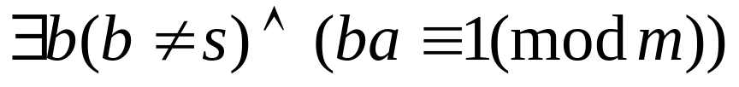
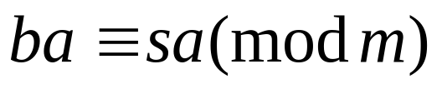

Existence of Inverse of Modulo
Theorem: If gcd(a,m)=1 and m>1, then
Proof:
Since m>1, we have
Suppose
Hence
Since gcd(a,m)=1,
_{existence}
_{uniquenes}
Notes:
s is the Inverse of a modulo m

Slide 50


Example
Find an inverse of 3 modulo 7.
Since gcd(3,7)=1, by Euclidean algorithm: , we see that . This shows that –2 is an inverse of 3 modulo 7.

Slide 51
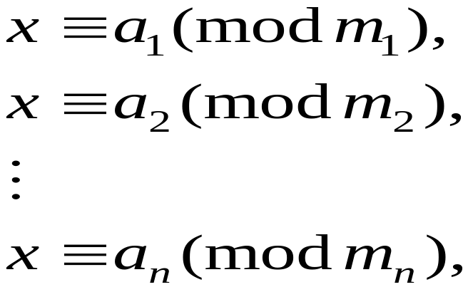


Chinese Remainder Theorem
Let m₁,m₂,…,m_{n} be pairwise relatively prime positive integers. The system
has a unique solution modulo m, where
(That is, there is a solution x with , and all other solutions are congruent modulo m to this solution)
Notes:
孙子定理

Slide 52

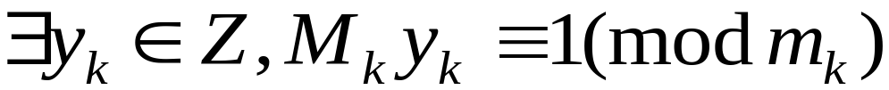
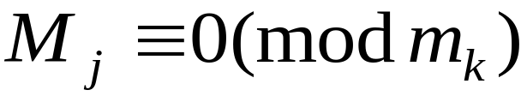

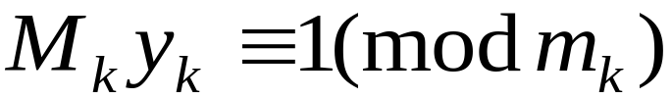
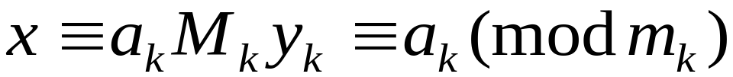
Proof of Chinese Remainder Theorem
Proof: Let M_{k}=m/m_{k} for k=1,2,…,n.
Since gcd(m_{i} , m_{k})=1 for , gcd(m_{k}, M_{k})=1.
Consequently, .
Let .
Since whenever .
Since ,
, for k=1,2,…,n.
Notes:
X=a₁M₁y₁+a₂M₂y₂+….+a_{k}M_{k}y_{k} (mod m)
唯一性：m₁|(x₁-x₀), m₂|(x₁-x₀), m₃|(x₁-x₀)…=> m|(x₁-x₀)

Slide 53
Examples
Find a number x such that have remainders of 1 when divided by 3, 2 when divided by 5 and 3 when divided by 7. i.e.
  x =1 mod 3
  x = 2 mod 5
  x = 3 mod 7
Sol: 2*35≡1(mod 3) 1*21≡1(mod 5)
1*15≡1(mod 7),
so x ≡ 1*2*35+2*1*21+3*1*15 ≡52 (mod 105)

Slide 54
Examples
Represent 973 in Z₁₈₁₃ as a k-tuple:
Answer:
  M = 1813 = 37 * 49 ➔ m₁ = 37 & m₂ = 49
  A = 973
  A = (A mod m₁, A mod m₂) = (11, 42)
We can recover its value using Chinese remainder theorem.
Applied in computer arithmetic with large integers.
Notes:
X≡11 (mod 37) x≡42 (mod 49) x≡23 (mod 50) 取其中任意两个都可以恢复973.
X*Y≡(X mod m₁)*(Y mod m₁) (mod m₁)

Slide 55
§4.5: Applications of Congruences
Hashing function. E.g. let k be your id. no. Assume we have m locations and hashing function: h(k) = k mod m
  h(064212848) = 064212848 mod 111=14
  h(037149212) = 037149212 mod 111=65
For collision resolution, we can use a linear probing function:
  h(k,i) = (h(k) + i) mod m, where i runs from 0 to m − 1.

Slide 56
Pseudorandom Numbers
A sequence of pseudorandom numbers {x_{n}}, with 0 ≤ x_{n} < m for all n, generated by successively using the recursively defined function.
  Let modulus m, multiplier a, increment c, seed x₀, x_{n+1}=(ax_{n}+c) mod m
  example: x_{n+1} = (7x_{n} + 4) mod 9, with x₀ = 3.
    x₁ = 7x₀ + 4 mod 9 = 7∙3 + 4 mod 9 = 25 mod 9 = 7,
    x₂ = 7x₁ + 4 mod 9 = 7∙7 + 4 mod 9 = 53 mod 9 = 8,
    x₃ = 7x₂ + 4 mod 9 = 7∙8 + 4 mod 9 = 60 mod 9 = 6,…..

Slide 57
Check Digits: UPCs
Retail products are identified by their Universal Product Codes (UPCs). Usually these have 12 decimal digits, the last one being the check digit. The check digit is determined by the congruence:
3x₁+ x₂ +3x₃ +x₄ +3x₅ +x₆ +3x₇ +x₈ +3x₉+x₁₀ +3x₁₁
+ x₁₂ ≡ 0 (mod 10).
      Suppose that the first 11 digits of the UPC are 79357343104. What is the check digit?
      Solution:
      3∙7 + 9 + 3∙3 + 5 + 3∙7 + 3 + 3∙4 + 3 + 3∙1 + 0 + 3∙4
      + x₁₂ ≡ 0 (mod 10)
      98 + x₁₂ ≡ 0 (mod 10)
      x₁₂ ≡ 0 (mod 10) So, the check digit is 2.

Slide 58
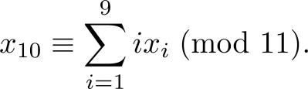
Check Digits:ISBNs
Books are identified by an International Standard Book Number (ISBN-10), a 10 digit code. The tenth digit is a check digit, which is determined by :
      Is 084930149X a valid ISBN10??
      Solution:
      1∙0+2∙8+3∙4+4∙9+5∙3+6∙0+7∙1+8∙4+9∙9+10∙10
      = 299 ≡ 2 ≢ 0 (mod 11)
      Hence, 084930149X is not a valid ISBN-10.

Slide 59
§4.6: Cryptography
Simple Encryption: Variations of the following have been used to encrypt messages for thousands of years.
Convert a message to capitals.
Think of each letter as a number of Z₂₆.
Apply an invertible modular function to each number.
Convert back to letters.
A | B | C | D | … | Y | Z
0 | 1 | 2 | 3 | … | 24 | 25
Notes:
Letter ←→ Number Conversion Table

Slide 60
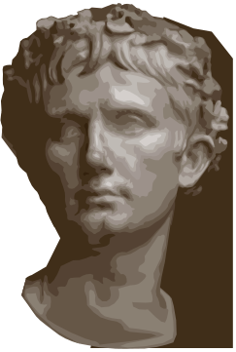
Caesar Cipher
The Caesar cipher is one of a family of ciphers called shift ciphers. Letters can be shifted by an integer k, with 3 being just one possibility. The encryption function is
  f(p) = (p + k) mod 26
  and the decryption function is
  f⁻¹(p) = (p−k) mod 26
The integer k is called a key.
Notes:
移位加密

Slide 61
Shift Cipher
Example 1: Encrypt the message “STOP GLOBAL WARMING” using the shift cipher with k = 11.
Solution: Replace each letter with the corresponding element of Z₂₆.
18 19 14 15 6 11 14 1 0 11 22 0 17 12 8 13 6.
Apply the shift f(p) = (p + 11) mod 26, yielding
3 4 25 0 17 22 25 12 11 22 7 11 2 23 19 24 17.
Translating the numbers back to letters produces the ciphertext
“DEZA RWZMLW HLCXTYR.”

Slide 62
Affine Ciphers
Shift ciphers are a special case of affine ciphers which use functions of the form
  f(p) = (ap + b) mod 26,
where a and b are integers, f is a bijection.
The function is a bijection (thus invertible)
iff gcd(a,26) = 1.

Slide 63
Encryption example
Let the encryption function be
f (a) = (3a + 9) mod 26
Encrypt “Stop Thief”
STOP THIEF (capitals)
18,19,14,15 19,7,8,4,5
11,14,25,2 14,4,7,21,24
LOZC OEHVY

Slide 64
Decryption example
Decryption works the same, except that you apply the inverse function.
EG: Find the inverse of f (a) = (3a + 9) mod 26
  If we didn’t have to deal with mod 26, inverse would be g (a) = 3⁻¹ (a - 9)
  since gcd(3,26) = 1, the inverse of 3 modulo 26 is 9. This gives: g (a) = (9a – 3) mod 26
  Apply the inverse function for the Decryption.
  LOZC OEHVY
  11,14,25,2 14,4,7,21,24
  18,19,14,15 19,7,8,4,5
  STOP THIEF
Notes:
The Caesar cipher was used at least as early as 100 B.C.

Slide 65
Cryptanalysis of Affine Ciphers
The nine most common letters in the English texts are E 13%, T 9%, A 8%, O 8%, I 7%, N 7%, S 7%, H 6%, and R 6%.
To analyze ciphertext:
  Find the frequency of the letters in the ciphertext.
  Hypothesize that the most frequent letter is produced by encrypting E.
  If the value of the shift from E to the most frequent letter is k, shift the ciphertext by −k and see if it makes sense.
  If not, try T as a hypothesis and continue.

Slide 66
Cryptanalysis of Affine Ciphers
Example: We intercepted the message “ZNK KGXRE HOXJ MKZY ZNK CUXS” that we know was produced by a shift cipher. Let’s try to cryptanalyze.
Solution: The most common letter in the ciphertext is K. So perhaps the letters were shifted by 6 since this would then map E to K. Shifting the entire message by −6 gives us “THE EARLY BIRD GETS THE WORM.”

Slide 67
Block Ciphers
Affine Ciphers are vulnerable to cryptanalysis based on letter frequency. Block ciphers avoid this problem, by replacing blocks of letters with other blocks of letters.
A simple type of block cipher is called the transposition cipher.
  To encrypt a message, split the letters into blocks of size m, adding additional letters to fill out the final block. We encrypt p₁,p₂,…,p_{m} as c₁,c₂,…,c_{m} = p_{σ(1)},p_{σ(2)},…,p_{σ(m)}.
  To decrypt the c₁,c₂,…,c_{m} transpose the letters using the inverse permutation σ⁻¹.
Notes:
transposition cipher 置换密码

Slide 68
Block Ciphers
Example: Using the transposition cipher based on the permutation σ of the set {1,2,3,4} with σ(1) = 3, σ(2) = 1, σ(3) = 4, σ(4) = 2,
  Encrypt the plaintext PIRATE ATTACK
  Decrypt the ciphertext message SWUE TRAEOEHS
  Solution:
  Split into four blocks PIRA TEAT TACK.
Apply the permutation σ giving IAPR ETTA AKTC.
  σ⁻¹ : σ ⁻¹(1) = 2, σ ⁻¹(2) = 4, σ ⁻¹(3) = 1, σ ⁻¹(4) = 3.
  Apply the permutation σ⁻¹ giving USEW ATER HOSE.
  Split into words to obtain USE WATER HOSE.

Slide 69
Public Key Cryptography
All classical ciphers, including shift and affine ciphers, are private key cryptosystems.
  Knowing the encryption key allows one to quickly determine the decryption key.
  All parties who wish to communicate using a private key cryptosystem must share the key and keep it a secret.
In public key cryptosystems, everyone can have a publicly known encryption key. The only key that needs to be kept secret is the decryption key.

Slide 70
An Application of Primes!
When you visit a secure web site (https:… address, indicated by padlock icon in IE), the browser and web site may be using a technology called RSA encryption.
This public-key cryptography scheme involves exchanging public keys containing the product pq of two random large primes p and q, which must be kept secret by a given party.
So, the security of your day-to-day web transactions depends critically on the fact that all known factoring algorithms are intractable!
Notes:
Note: There is a tractable quantum algorithm for factoring; so if we can ever build big quantum computers, then RSA is not secure.

Slide 71
RSA Cryptosystem
Setup:
  n = pq, with p and q primes
  e relatively prime to φ(n) = (p − 1) (q − 1)
  d inverse of e in Z_{φ(n)}
Keys:
  Public key: K_{E} = (n, e)
  Private key: K_{D} = d
Plaintext M in Z_{n}
  Encryption: C = Me mod n
  Decryption: M = C^{d} mod n

Slide 72
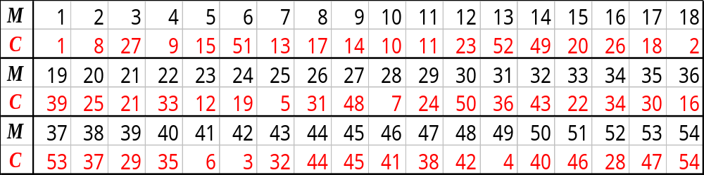
Complete RSA Example
Setup:
  p = 5, q = 11
  n = 5⋅11 = 55
  φ(n) = 4⋅10 = 40
  e = 3
  d = 27
Encryption
  C = M³ mod 55
Decryption
  M = C²⁷ mod 55
Notes:
40=3*13+1

Slide 73
Security
The security of the RSA cryptosystem is based on the widely believed difficulty of factoring large numbers
The RSA challenge, sponsored by RSA Security, offers cash prizes for the factorization of given large numbers
  In April 2002, prizes ranged from $10,000 (576 bits) to $200,000 (2048 bits)
Estimated resources needed to factor a number within one year
Bits | PCs | Memory
430 | 1 | 128MB
760 | 215,000 | 4GB
1,020 | 342×10⁶ | 170GB
1,620 | 1.6×10¹⁵ | 120TB
Notes:
The best known factoring algorithm (general number field sieve) takes time exponential in the number of bits of the number to be factored

Slide 74
Euler’s Theorem
The multiplicative group for Z_{n}, denoted with Z*_{n}, is the subset of elements of Z_{n} relatively prime with n
The totient function of n, denoted with φ(n), is the size of Z*_{n.} E.g: Z*₁₀ = { 1, 3, 7, 9 }, φ(10) = 4
If p is prime, we have Z*_{p} = {1, 2, …, (p − 1)}, φ(p) = p − 1.
For each element x of Z*_{n}, we get x^{φ(n)} mod n = 1.
E.g(n = 10): 3^{φ(10)} mod 10 = 3⁴ mod 10 = 1
Notes:
multiplicative group 乘法群
For n=10, 1x*3x*7x*9x=1*3*7*9 mod 10

Slide 75
Correctness
We show the correctness of the RSA cryptosystem for the case when the plaintext M does not divide n
  Namely, we show that (Me)^{d} mod n = M
Since ed mod φ(n) = 1, there is an integer k ed = kφ(n) + 1
Since M does not divide n, by Euler’s theorem we have
  M^{φ(n)} mod n = 1

Slide 76
Correctness
Thus, we obtain
(Me)^{d} ≡M^{ed} ≡ M^{kφ(n) + 1} ≡MM^{kφ(n)}
≡M (M^{φ(n)})^{k}≡ M (M^{φ(n)} mod n)^{k}
≡ M (1)^{k} ≡ M (mod n)
the proof of correctness in the case when the plaintext M divides n is rather complex.
Notes:
the proof of correctness in the case when the plaintext M divides n is rather complex.

Slide 77
Cryptographic Protocols: Key Exchange
Key exchange is a protocol by which two parties can exchange a secret key over an insecure channel.
Diffe-Hellman key agreement protcol.
  Suppose that A and B want to share a common key.
  They use a prime p and a primitive root a of p.
  A chooses a secret integer k₁ and sends a^{k1} mod p to B.
  B chooses a secret integer k₂ and sends a^{k2} mod p to A.
  A computes (a^{k2})^{k1} mod p, and B computes (a^{k1})^{k2} mod p.
  At the end, they have their shared key
(a^{k2})^{k1} mod p = (a^{k1})^{k2} mod p.
Notes:
primitive root 原根
to find k₁ and k₂ from a^{k1} mod p and a^{k2} mod p respectively is an instance of the discrete logarithm problem, considered to be computationally infeasible when p and a are sufficiently large.

Slide 78
Cryptographic Protocols: Digital Signatures
Alice wants to send a message M so that everyone who receives the message knows that it came from her.
  She translates the message to numerical equivalents and splits into blocks, just as in RSA encryption.
  She then applies her decryption function D_{(n,e)} to the blocks and sends the results to all intended recipients.
  The recipients apply Alice’s encryption function and the result is the original plain text since
  E_{(n,e)} (D_{(n,e)} (x))= x.
Everyone who receives the message can then be certain that it came from Alice.

