Slide 1
Chapter 5:
Induction and recursion

Slide 2
§5.1&5.2: Induction and Well-Ordering
Definition: A set S is well ordered if every subset has a least element.
  Note: (0, 1] is not well ordered since (0,1] does not have a least element.
Examples:
  N is well ordered (under the ≤ relation)
  Any coutably infinite set can be well ordered
    The least element in a subset is determined by a bijection (list) which exists from N to the countably infinite set.
  Z can be well ordered but it is not well ordered under the ≤ relation (Z has no smallest element).
Notes:
良序

Slide 3
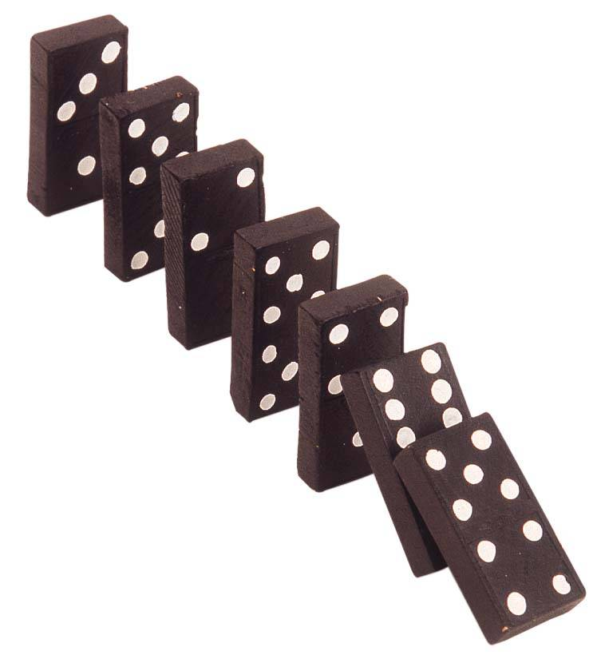
The “Domino Effect”
Premise #1: Domino #0 falls.
Premise #2: For every k∈N,
if domino #k falls, then so does domino #k+1.
Conclusion: All of
the dominoes fall
down!
Note:
this works even if there are infinitely many dominoes!
Notes:
It is like a row of dominos

Slide 4
Mathematical Induction
Let P(x) be a predicate over a well ordered set S. The problem is to prove ∀x∈S:P(x).
A powerful, rigorous technique for proving that a predicate P(n) is true for every natural number n, no matter how large.
Essentially a “domino effect” principle.
Based on a predicate-logic inference rule:
  P(0)
  ∀k≥0, k<n (P(k)→P(k+1))
  ∴∀n≥0 P(n)
“The First Principle
of Mathematical
Induction”
Notes:
In the case that S = N

Slide 5
Validity of Induction
Proof that ∀n≥0 P(n) is a valid consequent:
Given any k≥0, the 2nd antecedent :
∀k≥0 (P(k)→P(k+1)) trivially implies that
∀k≥0 (k<n)→(P(k)→P(k+1)), i.e., that (P(0)→P(1)) ∧ (P(1)→P(2)) ∧ … ∧ (P(n−1)→P(n)). Repeatedly applying the hypothetical syllogism rule to adjacent implications in this list k−1 times then gives us P(0)→P(n); which together with P(0) (antecedent #1) and modus ponens gives us P(n). Thus ∀n≥0 P(n). ■

Slide 6
Outline of an Inductive Proof
(Also called 1st principle)
Let us say we want to prove ∀n P(n)…
  Do the base case (or basis step): Prove P(0)
  Do the inductive step:
  Prove ∀k, k<n P(k)→P(k+1).
  In this class we will use P(n)→P(n+1).
    E.g. you could use a direct proof, as follows:
    Let n∈N, assume P(n). (inductive hypothesis)
    Now, under this assumption, prove P(n+1).
  The inductive inference rule then gives us
  ∀n P(n).

Slide 7
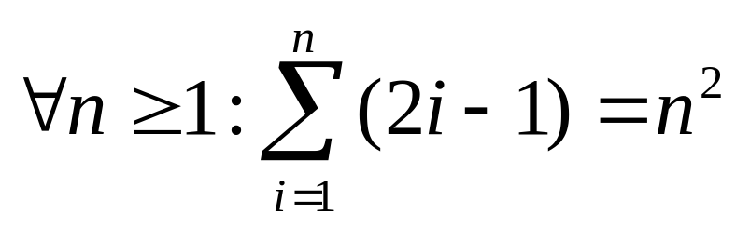
Induction Example (1st princ.)
Prove that the sum of the first n odd positive integers is n². That is, prove:
Proof by induction.
  Base case: Let n=1. Then find P(1).
  The sum of the first 1 odd positive integer is 1 which equals 1².
  (Cont…)
P(n)

Slide 8
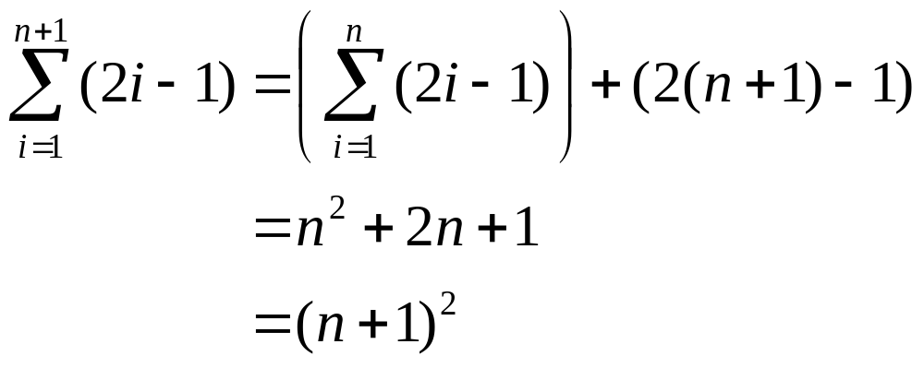
Example cont.
Inductive step: Prove ∀n≥1: P(n)→P(n+1).
  Let n≥1, assume P(n), and prove P(n+1).
P(n+1)
P(n)
(n+1)^{th} term
By inductive
hypothesis P(n)

Slide 9
Another Induction Example
Prove that ∀n>0, n<2^{n}. Let P(n)=(n<2^{n})
  Base case: P(1)=(1<2¹)=(1<2)=T.
  Inductive step: For n>0, prove P(n)→P(n+1).
    Assuming n<2^{n}, prove n+1 < 2^{n+1}.
    Note n + 1 < 2^{n} + 1 (by induct. hypothesis)
    < 2^{n} + 2^{n} (because 1<2≤2^{n})
    = 2^{n+1}
    So n + 1 < 2^{n+1}, and we’re done.

Slide 10
More Examples..
Use Math. Induction to show that
1 + 2 + 2² + ….. + 2^{n} = 2^{n+1} -1
for all nonnegative integers.
Basis Step: P(0) : 2⁰ = 1 = 2¹ -1
Inductive Hypothesis: Assume
P(n): 1 + 2 + 2² +…..+2^{n =} 2^{n+1} -1
Prove:
P(n+1):1 + 2 + 2² +…..+ 2^{n} + 2^{n+1} ⁼ 2^{n+1+1}-1

Slide 11
Cont.
P(n + 1) 1 + 2 + 2² + ….. + 2^{n} + 2^{n+1}
P(n)
= 2^{n+1} - 1
+ 2^{n+1}
= 2. 2^{n+1} - 1
= 2^{n+2} - 1

Slide 12
Generalized Induction
Generalized induction is used to prove results about sets other than the integers that have the well-ordering property.
Since Z is well ordered, rule can also be used to prove general assertions: ∀n≥c P(n) for a given constant c∈Z, where maybe c≠0.
  In this circumstance, the base case is to prove P(c) rather than P(0), and the inductive step is to prove ∀n≥c (P(n)→P(n+1)).
Induction can also be used to prove
∀n≥c P(a_{n}) for any arbitrary series {a_{n}}.
Notes:
We can prove these from the form

Slide 13

Show 3n+5 is O(n²)
Proof: We must find C=1 and k=5 such that
3n + 5 ≤ Cn²
whenever n ≥ k. Hence we prove by induction that
Basis step: P(5): 3x5 + 5=20 ≤ (5)².
IH: assume P(n): 3n + 5 ≤ n² is true for n ≥5.
Prove P(n+1): 3(n +1)+ 5 ≤ (n +1)²
3(n +1)+ 5=3n+5+3 ≤ n²+3= n²+2+1 ≤ (n +1)²
Notes:
which
Which establishes the basis step

Slide 14
Generalized Induction
consider an ordering on N⨉ N, ordered pairs of nonnegative integers. Specify that (x₁ ,y₁) is less than or equal to (x₂,y₂) if either x₁ < x₂, or x₁ = x₂ and y₁ <y₂ . This is called the lexicographic ordering.
Strings are also commonly ordered by a lexicographic ordering.
The next example uses generalized induction to prove a result about ordered pairs from N⨉ N.

Slide 15
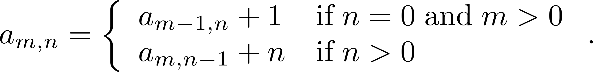
Generalized Induction
Example: Suppose that a_{m,n} is defined for (m,n)∊N ×N
by a_{0,0} = 0 and
Show that a_{m,n} =m+n(n+1)/2 is defined for all (m,n)∊N ×N.
Solution:
  BASIS STEP: a_{0,0} = 0 = 0 + (0∙1)/2
  INDUCTIVE STEP: Assume that a_{m̍,n̍} = m̍+ n̍(n̍ + 1)/2 whenever(m̍,n̍) is less than (m,n).
    If n = 0, by the inductive hypothesis we can conclude
    a_{m,n} = a_{m−1,n} + 1 = m − 1+ n(n + 1)/2 + 1 = m + n(n + 1)/2 .
    If n > 0, by the inductive hypothesis we can conclude
    a_{m,n} = a_{m−1,n} + 1 = m + n(n − 1)/2 +n = m + n(n + 1)/2 .
⁻² .

Slide 16
Strong Induction (2nd Principle)
Characterized by another inference rule:
P(0)
∀n≥0: (∀0≤k ≤ n: P(k)) → P(n+1)
∴∀n≥0: P(n)
The only difference between this and the 1st principle is that:
  The inductive step here makes use of the stronger hypothesis that P(k) is true for all smaller numbers k ≤ n, not just for one k.
P is true in all previous cases
Notes:
Note the precedence of connectives, 冒号：colon

Slide 17
Example of 2nd Principle
Show that every n>1 can be written as a product
∏ p_{i} = p₁p₂…p_{s} of some series of s prime numbers.
  Let P(n)=“n has that property”
Base case: n=2, let s=1, p₁=2.
Inductive step: Let n≥2. Assume ∀2≤k≤n: P(k).
Consider n+1. If it’s prime, let s=1, p₁=n+1.
Else n+1=ab, where 1<a≤n and 1<b≤n.
Then a=p₁p₂…p_{t} and b=q₁q₂…q_{u}. Then we have that n+1 = p₁p₂…p_{t} q₁q₂…q_{u}, a product of s=t+u primes.

Slide 18
Another 2nd Principle Example
Prove that every amount of postage of 12 cents or more can be formed using just 4-cent and 5-cent stamps. P(n)=“n can be…”
Base case: 12=3{4}, 13=2{4}+1{5}, 14=1{4}+2{5}, 15=3{5}, so ∀12≤n≤15, P(n).
Inductive step: Let n≥15, assume
∀12≤k≤n: P(k). Note 12≤n−3≤n, so P(n−3), so add a 4-cent stamp to get postage for n+1.

Slide 19
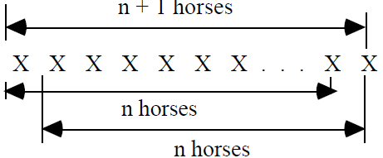
All horses are the same color?
Proof: We do induction on the size of sets of horses of the same color.
Basis step: Obviously true for all sets with 1 horse.
IH: Assume it is true for all sets with n horses.
Prove: it is true for all sets with n+1 horses.
every set of n+1 horses has an overlap of horses which are the
same color.
What's wrong?
Notes:
What's wrong?

Slide 20
§5.3: Recursive definitions and structural Induction
Recursive (or inductive ) def.: Define value of objects (sequences, functions, sets, ...) in terms of themselves (smaller similar ones).
  Ex: The factorial function f(n) = n!
  1. f(0) = 1
      2. f(n) = n x f(n-1) for all n > 0.
  Ex: the sequence 1,2,4,... (a_{n} = 2^{n}) can be defined recursively as follows:
    1. a₀ = 1;
    2. a_{n+1} = 2 x a_{n} for n > 0.
Notes:
Sometimes it’s easier. Example: Descendant 1.the person’s children 2. all the children’s descendants

Slide 21
Bad recursive definitions
Definition can’t be completely self-referential
Must eventually come down to something that’s solved “directly”
Consider:
  f(0) = 1; f(n) = 1 + f(n-2)
  What is f(1)?
Consider:
  f(0) = 1; f(n) = 1+f(-n)
  What is f(1)?

Slide 22
Recursively Defined Sets and Structures
BASIC STEP: Indicate a basic set of elements that are contained in the set.
RECURSIVE STEP: Indicate how additional elements are in the set by performing operations on the elements already in the set.
Example (Positive Multiples of 3):
  BASIC STEP: 3∈S
  RECURSIVE STEP : If x∈S and y ∈S then x+y ∈S

Slide 23
Defining sets via recursion
The set of odd positive integers
  1 ∈ S
  If x ∈ S, then x+2 ∈ S
The set of positive integer powers of 3
  3 ∈ S
  If x ∈ S, then 3*x ∈ S
The set of polynomials with integer coefficients
  0 ∈ S
  If p(x) ∈ S, then p(x) + cx^{n} ∈ S for c ∈ Z, n ∈ N

Slide 24
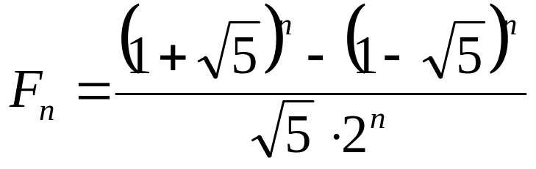
Fibonacci sequence
Definition of the Fibonacci sequence
1,1,2,3,5,8,...
  Non-recursive:
  Recursive: F_{n} = F_{n-1} + F_{n-2}
Must always specify two parts:
  Base case (or basis step): F₁ = 1, F₂ = 1
  Recursive step: F_{n} = F_{n-1} + F_{n-2} for n > 2
Notes:
Proof this non-recursive formula by induction.

Slide 25
Defining strings via recursion
Terminology
  λ is the empty string: “”
  Σ is the set of all letters: e.g. { a, b, c, …, z }
We can define a set of strings Σ* as follows
  Base step: λ ∈ Σ*
  If w ∈ Σ* and x ∈ Σ, then xw ∈ Σ*
  Thus, Σ* is the set of all the possible strings that can be generated with the alphabet
if Σ = {0,1,2}, then 1201 ∈ Σ* since
  λ → 1 λ = 1 → 01 → 201 →1201.

Slide 26
Well-Formed Formula in Propositional Logic
Definition: The set of well-formed formula in propositional logic involving T, F, propositional variables, and operators from the set {¬,∧,∨,→,↔}.
  BASIS STEP: T,F, and s, where s is a propositional variable, are well-formed formulae.
  RECURSIVE STEP: If E and F are well formed formulae, then (¬ E), (E ∧ F), (E ∨ F), (E → F), (E ↔ F), are well-formed formulae.
Examples:
  ((p ∨q) → (q ∧ F)) is a well-formed formula.
  pq ∧ is not a well formed formula.

Slide 27
Palindromes
We will define set P, which is the set of all palindromes
  Basis step: λ ∈ P
  Second basis step: x ∈ P when x ∈ Σ
  Recursive step: xpx ∈ P if x ∈ Σ and p ∈ P
How to prove all elements contained in set P are all palindromes?
  This requires structural induction

Slide 28
Structural Induction
To Prove that a certain property is true for all elements in a recursively defined structure.
  Structural induction will work on some recursive problems which mathematical induction will not.
Similar two parts:
  Basic Step: Show that the result holds for all elements specified in the basic step
  Recursive step: Show that if the statement is true for each of the elements used to construct new elements in the recursive definition, the result also holds for this new elements.
Notes:
Such as Trees, strings, etc.

Slide 29
Example
Let F_{n} denote the n^{th} term in the Fibaonacci sequence and let α = (1+√5)/2 then
for any n ≥ 3, F_{n} > α^{n-2}.
Basis step: F₃ =2 > α¹; F₄ =3 > α²
Inductive hypothesis:
  Assume F_{n} > α^{n-2} and F_{n-1} > α^{n-3}
Recursive step: Show true for new element F_{n+1}
  F_{n+1}=F_{n} + F_{n-1} > α^{n-2}+ α^{n-3}= α^{n-3}(α+1) > α^{n-1}
  Proven!

Slide 30
Palindrome revisit
  1. Basis step: λ ∈ P
  2. Second basis step: x ∈ P when x ∈ Σ
  3. Recursive step: xpx ∈ P if x ∈ Σ and p ∈ P
Def. of P:
Basis step: x ∈ Σ or x= λ → x is a Palindrome
Inductive hypothesis:
  Assume for any p ∈ P and p is a Palindrome
Recursive step: Show true for new element
  If p is a Palindrome and x ∈ Σ, then xpx is a Palindrome.

Slide 31
§5.4: Recursive Algorithms
Definition: an algorithm is recursive if it solve a problem by reducing it to an instance of the same problem with smaller inputs.
Example: gcd(a,b) a, b ∈ N, a > b
    procedure gcd(a, b: Nat)
if b = 0 then
return a
else
return gcd(b, a mod b).
Recursive algorithms will always terminate.
Notes:
According to the well-ording property, the set of all pairs of Natural numbers computed in gcd has a least element, and (b,a mod d)<(a,b)
Every strictly decreasing sequence of elements of the set must terminate after only finitely many steps

Slide 32
Rules for Recursive Algorithms
Base case - must have a way to end the recursion
Recursive call - must change at least one of the parameters and make progress towards the base case
  exponentiation (x,y)
    base: if y is 0 then return 1
    recursive: else return (x*exponentiation(x,y-1))

Slide 33
Towers of Hanoi
“Towers of Hanoi” is commonly used as an example of a problem with a simple recursive solution
  There are three pegs
  The first (source) peg holds some number of rings
src aux dest
  You want to move all rings to the last peg
  You can only move one ring at a time
  You can never put a larger ring on top of a smaller ring
  You have one auxiliary peg you can use

Slide 34
Solution to Towers of Hanoi
src aux dest
Move the top n-1 rings from src to aux (recursively)
Move the largest ring from src to dest
Move the n-1 rings from aux to dest (recursively)
Ex. making an implementation of “Towers of Hanoi”

Slide 35
Tiling
A tromino tile:
And a 2^{n}x2^{n} board with a hole:
A tiling of the board with trominos:

Slide 36
Tiling: Trivial Case (n = 1)
Trivial case (n = 1): tiling a 2x2 board with a hole:
Idea – try somehow to reduce the size of the original problem, so that we eventually get to the 2x2 boards which we know how to solve…

Slide 37
Tiling: Dividing the Problem
To get smaller square boards let’s divide the original board into for boards
Great! We have one problem of the size 2^{n-1}x2^{n-1}!
But: The other three problems are not similar to the original problems – they do not have holes!

Slide 38
Tiling: Dividing the Problem
Idea: insert one tromino at the center to get three holes in each of the three smaller boards
Now we have four boards with holes of the size
2^{n-1}x2^{n-1}.
Keep doing this division, until we get the 2x2 boards with holes – we know how to tile those

Slide 39
Tiling: Algorithm
INPUT: n – the board size (2^{n}x2^{n} board), L – location of the hole.
OUTPUT: tiling of the board
Tile(n, L)
if n = 1 then
Trivial case
Tile with one tromino
return
Divide the board into four equal-sized boards
Place one tromino at the center to cut out 3 additional holes
Let L1, L2, L3, L4 denote the positions of the 4 holes
Tile(n-1, L1)
Tile(n-1, L2)
Tile(n-1, L3)
Tile(n-1, L4)

Slide 40
Recursive Fibonacci method
Is this code elegant? No!
long fib(int n) {
if ( n == 0 ) return 1;
if ( n == 1 ) return 1;
return fib(n-1) + fib(n-2);
}
Let’s start to trace it for fib(5)

Slide 41
Trace of fib(5)
For fib(5), we call fib(4) and fib(3)
  For fib(4), we call fib(3) and fib(2)
    For fib(3), we call fib(2) and fib(1)
      For fib(2), we call fib(1) and fib(0). Base cases!
      fib(1). Base case!
    For fib(2), we call fib(1) and fib(0). Base cases!
  For fib(3), we call fib(2) and fib(1)
    For fib(2), we call fib(1) and fib(0). Base cases!
    fib(1). Base case!

Slide 42
Fibonacci: recursion is a bad choice
Note that subproblems (like fib(2) ) repeat, and solved again and again
  We don’t remember that we’ve solved one of our subproblems before
  For this problem, better to store partial solutions instead of recalculating values repeatedly
  Turns out to have exponential time-complexity!

Slide 43
Non-recursive Fibonacci
Two bottom-up iterative solutions:
  Create an array of size n, and fill with values starting from 1 and going up to n
  Or, have a loop from small values going up, but
    only remember two previous Fibonacci values
    use them to compute the next one
    (See next slide)

Slide 44
Non-recursive Fibonacci (Iterative)
long fib(int n) {
if ( n < 2 ) return 1;
long answer;
long prevFib=1, prev2Fib=1; // fib(0) & fib(1)
for (int k = 2; k <= n; ++k) {
answer = prevFib + prev2Fib;
prev2Fib = prevFib;
prevFib = answer;
}
return answer;
}

Slide 45
Recursion isn’t necessary
Computers don’t have “recursive hardware”!
When a higher-level language is compiled, recursive calls are implemented with a stack
The compiler changes recursive code into nonrecursive code
It follows, then, that anything you could do recursively, you could also do nonrecursively by using loops and a stack

Slide 46
§5.5: Program Correctness
After designing a program to solve a problem, how can we assure that the program always produce correct output?
Types of errors in a program:
syntax error: easy to detect by the help of compiler
semantic error: test or verify

Slide 47
Test or Verify
Program testing can only increase our confidence about the correctness of a program; it can never guarantee that the program passing test always produce correct output.
A program is said to be correct if it produces the correct output for every possible input.
Correctness proof generally consists of two steps:
  Termination proof :
  Partial correctness: whenever the program terminates, it will produce the correct output.

Slide 48
Program verification
Problem: what does it mean that a program produce the correct output?
  By specifying assertions (or descriptions) about the expected outcome of the program.
Hoare triple: P {S} Q
  P : Preconditions (assertions) , giving the properties that the initial input values are required to have.
  S : Program or program segment to be verified.
  Q : Postconditions (final assertions), giving the properties that the output of the program should have
Notes:
(or results)

Slide 49
Partial & Total Correctness
P {S} Q is partially correct whenever P is true for input value of S and S terminates, then Q is true for the output values of S.
If in addition we prove termination of S, then we have total correctness
Ex1: x=1 {y := 2; z := x+ y} z = 3
Ex2: x = 1 { while x > 0 x++ } x = 0
Notes:
Partially correct; Totally correct

Slide 50
Typical program constructs
1. assignment: x := expr
2. composition: S1;S2
  Execute S1 first, after termination, then execute S2.
3. Conditional:
  3.1 If <cond> then S
4. Loop:
  4.1 while <cond> do S
Other constructs possible, But it can be shown that any program can be converted into above

Slide 51
Assignments
D₀ Axiom of assignments
  P {x = f} R
  where
  P is derived from R by replacing all occurrences of x with f.
Example:
y + 1 < 10 {y = y+1} y < 10

Slide 52
Consequence
D₁ Inference rules for consequence
P {Q} R R → S (weak postcondition)
P {Q} S
P {Q} R S → P (strengthen precondition)
S {Q} R
Example
  y + 1 < 10 {y = y+1} y < 10 y < 10 → x = 1
        y + 1 < 10 {y = y+1} x = 1

Slide 53
Composition
D₂ Inference rule for composition
  P {Q1} R1 R1 {Q2} R
  P {Q1; Q2} R
Example:
  x=1 {y = x} y=1 y=1 {z=y} z=1
  x=1{y=x; z=y} z=1

Slide 54
Iteration
Consider the statement: while B do S
D₃ Inference rule for iteration
P∧B {S}P
P {while B do S} ¬B ∧ P
Example
  x < 5 {x = x+1} x < 10
  x<10 {while (x < 5) x = x + 1} x ≥ 5 ∧ x < 10

Slide 55
if-then-else
D₄ if-then-else inference rule
  P ∧ e {Q1} R P ∧ ¬e {Q2} R
P {if e then Q1 else Q2 fi} R
Example
z = 0 ∧ x < 0 {y := -x + z} y ≥ 0
z = 0 ∧ x ≥ 0 {y := x + z} y ≥ 0
z = 0 {if (x<0) y := -x + z else y := x + z} y ≥ 0

Slide 56
Example
Consider the following program for finding the quotient and remainder of x / y.
r := x;
q := 0;
while (y <= r) {
r := r – y;
q := 1 + q;}
We will try to prove that in the end:
  x = r + y×q and y > r.

Slide 57
Example (cont.)
True {r := x; q := 0; while (y <= r) {r := r – y; q := 1 + q;}}
x = r + y× q ∧ y > r.
Proof：
true → x = x + y × 0
x = x + y × 0 {r := x} x = r + y × 0 D₀
x = r + y × 0 {q := 0} x = r + y × q D₀
true {r := x} x = r + y × 0 D₁, 1,2
true {r := x; q :=0} x = r + y × q D₂, 3,4

Slide 58
Example (cont.)
True {r := x; q := 0; while (y <= r) {r := r – y; q := 1 + q;}}
x = r + y× q ∧ y > r.
Proof：
true {r := x; q :=0} x = r + y × q D₂, 3,4
x = r + y×q ∧ y ≤ r → x = (r-y) + y×(1+q)
x = (r-y)+y×(1+q) {r:=r-y; q:=1+q} x = r+y×q
x = r+y×q ∧ y ≤ r {r:=r-y; q:=1+q} x = r+y×q
x = r + y × q { while .. } y > r ∧ x = r+y×q D₃

