Slide 1
Chapter 7:Discrete Probability

Slide 2
§7.1 An Introduction to Discrete Probability
We first define some key terms:
  An experiment is a procedure that yields one of a given set of possible outcomes.
  The sample space of the experiment is the set of possible outcomes.
  An event is a subset of the sample space.
Laplace defined the probability of an event.
Definition: If S is a finite sample space of equally likely outcomes, and E is an event, that is, a subset of S, then the probability of E is p(E) = |E| / |S|.

Slide 3

Probability
Define a probability measure on a set S to be a real-valued function, Pr, with domain 2^{S} so that:
For any subset A in 2^{S}, 0 ≤ Pr(A) ≤ 1.
Pr(∅) = 0, Pr(S) = 1.
If subsets A and B are disjoint, then Pr(A U B) = Pr(A) + Pr(B).
Pr(A) is “the probability of event A.”
A sample space, together with a probability measure, is called a probability space.
S = {1,2,3,4,5,6}
For A ⊆ S, Pr(A) = |A|/|S|
Ex. “Prob of an odd #”
A = {1,3,5}, Pr(A) = 3/6

Slide 4
Examples
Lottery: What is the probability that a person picks the correct six numbers out of 40?
Solution: The number of ways to choose six numbers out of 40 is
C(40,6) = 40!/(34!6!) = 3,838,380.

Slide 5

Examples
What is the probability that a 5 card poker hand contains a royal flush?
S = all 5 card poker hands.
A = all royal flushes
Pr(A) = |A|/|S|
Pr(A) = 4/C(52,5)

Slide 6
Examples
What is the probability of a total of 8 when 2 dice are rolled?
What is the size of the sample space?
36
How many rolls satisfy our condition of interest?
5
So the probability is 5/36.

Slide 7
Examples
What is the probability of a total of 8 when 3 dice are rolled?
What is the size of the sample space?
216
C(7,2)
How many rolls satisfy our condition of interest?
So the probability is 21/216.

Slide 8
Monty Hall Puzzle
1
2
3
Example: There is a large prize behind one of the doors. You are asked to select one of the three doors to open. After you select a door, the game show host opens one of the other doors (which he knows is not the winning door), and he gives you the opportunity to switch your selection. Should you switch?
Solution: You should switch.

Slide 9

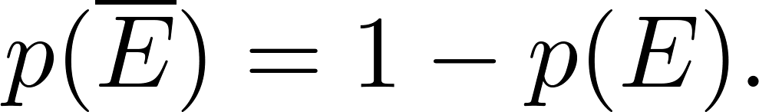
The Probability of Complements and Unions of Events
Theorem 1: Let E be an event in sample space S. The probability of the event = S − E, the complementary event of E, is given by
Proof: Using the fact that | | = |S| − |E|,

Slide 10
The Probability of Complements and Unions of Events
Example: A sequence of 10 bits is chosen randomly. What is the probability that at least one of these bits is 0?
Solution: Let E be the event that at least one of the 10 bits is 0. Then is the event that all of the bits are 1s. The size of the sample space S is 2¹⁰. Hence,

Slide 11
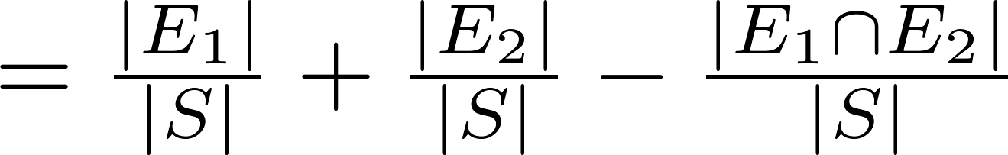
The Probability of Complements and Unions of Events
Theorem 2: Let E₁ and E₂ be events in the sample space S. Then
Proof: Since |A ∪ B| = |A| + | B| − |A ∩ B|, it follows that

Slide 12
The Probability of Complements and Unions of Events
Example: What is the probability that a positive integer selected at random from the set of positive integers not exceeding 100 is divisible by either 2 or 5?
Solution: Let E₁ be the event that the integer is divisible by 2 and E₂ be the event that it is divisible 5. It follows that:
p(E₁ ∪ E₂) = p(E₁) + p(E₂) – p(E₁ ∩ E₂)
= 50/100 + 20/100 − 10/100 = 3/5.

Slide 13
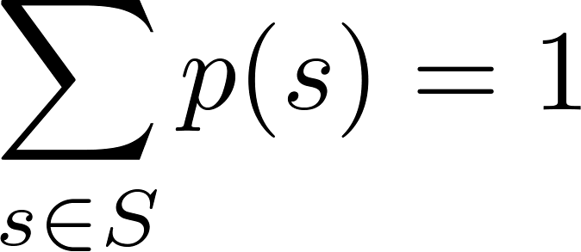
§7.2 Probability Theory
Let S be a sample space of an experiment with a finite number of outcomes. We assign a probability p(s) to each outcome s, so that:
      i. 0 ≤ p(s) ≤ 1 for each s ∈ S
      ii.
The function p from the set of all outcomes of the sample space S is called a probability distribution.

Slide 14
Assigning Probabilities
Example: What probabilities should be assigned to these outcomes when the coin is biased so that heads comes up twice as often as tails?
Solution: We have p(H) = 2p(T).
Because p(H) + p(T) = 1, it follows that
2p(T) + p(T) = 3p(T) = 1.
Hence, p(T) = 1/3 and p(H) = 2/3.

Slide 15
Uniform Distribution
Definition: Suppose that S is a set with n elements. The uniform distribution assigns the probability 1/n to each element of S. (Note that we could have used Laplace’s definition here.)
Example: Consider again the coin flipping example, but with a fair coin. Now p(H) = p(T) = 1/2.

Slide 16
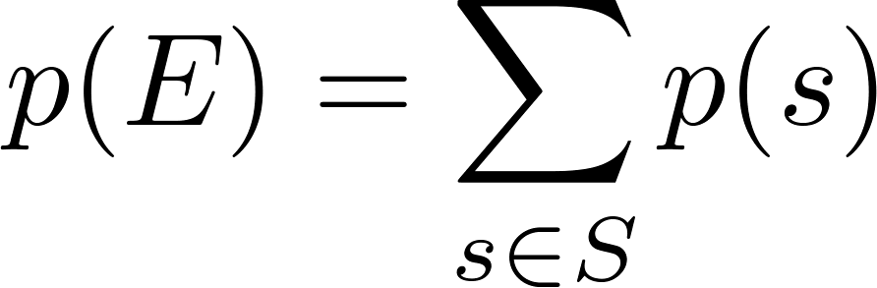
Probability of an Event
Definition: The probability of the event E is the sum of the probabilities of the outcomes in E.
Note that now no assumption is being made about the distribution.

Slide 17
Example
Example: Suppose that a die is biased so that 3 appears twice as often as each other number, but that the other five outcomes are equally likely. What is the probability that an odd number appears when we roll this die?
Solution: We want the probability of the event E = {1,2,3}. We have p(3) = 2/7 and
p(1) = p(2) = p(4) = p(5) = p(6) = 1/7.
Hence, p(E) = p(1) + p(3) + p(5) =
1/7 + 2/7 + 1/7 = 4/7.

Slide 18
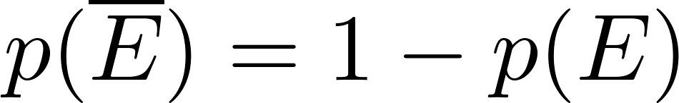
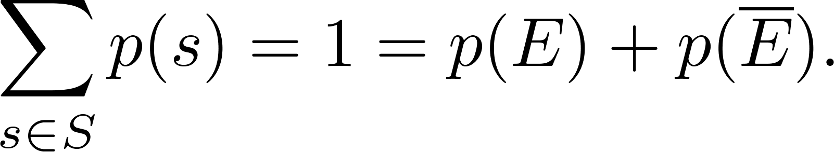
Probabilities of Complements and Unions of Events
Complements: still holds. Since each outcome is in either E or , but not both,
Unions:
also still holds under the new definition.

Slide 19
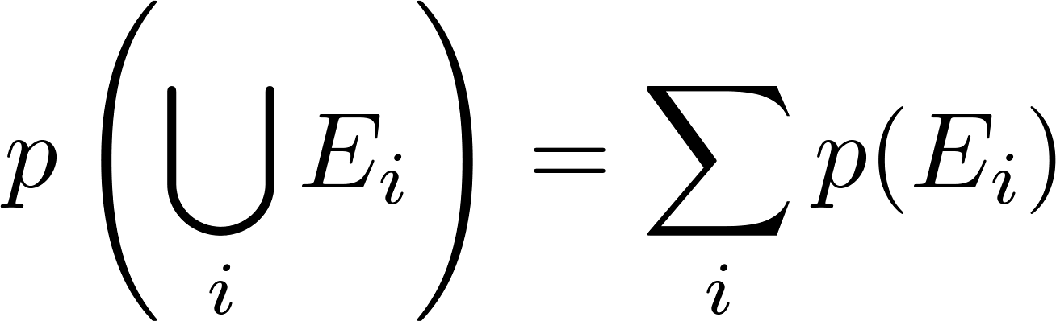
Combinations of Events
Theorem: If E₁, E₂, … is a sequence of pairwise disjoint events in a sample space S, then

Slide 20
Conditional Probability
Let E and F be events with Pr(F) > 0. The conditional probability of E given F, denoted by Pr(E|F) is defined to be:
Pr(E|F) = Pr(E∩F)/Pr(F).
F
E

Slide 21
Conditional Probability
Pr(E|F) = Pr(E∩F)/Pr(F).
A bit string of length 4 is generated at random so that each of the 16 bit strings is equally likely. What is the probability that it contains at least two consecutive 0s, given that its first bit is a 0?
Pr(F) = 1/2
Pr(E∩F)?
0000 0001 0010 0011 0100
Pr(E∩F) = 5/16
Pr(E|F) = 5/8

Slide 22
Independence
The events E and F are independent if and only if Pr(E∩F) = Pr(E) x Pr(F).
Let E be the event that a family of n children has children of both sexes.
Lef F be the event that a family of n children has at most one boy.
Are E and F independent if
n = 2?
No
n = 4?
No
n = 3?
Yes
n = 5?
No
Notes:
N=3 Pr(E n F)=3/8 Pr(E)=4/8 Pr(F)=6/8

Slide 23
Pairwise and Mutual Independence
Definition: The events E₁, E₂, …, E_{n} are pairwise independent if and only if p(E_{i}⋂E_{j}) = p(E_{i}) p(E_{j}) for all pairs i and j with i ≤ j ≤ n.
The events are mutually independent if
whenever i_{j}, j = 1,2,…., m, are integers with
1 ≤ i₁ < i₂ <∙∙∙ < i_{m} ≤ n and m ≥ 2.

Slide 24
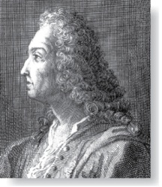
Bernoulli Trials
James Bernoulli
(1854 – 1705)
Definition: Suppose an experiment can have only two possible outcomes, e.g., the flipping of a coin or the random generation of a bit.
  Each performance of the experiment is called a Bernoulli trial.
  One outcome is called a success and the other a failure.
  If p is the probability of success and q the probability of failure, then p + q = 1.
Many problems involve determining the probability of k successes when an experiment consists of n mutually independent Bernoulli trials.

Slide 25
Bernoulli Trials
A coin is tossed 8 times. What is the probability of exactly 3 heads in the 8 tosses?
THHTTHTT is a tossing sequence…
How many ways of choosing 3 positions for the heads?
C(8,3)
What is the probability of a particular sequence?
.5⁸
In general: The probability of exactly k successes in n independent Bernoulli trials with probability of success p, is
C(n,k)p^{k}(1-p)^{n-k}

Slide 26
Bernoulli Trials
A game of Jewel Quest is played 5 times. You clear the board 70% of the time. What is the probability that you win a majority of the 5 games?
Sanity check: What is the probability the the result is WWLLW?
.7³.3²
Assumes independent trials
In general: The probability of exactly k successes in n independent Bernoulli trials with probability of success p, is
C(n,k)p^{k}(1-p)^{n-k}
C(5,3)0.7³0.3² + C(5,4)0.7⁴0.3¹ + C(5,5)0.7⁵0.3⁰

Slide 27

Random Variables
For a given sample space S, a random variable is any real valued function on S.
-2
0
2
S
Suppose our experiment is a roll of 2 dice. S is set of pairs.
X = sum of two dice. X((2,3)) = 5
Y = difference between two dice. Y((2,3)) = 1
Z = max of two dice. Z((2,3)) = 3

Slide 28
Random Variables
Example: Suppose we are playing a game with cards labeled 1 to 20, and we draw 3 cards. We bet that the maximum card has value 17 or greater. What’s the probability we win the bet?
Let r.v. X denote the maximum card value. The possible values for X are 3, 4, 5, …, 20.
i | 3 | 4 | 5 | 6 | 7 | 8 | 9 | … | 20
Pr(X = i) | ? | ? | ? | ? | ? | ? | ? |  | ?
Filling in this box would be a pain. We look for a general formula.

Slide 29
Random Variables
X is value of the highest card among the 3 selected. 20 cards are labeled 1 through 20.
We want Pr(X = i), i = 3,…20.
Denominator first: How many ways are there to select the 3 cards?
C(20,3)
How many choices are there that result in a max card whose value is i?
C(i-1,2)
These are the table values.
Pr(X = i) = C(i-1, 2) / C(20,3)
We win the bet if the max card, X is 17 or greater. What’s the probability we win?
Pr(X = 17) + Pr(X = 18) + Pr(X = 19) + Pr(X = 20)
≈0.51

Slide 30
The Famous Birthday Problem
The puzzle of finding the number of people needed in a room to ensure that the probability of at least two of them having the same birthday is more than ½ has a surprising answer, which we now find.
Solution: We assume that all birthdays are equally likely and that there are 366 days in the year. First, we find the probability p_{n} that at least two of n people have different birthdays.
Now, imagine the people entering the room one by one. The probability that at least two have the same birthday is 1− p_{n} .

Slide 31
The Famous Birthday Problem
  The probability that the birthday of the second person is different from that of the first is 365/366.
  The probability that the birthday of the third person is different from the other two, when these have two different birthdays, is 364/366; …...
  Hence, p_{n} = (365/366)(364/366)∙∙∙ (367 − n)/366.
  Checking various values for n with computation help tells us that for n = 22, 1− p_{n} ≈ 0.457, and for n = 23, 1− p_{n} ≈ 0.506. Consequently, a minimum number of 23 people are needed.

Slide 32
Monte Carlo Algorithms
Algorithms that make random choices at one or more steps are called probabilistic algorithms.
Monte Carlo algorithms are probabilistic algorithms used to answer decision problems, which are problems that either have “true” or “false” as their answer.
  A Monte Carlo algorithm consists of a sequence of tests. For each test the algorithm responds “true” or ‘unknown.’
  If the response is “true,” the algorithm terminates with the answer is “true.”
  After running a specified sequence of tests where every step yields “unknown”, the algorithm outputs “false.”
  The idea is that the probability of the algorithm incorrectly outputting “false” should be very small as long as a sufficient number of tests are performed.

Slide 33
Probabilistic Primality Testing
Probabilistic primality testing is an example of a Monte Carlo algorithm.
  An integer n greater than 1 can be shown to be composite if it fails Miller’s test. But if n passes Miller’s test, it may either be prime or composite. The probability that a composite integer passes Miller’s test is less that ¼.
  So failing the test, is the “true” response in a Monte Carlo algorithm, and passing the test is “unknown.”
  If the test is performed k times and the number n passes Miller’s test at every iteration, then the probability that it is composite is less than (1/4)^{k}. For example, with 10 iterations, the probability that n is composite is less than 1 in 1,000,000.
Notes:
It is used to find large primes to generate the encryption keys for RSA cryptography

Slide 34
§7.3 Bayes’ Theorem
Bayes’ theorem allows us to use probability to answer questions such as the following:
  Given that someone tests positive for having a particular disease, what is the probability that they actually do have the disease?
  Given that someone tests negative for the disease, what is the probability, that in fact they do have the disease?

Slide 35
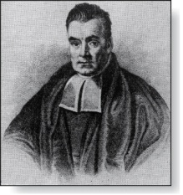
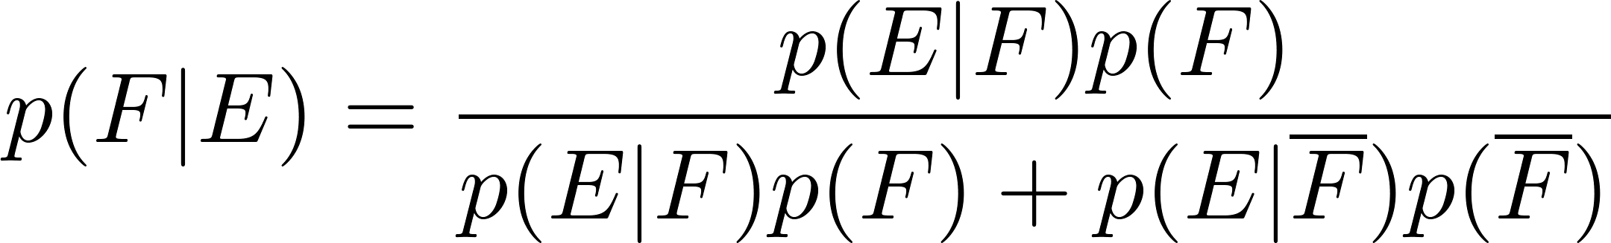
Bayes’ Theorem
Thomas Bayes
(1702-1761)
Bayes’ Theorem: Suppose that E and F are events from a sample space S such that p(E)≠ 0 and p(F) ≠ 0. Then:
Example: We have two boxes. The first box contains two green balls and seven red balls. The second contains four green balls and three red balls. Bob selects one of the boxes at random. Then he selects a ball from that box at random. If he has a red ball, what is the probability that he selected a ball from the first box.
  Let E be the event that Bob has chosen a red ball and F be the event that Bob has chosen the first box.
  By Bayes’ theorem the probability that Bob has picked the first box is:

Slide 36
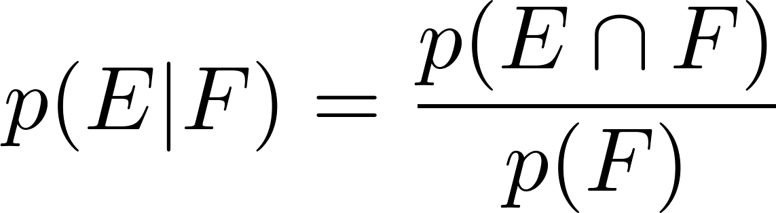
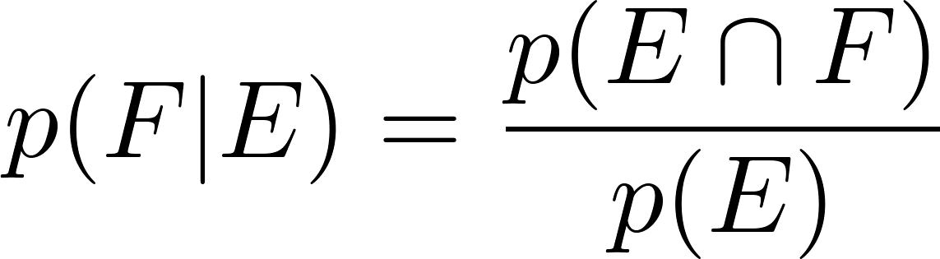
Derivation of Bayes’ Theorem
Recall the definition of the conditional probability p(E|F):
From this definition, it follows that:
,
continued →

Slide 37
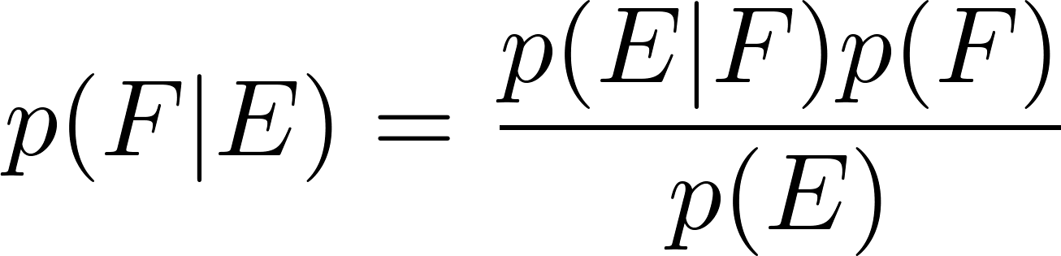
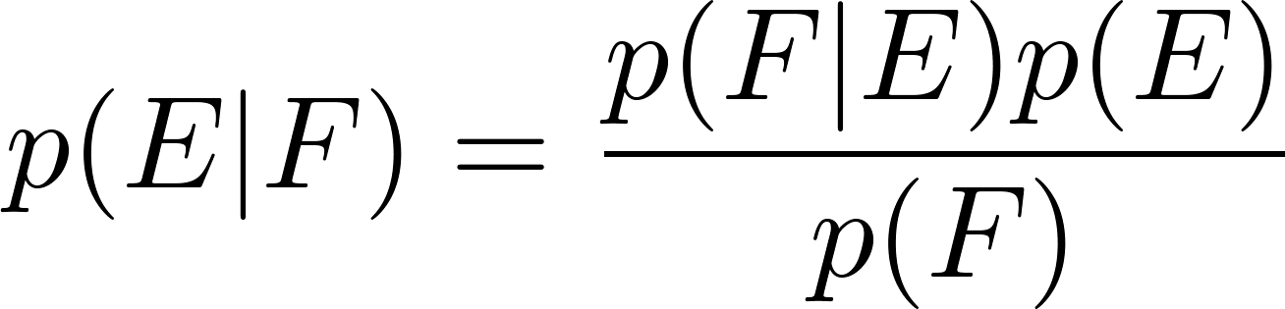
Derivation of Bayes’ Theorem
On the last slide we showed that
,
Equating the two formulas for p(E F) shows that
Solving for p(E|F) and for p(F|E) tells us that
,
continued →

Slide 38
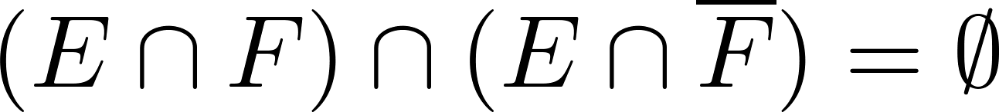
Derivation of Bayes’ Theorem
On the last slide we showed that:
Note that
since
because
and
By the definition of conditional probability,
Hence,

Slide 39
Applying Bayes’ Theorem
Example: Suppose that one person in 100,000 has a particular disease. There is a test for the disease that gives a positive result 99% of the time when given to someone with the disease. When given to someone without the disease, 99.5% of the time it gives a negative result. Find
  the probability that a person who test positive has the disease.
  the probability that a person who test negative does not have the disease.
Should someone who tests positive be worried?

Slide 40

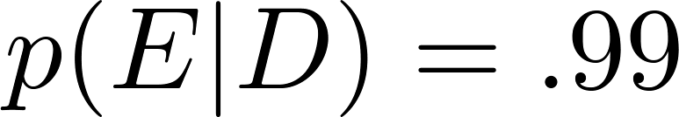

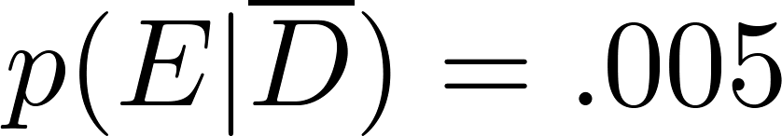
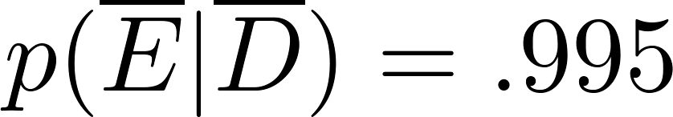
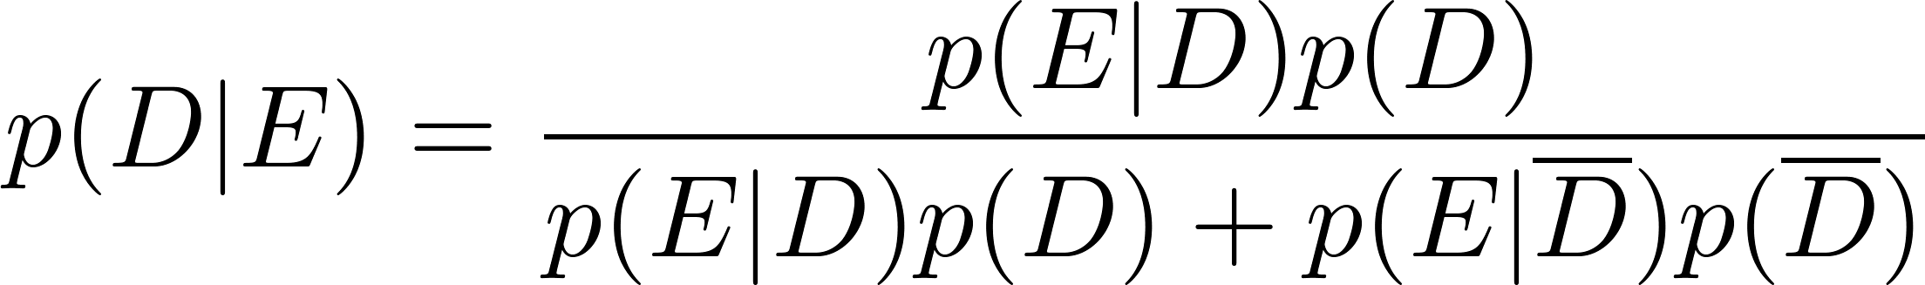
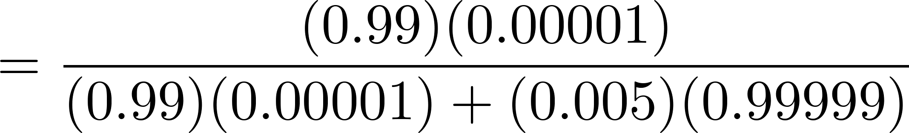

Applying Bayes’ Theorem
Solution: Let D be the event that the person has the disease, and E be the event that this person tests positive. We need to compute p(D|E) from p(D), p(E|D), p( E | ), p( ).
Can you use this formula to explain why the resulting probability is surprisingly small?
So, don’t worry too much, if your test for this disease comes back positive.

Slide 41
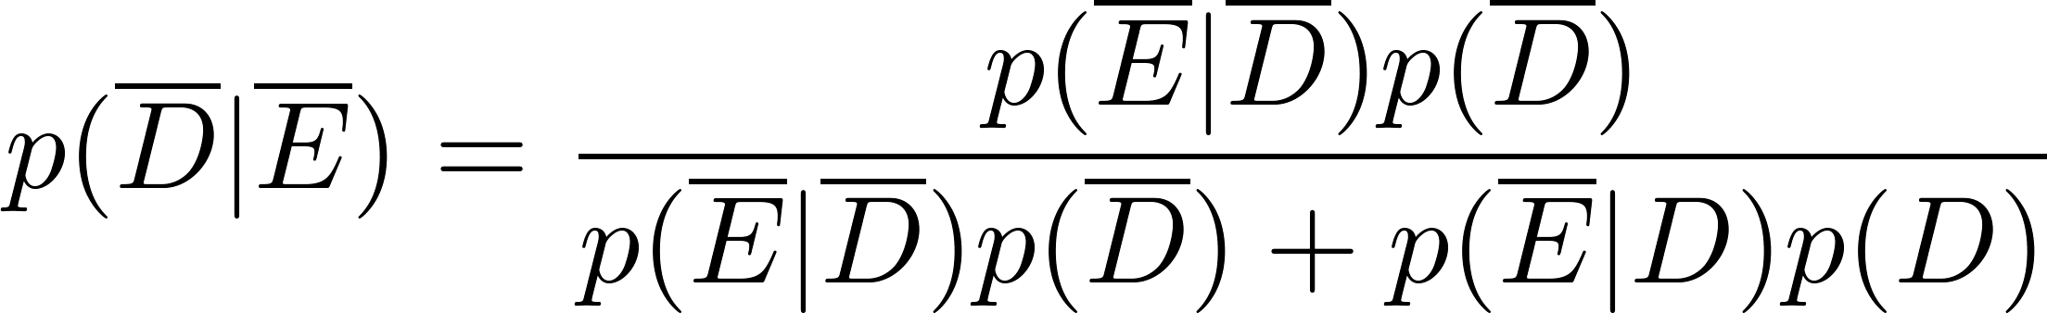
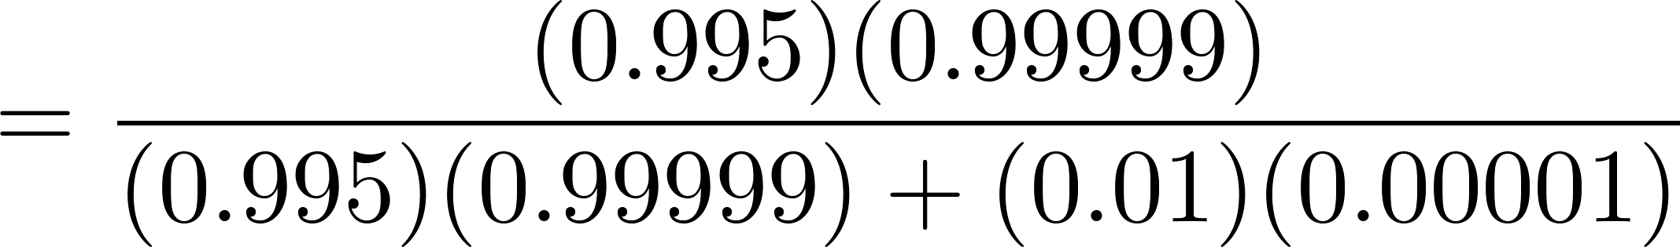
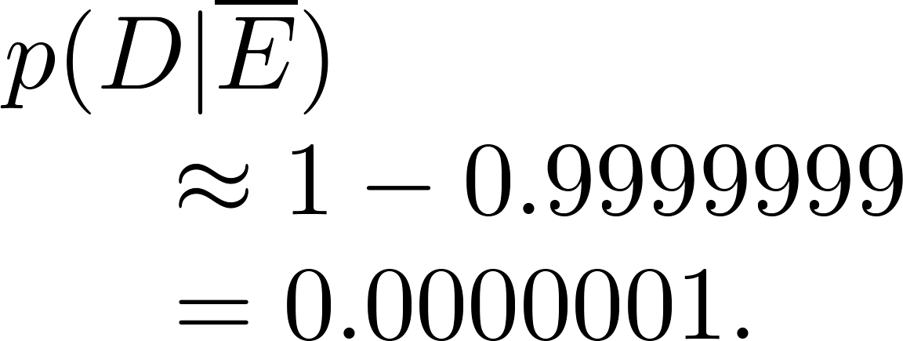

Applying Bayes’ Theorem
  What if the result is negative?
  So, it is extremely unlikely you have the disease if you test negative.
So, the probability you have the disease if you test negative is

Slide 42
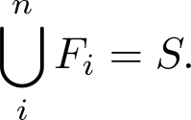
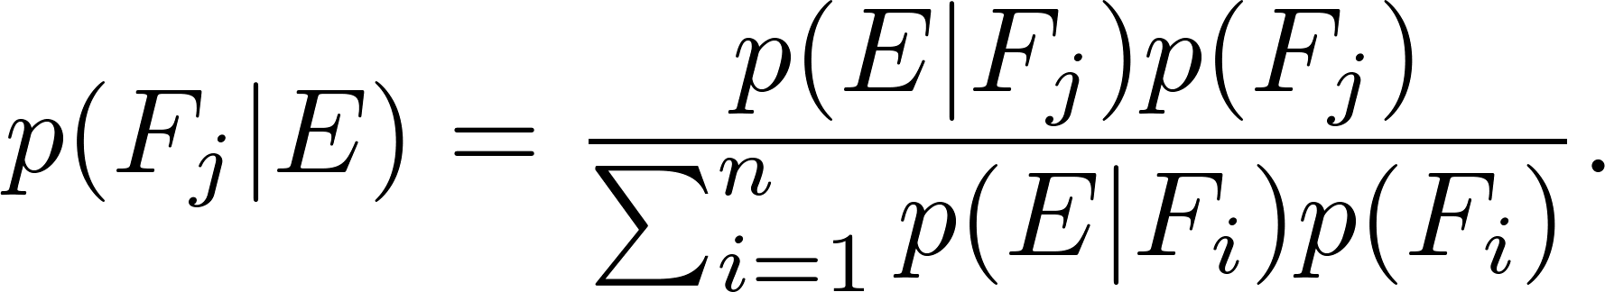
Generalized Bayes’ Theorem
Generalized Bayes’ Theorem: Suppose that E is an event from a sample space S and that F₁, F₂, …, F_{n} are mutually exclusive events such that
Assume that p(E) ≠ 0 for i = 1, 2, …, n. Then
Exercise 17 asks for the proof.

Slide 43
Bayesian Spam Filters
How do we develop a tool for determining whether an email is likely to be spam?
If we have an initial set B of spam messages and set G of non-spam messages. We can use this information along with Bayes’ law to predict the probability that a new email message is spam.
We look at a particular word w, and count the number of times that it occurs in B and in G; n_{B}(w) and n_{G}(w).
  Estimated probability that an email containing w is spam: p(w) = n_{B}(w)/|B|
  Estimated probability that an email containing w is spam: q(w) = n_{G}(w)/|G|
continued →

Slide 44
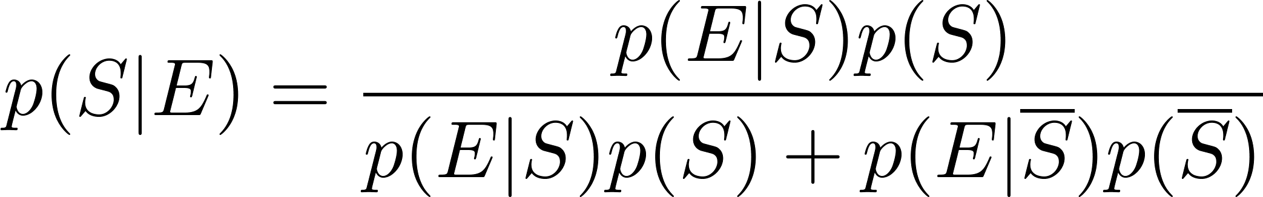
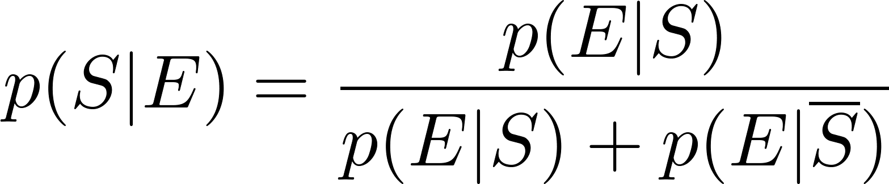
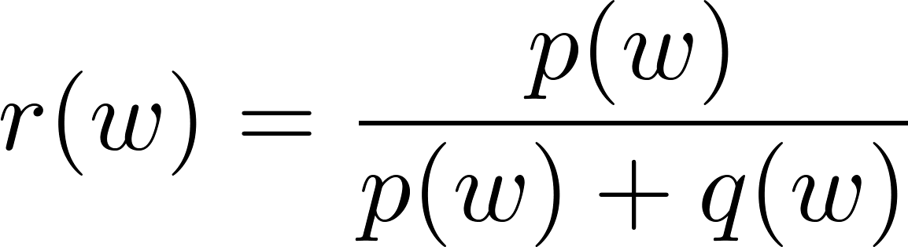
Bayesian Spam Filters
Let S be the event that the message is spam, and E be the event that the message contains the word w.
Using Bayes’ Rule,
Assuming that it is equally likely that an arbitrary message is spam and is not spam; i.e., p(S) = ½.
Note: If we have data on the frequency of spam messages, we can obtain a better estimate for p(s).
(See Exercise 22.)
Using our empirical estimates of
p(E | S) and
p(E |‾S).
r(w) estimates the probability that the message is spam. We can class the message as spam if r(w) is above a threshold.

Slide 45
Bayesian Spam Filters
Example: We find that the word “Rolex” occurs in 250 out of 2000 spam messages and occurs in 5 out of 1000 non-spam messages. Estimate the probability that an incoming message is spam. Suppose our threshold for rejecting the email is 0.9.
Solution: p(Rolex) = 250/2000 =.0125 and q(Rolex) = 5/1000 = 0.005.
We class the message as spam and reject the email!

Slide 46
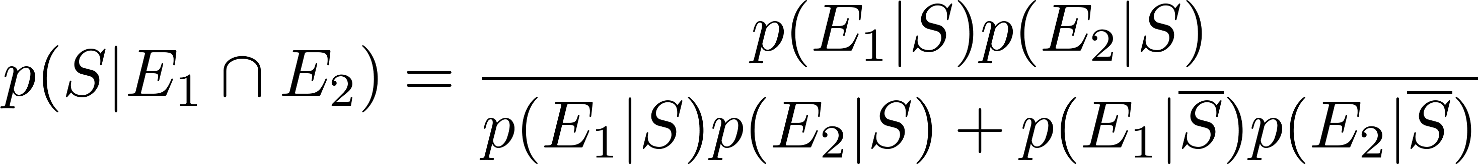
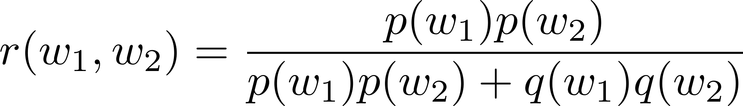
Bayesian Spam Filters using Multiple Words
Accuracy can be improved by considering more than one word as evidence.
Consider the case where E₁ and E₂ denote the events that the message contains the words w₁ and w₂ respectively.
We make the simplifying assumption that the events are independent. And again we assume that p(S) = ½.

Slide 47
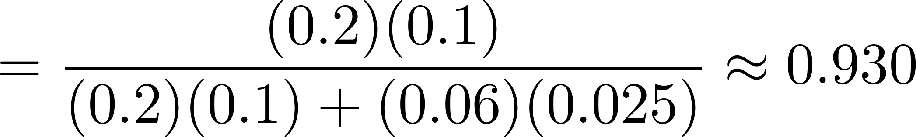
Bayesian Spam Filters using Multiple Words
Example: We have 2000 spam messages and 1000 non-spam messages. The word “stock” occurs 400 times in the spam messages and 60 times in the non-spam. The word “undervalued” occurs in 200 spam messages and 25 non-spam.
Solution: p(stock) = 400/2000 = .2, q(stock) = 60/1000=.06,
p(undervalued) = 200/2000 = .1, q(undervalued) = 25/1000 = .025
If our threshold is .9, we class the message as spam and reject it.

Slide 48
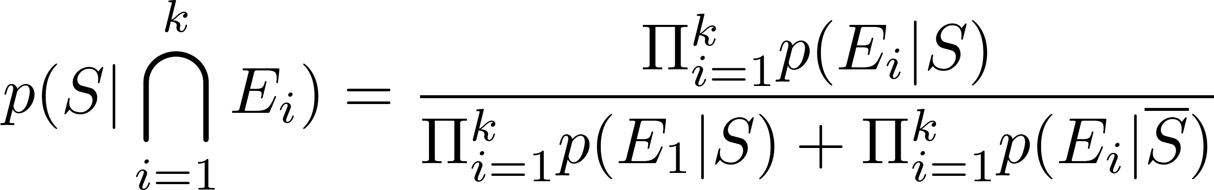
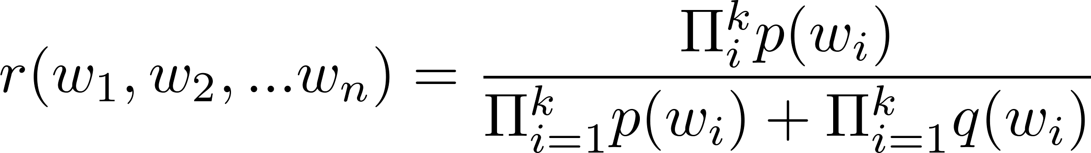
Bayesian Spam Filters using Multiple Words
In general, the more words we consider, the more accurate the spam filter. With the independence assumption if we consider k words:
We can further improve the filter by considering pairs of words as a single block or certain types of strings.

Slide 49
Expected Value and Variance
Section 6.4

Slide 50
Section Summary
Expected Value
Linearity of Expectations
Average-Case Computational Complexity
Geometric Distribution
Independent Random Variables
Variance
Chebyshev’s Inequality

Slide 51
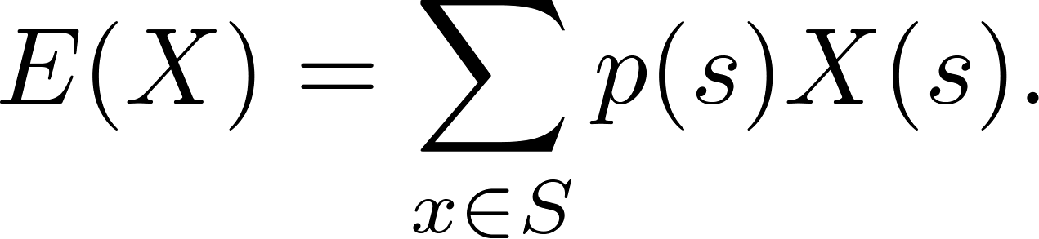
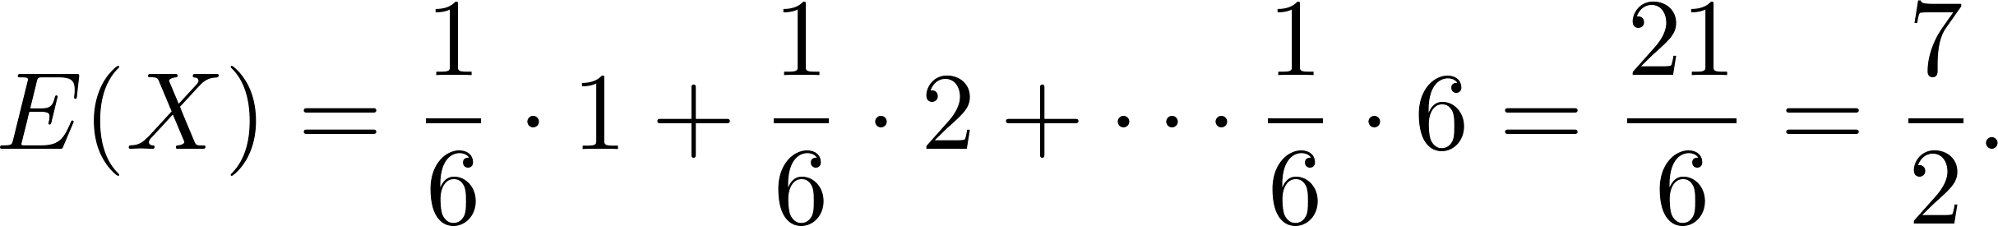
Expected Value
Definition: The expected value (or expectation or mean) of the random variable X(s) on the sample space S is equal to
Example-Expected Value of a Die: Let X be the number that comes up when a fair die is rolled. What is the expected value of X?
Solution: The random variable X takes the values 1, 2, 3, 4, 5, or 6. Each has probability 1/6. It follows that

Slide 52
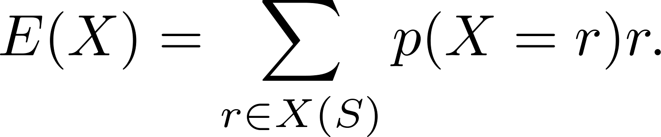
Expected Value
Theorem 1: If X is a random variable and p(X = r) is the probability that X = r, so that
then
Proof: Suppose that X is a random variable with range X(S) and let p(X = r) be the probability that X takes the value r. Consequently, p(X = r) is the sum of the probabilities of the outcomes s such that X(s) = r. Hence,

Slide 53
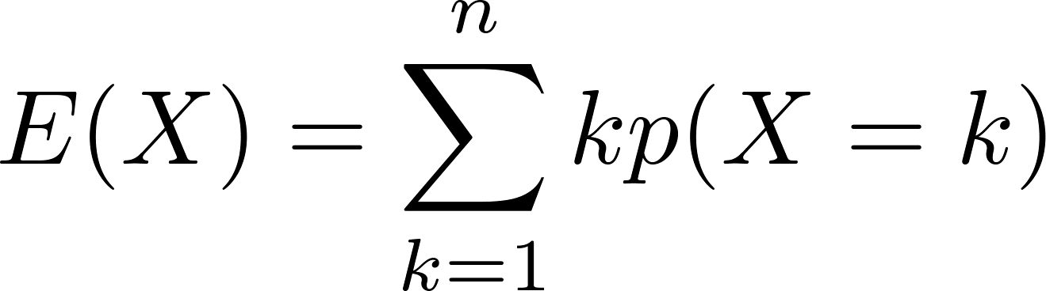
Expected Value
Theorem 2: The expected number of successes when n mutually independent Bernoulli trials are performed, where, the probability of success on each trial, p = np.
Proof: Let X be the random variable equal to the number of success in n trials. By Theorem 2 of section 7.2, p(X = k) = C(n,k)p^{k}q^{n−k}. Hence,
by Theorem 1
continued →

Slide 54
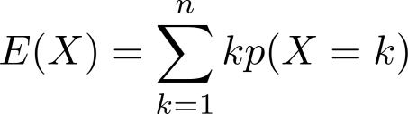
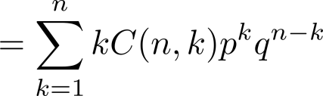
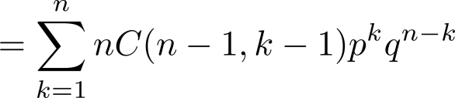
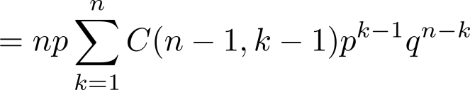
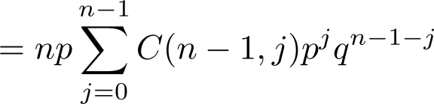

Expected Value
from previous page
by Theorem 2 in Section 7.2
by Exercise 21 in Section 6.4
factoring np from each term
shifting index of summation with j = k − 1
by the binomial theom
because p + q = 1
We see that the expected number of successes in n mutually independent Bernoulli trials is np.

Slide 55
Linearity of Expectations
The following theorem tells us that expected values are linear. For example, the expected value of the sum of random variables is the sum of their expected values.
Theorem 3: If X_{i}, i = 1, 2, …,n with n a positive integer, are random variables on S, and if a and b are real numbers, then
  (i) E(X₁ + X₂ + …. + X_{n}) = E(X₁ )+ E(X₂) + …. + E(X_{n})
  (ii) E(aX + b) = aE(X) + b.
see the text for the proof

Slide 56
Linearity of Expectations
Expected Value in the Hatcheck Problem: A new employee started a job checking hats, but forgot to put the claim check numbers on the hats. So, the n customers just receive a random hat from those remaining. What is the expected number of hat returned correctly?
Solution: Let X be the random variable that equals the number of people who receive the correct hat. Note that X = X₁ + X₂ + ∙∙∙ + X_{n},
where X_{i} = 1 if the ith person receives the hat and X_{i} = 0 otherwise.
  Because it is equally likely that the checker returns any of the hats to the ith person, it follows that the probability that the ith person receives the correct hat is 1/n. Consequently (by Theorem 1), for all I
  E(X_{i}) = 1 ∙p(X_{i} = 1) + 0 ∙p(X_{i} = 0) = 1 ∙ 1/n + 0 = 1/n .
  By the linearity of expectations (Theorem 3), it follows that:
  E(X )= E(X₁) + E(X₂) + ∙∙∙ + E(X_{n}) = n ∙ 1/n – 1.
Consequently, the average number of people who receive the correct hat is exactly 1. ( Surprisingly, this answer remains the same no matter how many people have checked their hats!)

Slide 57
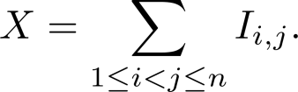

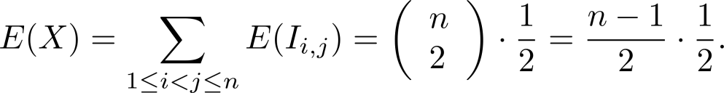
Linearity of Expectations
Expected Number of Inversions in a Permutation: The ordered pair (i,j) is an inversion in a permutation of the first n positive integers if i < j, but j precedes i in the permutation.
Example: There are six inversions in the permutation of 3,5, 1, 4, 2
(1, 3), (1, 5), (2, 3), (2, 4), (2, 5), (4, 5).
Find the average number of inversions in a random permutation of the first n integers.
Solution: Let I_{i,j} be the random variable on the set of all permutations of the first n positive integers with I_{i,j} = 1 if (i,j) is an inversion of the permutation and I_{i,j} = 0 otherwise. If X is the random variable equal to the number of inversions in the permutation, then
  Since it is equally likely for i to precede j in a randomly chosen permutation as it is for j to precede i, we have: E(I_{i,j}) = 1 ∙p(I_{i ,j} = 1) + 0 ∙p(I_{i,j} = 0) = 1 ∙ 1/2 + 0 = ½, for all (i,j) .
  Because there are pairs i and j with 1 ≤ i < j ≤ n, by the linearity of expectations (Theorem 3), we have:
Consequently, it follows that there is an average of n(n −1)/4 inversions in a random permutation of the first n positive integers.

Slide 58
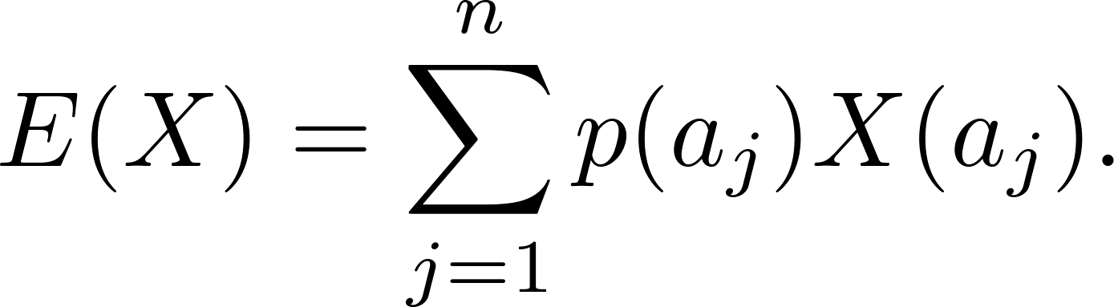
Average-Case Computational Complexity
The average-case computational complexity
of an algorithm can be found by computing the
expected value of a random variable.
Let the sample space of an experiment be the set of possible inputs a_{j}, j = 1, 2, …,n, and let the random variable X be the assignment to a_{j} of the number of operations used by the algorithm when given a_{j} as input.
Assign a probability p(a_{j}) to each possible input value a_{j}.
The expected value of X is the average-case computational complexity of the algorithm.

Slide 59
Average-Case Complexity of Linear Search
What is the average-case complexity of linear search (described in Chapter 3) if the probability that x is in the list is p and it is equally likely that x is any of the n elements of the list?
procedure linear search(x: integer, a₁, a₂, …,a_{n}: distinct integers)
i := 1
while (i ≤ n and x ≠ a_{i})
i := i + 1
if i ≤ n then location := i
else location := 0
return location{location is the subscript of the term that equals x, or is 0 if x is not found}
continued →

Slide 60
Average-Case Complexity of Linear Search
Solution: There are n + 1 possible types of input: one type for each of the n numbers on the list and one additional type for the numbers not on the list.
Recall that:
  2i + 1 comparisons are needed if x equals the ith element of the list.
  2n + 2 comparisons are used if x is not on the list.
The probability that x equals a_{i} is p/n and the probability that x is not in the list is q = 1− p. The average-case case computational complexity of the linear search algorithm is:
E = 3p/n + 5p/n + … + (2n + 1)p/n + (2n + 2)q
= (p/n)( 3 + 5 + …. + (2n + 1)) + (2n + 2)q
= (p/n)((n + 1)² − 1) + (2n + 2)q (Example 2 from Section 5.1)
= p(n + 2) + (2n + 2)q.
When x is guaranteed to be in the list, p = 1, q = 0, so that E = n + 2.
When p is ½ and q = ½, then E = (n + 2)/2 + n + 1 = (3n + 4) /2.
When p is ¾ and q = ¼ then E = (n + 2)/4 + (n + 1)/2 = (5n + 8) /4.
When x is guaranteed not to be in the list, p = 0 and q = 1, then E = 2n + 2.

Slide 61
Average-Case Complexity of Insertion Sort
What is the average number of comparisons used by insertion sort from Chapter 3) to sort n distinct elements?
procedure insertion sort
(a₁,…,a_{n}: reals with n ≥ 2)
for j := 2 to n
i := 1
while a_{j} > a_{i}
i := i + 1
m := a_{j}
for k := 0 to j − i − 1
a_{j-k} := a_{j-k-1}
a_{i} := m
{Now a₁,…,a_{n} is in increasing order}
At step i for i = 2, ….,n, insertion sort inserts the ith element in the original list into the correct position in the sorted list of the first i -1 elements.
continued →

Slide 62
Average-Case Complexity of Insertion Sort
Solution: Let X be the random variable equal to the number of comparisons used by insertion sort to sort a list of a₁, a₂, …., a_{n} distinct elements. E(X) is the average number of comparisons.
  Let X_{i} be the random variable equal to the number of comparisons used to insert a_{i} into the proper position after the first i −1 elements a₁, a₂, …., a_{i-1} have been sorted.
  Since X = X₂ + X₃ + ∙∙∙ + X_{n},
  E(X) = E(X₂ + X₃ + ∙∙∙ + X_{n}) = E(X₂) + E(X₃) + ∙∙∙ + E(X_{n}).
To find E(X_{i}) for i = 2,3,…,n, let p_{j}(k) be the probability that the largest of the first j elements in the list occurs at the kth position, that is, max(a₁, a₂, …., a_{j} ) = a_{k}, where 1 ≤ k ≤ j.
Assume uniform distribution; p_{j}(k) = 1/j .
Then X_{i}(k) = k.
continued →

Slide 63
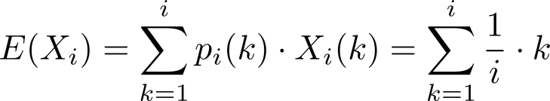
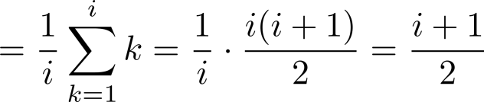
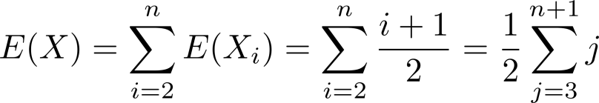
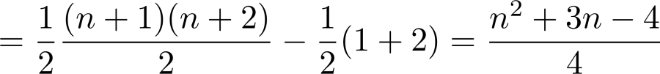

Average-Case Complexity of Insertion Sort
Since a_{i} could be inserted into any of the first i positions
It follows that
Hence, the average-case complexity is .

Slide 64
The Geometric Distribution
Definition 2: A random variable X has geometric distribution with parameter p if p(X = k) = (1 − p)^{k-1}p for k = 1,2,3,…, where p is a real number with 0 ≤ p ≤ 1.
Theorem 4: If the random variable X has the geometric distribution with parameter p, then E(X) = 1/p.
Example: Suppose the probability that a coin comes up tails is p. What is the expected number of flips until this coin comes up tails?
  The sample space is {T, HT, HHT, HHHT, HHHHT, …}.
  Let X be the random variable equal to the number of flips in an element of the sample space; X(T) = 1, X(HT) = 2, X(HHT) = 3, etc.
  By Theorem 4, E(X) = 1/p.
see text for full details

Slide 65
Independent Random Variables
Definition 3: The random variables X and Y on a sample space S are independent if
p(X = r₁ and Y = r₂) = p(X = r₁)∙ p(Y = r₂).
Theorem 5: If X and Y are independent variables on a sample space S, then E(XY) = E(X)E(Y).
see text for the proof

Slide 66
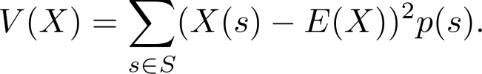

Variance
Deviation: The deviation of X at s ∊ S is X(s) − E(X), the difference between the value of X and the mean of X.
Definition 4: Let X be a random variable on the sample space S. The variance of X, denoted by V(X) is
That is V(X) is the weighted average of the square of the deviation of X. The standard deviation of X, denoted by σ(X) is defined to be
Theorem 6: If X is a random variable on a sample space S, then V(X) = E(X²) − E(X)².
Corollary 1: If X is a random variable on a sample space S and E(X) = μ , then V(X) = E((X −μ)²).
see text for the proof
see text for the proof.

Slide 67

Variance
Example: What is the variance of the random variable X, where X(t) = 1 if a Bernoulli trial is a success and X(t) = 0 if it is a failure, where p is the probability of success and q is the probability of failure?
Solution: Because X takes only the values 0 and 1, it follows that X²(t) = X(t). Hence,
Variance of the Value of a Die: What is the variance of a random variable X, where X is the number that comes up when a fair die is rolled?
Solution: We have V(X) = E(X²) − E(X)² . In an earlier example, we saw that E(X) = 7/2. Note that
E(X²) = 1/6(1² + 2² + 3² +4² + 5² + 6²) = 91/6.
We conclude that
V(X) = E(X²) − E(X)² = p − p² = p(1 − p) = pq.

Slide 68

Variance
Irenée-Jules Bienaymé
(1796-1878)
Bienaymé‘s Formula: If X and Y are two independent random variables on a sample space S, then V(X + Y) = V(X) + V(Y). Furthermore, if X_{i}, i = 1,2, …,n, with n a positive integer, are pairwise independent random variables on S, then
V(X₁ + X₂ + ∙∙∙ + X_{n}) = V(X₁) + V(X₂) + ∙∙∙ + V(X_{n}).
Example: Find the variance of the number of successes when n independent Bernoulli trials are performed, where on each trial, p is the probability of success and q is the probability of failure.
Solution: Let X_{i} be the random variable with X_{i} ((t₁, t₂, …., t_{n})) = 1 if trial t_{i} is a success and X_{i} ((t₁, t₂, …., t_{n})) = 0 if it is a failure. Let X = X₂ + X₃ + …. X_{n}. Then X counts the number of successes in the n trials.
  By Bienaymé ‘s Formula, it follows that V(X)= V(X₁) + V(X₂) + ∙∙∙ + V(X_{n}).
  By the previous example ,V(X_{i}) = pq for i = 1,2, …,n.
Hence, V(X) = npq.
see text for the proof

Slide 69

Chebyshev’s Inequality
Pafnuty Lvovich Chebyshev
(1821-1894)
Chebyschev’s Inequality: Let X be a random variable on a sample space S with probability function p. If r is a positive real number, then
p(|X(s) − E(X)| ≥ r ) ≤ V(X)/r².
Example: Suppose that X is a random variable that counts the number of tails when a fair coin is tossed n times. Note that X is the number of successes when n independent Bernoulli trials, each with probability of success ½ are done. Hence, (by Theorem 2) E(X) = n/2 and (by Example 18) V(X) = n/4.
By Chebyschev’s inequality with r = √n,
p(|X(s) − n/2 | ≥ √n ) ≤ (n/4 )(√n )² = ¼.
This means that the probability that the number of tails that come up on n tosses deviates from the mean , n/2, by more than √n is no larger than ¼.
see text for the proof

Slide 70
§ 6.4 Expected Value
Since a random variable can be described by its probability distribution, it can be characterized by means of two measures – its mean/expected value, which is a measure of central tendency, and its variance, which is a measure of dispersion.
Average Time Complexity of an algorithm
  Expected value can be used

Slide 71


Expected Value
The mean or expected value of X is defined as
e.g. when a fair coin is tossed four times then
= 0 . 1/16 + 1 . 4/16 + 2 . 6/16 + 3 . 4/16 + 4 . 1/16
0+4+12+12+4
= 2
16
i.e. the expected value E(X) is found to be among the values
determined by the random variable X = 2 with a probability
of 3/8.

Slide 72
Variance of Random Variable
Suppose X is the random variable defined on the sample space Sx={a, b, c}, where X(a)= -1, X(b)= 0, X(c)= 1 and P(X=x) = 1/3, for x= -1, 0, 1, then E(X) = 0.
Y is a random variable defined on the sample space Sy = {r, s, t, u, v}, where Y(r) = -4, Y(s) = -2, Y(t) = 0, Y(u) = 2, Y(v) = 4, and P(Y = y) = 1/5, for y= -4, -2, 0, 2, 4, we get the same mean – that is E(Y) = 0.
However, the values determined by Y are more spread out about the mean of 0 than the values determined by X.
This is measured by variance, denoted by σ²_{x}.

Slide 73
Variance of Random Variable
σ²_{x}= Var(x) = E(X – E(X))² =∑(x –E(X))^{2 .} P(X = x)
Suppose the probability distribution for X is
x P(X = x)
1 1/5 E(X) = 17/5
3 2/5 σ²_{x}= 66/25
4 1/5 and standard deviation of X
6 1/5. σ_{x}= 1.62

Slide 74
Expected value and Variance
Tossing a fair coin 4 times
x P(X = x) E(X) = 2
0 1/16 and
1 4/16 = 1/4 σ_{x} = 1
2 6/16 = 3/8
3 4/16 = 1/4
4 1/16

Slide 75
Probabilistic Method
Probabilistic algorithms are algorithms that make random choices at one or more steps. Some times called randomize algorithms, the result and /or the way the result is obtained depends on chance.
  For example, simulating the behavior of some existing or planned system over time.

Slide 76
Probabilistic Method
For some problems where trivial exhaustive search is not feasible probabilistic algorithms can be applied giving a result that is correct with a probability less than one (eg. primality testing, string equality testing). The probability of failure can be made arbitrary small by repeated applications of the algorithm.

Slide 77
§7.1: Recurrence Relations
A recurrence relation (R.R., or just recurrence) for a sequence {a_{n}} is an equation that expresses a_{n} in terms of one or more previous elements
a₀, …, a_{n−1} of the sequence, for all n≥n₀.
  i.e., just a recursive definition, without the base cases.
A particular sequence (described non-recursively) is said to solve the given recurrence relation if it is consistent with the definition of the recurrence.
  A given recurrence relation may have many solutions.

Slide 78
Recurrence Relation Example
Consider the recurrence relation
a_{n} = 2a_{n−1} − a_{n−2} (n≥2).
Suppose a₀ = 3 and a₁ = 5, what are a₂, a₃?
a₂ ₌ a₁ - a₀ = 5 – 3 = 2
a₃ ₌ a₂ - a₁ = 2 – 5 = -3
Which of the following are solutions?
a_{n} = 3n
a_{n} = 2^{n}
a_{n} = 5
Yes
3n = 2. 3(n-1) - 3. (n-2)
No
Yes

Slide 79
Example Applications
Recurrence relation for growth of a bank account with P% interest per given period:
M_{n} = M_{n−1} + (P/100)M_{n−1}
Growth of a population in which each organism yields 1 new one every period starting 2 time periods after its birth.
P_{n} = P_{n−1} + P_{n−2} (Fibonacci relation)

Slide 80
Solving Compound Interest RR
M_{n} = M_{n−1} + (P/100)M_{n−1}
= (1 + P/100) M_{n−1}
= r M_{n−1} (let r = 1 + P/100)
= r (r M_{n−2})
= r·r·(r M_{n−3}) …and so on to…
= r^{n} M₀

Slide 81
Towers of Hanoi Example
Problem: Get all disks from peg 1 to peg 2.
  Rules: (a) Only move 1 disk at a time.
  (b) Never set a larger disk on a smaller one.
Peg #1
Peg #2
Peg #3
Notes:
Instructor can solve the puzzle interactively by dragging the disks around.

Slide 82
Hanoi Recurrence Relation
Let H_{n} = # moves for a stack of n disks.
Here is the optimal strategy:
  Move top n−1 disks to spare peg. (H_{n−1} moves)
  Move bottom disk. (1 move)
  Move top n−1 to bottom disk. (H_{n−1} moves)
Note that: H_{n} = 2H_{n−1} + 1
  The # of moves is described by a Rec. Rel.
  Result: 2^{n} -1

Slide 83
A recursive solution
Let’s see a demo of it:
http://members.shaw.ca/orionx/th/Hanoi.html?English
You can implement a recursive function to solve this
  F(n) = 2. F(n-1) + 1
If it takes 1 sec for each move and we have 64 gold disks, according to the myth ☺
  It will take 2⁶⁴ -1 = 18446744073709551615
  End of days!!! → 500 billion years

