Slide 1
§9.1 Relations
Mathematical objects designed to specify and describe relationships between elements of a set or sets.
A function f from a set A to a set B assigns exactly one element of B to each element of A.
In relations there is no restriction. An element in A can be assigned more than one element in B.
Relations are generalization of functions; they can be used to express a much wider class of relationships between sets.

Slide 2

Binary Relations
Let A, B be any sets. The relationship between the elements of these two sets are represented by a Binary Relation.
A binary relation from A to B is a set R where
a R b denotes (a, b) ∈ R A X B. a is said to be related to b by R.
The elements of A X B and R are said to be ordered pair.
  Let A = {2, 3, 4}, and B ={4, 5}. Then
  A X B ={(2, 4), (2, 5), (3, 4), (3, 5), (4, 4), (4, 5)}.
Notes:
the first element in the set comes from the set A and the second element comes from the set B

Slide 3
Binary Relations
For finite sets A, B with |A| = m and |B| = n, there are 2^{mn} relations from A to B, including the empty relation as well as the relation A X B.
E.g., let A = {2, 3, 4}, and B ={4, 5}. Then
relations from A to B:
  Ø
  {(2, 4)},…
  {(2, 4), (2, 5)},…
  {(2, 4), (3, 4), (4, 4)},…
  A X B

Slide 4
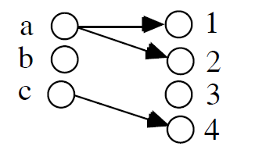
Relations as graph
Let A = { a, b, c}, B = {1, 2, 3, 4}, R is defined by the ordered pairs or edges {(a, 1), (a, 2), (c, 4)}
can be represented by the digraph D:

Slide 5
Properties of Relations
Of special Binary Relation is the relation of the set A on A i.e. A X A called a binary relation on A.
The Relation is called Reflexive, which simply means that each element a of A is related to itself.
R on a set A is called reflexive if
∀a∈ A ((a, a) ∈ R) where A is the universe of discourse.

Slide 6
Properties of Relations
Let A = {1, 2, 3, 4}
R₁ and R₂ are examples of reflexive relations since they contain all pairs of the form (a, a).
R₁ = {(1, 1), (1, 2), (1, 4), (2, 1), (2, 2), (3, 3), (4, 1), (4, 4)}.
R₂ = {(1, 1), (1, 2), (1, 3), (1, 4), (2, 2), (2, 3), (2, 4), (3, 3), (3, 4), (4, 4)}.

Slide 7
Properties of Relations
Relation R on set A is called symmetric if
(a, b) ∈ R ⇒ (b, a) ∈ R, for all a, b ∈ A
Let A={1, 2, 3}
R₁ = {(1, 2), (2, 1), (1, 3), (3, 1)}. symmetric
R₂= {(1, 1), (2, 2), (3, 3), (2, 3), (3, 2)}.
reflexive and symmetric
R₃= {(1, 1), (2, 3), (3, 3)}.
Neither reflexive nor symmetric.

Slide 8
Properties of Relations
A relation R on a set A is called antisymmetric if (a, b)∈R and (b, a)∈R only when a = b
Another way of stating this is
∀a≠b, (a,b)∈R → (b,a)∉R.
A relation R on a set A is called asymmetric if (a, b)∈R implies that (b,a)∉R for all a, b∈A.
Notes:
Another definition of asymmetric makes asymmetry equivalent to antisymmetry plus irreflexivity.

Slide 9
Antisymmetry
The terms symmetry and antisymmetry are not opposites, since a relation can have both of these properties or may lack both of them.
A relation can not be both if it contains some pair of the form (a, b) where a ≠ b.
Symmetry and Asymmetry, are not opposite either!

Slide 10
Symmetry - Antisymmetry
A = {1, 2, 3, 4}
R₁ = {(1,1), (1, 2), (2, 1)} → Symmetric
R₂ = {(1,1), (1, 2), (1, 4), (2, 1), (2, 2), (3, 3),
(4, 1), (4, 4)} → Symmetric
R₃ = {(1, 1), (1, 2), (1, 3), (1, 4), (2, 2), (2, 3), (2, 4), (3, 3), (3, 4), (4, 4)} →Antisymmetry
R₄ = {(1, 2), (1, 3), (1, 4), (2, 3), (2, 4), (3, 4)} → Asymmetry

Slide 11
Transitivity
A relation R is transitive iff (for all a,b,c)
(a,b)∈R ∧ (b,c)∈R → (a,c)∈R.
So if a is “related to” b and b is “related to” c, we want a “related to” c with b playing the role of “intermediary”.
e.g. A = {1, 2, 3, 4)
R = {(2, 1), (3, 1), (3, 2), (4, 1), (4, 2), (4, 3)}

Slide 12
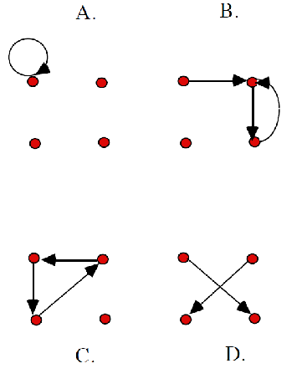
Examples:
A: not reflexive; symmetric; antisymmetric; transitive
B: not reflexive;
not symmetric;
not antisymmetric;
not transitive
C: not reflexive;
not symmetric;
antisymmetric; not transitive
D: not reflexive;
not symmetric;
antisymmetric; transitive

Slide 13
Combining Relations
Relations are sets, and therefore, we can apply the usual set operations to them.
If we have two relations R1 and R2, and both of them are from a set A to a set B, then we can combine them to R1 U R2, R1 ∩ R2, or R1 – R2.
In each case, the result will be another relation from A to B.

Slide 14
Combining Relations Example
Let A = {1, 2, 3} and B = {1, 2, 3, 4}
R₁ ={(1, 1),(2, 2),(3, 3)}
R₂ = {(1, 1),(1, 2),(1, 3),(1, 4)}
R₁∪R₂={(1, 1),(1, 2),(1, 3),(1, 4),(2, 2),(3, 3)}
R₁∩ R₂={(1, 1)}
R₁ – R₂={(2, 2), (3, 3)}
R₂ – R₁={(1, 2),(1, 3),(1, 4)}

Slide 15
Combining Relations
There is another important way to combine relations.
Definition: Let R be a relation from a set A to a set B and S a relation from B to a set C. The composite of R and S is the relation from A to C, denoted by S°R.
In other words, if relation R contains a pair (a, b) and relation S contains a pair (b, c), then S°R contains a pair (a, c).

Slide 16
Combining Relations
Example: Let D and S be relations on A = {1, 2, 3, 4}: D = {(a, b) | b = 5 - a}, S = {(a, b) | a < b}.
D = {(1, 4), (2, 3), (3, 2), (4, 1)}
S = {(1, 2), (1, 3), (1, 4), (2, 3), (2, 4), (3, 4)}
S°D =
{(2, 4),
(3, 3),
(3, 4),
(4, 2),
(4, 3),
(4, 4)}
D maps an element a to the element (5 – a), and afterwards S maps (5 – a) to all elements larger than (5 – a), resulting in S°D = {(a,b) | 5 – a<b}.

Slide 17
Question
Question: Let R1 and R2 be transitive on A. Does it follow that R1∪R2 is transitive?
Consider A = {1, 2},
R1 = {(1,2)},
R2 = {(2, 1)}
Then R1∪ R2 = {(1, 2), (2,1)},
which is not transitive!
However, R1°R2 or R2°R1 is transitive.
Notes:
However it is Not true.R1={(1,2) (3,5)} R2={(2,3),(5,1)} then R2°R1={(1,3) (3,1)} is not transitive.

Slide 18
Combining Relations
Definition: Let R be a relation on the set A.
The powers R^{n}, n = 1, 2, 3, …, are defined inductively by
  R¹ = R
  R^{n+1} = R^{n}°R
  In other words:
  R^{n} = R°R° … °R (n times the letter R)

Slide 19
§9.2 n-ary Relations
An n-ary relation R on sets A₁,…,A_{n},
written (with signature) R:A₁×…×A_{n} is simply a subset R ⊆ A₁× … × A_{n}.
The sets A_{i} are called the domains of R.
The degree of R is n.
R is functional in the domain A_{i} if it contains at most one n-tuple (…, a_{i} ,…) for any value a_{i} within domain A_{i}.
Notes:
Degree: 阶

Slide 20
Examples
Let R be a relation on NxNxN consisting of triples (a,b,c) where a, b, c are integers with a < b < c.
  Then (1, 2, 3) is an element of R, (2, 4, 3) is not.
Let R be the relation with 5-tuples (A, N, S, D, T). A: Airline, N: flight number, S: starting point, D: destination, T: departure time
  Degree of this Relation is 5
  Domain: set of all airlines, all flight numbers, all cities, all cities, all times

Slide 21
Relational Databases
A relational database is essentially just an n-ary relation R.
A domain A_{i} is a primary key for the database if the relation R is functional in A_{i}.
Combinations of domains can also uniquely identify n-tuples : composite key
  A composite key for the database is a set of domains {A_{i}, A_{j}, …} such that R contains at most 1 n-tuple (…,a_{i},…,a_{j},…) for each composite value (a_{i}, a_{j},…)∈A_{i}×A_{j}×…
Notes:
主键码，复合键码

Slide 22
Selection Operators
We may define operations on n-ary relations
Let A be any n-ary domain A=A₁×…×A_{n}, and let C:A→{T,F} be any condition (predicate) on elements (n-tuples) of A.
Then, the selection operator s_{C} is the operator that maps any (n-ary) relation R on A to the n-ary relation of all n-tuples from R that satisfy C.
  I.e., ∀R⊆A, s_{C}(R) = {a∈R | s_{C}(a) = T}

Slide 23
Selection Operator Example
Let Rooms be the relation with attributes {Place, Seats, BoardType, Computer}
R={(Fan17, 80, Chalk, Yes), (Lws21, 25, No, Yes), (Nek13, 50, Chalk, No), (Agr21, 90, No, Yes), …}
R₁ select =( R, BoardType, Chalk)
R₁={(Fan17,80, Chalk, Yes), (Nek13, 50, Chalk, No), …}
R₂ select =(R₁, Computer, Yes)
R₂ = {(Fan17,80, Chalk, Yes),…}

Slide 24
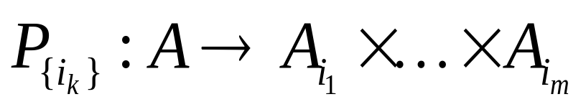
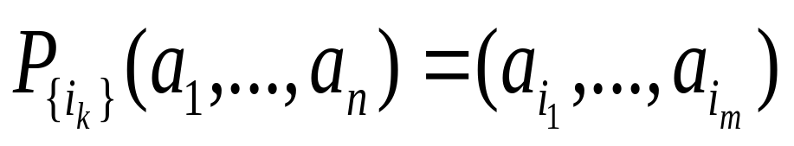
Projection Operators
Let A = A₁×…×A_{n} be any n-ary domain, and let {i_{k}}=(i₁,…,i_{m}) be a sequence of indices all falling in the range 1 to n,
  That is, where 1 ≤ i_{k} ≤ n for all 1 ≤ k ≤ m.
Then the projection operator on n-tuples
is defined by:
Notes:
投影

Slide 25
Projection Example
Let Rooms be the relation with attributes {Place, Seats, BoardType, Computer}
R={(Fan17, 80, Chalk, Yes), (Lws21, 25, No, Yes), (Nek13, 50, Chalk, No), (Agr21, 90, No, Yes), …}
R₁ = project (R, {Place, Seats}) will produce a relation limited to the place and number of seats.
R₁ ={(Fan17, 80), (Lws21, 25), (Nek13, 50), (Agr21, 90), …}

Slide 26
Join Operator
Puts two relations together to form a sort of combined relation.
If the tuple (A,B) appears in R₁, and the tuple (B,C) appears in R₂, then the tuple (A,B,C) appears in the join J(R₁,R₂).
  A, B, and C here can also be sequences of elements (across multiple fields), not just single elements.
Notes:
连接

Slide 27
Join Example
Suppose R₁ is a teaching assignment table, relating Professors to Courses.
Suppose R₂ is a room assignment table relating Courses to Rooms,Times.
Then J(R₁,R₂) is like your class schedule, listing (professor,course,room,time).

Slide 28
Join Example
Prof. Course
John CS202
Brian CS340
Kenny CS220
Kemal CS215
Course Class Time
CS215 FNR1326 11
CS220 FNR2332 9
CS340 Quig101 2
CS202 LWS202 3
R1
R2
What is the result of R1 joining R2?

Slide 29
Join Result
Prof. Course Class Time
Kemal CS215 FNR1326 11
Kenny CS220 FNR2332 9
Brian CS340 Quig101 2
John CS202 LWS202 3

Slide 30
§9.3 Representing Relations
Some ways to represent n-ary relations:
  With an explicit list or table of its tuples.
  With a function from the domain to {T,F}.
    Or with an algorithm for computing this function.
Some special ways to represent binary relations:
  With a zero-one matrix.
  With a directed graph.

Slide 31
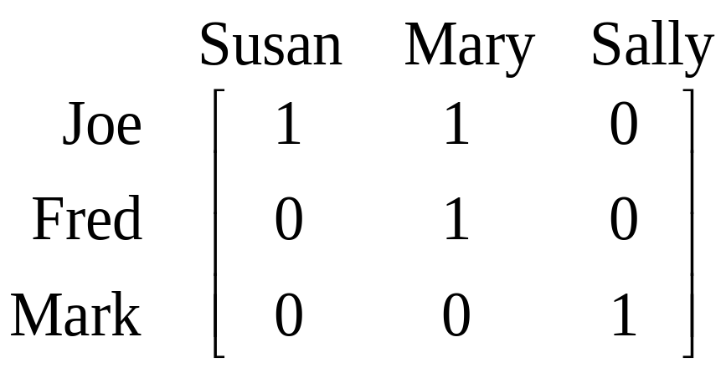
Using Zero-One Matrices
To represent a binary relation R:A×B by an |A|×|B| 0-1 matrix M_{R} = [m_{ij}], let m_{ij} = 1 iff (a_{i},b_{j})∈R.
E.g., Suppose Joe likes Susan and Mary, Fred likes Mary, and Mark likes Sally.
Then the 0-1 matrix
representation
of the relation
Likes:Boys×Girls
relation is:

Slide 32
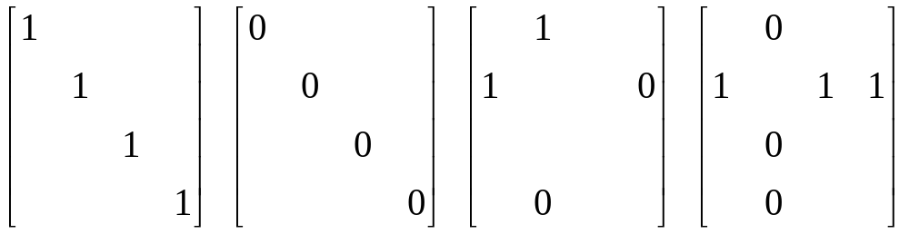
Zero-One Reflexive, Symmetric
Theorem: Let R be a binary relation on a set A and let M be its connection matrix. Then
  • R is reflexive iff M_{ii} = 1 for all i, irreflexive iff M_{ii} = 0.
  • R is symmetric iff M is a symmetric matrix: M = M^{T}
  • R is antisymetric if M_{ij} = 0 or M_{ji} = 0 for all i≠j.
any-
thing
any-
thing
anything
any-
thing
any-
thing
Reflexive:
all 1’s on diagonal
Irreflexive:
all 0’s on diagonal
Symmetric:
all identical
across diagonal
Antisymmetric:
all 1’s are across
from 0’s
Notes:
自反和反自反关系Reflexive and Irreflexive

Slide 33
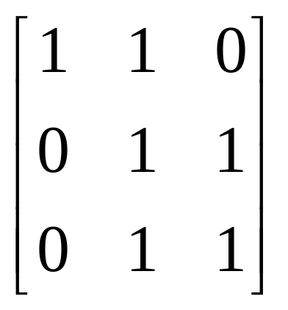
Example
M =
Reflexive?
Symmetric?
Antisymmetric?

Slide 34
Combining Connection Matrices
If M₁ is the connection matrix for R₁ and M₂ is the connection matrix for R₂ then
Definition: the join of two matrices M₁, M₂, denoted M₁∨M₂ is the component wise boolean ‘or’ of the two matrices. It is the connection matrix for R₁∪R₂.
Definition: the meet of two matrices M₁, M₂, denoted M₁∧M₂ is the component wise boolean ‘and’ of the two matrices. It is the connection matrix for R₁∩R₂.
Notes:
the connection matrix for the composition of R2 with R1, R 2 o R1.

Slide 35
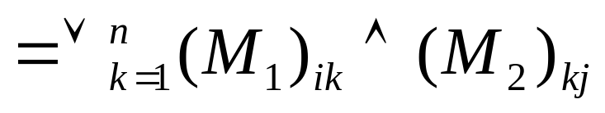
The Composition
The boolean product of two connection matrices (M₁)_{m×n} and (M₂)n×p, denoted M₁ ⊙ M₂ , is the connection matrix for the composition of R₂ with R₁, R₂ o R₁.
M₁ ⊙ M₂
Why? In order for there to be a link <x, z> in the composition then there must be a link <x, y> in R₁ and a link <y, z> in R₂ for some y!
The Boolean product checkes all possible y’s. If at least one such path exists, that is sufficient.
Notes:
the connection matrix for the composition of R2 with R1, R 2 o R1.

Slide 36
Using Directed Graphs
A directed graph or digraph G=(V_{G},E_{G}) is a set V_{G} of vertices (nodes) with a set E_{G}⊆V_{G}×V_{G} of edges (links). Visually represented using dots for nodes, and arrows for edges. Notice that a relation R:A×B can be represented as a graph G_{R}=(V_{G}=A∪B, E_{G}=R).
Edge set E_{G}
(blue arrows)
Matrix representation M_{R}:
Graph
rep. G_{R}:
Joe
Susan
Fred
Mary
Mark
Sally
Node set V_{G}
(black dots)

Slide 37
Digraph Reflexive, Symmetric
It is extremely easy to recognize the reflexive/irreflexive/ symmetric/antisymmetric properties by graph inspection.











Reflexive:
Every node
has a self-loop
Irreflexive:
No node
links to itself
Symmetric:
Every link is
bidirectional
Antisymmetric:
No link is
bidirectional
These are non-symmetric & non-antisymmetric
These are non-reflexive & non-irreflexive
Notes:
self loop. 自身环

Slide 38
§9.4 Closures of Relations
Three types we will study
  Reflexive
    Easy
  Symmetric
    Easy
  Transitive
    Hard

Slide 39
Reflexive closure
Consider a relation R:
We want to add edges to
make the relation reflexive
By adding those edges,
we have made a non-
reflexive relation R into
a reflexive relation
This new relation is called the reflexive closure of R

Slide 40
Reflexive closure
In order to find the reflexive closure of a relation R, we add a loop at each node that does not have one
The reflexive closure of R is R U Δ
  Where Δ = { (a,a) | a ∈ R }
    Called the “diagonal relation”
  With matrices, we set the diagonal to all 1’s

Slide 41
Example
Let R be a relation on the set { 0, 1, 2, 3 } containing the ordered pairs (0,1), (1,1), (1,2), (2,0), (2,2), and (3,0)
What is the reflexive closure of R?
We add all pairs of edges (a,a) that do not already exist
0
1
We add edges:
(0,0), (3,3)
3
2

Slide 42
Symmetric closure
Consider a relation R:
We want to add edges to
make the relation symmetric
By adding those edges,
we have made a non-
symmetric relation R into
a symmetric relation
The new relation is called the symmetric closure of R

Slide 43
Symmetric closure
To find the symmetric closure of relation R, we add an edge from a to b, where there is already an edge from b to a.
The symmetric closure of R is R U R⁻¹
  If R = { (a,b) | … }, then R⁻¹ = { (b,a) | … }
  To get R⁻¹, reverse all links in the digraph representation of R, or take the transpose M^{T} of the connection matrix M of R.

Slide 44
Example
Let R be a relation on the set { 0, 1, 2, 3 } containing the ordered pairs (0,1), (1,1), (1,2), (2,0), (2,2), and (3,0)
What is the symmetric closure of R?
We add all pairs of edges (a,b) where (b,a) exists
  We make all “single” edges into anti-parallel pairs
0
1
We add edges:
(0,2), (0,3)
(1,0), (2,1)
3
2

Slide 45
Paths in directed graphs
A path is a sequences of connected edges from vertex a to vertex b
No path exists from
the noted start location
A path that starts and
ends at the same
vertex is called a
circuit or cycle
  Must have length ≥1
Start (a)
End (b)
Start (a)
End (b)
Start (a)

Slide 46
More on paths…
The length of a path is the number of edges in the path, not the number of nodes
What is really needed in most applications is finding the shortest path between two vertices

Slide 47
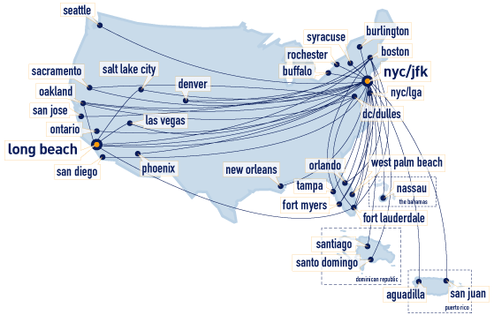
Transitive closure
The transitive closure would contain edges between all nodes reachable by a path of any length

Slide 48
Transitive closure
Informal definition: If there is a path from a to b, then there should be an edge from a to b in the transitive closure
In order to find the transitive closure of a relation R, we add an edge from a to c, when there are edges from a to b and b to c. Repeat this step until no new edges are added to the relation.
R = { (1,2), (2,3), (3,4) }
4
(1,2) & (2,3) ∴ (1,3)
(2,3) & (3,4) ∴ (2,4)
(1,2) & (2,4) ∴ (1,4)
1
2
3

Slide 49
6 degrees of separation
The idea that everybody in the world is connected by six degrees of separation
  Where 1 degree of separation means you know (or have met) somebody else
Let R be a relation on the set of all people in the world
  (a,b) ∈ R if person a has met person b
So six degrees of separation for any two people a and g means:
  (a,b), (b,c), (c,d), (d,e), (e,f), (f,g) are all in R
Or, (a,g) ∈ R⁶

Slide 50
Connectivity relation
R contains edges between all the nodes reachable via 1 edge
R◦R = R² contains edges between nodes that are reachable via 2 edges in R
R^{n} = contains edges between nodes that are reachable via n edges in R
R* contains edges between nodes that are reachable via any number of edges (i.e. via any path) in R
R* is the transitive closure of R
  The definition of a transitive closure is that there are edges between any nodes (a,b) that contain a path between them

Slide 51
How long are the paths in a transitive closure?
Let R be a relation on set A, and let A be a set with n elements
  Rephrased: consider a graph G with n nodes and some number of edges
Lemma 1: If there is a path (of length at least 1) from a to b in R, then there is a path between a and b of length not exceeding n
Proof by contradiction:
  Assume there are more than n nodes in the path
    Let the length of that path be m
    Thus, m ≥ n+1

Slide 52
How long are the paths in a transitive closure?
  By the pigeonhole principle, there are m (≥ n+1) nodes in the path (pigeons) and the n nodes in the graph (pigeonholes)
  Thus, there must be at least one node in the graph that has two occurrences in the nodes of the path
    Not possible, as the path would not be the shortest path
If there exists a path from a to b, then there is a path from a to b of at most length n

Slide 53

Finding the transitive closure
Let M_{R} be the zero-one matrix of the relation R on a set with n elements. Then the zero-one matrix of the transitive closure R* is:
Nodes reachable with one application of the relation
Nodes reachable with two applications of the relation
Nodes reachable with n applications of the relation

Slide 54
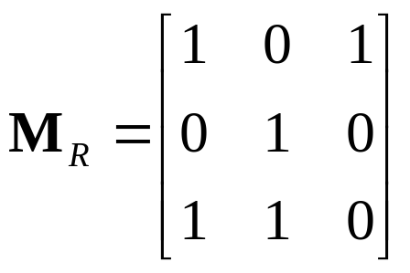


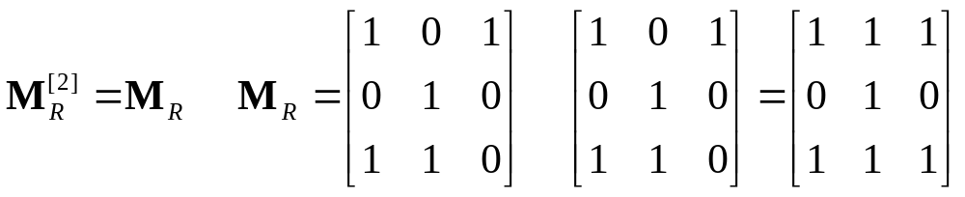
Example
Find the zero-one matrix of the transitive closure of the relation R given by:
1
2
1
2
3
3
⋅
⋅

Slide 55
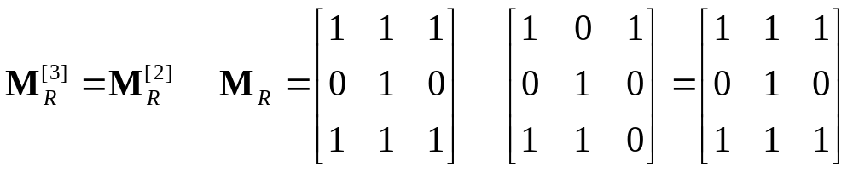
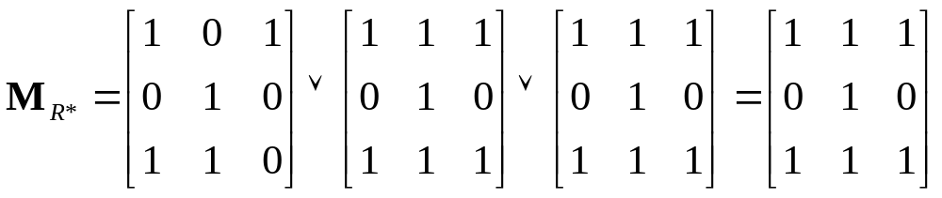
Example (Cont.)
⋅
⋅
1
2
3

Slide 56
§9.5 Equivalence Relations
An equivalence relation on a set A is a binary relation that is reflexive, symmetric, and transitive.
E.g., For any function f:A→B, the relation “have the same f value”, or =_{f} :≡ {(a₁,a₂) | f(a₁)=f(a₂)} is an equivalence relation.
  Reflexivity: f(x) = f(x)
    True, as given the same input, a function always produces the same output
  Symmetry: if f(x) = f(y) then f(y) = f(x)
    True, by the definition of equality
  Transitivity: if f(x) = f(y) and f(y) = f(z) then f(x) = f(z)
    True, by the definition of equality

Slide 57
Equivalence Relation Examples
Consider relation R = { (a,b) | len(a) = len(b) }
  where len(a) means the length of string a
  Reflexivity: len(a) = len(a)
  Symmetry: if len(a) = len(b), then len(b) = len(a)
  Transitivity: if len(a) = len(b) and len(b) = len(c), then len(a) = len(c)
  Thus, R is a equivalence relation

Slide 58
Equivalence Relation Examples
Consider the relation R = { (a,b) | a ≡ b (mod m) }
Reflexivity: (a,a) ∈ R means that m | a-a
  a-a = 0, which is divisible by m
Symmetry: if (a,b) ∈ R then (b,a) ∈ R
  (a,b) ∈ R means that m | a-b
  Thus, m | b-a, so (b,a) ∈ R
Transitivity: if (a,b) ∈ R and (b,c) ∈ R then (a,c) ∈ R
  (a,b) ∈ R means that m | a-b, (b,c) ∈ R means that
  m | b-c. Thus, m | a-c, and (a,c) ∈ R
Thus, congruence modulo m is an equivalence relation

Slide 59
Equivalence Relation Examples
“Integers a and b have the same absolute value.”
“Real numbers a and b have the same fractional part.” (i.e., a − b ∈ Z)
the relation R, consisting of all pairs (x,y) where x and y are bit strings of length three or more that agree except perhaps in their first three bits

Slide 60
Equivalence classes
Let R be an equivalence relation on a set A. The set of all elements that are related to an element a of A is called the equivalence class of a.
The equivalence class of a with respect to R is denoted by [a]_{R}
When only one relation is under consideration, the subscript is often deleted, and [a] is used to denote the equivalence class
Note that these classes are disjoint!
  As the equivalence relation is symmetric

Slide 61
More on equivalence classes
Consider the relation R = { (a,b) | a mod 2 = b mod 2 }
  Thus, all the even numbers are related to each other
  As are the odd numbers
The even numbers form an equivalence class
  As do the odd numbers
The equivalence class for the even numbers is denoted by [2] (or [4], or [784], etc.)
  [2] = { …, -4, -2, 0, 2, 4, … }
  2 is a representative of it’s equivalence class
There are only 2 equivalence classes formed by this equivalence relation

Slide 62
More on equivalence classes
Consider the relation R = { (a,b) | a = b or
a = -b }
  Thus, every number is related to additive inverse
The equivalence class for an integer a:
  [7] = { 7, -7 }
  [0] = { 0 }
  [a] = { a, -a }
There are an infinite number of equivalence classes formed by this equivalence relation

Slide 63
Partitions
Formally, a partition of a set S is a collection of non-empty disjoint subsets of S whose union is S.
∀i, j: A_{i} ≠∅ ∧( i≠j → A_{i}∩A_{j} = ∅ ), and
∪A_{i} = S.
Theorem: Let R be an equivalence relation on a set A.
Then the equivalence classes of R form a partition of A.
Consider the relation R = { (a,b) | a mod 2 = b mod 2 }. This splits the integers into two equivalence classes, which together form a partition of the integers. The partition is { [0], [1] }
  Or { {…, -3, -1, 1, 3, …}, {…, -4, -2, 0, 2, 4, …} }
Notes:
分割
The subsets in the partition are the equivalence class

Slide 64

Examples
Which of the following are partitions of the set of integers?
The set of even integers and the set of odd integers
  Yes, it’s a valid partition
The set of positive integers and the set of negative integers
  No: 0 is in neither set
The set of integers divisible by 3, the set of integers leaving a remainder of 1 when divided by 3, and the set of integers leaving a remaineder of 2 when divided by 3
  Yes, it’s a valid partition

Slide 65
Examples
The set of integers less than -100, the set of integers with absolute value not exceeding 100, and the set of integers greater than 100
  Yes, it’s a valid partition
The set of integers not divisible by 3, the set of even integers, and the set of integers that leave a remainder of 3 when divided by 6
  The first two sets are not disjoint (2 is in both), so it’s not a valid partition

Slide 66
§9.6 Partial Orderings
A relation R on A is called a partial ordering or partial order iff it is reflexive, antisymmetric, and transitive.
  We often use a symbol looking something like ≼ (or analogous shapes) for such relations.
A set A together with a partial order ≼ on A is called a partially ordered set or poset and is denoted (A, ≼).
Examples: ≤, ≥ on real numbers, ⊆, ⊇ on sets.
  3 ≤ 3 : Reflexive
  3 ≤ 4 but 4 is not ≤ 3 : Antisymmetric
  3 ≤ 4 and 4 ≤ 5 then 3 ≤ 5 : Transitive

Slide 67
Hasse Diagrams
When we KNOW it’s a poset, we construct a
Hasse diagram to simplify the graph:
1) Construct a digraph representation of the poset so that all links point up (except the loops).
2) Eliminate all loops
3) Eliminate all arcs that are redundant because of transitivity
4) Eliminate the arrows at the ends of links since everything points up.
Notes:
To construct a Hasse diagram:
1) Construct a digraph representation of the poset (A, R) so that all arcs point up (except the loops).
2) Eliminate all loops
3) Eliminate all arcs that are redundant because of transitivity
4) eliminate the arrows at the ends of arcs since everything points up.

Slide 68
Hasse Diagrams
Consider the graph for a finite poset ({1,2,3,4},≤)
4
3
2
1
4
3
2
1
4
3
2
1
4
3
2
1
Called the
Hasse
diagram
Notes:
To construct a Hasse diagram:
1) Construct a digraph representation of the poset (A, R) so that all arcs point up (except the loops).
2) Eliminate all loops
3) Eliminate all arcs that are redundant because of transitivity
4) eliminate the arrows at the ends of arcs since everything points up.

Slide 69
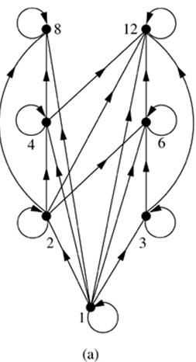
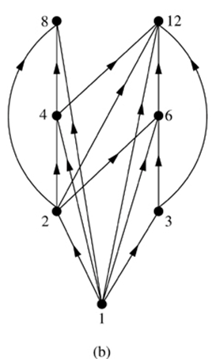
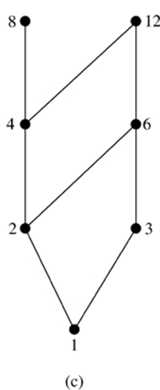
Hasse Diagrams
For the poset ({1,2,3,4,6,8,12}, |)

Slide 70
Maximal and Minimal Elements
That is, a is maximal in the poset (S, ≼) if there is no b∈S such that a ≼ b ,
That is, a is minimal if there is no b ∈S such that b ≼ a .
There can be more than one minimal and maximal element in a poset.

Slide 71
Lexicographic Order
Consider two posets: (S,≼₁) and (T,≼₂)
We can order Cartesian products of these two posets via lexicographic ordering
  Let s₁ ∈ S and s₂ ∈ S
  Let t₁ ∈ T and t₂ ∈ T
  (s₁,t₁) ≼(s₂,t₂) if either:
    s₁ ≼₁s₂
    s₁ = s₂ and t₁ ≼₂ t₂
We can do this on more than 2-tuples
  (1,2,3,5) ≼ (1,2,4,3)

Slide 72
Total Ordering
Another example: the divides relation | on Z⁺.
  Note it is not necessarily the case that either a≼b or b≼a.
  3 | 9 but neither 5 | 7 nor 7 | 5
  3 and 9 are comparable but not 5 and 7
  That’s why divides relation is a “partial” ordering
If we need a total ordering then any two elements of a poset (A, ≼) should be comparable
  (Z, ≤ ) is a totally ordered poset.

Slide 73
Topological Sorting
Constructing a compatible total ordering from a partial ordering is called topological sorting.
  Useful in determining an ordering of tasks
  Useful in rendering in graphics to render objects from back to front to obscure hidden surfaces
Topological sorting Algorithm:
  Select a (any) minimal element and put it in the list. Delete it from the poset S.
  Continue until all elements appear in the list (and S is void).
Notes:
Every finite nonempty poset (S, ≼), has at least one minimal element.

