Slide 2
Tim Nowaczyk
All Points Broadband
Senior Network Manager and Employee #1
tnowaczyk@allpointsbroadband.com

Slide 3
Virtual Routing and Forwarding
Multiple Routing Tables
Using BGP to exchange routes

Slide 4
Virtual Routing and Forwarding

Slide 5
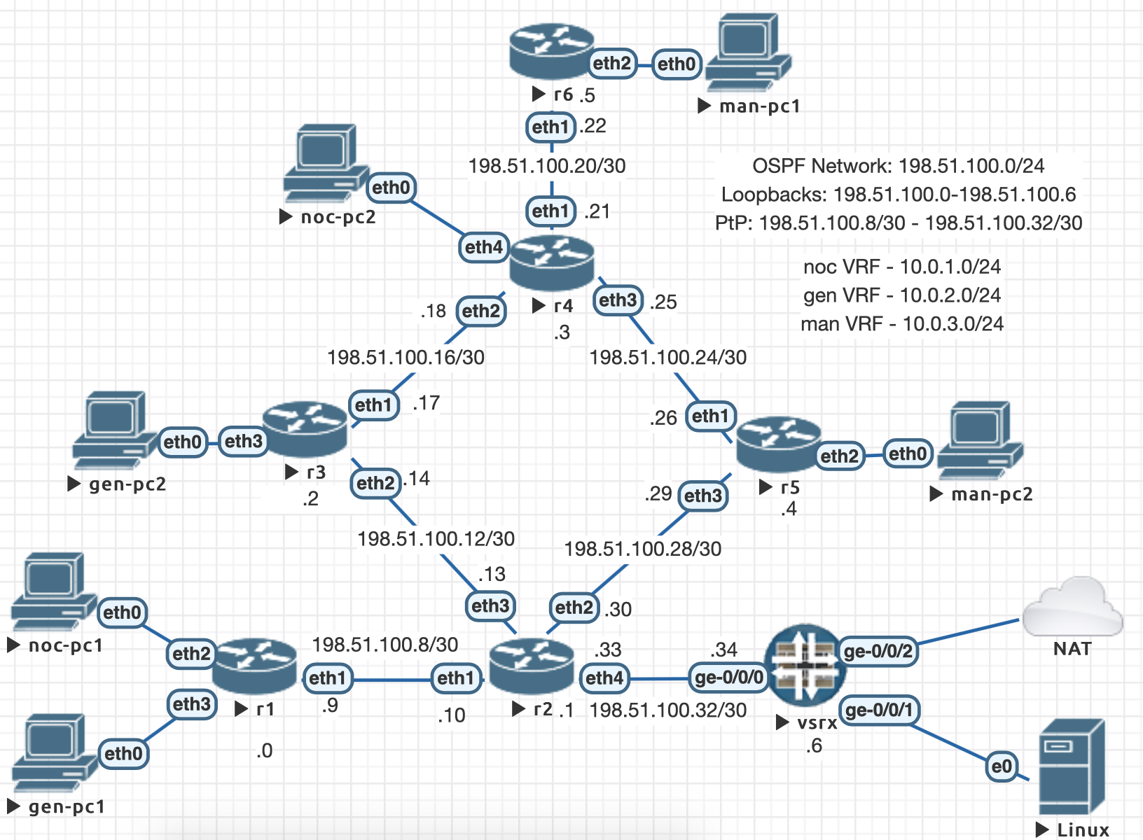
Topology

Slide 6
r1 config
/interface bridge add name=lo0
/routing bgp instance set default as=65000 router-id=198.51.100.0
/routing ospf instance set [ find default=yes ] router-id=198.51.100.0
/ip address
add address=198.51.100.0 interface=lo0 network=198.51.100.0
add address=198.51.100.9/30 interface=ether1 network=198.51.100.8
/routing bgp peer
add comment=r2 name=r2 remote-address=198.51.100.1 remote-as=65000 update-source=lo0
add comment=r3 name=r3 remote-address=198.51.100.2 remote-as=65000 update-source=lo0
add comment=r4 name=r4 remote-address=198.51.100.3 remote-as=65000 update-source=lo0
add comment=r5 name=r5 remote-address=198.51.100.4 remote-as=65000 update-source=lo0
add comment=r6 name=r6 remote-address=198.51.100.5 remote-as=65000 update-source=lo0
/routing ospf interface
add interface=lo0 passive=yes
add interface=ether1 network-type=point-to-point
/routing ospf network add area=backbone network=198.51.100.0/24

Slide 7
r2 config
/interface bridge add name=lo0
/routing bgp instance set default as=65000 router-id=198.51.100.1
/routing ospf instance set [ find default=yes ] router-id=198.51.100.1
/ip address
add address=198.51.100.1 interface=lo0 network=198.51.100.1
add address=198.51.100.10/30 interface=ether1 network=198.51.100.8
add address=198.51.100.13/30 interface=ether3 network=198.51.100.12
add address=198.51.100.33/30 interface=ether4 network=198.51.100.32
add address=198.51.100.30/30 interface=ether2 network=198.51.100.28
/routing bgp peer
add comment=r1 name=r1 remote-address=198.51.100.0 remote-as=65000 update-source=lo0
add comment=r3 name=r3 remote-address=198.51.100.2 remote-as=65000 update-source=lo0
add comment=r4 name=r4 remote-address=198.51.100.3 remote-as=65000 update-source=lo0
add comment=r5 name=r5 remote-address=198.51.100.4 remote-as=65000 update-source=lo0
add comment=r6 name=r6 remote-address=198.51.100.5 remote-as=65000 update-source=lo0
/routing ospf interface
add interface=lo0 passive=yes
add interface=ether1 network-type=point-to-point
add interface=ether3 network-type=point-to-point
add interface=ether4 network-type=point-to-point
add interface=ether2 network-type=point-to-point
/routing ospf network
add area=backbone network=198.51.100.0/24

Slide 8
Add LDP
[admin@r2] > mpls ldp set enabled=yes \
\... transport-address=198.51.100.1
[admin@r2] > mpls ldp interface add interface=ether1
[admin@r2] > mpls ldp interface add interface=ether2
[admin@r2] > mpls ldp interface add interface=ether3

Slide 9
Test With Traceroute
[admin@r1] > tool traceroute r6.example.net count=5 use-dns=yes
# ADDRESS LOSS SENT LAST AVG BEST WORST STD-DEV STATUS
1 ether1.r2.example.net 0% 5 2.3ms 2.1 1.8 2.3 0.2 <MPLS:L=19,E=0>
2 ether2.r3.example.net 0% 5 2.1ms 2.1 1.9 2.3 0.1 <MPLS:L=20,E=0>
3 ether2.r4.example.net 0% 5 1.8ms 2 1.8 2.1 0.1 <MPLS:L=19,E=0>
4 r6.example.net 0% 5 2ms 2.1 1.9 2.4 0.2

Slide 10
Route Distinguishers
noc VRF – RD 65000:100
gen VRF – RD 65000:200
man VRF – RD 65000:300

Slide 11
Add VRFs
[admin@r1] > ip address add address=10.0.1.1/30 interface=ether2
[admin@r1] > ip address add address=10.0.2.1/30 interface=ether3
[admin@r1] > ip route vrf add routing-mark=vrf_noc interfaces=ether2 \
\... route-distinguisher=65000:100 export-route-targets=65000:100 \
\... import-route-targets=65000:100
[admin@r1] > ip route vrf add routing-mark=vrf_gen interfaces=ether3 \
\... route-distinguisher=65000:200 export-route-targets=65000:200 \
\... import-route-targets=65000:200
[admin@r1] > routing bgp peer set 0,1,2,3,4 address-families=vpnv4
[admin@r1] > routing bgp instance vrf add instance=default \
\... routing-mark=vrf_noc redistribute-connected=yes
[admin@r1] > routing bgp instance vrf add instance=default \
\... routing-mark=vrf_gen redistribute-connected=yes

Slide 12
Show Route Table
[admin@r4] > ip route print
Flags: X - disabled, A - active, D - dynamic, C - connect, S - static,
r - rip, b - bgp, o - ospf, m - mme, B - blackhole, U - unreachable,
P – prohibit
# DST-ADDRESS PREF-SRC GATEWAY DISTANCE
0 ADb 10.0.1.0/30 198.51.100.0 200
1 ADC 10.0.1.4/30 10.0.1.5 ether4 0
2 ADo 0.0.0.0/0 198.51.100.26 110
198.51.100.17
3 ADo 198.51.100.0/32 198.51.100.26 110
198.51.100.17
4 ADo 198.51.100.1/32 198.51.100.26 110
198.51.100.17
5 ADo 198.51.100.2/32 198.51.100.17 110
6 ADC 198.51.100.3/32 198.51.100.3 lo0 0
7 ADo 198.51.100.4/32 198.51.100.26 110
8 ADo 198.51.100.5/32 198.51.100.22 110
9 ADo 198.51.100.6/32 198.51.100.26 110
198.51.100.17
10 ADo 198.51.100.8/30 198.51.100.26 110
198.51.100.17
11 ADo 198.51.100.12/30 198.51.100.17 110
12 ADC 198.51.100.16/30 198.51.100.18 ether2 0
13 ADC 198.51.100.20/30 198.51.100.21 ether1 0
14 ADC 198.51.100.24/30 198.51.100.25 ether3 0
15 ADo 198.51.100.28/30 198.51.100.26 110
16 ADo 198.51.100.32/30 198.51.100.26 110
198.51.100.17

Slide 13
Pinging Across the VRF
[admin@r4] > ping 10.0.1.1 count=5
SEQ HOST SIZE TTL TIME STATUS
0 10.0.1.1 timeout
1 10.0.1.1 timeout
2 10.0.1.1 timeout
3 10.0.1.1 timeout
4 10.0.1.1 timeout
sent=5 received=0 packet-loss=100%
[admin@r4] > ping 10.0.1.1 count=5 routing-table=vrf_noc src-address=10.0.1.5
SEQ HOST SIZE TTL TIME STATUS
0 10.0.1.1 56 62 1ms
1 10.0.1.1 56 62 1ms
2 10.0.1.1 56 62 1ms
3 10.0.1.1 56 62 1ms
4 10.0.1.1 56 62 1ms
sent=5 received=5 packet-loss=0% min-rtt=1ms avg-rtt=1ms max-rtt=1ms

Slide 14
Pinging Across the VRF
nocpc1> ping 10.0.1.5 -c 1
84 bytes from 10.0.1.5 icmp_seq=1 ttl=61 time=2.020 ms
nocpc1> trace 10.0.1.5 -P 1
trace to 10.0.1.5, 8 hops max (ICMP), press Ctrl+C to stop
1 * * *
2 * * *
3 * * *
4 10.0.1.5 1.214 ms 1.034 ms 1.082 ms

Slide 15
Pinging Across the VRF
nocpc1> ping 10.0.1.6 -c 1
84 bytes from 10.0.1.6 icmp_seq=1 ttl=60 time=2.244 ms
nocpc1> trace 10.0.1.6 -P 1
trace to 10.0.1.6, 8 hops max (ICMP), press Ctrl+C to stop
1 * * *
2 * * *
3 * * *
4 * * *
5 10.0.1.6 2.602 ms 2.275 ms 2.227 ms

Slide 16
NAT the noc VRF
[admin@r2] > ip route vrf add export-route-targets=65000:100 \
\... import-route-targets=65000:100 route-distinguisher=65000:100 \
\... routing-mark=vrf_noc
[admin@r2] > ip address add address=198.51.100.255 interface=lo0 \
\... network=198.51.100.255
[admin@r2] > ip firewall mangle add action=mark-routing \
\... chain=prerouting dst-address=198.51.100.255 \
\... new-routing-mark=vrf_noc passthrough=yes
[admin@r2] > ip firewall nat add action=src-nat chain=srcnat \
\... routing-mark=vrf_noc to-addresses=198.51.100.255
[admin@r2] > ip route add distance=1 gateway=198.51.100.34@main \
\... routing-mark=vrf_noc

Slide 17
Pinging the Firewall
nocpc1> ping 198.51.100.34 –c 1
84 bytes from 198.51.100.34 icmp_seq=1 ttl=62 time=1.669 ms

Slide 18
Router Configs
Router configs at: https://github.com/zimage/wispamerica2019-MPLS

