Slide 1
2026_proj_Zimcik_Xenium

Slide 2
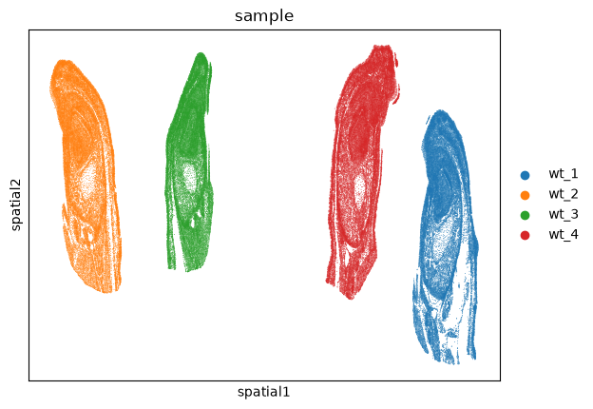
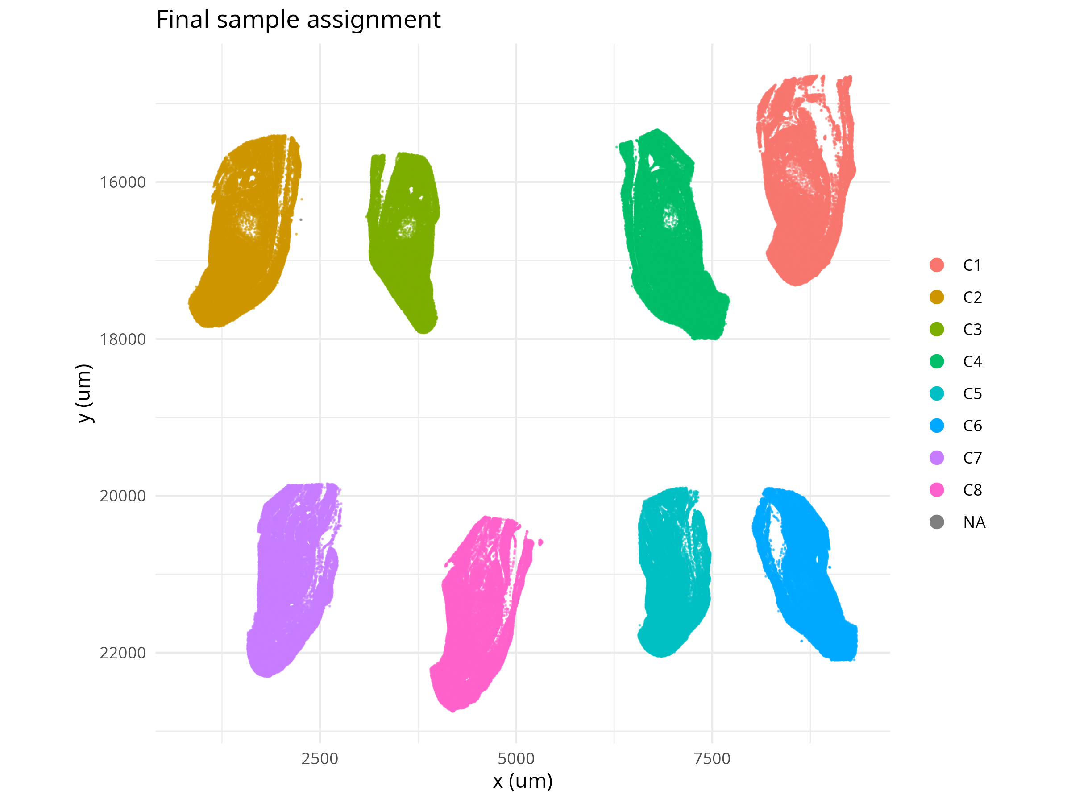
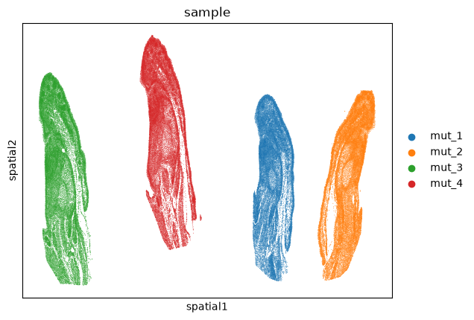

Slide 3
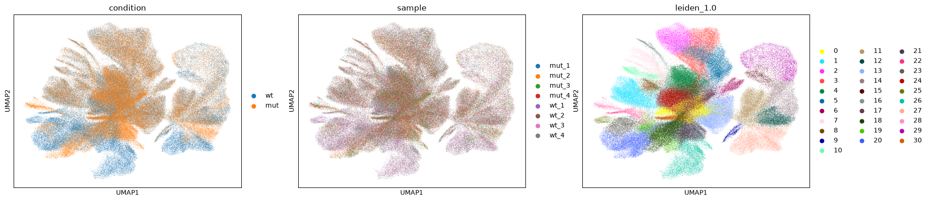
Normalizations
Normalize + log1p
normalize_pearson_residuals

Slide 4
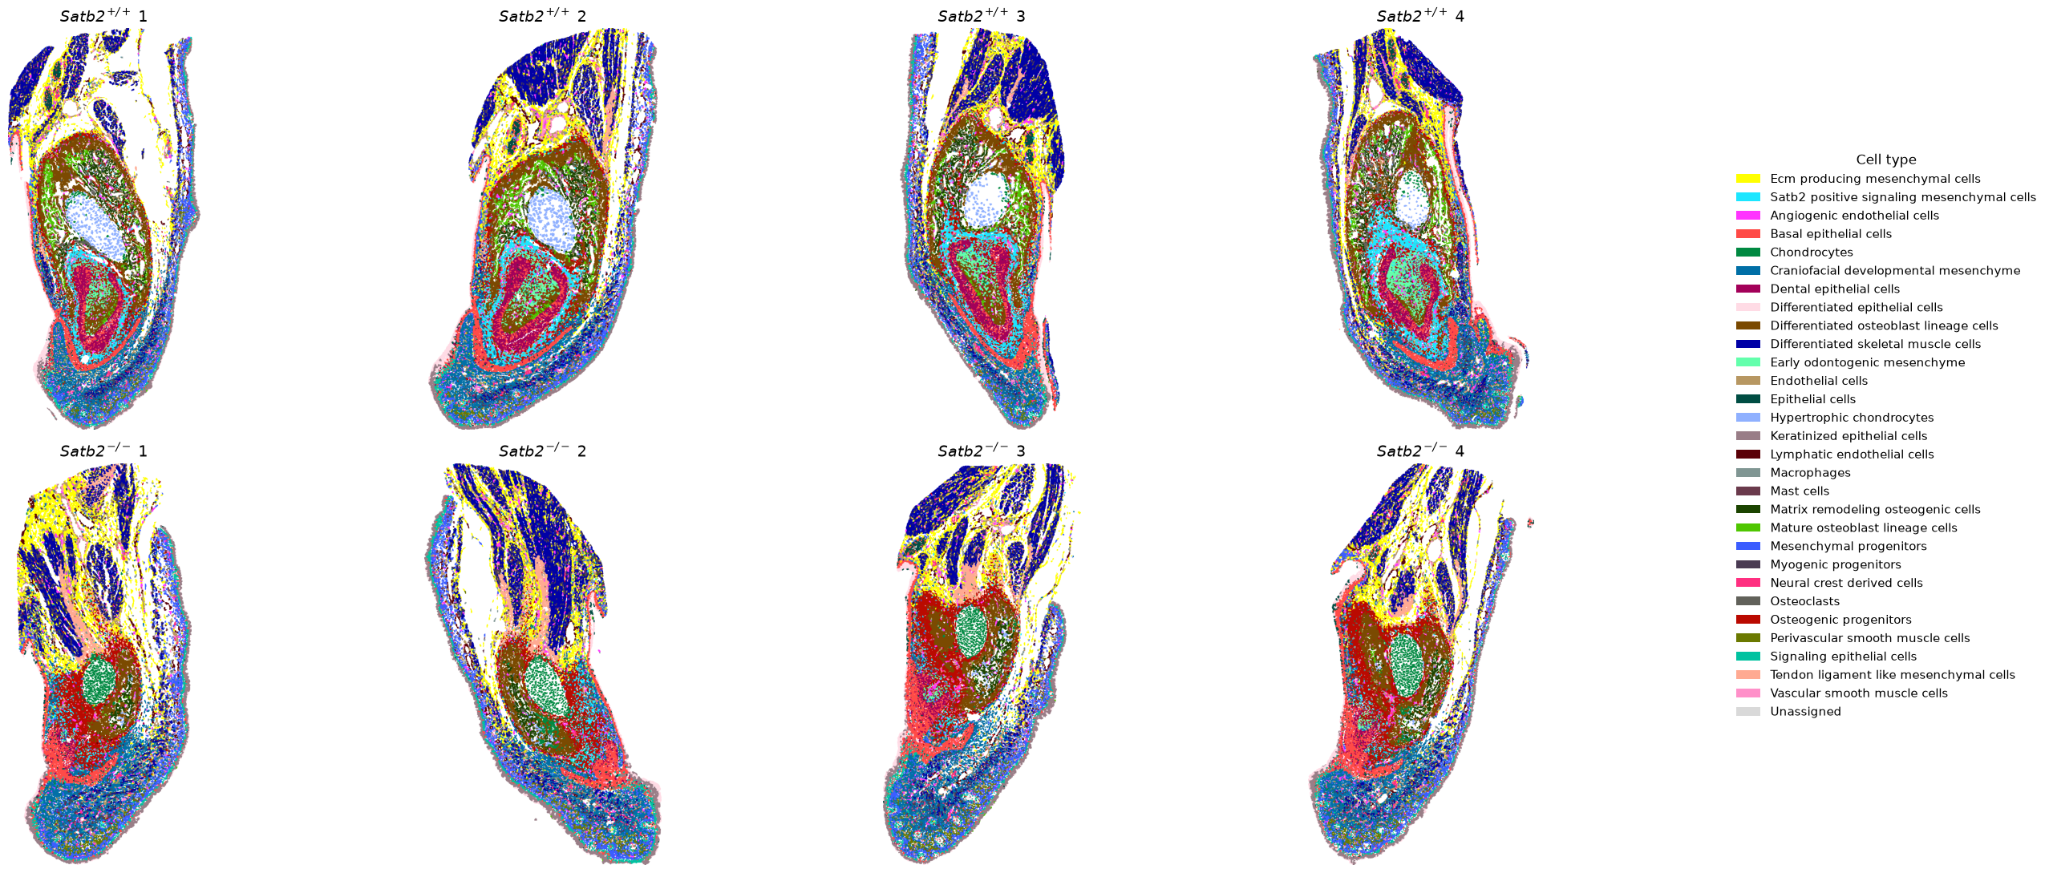

Slide 5
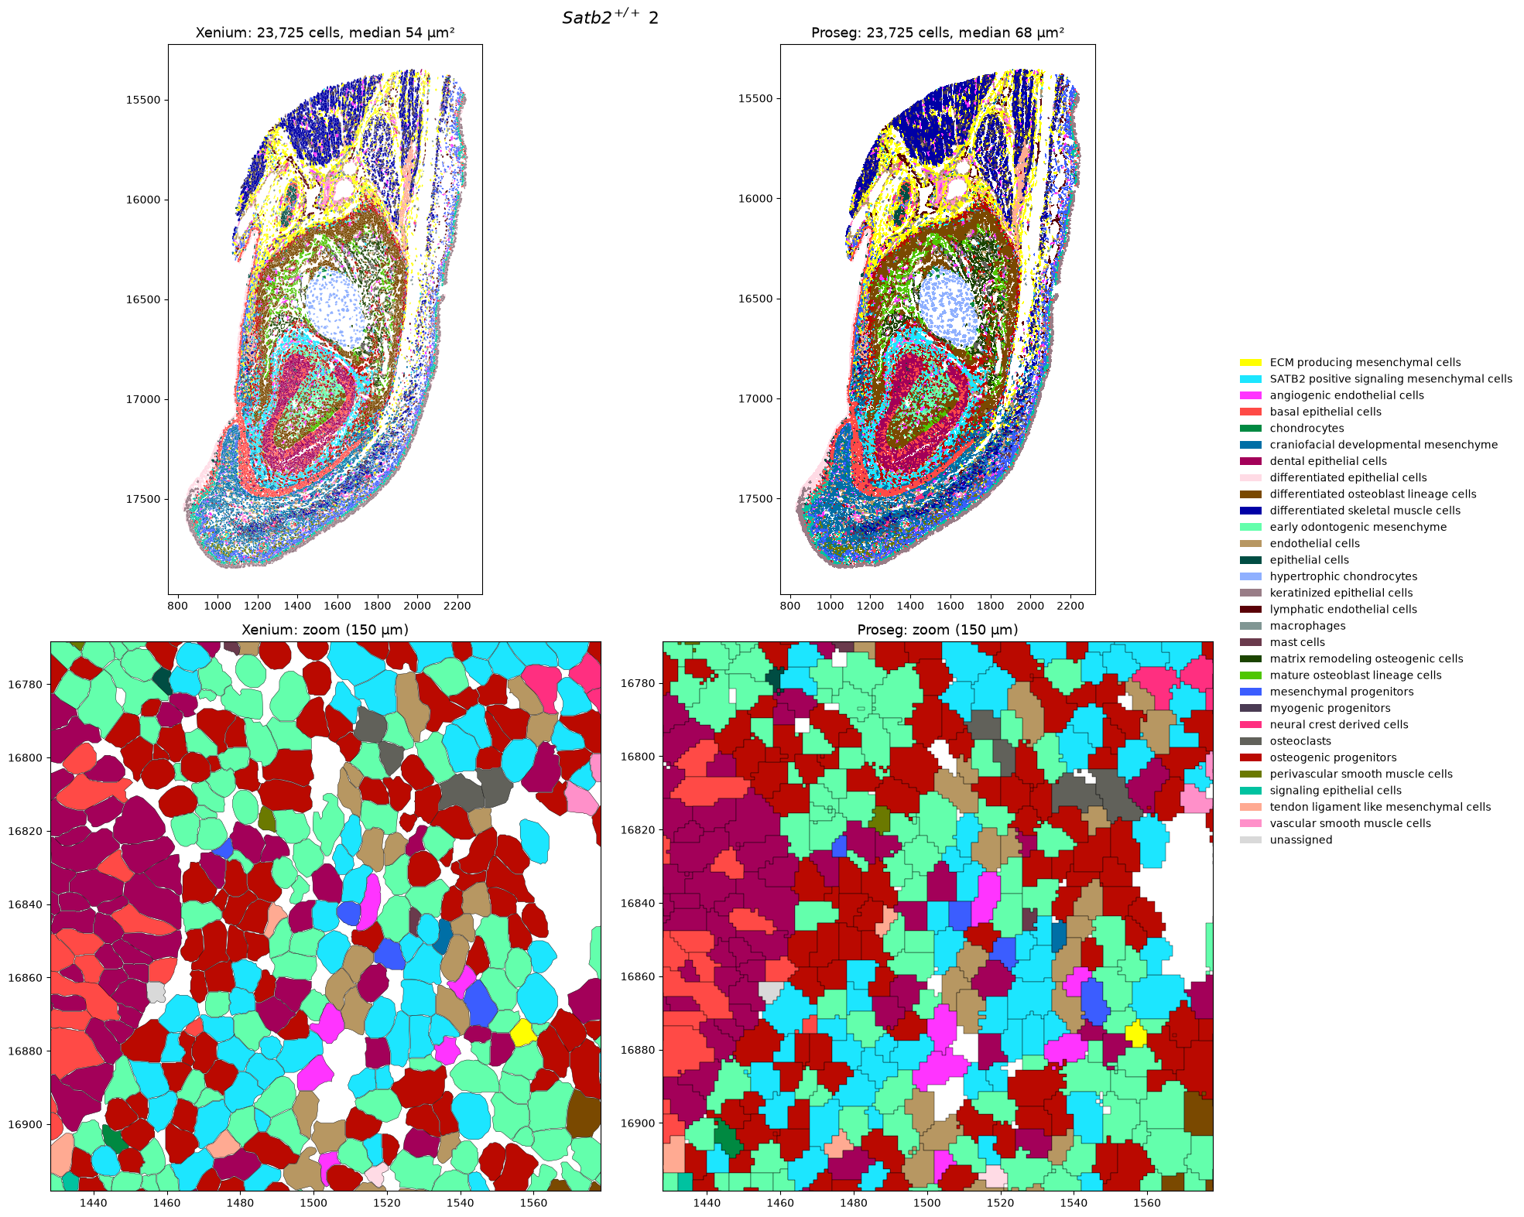
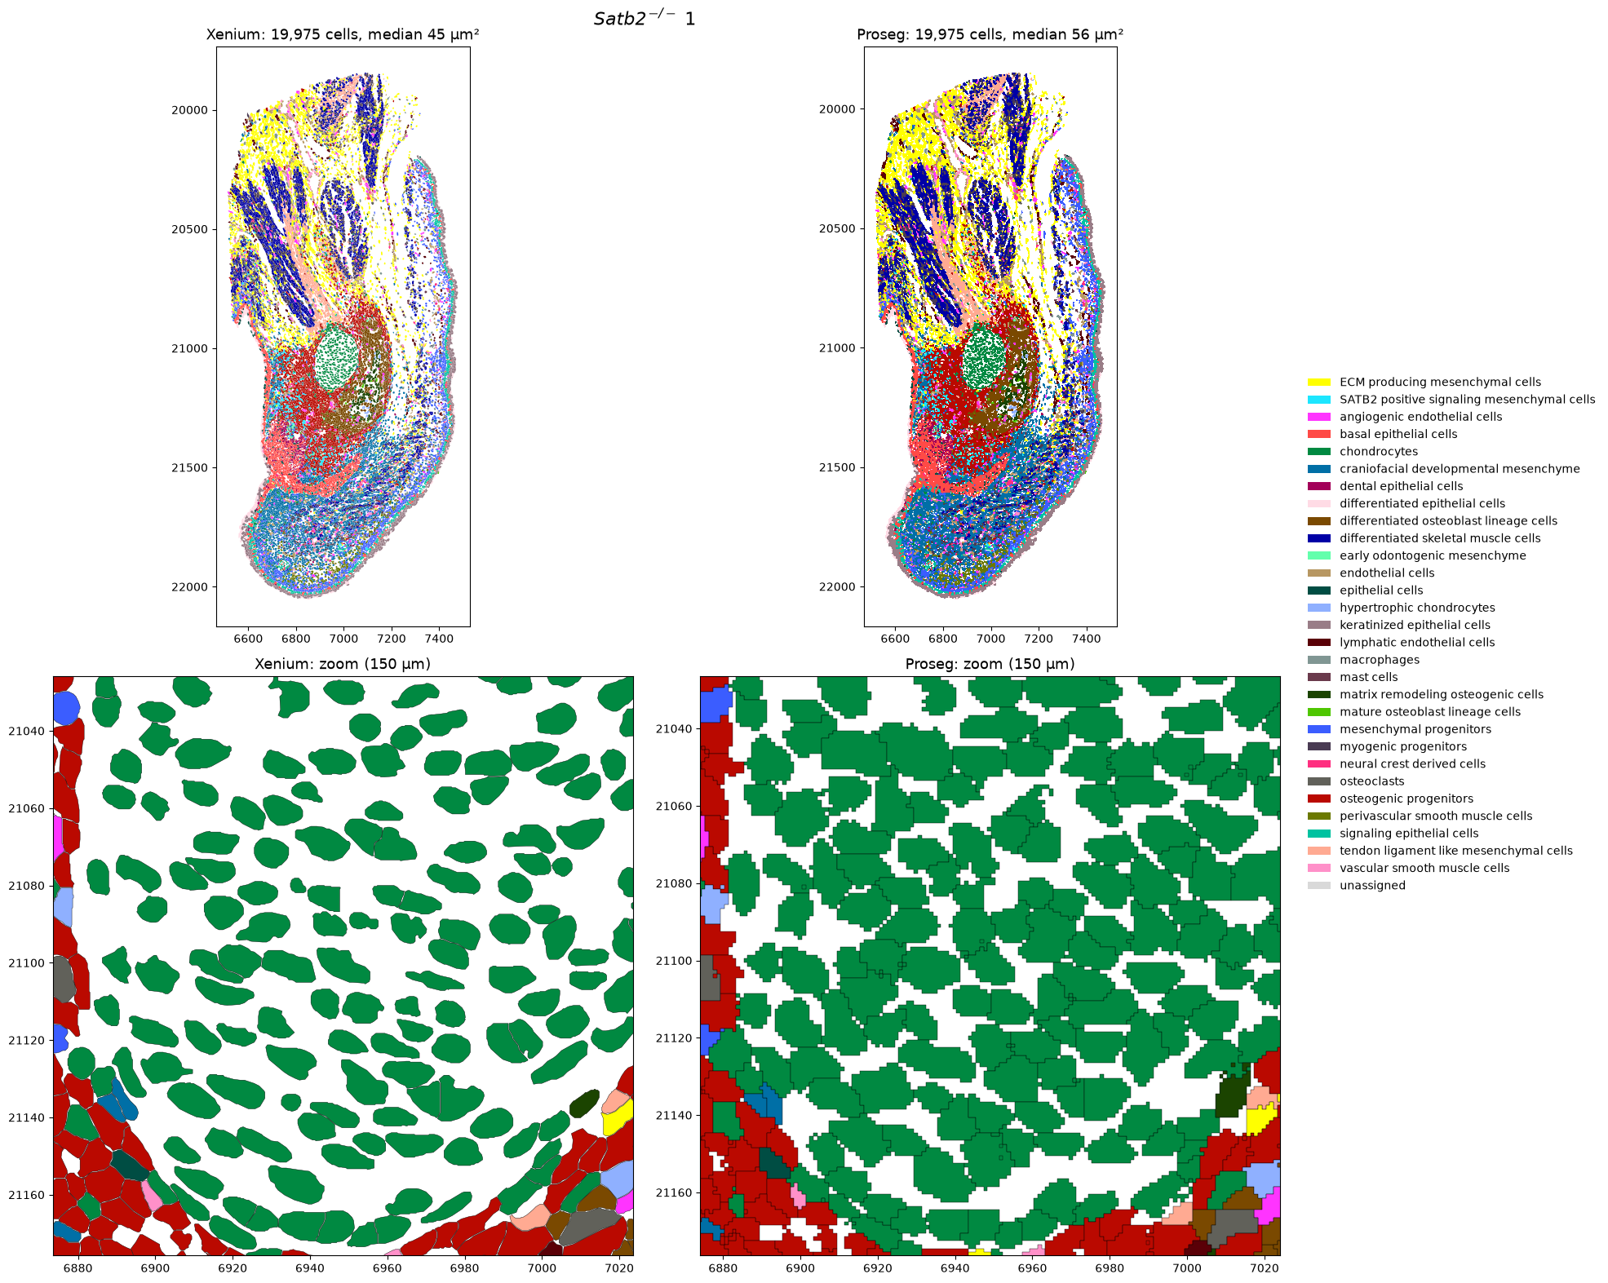
Decision – PROSEG

Slide 6
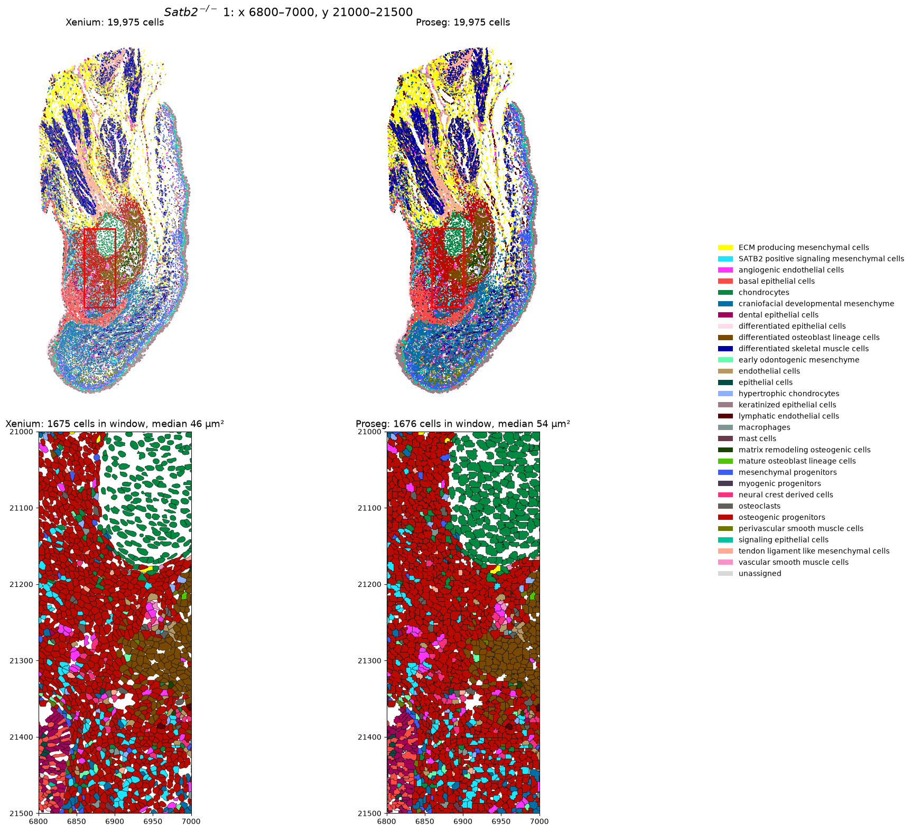

Slide 7
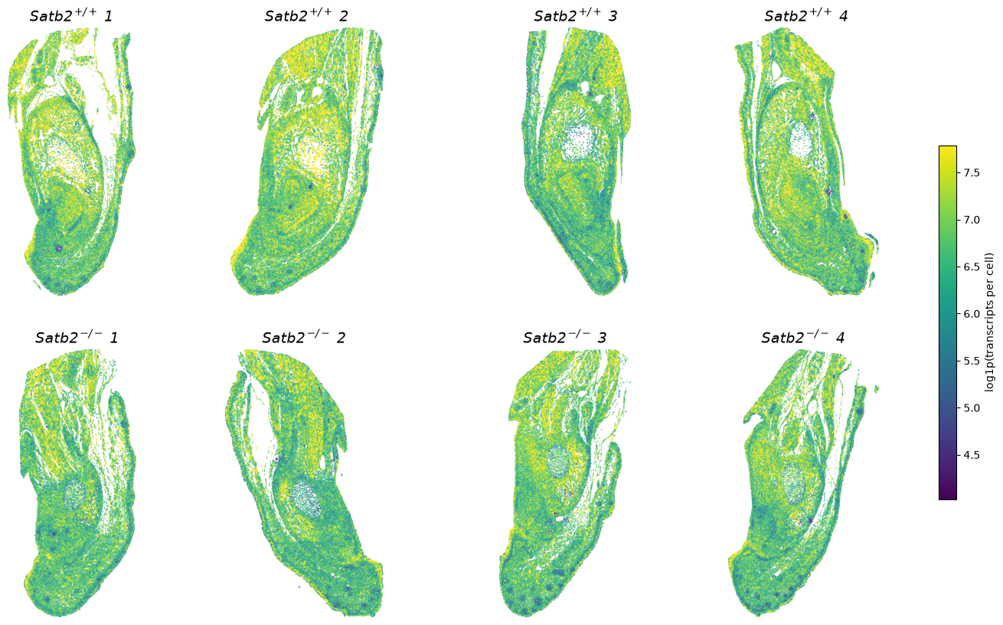
Proseg – resegmentation, coloured by n_transcripts

Slide 8
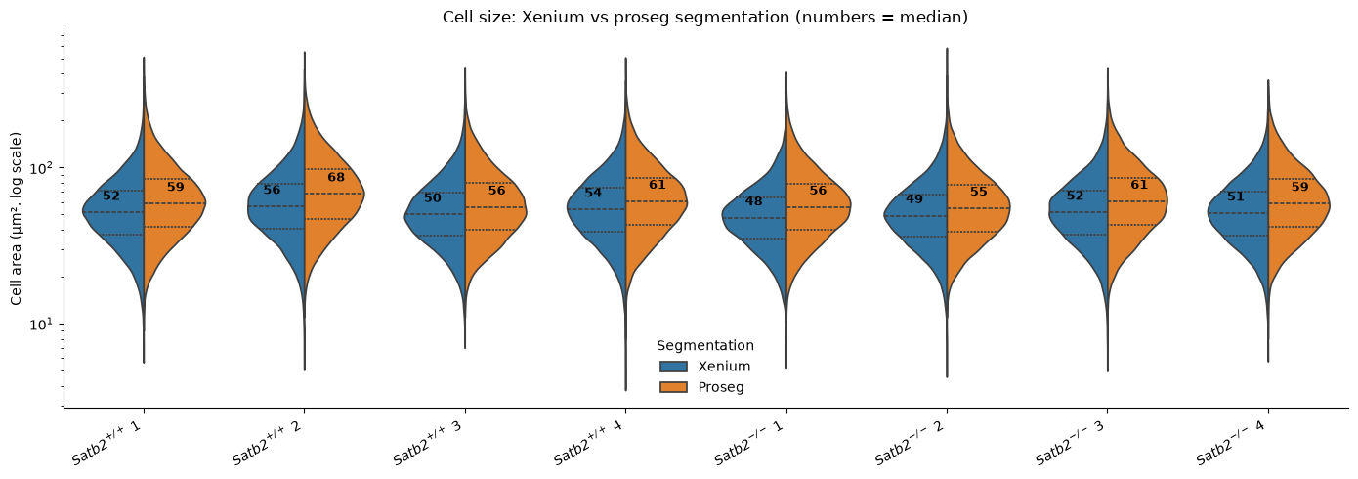

Slide 9
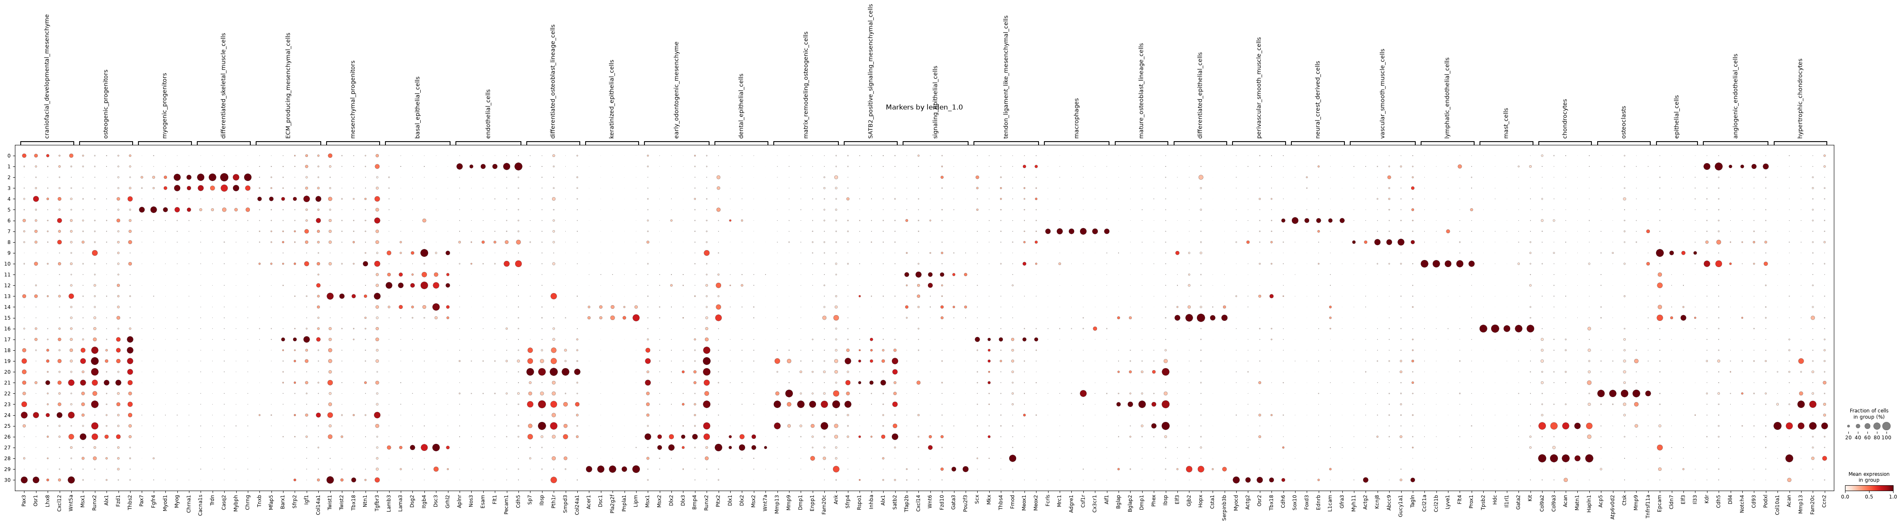
Annotation

Slide 10
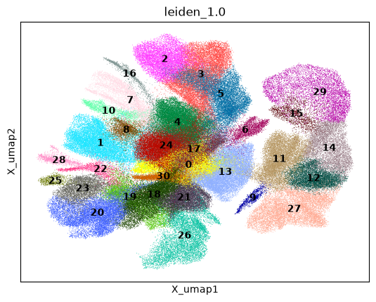
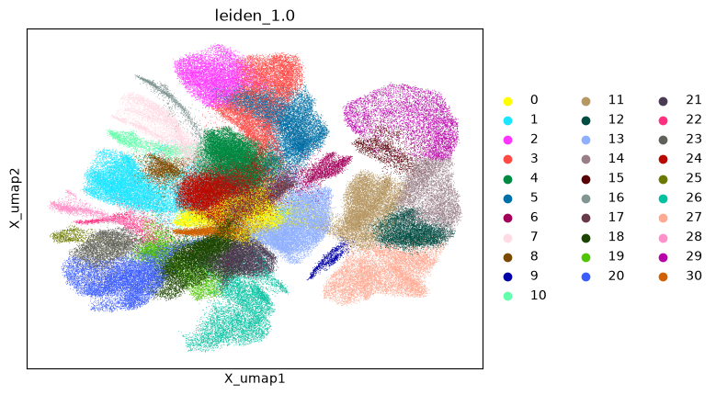

Slide 11
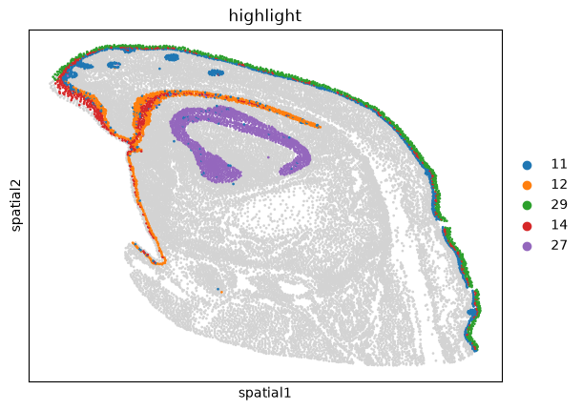
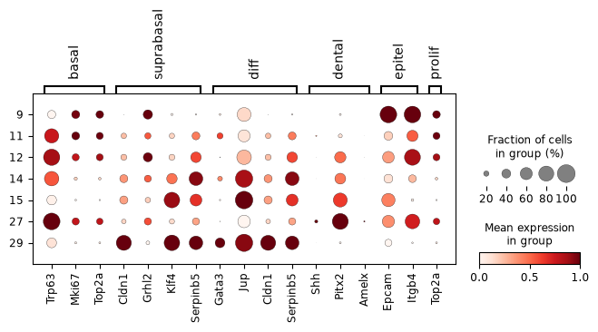
"11": "Signaling epithelial cells",
"12": "Basal epithelial cells",
"14": "Differentiated epithelial cells",
"29": "Keratinized epithelial cells",
"27": "Dental epithelial cells",

Slide 12
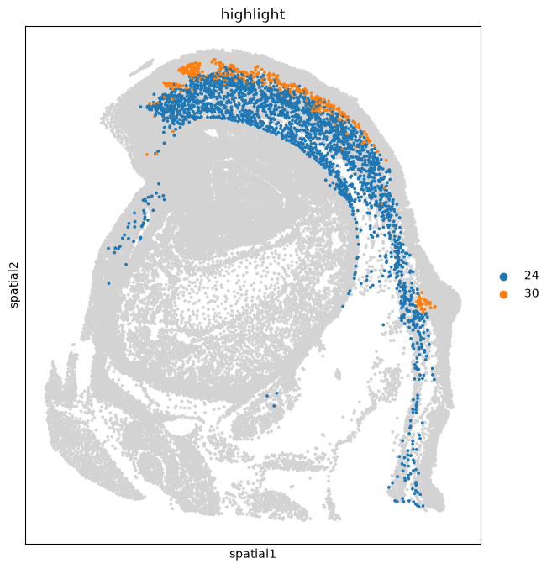
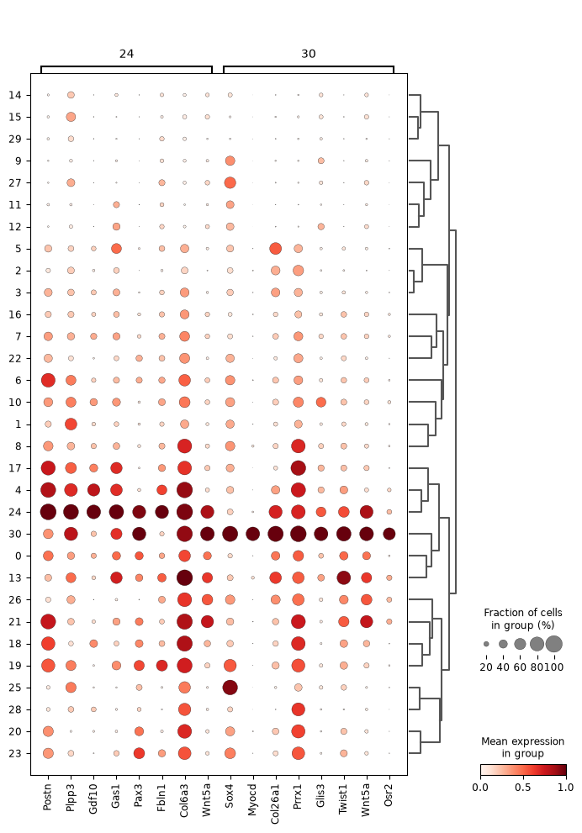
"24": "claniofacial developmental mesenchymal cells",
"30": "perivascular smooth muscle cells",

Slide 13
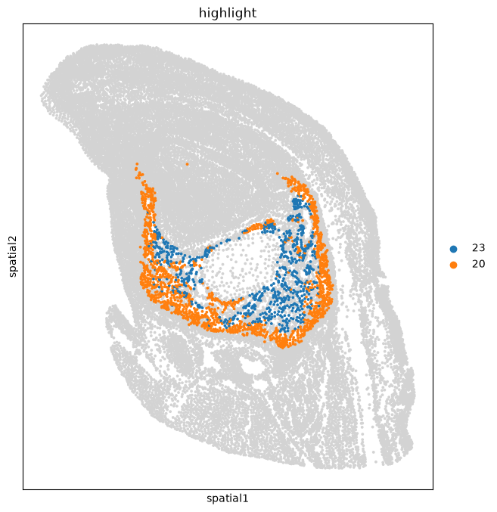
Cluster 20 is mature, matrix-secreting osteoblasts. It has the full active osteoblast program: Sp7 (Osterix, 88%), Alpl (95%), Runx2, Col1a1/Col1a2 and Ibsp. It also carries the genes that start mineralization: Smpd3 and Sgms2 (sphingomyelin metabolism, required for matrix mineralization), Panx3 (a channel that drives osteoblast differentiation), and Tmem119 (a Runx2 cofactor). Pth1r shows the cells respond to PTH/PTHrP, as active osteoblasts on bone surfaces do, and Tcf7 indicates Wnt signaling. These cells are building bone.
Cluster 23 is the next stage: osteoblasts becoming embedded as osteocytes. Compared with 20, it has lost part of the active osteoblast program (lower Sp7, Alpl, Panx3, Smpd3 and Tmem119) and switched on Dmp1, Fam20c, Enpp1 and Ank. That's the textbook shift when an osteoblast gets surrounded by its own matrix: Alpl and Sp7 go down, Dmp1 goes up, and the cell starts regulating mineralization and phosphate locally. Its high Mmp13, Timp1 and Csf1 add matrix remodeling and osteoclast recruitment. Egr1 fits the mechanosensitive, early-osteocyte state.
Taken together with the earlier clusters, this gives a complete lineage:
Cluster 21 (Msx1, Alx1, Postn): progenitors / dental follicle → osteogenic_progenitors
The Alpl/Runx2/Satb2/Fgfr2/Ptch1 cluster: committed pre-osteoblasts
Cluster 20 (Sp7, Panx3, Smpd3): active mature osteoblasts → mature_osteoblast_lineage_cells
Cluster 23 (Dmp1, Enpp1, Fam20c): pre-osteocytes → differentiated_osteoblast_lineage_cells

Slide 14
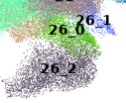
Cluster 21: osteogenic progenitors / dental follicle (Msx1, Alx1, Postn)
Cluster 19: committed pre-osteoblasts (Alpl, Runx2, Satb2, Fgfr2/3, Ncam1)
Cluster 20: mature, matrix-secreting osteoblasts (Sp7, Panx3, Smpd3)
Cluster 23: pre-osteocytes (Dmp1, Enpp1, Fam20c)
High: 26_2 is dental papilla. The filled core inside a ring, with an unlabeled epithelial layer in between, plus Msx1/Msx2/Ptch1, is a very consistent picture.
High: 26_0 is dental follicle. It's the outer ring around the enamel organ, consistent with the profile of cluster 21 near the incisor tip.
Medium: the stage is bell stage, with pre-odontoblast commitment. This is based on Sp7/Smpd3/Sgms2 and needs confirmation with Dspp and papilla-specific genes
High: 26_0 is dental follicle. The ring around the enamel organ that thickens at the cervical loop, together with Msx1/Alx1/Runx2, is very consistent.
Medium-high: it's the inner, Shh/Wnt-responsive part of the follicle, next to the epithelium. Ptch1, Lef1, Tcf7 and Wif1 all point to cells receiving epithelial signals directly.
Medium: 26_0 and cluster 21 are two states of the same follicle. 26_0 would be the signaling-active layer at the cervical loop, and 21 the more fibrous, Postn-rich layer further along the tooth toward the tip. This needs a direct comparison to confirm.
By markers alone, yes: 26_1 looks like an earlier, less differentiated state. But the markers can't tell you whether it's an earlier stage of 26_2 or 26_0, and "earlier stage" and "mutant state" aren't mutually exclusive. The most likely answer combines both: mutant cells arrested at an earlier stage.
Why it looks earlier
26_1 lacks the differentiation genes of both neighbors. It doesn't have the pre-odontoblast program of 26_2 (Sp7, Smpd3, Sgms2, Msx2) or the osteogenic genes of 26_0 (Runx2, Dlx5, Alx1). Instead, it has Twist1 and Sox4, which actively hold neural-crest mesenchyme in an undifferentiated state, and it keeps the signaling-responsive genes (Ptch1, Wif1, Bmp4, Sdc1). That's what an upstream progenitor state would look like.
Why the markers can't decide between 26_2 and 26_0
The overlaps split both ways. With 26_2 it shares Ptch1, Tbx2 and Gja1; with 26_0 it shares Ptch1, Wif1, Sdc1 and Bmp4. Since the genes that distinguish 26_2 from 26_0 are exactly the differentiation genes 26_1 lacks, the markers alone are ambiguous. There's also a third option: both 26_0 and 26_2 express Satb2, so in mutants, both the papilla and the inner follicle could fail to differentiate and end up merged into one 26_1 cluster.
How "earlier stage" and "mutant-exclusive" fit together
The continuously growing incisor always contains every stage at once, with the earliest ones near the cervical loop. So a normal early stage should also be present in wt samples. That leaves two scenarios:
If wt has a small number of 26_1 cells, located near the cervical loop or in the apical papilla, then 26_1 is a normal, short-lived early stage that accumulates in mutants because cells can't progress past it. That's a differentiation arrest, and the label would be "early (pre-odontoblast) odontogenic mesenchyme, expanded in Satb2 mutants".
If wt has essentially none, and Tac1/Ntng1 are completely absent in wt, then 26_1 is an aberran

Slide 15
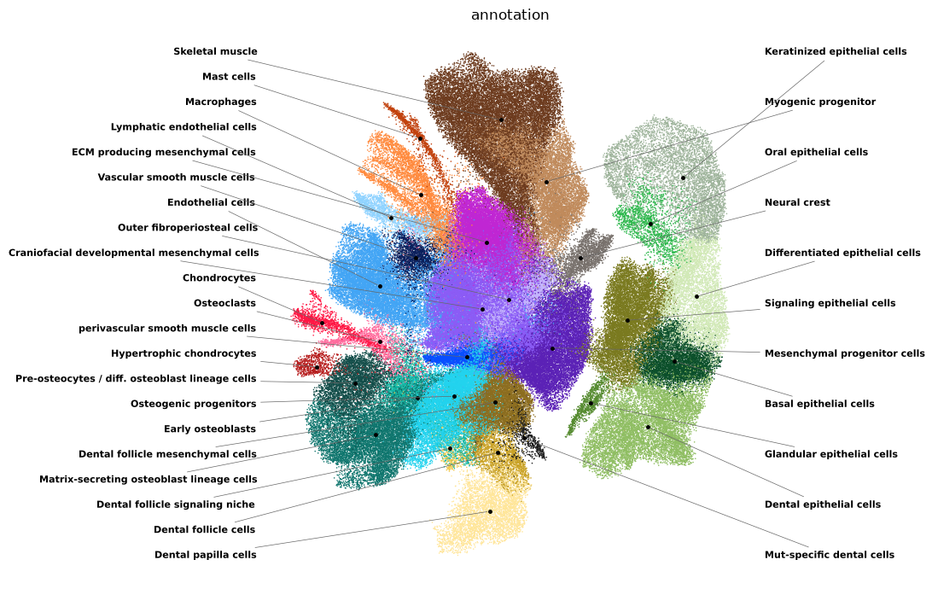

Slide 16
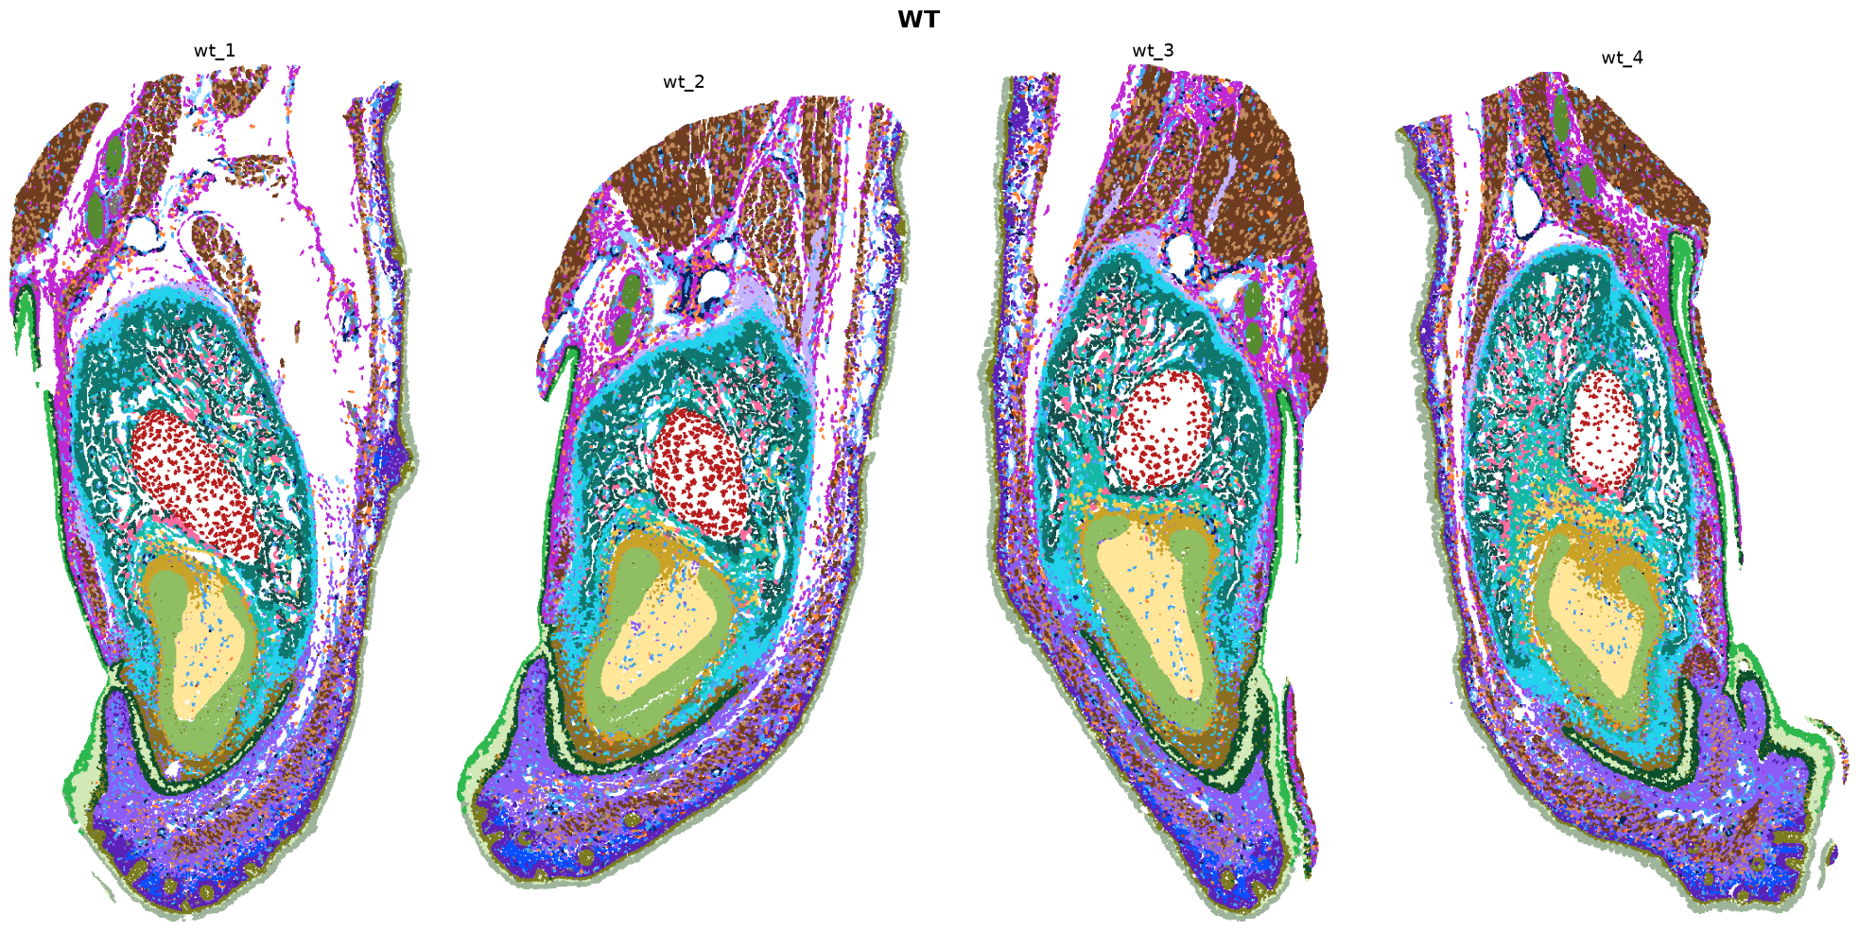

Slide 17
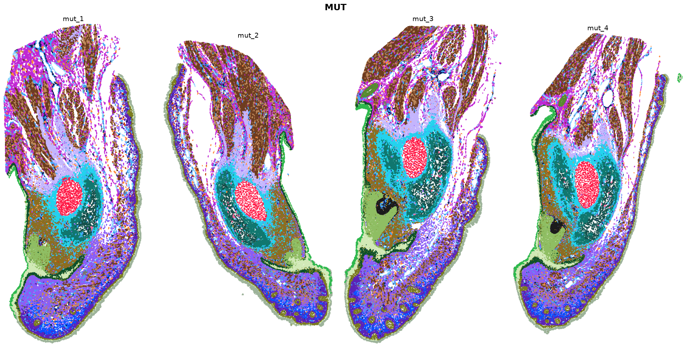

Slide 18
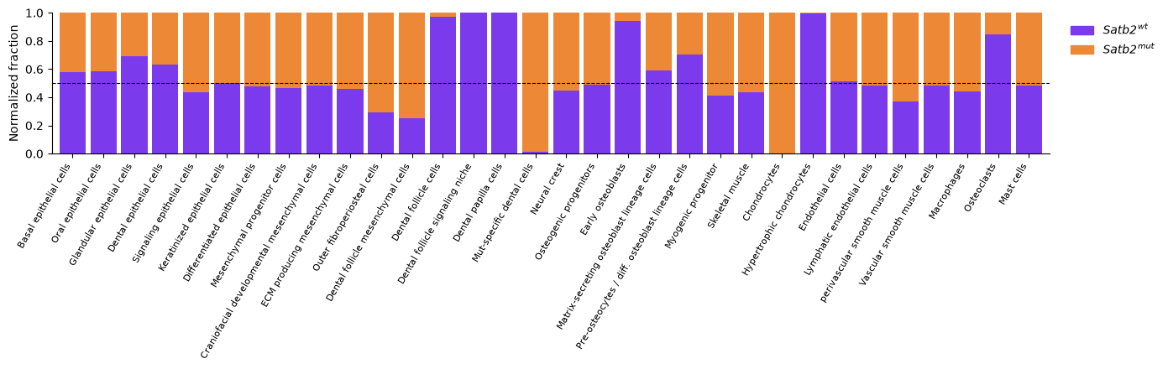

Slide 19
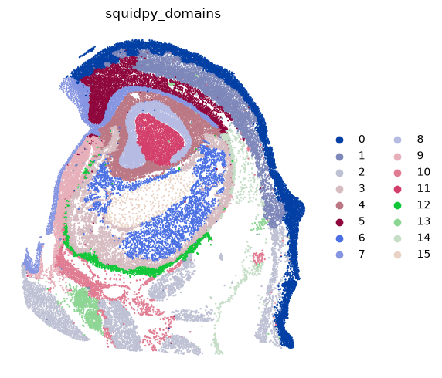
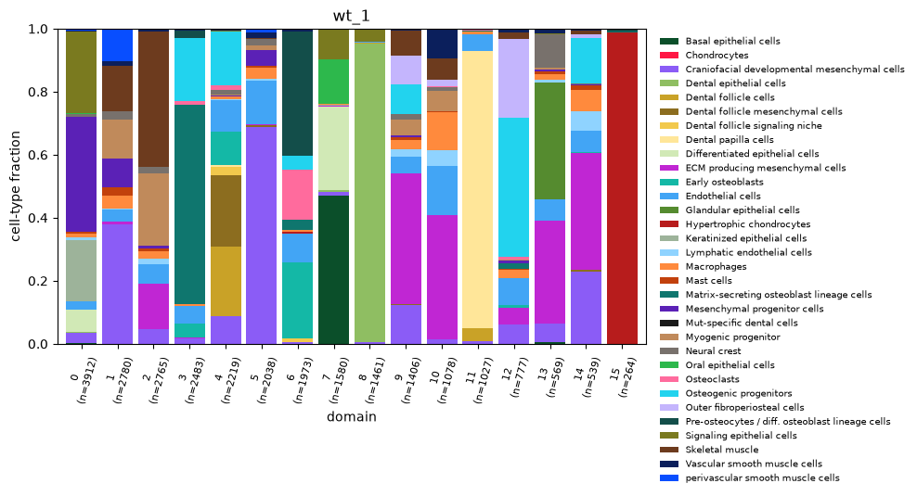
Spatial analysis

