Slide 1
Can TF-IDF analysis of book titles be used to construct an accurate book recommender system?
W06G7
Miles Sandles, Alexander Broadley, Quoc Khang Do

Slide 2
Introduction
Use TF-IDF on book titles to capture book theme
Use distance in vector space as item similarity measure
Predict user ratings for unread books
Significant commercial applications
Notes:
In this project we wanted to use TF-IDF on book titles to capture information regarding their theme. The distance between books in TF-IDF vector space, could then be used as a measure of thematic similarity. We would then use this similarity metric to predict the ratings of books users had not yet read, based on the scores they had given books of a similar theme.
The motivation for designing such a system is the obvious commercial benefits. If retailers have accurate predictions of user scores, they can better allocate their spending. For example, they could heavily stock books predicted to be popular amongst large proportions of the their readers, while spending less money on books predicted to be widely unpopular, or popular amongst a niche of the user base. Furthermore, if book sellers consistently recommend books to customers that they enjoy, they are more likely to retain their custom, generating more profit.

Slide 3
Data pre-processing
Notes:
First we had to pre-process our data. Although we cleaned all the data in the datasets provided, I will be focusing on the cleaning process for the data used in our analysis.

Slide 4
ISBN number
10 or 13 digits
0395489326 / ‎9780395489321
Only check digit can be letter ‘X’
038550120X / 038550120X
B00009EF82 038529929X
Notes:
So first we checked the formatting of all the ISBN numbers in all the data files, which was crucial as this was how we were going to merge all the data.
ISBN numbers can either be 10 or 13 digits long, with the only letter allowed a final X in the case of the check digit being 10
We found no missing values, but found that one book had its ASIN number stored instead of its ISBN and corrected this. We also found one case of a non-capitalised X which we fixed. However this also happened to be a duplicated ISBN number in ‘BX-Books’, so we removed one of these instances.

Slide 5
Ratings and user-ID
Checked for missing values
Checked for non-integer values
Checked ratings between 0 and 10 inclusive
Notes:
When cleaning user ratings and ID’s we checked for any missing or non-integer values, or ratings that were outside the acceptable range, and found none, so no excessive cleaning was necessary for these values.

Slide 6
Book title
40 records missing title
ISBN db API retrieved all 40
Cleaned titles in preparation for TF-IDF
Notes:
This was arguably the most important cleaning step, as the book titles were central to the rest of our analysis. After identifying that we were missing the titles of 40 books, we used the ISBN db API to attempt to retrieve the book titles using the ISBN numbers, which were present in every record. They had the book title for each of these missing books stored so this was successful. We then cleaned the titles in preparation for the TF-IDF calculation.

Slide 7
‘ The Lord of the Rings : the fellowship of the ring (book 1) ’
‘the lord of the rings the fellowship of the ring’
‘lord rings fellowship ring’
‘lord ring fellowship ring’
Notes:
So let’s run through a quick example of how this worked. Suppose this is the book title stored in the dataframe.
We first made all letters lowercase, removed any multiple, leading or trailing white spaces and removed all text in brackets, as, like here, it was usually information that did not reflect content about a books theme, such as its position in a series, or whether it was hard or paperback.
We then removed all stopwords, using the nltk library, a standard step in text processing, as these words are also deemed uninformative to a texts theme.
We then stemmed and lemmatized all the remaining words, which converges words in different tenses or pluralisations to the same format, which is essential for later calculation of frequencies.

Slide 8
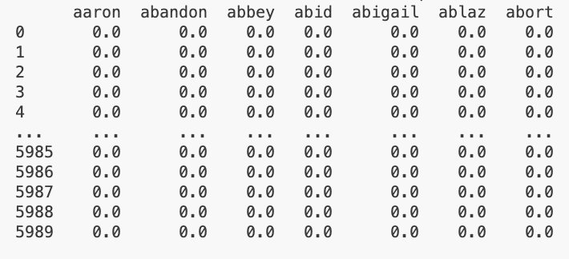
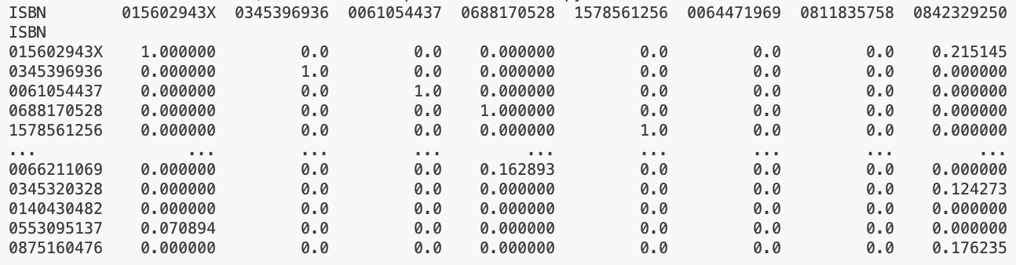
Implementing the recommender system
1. Create a TF-IDF matrix on the stemmed and lemmatised book titles
Words (components of the vector)
Book titles/ documents (vector)
TF-IDF scores
2. Create a similarity matrix for all the books (cosine similarity)
All books
similarity scores
All books
Notes:
Obviously, the core of this project was to design and implement a recommendation system to predict the books most likely for readers to rate highly. Doing so using a tf-idf system required us to first construct a matrix of similarity values between every old and new book title by counting the frequencies of terms in the title of every book and using the tf-idf equation to get the according score for every entry. This process consumed the majority of the computing time, but served as the foundation of our entire project.

Slide 9
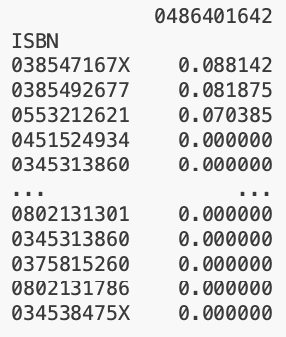
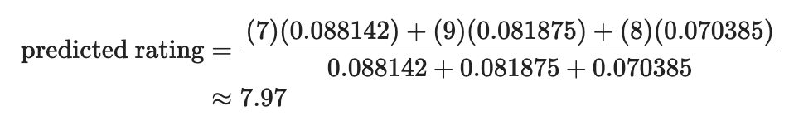
Implementing the recommender system
Top 3 most similar books
New book
3. Predict a user’s rating of a new book:
There are 3 cases:
If there are no similar books that user has rated before (i.e. similarity score = 0), then we cannot make a recommendation → return NaN.
If the new book is identical (same title) to a book that they have rated before (i.e. similarity score = 1), then the predicted rating for the new book is the same rating that the user gave the identical book.
Otherwise,
Find the top 3 similar books to the new book – of which that user has rated before.
Find the ratings that the users gave those three books.
Predicted rating = weighted average of the 3 ratings (weights are similarity scores)
similarity scores
Similar books users have rated in the past
ISBN | Rating
038547167X | 7
0385492677 | 9
0553212621 | 8
Top 3 books with highest similarity score
Notes:
Armed with a completed similarity matrix, finding the most similar books was simple, every book fell into one of three cases: if a user has no unrated books with a similarity value greater than 0, we just return an empty value. When the new book has already been rated by the user, we use that rating. And when the new book is unrated, we find the most similar titles and use the item-based recommendation equation to give it a predicted rating.

Slide 10
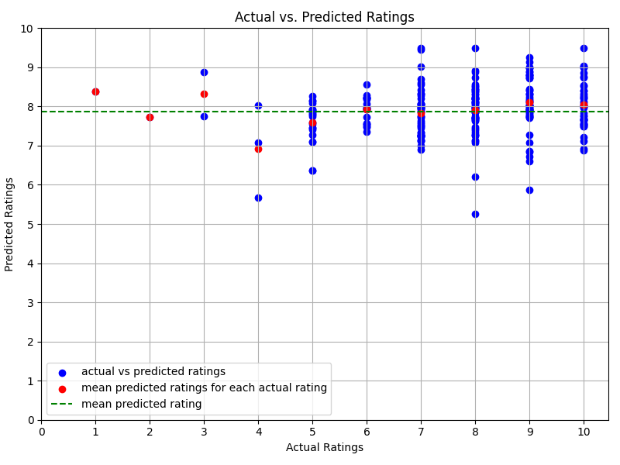
Findings + Interpretation
Mean absolute error (MAE) ≈ 1.29
Overall mean predicted rating ≈ 7.88
No correlation
All the predicted ratings lie between 5-10
Majority of users have not rated (their predicted ratings are NaN), so this evaluation might not be representative of the whole dataset
Figure 1: Scatter plot showing actual rating given to books in the ‘BX-NewBooks’ dataset against predicted ratings. Red dots show the mean predicted rating for each ‘actual’ rating, and the green line shows the overall mean predicted rating.
Notes:
However as you can see, despite a promising MAE our predictions were largely varied. The mean overall rating was ~7.9, and there was no correlation between actual and predicted rating. Rather, our low mean predicted error is likely to be a reflection of the fact that the majority of books were rated between 7 and 10.

Slide 11
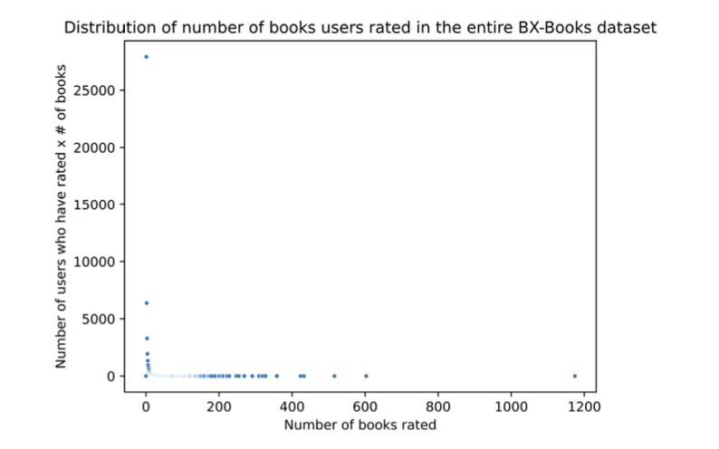
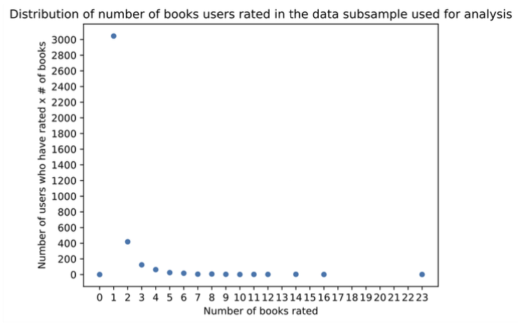
Limitations and Improvement opportunities
Figure 2: Distribution of the number of books users rated in the entire ‘BX-Books’ dataset
Figure 3: Distribution of the number of books users rated in the subsample of the merged ‘BX-Books’ datasets
Notes:
One reason for this is that very few users rated more than 2 books even in the full dataset, with very few users rating more than 1 book in the subsample we used for our analysis due to our computational constraints. As such, it was unlikely users had rated multiple similar books. When this was the case, our predicted ratings are more likely to be affected by noise. Furthermore, it was impossible to predict a rating for a book when a user had not read a similar one before.

Slide 12
Limitations and improvement opportunities
Dune, Dune Messiah, Dune: House atreides
Similar term content and theme
The Hobbit, The Lord of the Rings, Game of thrones
Similar theme, dissimilar term content
Book summaries would be better
Notes:
Another issue is how accurately term frequency analysis on book titles would group books based on their themes. As you can see here, these first set of books are similar thematically, and would be close in TF-IDF vector space. The same cannot be said for this second set of books.
Using book summaries is likely to be a much better way of capturing whether or not books share a similar theme, but we lacked the storage space and computing power to run our analysis on these book summaries, tho they could also be obtained through the ISBN db API.

