Slide 1

You Can Get There From Here!
How a few simple actions can restore sense to it all

Slide 2
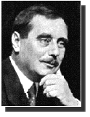
H. G. Wells, World Brain: The Idea of a Permanent World Encyclopaedia
Encyclopédie Française, August, 1937
Encyclopaedias of the past sufficed for the needs of a cultivated minority
  universal education was unthought of
  gigantic increase in recorded knowledge
Discontent with the role of universities and libraries in the intellectual life of mankind
Universities multiply but do not enlarge their scope
  thought & knowledge organization of the world
No obstacle to the creation of an efficient index to all human knowledge, ideas and achievements

Slide 3
The Optimal and Inevitable for Researchers
All of this will come to pass. The only question is “How Soon?”
The entire full-text refereed corpus online
On every researcher’s desktop, everywhere
24 hours a day
All papers citation-interlinked
Fully searchable, navigable, retrievable
For free, for all, forever

Slide 4
The Subversive Proposal:
Sufficient to free entire refereed corpus forever, immediately:
1. Universities install off-the-shelf, OAI-compliant Eprint software
2. Authors self-archive (preprints & postprints)
3. Institutions subsidize first start-up wave of self-archiving
4. The Give-Away corpus is freed
___________________________________________________________
Hypothetical Sequel:
5. Users prefer free version?
6. Publisher S/L/P revenues shrink, Library S/L/P savings grow?
7. Publishers downsize to QC/C service-providers + optional add-ons?
8. QC/C service costs funded by author-institution out of reader-institution S/L/P savings?

Slide 5
Five Essential PostGutenberg Distinctions:
(if you don’t make them, none of this will make sense)
1. Distinguish the non-give-away vs. give-away literature Litmus test: “Does the author seek a royalty/fee?”: books (yes) vs. refereed journal papers (no)
2. Distinguish income (from paper sale) vs. impact (from paper use) (and distinguish give-away-author imprint-income [0] vs. impact-income [??])
3. Distinguish give-away author copyright protection from: theft-of-authorship (wanted) vs. theft-of-text (unwanted)
4. Distinguish self-publishing (vanity press) vs. self-archiving (of published, refereed research)
5. Distinguish unrefereed preprints vs. refereed postprints “eprints” = preprints + postprints

Slide 6
Zeno’s Prima-FaQs
“I worry about self-archiving because…”:
1. Preservation
2. Authentication
3. Corruption
4. Navigation (info-glut)
5. Certification
6. Evaluation
7. Peer review
8. Paying the piper
9. Downsizing
10. Copyright
11. Plagiarism
12. Priority
13. Censorship
14. Capitalism
15. Readability
16. Graphics
17. Publishers’ future
18. Libraries’ future
19. Learned Societies’ future
20. University conspiracy
21. Serendipity
22. Tenure/Promotion
23. (your prima-FaQ here…)
Answers available at
Answers available at < http://cogsci.soton.ac.uk/~harnad/Tp/resolution.htm >

Slide 7
www.eprints.org
Rob Tansley’s Eprints < www.eprints.org > is dedicated to freeing the research literature, pre- and post-refereeing, through author/institution self-archiving in interoperable
Open Archives < www.openarchives.org >
To help the self-archiving initiative quickly gain momentum, archive-creating software, compliant with the OAi protocol, hence fully interoperable with all other Open Archives, has been developed at the University of Southampton.
Eprints is designed to be as flexible and adaptable as possible, so that all universities world-wide can immediately adopt and configure it with minimal effort for all their disciplines’ self-archiving needs.
The Eprints software, is available (for free, of course) from eprints.org since December 2000.

Slide 8
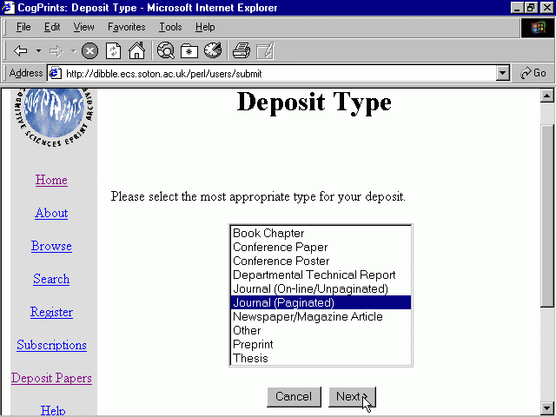
Notes:
Submit many types of document

Slide 9
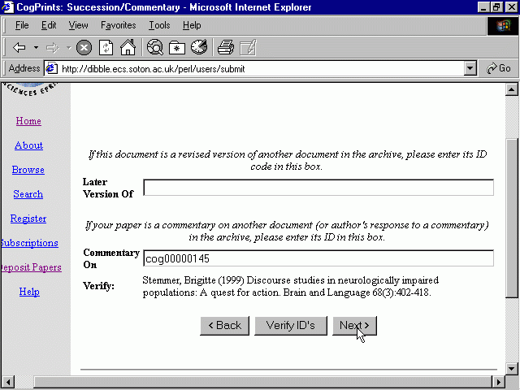
Notes:
Explicitly captures commentary relationships

Slide 10
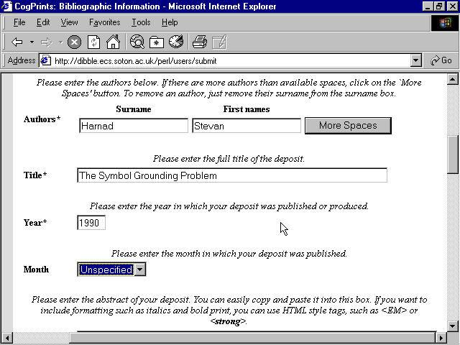
Notes:
Add Bibliographic Information

Slide 11
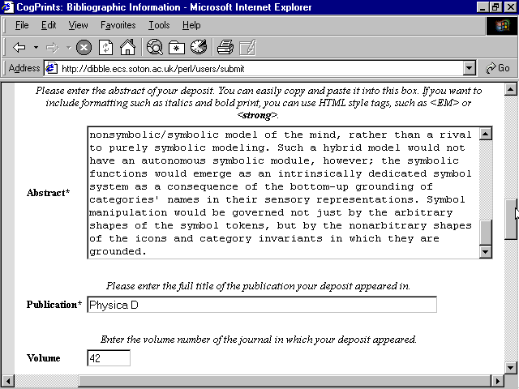
Notes:
Further Bibliographic Information

Slide 12
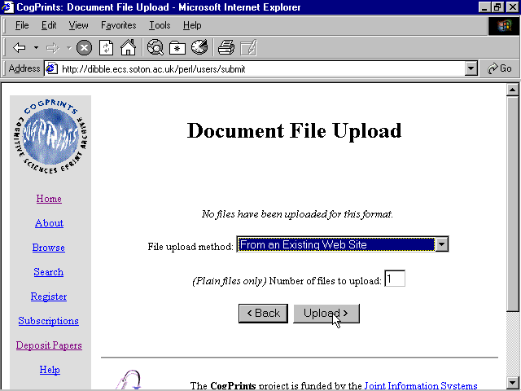
Notes:
Upload File

Slide 13
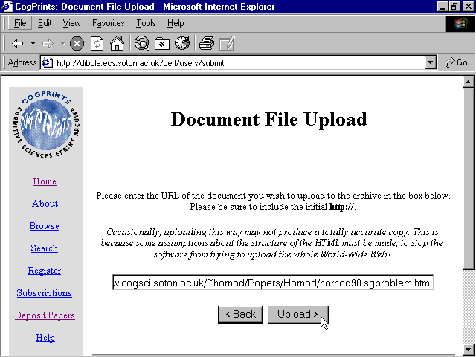
Notes:
Upload (2)

Slide 14
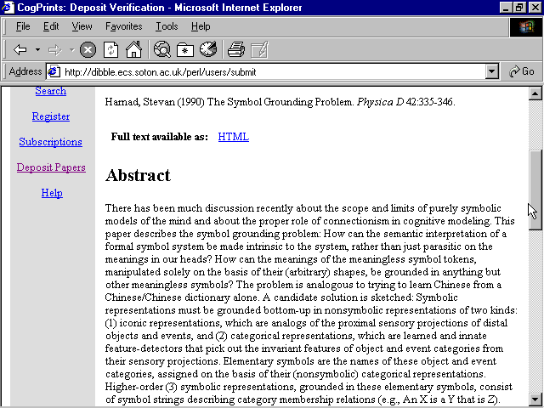

Slide 15
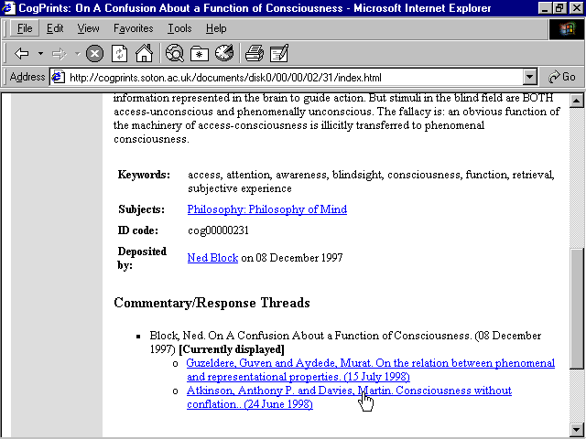

Slide 16
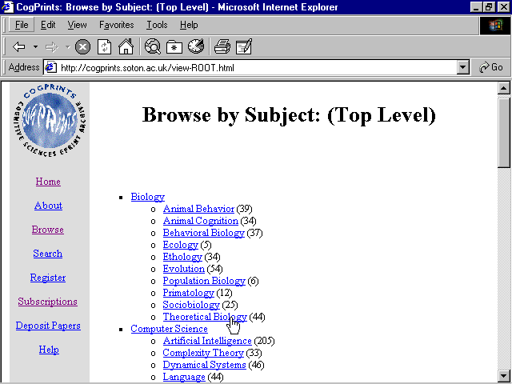

Slide 17
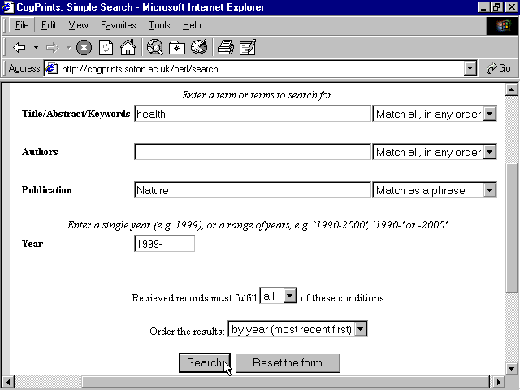

Slide 18
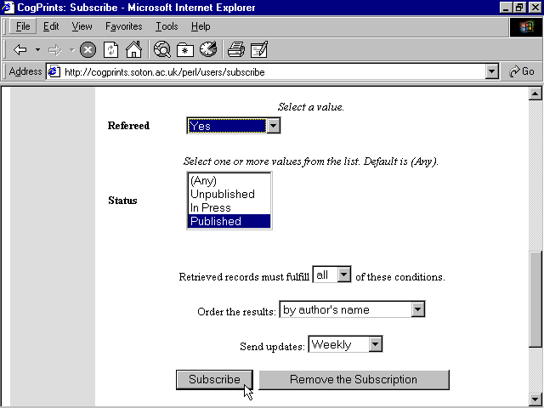

Slide 19
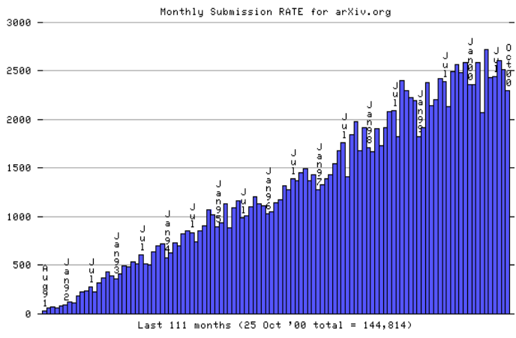
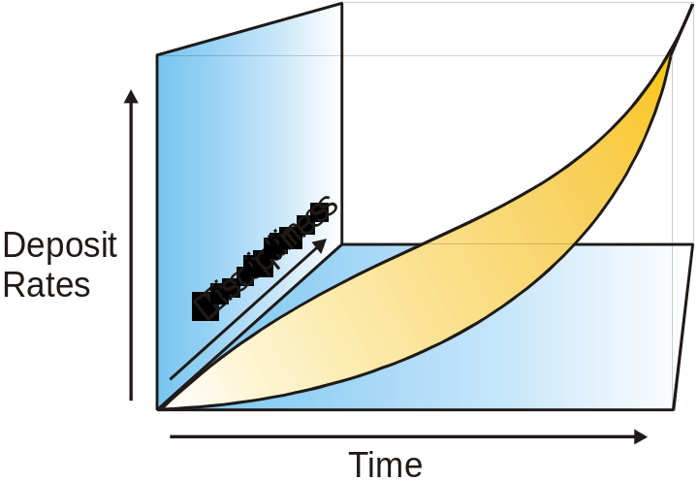
From Linear Growth to Exponential
arXiv submission rates - linear growth only
30% of citations to papers deposited in arXiv
Exponential growth in archiving to catch up with paper-based research
100% of papers archived, in all disciplines
Notes:
2
XXX has linear growth only
Nearly all HEP papers are deposited, but only 40% citations are internal
Growth is from new areas
Only a small amount of all physics research
Will take another 10 years for all papers that XXX covers to be deposited

Slide 20
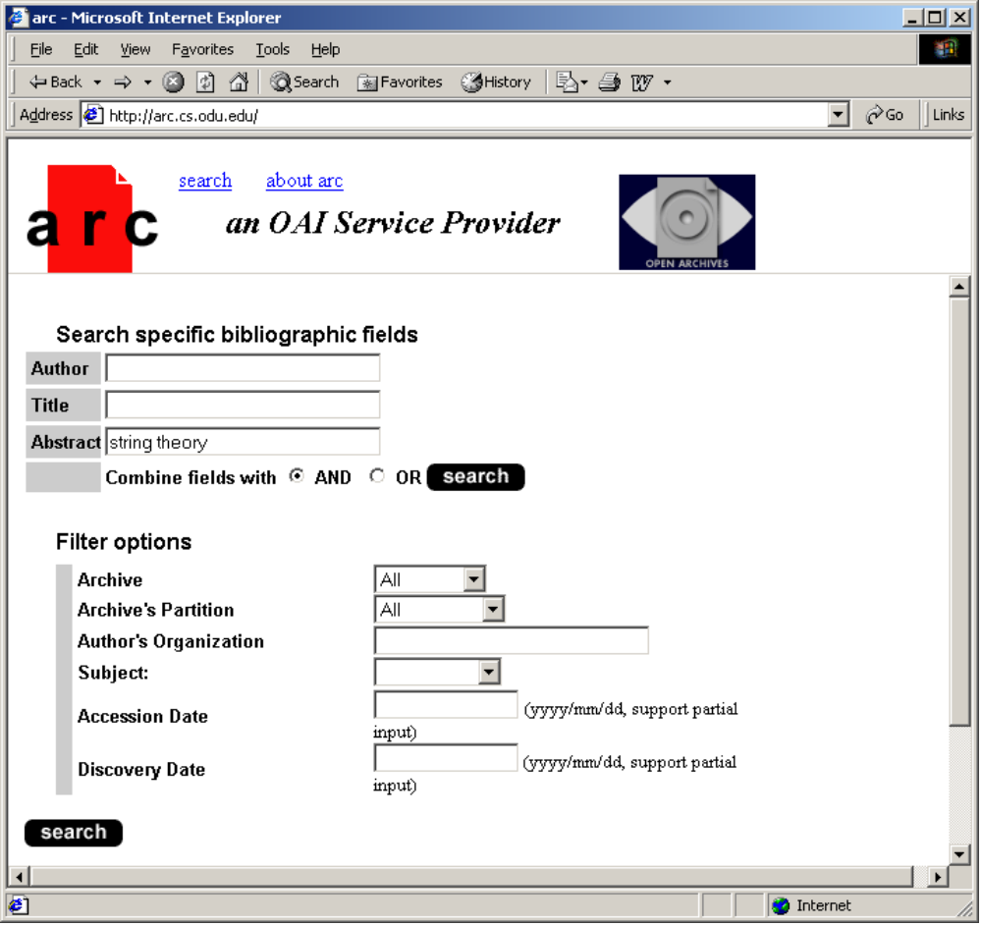
Well’s Global Research Database?
Notes:
7

Slide 21
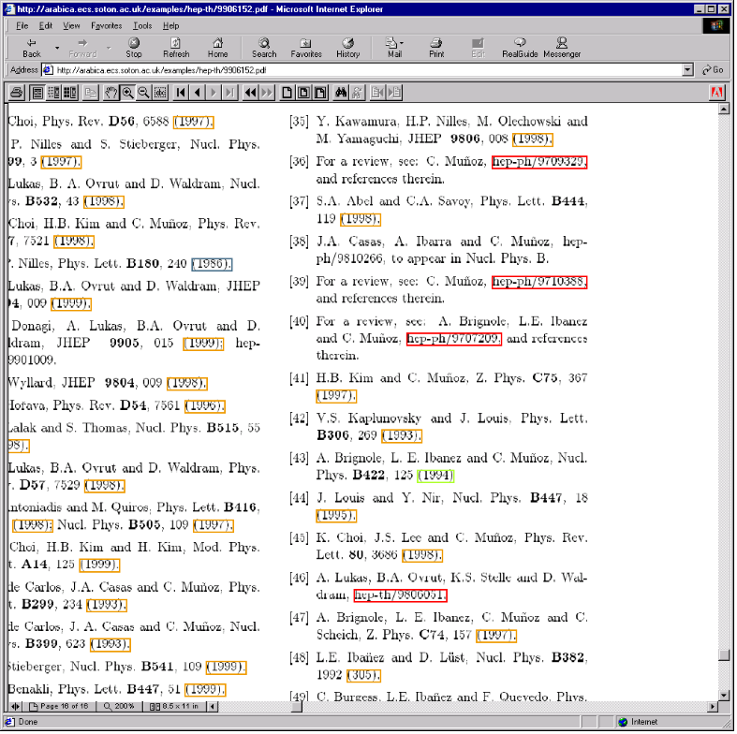
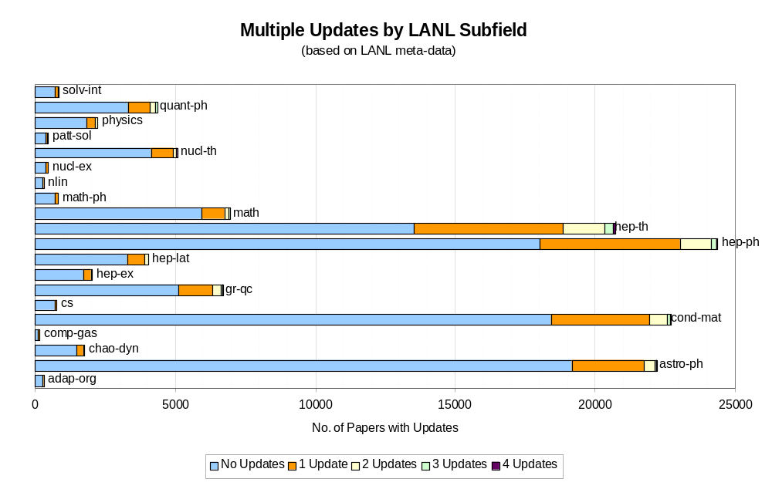
New OAI Services
Citation Linking
& Scientometric Analysis
Notes:
14

Slide 22
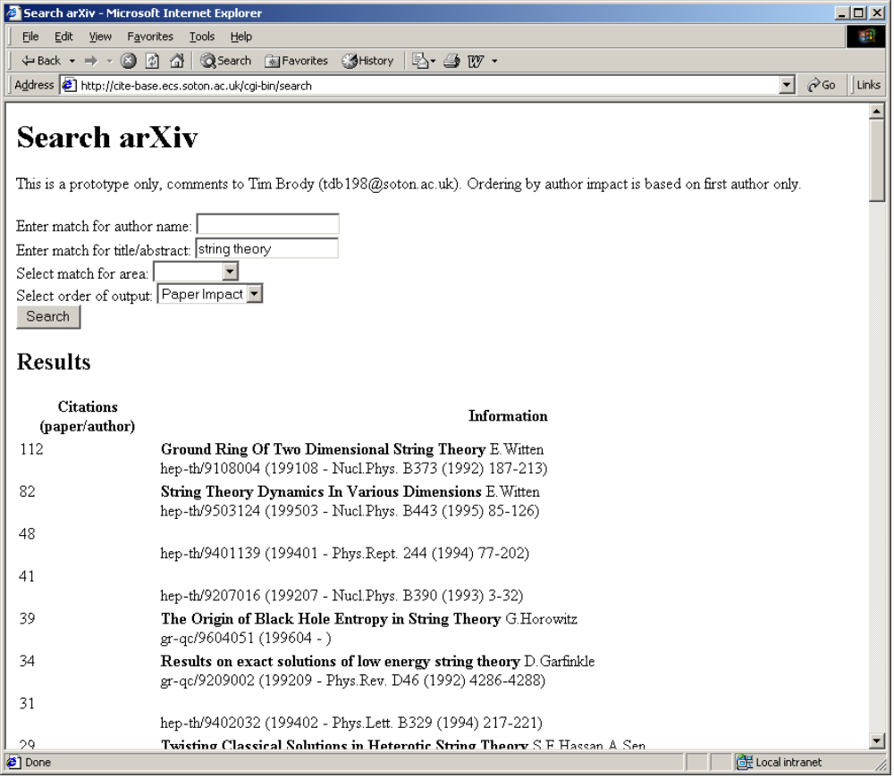
Citation-Ranked Searches
Notes:
8

Slide 23
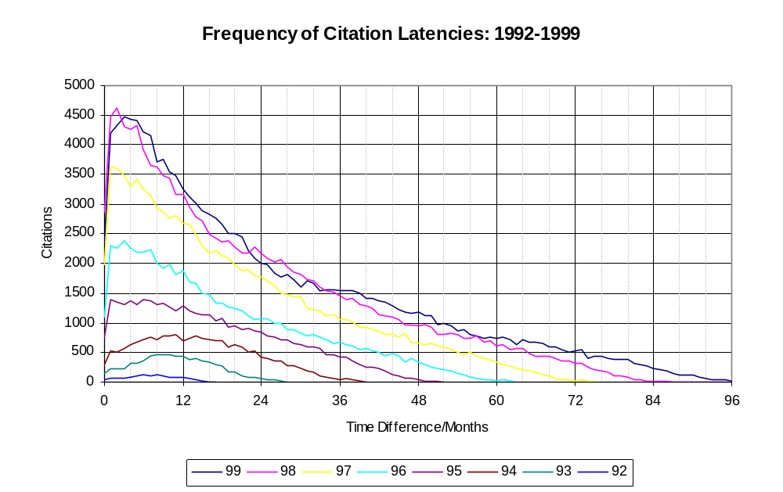
Decreasing Citation Latencies
The raw data show that the latency of the citation peak has been reducing over the period of the archive

Slide 24
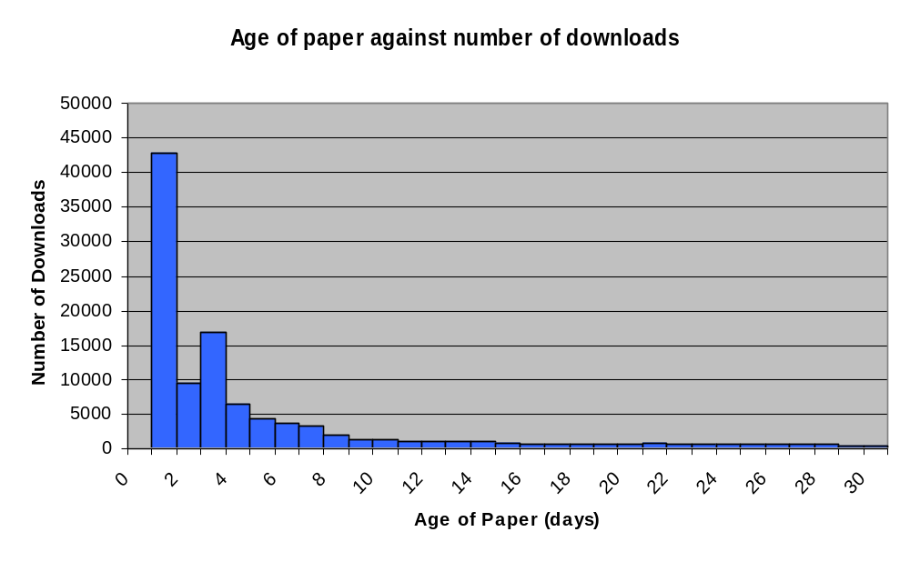
The “New Paper Rush”
Users subscribe to an email alerting service that informs them of new papers.

Slide 25
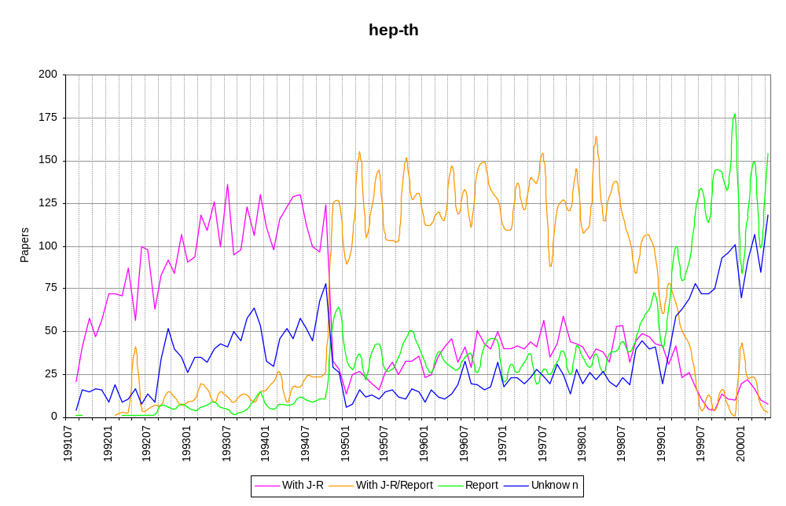
Article Embryology
Papers with a journal reference [J-R] cross papers without a J-R at an age of 13 months, suggesting a time difference of 13 months between pre-print and post-print

Slide 26
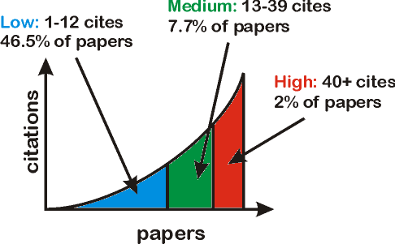
Effect of Paper Impact
The papers were split into three sets based on the number of citations to them.
There are an equal number of citations to the papers in the low, medium and high sets.

Slide 27
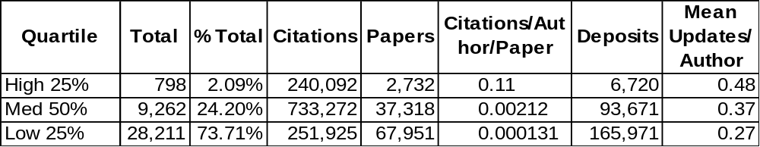
Author Impact Quartiles
High impact authors update more than medium or low
High and medium impact authors deposit more papers than low

Slide 28
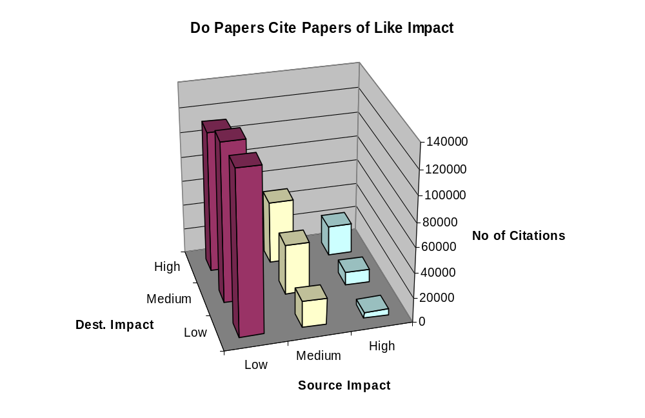
Citation Quality
Papers generally cite papers of like impact (χ² underway).

Slide 29
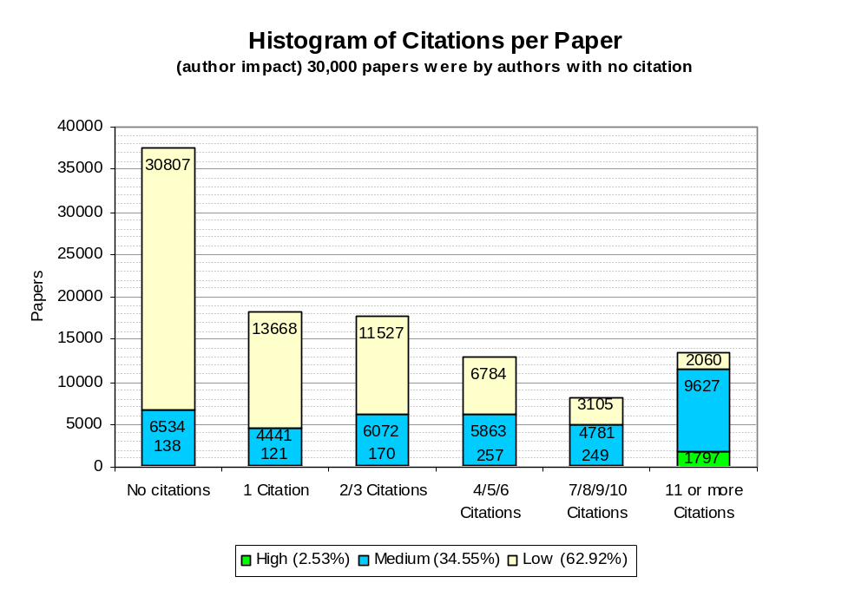
Citation Spread
A small number of papers receive a very large number of citations

Slide 30
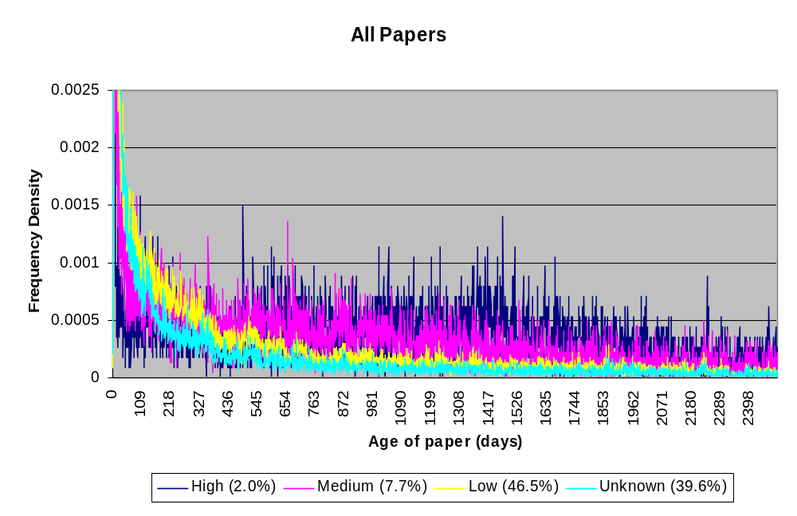
Effect of Paper Impact on Usage
Higher impact papers have a longer download life expectancy.

Slide 31
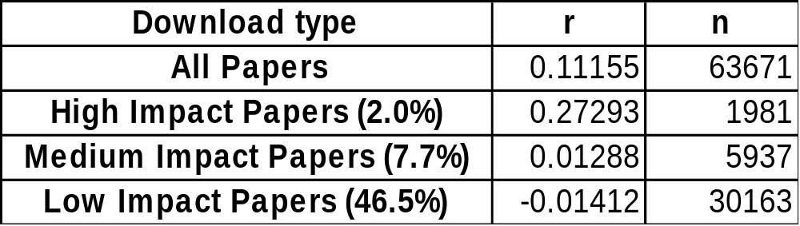
Correlating citations and downloads
There is a significant positive correlation between citations and downloads for high impact papers.

