Slide 1

Arc – Federated Searching Service
Kurt Maly, Xiaoming Liu, M.Zubair, Michael L.Nelson
Old Dominion University
January 23, 2001

Slide 2
Introduction
Federated searching service
  http://arc.cs.odu.edu
Participant of OAI alpha test
  http://www.cs.odu.edu/~dlibug/alpha

Slide 3
Background
Universal Preprint Service.
  http://ups.cs.odu.edu/.
  Initial demonstration vehicle for OAI.
  Based on NCSTRL+ which is an extension of NCSTRL.
Buckets.
Search engine developed at ODU based on Oracle database.

Slide 4
Service (1/2)
Simple search.
  Search freetext across archives.
  Support boolean operator (and/or).
Advanced search.
  Search across archives, or in specific archive and its subset.
  Search free text in author/title/abstract fields.
  Filter search/browse by archive/set/subject/type/language/datestamp/discovery date.
  Controlled vocabulary extracted from archives.

Slide 5
Service (2/2)
Result sorting.
  By datestamp,archive,relevant ranking.
Result display.
  Result list – NCSTRL+ like interface.
  Display single document in detail.
    Lightweight bucket.
    Link to data source.

Slide 6

Collections being harvested
Data harvested from OAI1.0 compliant
Identifier
Full name of the archive
arXiv
arXiv e-print archive
CogPrints
CogPrints
NACA
National Advisory Committee for Aeronautics
NDLTD
Virginia Tech Thesis/Dissertation Collection
LTRS
Langley Tehcnical Report Server
Data harvested from old SFC
    WCR
    NCSTRL

Slide 7
Harvesting - For Alpha Test Only
Identifier
Organization
Harvest URL
HeinOnline
Cornell
http://heinonline.org/OAI-script
NSDL-CU
Cornell
http://heinonline.org/OAI-NSDL
ldc
UPenn
http://www.ldc.upenn.edu:85/oai/ldc/test.php3
elra
UPenn
http://www.ldc.upenn.edu:85/oai/elra/elra.php3
lcoa1
LOC
http://lcweb2.loc.gov/cgi-bin/oai0_9
tkn
UTK
http://helios.dii.utk.edu/cgi-bin/oai.cgi
idli
UIUC
http://bolder.grainger.uiuc.edu/dlibmeta/oai.asp

Slide 8
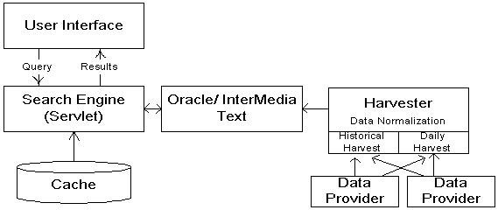
Implementation (1/3)

Slide 9
Implementation (2/3)
Data Normalization
  Different archives have different format/naming conventions for specific metadata fields.
Harvest
  Historical Harvest
    Collected archival data published before a fixed time
  Fresh Harvest
    An incremental harvester daemon periodically fetches new published metadata from data providers.

Slide 10
Implementation (3/3)
Metadata indexed with Oracle’s context cartridge server
Session information maintained in local cache
  For performance reasons; result sets can be large and are manipulated in cache rather than from the RDBMS
More info about architecture: ECDL 2000, Maly et al., pp. 168-179

Slide 11
Lessons Learned (1/2)
Quality of data providers
  The expense of maintaining a quality federation service is highly dependant on quality of data providers.
Controlled vocabulary
  Using unified controlled vocabulary, or at least defining mapping relationship, is important in a cross archive service.

Slide 12
Lessons Learned (2/2)
XML syntax and character encoding
  A single error could influence large set of data.
  The character encoding error occurs frequently in most data providers.
Harvest schedule
  We use historical harvest + daily based incremental harvest.
  The trade-off between data freshness and harvest efficiency.

Slide 13
Future Work
Create authority file for author, organization, format, etc.
Map different subject classification system to a canonical one.
Adding full bucket support.
Link service, customized collections, change the nature of the collection based on usage ... and other value added service if possible.

Slide 14
Acknowledgements
Thanks for the help from OAI alpha group and data providers.
Thanks for the help from ODU DL Group (http://dlib.cs.odu.edu)

