Slide 1
Distributed Archive Networks in the Open Archives Initiative
Heinrich Stamerjohanns stamer@uni-oldenburg.de
Eberhard R. Hilf hilf@scineo.de
Thomas Severiens severien@uni-oldenburg.de
Institute for Science Networking, Oldenburg
Susanne Dobratz dobratz@rz.hu-berlin.de
Uwe Müller u.mueller@rz.hu-berlin.de
Computing Centre, Humboldt-University Berlin

Slide 2

Implementing OAI at German Universities
DINI: (http://www.dini.org)
  German Initiative for Networked
  Information
  carries out guidance for implementations all over Germany
  develop a strategy to cover German universities (libraries with document servers)
Aim:
  Serving a distributed archive network
  Setting up a contact point for OAI in Germany

Slide 3

Collections Represented
PhysDoc:
  Distributed document Database for Physics worldwide
  using HARVEST as Retrieval mechanism
Universities document servers
  Humboldt-University as one example
  small number of documents (up to 500)
  document formats: PDF, HTML, SGML, (PS)
  DissOnline.de Initiative
  Part of NDLTD

Slide 4
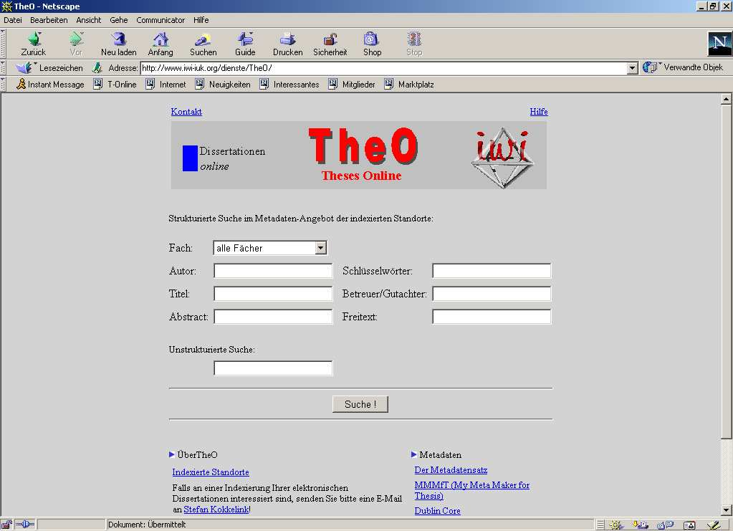
Why OAI?
DissOnline.de Retrieval interface TheO
  http://www.iwi-iuk.org/dienste/TheO/
  using Dublin Core Set for Theses and Diss.

Slide 5
Why OAI?
Interface to NDLTD and others
Using Dublin Core Metadata Set for Theses and Dissertations
Platform for integration
  within subject specific gateways as PhysDoc, MathDiss,
  Within local services (German library consortia)

Slide 6
Context & Motivation
OAI – different strategies emerge
  incorporate existing repositories by implementing OAI compliant wrapper
  fits for larger centers, institutions with active computer/library centers
  unrealistic for large number of small places or even individual authors

Slide 7
Strategy for OAI Compliance
Most dissertation archives use
  Harvest for Retrieval / HTML-Titlepages / HTML coded Dublin Core or
  Databases for metadata storage
    Sybase (Humboldt-University)
    Oracle
    mysql ...
Implementing OAI protocol
  scripts: perl / php4 or 3
  supporting Dublin Core

Slide 8
OAI Compliance
Humboldt University of Berlin, GERMANY, Document Server
  OAI 1.0 compliant repository
  since Feb. 16th 2001
  http://dochost.rz.hu-berlin.de/OAI-script
    ?verb=identify/ListRecords/...
  original implementation (Uwe Müller) took a few hours
  some problems with XML encoding
    (UNICODE/UTF-8) not (ISO-8859-1) of German „Umlaute“ ä ö ü ß and XML-characters < >
    -> php4 library for conversion used

Slide 9
OAI Compliance of HUBerlin
Header
  Unique Identifier: HUBerlin
  Datestamp: response date
protocol requests implemented:
  GetRecord
  Identify
  ListIdentifiers
  ListMetadataFormats: OAI_DC
  ListRecords
  ListSets
Resumption token (100 items)

Slide 10
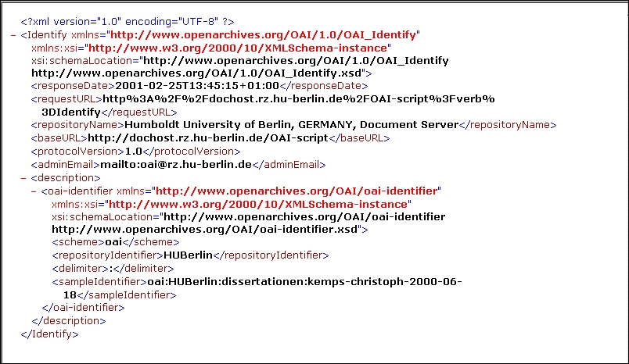
OAI _Identify

Slide 11
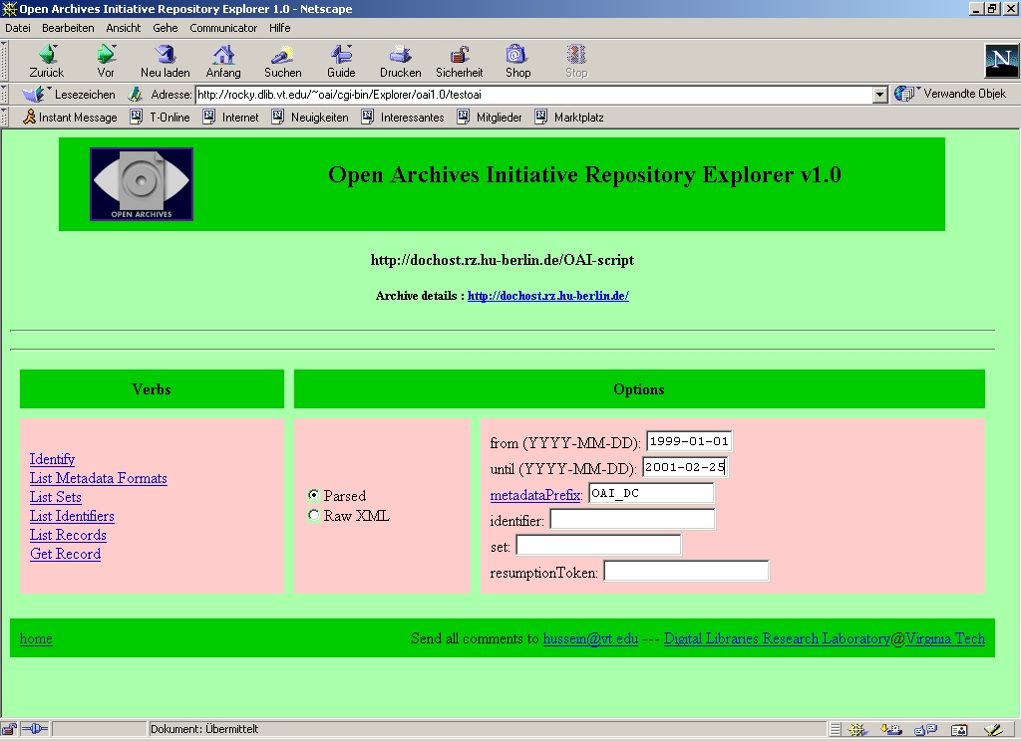
OAI_ListRecords / Resumption Token
Using Virginia Tech Repository Explorer at http://purl.org/net/oai_explorer

Slide 12
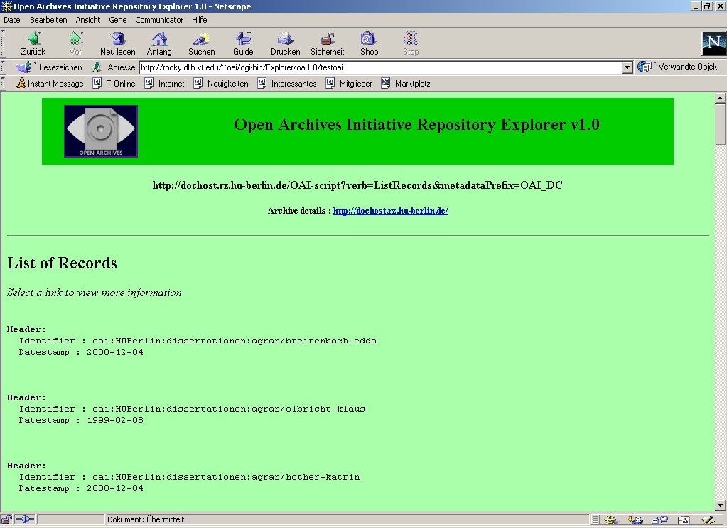
OAI_ListRecords / Resumption Token
Using Virginia Tech Repository Explorer at http://purl.org/net/oai_explorer

Slide 13
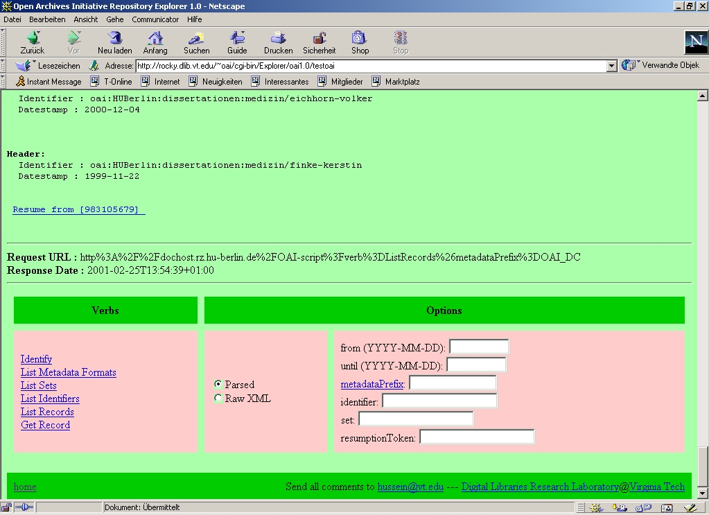
OAI_ListRecords / Resumption Token
Using Virginia Tech Repository Explorer at http://purl.org/net/oai_explorer

Slide 14
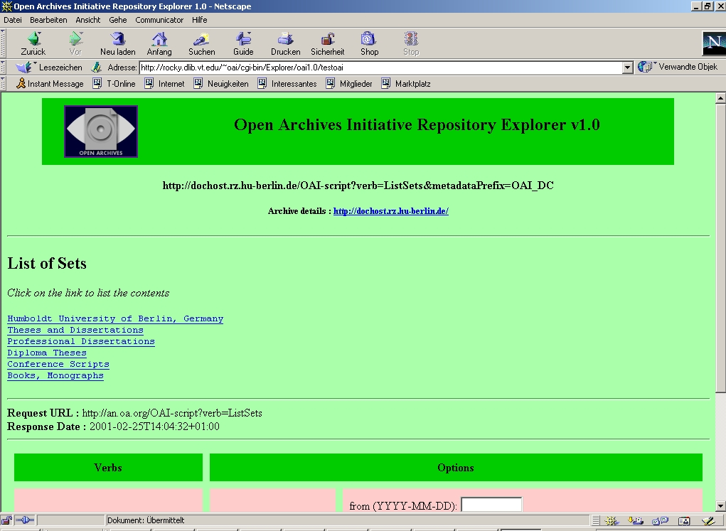
OAI_ListSets
Using Virginia Tech Repository Explorer at http://purl.org/net/oai_explorer

Slide 15
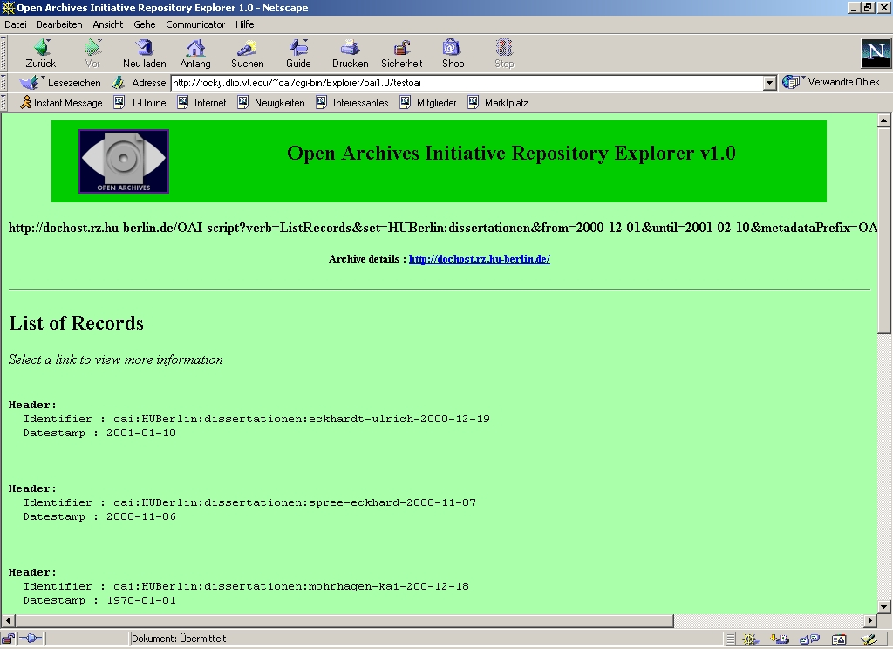
OAI_ListRecords
Using Virginia Tech Repository Explorer at http://purl.org/net/oai_explorer

Slide 16
Experiences at HUBerlin
Use Databases
  agree to datamodel for Dublin Core for theses and dissertations
  php4 from HUBerlin scripts can be used
Next:
  Integration into NDLTD and PhysDis
  within DINI: usage e.g. for educational materials
Protocol may be not sufficient for specific user domains

Slide 17
PhysDoc
PhysDoc is itself a distributed document database network, started in 1995
Especially for individual authors, smaller departments and institutions
HARVEST gatherer collects documents and its metadata from linklists of document collections
40000 documents used in alpha test

Slide 18
OAI Implementation
modified HARVEST holds SOIF and DC metadata in local text files
storage size no problem
decision to convert data offline and store structured data in SQL database (mysql)
use DC when possible, otherwise map SOIF to DC

Slide 19
OAI Implementation
documents
documents
documents
HARVEST
SQL DB
normalize
metadata
OAI Server

Slide 20
OAI Implementation
software written in PHP
protocol
  easy because it uses modified implementation of HU Berlin
metadata converter
  maps SOIF to DC
  converts different DC representations to one common one

Slide 21
Metadata quality
good quality important
currently 988 documents out of 40000 provide DC metadata
DC is not DC...

Slide 22
Future work
improve metadata converter
  improve summarizers
  closer look at different DC representations
tell people to use metadata
  OAI workshops
ease production of metadata

Slide 23
OAI in Germany
Supported by DINI
First Implementation Workshop
  June 2001
  by
    Humboldt-University Berlin, Computing Centre (Peter Schirmbacher)
    University Library of Oldenburg (Han Wätjen)
    Institute for Science Networking, Univ. Oldenburg (Prof. Hilf)

Slide 24
Thank You!
OAI-project page at RZ HU Berlin:
  http://dochost.rz.hu-berlin.de/oai
  /OAI-Script
OAI at Institute of Science Networking, Oldenburg:
http://physnet.uni-oldenburg.de/oai/oai.php
stamer@uni-oldenburg.de
dobratz@rz.hu-berlin.de

