Slide 1
Creating an Open Archives Metadata Harvesting Protocol Compliant Repository for the American Memory Online Collections
OAI Open Meeting, Washington, DC
January 23, 2001
Dave Woodward, Library of Congress

Slide 2
Why is this important for the
AM Online Collections?
With LC as data provider:
  American Memory content could be made more accessible through new value-added services that utilize harvested metadata, e.g., search services or specially targeted services
  metadata harvesting would be enabled for other groups such as researchers and educators

Slide 3
Why is this important for the
AM Online Collections?
Perhaps with LC as a service provider:
  integration of content into American Memory could be simplified and standardized
  collaborative collection development would be less labor intensive

Slide 4
Why is this important for the
AM Online Collections?
Participation in the development and testing of OAI has provided valuable practical experience with wide applicability, i.e.,
  conversion of MARC8 character encoding to UTF-8 w/ Unicode character references
  MARC -> dc mapping
  MARC -> xml conversion

Slide 5
What collections were used?
From American Memory (alpha test):
  Map Collections:1500-1999
    The focus of Map Collections is Americana and Cartographic Treasures of the Library of Congress. These images were created from maps and atlases ...
  Dance Instruction Manuals: ca. 1490-1920
    An American Ballroom Companion presents a collection of over two hundred social dance manuals at the Library of Congress

Slide 6
What collections were used?
Data characteristics:
  same data stores used for AM web site and OAI
  item-level MARC descriptive records
Why this data?
  common data characteristics
  various MARC fields used
  interesting character set challenges

Slide 7
What is the technical infrastructure?
Hardware, OS and systems software:
  IBM rs6000, AIX, Apache
Application software:
  one perl script for handling requests via CGI
    CPAN stuff: cgi.pm, sgmls.pm
    existing MARC parsing tools
    upgrade of existing MARC8 character set tools
  another perl script to create index files

Slide 8
How was it implemented?
separate from the American Memory online application, but built on same data stores
a simple index of identifiers, status, and dates was built
  ListIdentifiers becomes an “index only” verb
  enables dynamic access to MARC records in flat files

Slide 9
How was it implemented?
dynamic translation from MARC
  MARC is a popular storage format at LC
  flexible for updating/adding metadata formats
  flexible for adjusting mappings
Resumption token & “retry after” responses
  thresholds, time-to-live
Verified results in a variety of ways:
  Hussein Suleman’s excellent repository explorer!
  XSV from w3c.org, some XML Spy

Slide 10
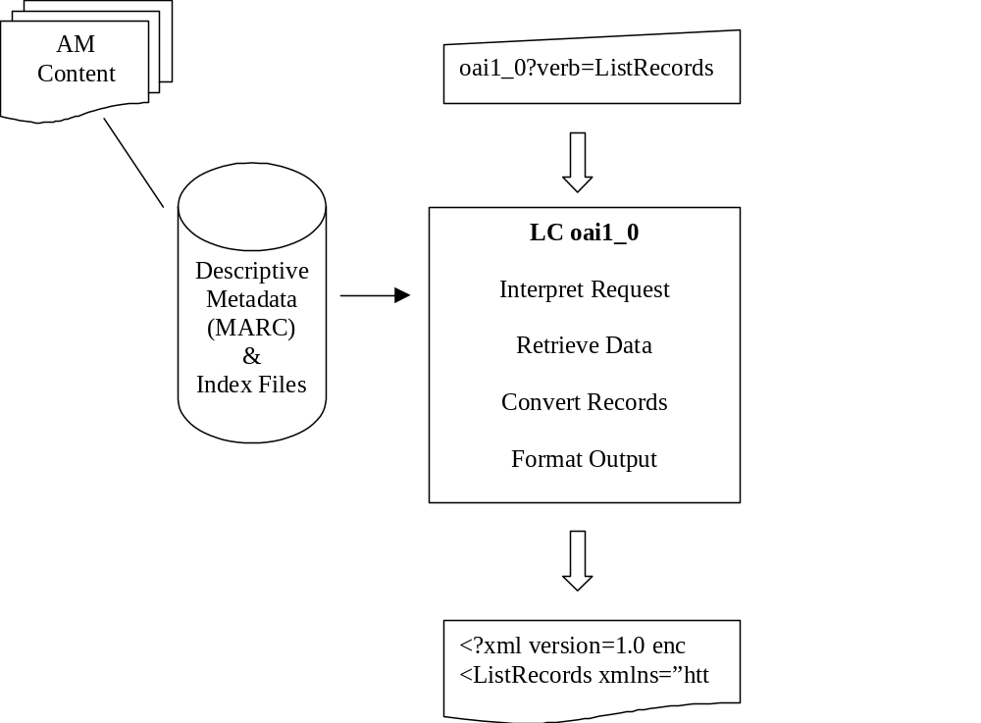
How was it implemented?

Slide 11
What was the level of effort?
Very simple:
  handling the protocol requests and responses
A little more difficult:
  selecting and organizing collections
Most challenging:
  mapping (format crosswalks)
  preparing data for transport

Slide 12
Where do we go from here?
Expand to include more sets
Offer non-MARC collections
Experiment with other metadata formats, i.e., LC’s MARC21 xml format
Continue to refine MARC mappings and character reference encoding
Tune flow controls

